Slide 1
Doc(S)implr!
By:
Amitkumar Dubey (17DCS011)
Mahavir Gohil (17DCS017)
(6th Semester – CSE-A BATCH)
Guide: Prof. Priyal Vaghela
Classifying your docs as per your needs.
Domain: Natural Language Processing

Slide 2
The Problem Statement
Recruiters while hiring for any position have to go through the tedious process of reviewing each and every resume of all the applicants and sort them out for the one’s that they are interested in for an interview.

Slide 3
The Proposed Solution
An web-app, which does all the sorting work!
Easy to use with efficient results.
Recruiters just need to worry about where and when to take the interviews of the eligible candidates and not of the sorting phase.

Slide 4





Hardware and Software Requirements
Hardware Requirements:
Machine with at least 256 MB RAM
Software Requirements:
Python 2.7.x
Matplotlib
Flask
Pandas
Spacy
PyPDF2
ZipFile

Slide 5
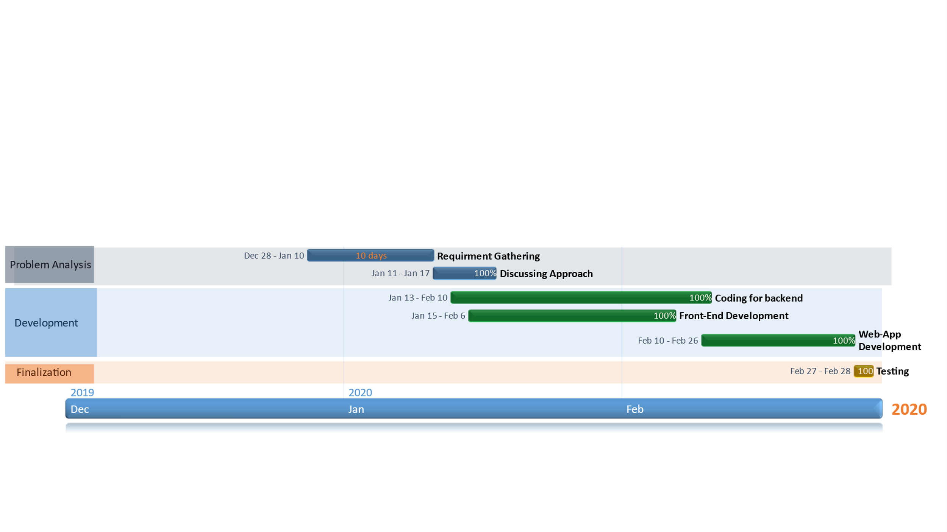
Project Planning (Gantt Chart)

Slide 6
BASIC FUNCTIONALITIES
Classify the resumes according to appropriate tags
E-mail the results to e-mail id specified by user.
Generate easily-understandable results

Slide 7
NON-FUNCTIONAL REQUIREMENTS
Easy to navigate, user friendly WebApp
Available to users 24x7
Proper classification of the docs
Sending correct results to user
Less Latency
Sending results to correct user

Slide 8
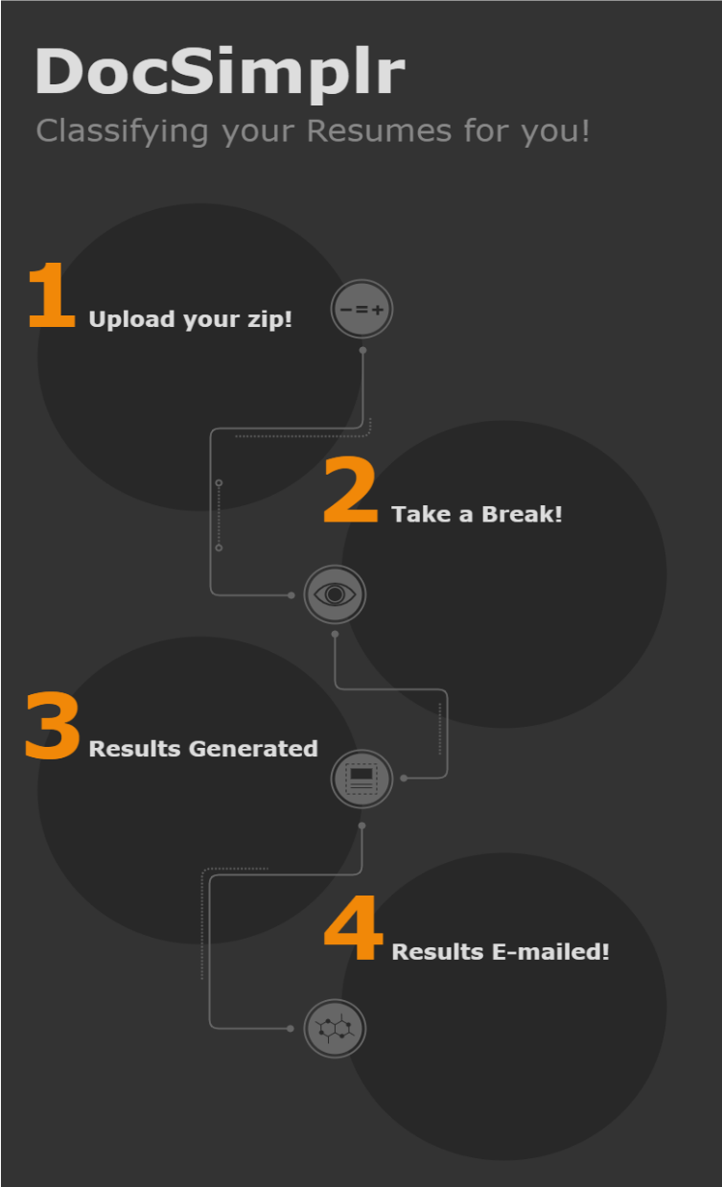
Process flow of the App!

Slide 9
WORK DONE...

Slide 10
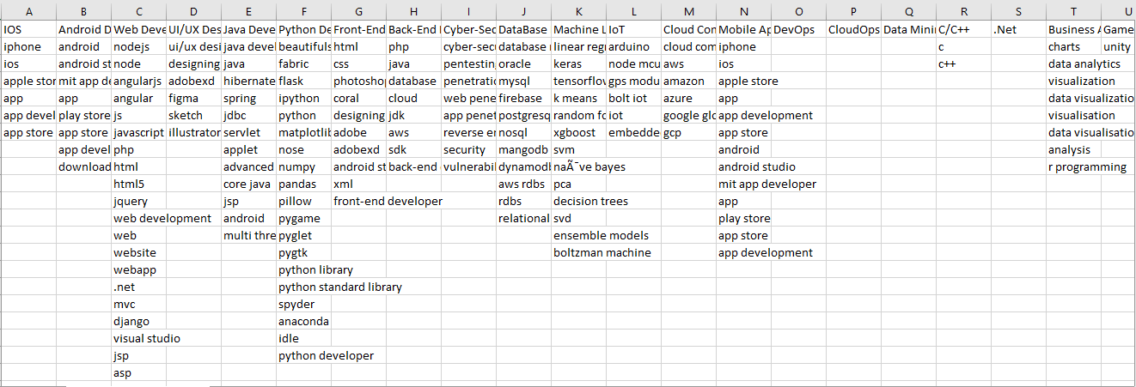
DATASET OF KEYWORDS FOR CLASSIFICATION
(Still in information gathering phase..)

Slide 11
Snapshots of the Developed WebApp

Slide 12
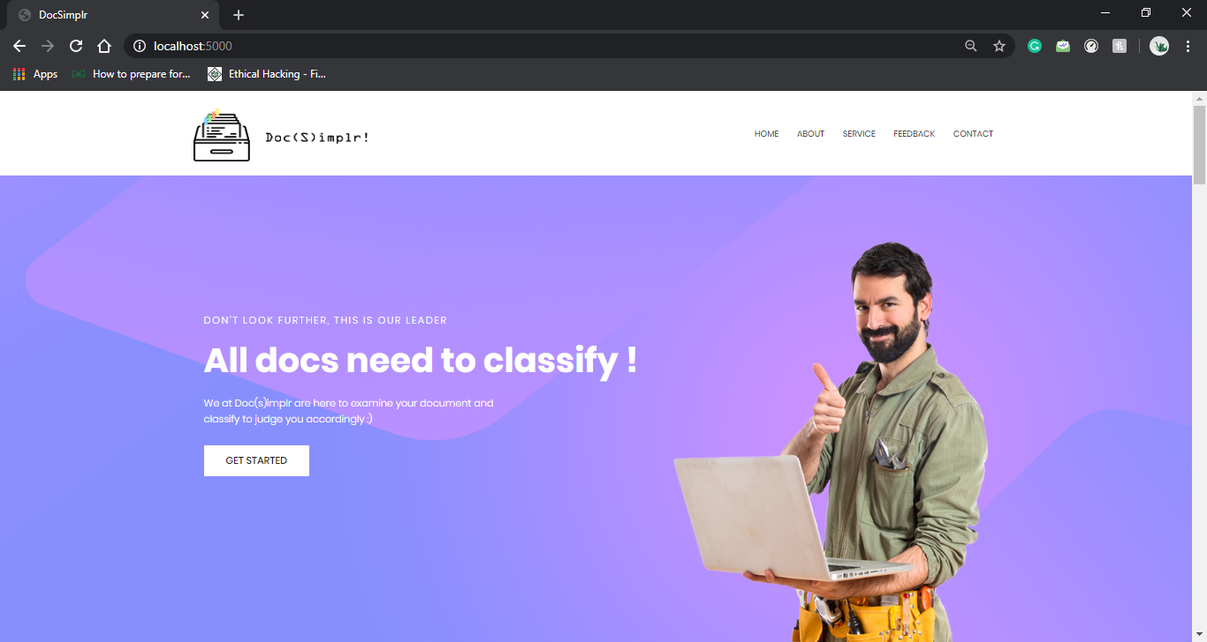

Slide 13
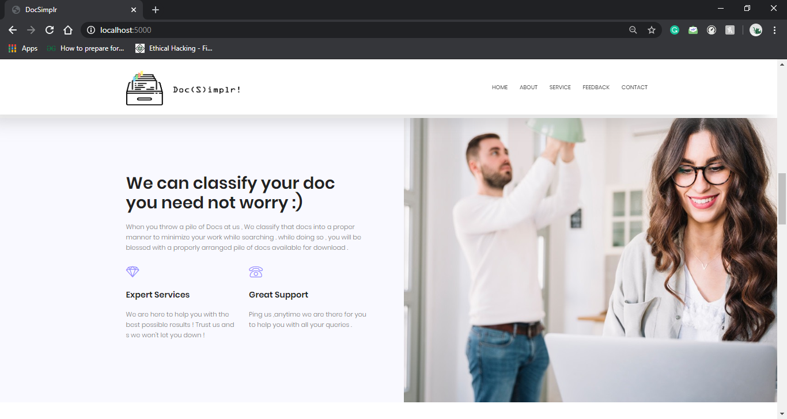

Slide 14
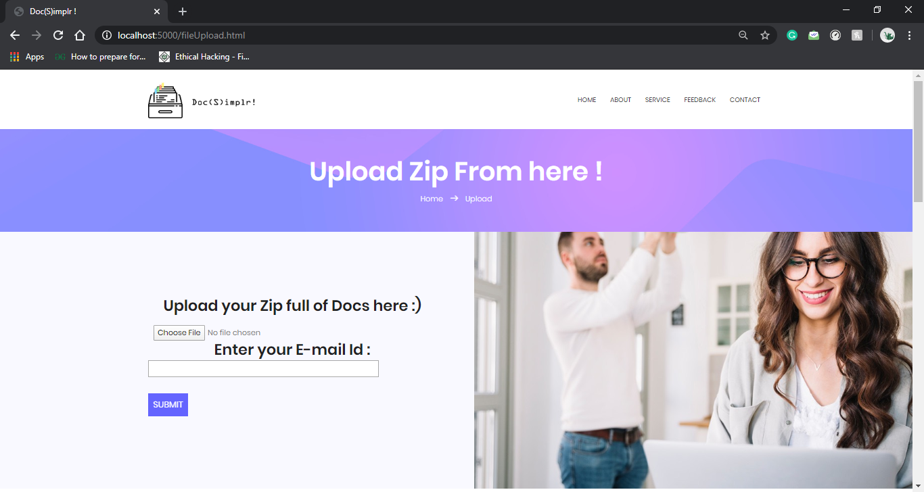

Slide 15
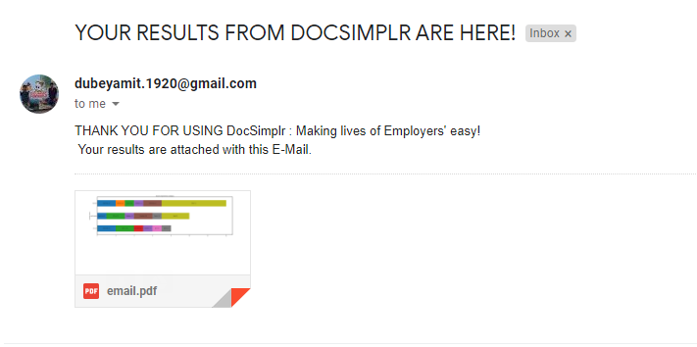

Slide 16
Future Enhancement:
Provide authentication for two types of users: Registered and Guest users, so that premium registered users can store their docs for any future reference.
Provide option of tag selection(i.e. classifications based on which tag the users need in their results)

Slide 17
References:
https://pythonhosted.org/PyPDF2/
https://spacy.io/usage
https://flask.palletsprojects.com/en/1.1.x/
https://docs.python.org/3/library/zipfile.html

Slide 18


