Slide 1
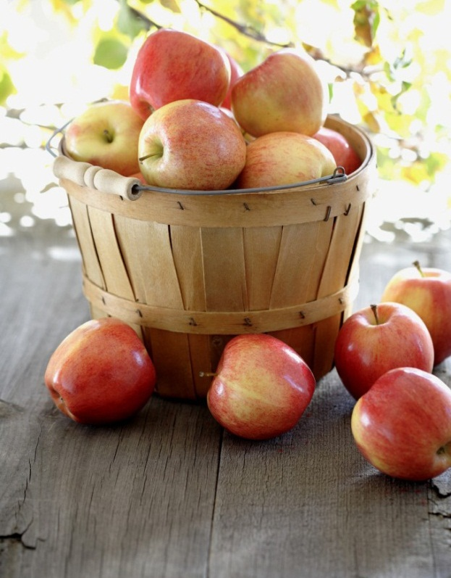


HAPPY TUMMY
Good FOOD….Good “MOOD”
Notes:
NOTE: To replace a picture, just select and delete it. Then use the Insert Picture icon to replace it with one of your own!

Slide 2
Team details
Client Team : 25
Pallavi Marni pl381965@dal.ca
Smit Hasmukhbhai Gor sm267551@dal.ca
Fenil Patel fenil.patel@dal.ca
Shaswat Doshi sh667879@dal.ca
Mayank Pandey my880578@dal.ca
TA : Shathish Annamalai sh495601@dal.ca
Development Team : 6
Aashray Zaveri as229109@dal.ca
Mohit Rajeshkumar Sojitra mh546676@dal.ca
Navyanka Thorothu nv499677@dal.ca
Vidhi Jayeshbhai Maheriya vd950858@dal.ca
Vikram Venkatapathi vk485591@dal.ca
TA : Indranil Palit Indranil.Palit@dal.ca

Slide 3
PROJECT SUMMARY
PROBLEM : People with no basic knowledge in cooking and the ones with very busy lifestyles compromise and struggle to prepare food which they like.
SOLUTION :
Happy Tummy is a go to buddy for rookie and bustling chefs wanting to have delicious food but can’t manage to make it.
Ex : WE … THE STUDENTS
The app helps users find easy-to-use recipes based on ingredients they already have in their kitchen and provides detailed nutritional information for each recipe.
Let Happy Tummy help make your life easier and healthier.

Slide 4
Dashboard Stats
Total Tasks-52

Slide 5
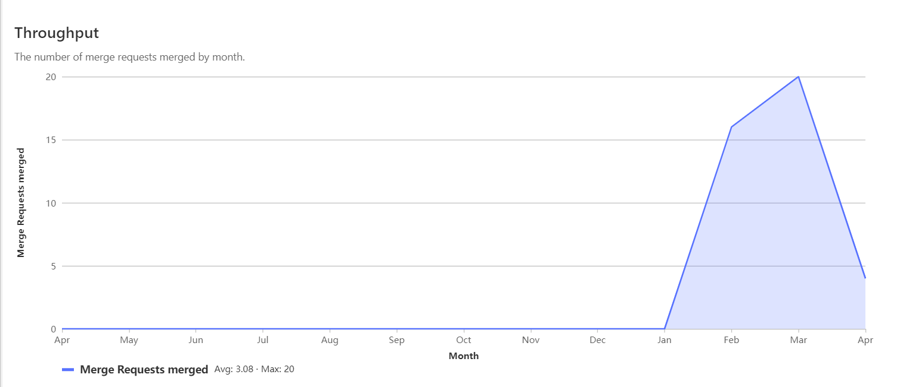
Merge Requests

Slide 6
Project status-:
Tasks Planned | Status
Recommendation of recipes | Completed
User Authentication | Completed
CI/CD Pipeline on gitlab | Completed
User able to post their recipes | Completed
Get location for nearest grocery store | Completed
Filter for veg/non veg recipe | Completed

Slide 7
Unplanned features-:
There are certain features which we were not supposed to implement but seemed too good to left those out. Those features are as under-:
Like button for users
Comments option on user’s post
Review option for each User’s recipe

Slide 8
Features after mid-term-:
After mid-term review , following features got added till now-:
Filter for veg/non-veg recipe
Grocery store location suggestion for users
Review , like and comments options for user
Letting users follow each other.

Slide 9
Learning
Became more proficient in using the Version control system.
Understood software architecture and design principles well to create a scalable, maintainable, and efficient system.
Learned and followed Coding standards and best practices to ensure the code is readable and maintainable.
Understood the importance of code refactoring to develop a maintainable and flexible system.
Testing and debugging to ensure the product meets the requirements and functions correctly.
Deployment using CI/CD: setting up and configuring environments, and automating deployment processes.

Slide 10
Live URL of our Project
http://csci5308vm6.research.cs.dal.ca

