Slide 1
Practice Questions
Session 3 | SQL Session 2

Slide 2
Instructions
There could be multiple ways to solve the same task, but all the questions in this list can be solved using the concepts discussed till last session. So kindly stick to those

Slide 3
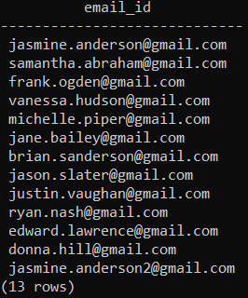
Task 1
Find the list of email IDs of all the customers

Slide 4
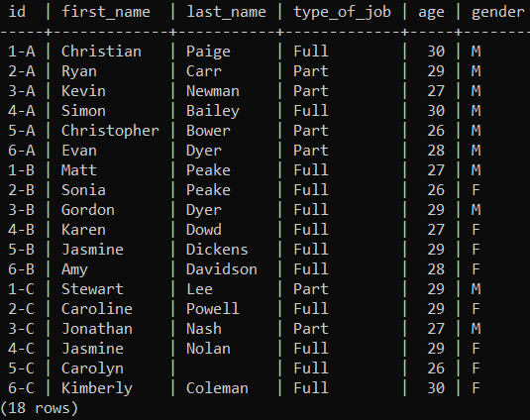
Task 2
Get all attributes of the vendors data

Slide 5
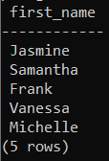
Task 3
Check the first 5 first names of customers

Slide 6
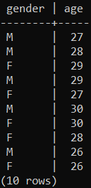
Task 4
Check the list of unique ages of vendors for each gender

Slide 7


Task 5
Check for count of unique customers in the Customers dataset
Also check for count of unique customers who made a purchase at the store

Slide 8
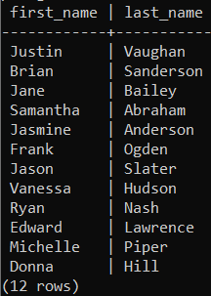
Task 6
Find the unique list of first name and last name of customers

Slide 9

Task 7
Find the count of distinct dates that sales were made on in the month of February
Note – format of date is ‘YYYY-MM-DD’, so 2nd Jan 2020 is written as ‘2020-01-02’

Slide 10
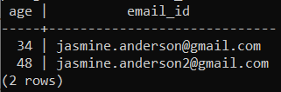
Task 8
Find the age and email id of the customer by the name Jasmine.

Slide 11

Task 9
Find the number of transactions that took place all dates except for 18th January 2020 and 1st March 2020

Slide 12
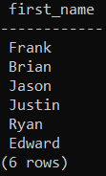
Task 10
Check first name of all the Male customers
(There is a catch here)

Slide 13
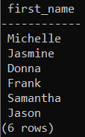
Task 11
Find the unique list of first name of customers who either have ID more than 15000 or are female and at least 34 years old.
(Again, there is a catch here)

Slide 14

Task 12
Find out how many returns (negative sale amount) happened between 1st Jan and 1st March

Slide 15

Task 13
Find first name of the customers who have a 2 in their email ID.

Slide 16
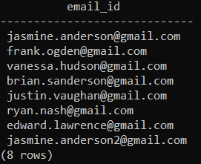
Task 14
Find list of email id of the customers whose last name contains the letter ‘N’.

Slide 17
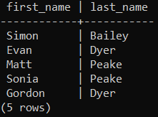
Task 15
Find first name and last name of vendors with either first name or last name as one of the following :
Peake
Matt
Simon
Dyer

Slide 18

Task 16
What is wrong with the following query?

Slide 19

Task 17
What is wrong with the following query?

Slide 20
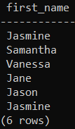
Task 18
Find first name of all customers whose first name has the character ‘a’ as the second letter

Slide 21
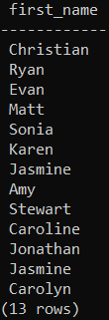
Task 19
Find first name of all vendors whose first name has the character ‘a’

