Slide 1
LogGP based analysis of Collective Communication Algorithms
Presented By :
Geetika Bakshi RIT205003
Shivangi Singhal RIT2015011
Bobbili Vineela Moses RIT2015041
Megha Mishra RIT2015074

Slide 2
Introduction
Collective
Communication

Slide 3


What does Collective Mean
“Collective communication is a method of communication which involves participation of all process in a communicator”
Example

Slide 4

Objective
Implement
Analyse
Summarize
To implement different collective communication algorithms using MPI (Message Passing Interface).
To analyse these algorithms on the basis of bandwidth utilization (runtime) under different parameters such as number of process and message size.
After analyzing each algorithm we intend to compare the results for different algorithms and thus provide a tool to choose the best algorithm suitable under given parameters.

Slide 5
Basic Collective Operations
Reduce
All Reduce
Broadcast

Slide 6
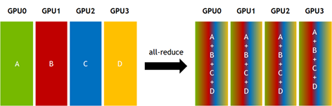
Notes:
Broadcast, Reduce, All reduce

Slide 7
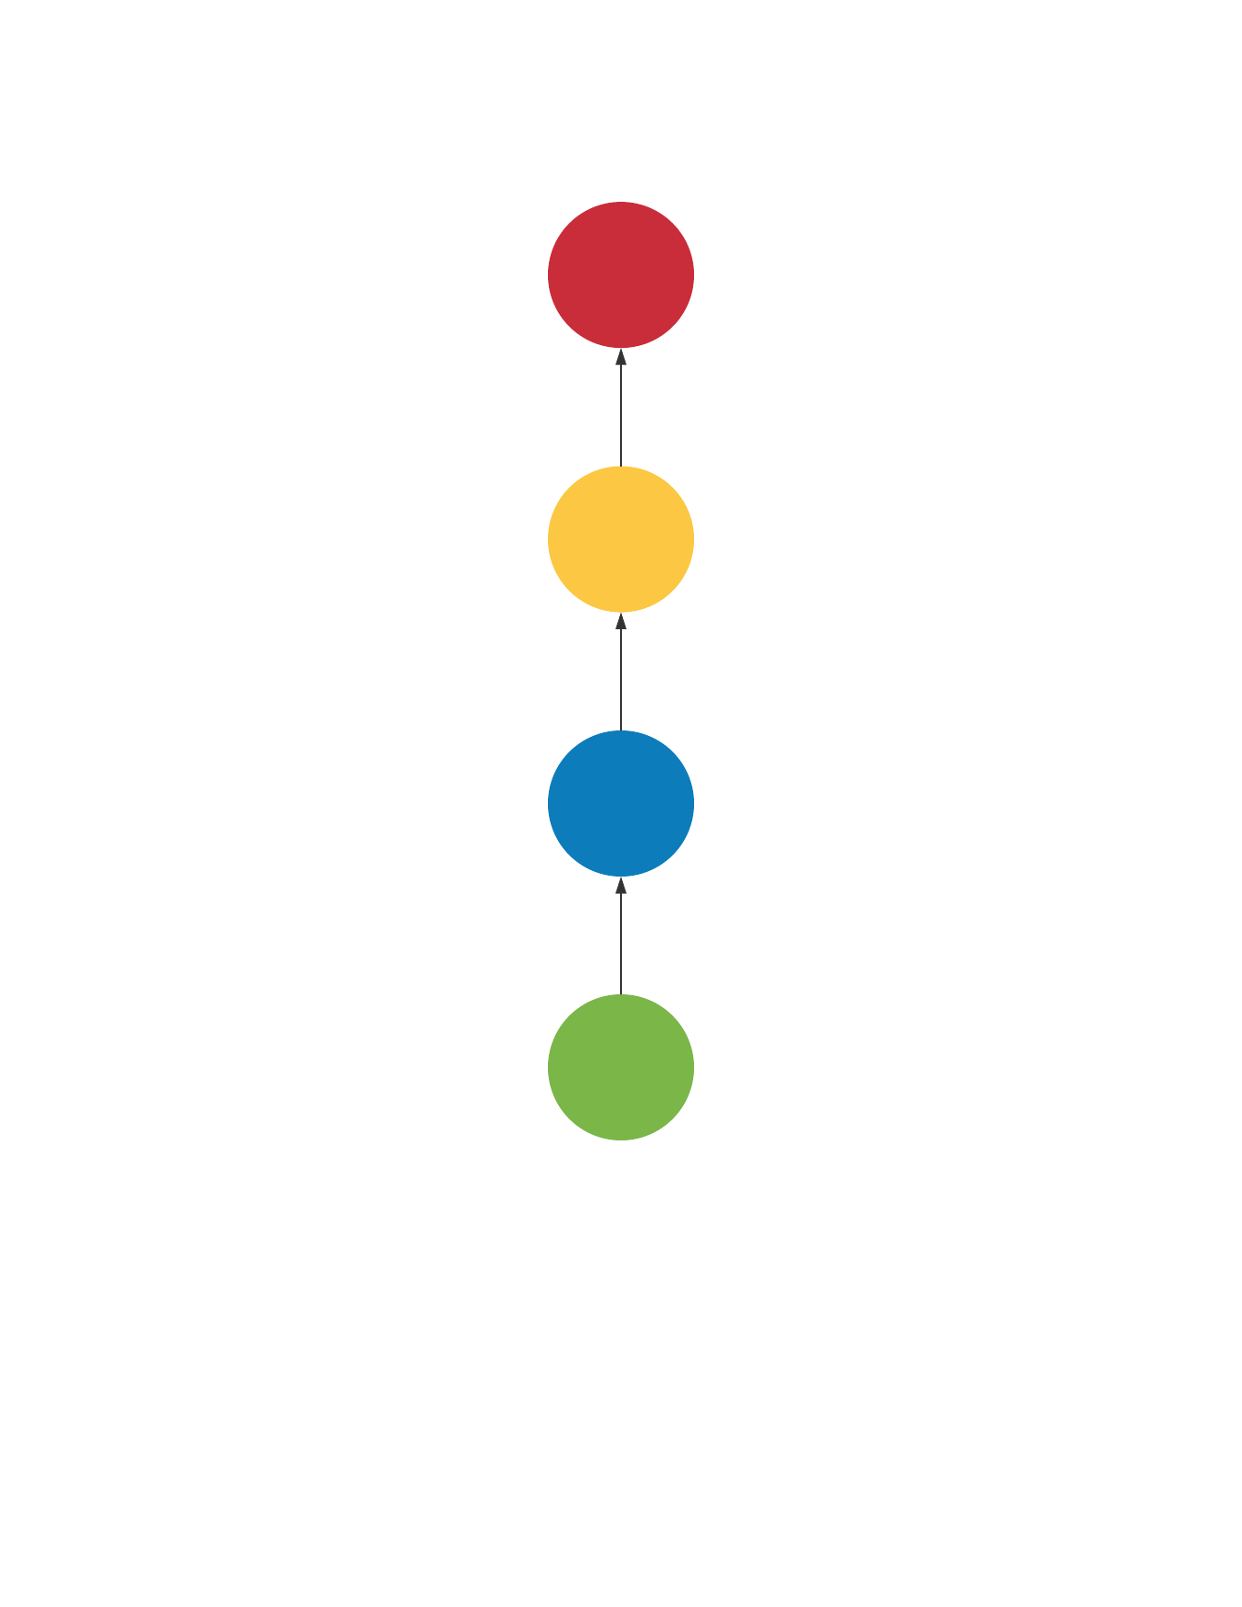
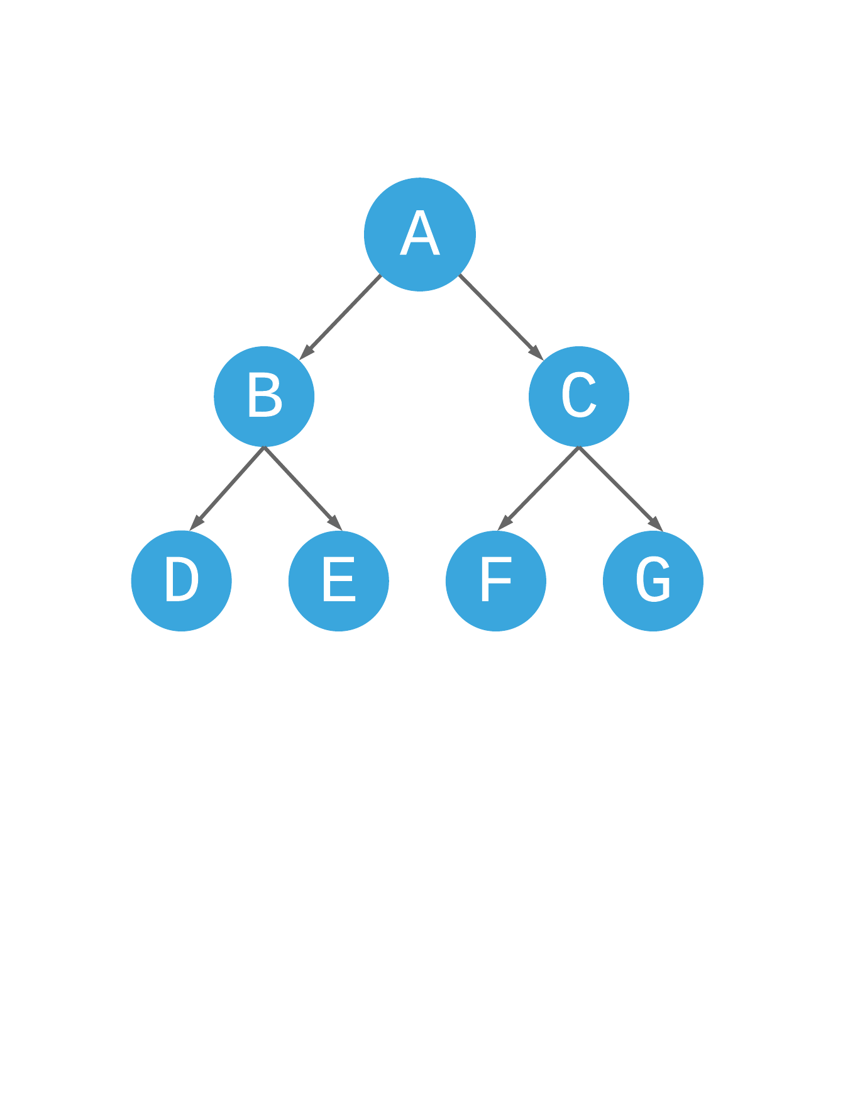
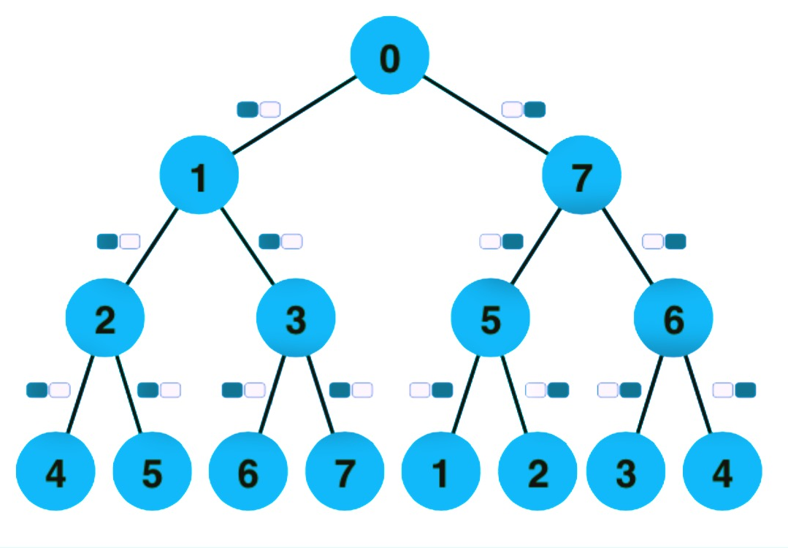
TOPOLOGIES
Linear Topology
Binary Tree Topology
2 Tree Topology
Notes:
Topologies

Slide 8
RUNTIME ARCHITECTURAL MODEL
L denotes the maximum communication latency between two endpoints
The parameter o represents the constant CPU overhead for sending or receiving a single message.
The parameter g is the equivalent overhead for sending or receiving a message caused by the network interface.
The parameter G models the cost per injected Byte at the network interface
The number of processes is represented by P.
LogGP

Slide 9
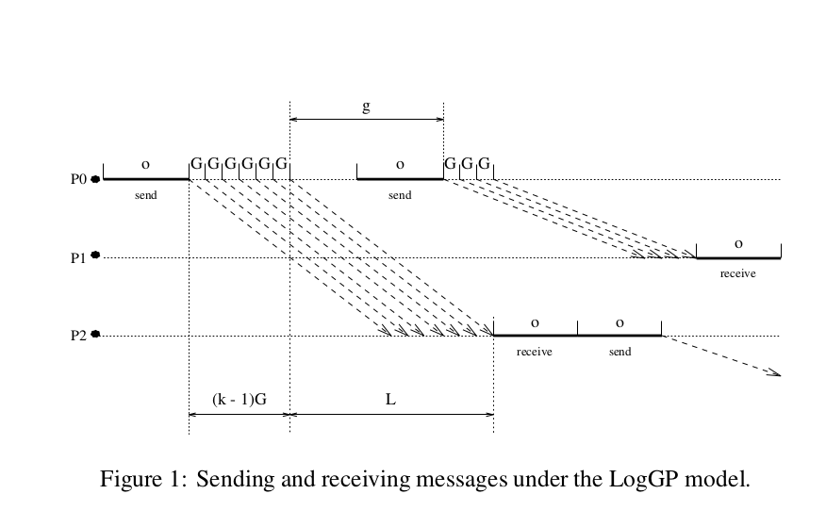
LogGP Analysis of linear pipelined reduce algorithm
T = (2o+sG+L+C)*(p-2+n)
Notes:
LogGP diagram

Slide 10
Why Different Algorithms
Each collective algorithm exploits a particular virtual topology, i.e., a directed graph representing message propagation between processes.
Trees can be used to implement any collective communication. Processes are arranged in a tree shape and messages are flowing from parents to children or vice versa, depending on the collective operation.
Trees are often used for communicating small messages because in most cases, leave processes only receive messages and are thus not able to use their own send bandwidth.
Simple pipelines that minimize the number of leaves often provide excellent and simple solutions for very large message sizes.

Slide 11
Implemented Algorithms
Linear pipelined reduce algorithm
2tree reduce algorithm

Slide 12


Slide 13
NEXT STEPS
Run and analyze reduce algorithm in LogGOPSim simulator.
Run the code in Piz Dent HPC.
Write, run and analyze all-reduce algorithm.

Slide 14
THANK YOU

Slide 16
References
Peter Sanders, J. Speck, Jesper Larsson, Two-Tree Algorithms for Full Bandwidth Broadcast, Reduction and Scan. Parallel Computing, Vol-35, No.-12, 2009.
Torsten Hoefler, Timo Schneider, Andrew Lumsdaine, LogGP in Theory and Practice - An In-depth Analysis of Modern Interconnection Networks and Benchmarking Methods for Collective Operations, Simulation Modelling Practice and Theory, Volume-17, 2009
Torsten Hoefler and Dmitry Moor, Energy, Memory, and Runtime Tradeoffs for Implementing Collective Communication Operations, Supercomputing Frontiers and Innovations, Volume-1, 2014
MPI Forum. MPI: A Message-Passing Interface standard. Version 3.0, 2012.
Torsten Hoefler and Timo Schneider, Optimization Principles for Collective Neighborhood Communications, SC '12 Proceedings of the International Conference on High Performance Computing, Networking, Storage and Analysis

Slide 18
Notes:
Thank you

