Slide 1
Markov Chain Monte Carlo
Mohit Kumar Soni
Btech ECE(Avionics)
Indian Institute of Space Science and Technology
Mohitsoni2091996@gmail.com
Code References at ..
https://github.com/mohit1soni/DeepLearningAssignments.git

Slide 2
Markov Chains
What are they the intuition
General Formulation
The state transition probability matrix
The convergence properity

Slide 3
Monte-Carlo Simulations
What are they and why them
Applications
The General Formulation
The convergence criteria

Slide 4
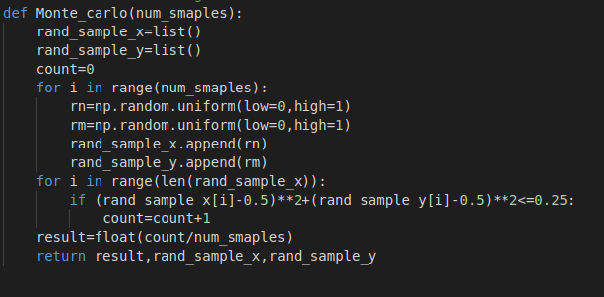
Example: The ration of areas
How to solve the problem

Slide 5
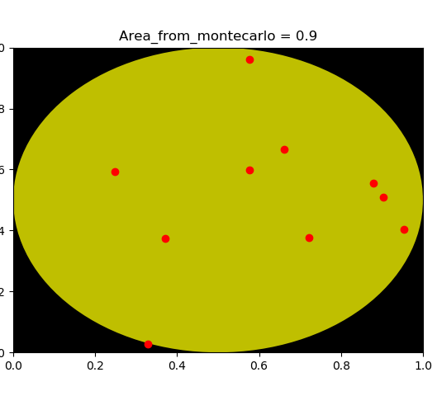
Simulation Results:
No of Samples :10
Actual Area: 0.786
Calculated Area: 0.9

Slide 6
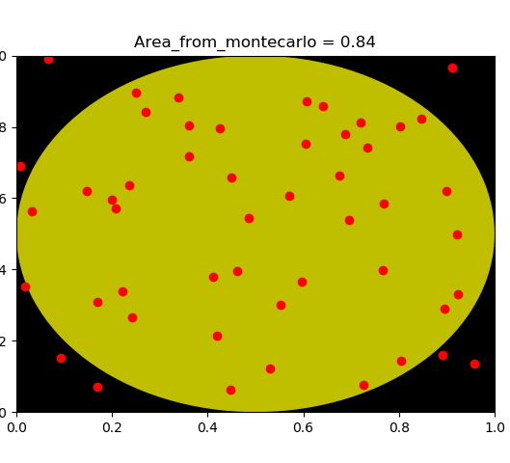
Simulation Results:
No of Samples :50
Actual Area: 0.786
Calculated Area: 0.84

Slide 7
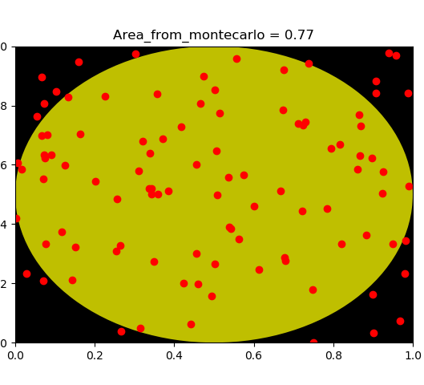
Simulation Results:
No of Samples :100
Actual Area: 0.786
Calculated Area: 0.77

Slide 8
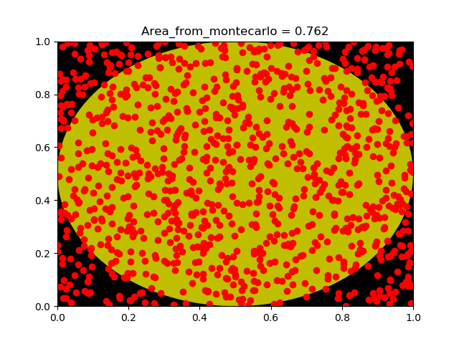
Simulation Results:
No of Samples :1000
Actual Area: 0.786
Calculated Area: 0.762

Slide 9
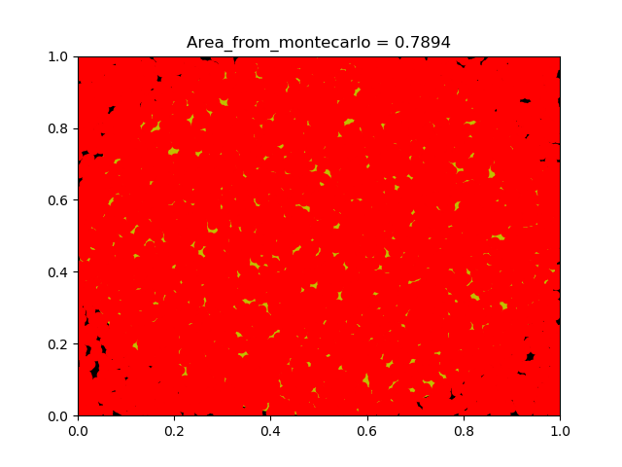
Simulation Results:
No of Samples :10000
Actual Area: 0.786
Calculated Area: 0.7894

Slide 10
Markov Chain Monte Carlo Sampling
Problems with simple monte-Carlo simulation
Intuition behind MCMC
Application
Methods
  Metropolis-Hastings Algorithms
    Random Walk Metropolis
    Independent proposal Metropolis
  Gibbs Sampling

Slide 11
Metropolis-Hasting Sampling Algorithm
Works on the principle of Markov sampling form proposal distribution
Generated samples are tested under likelihood criterion to accept the sample and update the state value.
General Algorithm
Types of Metropolis-Hasting Algorithm
  Random-walk
  Independent Proposal

Slide 12
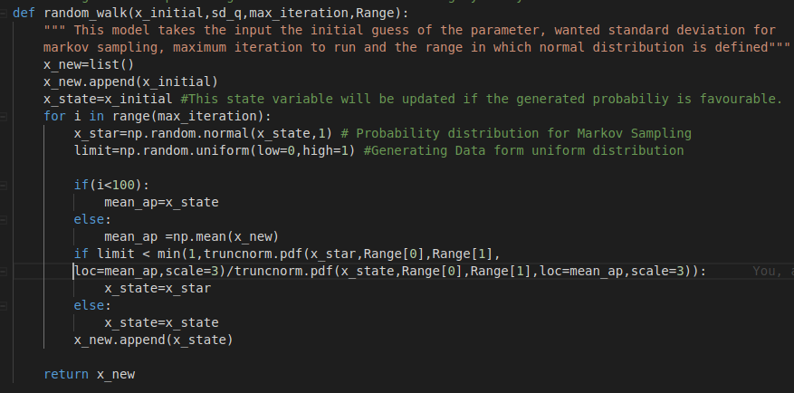
Random Walk Metropolis
Assumption
Formulation
Example Simulation

Slide 13
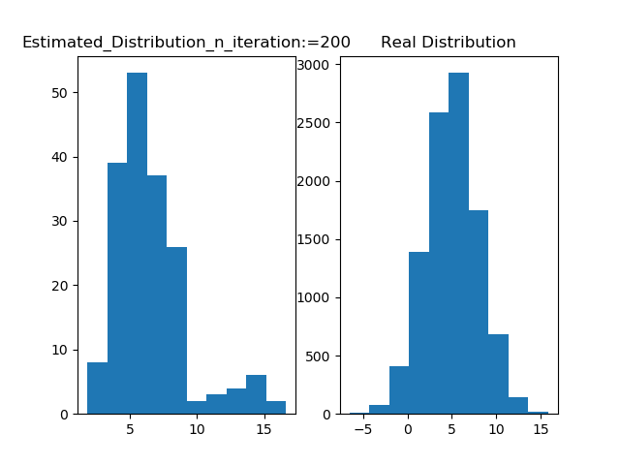
Simulation Results:
Number Of Iterations :200

Slide 14
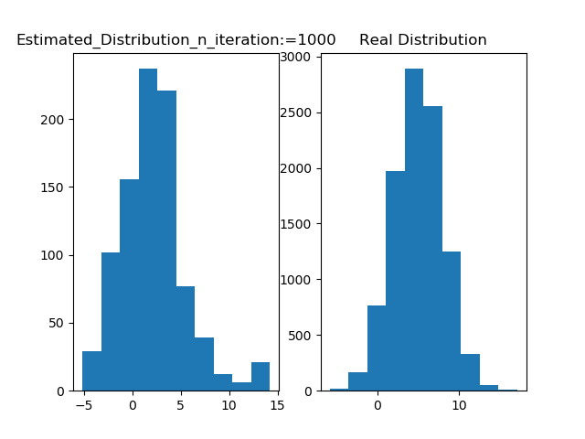
Simulation Results:
Number Of Iterations :1000

Slide 15
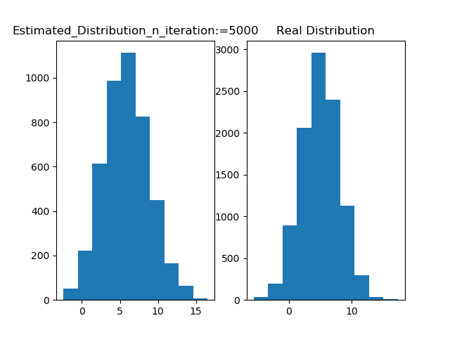
Simulation Results:
Number Of Iterations :5000

Slide 16
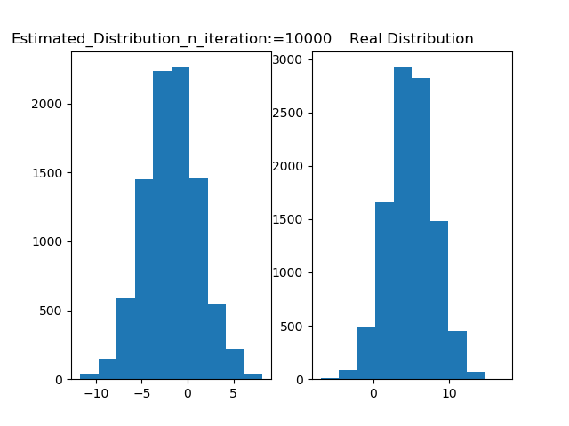
Simulation Results:
Number Of Iterations
10000

Slide 17
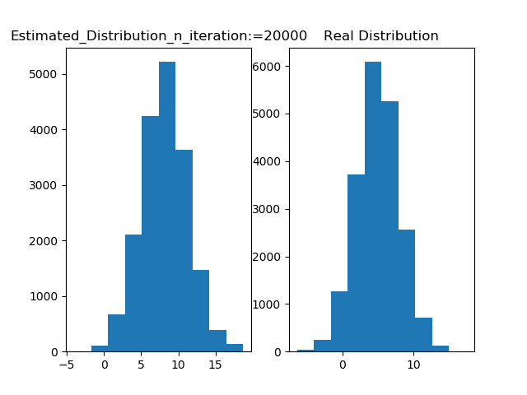
Simulation Results:
Number Of Iterations
20000

Slide 18
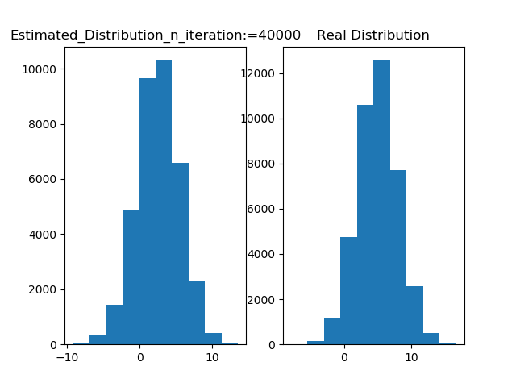
Simulation Results:
Number Of Iterations
40000

Slide 19
Independent Proposal
The Core Idea
Changes in the algorithm

Slide 20
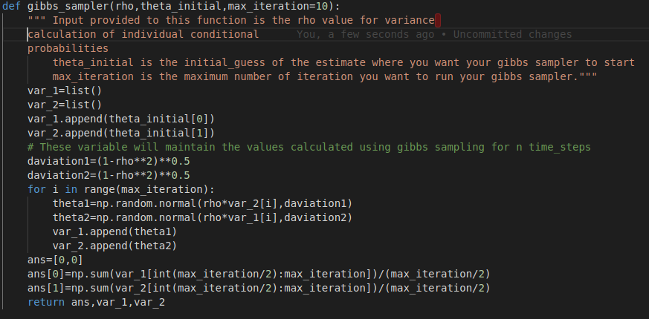
Gibbs Sampling:
The Core Idea of
Conditional Distribution
The algorithm
Example Simulation

Slide 21
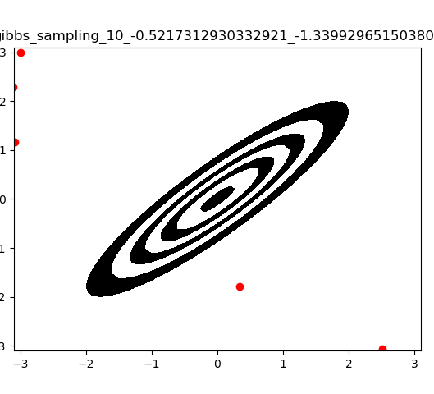
Simulation Result
No of Iterations
Estimate of Mean position
X: Y:

Slide 22
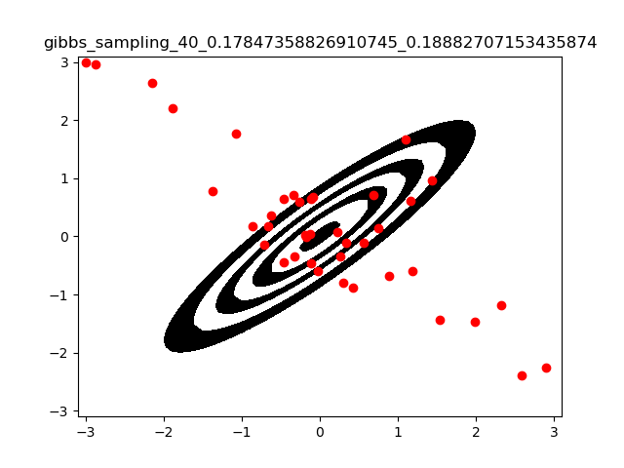
Simulation Result
No of Iterations
Estimate of Mean position
X: Y:

Slide 23
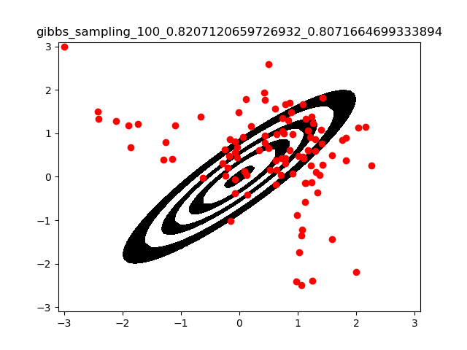
Simulation Result
No of Iterations
Estimate of Mean position
X: 0.8207 Y: 0.807

Slide 24
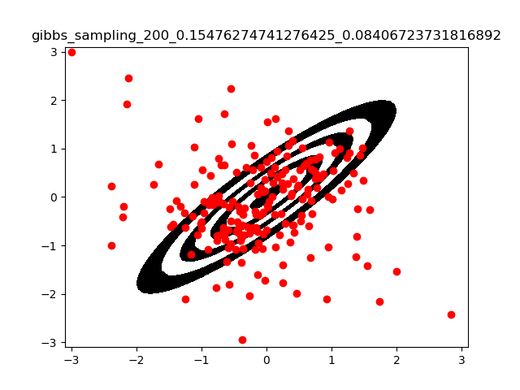
Simulation Result
No of Iterations = 200
Estimate of Mean position
X: 0.1547 Y: 0.08406

Slide 25
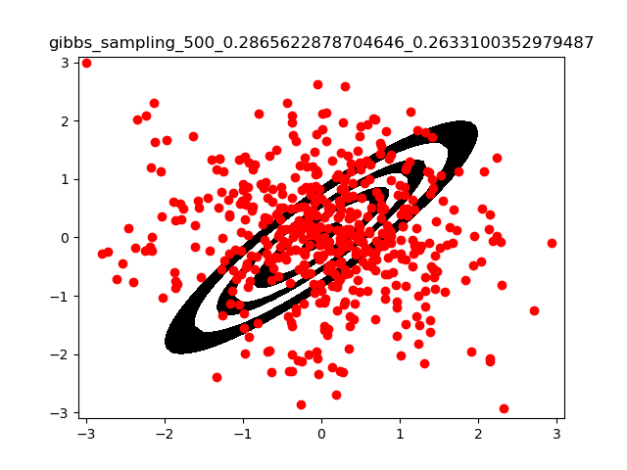
Simulation Result
No of Iterations = 500
Estimate of Mean position
X: 0.2865 Y: 0.2633

Slide 26
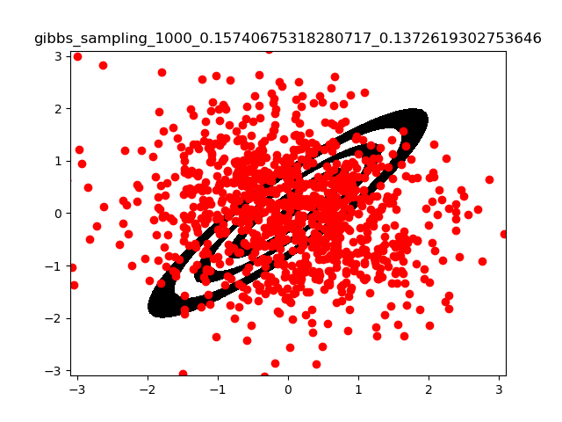
Simulation Result
No of Iterations = 1000
Estimate of Mean position
X: 0.15 Y: 0.13

Slide 27
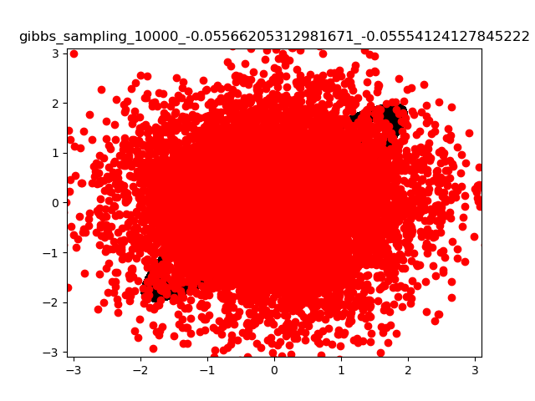
Simulation Result
No of Iterations = 10000
Estimate of Mean position
X: -0.0556 Y:-0.0555

Slide 28
Thank You
Questions.....

