Slide 1
UE24CS352A · MACHINE LEARNING MINI-PROJECT
Predicting eruptive
events at Kīlauea
Can earthquake patterns reveal volcanic activity?
Two tasks · Four model families · One important limitation
RETROSPECTIVE RESEARCH PROTOTYPE
Not an operational eruption-warning system
Presented by: Mohit S & Nishanth N Aralaguppe
UE24CS352A · Machine Learning Mini-Project
Notes:
Opening: “Our mini-project looks at whether earthquake data can help identify volcanic eruptive activity at Kīlauea in Hawaii. We reproduce two research tasks: identifying whether an eruption is underway, and estimating time until the next eruption. This is a retrospective experiment on historical records, not a real-world warning system.”

Slide 2
01 / PROBLEM
The problem has two different prediction goals
The project follows the research paper on Kīlauea and its East Rift Zone.
A
Classification
B
Regression
Is Kīlauea erupting when this earthquake occurs?
How many days until the next eruption begins?
OUTPUT: 0 OR 1
OUTPUT: NUMBER OF DAYS
0 = repose / not erupting
0 if an eruption is already underway
1 = erupting
A numeric estimate, not a guarantee
Research question
Do earthquake location, depth, magnitude and recent event rates contain useful signals?
Source: Mullet, Singh & Wong, “Predicting Eruptive Events at Volcanoes from Earthquake Data” (CS229, 2019)
02
Notes:
Explain the two targets distinctly. Classification is a yes/no question about the time of an earthquake. Regression estimates a number of days until an eruption starts. An important note is that these are retrospective labels created from historical eruption episodes. The output should not be described as a guaranteed warning.

Slide 3
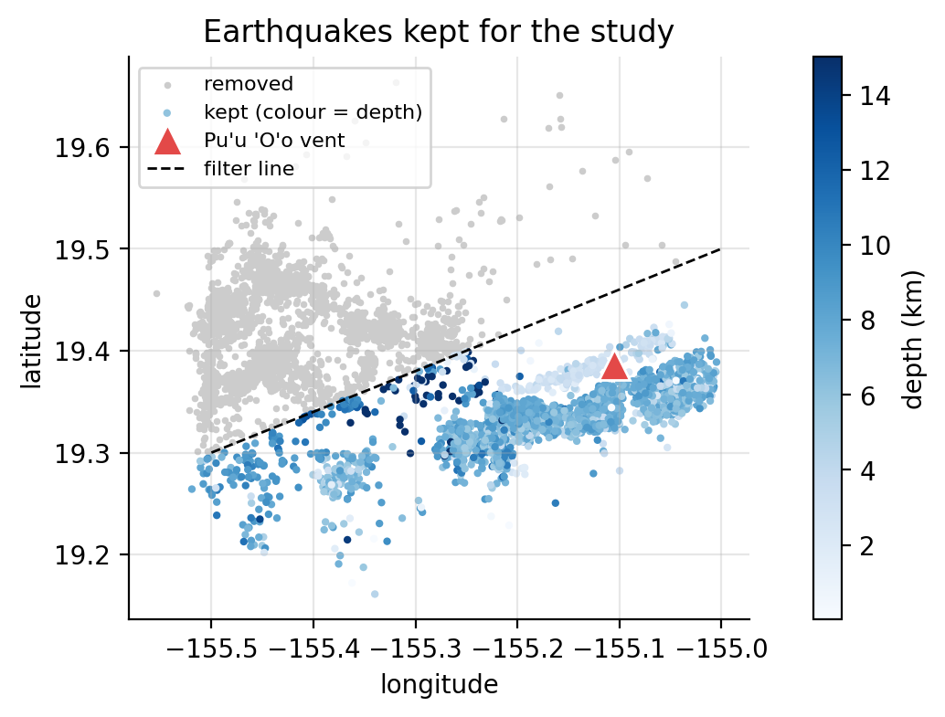
02 / DATA
The study combines earthquakes with eruption history
Earthquake records span 1983–1986; inputs are computed for each retained East Rift Zone earthquake.
6,485 → 3,764
49
7
earthquakes after spatial filtering
eruption episodes in the chronology
model input features
Inputs used by the models
1
Location
Latitude · longitude
2
Seismic size
Magnitude · depth
3
Recent activity
Earthquake counts in prior 1, 7 and 30 days
Labels
erupting (0/1) · days_to_eruption (numeric)
East Rift Zone filter: retained earthquakes in blue; removed events in gray.
Class balance: 22.4% erupting / 77.6% repose
Dataset details: supplied data card and results package; earthquake source described as ANSS/WOVOdat
03
Notes:
Describe the data simply: the raw earthquake catalogue contained 6,485 records; spatial filtering kept 3,764 earthquakes in the East Rift Zone, matching the reference paper. The eruption chronology contains 49 episode rows. Each earthquake is represented by seven model inputs: location, magnitude, depth, and earthquake counts in the last one, seven and thirty days. Only about 22% of retained earthquakes are labelled as erupting, so the dataset is imbalanced.

Slide 4
03 / METHOD
A reproducible pipeline turns records into testable predictions
The final results reported here use a stratified 70 / 20 / 10 train–development–test split.
01
02
03
04
Prepare data
Engineer features
Train models
Evaluate
Clean timestamps, filter the East Rift Zone and construct eruption labels.
Compute earlier earthquake counts over 1, 7 and 30 days.
Tune candidate models using the development split.
Use held-out test data and task-appropriate metrics.
Algorithms tested
How performance is measured
Logistic Regression
classification
CLASSIFICATION
AUROC · Cohen’s Kappa · confusion matrix
K-Means
classification + regression
REGRESSION
RMSE in days · R²
Random Forest
classification + regression
Neural Network
classification + regression
Final split: 2,634 train | 753 development | 377 test
Method and split: supplied Colab results package; seed 42
04
Notes:
Walk through the pipeline: first the earthquake catalogue is cleaned and filtered; then the team creates event-rate features and labels using the eruption chronology. Models are tuned on the development set, and final metrics are measured on a held-out test set. Logistic Regression is used only for classification. K-Means, Random Forest and a neural network are explored for both tasks. Explain that AUROC and Kappa are used because plain accuracy can be misleading when most records are non-erupting.

Slide 5
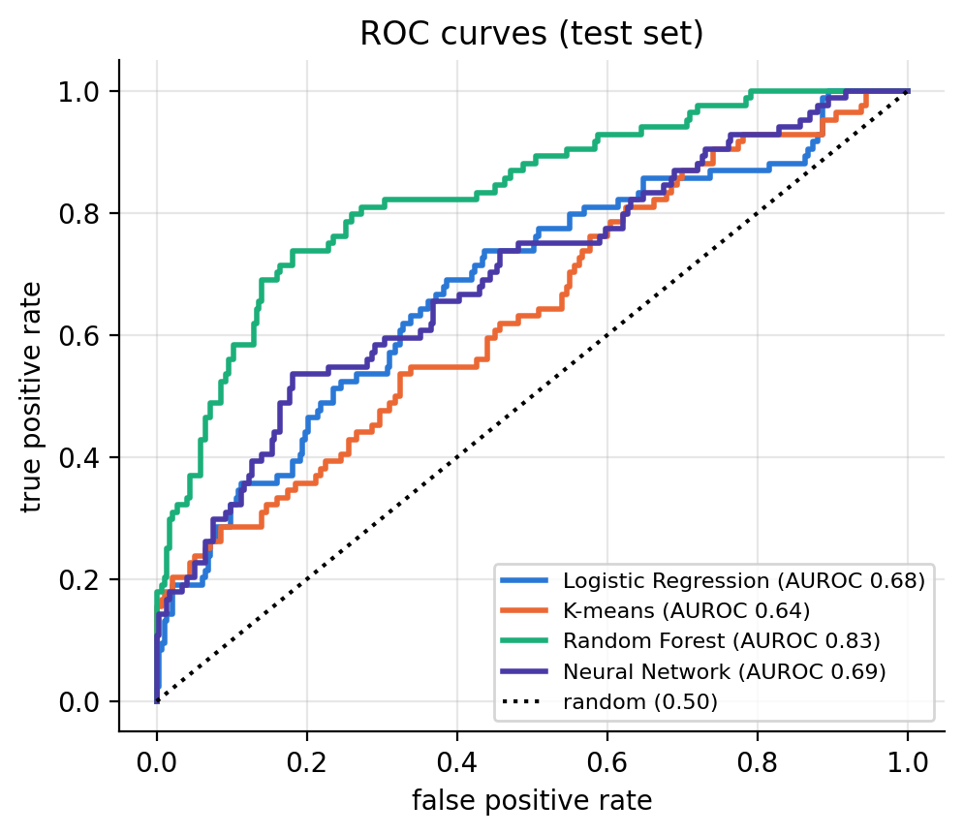
04 / RESULTS — CLASSIFICATION
Random Forest has the strongest test-set ranking performance
Held-out test metrics from the supplied Colab results package.
Test AUROC by model
ROC curves (test set)
Logistic Regression
0.68
K-Means
0.64
Random Forest
0.83
Neural Network
0.69
Random Forest on test set
Important trade-off
The model detected 27 of 84 erupting cases; 57 were missed.
Kappa 0.37 · Precision 0.75 · Recall 0.32
Source: notebook_results.zip / RESULTS.md; test set n = 377
05
Notes:
The Random Forest has the highest AUROC of 0.83 on the random held-out test split. AUROC measures how well the model ranks eruption versus repose examples; 0.5 is random ranking and 1.0 is perfect ranking. But ranking performance does not mean it catches most eruptions at the chosen threshold. Recall is 0.32: of 84 erupting cases in the test set, it correctly found 27 and missed 57. It also produced 9 false alarms. This is why we should not describe it as ready for real warning use.

Slide 6
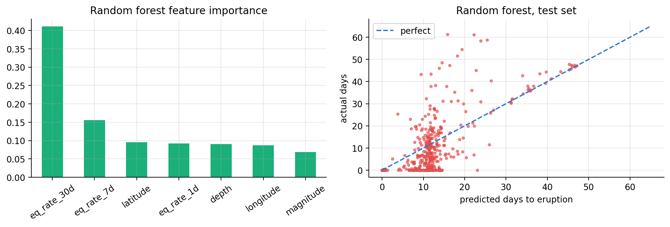
05 / RESULTS — REGRESSION
Random Forest gives the lowest reported time-to-eruption error
Regression predicts days until the next eruption begins; target is 0 when an episode is already underway.
Test RMSE (days)
Random Forest: feature importance & fit
K-Means
18.1
Random Forest
10.1
Neural Network
11.8
Most influential input
Random Forest test R²
0.47
30-day earthquake rate
41% feature importance
RMSE ≈ 10.1 days
Source: notebook_results.zip / RESULTS.md; RMSE converted from standardized target to days
06
Notes:
For regression, Random Forest has the lowest test RMSE at about 10.1 days and the highest R-squared at 0.47 among these models. K-Means performs poorly here, with negative R-squared, meaning it is worse than a simple mean prediction on this test split. Feature importance indicates the count of earthquakes over the previous 30 days is the strongest input, at about 41%. Emphasize that a roughly ten-day error is still large, and feature importance is not proof of causation.

Slide 7
06 / ROBUSTNESS CHECK
Performance drops when whole months are kept together
This is the most important limitation in the results: a random split may make the task look easier than it is.
Random folds vs. calendar-month grouped folds
INTERPRETATION
AUROC
Random
0.83
Ranking quality
Similar earthquake swarms can appear in both train and test sets.
Grouped
0.58
Kappa
Random
0.46
Agreement beyond chance
Keeping each calendar month together is a stricter test of performance on a different time period.
Grouped
0.03
R²
Random
0.39
Regression fit
Grouped-fold results
Grouped
-0.17
Kappa ≈ 0.03 and R² < 0
Generalization across time is weak.
Source: notebook_results.zip / RESULTS.md; 5-fold cross-validation comparison
07
Notes:
Be transparent about validation. Under random folds, AUROC is 0.83 and regression R-squared is 0.39. When validation folds are grouped by calendar month, AUROC falls to 0.58, Kappa falls to 0.03, and R-squared becomes negative. The report attributes this to similar earthquake swarms and labels appearing across random train/test folds. The stricter temporal check suggests that the model may not generalize well to genuinely later time periods. This caveat is central to the conclusion.

Slide 8
07 / CONCLUSION
Useful patterns exist, but reliable forecasting is not established
What we learned and what to demonstrate during the review.
Key findings
Live demo flow
01
Random Forest ranked best on the random held-out test split.
1
Load the two CSV files
AUROC 0.83 · Kappa 0.37
2
Build labels and seven features
02
Recent earthquake activity was the strongest regression feature.
30-day rate: 41% importance
3
Run the trained models
03
Temporal validation sharply reduced performance.
4
Show test metrics and limitations
Grouped AUROC 0.58 · Kappa 0.03
Prototype only — not an eruption alert system
Next steps
Use time-based evaluation and add deformation / gas signals where available.
Conclusion grounded in the supplied Colab result package and its grouped-validation experiment
08
Notes:
Conclude that Random Forest had the strongest metrics on the random held-out split and the 30-day event rate was the most influential feature in regression. However, the month-grouped experiment drops close to chance for classification and below zero for regression fit. So the result is a useful ML investigation, not evidence that earthquakes alone can reliably predict future eruptions. In the live demo, show data loading, feature/label creation, model results, and then explicitly mention the grouped validation limitation. Further work should use stronger time-based splits and additional signals such as ground deformation and gas emissions, as suggested by the reference paper.

Slide 9
REFERENCES & PROJECT MATERIALS
Sources behind this presentation
RESEARCH PAPER
Mullet, B., Singh, A. & Wong, Y. Q. “Predicting Eruptive Events at Volcanoes from Earthquake Data.” Stanford CS229, 2019.
EARTHQUAKE CATALOGUE
Advanced National Seismic System (ANSS), accessed through WOVOdat; Kīlauea catalogue, 1983–1986. Dataset details in the project data card.
ERUPTION CHRONOLOGY
Hawaii Center for Volcanology, Pu‘u ‘O‘o eruption episodes chronology; historical eruption starts and durations.
EXPERIMENT RESULTS
Supplied `notebook_results.zip` / `RESULTS.md`, identified as a Google Colab run dated 13 Oct 2026; seed 42. Results are reported as recorded, not independently reproduced here.
PROJECT REPOSITORY
github.com/mohit2007malur-png/volcano-eruption-prediction
Thank you
Notes:
Use this slide if someone asks for sources. The original research paper provides the two prediction tasks and benchmark study. The earthquake catalogue is attributed to ANSS via WOVOdat, and eruption dates are from the Hawaii Center for Volcanology chronology. The reported evaluation numbers come from the supplied results package recorded as a Colab run on 13 October 2026. Be transparent that this presentation is based on the supplied result record rather than a run independently reproduced during slide preparation.

