Slide 1


MARGDARSHAK Android Based Tourist Guide
Submitted By:
KSHITIJ SRIVASTAVA
MOHIT RATHAUR
MRIDUL ARORA
PRASHANT GUPTA
GUIDED BY:-
Ms. PRIYANKA UPADHYAY
Assistant Professor , CSE DEPT

Slide 2
WHAt IS MARGDARSHAK?
The tag line says “ MARGDARSHAK”. It is a complete android application on the internet that is dedicated to travel. A great app to search any type of place near your location. You can search Tourist Places, Bank, ATM, Café, Night Club, Hospital, Departmental Stores, Hotels and many more places near you.
Get all the details about the place like Contact, Rating, User Reviews and Images.
Just tap and Go anywhere you want!

Slide 3
Objectives of MARGDARSHAK
To provide location base services for tourist using GPS coordinates.
To calculate distance between current locations to desired location.
To provide basic information about the tourist spots.
To facilitate tourism industry by using modern technologies to boost tourism.
To make available desired direction services and compass for right direction.
To give rewards to users for certain actions.

Slide 4
Scope and limitations
Scope
It supports almost 90% android phones.
After searching a location using Internet we can use that location data outline.
It can be use without sign-up.
Users will be able to earn rewards for certain actions.
Limitation
It required a device (smart phones) which should have installed android operating System.
It could only locate the locations which the developer marked on the map by custom markers.
Internet, global positioning system (GPS) and cellular data required continuously.
It cannot be run on personal computers without any virtual device.

Slide 5


Technology used
ANDROID STUDIO: Android Studio is the official integrated development environment for Google's Android operating system, built on JetBrains' IntelliJ IDEA software and designed specifically for Android development.
Android Studio provides a unified environment where you can build apps for Android phones, tablets, Android Wear, Android TV, and Android Auto. Structured code modules allow you to divide your project into units of functionality that you can independently build, test, and debug.
FLUTTER:Flutter is an open-source UI software development kit created by Google. It is used to develop applications for Android, iOS, Linux, Mac, Windows, Google Fuchsia and the web from a single codebase. The first version of Flutter was known as codename "Sky" and ran on the Android operating system. This means that you can use one programming language and one codebase to create two different apps (for iOS and Android).

Slide 6


Technology used
DART: Dart is a client-optimized programming language for apps on multiple platforms. It is developed by Google and is used to build mobile, desktop, server, and web applications. Dart is an object-oriented, class-based, garbage-collected language with C-style syntax. Dart can compile to either native code or JavaScript.
FIREBASE: Firebase is a platform for creating mobile and web applications developed by Google. The Firebase Realtime Database is a cloud-hosted NoSQL database that lets you store and sync data between your users in realtime. NEW: Cloud Firestore enables you to store, sync and query app data at global scale.

Slide 7
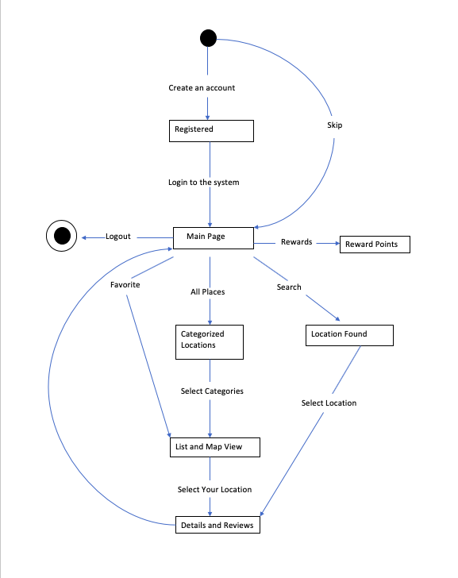
sTate transition diagram

Slide 8
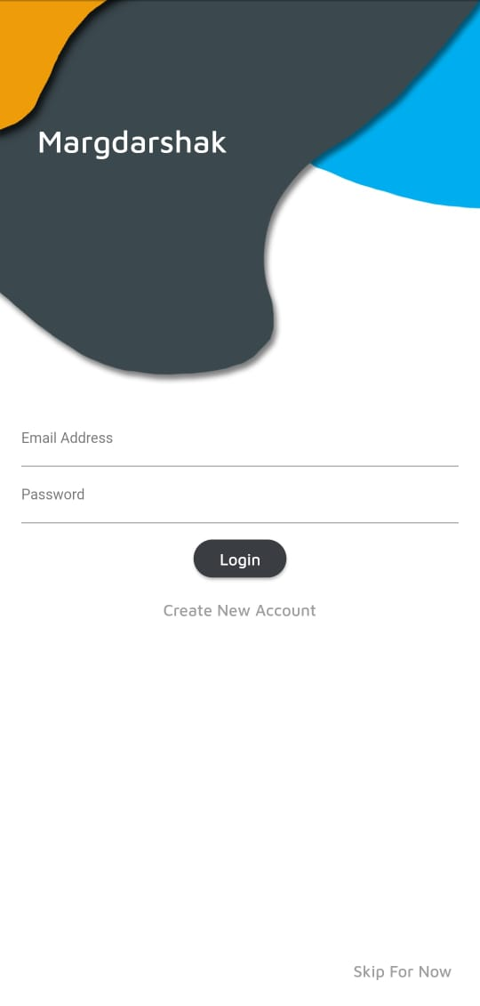
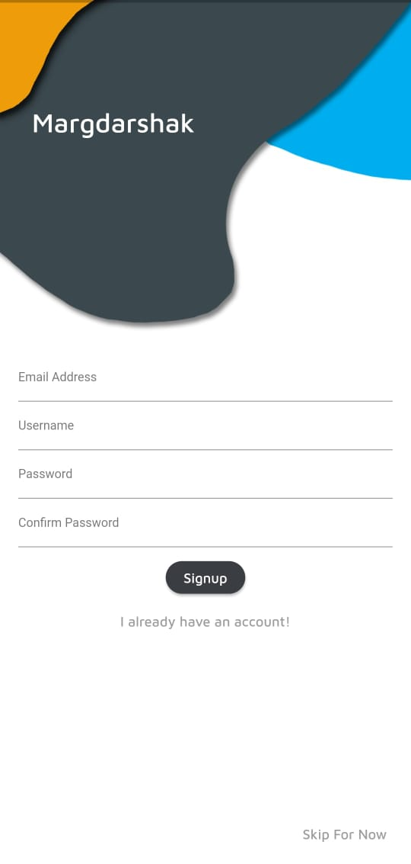
Application screenshots
LOGIN AND REGISTRATION

Slide 9
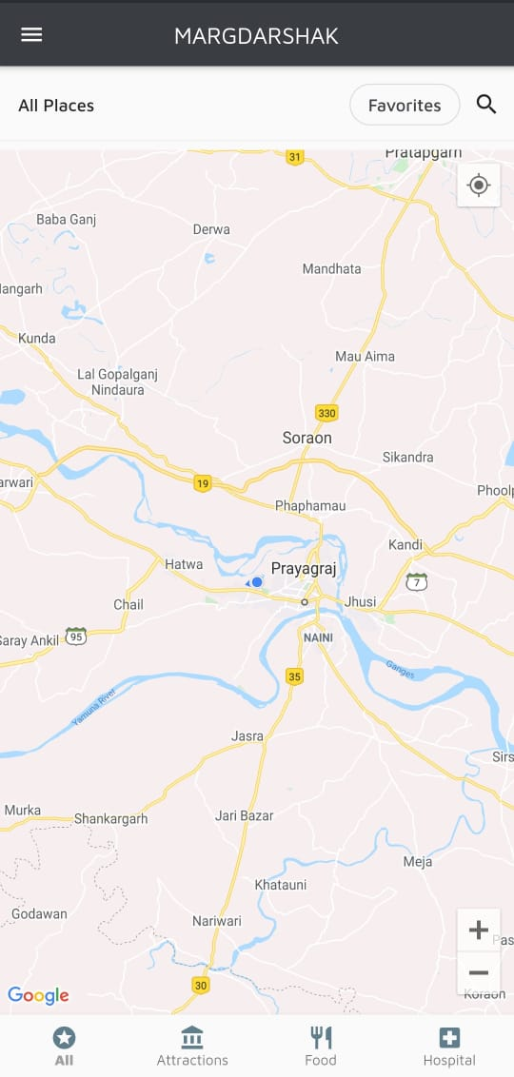
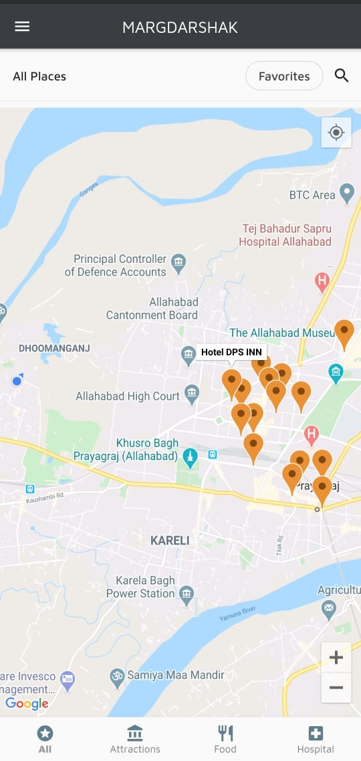
Application screenshots
HOME SCREEN AND
NEARBY PLACES

Slide 10
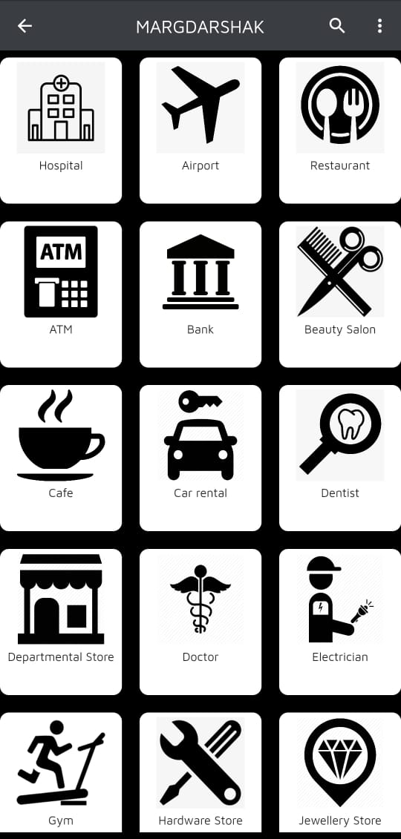
Application screenshots
CATEGORICAL VIEW

Slide 11
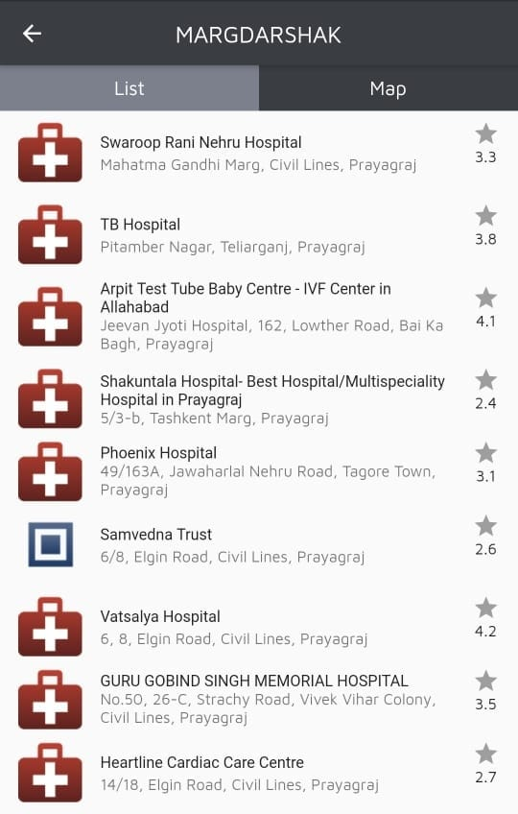
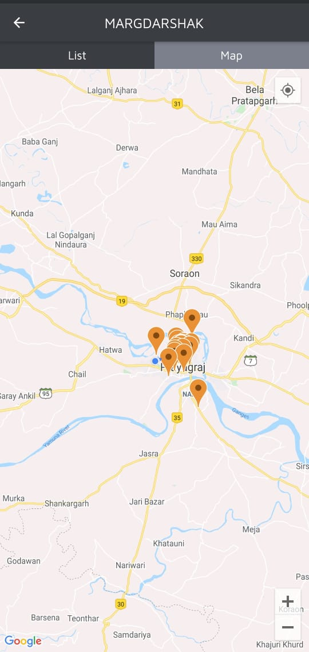
Application screenshots
LIST VIEW AND MAP VIEW

Slide 12
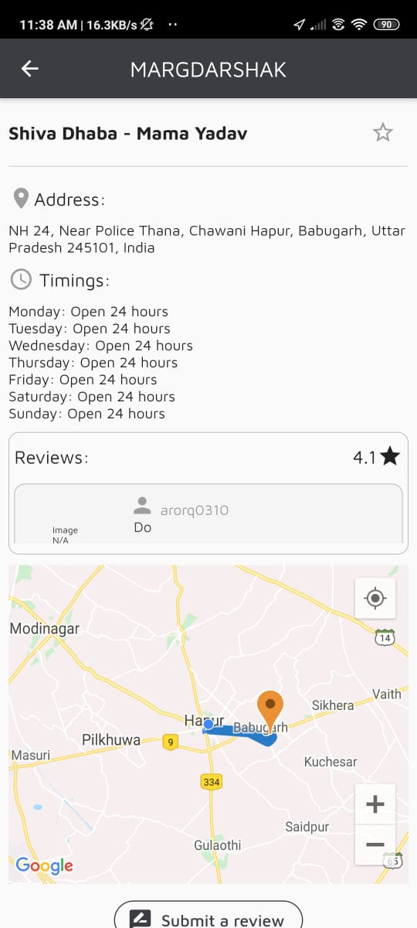
Application screenshots
LOCATION DETAILS AND REVIEW

Slide 13
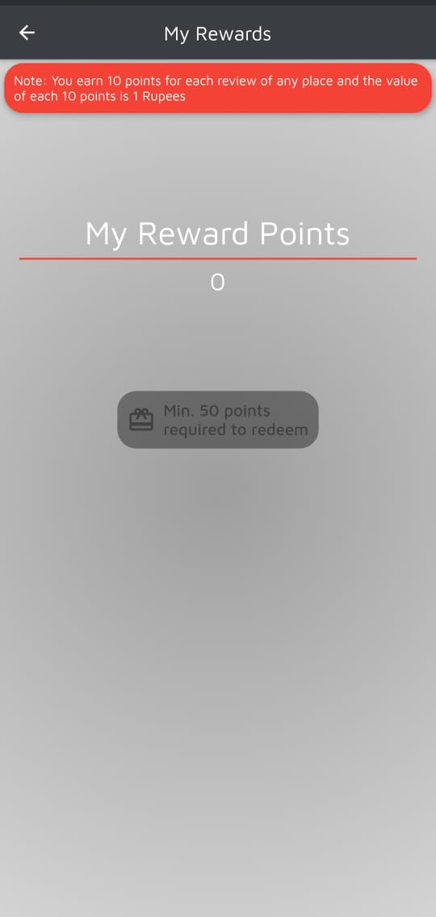
Application screenshots
REWARDS

Slide 14
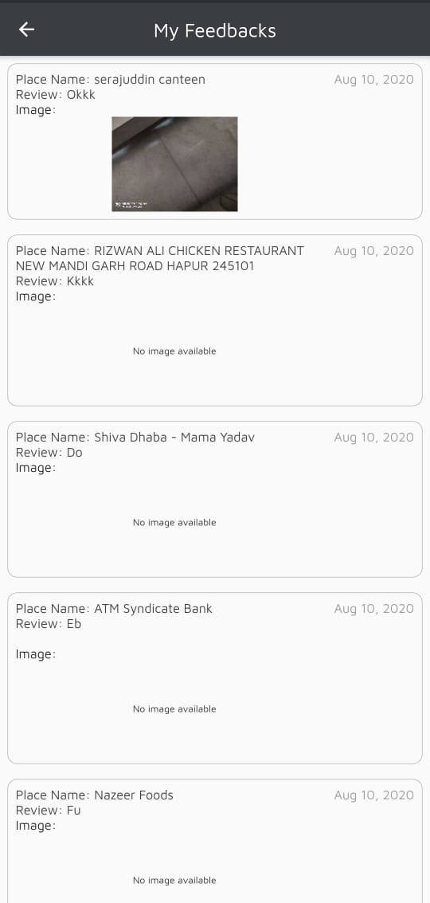
Application screenshots
USER FEEDBACK

Slide 15
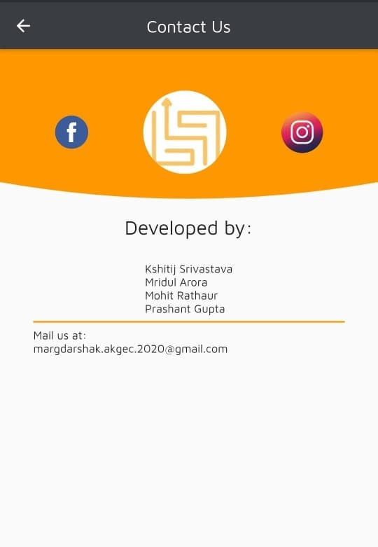
Application screenshots
CONTACT US

Slide 16
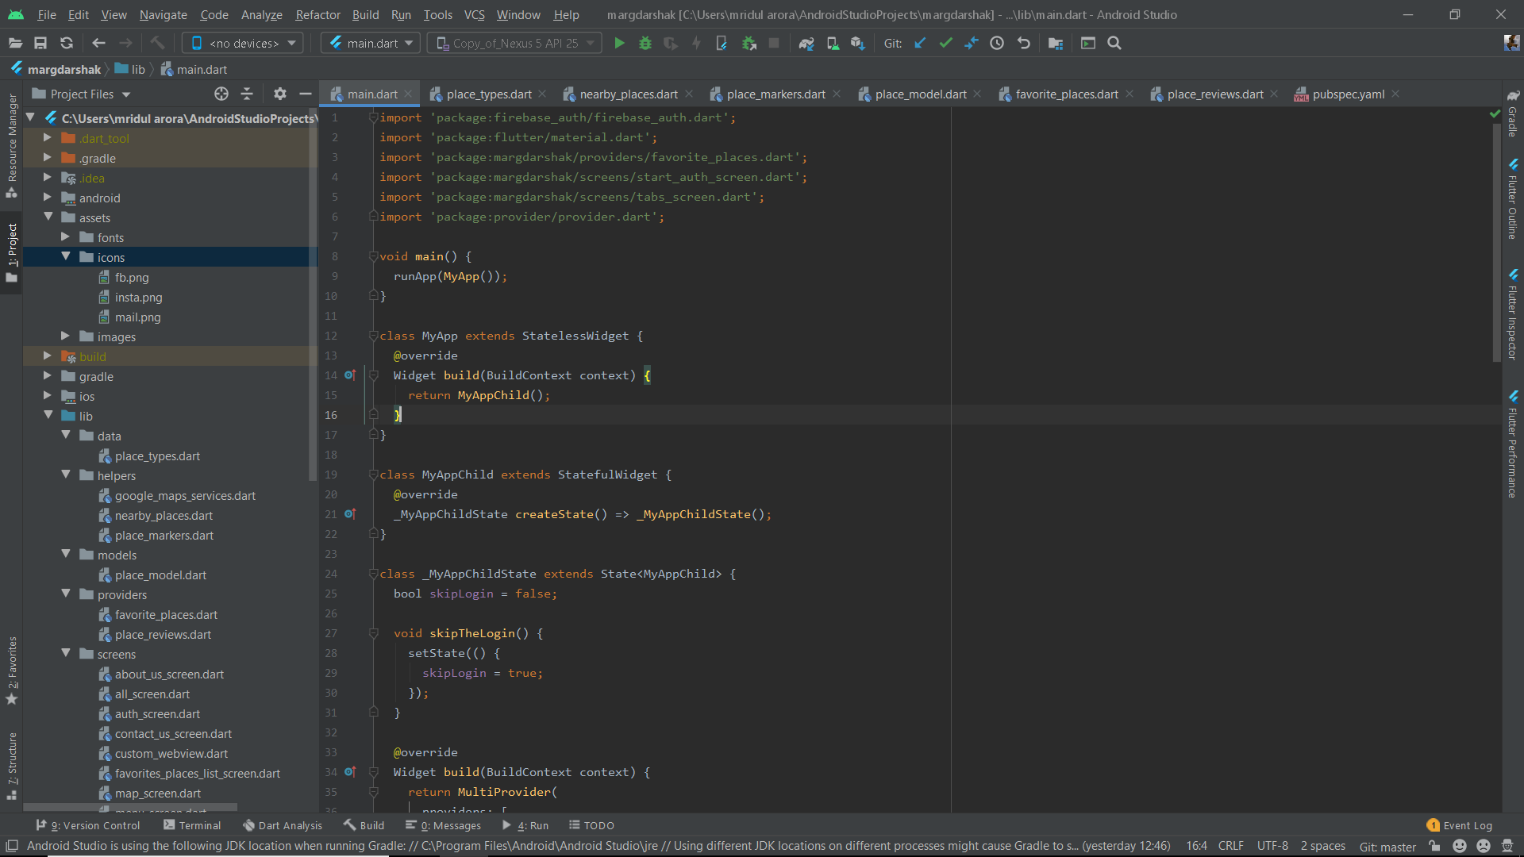
Main.dart file screenshot

Slide 17
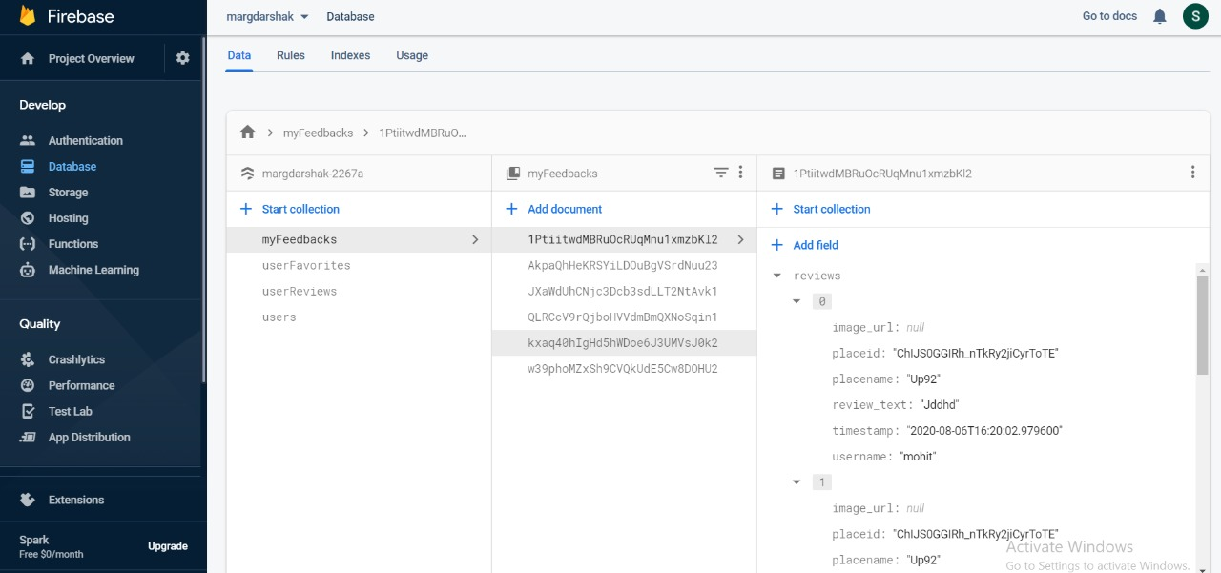
Firebase screenshot

Slide 18
conclusions
The login system works fine and all the locations can be seen without any errors.
There are no distractions within the app that can irritate the user.
The design is very simple and every button has its clear purpose.
The user can earn rewards and redeem them through paytm.
Categorical view helps user to find location by simply looking in the category it belong.

Slide 19
THANK YOU

