Slide 1


GREATER NOIDA, UTTAR PRADESH
Codec Technologies Pvt. Ltd.
Web Developer Internship
1-Month Professional Internship Presentation Report

Slide 2


Candidate & Program Overview
Candidate
Program Details
Mohit Rajput
Roll: 25SCS1003001547
Web Developer Intern
Duration: 1 Month (July2026-August2026)
Organization: Codec Technologies Pvt. Ltd.
Mode: Pan India, Hybrid
Program: 1-Month Web Developer Internship

Slide 3
Organization Profile: Codec Technologies
🌍 Global Presence
🏅 Certified
Operating across 27+ countries
ISO 9001:2015 certified quality standards
🎓 Partnership
🚀 Mission
Google for Education Partner
Empowering learners & connecting diverse talent worldwide
Dedicated IT and business consultancy services · Global innovation & strategic growth

Slide 4
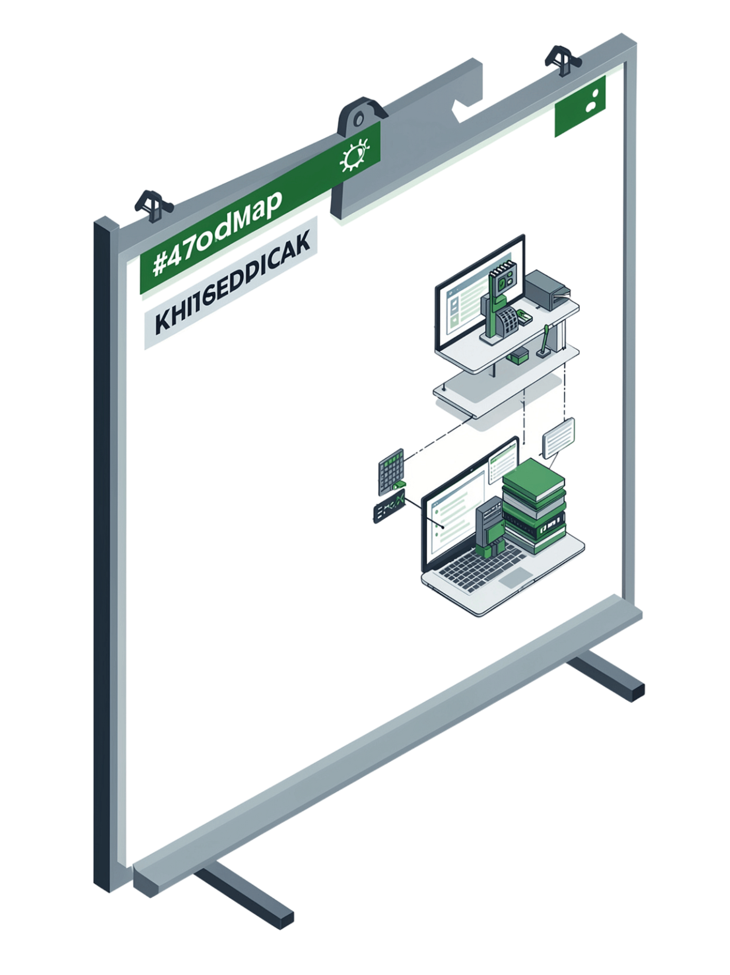
Program Objectives
1
Industry-Level Web Development
Full-stack skills · Front-end frameworks · Responsive design
2
Back-End & Database Mastery
Node.js · Express · MongoDB management
3
Production Deployment & AI Integration
Deploy to live environments · Build real-world AI-powered projects

Slide 5
Problem Statement & Industry Context
The Challenge
The Opportunity
40+ hours/week on resume screening
High bias in candidate evaluation
Poor skill-to-job alignment
45+ day hiring cycles
70% time reduction with AI
85% accuracy improvement
15–20 day hiring cycles
Data-driven decisions

Slide 6
Week 1 & 2: Building the Foundation
HTML & CSS
JavaScript
Tags, forms, tables
Selectors, box model
Text styling
Variables, operators
Control flow, loops
Functions, events
Responsive Design
React & Backend
Media queries
Flexbox, Grid
Bootstrap
Components, state
Node.js, Express
MongoDB CRUD

Slide 7
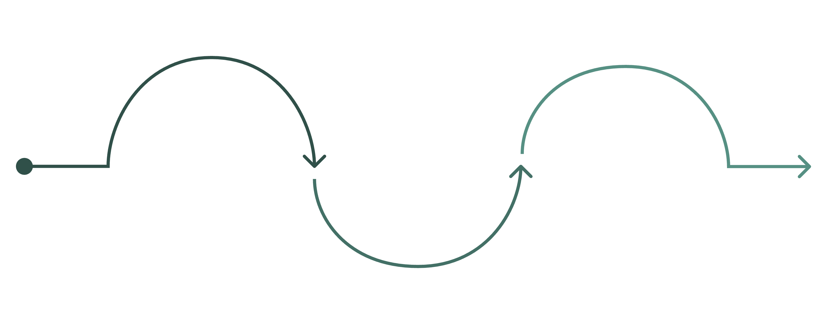
Week 3: APIs, Deployment & Version Control
Build APIs
Version Control & Testing
Deploy to Production
REST design, data fetching, custom endpoints
Git, GitHub workflows and debugging
Host on Heroku or Netlify

Slide 8

Project: AI-Powered ATS Platform
Objective
Tech Stack
Intelligent end-to-end recruitment system
React · Python · FastAPI · PostgreSQL
Core Features
Resume parsing · Skill matching · Pipeline visualization · Interview scheduling

Slide 9
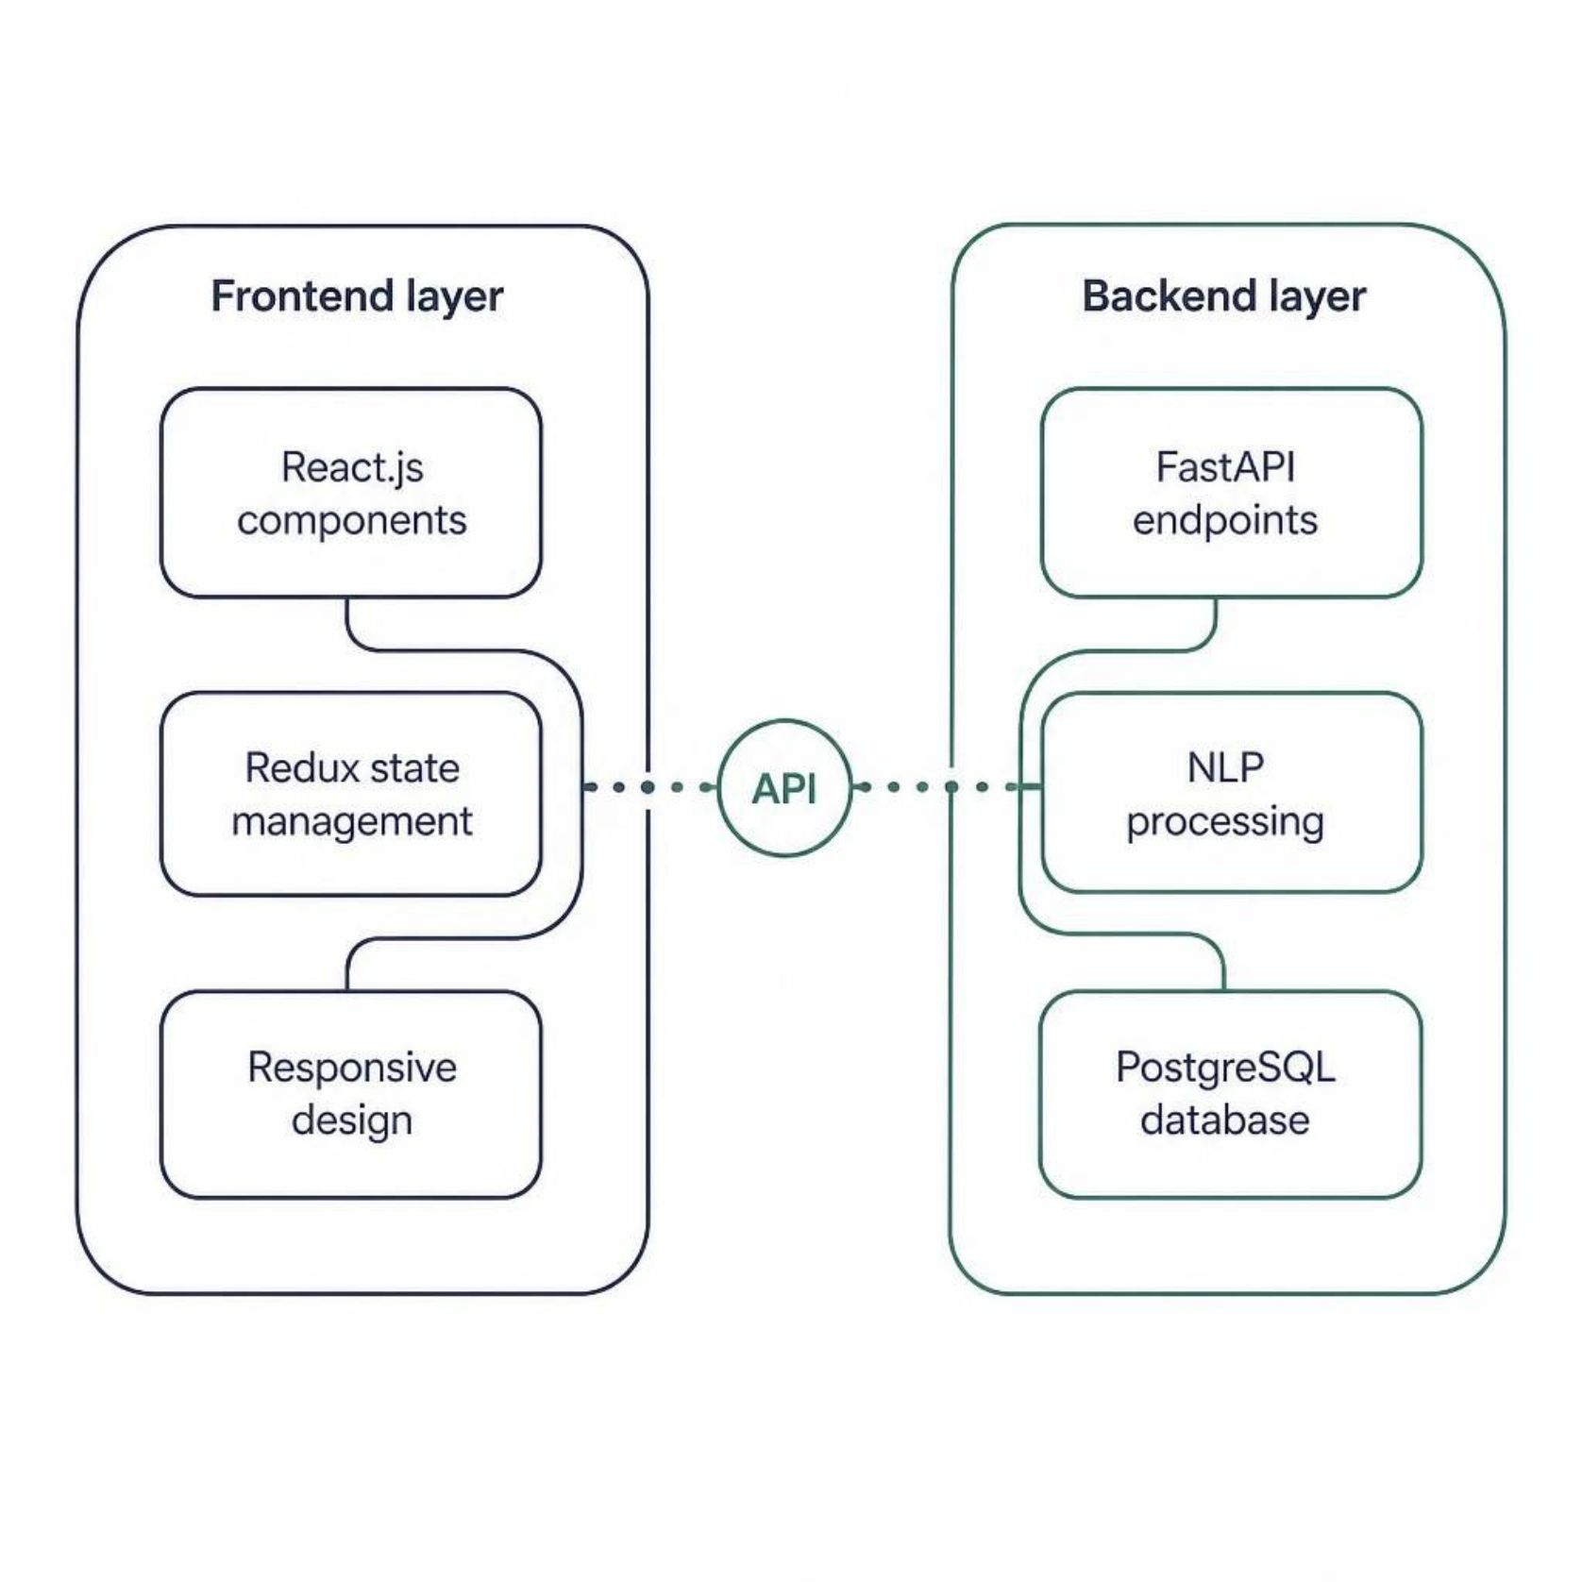
Technical Architecture
Frontend
React.js components
Redux state management
Responsive design
Backend
FastAPI endpoints
NLP processing
PostgreSQL database

Slide 10
Key Features
📄 Resume Parsing
🎯 Skill Matching
📋 Pipeline & Scheduling
Auto extraction
Multi-format support
Entity recognition
Requirement comparison
Gap identification
Confidence scoring
Kanban board
Calendar integration
Auto reminders

Slide 11
Certification & Official Verification

Slide 12

THANK YOU
Mohit Rajput
School of Computer Science &
Engineering
Roll No: 25SCS1003001547
IILM University, Greater Noida, U.P

