Slide 1
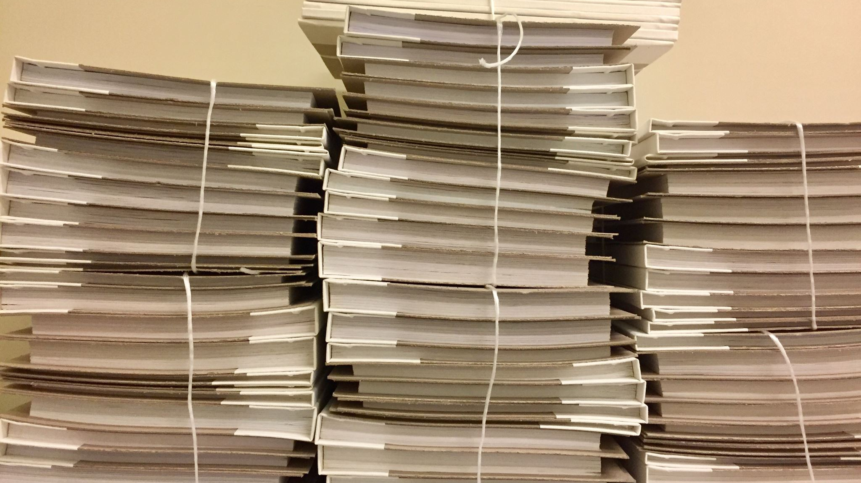
Face Recognition-Based Smart Attendance System

Slide 2
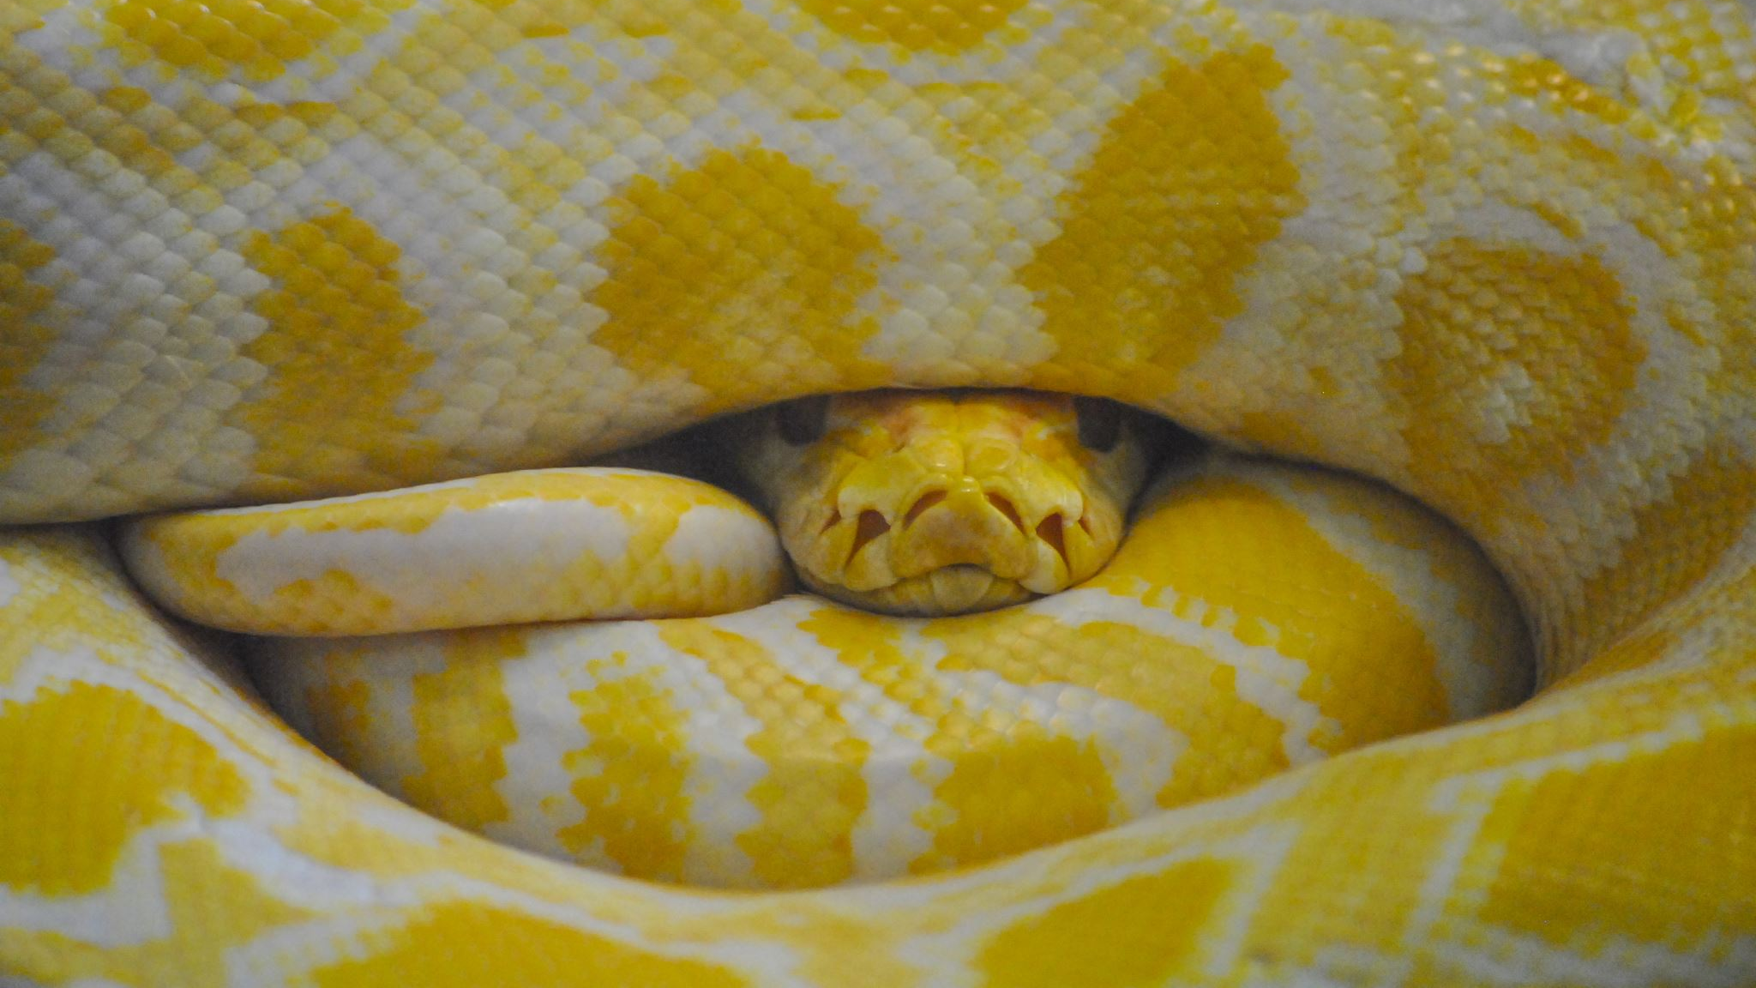
Face recogniti based smart attendance system using
Python and Machine learning

Slide 3
Step1: Collection Of Data User Face And Their Name
Step2:Train And Test With Machine Learning algorithm
Step3:Create and use web app for user interface

Slide 4
Objectives**
Listing the objectives of the presentation
Highlighting the main goals: Automation, Accuracy, and Efficiency

Slide 5
System Components**
Briefly explain the components of the system
Face Detection Module
Face Recognition Module
KNN Algorithm
CSV Data Storage
Streamlit Interface

Slide 6
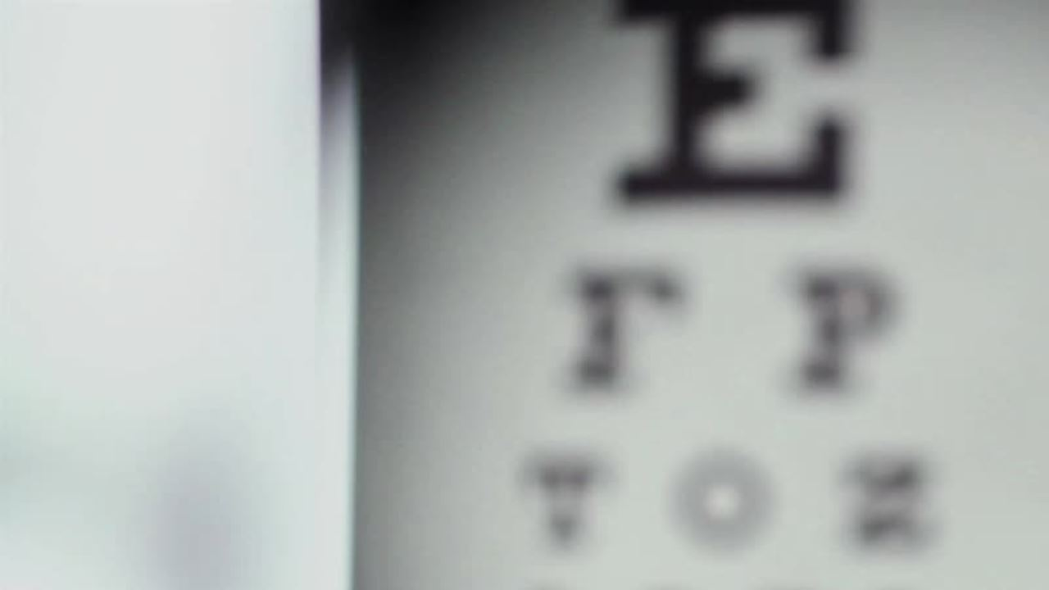
Face Detection**
Explain the face detection process
Use of OpenCV for face detection
Briefly describe Haar Cascade Classifier

Slide 7
Data Storage**
- Describe how attendance data is stored in CSV files
- Data structure
- Benefits of CSV for simplicity and compatibility

Slide 8
Streamlit Interface**
- Introduction to Streamlit
- Its role in displaying attendance data
- User-friendly interface for viewing attendance

Slide 9
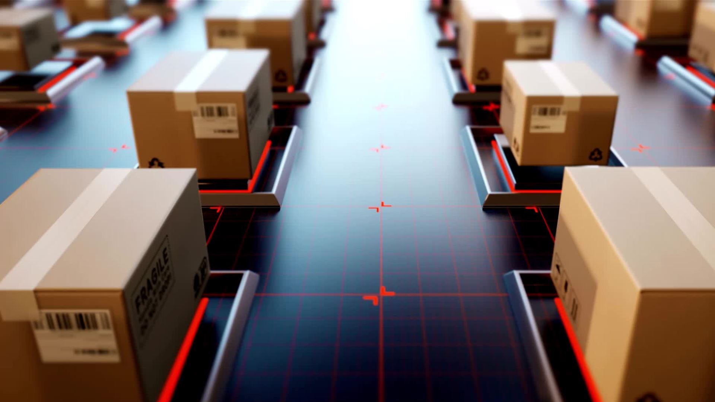
System Workflow**
- Describe the step-by-step workflow of the system

Slide 10
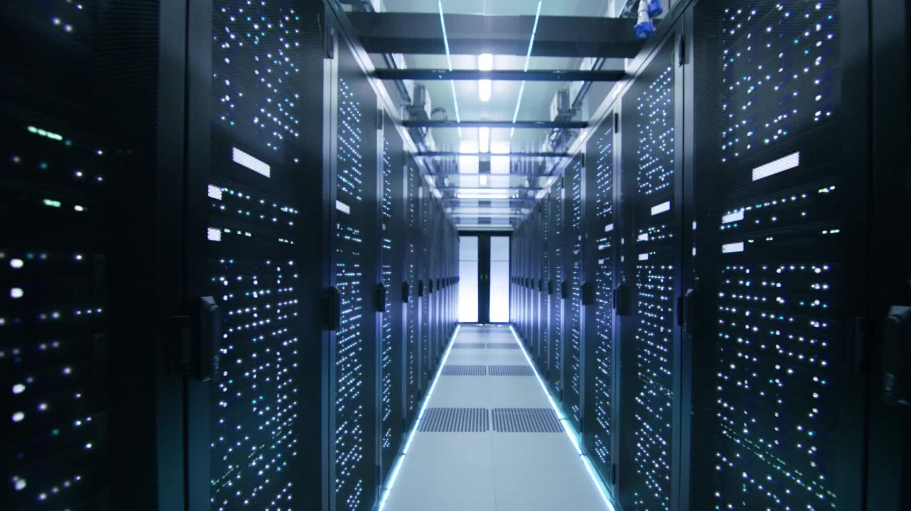
System Implementation**
- Discuss how to implement the system
- Python libraries used
- Training the model

Slide 11
Challenges & Solutions**
- Highlight common challenges and their solutions
- Variability in lighting conditions
- Handling errors and exceptions

Slide 12
Benefits**
- Discuss the benefits of the system
- Improved accuracy in attendance tracking
- Time-saving and efficiency
- Reduced administrative workload

Slide 13
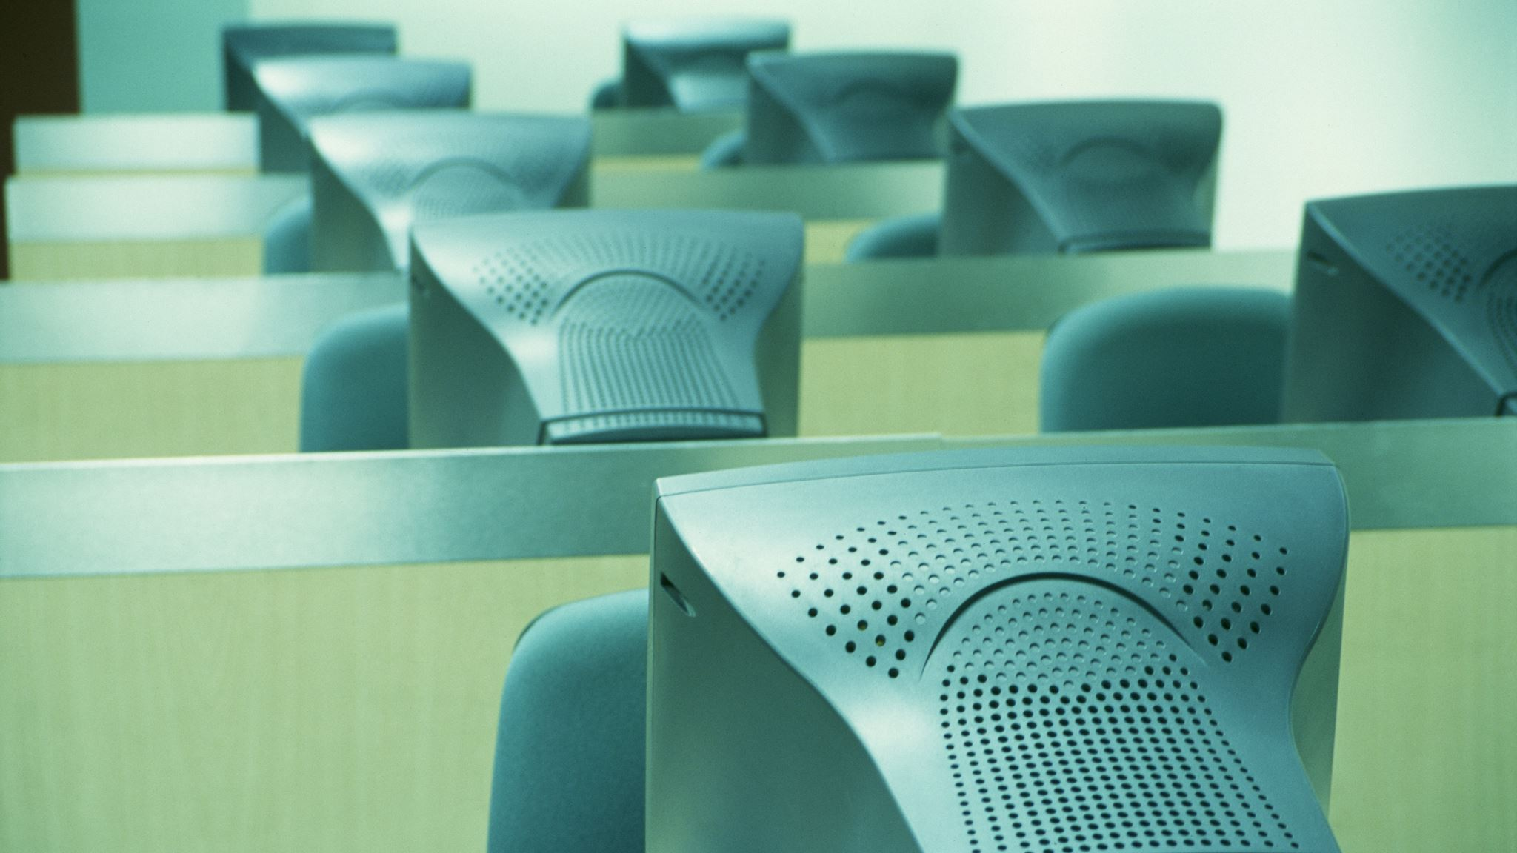
Use Cases**
- Share potential use cases
- Educational institutions
- Corporations
- Any organization requiring attendance tracking

Slide 14
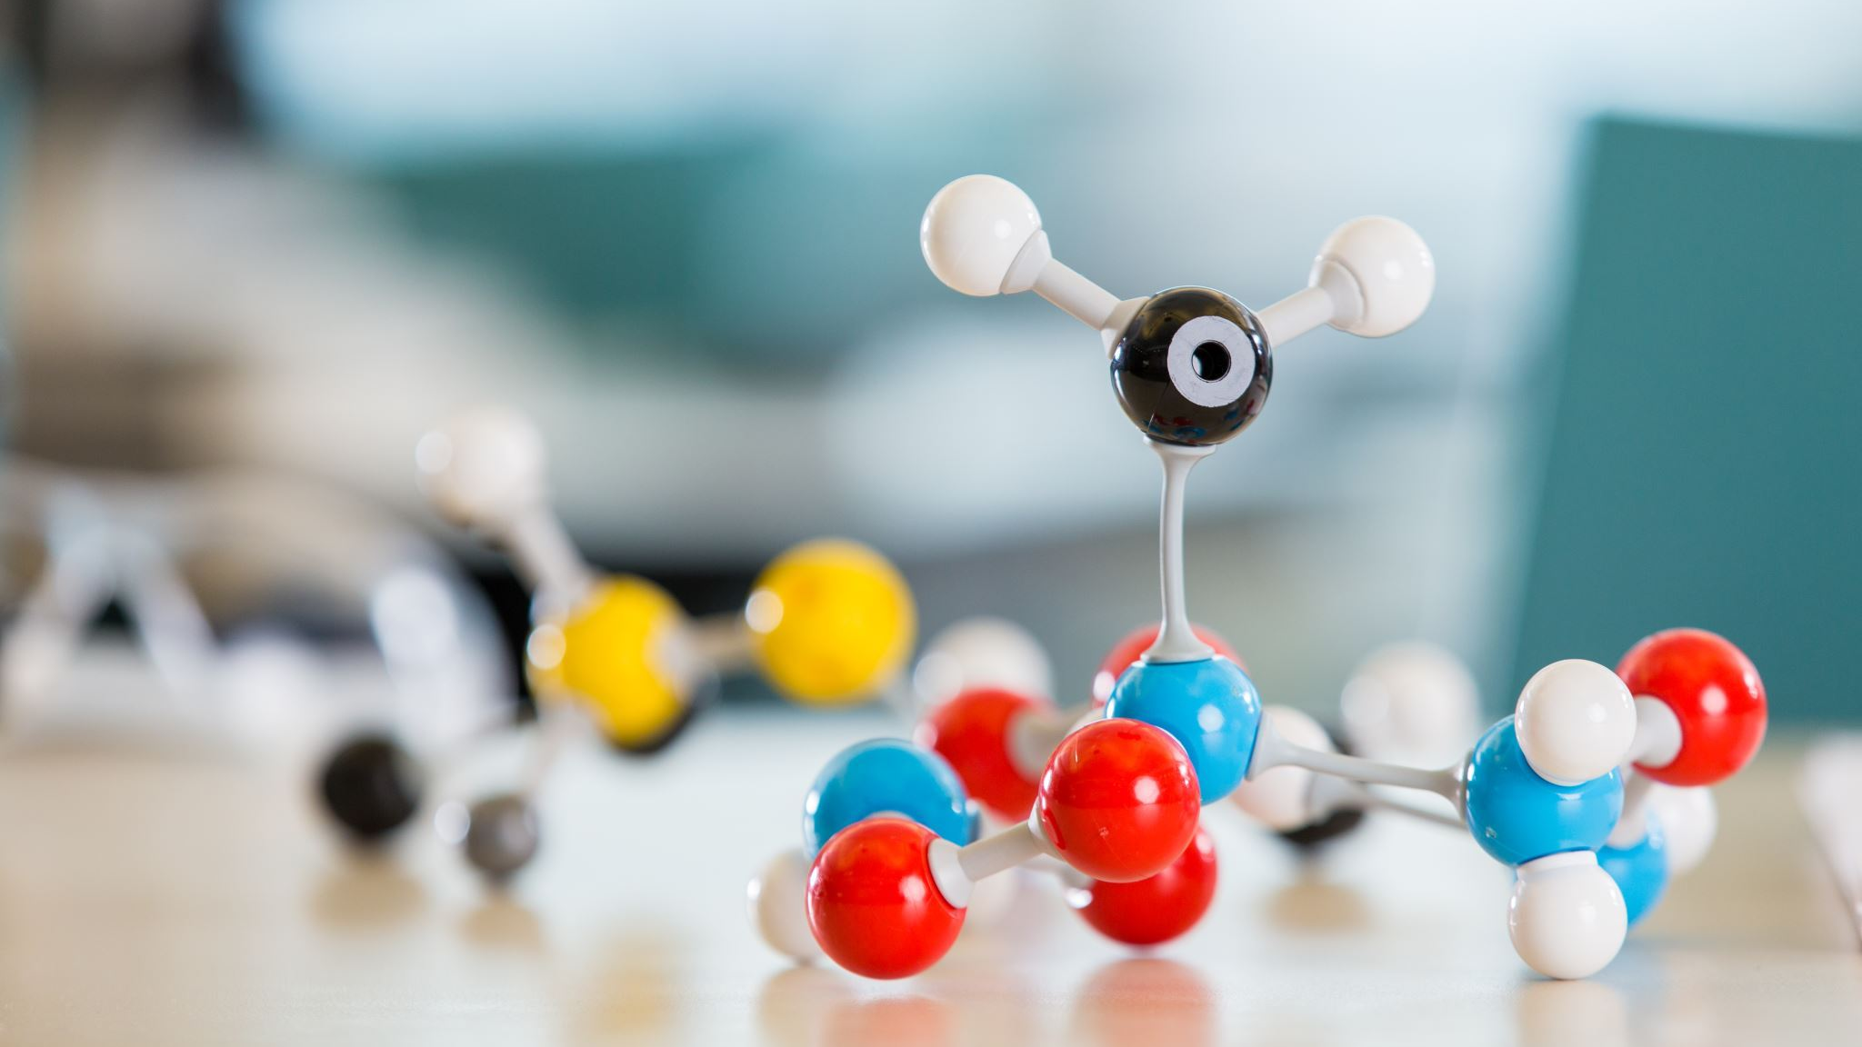
Conclusion**
- Summarize the key points
- Reiterate the importance of the system

Slide 15
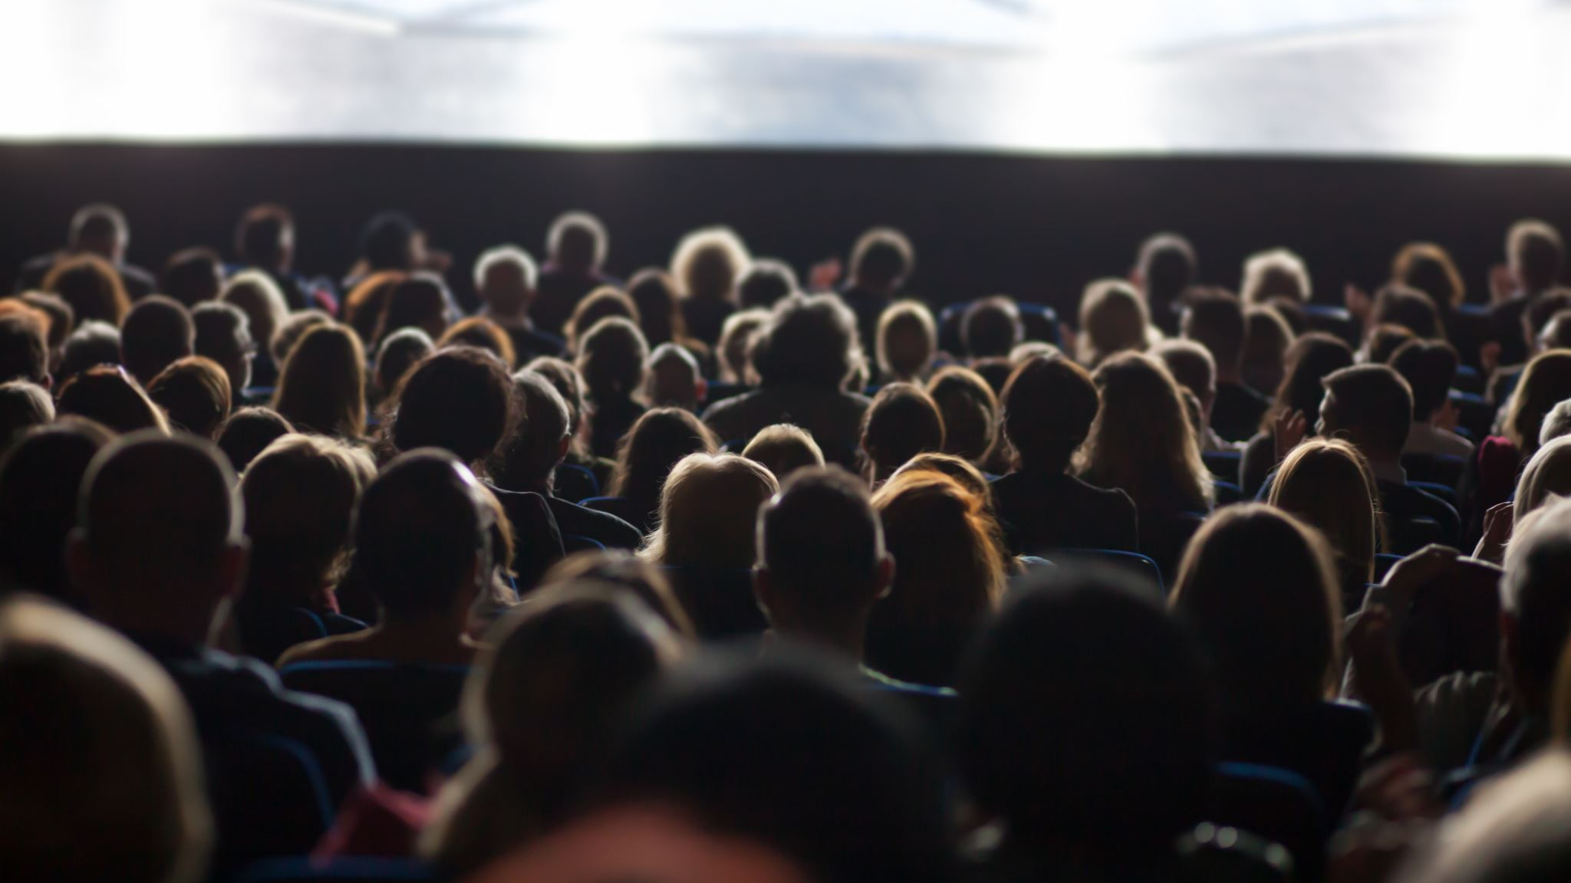
Q&A**
- Invite questions from the audience

Slide 16
Thank You** github link:https://github.com/mohit43215678/smartattendence.git
- Express gratitude to the audience for their attention
- Provide contact information for further inquiries

