Slide 1


Open up your favourite browser

Slide 2
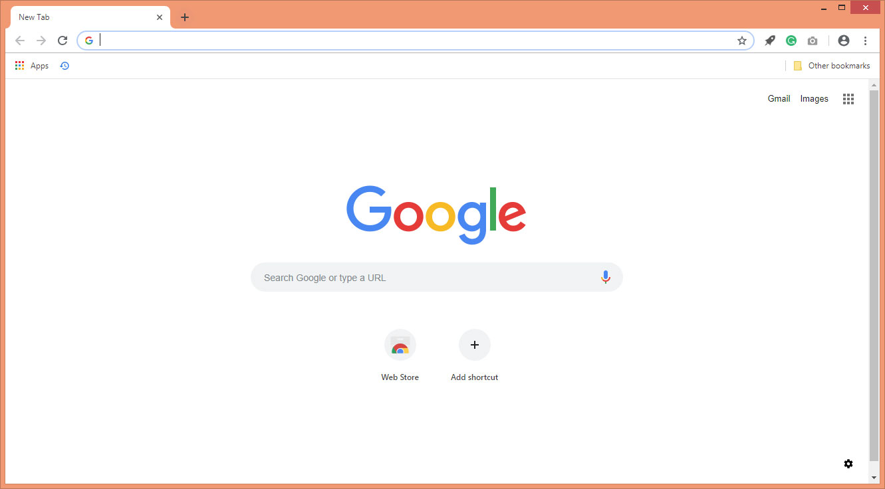


Slide 3
www.edifyskooling.com/app

Slide 4
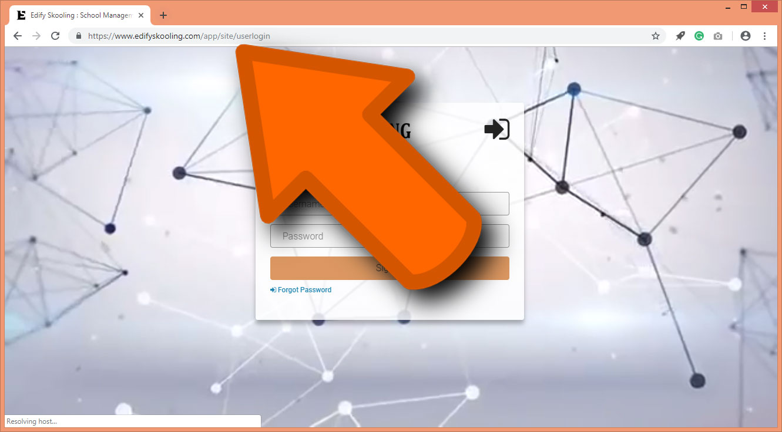

Slide 5
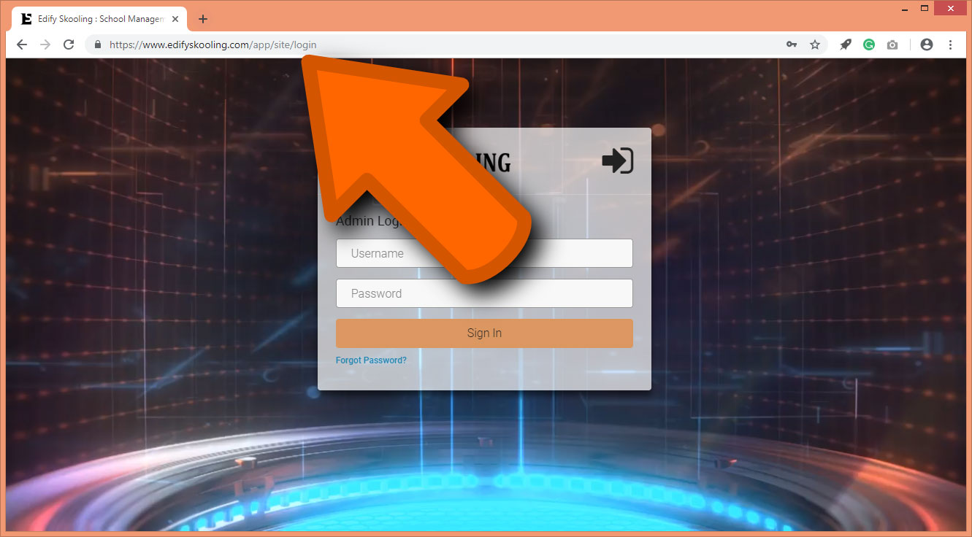

Slide 6
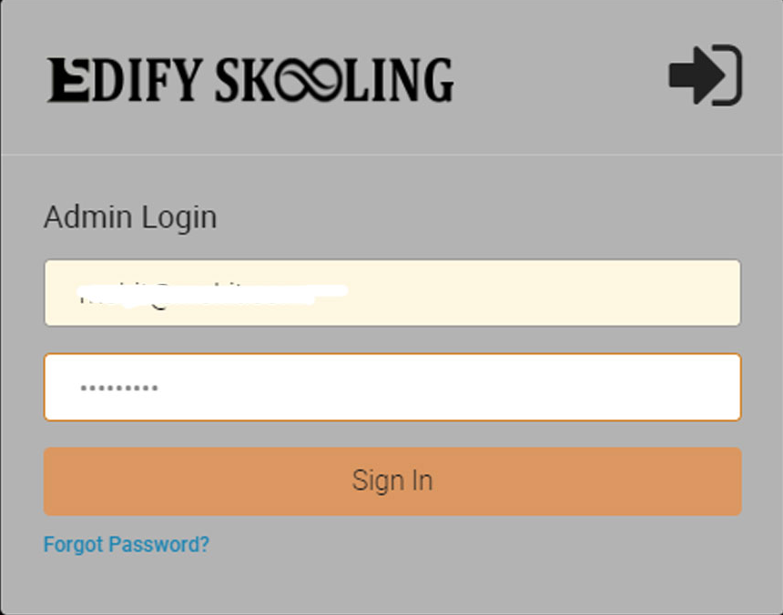

Slide 7
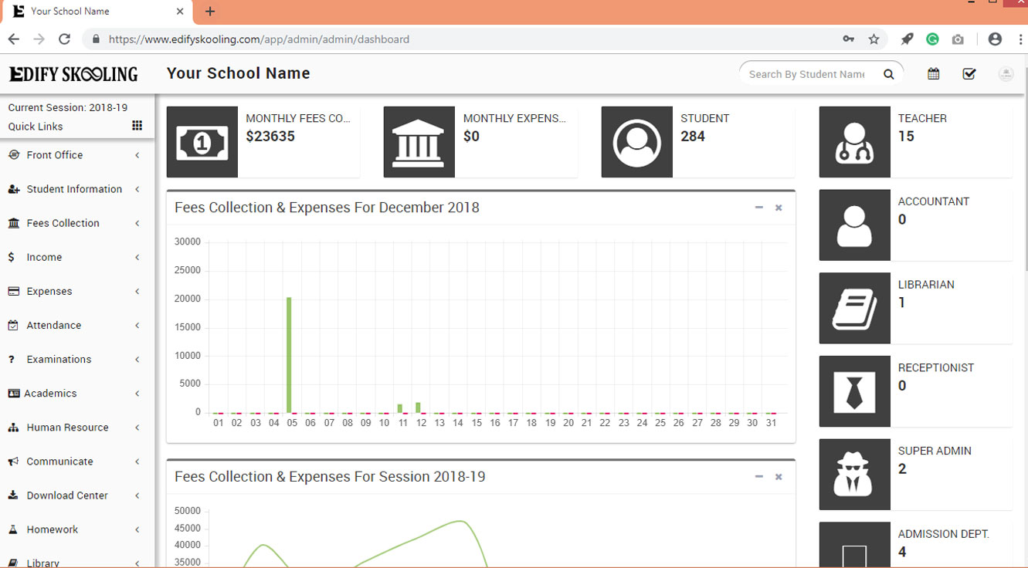

Slide 8
The easiest smart school application on the earth

