Slide 1
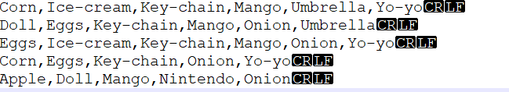
Apriori Templete
Data
Market_data(shown in the picture)
Gene_data
Function loadDataSet is already implemented in the template

Slide 2
Apriori Templete
run_apriori
Function call relationship
loadDataSet
apriori
create_candidates
apriori_gen
get_freq

Slide 3
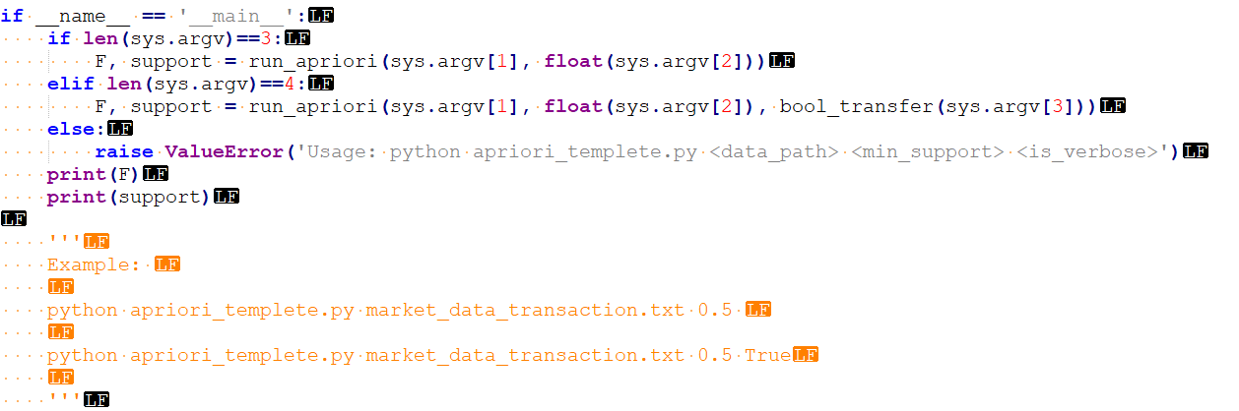
Main function
How to run the file

Slide 4
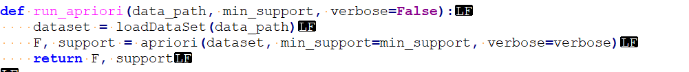
Run_apriori
Load dataset as list
Run apriori

Slide 5
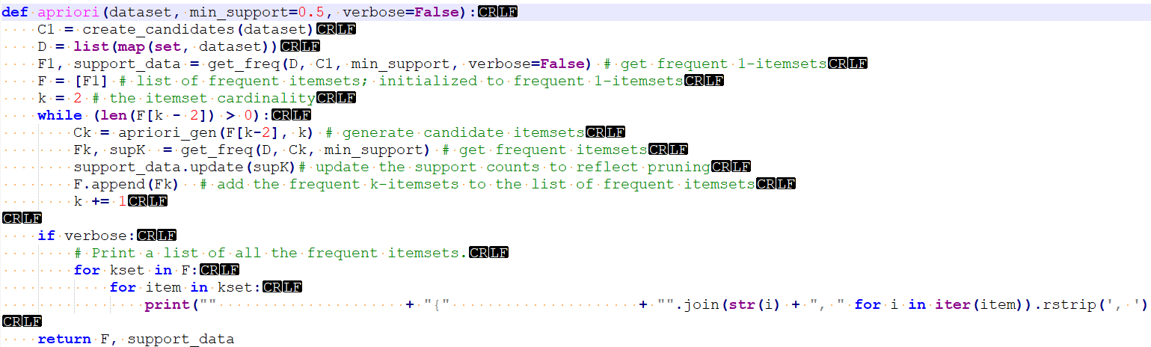
Apriori
the set of single item
the set of single item whose support is not less than minSupport

Slide 6
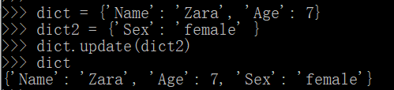
Detail
update method
You can use a.update(b) to add keys and values in dict b into dict a.

Slide 7
apriori_gen
The apriori_gen function performs two operations:
Generate length k candidate itemsets from length k-1 frequent itemsets
Prune candidate itemsets containing subsets of length k-1 that are infrequent
Input:
freq_sets: The list of frequent (k-1)-itemsets.
k: The cardinality of the current itemsets being evaluated.
Output:
candidate_list : The list of candidate itemsets.

Slide 8
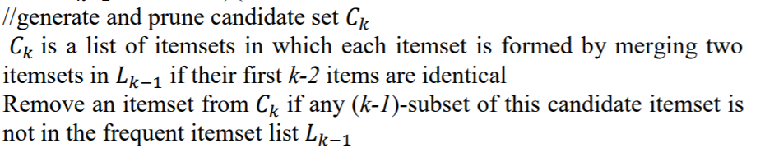
apriori_gen
It can be implemented following the pseudo-code.

Slide 9
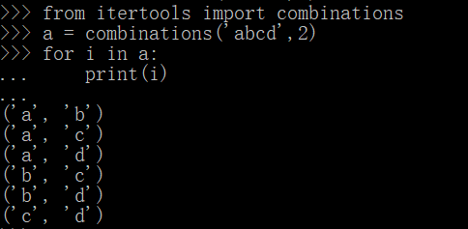
apriori_gen
You may use combinations method to enumerate all the subsets.
You must import itertools first!

Slide 10
get_freq
Input
dataset: a list of transactions from which to generate candidate itemsets
candidates: the list of candidate itemsets
min_support
Output
freq_list: the list of frequent itemsets
support_data: the support data for all candidate itemsets

Slide 11
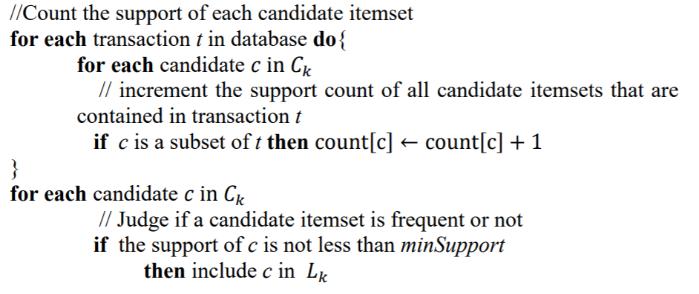
get_freq
It can be implemented following the pseudo-code.

Slide 12
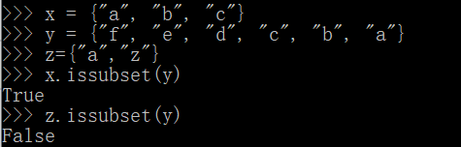
get_freq
You may use issubset method during support counting in get_freq.

