Slide 1
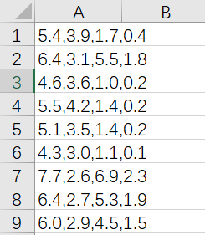
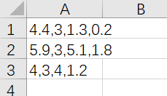
K-means
Datasets
Iris
Iris_Initial_Centroids

Slide 2
K-means
assignCluster
For each data point, the function is to assign it to the closest centroid.
Input
dataSet: each row represents an observation and each column represents an attribute;
k: number of clusters
centroids: initial centroids or centroids of last iteration
Output
clusterAssment: a list, which contains assigned cluster id for each data point

Slide 3
K-means
assignCluster
To implement this function, you can follow the following pseudo-code
for data in dataSet:
minDist = Inf, minIndex = -1
for center in centroids:
d = distance(data, center)
if d<minDist:
minDist = d, minIndex = index of center
clusterAssment.append(minIndex)

Slide 4
K-means
getCentroid
The function is to recalculate centroids.
Input
dataSet: each row represents an observation and each column represents an attribute
k: number of clusters
clusterAssment: a list, which contains assigned cluster id for each data point
Output
centroids: cluster centroids

Slide 5
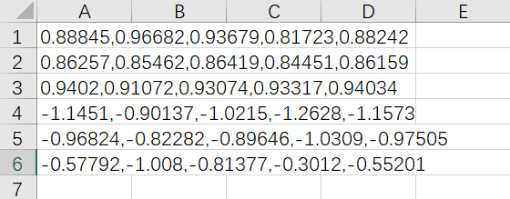
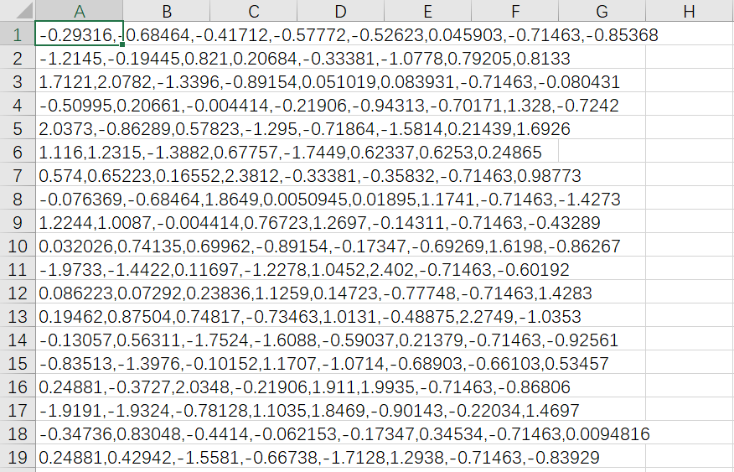
Hierarchical clustering
attribute
Datasets
Example
Utilities

Slide 6
Hierarchical clustering
merge_cluster
The function is to merge two closest clusters according to min distances.
Input
distance_matrix: a 2-D array distance matrix
cluster_candidate: a dictionary. Key is the cluster id, and value is point ids in the cluster.
T: current cluster index
Output
cluster_candidate: a dictionary. We update cluster dictionary after merging two clusters. Key is the cluster id, and value is a list of point ids in the cluster
merge_list: list of tuples. It records the two old clusters' id and points that have just been merged.
[(cluster_one_id, point_ids_in_cluster_one),
(cluster_two_id, point_ids_in_cluster_two)]

Slide 7
Hierarchical clustering
merge_cluster
You can implement this function by the following steps:
Find the smallest value in the distance matrix—suppose the entry is i-th row and j-th column, so the i-th and j-th data points are the closest at the current step.
Find the clusters that contain the i-th data point (the s-th cluster) and the j-th data point (the t-th cluster).
Merge the s-th and t-th clusters as a new cluster with index T and remove the s-th and t-th clusters.

Slide 8


Hierarchical clustering
merge_cluster
When you find minimum value indices in distance matrix, you may use the following methods in NumPy:
.flatten()
Return a copy of the array collapsed into one dimension.
np.unravel_index()
Converts a flat index or array of flat indices into a tuple of coordinate arrays

Slide 9
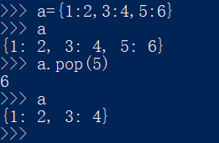
Hierarchical clustering
merge_cluster
To implement the removal of clusters, you may use the following method in python:
.pop
It can remove data in dictionary.

Slide 10
Hierarchical clustering
update_distance
This function is to update the distance matrix.
Input
distance_matrix: 2-D array
cluster_candidate: a dictionary. Key is the updated cluster id, value is point ids in the cluster.
merge_list: list of tuples. It records the two old clusters' id and points that have just been merged.
[(cluster_one_id, point_ids_in_cluster_one),
(cluster_two_id, point_ids_in_cluster_two)]
Output
distance_matrix: 2-D array. Updated distance matrix.

Slide 11
Hierarchical clustering
You need to mark all distance between points in two clusters in merge_list to be a large value.
You can use “merge_list[0][1]” and “merge_list[1][1]” to get points indices in two clusters in merge_list .
You can simply set the large value as 1e6, 1e7 or others.

