Slide 1
Memory Game - Final Version (Week 11)
Mohit Sharma
INFO 655 - Intro to Web Programming
March 2025

Slide 2
Project Overview
Memory Game built using React.js
Card matching game with timer & move tracking
Dynamic images from 'Deck of Cards' API
Improved UI
Leaderboard using Firebase (server-side) - is left

Slide 3
Features Implemented Since Week 9
Enhanced UI/UX: Center-aligned, bigger cards, green background
Integrated Deck of Cards API for dynamic images
Smooth card flipping animations
Game timer starts/stops correctly
Leaderboard (Firebase backend) - Under progress

Slide 4
API Integration
Using 'Deck of Cards API':
- Fetches random card images dynamically
- Cards shuffled and displayed each game
- Enhances user experience and replayability

Slide 5
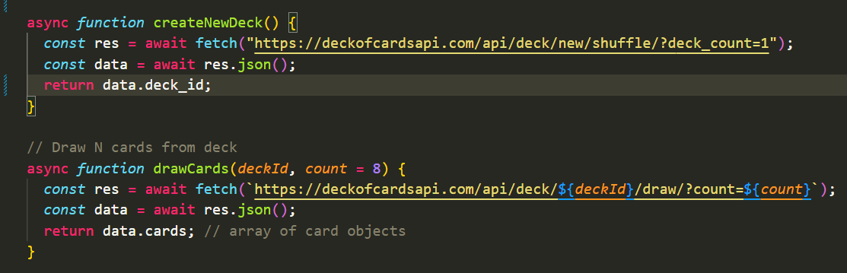
Relevant Code for API Integration

Slide 6
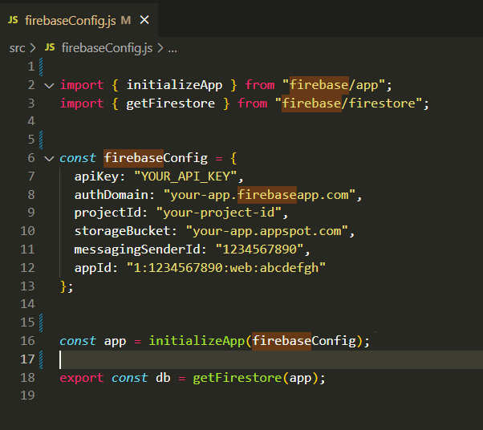
Relevant Code for Firebase Integration

Slide 7
Firebase Leaderboard (Server-side)
Firebase integration to store scores
TODO: Finalize server-side integration for online leaderboard
Players will be ranked by moves & time

Slide 8
UI Improvements
- Game board centrally aligned
- Enhanced visuals with larger cards
- Attractive green-themed UI
- Intuitive user interactions

Slide 9
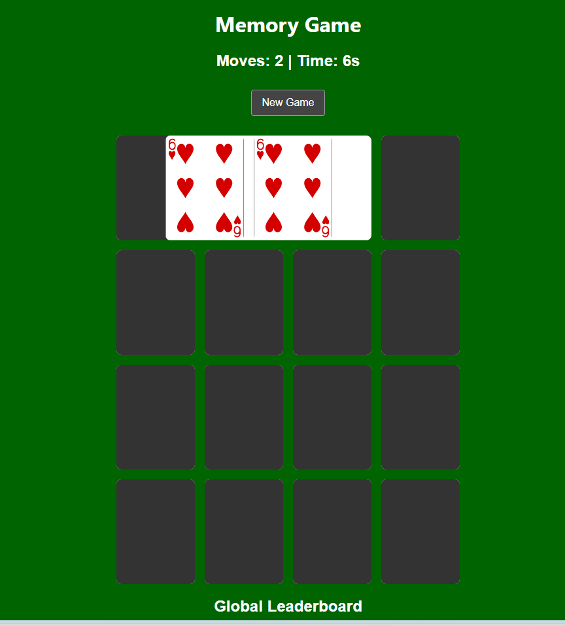
UI Screenshot

Slide 10
Challenges and Solutions
- Timer: Fixed to start on first click
- API integration successful.

Slide 11
Next Steps
- Complete Firebase leaderboard integration
- Deploy and verify online hosting on Firebase or github
- Conduct user-testing for feedback and improvement

Slide 12
Conclusion
Final version demonstrates improved UI & API integration
Major challenges solved
Final step: Completing server-side leaderboard integration & deployment
Thank you!

