Slide 1
Memory Game (Week 5 - Mini Version)
A simple card-flipping game using React

Slide 2
Project Overview
This project is a simple Memory Game using React.
In this version, cards can be flipped but do not check for matches.
Future iterations will add matching logic, shuffling, timer and API integration.

Slide 3
Current Features
Flipping cards using React state.
Static emojis are used as card faces.
Simple UI with a basic grid layout.
No matching logic yet.
No shuffling, reset button, or timer.

Slide 4
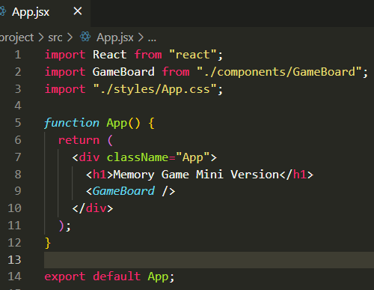
Code Snippet-1
This is the App.jsx file, which loads GameBoard.jsx and applies basic styles. The main component remains simple for modularity

Slide 5
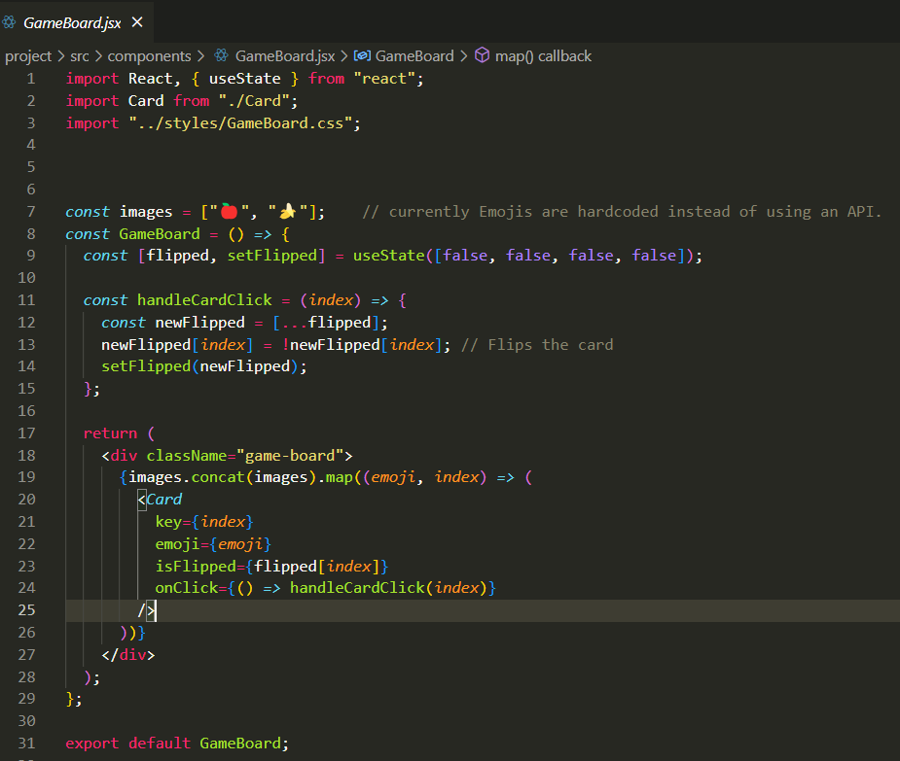
Code Snippet-2
This code snippet shows how useState is used to track which cards are flipped. Clicking a card updates its state dynamically.

Slide 6
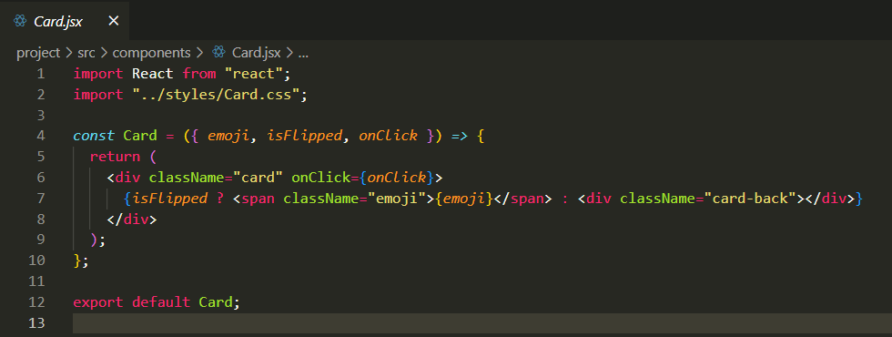
Code Snippet-3
Each Card component receives its emoji and flip state as props from GameBoard.jsx. Clicking on it updates the state

Slide 7
Project Folder Structure
memory-game/
├── public/
│ ├── index.html
├── src/
│ ├── components/
│ │ ├── GameBoard.jsx
│ │ ├── Card.jsx
│ ├── styles/
│ │ ├── App.css
│ │ ├── GameBoard.css
│ │ ├── Card.css
│ ├── App.jsx
│ ├── main.jsx
│ ├── index.css
├── package.json
├── vite.config.js
├── README.md

Slide 8
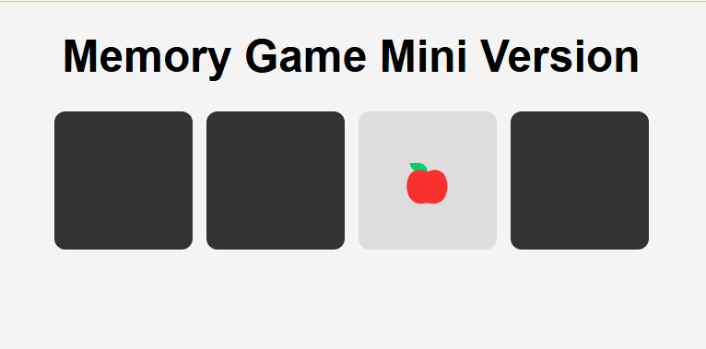
Current Version(incomplete)

Slide 9
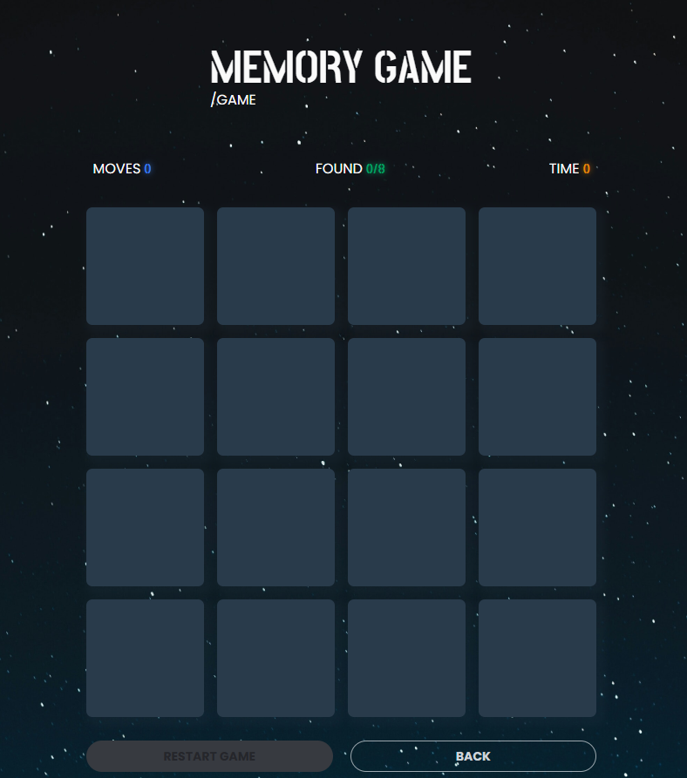
Final Version(expected)

Slide 10
What’s Next? (Week 8 & 11 Plan)
Planned Improvements (Week 8):
Add Matching Logic → Cards will stay face-up if they match.
Increase Number of Cards → More pairs for better gameplay.
Shuffle Cards on Game Start → To avoid fixed positions.
Add a Reset Button → Allows restarting the game.
Introduce a Move Counter & Timer → Tracks performance. Week 11: Replace emojis with API images (Picsum Photos API), add animations, refine UI.
Final Phase (Week 11):
Integrate API (Picsum Photos API) → Fetch real images dynamically.
UI Enhancements & Animations → Improve card flipping effects.
Optimize Performance → Ensure smooth gameplay.
Deploy the Game → Make it accessible online.

