Slide 1
Memory Game (Week 8 - Midway Version)
Enhancing the Game with Matching Logic, Shuffling, and UI Improvements

Slide 2
Project Overview
This is an improved version of the Memory Game.
Cards can now be matched and stay face-up when paired.
More card pairs have been added to increase difficulty.
Introduced shuffling, a move counter, a timer, and a reset button.

Slide 3
New Features Implemented (Week 8)
Matching logic added - cards stay face-up if matched.
Increased the number of card pairs for better gameplay.
Cards now shuffle on game start.
Added a reset button to restart the game.
Introduced a move counter and a timer.

Slide 4
Updated Project Folder Structure
memory-game/
├── public/
│ ├── index.html
├── src/
│ ├── components/
│ │ ├── GameBoard.jsx
│ │ ├── Card.jsx
│ ├── styles/
│ │ ├── App.css
│ │ ├── GameBoard.css
│ │ ├── Card.css
│ ├── App.jsx
│ ├── main.jsx
│ ├── index.css
├── package.json
├── vite.config.js
├── README.md

Slide 5
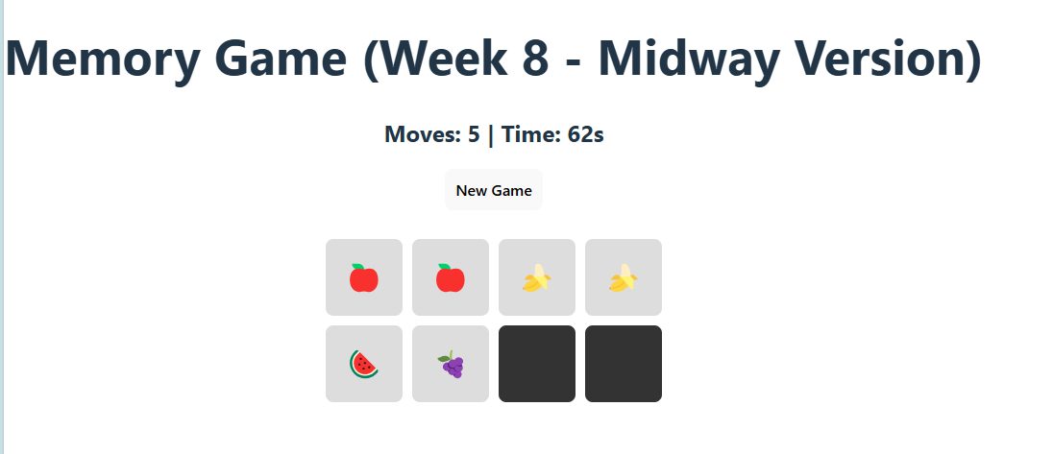
Current Version
non-matching pair

Slide 6
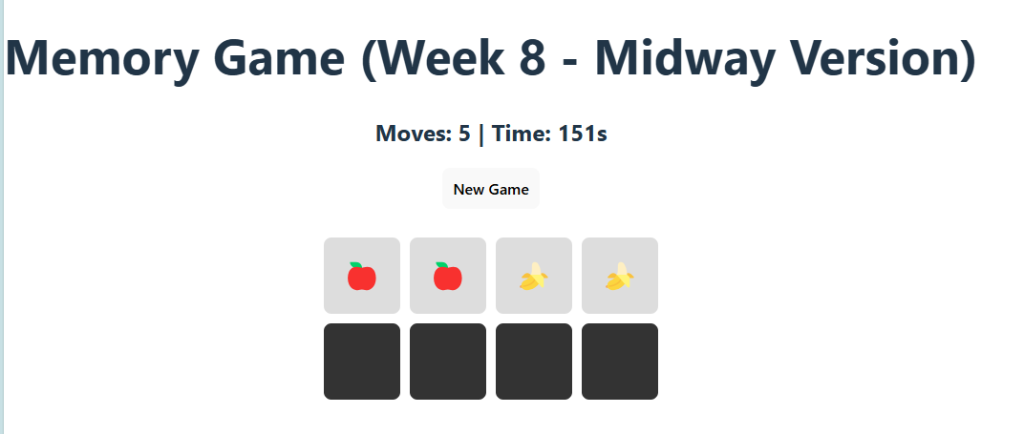
Game Reverts Non Matching Pair

Slide 7
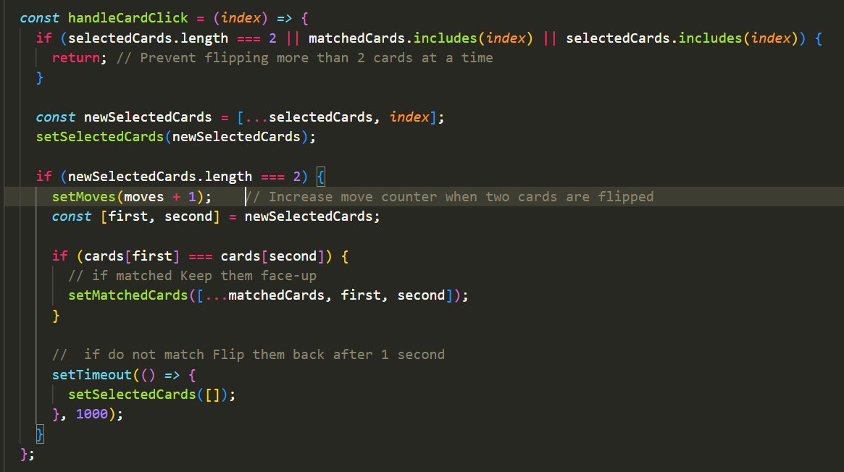
Key Code: Matching Logic (GameBoard.jsx)

Slide 8
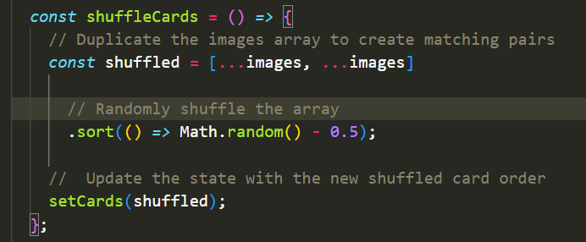
Key Code: Shuffling Cards (GameBoard.jsx)

Slide 9

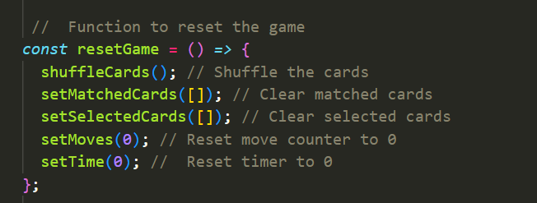
Key Code: Reset Button & Move Counter

Slide 10
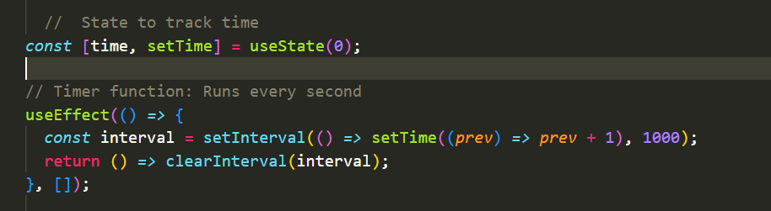
Tracks Time

Slide 11
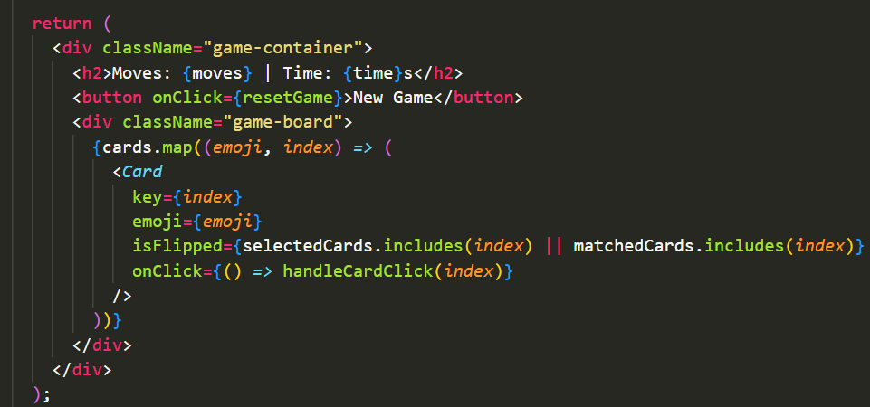
Displays Moves, Timer, Cards in UI
Shows how everything is displayed on the game screen. Move counter and timer are visible at the top. Cards are displayed dynamically using .map().

Slide 12
What’s Next? (Week 11 Plan)
Replace emojis with real images using Picsum Photos API.
Improve UI with animations and flip effects.
Optimize performance for smooth gameplay.
Deploy the final game version online.

