Slide 1
Memory Game - Week 9 Pre-Final Version
Progress Update for Week 9 Check-in
INFO 655 - Intro to Web Programming
Mohit Sharma
03-06-2025

Slide 2
Project Overview
A card-matching game where players flip two cards at a time to find matching pairs.
The goal is to match all pairs in the fewest moves and shortest time possible.
Technology Stack:
React.js (Component-based UI)
CSS (Game styling & animations)
JavaScript

Slide 3
Features Implemented (Since Week 8)
Timer Fix - Now timer starts only after the first move and stops when the game ends.
Game Over Message - Displays when all cards are matched.
Card Flipping Animation - Smooth transitions for better user experience.
Increased grid size from 4*2 to 4*4

Slide 4
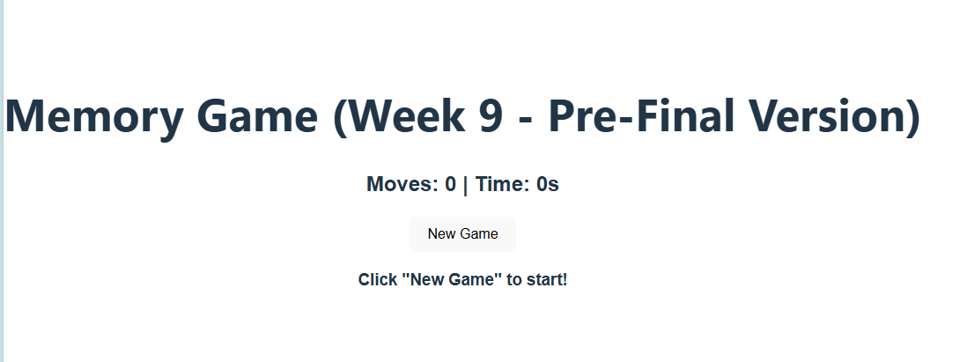
Screenshots
Screenshot of Game UI:
• During the game (cards being flipped, moves & timer updating)
• After the game ('Game Over' message with moves count)
Now the timer stays at 0 and starts only when new Game is clicked and first move is played.

Slide 5
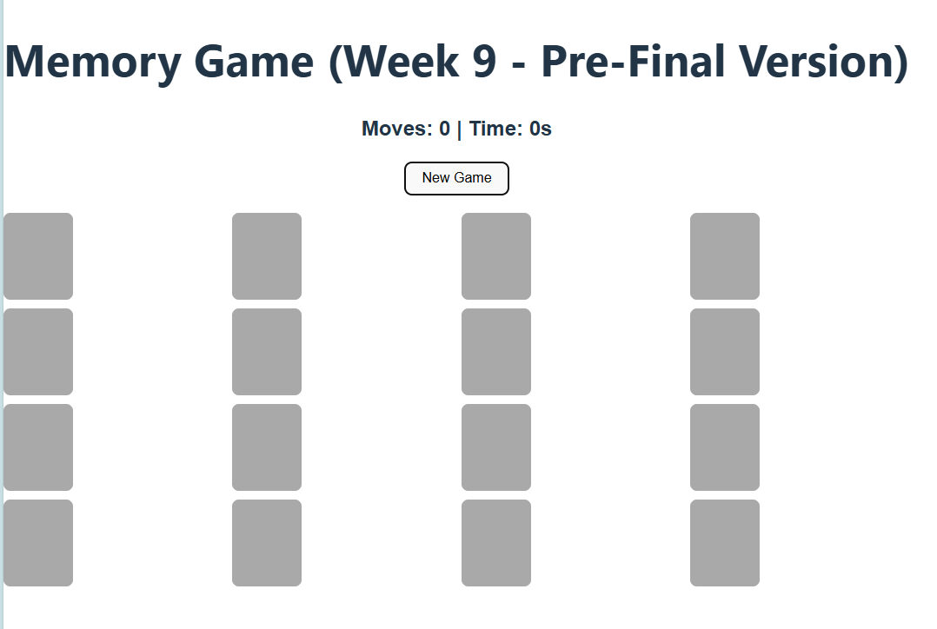
Increased Grid Size

Slide 6
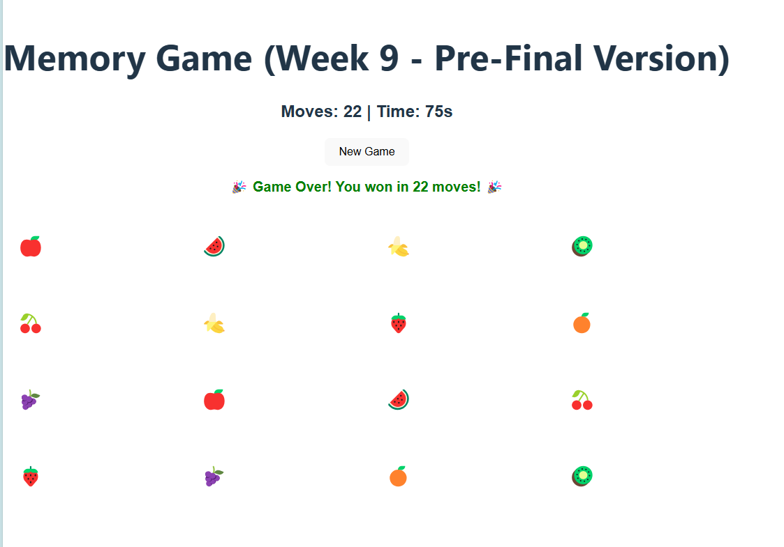
After Winning

Slide 7
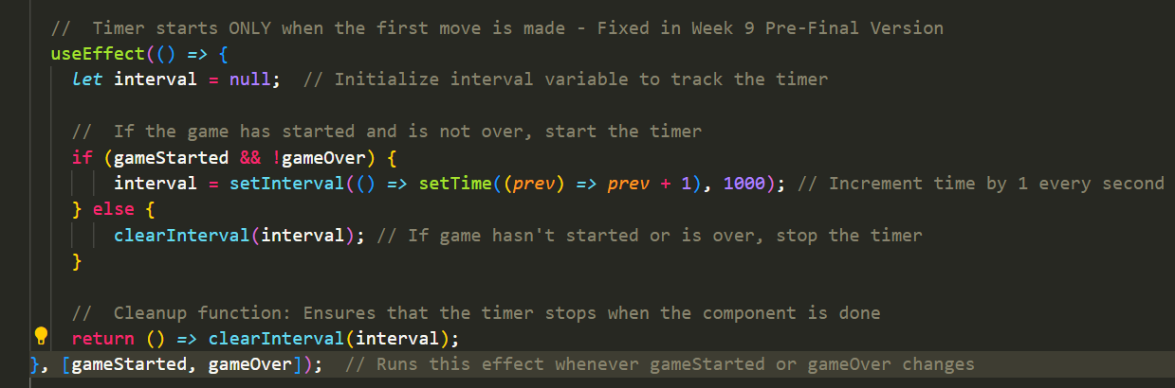
Key Code Snippets - Timer Fix

Slide 8
Challenges Faced & Fixes
Issue: Timer started running immediately on page load.
Fix: Timer now starts only after the first move.

Slide 9
Next Steps (For Final Version - Week 11)
Planned Improvements:
UI Enhancements: Better styling & animations for a smoother experience.
Replace emojis with real images using Picsum Photos API or any other API.
Deploy the final game version online.
Leaderboard : Track best scores based on moves & time.

Slide 10
Conclusion
Summary:
All core features are now working.
The game functions as expected, with a fixed timer and a proper 'Game Over' message.
Final Steps:
Polish UI, add a leaderboard, and deploy the game online for the final presentation.
Thank you!

