Slide 1
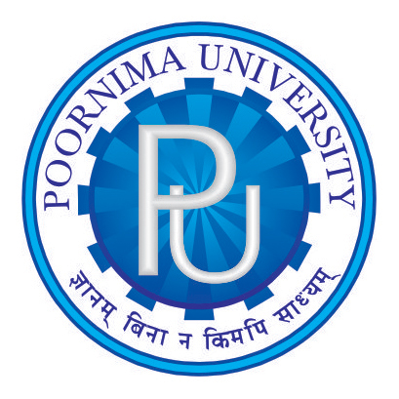
Framework for Deploying Containerized Application (Launching Kubernetes Cluster through Bash Script)
Presented by
Mohit Soni
(2018PUSETBCCX06516)
Khushbu Joshi
(2017PUSETBCCX05685)
Under Supervision of
Mr. Ishtiyaq Ahmad Khan

Slide 2
OUTLINE
Abstract
Technology Used
Terminology
Design
Implementation
Conclusion

Slide 3
Abstract
Launching Kubernetes cluster
Installing Kubernetes
Configuring Networking
Setting up firewall
Loading Kernel Module
Making Registry
Application Deployment on Kubernetes

Slide 4
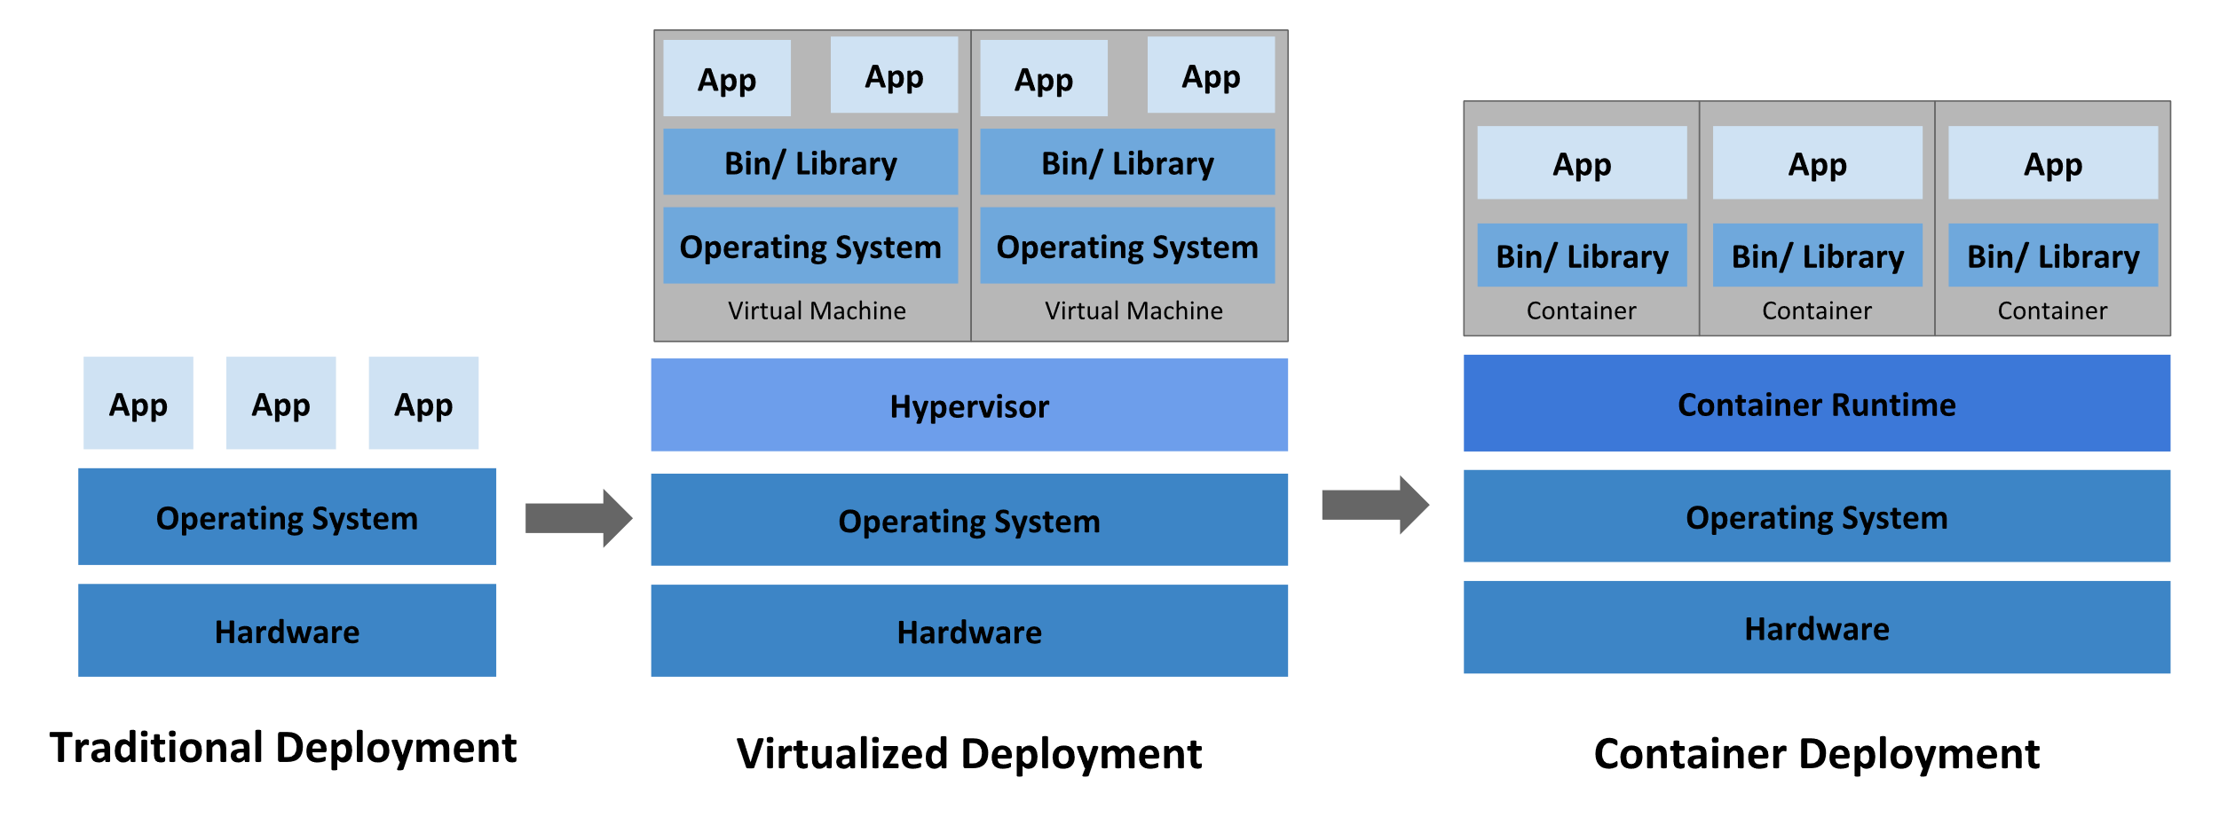

Slide 5
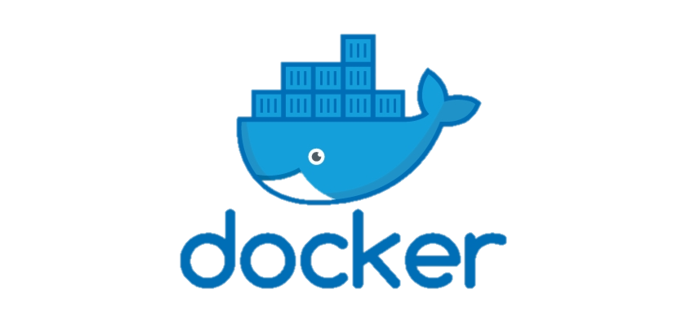
Technology Used
DOCKER :
Docker is a software platform for building applications based on containers — small and lightweight execution environments that make shared use of the operating system kernel but otherwise run-in isolation from one another.
While containers as a concept have been around for some time, Docker, an open source project launched in 2013, helped popularize the technology.
It has helped drive the trend towards containerization and microservices in software development that has come to be known as cloud-native development.

Slide 6
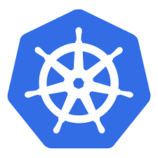
KUBERNETES :
Kubernetes is a portable, extensible, open-source platform for managing containerized workloads and services, that facilitates both declarative configuration and automation.
It is a container management tool.
It has a large, rapidly growing ecosystem. Kubernetes services, support, and tools are widely available.

Slide 7
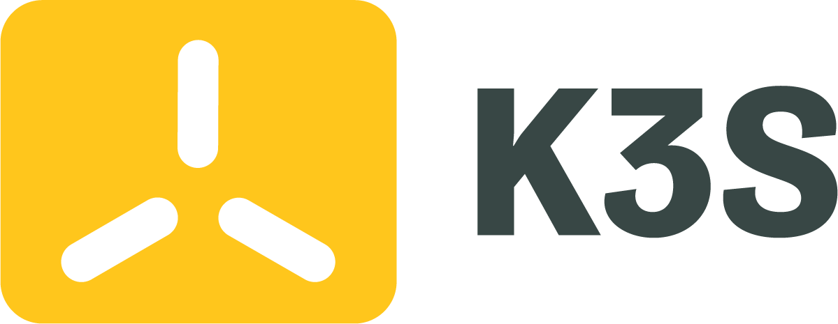
K3S :
K3s is a highly available, certified Kubernetes distribution designed for production workloads in unattended, resource-constrained, remote locations or inside IoT appliances.
Simplified & Secure
K3s is packaged as a single <40MB binary that reduces the dependencies and steps needed to `
Optimized for ARM
Both ARM64 and ARMv7 are supported with binaries and multiarc images available for both. K3s works great from something as small as a Raspberry Pi to an AWS a1.4xlarge 32GiB server.

Slide 8
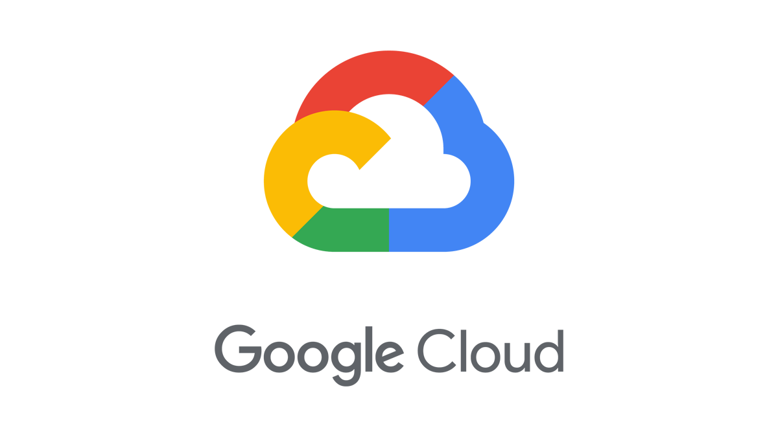
GOOGLE CLOUD PLATFORM :
Google Cloud consists of a set of physical assets, such as computers and hard disk drives, and virtual resources, such as virtual machines (VMs), that are contained in Google's data centers around the globe. Each data center location is in a region.
Google Cloud Platform (GCP), offered by Google, is a suite of cloud computing services that runs on the same infrastructure that Google uses internally for its end-user products, such as Google Search, Gmail, file storage, and YouTube.

Slide 9
Terminology
Node : A node is a worker machine in Kubernetes.
Object : An entity in the Kubernetes system. The Kubernetes API uses these entities to represent the state of your cluster.
Pod : The smallest and simplest Kubernetes object. A Pod represents a set of running containers on your cluster.
Pod Lifecycle : The sequence of states through which a Pod passes during its lifetime.

Slide 10
Terminology
Cluster : A set of worker machines, called nodes, that run containerized applications. Every cluster has at least one worker node.
Container : A lightweight and portable executable image that contains software and all of its dependencies.
Controller : In Kubernetes, controllers are control loops that watch the state of your cluster, then make or request changes where needed. Each controller tries to move the current cluster state closer to the desired state.

Slide 11
Benefits
Using Kubernetes and its huge ecosystem can improve your productivity.
Kubernetes and a cloud-native tech stack attracts talent.
It helps to make your application run more stable.

Slide 12
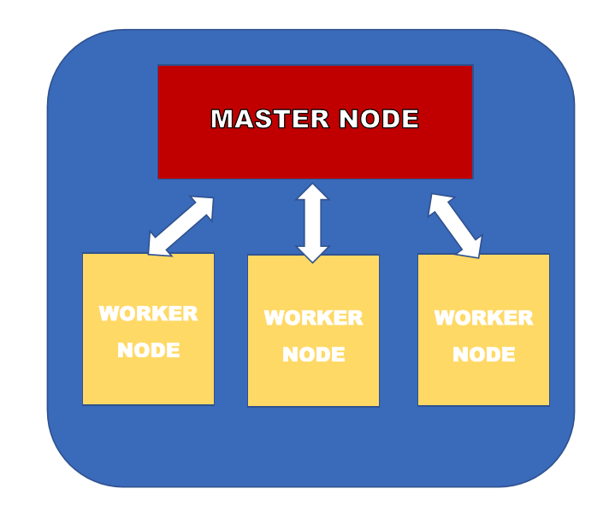
DESIGN
Google Cloud Architecture

Slide 13
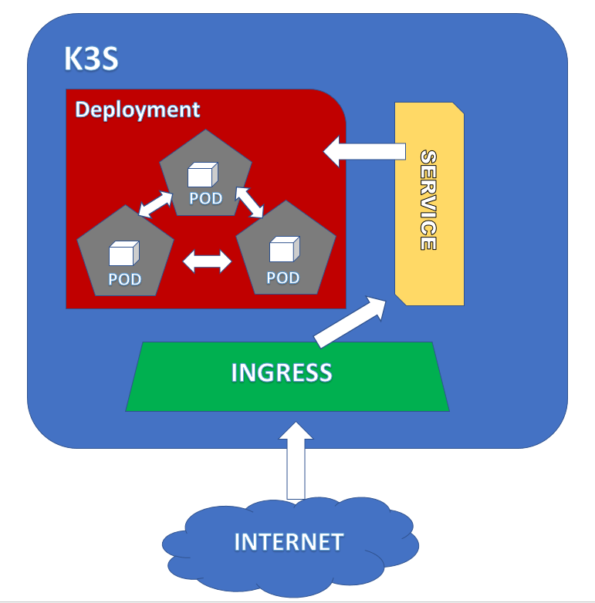
DESIGN
K3S Architecture

Slide 14
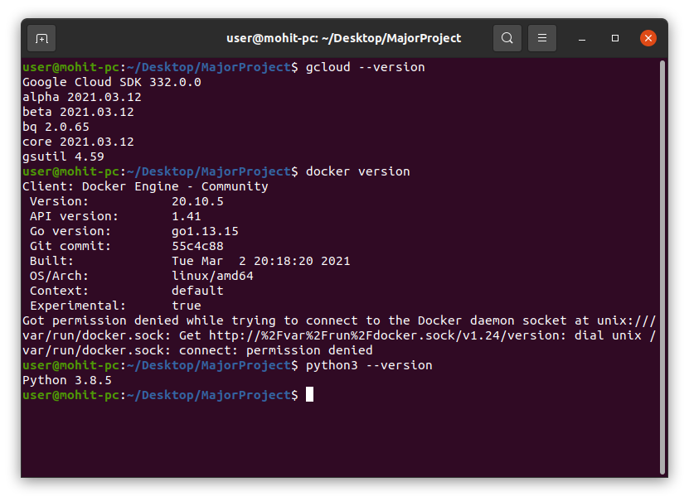
Implementation
Pre-requisites

Slide 15
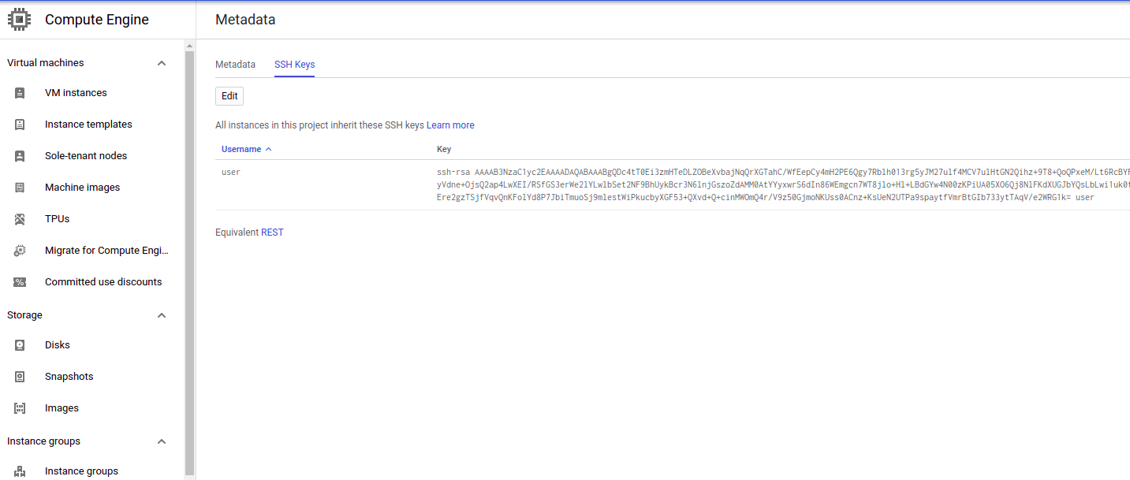
Implementation
Setting up SSH Keys on Google Cloud

Slide 16
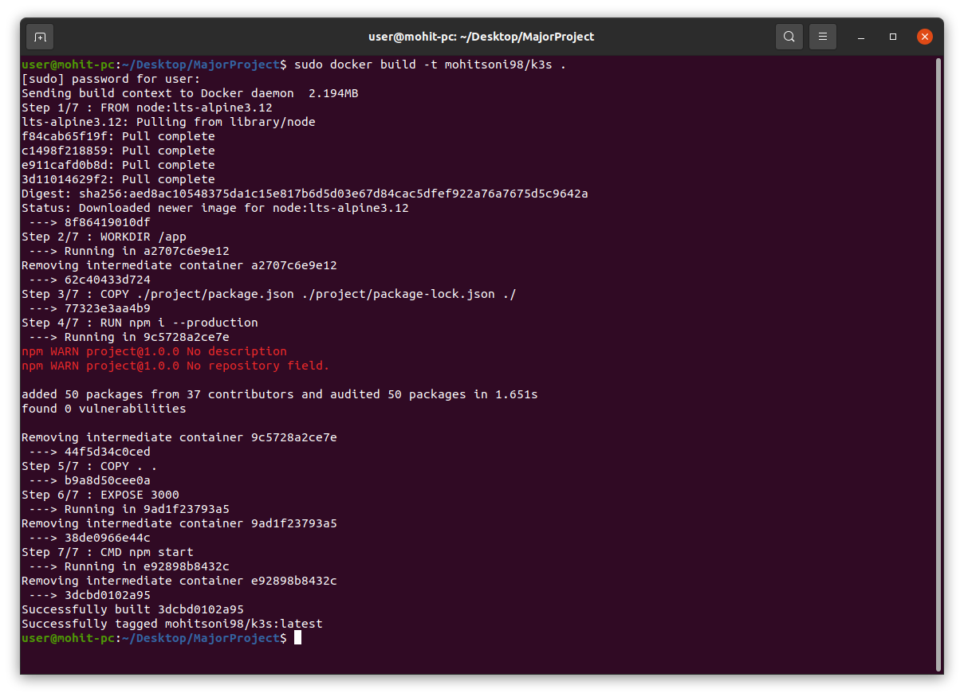
Implementation
Building Docker Image

Slide 17
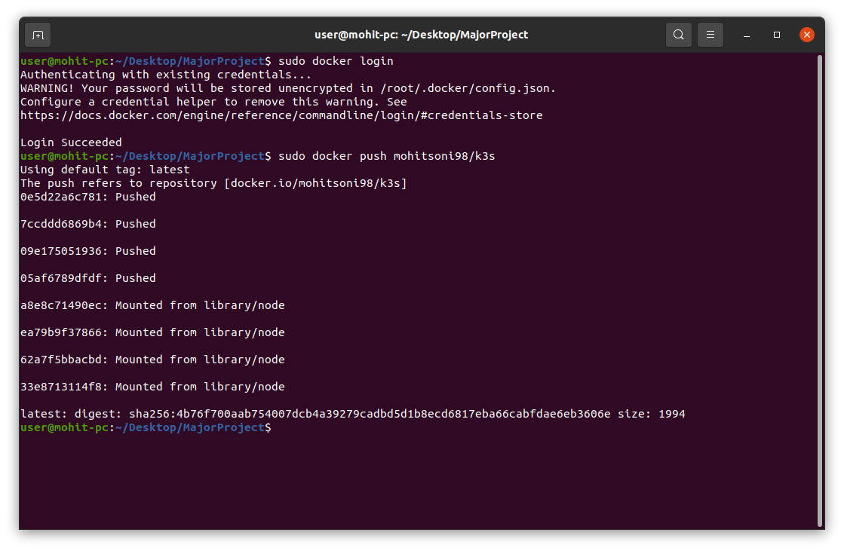
Implementation
Pushing Image to Docker Hub

Slide 18
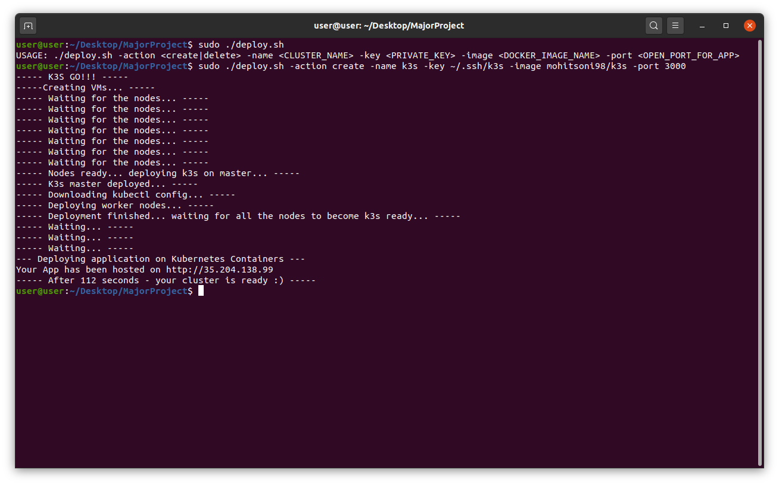
Implementation
Running the script

Slide 19
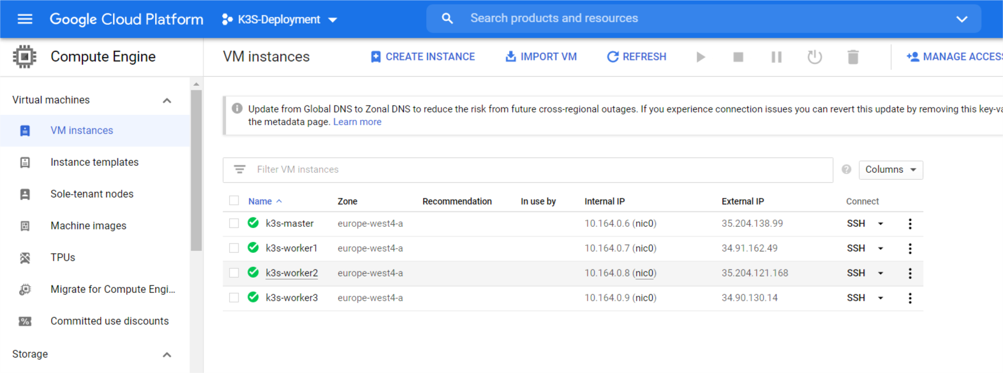
Implementation
Instance Deployed

Slide 20
Thank You

