Slide 1
IT308: Operating Systems
Concurrency and Synchronization

Slide 2
Agenda
Review basic concurrency concepts
  Thread, data race and mutual exclusion
  Locks and semaphores
New stuff
  Condition variables
  How to implement locks and condition variables efficiently
  Lock-free data structures

Slide 3
Thread
A new abstraction for a single running process
A multi-threaded program has more than one point of execution
  Multiple program counters, one for each thread
  They share the same address space
  Each thread has its own stack
  Each thread has its own private set of registers

Slide 4
Context switch between threads
Each thread has its own program counter and set of registers
  one or more thread control blocks (TCBs) are needed to store the state of each thread
When switching from running one thread (T1) to running the other (T2):
  The register state of T1 is saved
  The register state of T2 is restored
  The address space remains the space

Slide 5
Why use threads?
Two major reasons
  Parallelism
    Divide a task among several threads
    On a system with multiple processors threads can work in parallel with each other
  Overlap of I/O with other activities within a single program
    When one thread requests I/O from the system, switch to another thread ready to work
    Similar to multiprogramming across different processes

Slide 6

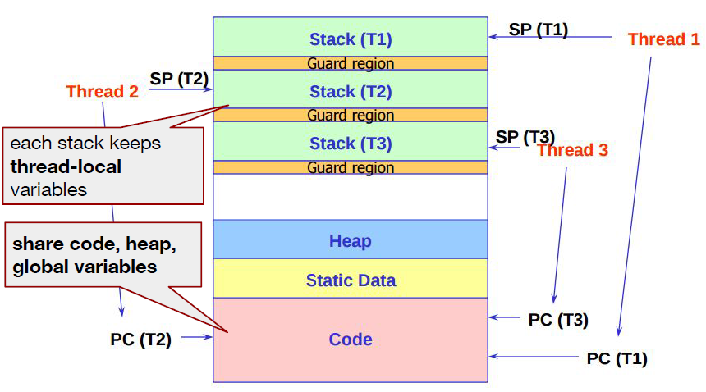
Multi-threaded Address Space

Slide 7
Thread programming
Linux pthreads using kernel-level threads
Thread prototypes: #include <pthread.h>
  > 60 functions
To compile:
gcc -lpthread prog.c -o prog

Slide 8
Basic operations on threads
Creating and starting a thread
  like an asynchronous procedure call
Joining with a thread
  blocks the calling thread until a target thread completes
  a typical operation when a thread needs to use the return value of the target-thread’s starting procedure

Slide 9
Thread Creation
int pthread_create (pthread_t *tid,
pthread_attr_t *attr,
void *(*func)(void *),
void *arg);
func : input parameter, the name of the user-defined function to be executed by the newly created thread.
  returns a void pointer, single void pointer argument
arg : input parameter, the argument to be passed to the function func

Slide 10
Thread Creation
int pthread_create (pthread_t *tid,
pthread_attr_t *attr,
void *(*func)(void *),
void *arg);
Why void * as argument type?
The argument type should:
  Work for all types and sizes of arguments
  Even work for different numbers of arguments

Slide 11
Thread Creation
int pthread_create (pthread_t *tid,
pthread_attr_t *attr,
void *(*func)(void *),
void *arg);
tid : output parameter, pointer to location where the id of the newly created thread will be stored.
attr : input parameter, pointer to structure specifying the thread’s attributes (e.g. stack size, etc.)
  If set to NULL, the system defaults are used

Slide 12
Threaded “hello, world”
/*
* hello.c - Pthreads "hello, world" program
*/
#include "csapp.h"
/* thread routine */
void *thread(void *vargp) {
printf("Hello, world!\n");
return NULL;
}
int main() {
pthread_t tid;
Pthread_create(&tid, NULL, thread, NULL);
exit(0);
}
Wrong!

Slide 13
Thread coordination
  Threads can only execute as long as their containing process exists
In the example, what could happen if the thread routine has not reached printf with the main thread reaching the end of main()?
We need to use join() to make the main thread wait for the other thread to finish

Slide 14
pthread_join()
int pthread_join(pthread_t thread,
void **value_ptr );
thread: input parameter, id of the thread to wait on
value_ptr: output parameter, value given to pthread_exit() by the terminating thread (which happens to always be a void *)
  Type is void ** because type of location to be updated is void *

Slide 15
Threaded “hello, world”
/*
* hello.c - Pthreads "hello, world" program
*/
#include "csapp.h"
/* thread routine */
void *thread(void *vargp) {
printf("Hello, world!\n");
return NULL;
}
int main() {
pthread_t tid;
Pthread_create(&tid, NULL, thread, NULL);
Pthread_join(tid, NULL);
exit(0);
}
Good!

Slide 16
Execution of threaded “hello, world”
main thread
Call Pthread_create()
Pthread_create() returns
peer thread
call Pthread_join()
main thread
waits for peer thread to terminate
printf()
return NULL;
(peer thread
terminates)
Pthread_join() returns
exit()
terminates
main thread and
any peer threads

Slide 17
What does this program print?
#include "csapp.h"
/* thread routine */
void *mythread(void *vargp) {
printf("Hello from the other thread\n");
return NULL;
}
int main() {
pthread_t tid;
Pthread_create(&tid, NULL, mythread, NULL);
printf("Hello from the main thread\n");
Pthread_join(tid, NULL);
exit(0);
}

Slide 18
Our previous example
No assumption about the statement execution order between threads is possible
  The output of the main thread might happen before the output of thread mythread
printf() is thread-safe
    Even if called by 2 threads simultaneously, it is guaranteed that outputs won’t be mixed

Slide 19
Example
#include "csapp.h"
/* thread routine */
void *mythread(void *vargp) {
printf("T.a\n");
printf("T.b\n");
return NULL;
}
int main() {
pthread_t tid;
printf("M.a\n");
Pthread_create(&tid, NULL,
mythread, NULL);
printf("M.b\n");
printf("M.c\n");
Pthread_join(tid, NULL);
printf("M.d\n");
exit(0);
}
Impossible statement orderings (printf output):
T.a
M.a
…
T.a
T.b
M.a
…
…
M.d
T.b
…
…
M.d
T.a
T.b

Slide 20
Example
#include "csapp.h"
/* thread routine */
void *mythread(void *vargp) {
printf("T.a\n");
printf("T.b\n");
return NULL;
}
int main() {
pthread_t tid;
printf("M.a\n");
Pthread_create(&tid, NULL,
mythread, NULL);
printf("M.b\n");
printf("M.c\n");
Pthread_join(tid, NULL);
printf("M.d\n");
exit(0);
}
Possible statement orderings (printf output):
M.a
M.b
M.c
T.a
T.b
M.d
…
M.a
T.a
M.b
M.c
T.b
M.d
…
M.a
T.a
M.b
T.b
M.c
M.d
…
several more?

Slide 21
Data race
A program has a data race if it is possible for a thread to modify an addressable location at the same time that another thread is accessing the same location
  The result/correctness depends on the sequence/timing of events; i.e., how things end up being scheduled.

Slide 22
Does this code have any race conditions?
void *foo(void *vargp) {
int id;
id = *((int *)vargp);
printf("Thread %d\n", id);
}
int main() {
pthread_t tid[2];
int i;
for (i = 0; i < 2; i++)
Pthread_create(&tid[i], NULL, foo, &i);
Pthread_join(tid[0], NULL);
Pthread_join(tid[1], NULL);
}
Yes!

Slide 23
Analysis
Inside the loop several threads are created
  Variable i is visible in all threads
  Variable i is modified in main after each thread is created
The threads may not access the parameter fast enough to read the value “assigned” to them

Slide 24
Does this code have any race conditions?
void *foo(void *vargp) {
int myid;
myid = *((int *)vargp);
Free(vargp);
printf("Thread %d\n", myid);
}
int main() {
pthread_t tid[2];
int i, *ptr;
for (i = 0; i < 2; i++) {
ptr = Malloc(sizeof(int));
*ptr = i;
Pthread_create(&tid[i], NULL, foo, ptr);
}
Pthread_join(tid[0], NULL);
Pthread_join(tid[1], NULL);
}
No!

Slide 25
Quiz
Can we avoid race conditions in the previous code without using malloc/free ?

Slide 26
Solution
Simply pass in the int directly!
void *foo(void *vargp) {
int id;
id = (int)vargp;
printf("Thread %d\n", id);
}
int main() {
pthread_t tid[2];
int i;
for (i = 0; i < 2; i++)
Pthread_create(&tid[i], NULL, foo, (void *)i);
Pthread_join(tid[0], NULL);
Pthread_join(tid[1], NULL);
}

Slide 27
Solution
Pro:
  No added overhead due to malloc/free
Con:
  Assumes that pointer datatype is at least bigger than size of int
  May not be true on all systems

Slide 28
Threads are not hierarchical
Unlike processes, a thread doesn’t have a parent or children – threads are peers
Any thread can pthread_join any other thread

Slide 29
Threads are not hierarchical
void *go1(void *ignored) {
sleep(1);
printf("1\n");
return NULL;
}
void *go2(void *th) {
pthread_join(*(pthread_t *)th, NULL);
printf("2\n");
return NULL;
}
int main() {
pthread_t one, two;
pthread_create(&one, NULL, go1, NULL);
pthread_create(&two, NULL, go2, &one);
pthread_join(two, NULL);
return 0;
}
Prints 1
then 2

Slide 30
Thread termination
4 possible ways
  Implicit termination: the thread routine returns; usually what we’ll use
  Explicit termination: the thread calls pthread_exit()
  Process exit: any thread calls exit(), which terminates the process and all associated threads; maybe not what you really want
  Thread cancellation: another thread calls pthread_cancel() to terminate a specific thread

Slide 31
Thread termination functions
void pthread_exit(void *val);
  terminates current thread, with a return value equal to the pointer val
  Note: Upon termination, a thread releases its runtime stack.
  Therefore the pointer should point to:
    a global variable, or
    a dynamically allocated variable.

Slide 32
Thread reaping
Threads are reaped by pthread_join()
  int pthread_join(
  pthread_t tid,
  void **val
  )
  on success, *val is the return value of the terminated thread

Slide 33
Return value example
void *get_rand_num(void *args) {
int *nump = malloc(sizeof(int));
srand(pthread_self());
*nump = rand();
printf("Random number: %d\n", *nump);
return nump;
}
int main() {
pthread_t tid;
void *ptr = NULL;
pthread_create(&tid, NULL, get_rand_num, NULL);
pthread_join(tid, &ptr);
printf("Random number: %d\n", *(int *)ptr);
return 0;
}

Slide 34
Notes
Our previous example had the thread just return from function thread
  In this case the call to pthread_exit()is implicit
  The return value of the function serves as the argument to the (implicitly called) pthread_exit()

Slide 35
Quiz
What is the output?
void *thread (void *vargp) {
int arg = *((int*)vargp);
return &arg;
}
int main () {
pthread_t tid;
int thread_arg = 0xDEADBEEF;
int *ret_value;
pthread_create(&tid, NULL, thread, &thread_arg);
pthread_join(tid, (void **)(&ret_value));
printf("%X\n", *ret_value);
return 0;
}

Slide 36
Thread termination
void pthread_exit(void *val);
  val must not point to an object local to thread, as these disappear when the thread terminates

Slide 37
pthread_exit vs exit
pthread_exit
  Terminates the calling thread.
  Does not terminate the entire process/other threads.
exit
  Terminates the entire process
  All threads are gone

Slide 38
pthread_exit vs exit
The main thread is a little special
  pthread_exit() waits for all threads in the process to terminate

Slide 39
Practice exercise
int a = 0, b = 0;
Thread T2:
print(1);
a=1;
while (b==0) ;
print(3);
Thread T1:
while (a == 0) ;
print(4);
b=1;
b=0;
print(A);
Write all possible outputs. Assume output is not buffered.

Slide 40
Shared counter
Two threads updating a single shared variable “cnt”
What happens when two threads execute concurrently?
Shared data
int cnt = 0;
void * worker( void *ptr )
{
int i;
for (i = 0; i < ITERATIONS_PER_THREAD; i++)
cnt++;
}

Slide 41
Order of execution of threads
Possible implementation of cnt++:
register ← cnt // read
      register ← register + 1 // modify
      cnt ← register // write
OS might decide to context switch from one thread to another at any time.
Thus the atomic actions of concurrent threads may be interleaved in any possible order

Slide 42
Possible interleaving
register_{i} denotes the value of register in thread i
register₁ ← cnt
register₁ ← register₁ + 1
<switch>
register₂ ← cnt
register₂ ← register₂ + 1
cnt ← register₂
<switch>
cnt ← register₁
Result: cnt one less than correct! (lost update)

Slide 43
Quiz
Consider two threads sharing a global variable count, initially 10:
What are the possible values for count after both threads finish executing:
Thread A
Thread B
count++;
count--;

Slide 44
Quiz
int count = 0;
Thread 2:
for (i=0; i<10; i++) {
count++;
}
Thread 1:
for (i=0; i<10; i++) {
count++;
}
What is the final value of count?
  A value between 2 and 20

Slide 45
count = 2
t1 and t2 read count
t1 increments 9 times. so count becomes 9
t2 increments once. so count becomes 1
t1 reads count (value is 1)
t2 increments 9 times. so count becomes 10
t1 increments once. so count becomes 2

Slide 46
Useful Terms
Critical section – code that access shared resource (e.g., variable or data structure)
Race condition – arises when multiple threads simultaneously enter critical section leading to non-deterministic outcome

Slide 47
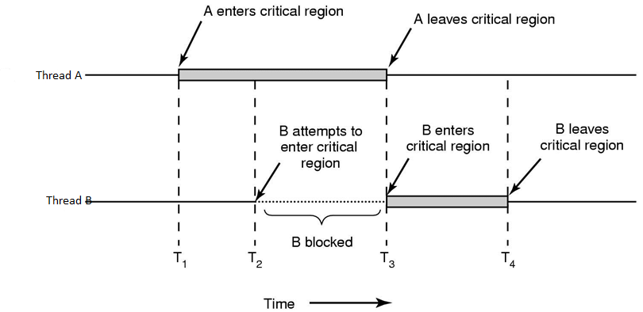
Illustration of critical region
What basic mechanism can stop B from entering critical region when A in?

Slide 48
Critical section access
Critical section access should satisfy multiple properties
  Mutual exclusion
    At most one thread can be in CS at a time
  Progress
    if no thread in critical section a thread can enter without waiting
  Bounded waiting
    Once a thread T starts trying to enter the CS, there is a bound on the number of times other threads get in

Slide 49
Locks (mutexes)
Locks can be used to enforce mutual exclusion
Multiple threads calling lock() result in exactly one thread acquiring the lock
  t’s lock() call returns: t holding the lock
  Other threads block on lock(), waiting for the lock to become available

Slide 50
Locks (mutexes)
A thread that is holding the lock calls unlock() to release the lock
  t’s unlock() call returns; the lock becomes available
  Another thread waiting for the lock may succeed in acquiring it

Slide 51
Locks: Usage example
1 #define MAX_ITER 1000000000
2 long counter = 0;
3 pthread_mutex_t mylock = PTHREAD_MUTEX_INITIALIZER;
4
5 void * thread_function(void * arg) {
6 long l;
7 for (l=0; l < MAX_ITER; l++) {
8 pthread_mutex_lock(&mylock);
9 counter = counter + 1; //critical section
10 pthread_mutex_unlock(&mylock);
11 }
12 }
In line 3, a mutex named “mylock” is declared.
Before a thread enters the critical section, it locks the mutex (Line 8).
When a thread leaves the critical section, it unlocks the mutex (Line 10).
The mutex ensures that at any time, only one thread will be allowed into the critical section. All other threads have to wait until the critical section becomes free again.

Slide 52
What is a semaphore?
A semaphore is an object with an integer value that we can manipulate with two routines:
  sem_wait(): decrement the value of semaphore and wait if its value is negative
  sem_post(): increment the value of semaphore and wake up a waiting thread, if any
  it keeps a queue of waiting threads
  wait and post operations are performed indivisibly

Slide 53
Binary semaphore
Functions like a lock
sem_t m;
sem_init(&m, 0, X);
sem_wait(&m); // lock
do_work(); // critical section
sem_post(&m); // unlock
What value should X be?
value = 1; T0 sem_wait, value = 0, enter CS;
T1 sem_wait, value = -1, wait until value = 0;
T0 finishes work, sem_post, value = 0, wake up T0

Slide 54
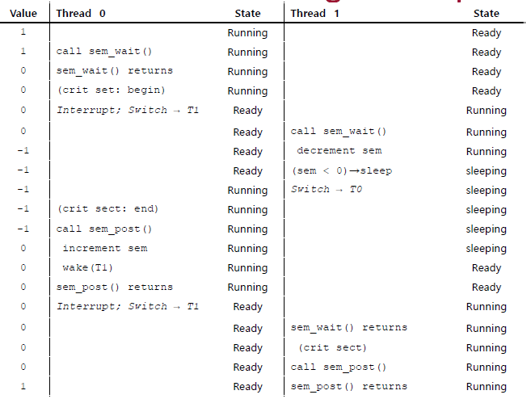
Thread trace

Slide 55
Condition synchronization
Threads may need to communicate about events
  “has event A already happened in another thread?”
  aka “precedence constraint”, or “scheduling constraint”
    Do B after A
semaphores are not only useful for enforcing mutual exclusion, but can be used for enforcing execution order

Slide 56
Execution order
Thread A Thread B
Requirement
  guarantee that a1 happens before b1
To guarantee a1 < b1
  B has to wait until A executes a1
  … then A needs to signal B that it can execute b1
  Can we solve this using semaphores?
1. statement a1
1. statement b1

Slide 57
Execution order
Thread A Thread B
To guarantee: a1 < b1
  Create a semaphore, named aDone that indicates whether thread A has completed a1
  B has to wait until A executes a1
    so, let B issue P(&aDone) before b1
  … then A needs to signal B that it can execute b1
    so, let A issue V(&aDone) after a1
1. statement a1
1. statement b1

Slide 58
Execution order
Thread A Thread B
How should we initialize ?
  aDone = 1 does not work
  aDone = 0 works
statement a1
V(&aDone)
P(&aDone)
statement b1

Slide 59
Practice Exercise
Thread A Thread B
Requirement
  guarantee that a1 happens before b1
  guarantee that b1 happens before a2
statement a1
Statement a2
1. statement b1

Slide 60
Practice Exercise
Thread A Thread B
We need to guarantee: a1 < b1, b1 < a2
Does this work?
Broken solution
  B must do its P operation before A reaches its P operation
  What can we do to fix this?
statement a1
V(&Done)
P(&Done)
statement a2
P(&Done)
statement b1
V(&Done)

Slide 61
Practice Exercise
Thread A Thread B
We need to guarantee: a1 < b1, b1 < a2
  In writing your solution, be sure to specify the names and initial values of your semaphores (little hint here)
  Now solve it!
statement a1
statement a2
statement b1

Slide 62
Practice Exercise
Thread A Thread B
Guarantee: a1 < b1, b1 < a2
Idea: A waits for B using a different semaphore
  Is this finally correct?
statement a1
V(&aDone)
P(&bDone)
statement a2
P(&aDone)
statement b1
V(&bDone)

Slide 63
Rendezvous
Thread A Thread B
Requirements
  guarantee that a1 happens before b2
  guarantee that b1 happens before a2
  we don’t care about the order of a1 and b1
statement a1
statement a2
statement b1
statement b2

Slide 64
Rendezvous
Requirement: a1 < b2, b1 < a2
Idea: use two semaphores
  lets call them aArrived, bArrived
  both initialized to 0
Thread A Thread B
This solution works, right?
statement a1
V(&aArrived)
P(&bArrived)
statement a2
statement b1
V(&bArrived)
P(&aArrived)
statement b2

Slide 65
Rendezvous
Requirement: a1 < b2, b1 < a2
You might have tried …
Thread A Thread B
This solution also works, right?
statement a1
V(&aArrived)
P(&bArrived)
Statement a2
statement b1
P(&aArrived)
V(&bArrived)
Statement b2

Slide 66
Rendezvous
Requirement: a1 < b2, b1 < a2
You might have tried …
Thread A Thread B
Why is this a flawed solution?
  Assuming A arrives first, it will block at its P
  When B arrives, it will also block, since A wasn’t able to signal aArrived
  So, neither thread can proceed, and never will
statement a1
P(&bArrived)
V(&aArrived)
statement a2
statement b1
P(&aArrived)
V(&bArrived)
statement b2

Slide 67
Practice exercise
sem r = 0, s = 1;
Thread T1:
P(r);
P(s);
A1;
V(s);
A2;
V(r);
Thread T2:
B1;
V(r);
B2;
P(s);
B3;
V(s);
True or False: Operation A1 cannot start until operation B1 is complete.

Slide 68
Practice exercise
sem r = 0, s = 1
Thread T1:
P(r);
P(s);
A1;
V(s);
A2;
V(r);
Thread T2:
B1;
V(r);
B2;
P(s);
B3;
V(s);
True or False: Operations A1 and B2 cannot execute concurrently.

Slide 69
Practice exercise
sem r = 0, s = 1
Thread T1:
P(r);
P(s);
A1;
V(s);
A2;
V(r);
Thread T2:
B1;
V(r);
B2;
P(s);
B3;
V(s);
True or False: Operations A1 and B3 cannot execute concurrently.

Slide 70
Practice exercise
sem r = 0, s = 1
Thread T1:
P(r);
P(s);
A1;
V(s);
A2;
V(r);
Thread T2:
B1;
V(r);
B2;
P(s);
B3;
V(s);
True or False: Operations A2 and B3 cannot execute concurrently.

Slide 71
Readers/Writers Problem
A set of threads access a shared variable
Some of these threads, the readers, only read the variable, whereas the remaining threads, the writers, only write to the variable

Slide 72
Readers/Writers Problem
When a writer thread accesses the shared variable:
  no other thread, either reader or writer, should access the shared variable
Since reading operations do not interfere with one another:
  we can allow simultaneous reading operations

Slide 73
Readers/Writers
readers/writers share:
  semaphore wrt; // initialized to 1
readers share:
  int readcount; // initialized to 0

Slide 74
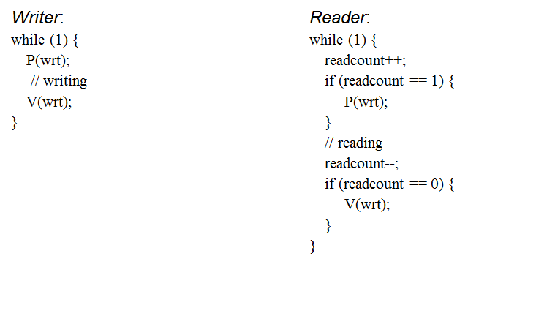
Seems simple, but this code is broken

Slide 75
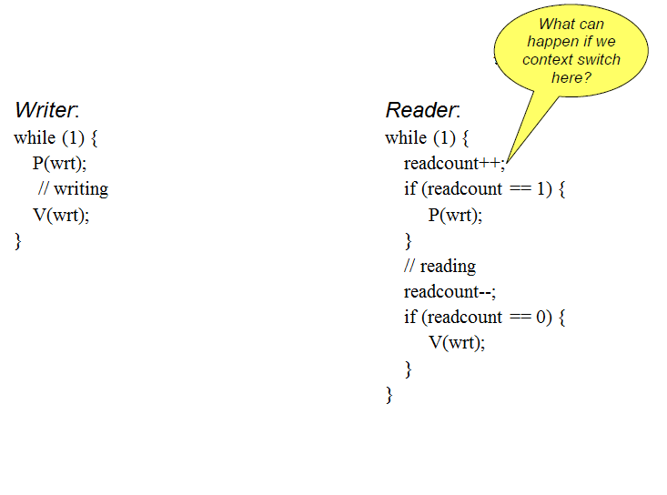

Slide 76
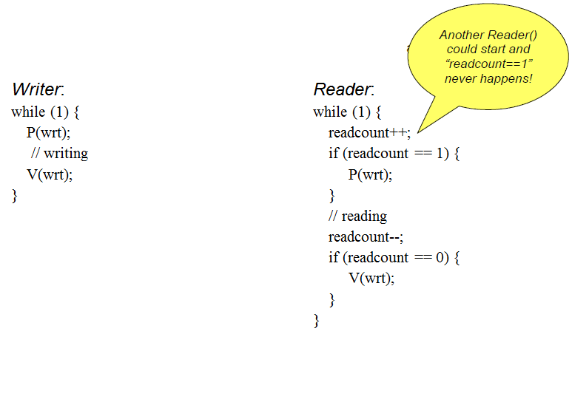

Slide 77
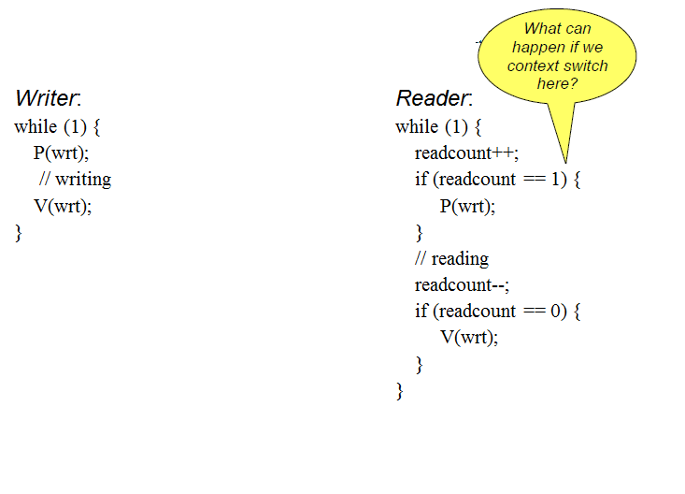

Slide 78
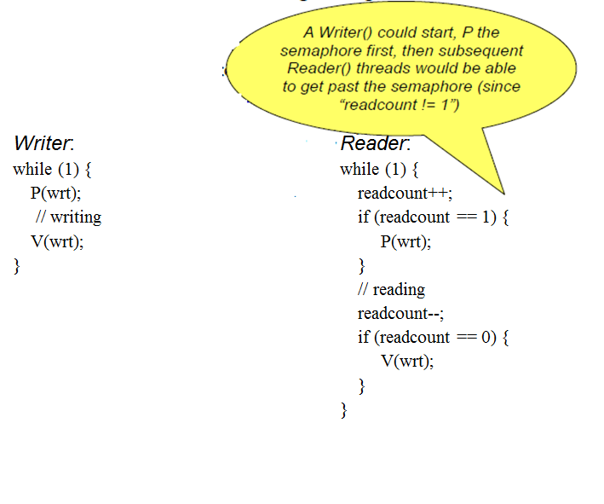

Slide 79
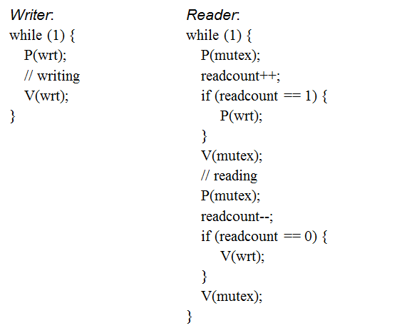
Fixed code

Slide 80
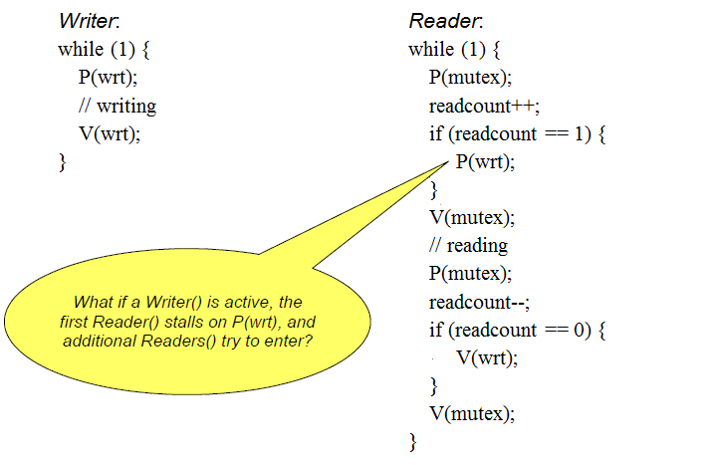
Fixed code

Slide 81
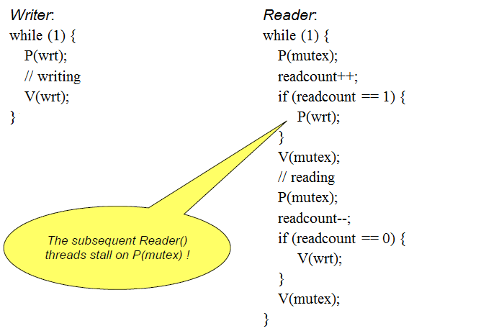
Fixed code

Slide 82
What bad thing could happen if we omitted the two red lines?

Slide 83
Readers’ preference
Assume some reader is accessing
Now
  if a reader and a writer arrive at their entry protocols
  in our solution the reader will always have preference over the writer (why?)
Called the readers’ preference solution

