Slide 1
COMPARATIVE STUDY OF STOCHASTIC MODELS FOR OPTION PRICING
In the Indian Stock Market (NIFTY 50)
Black-Scholes → Merton Jump-Diffusion → Heston → Bates
Project Report | Mid-Term Evaluation | Academic Year 2025-26
Under the supervision of Prof. Chaman Kumar
Department of Mathematics, IIT Roorkee

Slide 2
Presentation Outline
1. Motivation & Background
2. Data: NIFTY 50 (2018–2024)
3. Black-Scholes Model
• GBM, MLE, Closed-Form, MC
4. Merton Jump-Diffusion
• SDE, MLE, MC Pricing
5. Empirical Comparison
• Tail Behavior, IV Smile, VaR
6. Statistical Model Selection
• LRT, AIC/BIC
7. End-Term: Heston & Bates
8. Connection to Supervisor Research

Slide 3
1. Motivation & Background
• Indian derivatives market (NIFTY 50 options) is among the most liquid globally
• Black-Scholes assumes constant volatility & continuous paths — violated in practice
• Extreme events in India: COVID crash (−13% single day), IL&FS crisis,
election surprises — GBM cannot generate such dislocations
• Project goal: rigorous comparison of increasingly sophisticated stochastic models
calibrated to NIFTY 50 data, benchmarked on empirical features
Model Hierarchy (each relaxes a key BS assumption):
BS (constant σ) → MJD (+ jumps) → Heston (+ stochastic vol) → Bates (+ both)
References: Black & Scholes (1973), Merton (1976), Heston (1993), Bates (1996)

Slide 4
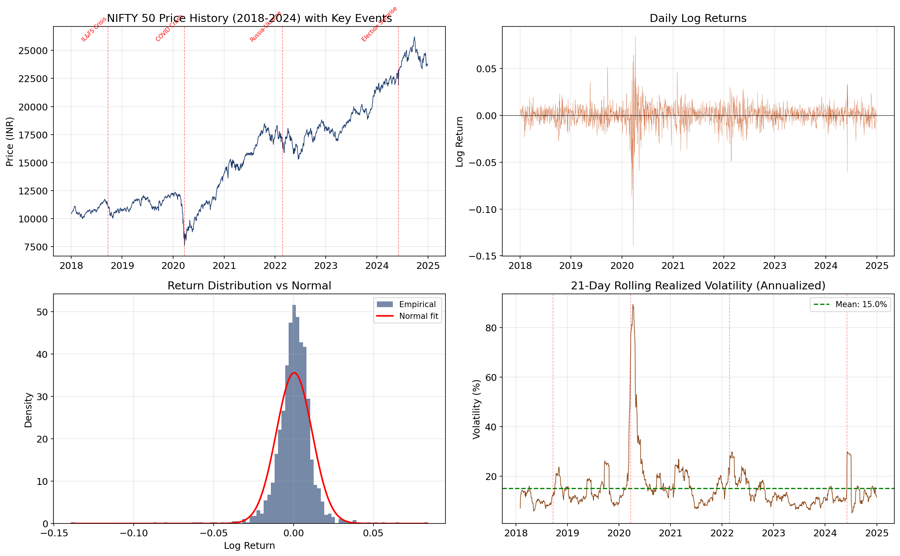
2. Data: NIFTY 50 (Jan 2018 – Dec 2024)
Source: Yahoo Finance (^NSEI) via yfinance | Risk-free rate: RBI repo rate ≈ 6.5%
Empirical return distribution shows negative skewness and excess kurtosis — fat tails that BS ignores

Slide 5
3. Black-Scholes Model — Theory
Geometric Brownian Motion (GBM):
dS(t) = μ S(t) dt + σ S(t) dW(t)
By Itô's Lemma:
S(T) = S(0) · exp[ (μ − σ²/2)T + σ√T · Z ], Z ~ N(0,1)
Log-returns: r_t = ln(S_t/S_{t−1}) ~ N( (μ − σ²/2)Δt, σ²Δt )
MLE Log-Likelihood:
ℓ(μ,σ) = −(n/2)ln(2π) − (n/2)ln(σ²Δt) − Σ (r_i − μ̃Δt)² / (2σ²Δt)
Risk-Neutral Pricing (Girsanov's theorem):
V(0) = e^{−r_f T} · E^Q[ Payoff(S(T)) ]
BS Call Formula: C = S₀ N(d₁) − K e^{−r_f T} N(d₂)
d₁ = [ln(S₀/K) + (r_f + σ²/2)T] / (σ√T), d₂ = d₁ − σ√T
[BS73] Black, F. & Scholes, M. (1973). J. Political Economy, 81(3), 637–654.
[Aït-Sa02] Aït-Sahalia, Y. (2002). Econometrica, 70(1), 223–262.

Slide 6
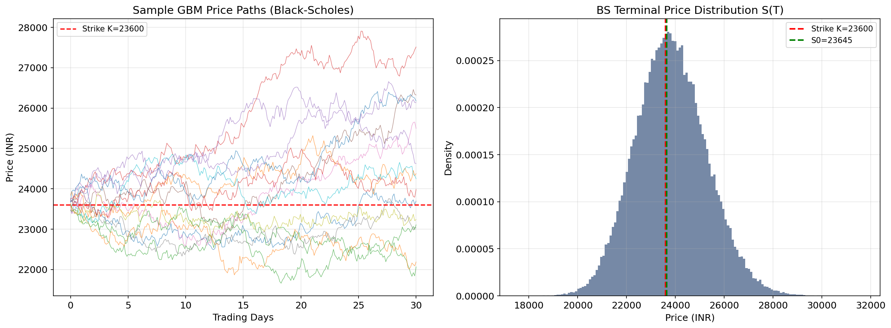
3. Black-Scholes — MC Simulation & Results
MC estimator: Ĉ_MC = e^{−r_f T} · (1/N) Σ max(S_T^(i) − K, 0) | SE ~ 1/√N by CLT
MC price converges to closed-form, validating SDE↔pricing formula link [Glasserman, 2003]

Slide 7
4. Merton Jump-Diffusion — Theory
SDE (Physical Measure):
dS(t) = μ S(t) dt + σ S(t) dW(t) + S(t⁻)(e^J − 1) dN(t)
N(t) ~ Poisson(λ), J ~ N(μ_J, σ_J²)
Log-return given k jumps:
r | N=k ~ N( (μ − σ²/2)Δt + k·μ_J, σ²Δt + k·σ_J² )
Marginal density (Gaussian mixture):
f(r) = Σ_{k=0}^∞ [e^{−λΔt}(λΔt)^k / k!] · φ(r; μ̃Δt + kμ_J, σ²Δt + kσ_J²)
Variance decomposition:
Var(r) = σ²Δt + λΔt·(μ_J² + σ_J²) ← jump component adds excess kurtosis
Risk-Neutral drift: κ = E[e^J − 1] = exp(μ_J + σ_J²/2) − 1
Compensated drift ensures E^Q[S(t)] = S(0)e^{r_f t} (no-arbitrage)
Parameters: θ = (μ, σ, λ, μ_J, σ_J) — 5 params vs BS's 2
[Me76] Merton, R.C. (1976). J. Financial Economics, 3(1-2), 125-144.
[CT04] Cont, R. & Tankov, P. (2004). Financial Modelling with Jump Processes.

Slide 8
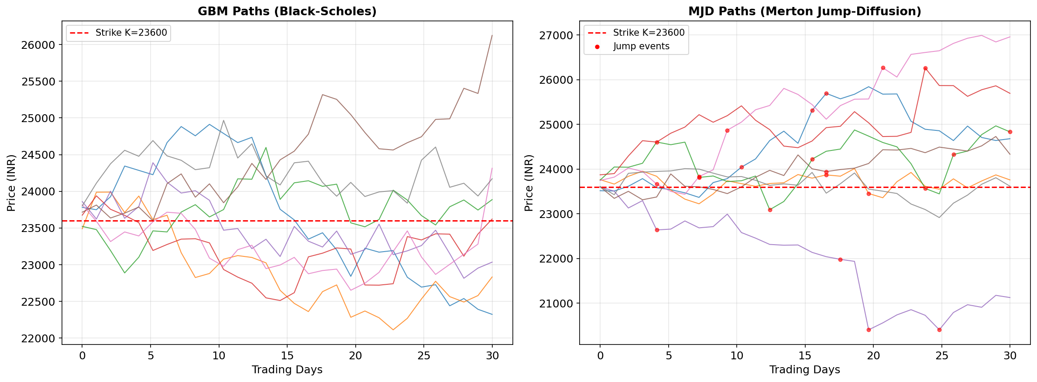
4. GBM vs MJD — Sample Price Paths
Red dots mark jump events in MJD paths. GBM paths are smooth — unable to capture sudden dislocations.
MJD naturally models events like the −13% NIFTY crash on 23 March 2020.

Slide 9
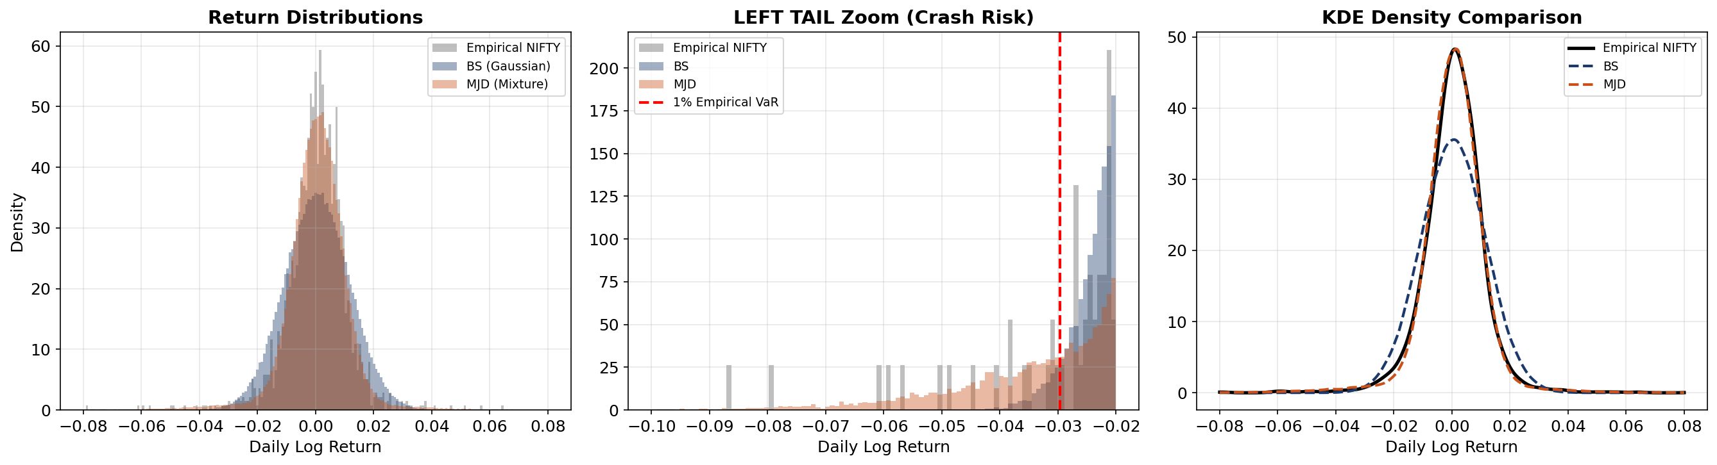
5. Tail Behavior — BS vs MJD vs Empirical
MJD's Gaussian mixture captures fat tails; BS (pure Gaussian) dramatically underestimates extreme returns.
Excess kurtosis: BS = 0 (by definition), MJD = 3λ(μ_J² + σ_J²)² / σ⁴ > 0, Empirical NIFTY >> 0

Slide 10
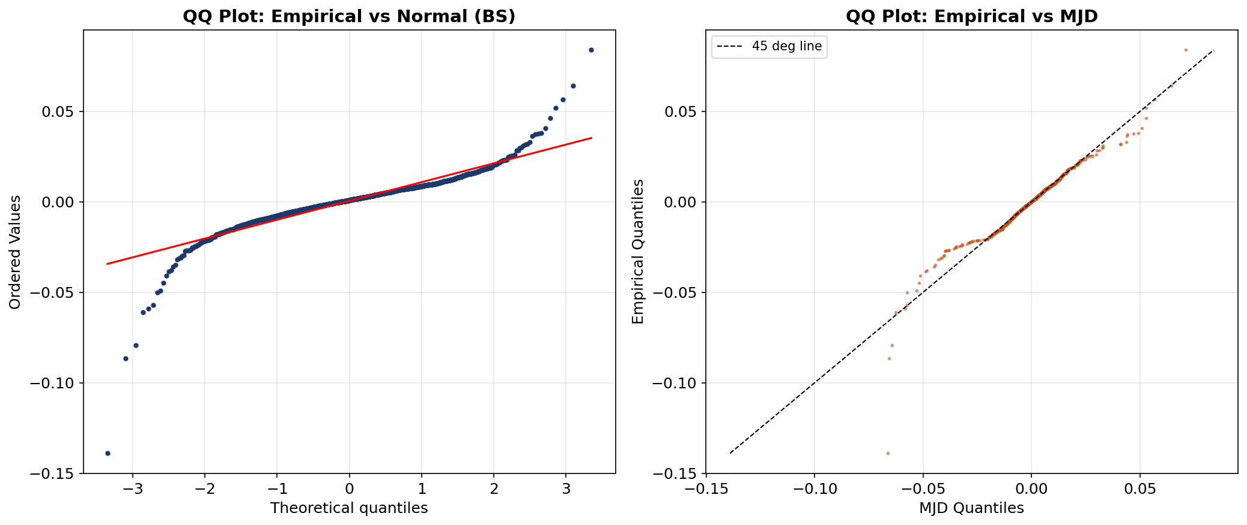
5. QQ Plots — Quantile Diagnostic
QQ vs Normal: heavy-tailed departure from 45° line at extremes → BS misfit.
QQ vs MJD: better alignment in tails → MJD captures empirical quantile structure of NIFTY 50.

Slide 11
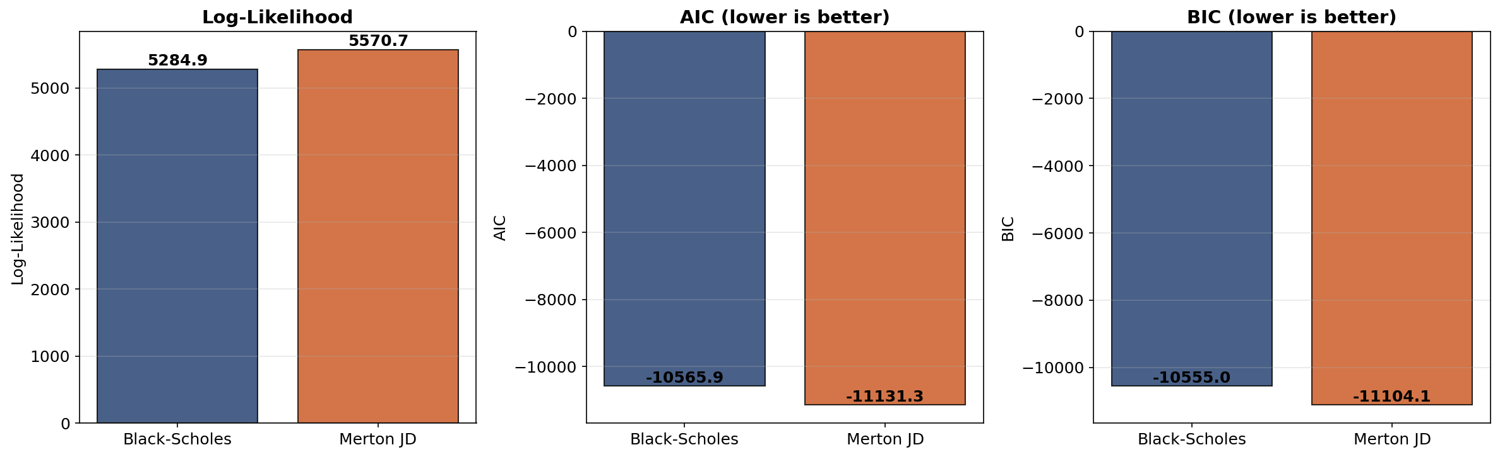
6. Statistical Model Selection
Likelihood Ratio Test: LRT = 2[ℓ(MJD) − ℓ(BS)] ~ χ²(3) under H₀: λ=0
AIC = 2k − 2ℓ, BIC = k·ln(n) − 2ℓ — penalize complexity; MJD overcomes penalty
[Aït-Ja07] Aït-Sahalia & Jacod (2007). Annals of Statistics, 35(1), 355-392.

Slide 12
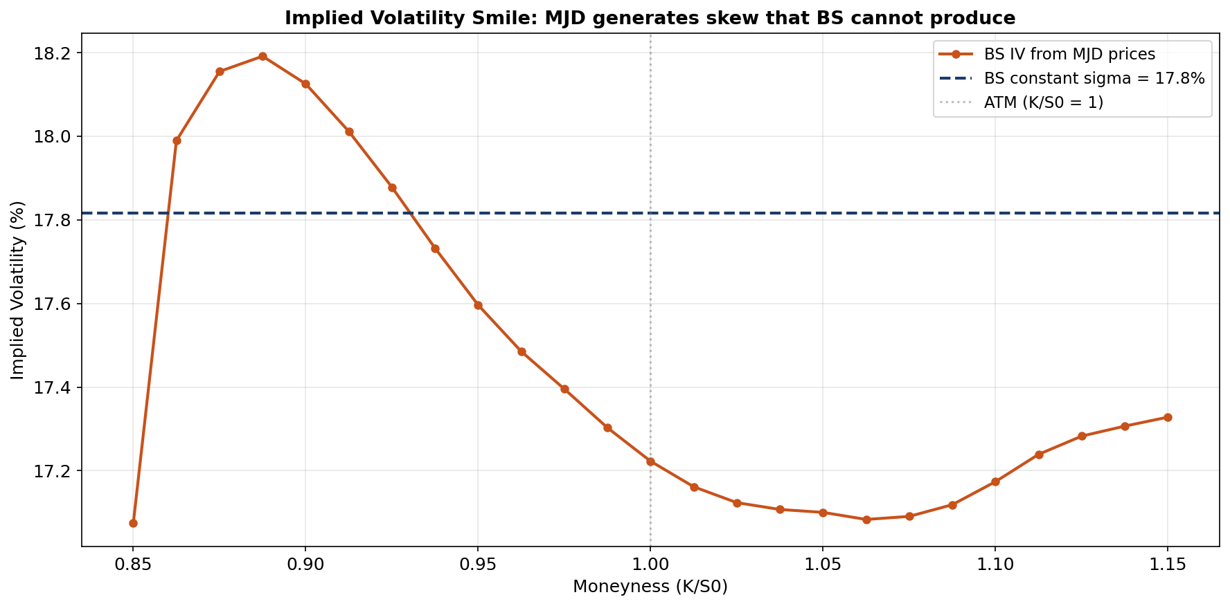
5. Implied Volatility Smile
BS produces flat IV by construction; MJD generates the "smile" / skew observed in NIFTY option markets.
This is the classical smile inconsistency — documented by Rubinstein (1994) [Ru94].

Slide 13
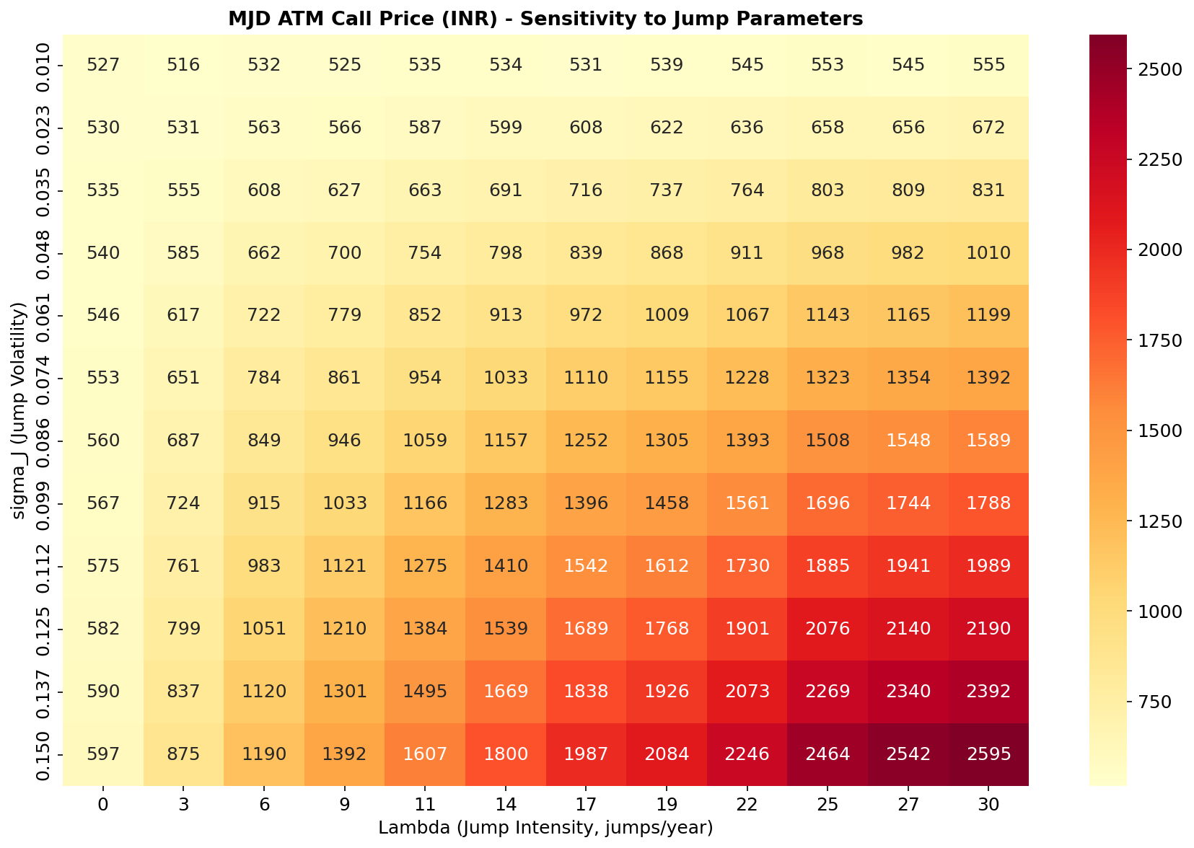
5. MJD Parameter Sensitivity
Non-linear interaction between λ (jump intensity) and σ_J (jump volatility) — unavailable in BS world.
Higher λ and σ_J → substantially higher option prices, reflecting crash risk premium.

Slide 14
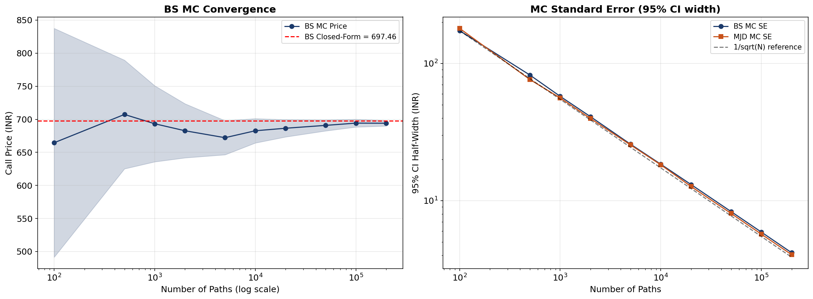
5. Monte Carlo Convergence
MC price → closed-form as N→∞, confirming 1/√N convergence rate (CLT).
Standard error comparison validates implementation correctness [Glasserman (2003)].

Slide 15
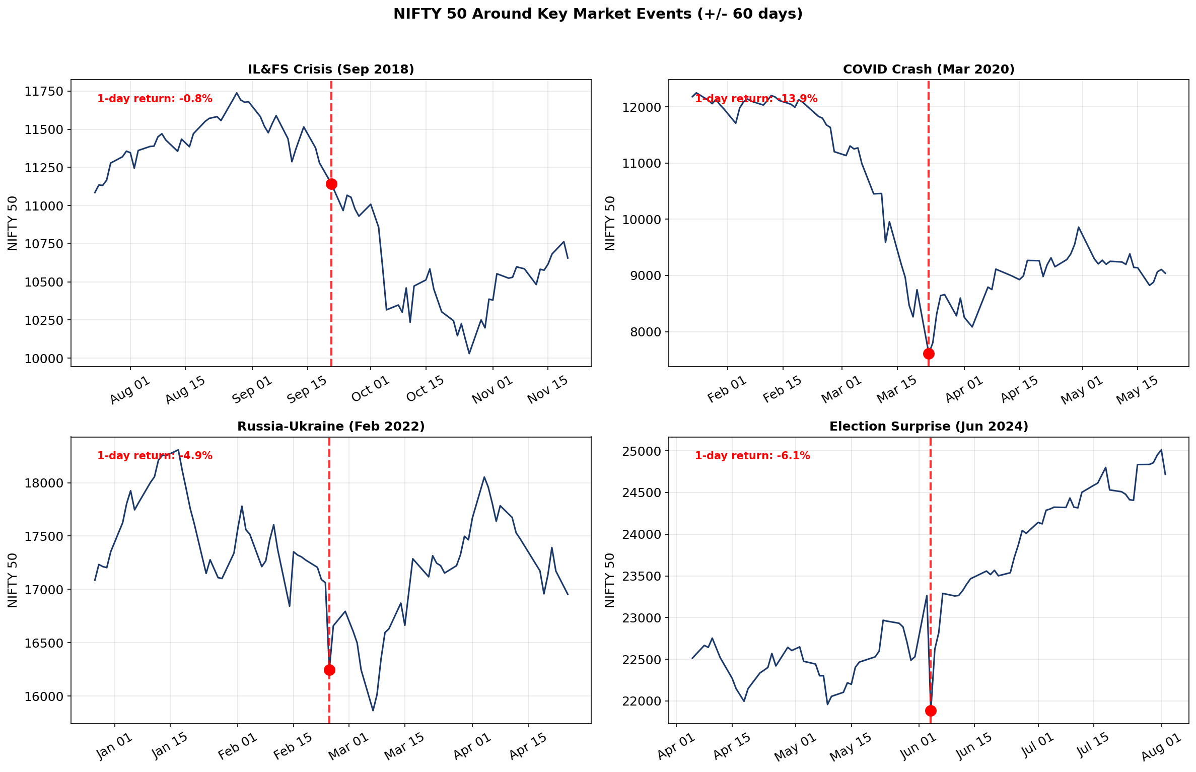
5. Indian Market Event Analysis
Key events: IL&FS crisis (Sep 2018), COVID crash (Mar 2020), Russia-Ukraine (Feb 2022), Election (Jun 2024)
BS assigns near-zero probability to such moves; MJD jump parameters capture this crash risk.

Slide 16
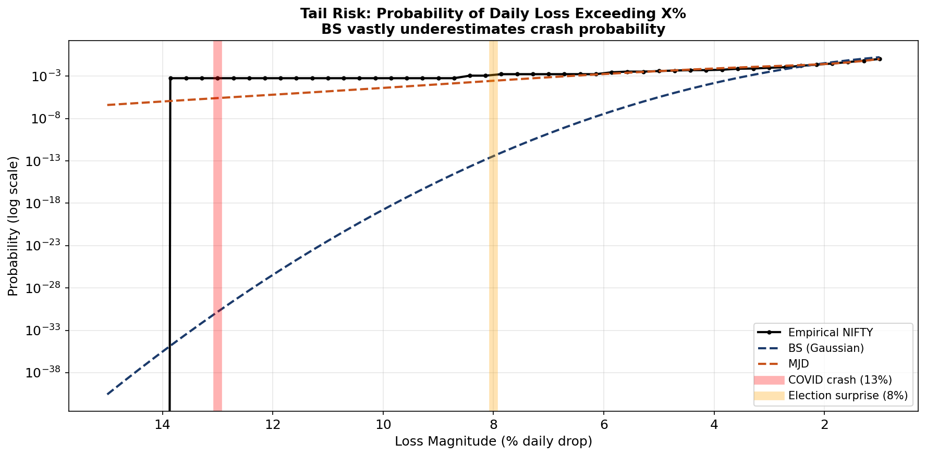
5. Tail Risk: Crash Probability
BS vastly underestimates the probability of large daily losses — a critical failure for risk management.
MJD provides realistic tail probabilities closer to empirical NIFTY returns, essential under SEBI regulations.

Slide 17
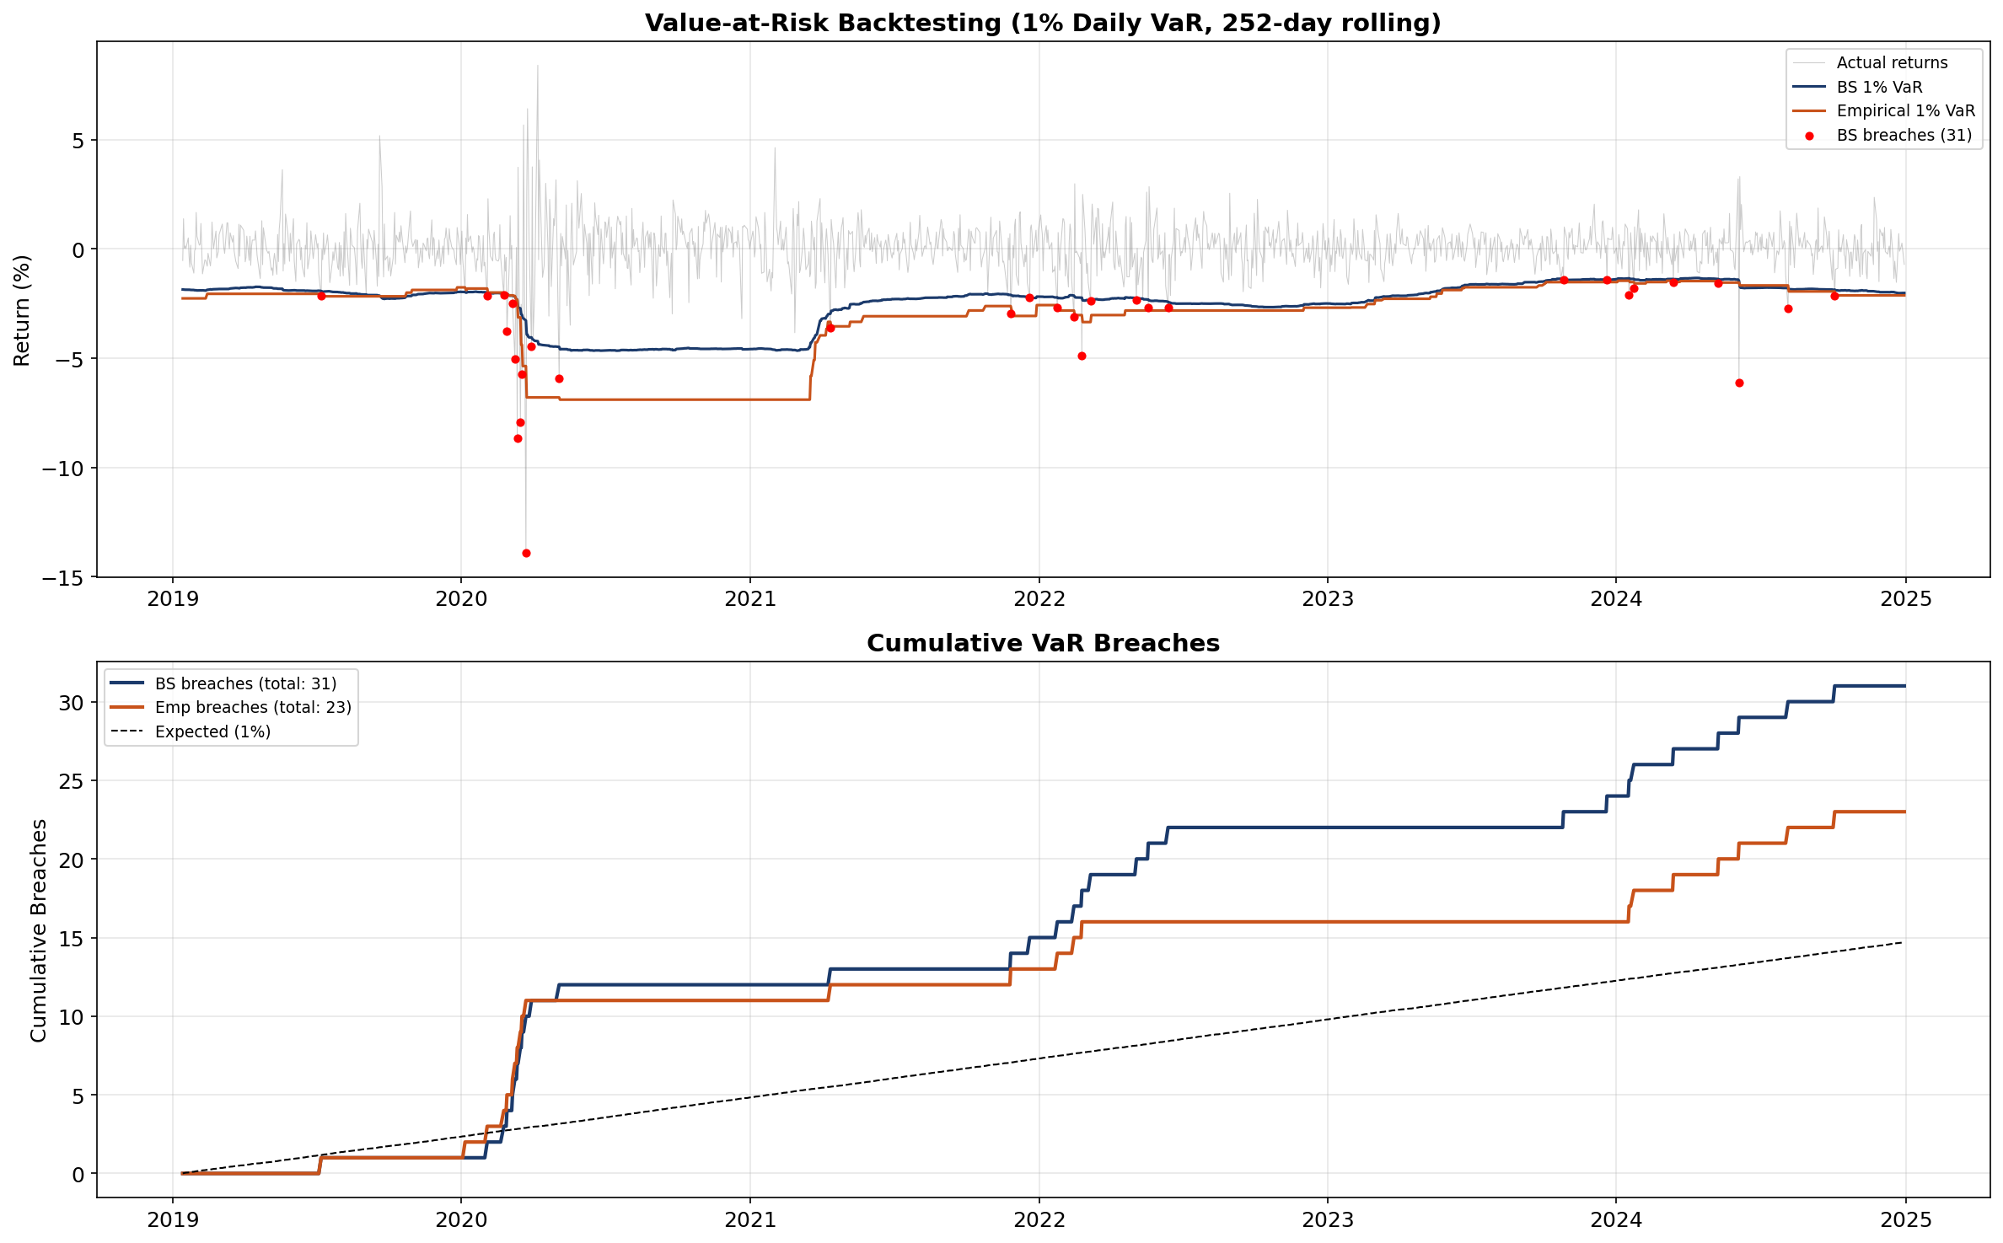
5. Value-at-Risk Backtesting
1% VaR breaches under BS Gaussian model exceed expected rate — BS fails Kupiec test.
Empirical VaR (from historical quantiles, analogous to MJD) stays closer to 1% expected rate.

Slide 18
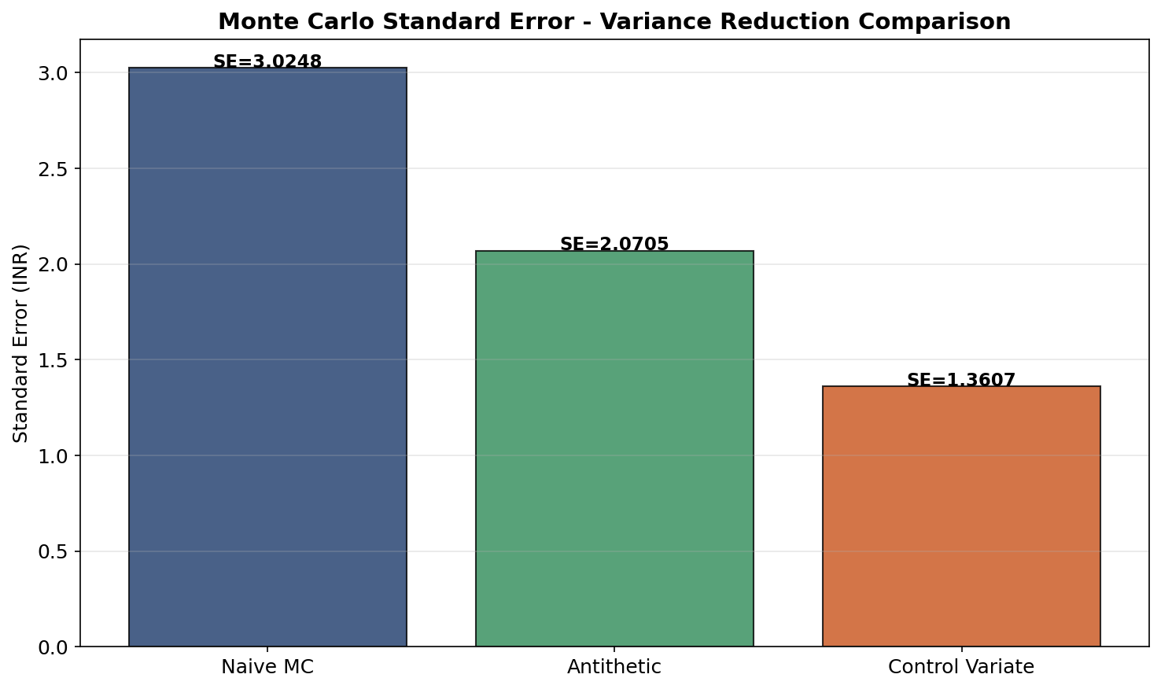
5. Variance Reduction Techniques
Antithetic variates: pair (Z, −Z) → roughly halves variance for smooth payoffs.
Control variate: use BS closed-form as control for MJD MC → 30-70% SE reduction near ATM.
[Gl03] Glasserman, P. (2003). Monte Carlo Methods in Financial Engineering. Springer.

Slide 19
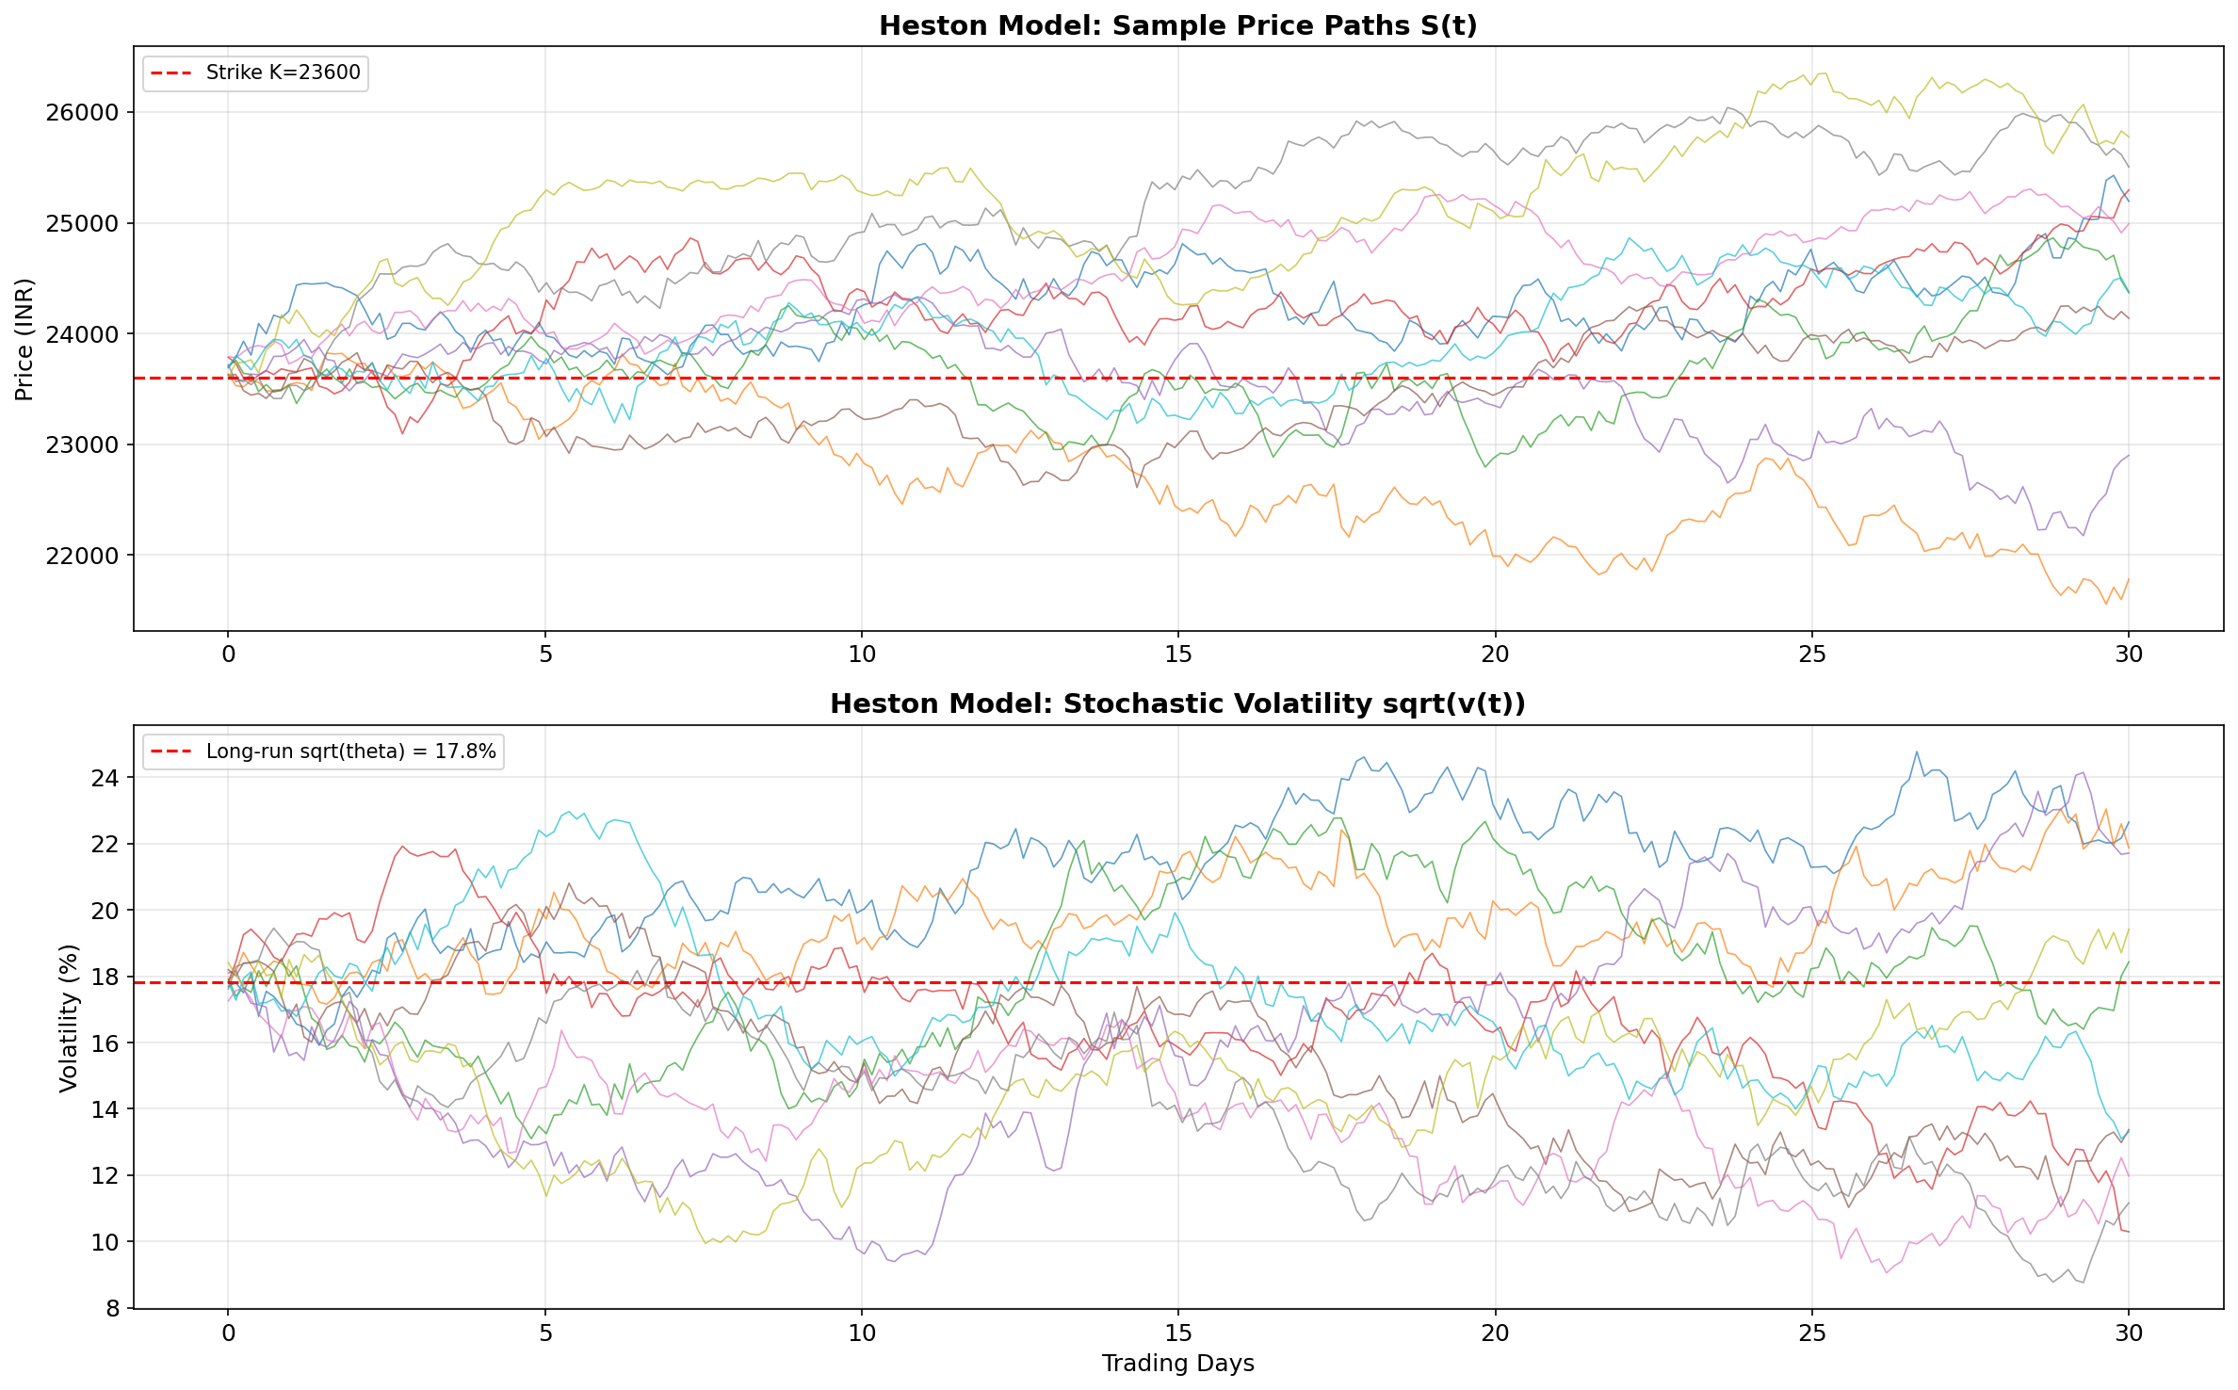
7. End-Term: Heston Stochastic Volatility
Heston (1993) — variance v(t) follows CIR process:
dS(t) = r_f S(t) dt + √v(t) S(t) dW_S^Q(t)
dv(t) = κ[θ − v(t)] dt + ξ √v(t) dW_v^Q(t)
Corr(dW_S, dW_v) = ρ dt (leverage effect: ρ < 0)
Parameters: κ (mean-reversion), θ (long-run var), ξ (vol-of-vol), ρ (correlation), v₀
Feller condition: 2κθ > ξ² ensures v(t) > 0
Produces full implied volatility smile & term structure
Semi-analytic pricing via Fourier inversion [Carr-Madan (1999)]
[He93] Heston, S.L. (1993). Review of Financial Studies, 6(2), 327-343.

Slide 20
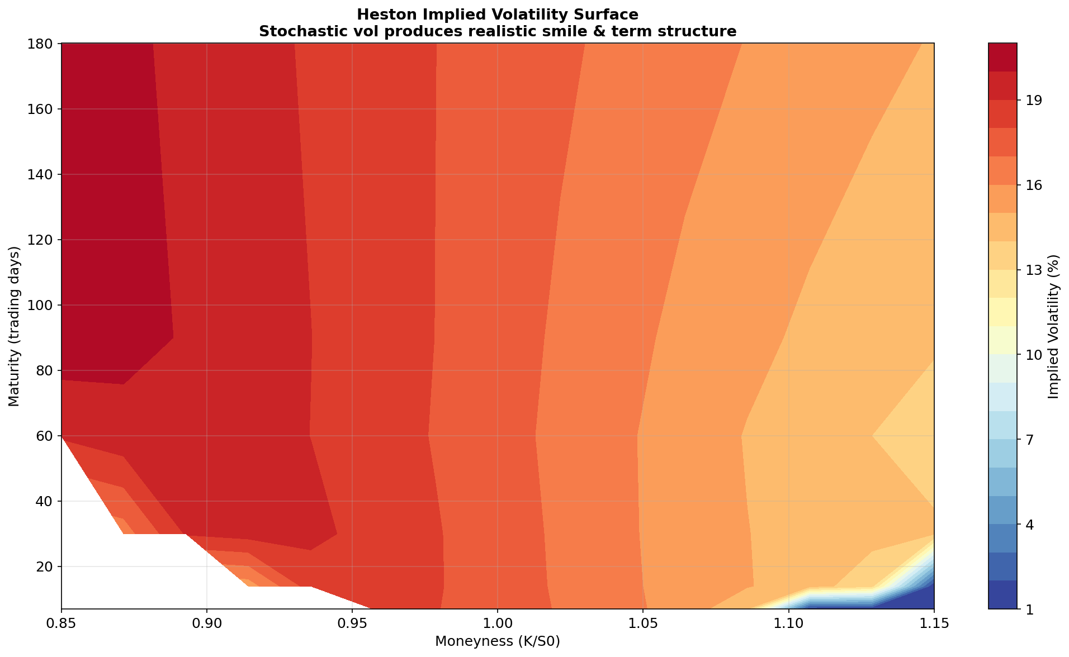
7. Heston Implied Volatility Surface
Stochastic volatility produces realistic IV smile & term structure — flat BS surface is a special case.
Negative ρ (leverage effect) creates the asymmetric skew observed in NIFTY index options.

Slide 21
8. Connection to Supervisor's Research
The CIR variance process √v(t) has non-globally-Lipschitz coefficients.
Standard Euler-Maruyama can produce negative variance — numerical instability.
Prof. Chaman Kumar's research directly addresses this:
• Tamed Euler scheme for Lévy-driven SDEs
[DKS16] Dareiotis, Kumar & Sabanis (2016). SIAM J. Numer. Anal., 54(3). IF: 2.712
• Explicit tamed Milstein for super-linear diffusion coefficients
[KS17a] Kumar & Sabanis (2017). Electronic J. Probability, 22, 1-19. IF: 1.123
• Milstein scheme for Lévy SDEs with super-linear coefficients
[K20] Kumar (2020). DCDS-B. DOI: 10.3934/dcdsb.2020167
• Tamed Milstein for SDEs with Markovian switching
[KK20] Kumar & Kumar (2020). J. Comp. Appl. Math., 377. IF: 2.037
• McKean-Vlasov equations — future scope for mean-field option markets
[KNRS20] Kumar, Neelima, Reisinger & Stockinger (2020). arXiv:2006.00463

Slide 22
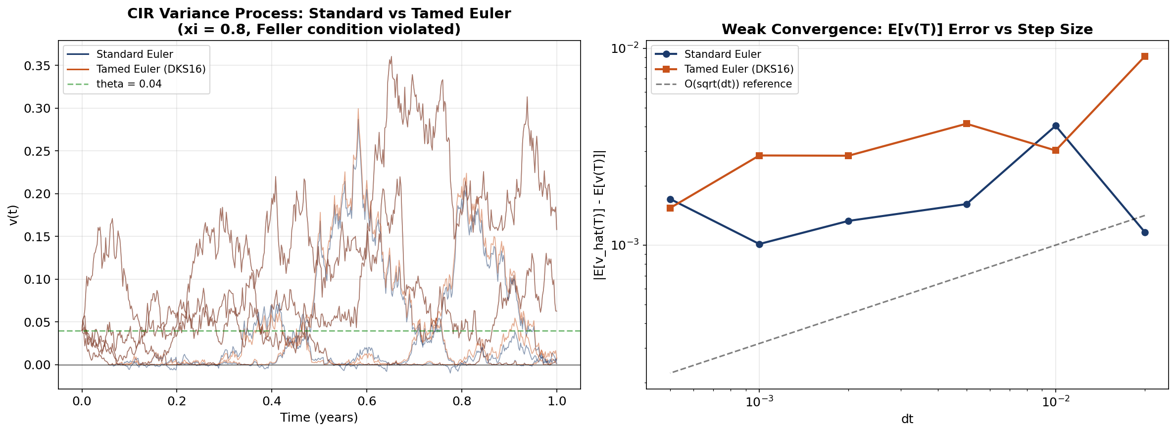
8. Tamed Euler — Numerical Comparison
Standard Euler produces negative variance excursions; Tamed Euler (DKS16) maintains positivity.
Convergence rate: slope ≈ 0.5 (Euler) confirmed — matches theoretical rates from cited papers.

Slide 23
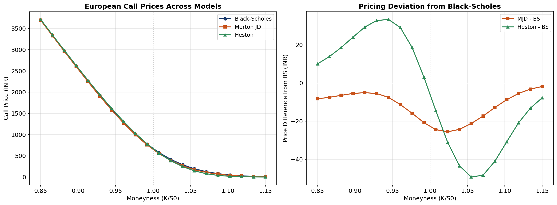
5. Option Prices — All Models Compared
MJD prices diverge from BS for OTM options (fat tails); Heston captures smile-driven deviation.
Bates (Heston + Jumps) will combine both effects — the most flexible model in this study.

Slide 24
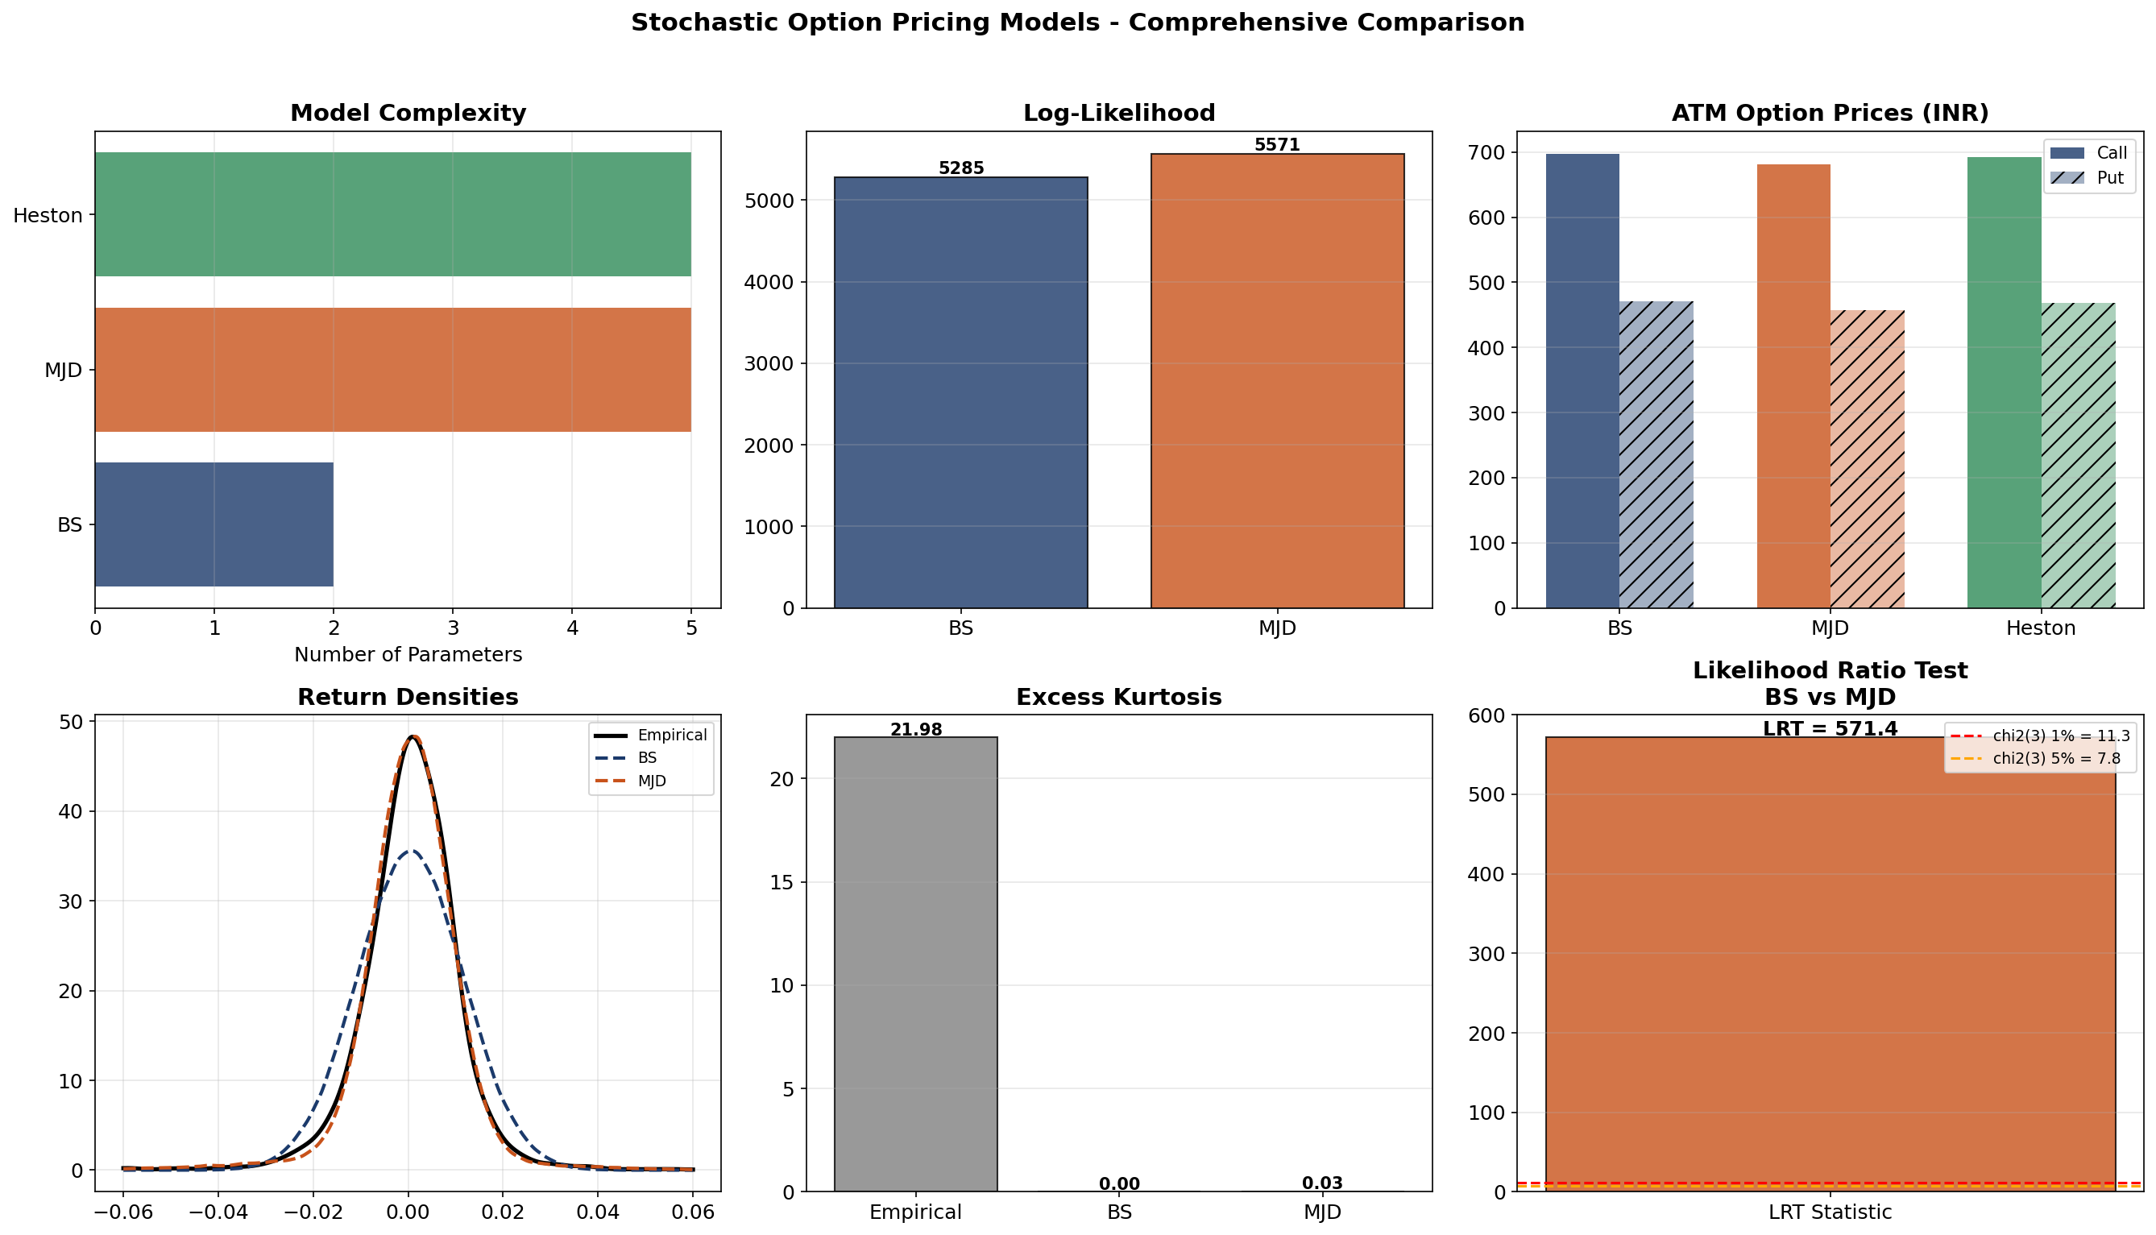
Summary — Comprehensive Comparison

Slide 25
Model Comparison Summary
Feature | Black-Scholes | Merton JD | Heston | Bates
SDE type | GBM | GBM + Poisson | GBM + CIR vol | GBM + CIR + Jumps
Parameters | 2 | 5 | 5 | 8
Return dist. | Gaussian | Mixture | Non-Gaussian | Non-Gaussian
Closed-form | Yes | Series approx. | Fourier | Fourier
Vol smile | No (flat IV) | Partial | Full smile | Full smile
Jumps | No | Yes | No | Yes
Extreme events | Poor | Good | Moderate | Best
Calibration | Analytic MLE | Numerical MLE | Option chain | Option chain

Slide 26
End-Term Evaluation Plan
Planned Deliverables:
1. Full Heston calibration to NIFTY option chain (3 maturities × 7 strikes)
2. Bates model (Heston + Jumps) — 8-parameter calibration
3. Comprehensive 4-model comparison:
• Option pricing RMSE on market prices
• Implied volatility smile fit across strikes & maturities
• 1% VaR backtesting on 2023-24 NIFTY data
4. Sensitivity analysis: Greeks (Δ, Γ, V) under each model
5. Statistical model selection: LRT (nested), AIC/BIC (non-nested)
6. Numerical methods: Tamed Euler vs Standard Euler convergence
for CIR process — connecting to Prof. Kumar's research
7. Future scope: McKean-Vlasov / mean-field game formulation
for multi-agent option markets [KNRS20]

Slide 27
References
Foundational Models:
[BS73] Black & Scholes (1973). J. Political Economy, 81(3), 637-654.
[Me76] Merton (1976). J. Financial Economics, 3(1-2), 125-144.
[He93] Heston (1993). Review of Financial Studies, 6(2), 327-343.
[Ba96] Bates (1996). Review of Financial Studies, 9(1), 69-107.
Statistical Methods:
[Aït-Sa02] Aït-Sahalia (2002). Econometrica, 70(1), 223-262.
[Aït-Ja07] Aït-Sahalia & Jacod (2007). Annals of Statistics, 35(1), 355-392.
[CT04] Cont & Tankov (2004). Financial Modelling with Jump Processes. CRC.
[Gl03] Glasserman (2003). MC Methods in Financial Engineering. Springer.
Supervisor's Research (Numerical SDE Methods):
[DKS16] Dareiotis, Kumar & Sabanis (2016). SIAM J. Numer. Anal., 54(3).
[KS17] Kumar & Sabanis (2017). Electr. J. Probability, 22, 1-19.
[KK20] Kumar & Kumar (2020). J. Comp. Appl. Math., 377, 112917.
[K20] Kumar (2020). DCDS-B. DOI: 10.3934/dcdsb.2020167.
[KNRS20] Kumar, Neelima, Reisinger & Stockinger (2020). arXiv:2006.00463.

Slide 28
Thank You
Comparative Study of Stochastic Models for Option Pricing in the Indian Stock Market
Under the supervision of Prof. Chaman Kumar
Department of Mathematics, IIT Roorkee
Questions?

