Slide 1
COMPARATIVE STUDY OF STOCHASTIC MODELS FOR OPTION PRICING
In the Indian Stock Market (NIFTY 50)
Black-Scholes → Merton Jump-Diffusion → Heston → Bates
Project Report | Mid-Term Evaluation | Academic Year 2025-26
Under the supervision of Prof. Chaman Kumar
Department of Mathematics, IIT Roorkee

Slide 2
Outline
1. Motivation & empirical stylised facts (Indian market)
2. Data: NIFTY 50 (2018–2024)
3. Black–Scholes model:
• GBM SDE and log‑price solution
• Maximum Likelihood Estimation (MLE)
• Closed‑form pricing & Monte Carlo
4. Merton Jump–Diffusion:
• SDE with jumps and log‑return derivation
• Gaussian‑mixture likelihood & MLE
5. Evidence from NIFTY 50:
• Fat tails, VaR failures, volatility smile
6. Model selection (LRT, AIC/BIC) & future work (Heston/Bates)

Slide 3
1. Motivation & Background
• Indian derivatives market (NIFTY 50 options) is among the most liquid globally
• Black-Scholes assumes constant volatility & continuous paths — violated in practice
• Extreme events in India: COVID crash (−13% single day), IL&FS crisis,
election surprises — GBM cannot generate such dislocations
• Project goal: rigorous comparison of increasingly sophisticated stochastic models
calibrated to NIFTY 50 data, benchmarked on empirical features
Model Hierarchy (each relaxes a key BS assumption):
BS (constant σ) → MJD (+ jumps) → Heston (+ stochastic vol) → Bates (+ both)
References: Black & Scholes (1973), Merton (1976), Heston (1993), Bates (1996)

Slide 4
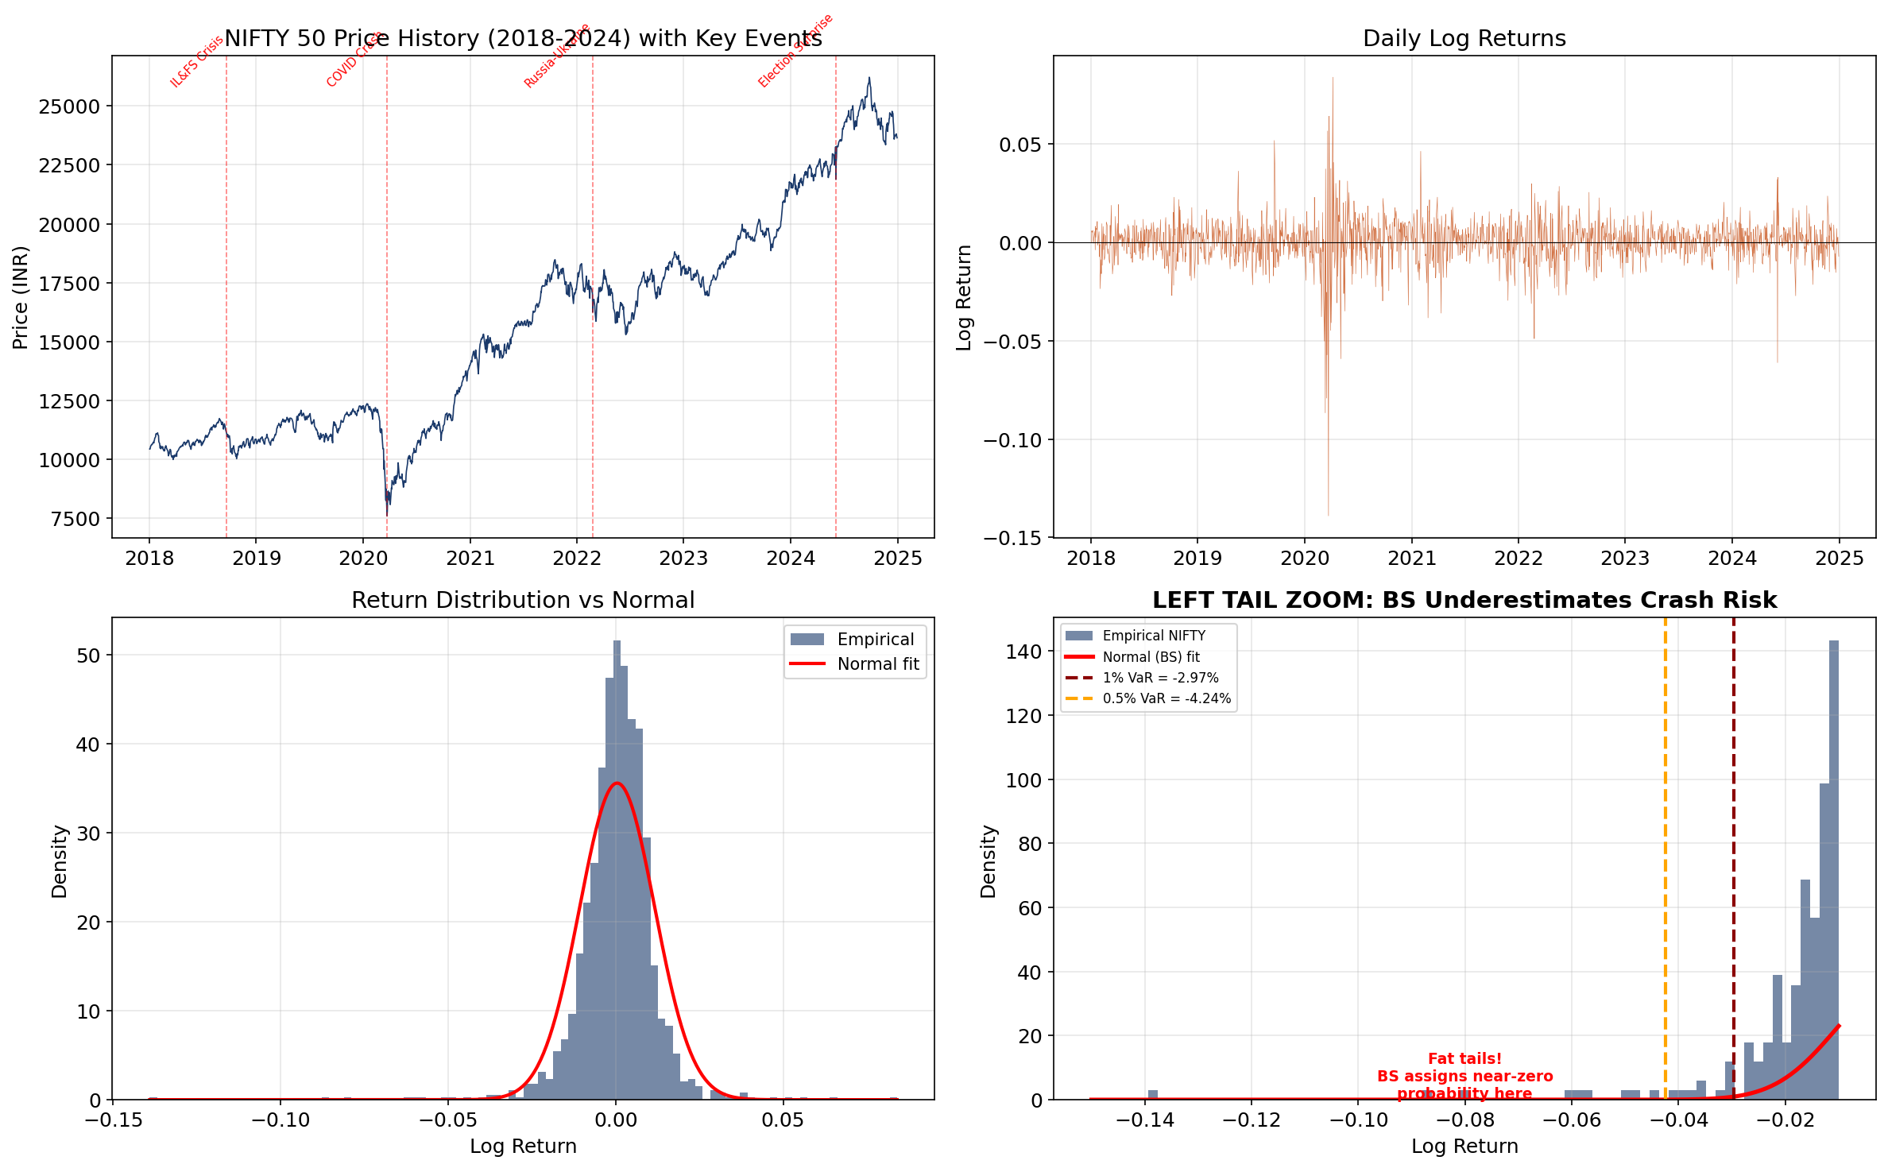
2. Data: NIFTY 50 (Jan 2018 – Dec 2024)
Source: Yahoo Finance (^NSEI) via yfinance | Risk-free rate: RBI repo rate ≈ 6.5%
Empirical return distribution shows negative skewness and excess kurtosis — fat tails that BS ignores

Slide 5
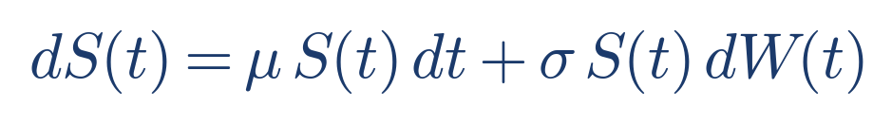
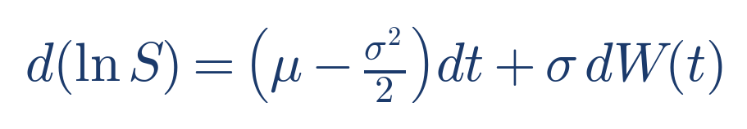
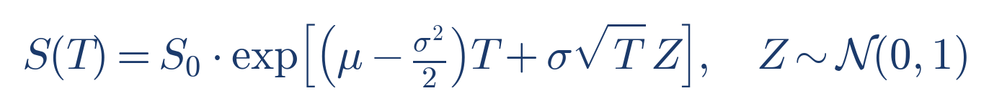
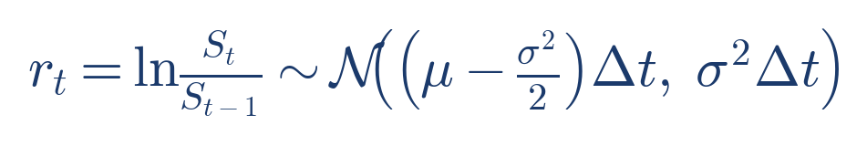
3. Black-Scholes Model — Theory
GBM SDE → log‑price SDE via Itô’s lemma.
Solution gives log‑normal terminal distribution; daily log‑returns Gaussian with mean (μ−σ²/2)Δt.
These expressions feed directly into the MLE and Monte Carlo estimator.
[BS73] Black & Scholes (1973), [Aït‑Sa02] Aït‑Sahalia (2002).

Slide 6
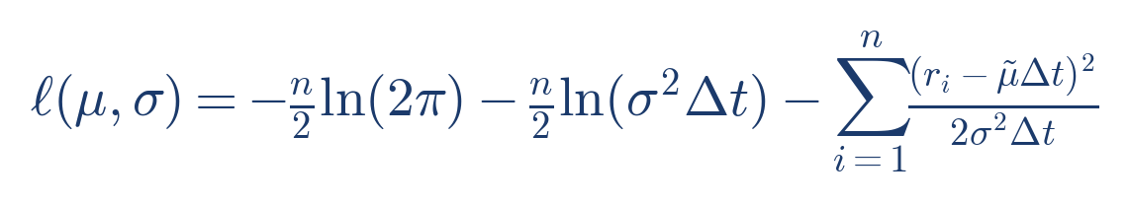
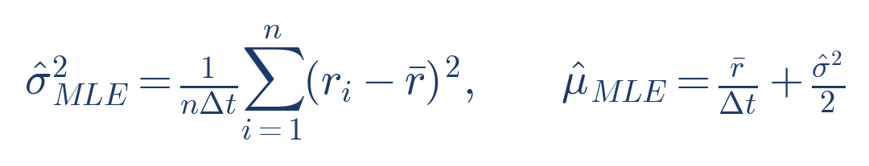
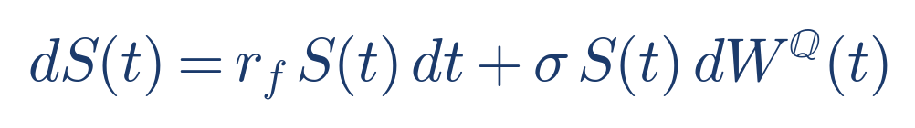
3. Black-Scholes — Maximum Likelihood Estimation
Under discretely observed GBM, log‑returns are i.i.d. Gaussian ⇒ closed‑form MLE for (μ,σ).
We still use numerical optimisation (Nelder–Mead) to match the framework used later for MJD.
Risk‑neutral drift replaces μ by r_f, but the volatility estimate σ̂_MLE is carried into pricing.
This slide is where you can explicitly mention numerical values of μ̂ and σ̂ from the code output.

Slide 7
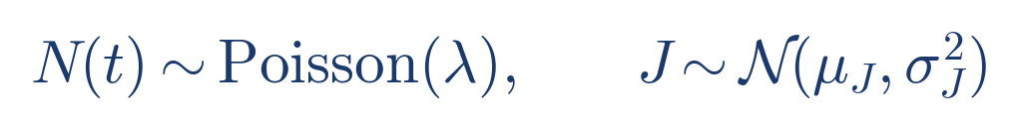
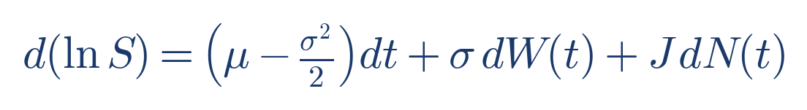
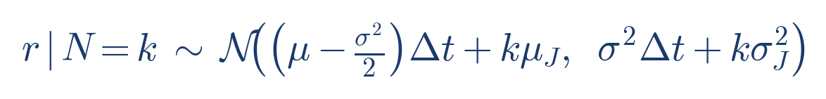
4. Merton Jump-Diffusion — SDE & Log-Return
Jump term S(t−)(e^J − 1)dN(t) superimposes compound Poisson jumps on GBM.
Applying Itô for jump–diffusions gives d(ln S) with an extra J dN(t) term.
Conditioning on N=k jumps → Gaussian with shifted mean/variance;
marginalising over k gives a Poisson‑weighted Gaussian mixture.
[Me76] Merton (1976), [CT04] Cont & Tankov (2004).

Slide 8
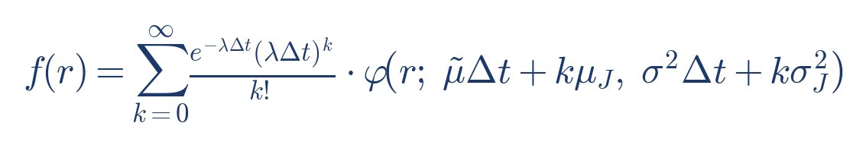
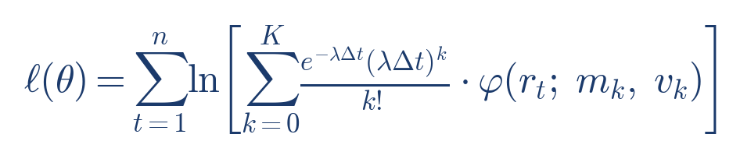
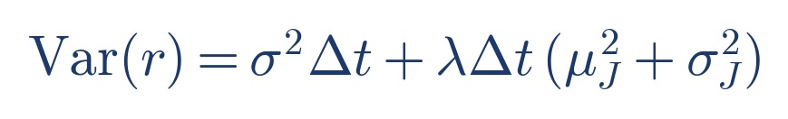
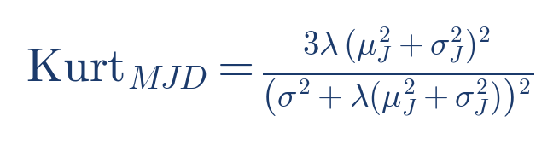
4. Merton Jump-Diffusion — Likelihood & Moments
Log‑likelihood is a sum of log Gaussian‑mixture densities evaluated at NIFTY log‑returns.
We maximise ℓ(θ) numerically (L‑BFGS‑B) over θ = (μ, σ, λ, μ_J, σ_J).
Variance decomposition highlights the role of λ(μ_J²+σ_J²) term in generating fat tails.
Closed‑form excess kurtosis shows MJD can match empirical kurtosis where BS cannot.

Slide 9
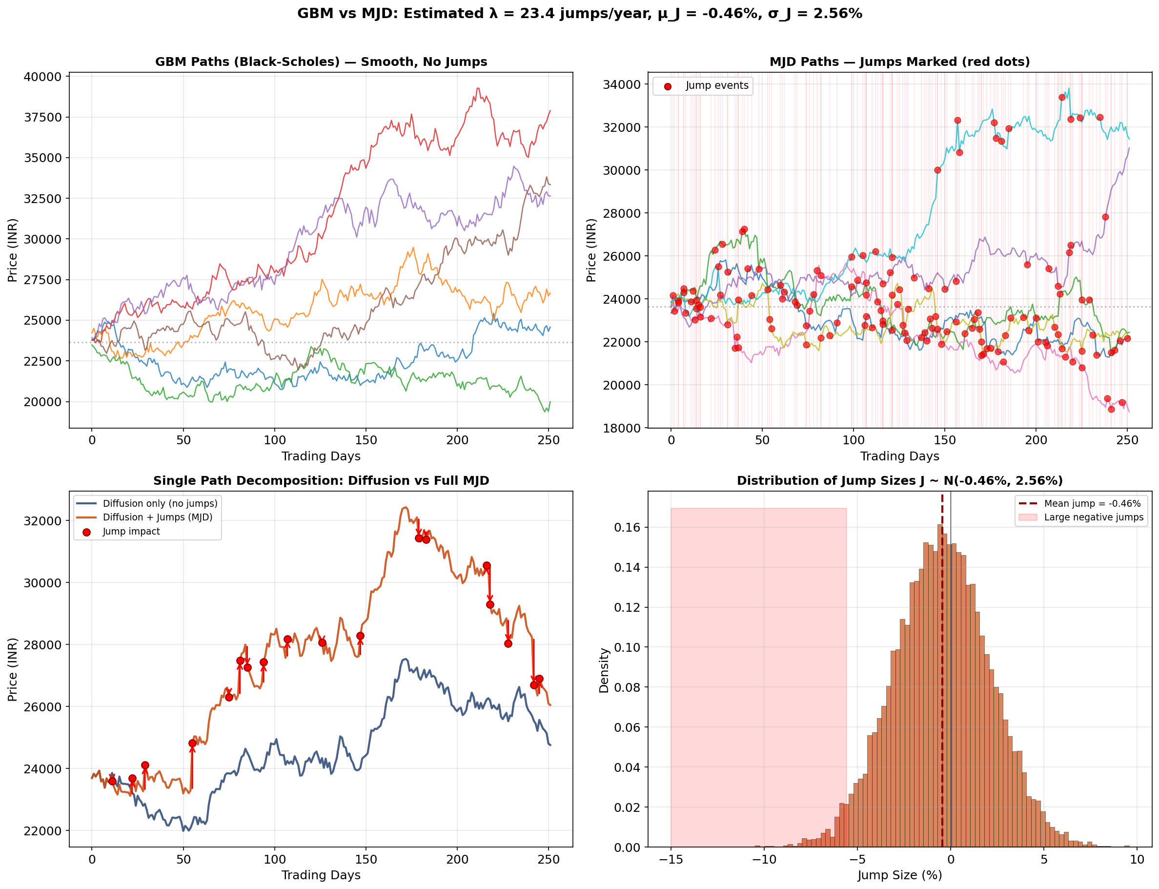
4. GBM vs MJD — Sample Price Paths
Top row: GBM paths are smooth; MJD paths show red vertical lines and dots at jump times.
Bottom‑left: single‑path decomposition — diffusion only vs diffusion+jumps; arrows show discrete jumps.
Bottom‑right: histogram of jump sizes J ~ N(μ_J, σ_J²); most jumps are small but frequent (λ≈23/year).

Slide 10
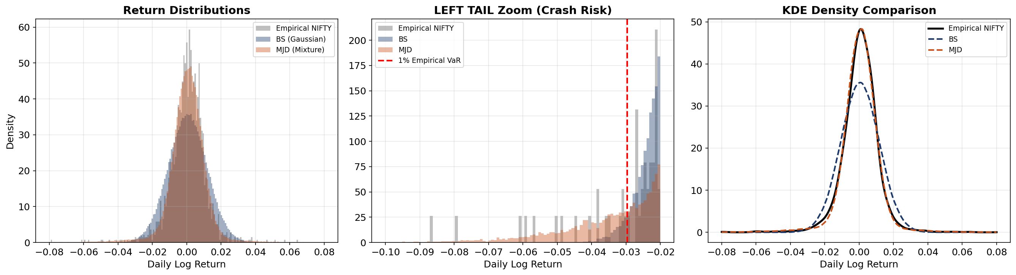
5. Tail Behavior — BS vs MJD vs Empirical
MJD's Gaussian mixture captures fat tails; BS (pure Gaussian) dramatically underestimates extreme returns.
Excess kurtosis: BS = 0 (by definition), MJD = 3λ(μ_J² + σ_J²)² / σ⁴ > 0, Empirical NIFTY >> 0

Slide 11
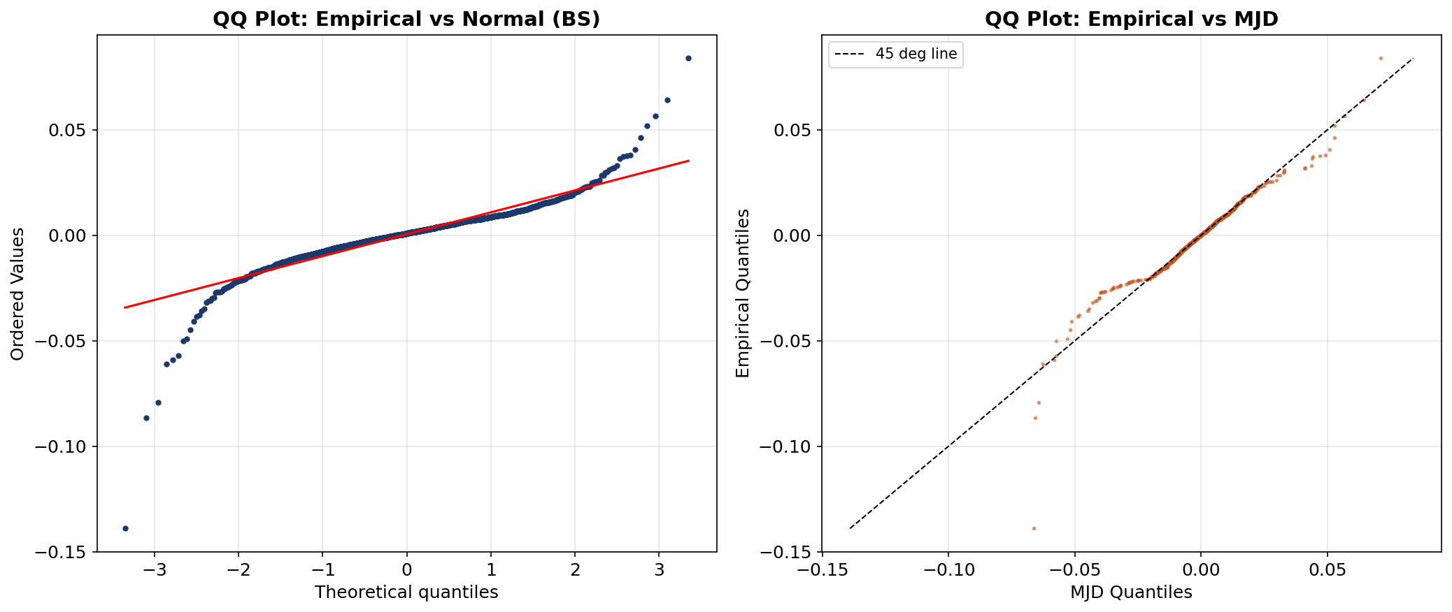
5. QQ Plots — Quantile Diagnostic
QQ vs Normal: heavy-tailed departure from 45° line at extremes → BS misfit.
QQ vs MJD: better alignment in tails → MJD captures empirical quantile structure of NIFTY 50.

Slide 12
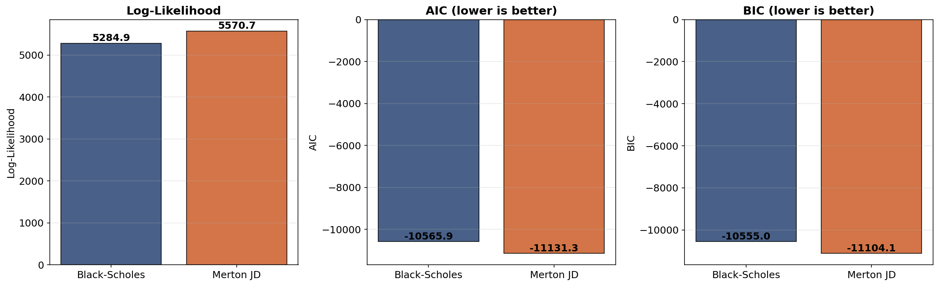
6. Statistical Model Selection
Likelihood Ratio Test: LRT = 2[ℓ(MJD) − ℓ(BS)] ~ χ²(3) under H₀: λ=0
AIC = 2k − 2ℓ, BIC = k·ln(n) − 2ℓ — penalize complexity; MJD overcomes penalty
[Aït-Ja07] Aït-Sahalia & Jacod (2007). Annals of Statistics, 35(1), 355-392.

Slide 13
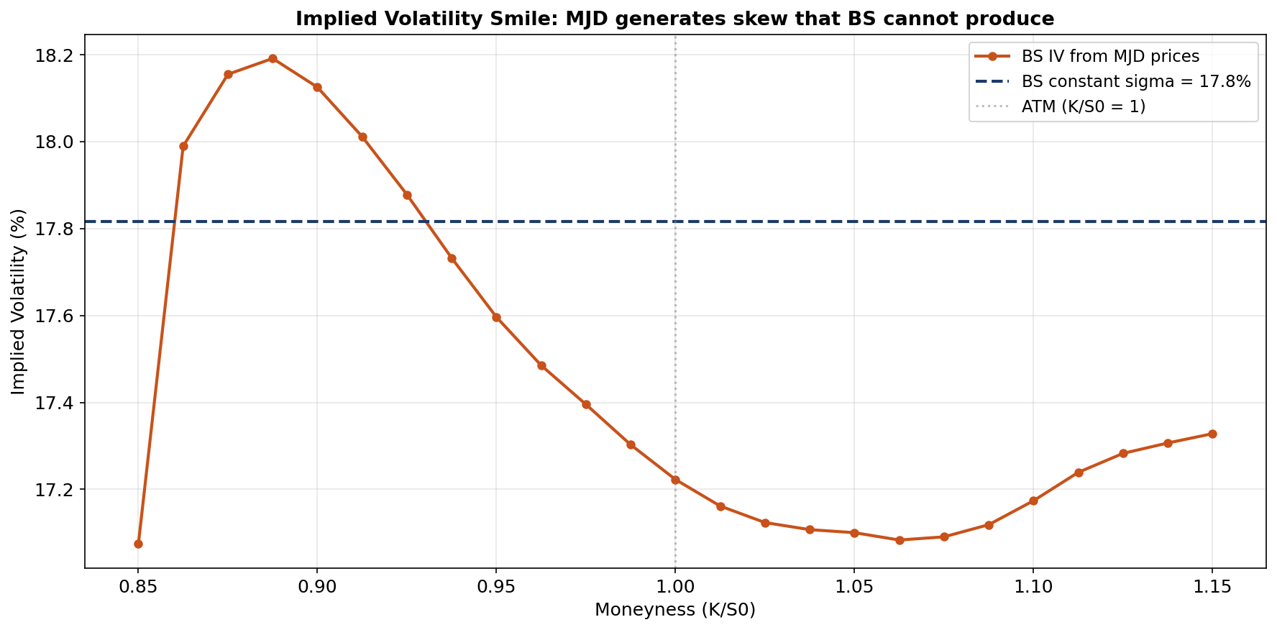
5. Implied Volatility Smile
BS produces flat IV by construction; MJD generates the "smile" / skew observed in NIFTY option markets.
This is the classical smile inconsistency — documented by Rubinstein (1994) [Ru94].

Slide 14
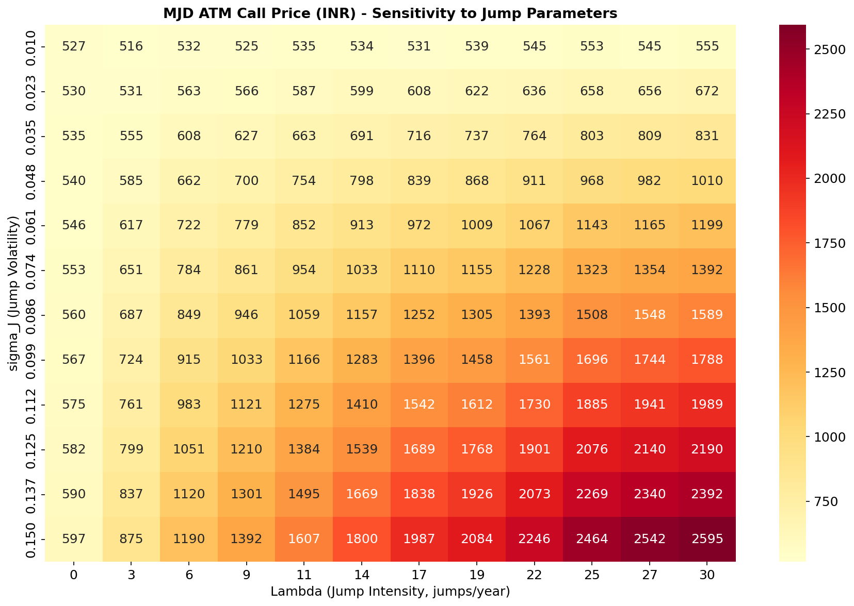
5. MJD Parameter Sensitivity
Non-linear interaction between λ (jump intensity) and σ_J (jump volatility) — unavailable in BS world.
Higher λ and σ_J → substantially higher option prices, reflecting crash risk premium.

Slide 15
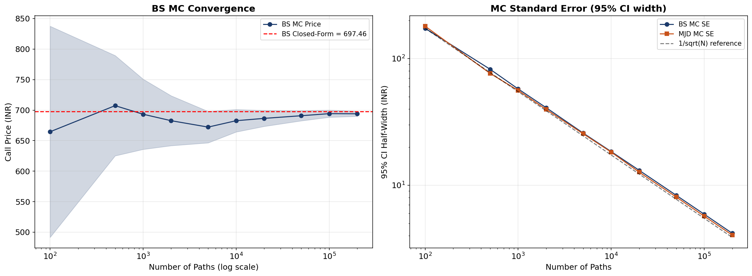
5. Monte Carlo Convergence
MC price → closed-form as N→∞, confirming 1/√N convergence rate (CLT).
Standard error comparison validates implementation correctness [Glasserman (2003)].

Slide 16
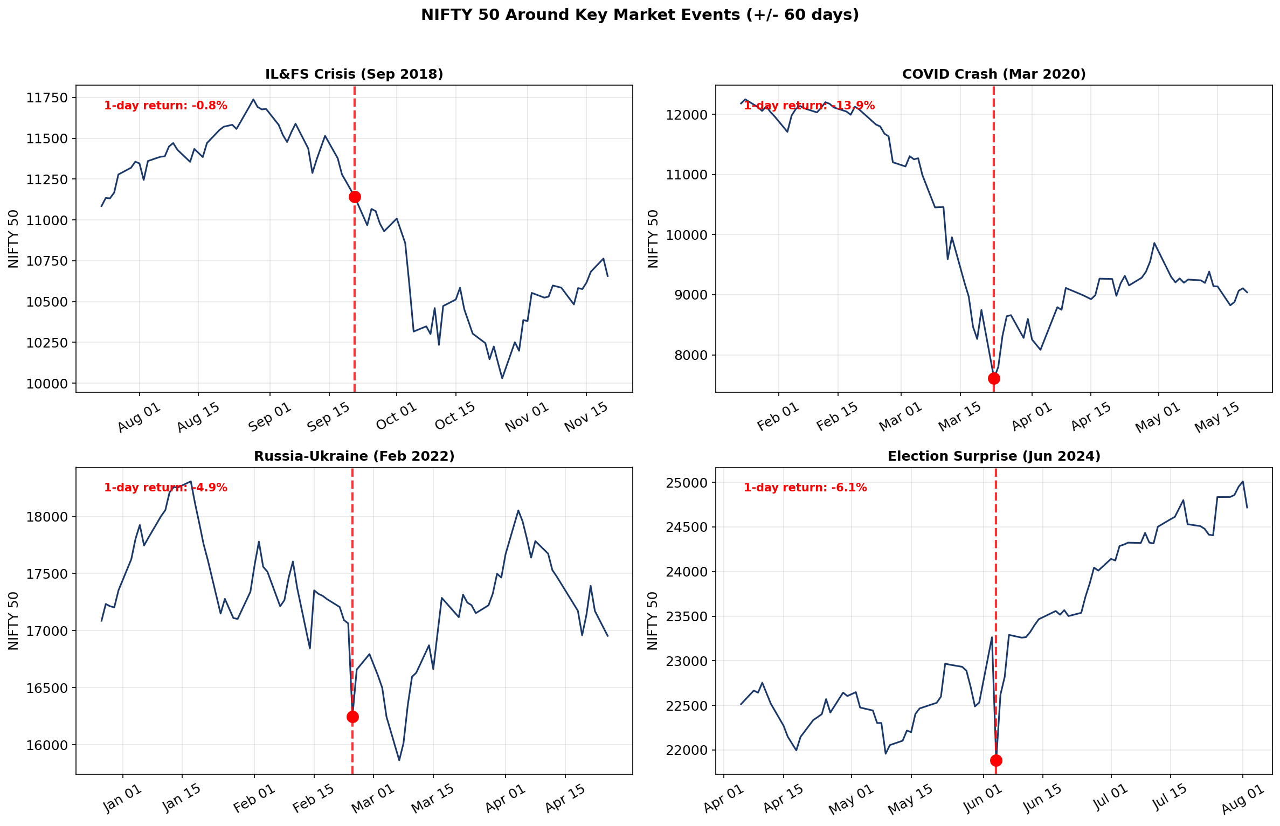
5. Indian Market Event Analysis
Key events: IL&FS crisis (Sep 2018), COVID crash (Mar 2020), Russia-Ukraine (Feb 2022), Election (Jun 2024)
BS assigns near-zero probability to such moves; MJD jump parameters capture this crash risk.

Slide 17
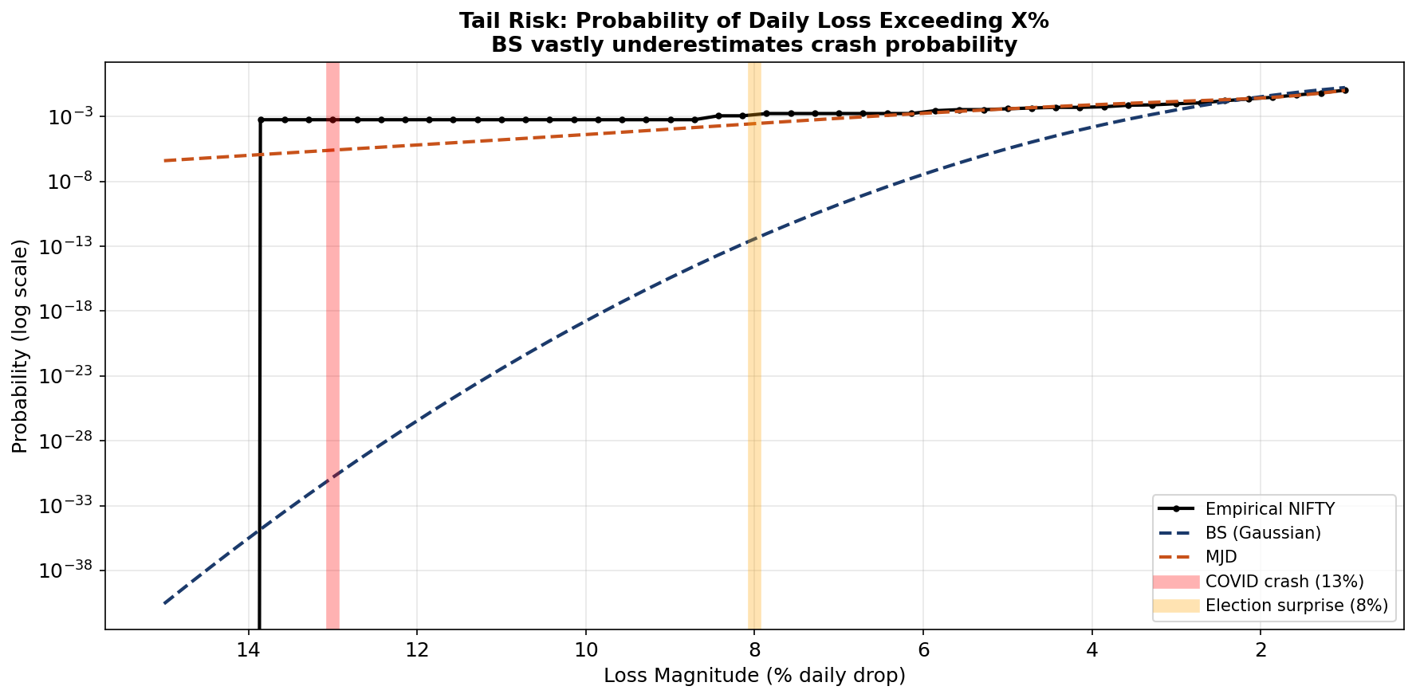
5. Tail Risk: Crash Probability
BS vastly underestimates the probability of large daily losses — a critical failure for risk management.
MJD provides realistic tail probabilities closer to empirical NIFTY returns, essential under SEBI regulations.

Slide 18
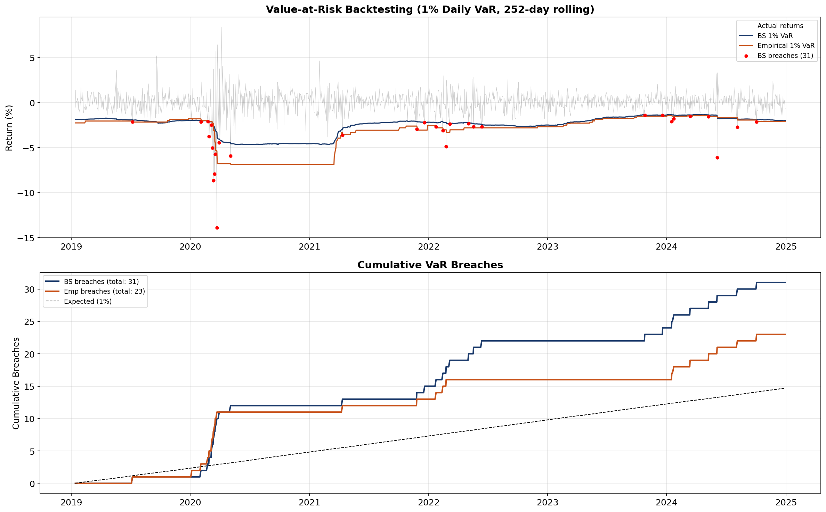
5. Value-at-Risk Backtesting
1% VaR breaches under BS Gaussian model exceed expected rate — BS fails Kupiec test.
Empirical VaR (from historical quantiles, analogous to MJD) stays closer to 1% expected rate.

Slide 19
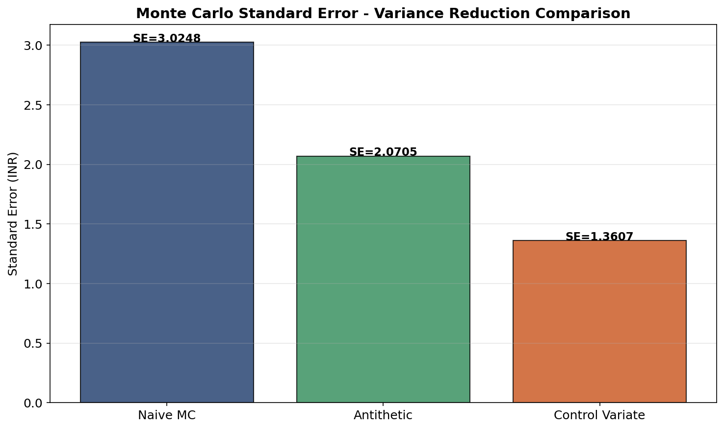
5. Variance Reduction Techniques
Antithetic variates: pair (Z, −Z) → roughly halves variance for smooth payoffs.
Control variate: use BS closed-form as control for MJD MC → 30-70% SE reduction near ATM.
[Gl03] Glasserman, P. (2003). Monte Carlo Methods in Financial Engineering. Springer.

Slide 20
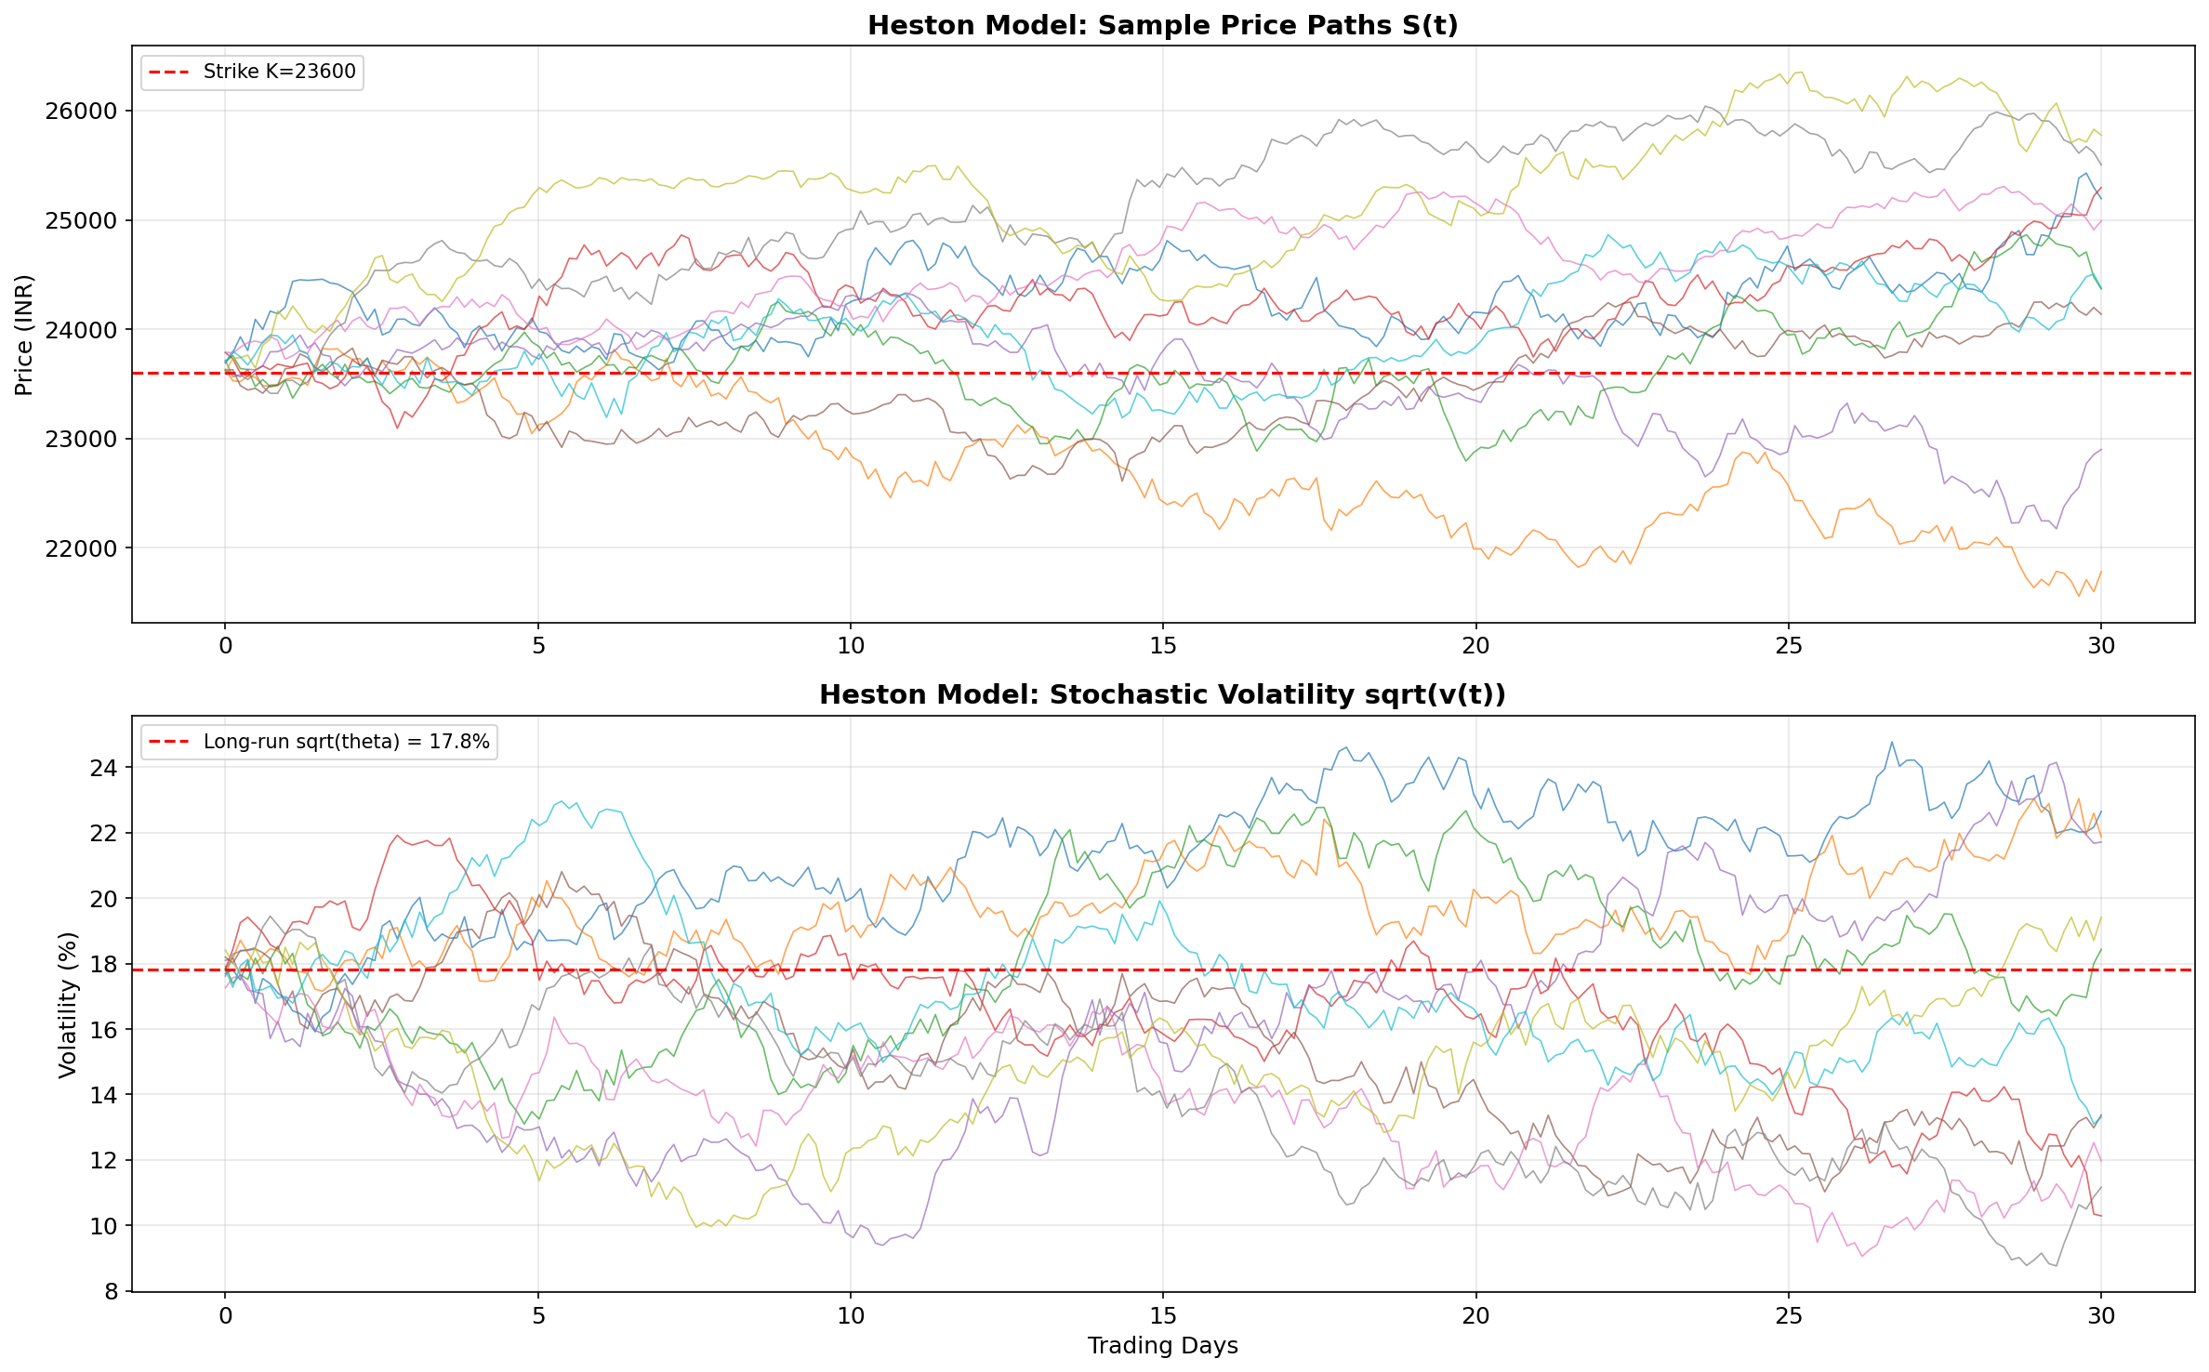
7. End-Term: Heston Stochastic Volatility
Heston (1993) — variance v(t) follows CIR process:
dS(t) = r_f S(t) dt + √v(t) S(t) dW_S^Q(t)
dv(t) = κ[θ − v(t)] dt + ξ √v(t) dW_v^Q(t)
Corr(dW_S, dW_v) = ρ dt (leverage effect: ρ < 0)
Parameters: κ (mean-reversion), θ (long-run var), ξ (vol-of-vol), ρ (correlation), v₀
Feller condition: 2κθ > ξ² ensures v(t) > 0
Produces full implied volatility smile & term structure
Semi-analytic pricing via Fourier inversion [Carr-Madan (1999)]
[He93] Heston, S.L. (1993). Review of Financial Studies, 6(2), 327-343.

Slide 21
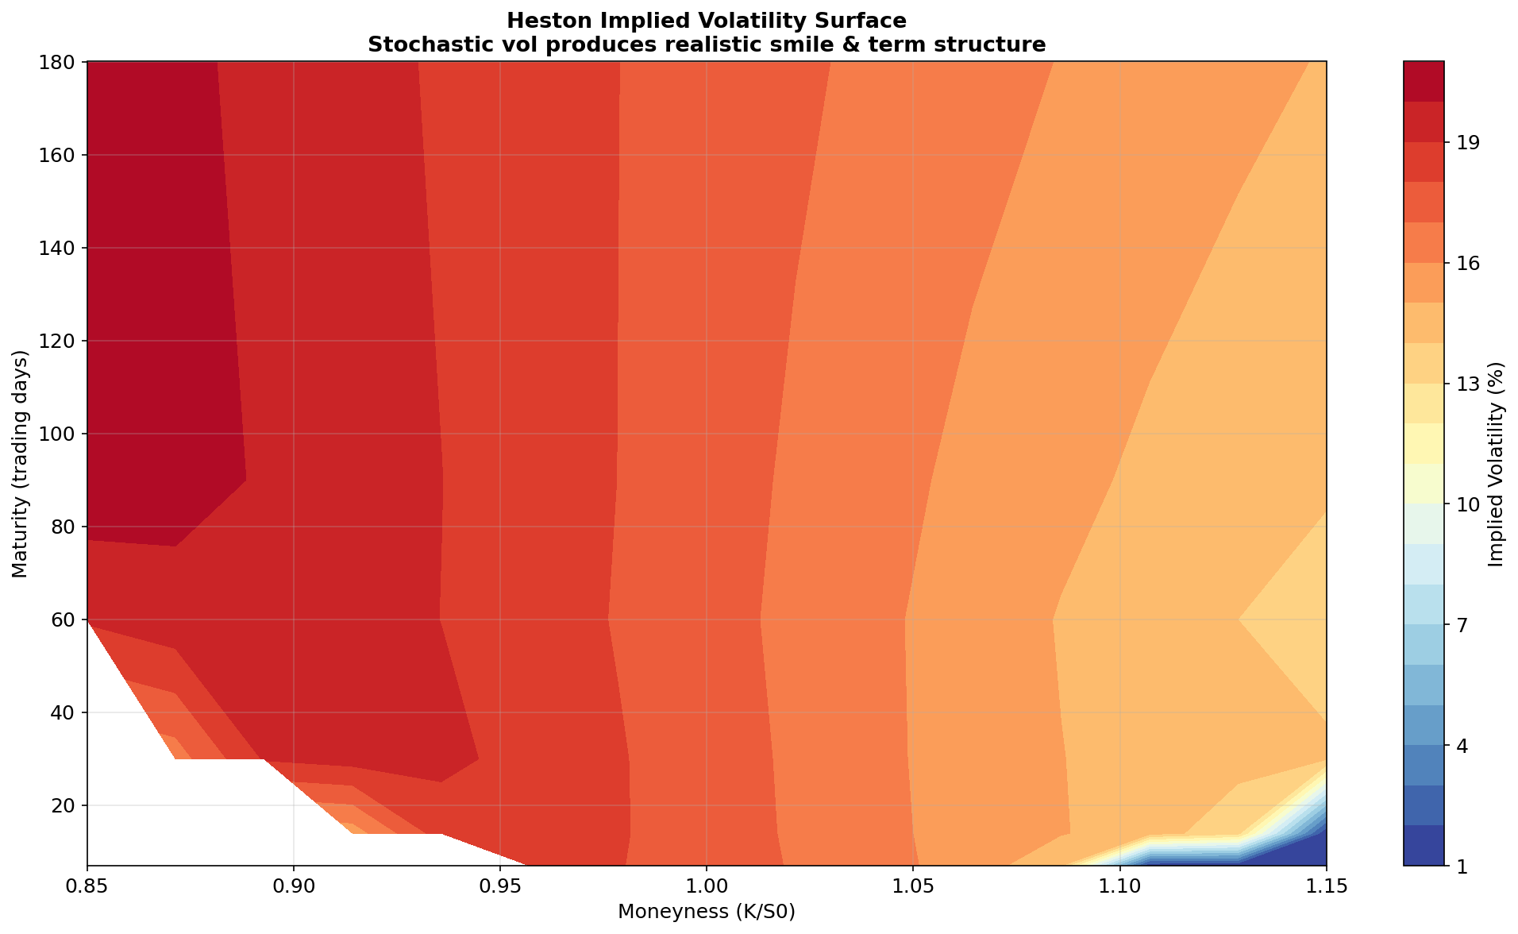
7. Heston Implied Volatility Surface
Stochastic volatility produces realistic IV smile & term structure — flat BS surface is a special case.
Negative ρ (leverage effect) creates the asymmetric skew observed in NIFTY index options.

Slide 22
8. Connection to Supervisor's Research
The CIR variance process √v(t) has non-globally-Lipschitz coefficients.
Standard Euler-Maruyama can produce negative variance — numerical instability.
Prof. Chaman Kumar's research directly addresses this:
• Tamed Euler scheme for Lévy-driven SDEs
[DKS16] Dareiotis, Kumar & Sabanis (2016). SIAM J. Numer. Anal., 54(3). IF: 2.712
• Explicit tamed Milstein for super-linear diffusion coefficients
[KS17a] Kumar & Sabanis (2017). Electronic J. Probability, 22, 1-19. IF: 1.123
• Milstein scheme for Lévy SDEs with super-linear coefficients
[K20] Kumar (2020). DCDS-B. DOI: 10.3934/dcdsb.2020167
• Tamed Milstein for SDEs with Markovian switching
[KK20] Kumar & Kumar (2020). J. Comp. Appl. Math., 377. IF: 2.037
• McKean-Vlasov equations — future scope for mean-field option markets
[KNRS20] Kumar, Neelima, Reisinger & Stockinger (2020). arXiv:2006.00463

Slide 23
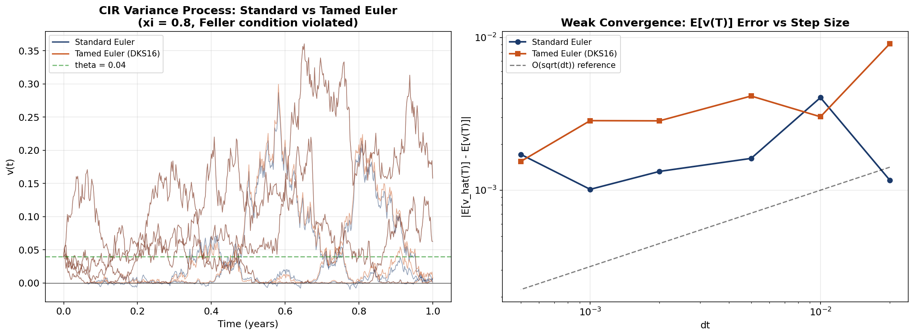
8. Tamed Euler — Numerical Comparison
Standard Euler produces negative variance excursions; Tamed Euler (DKS16) maintains positivity.
Convergence rate: slope ≈ 0.5 (Euler) confirmed — matches theoretical rates from cited papers.

Slide 24
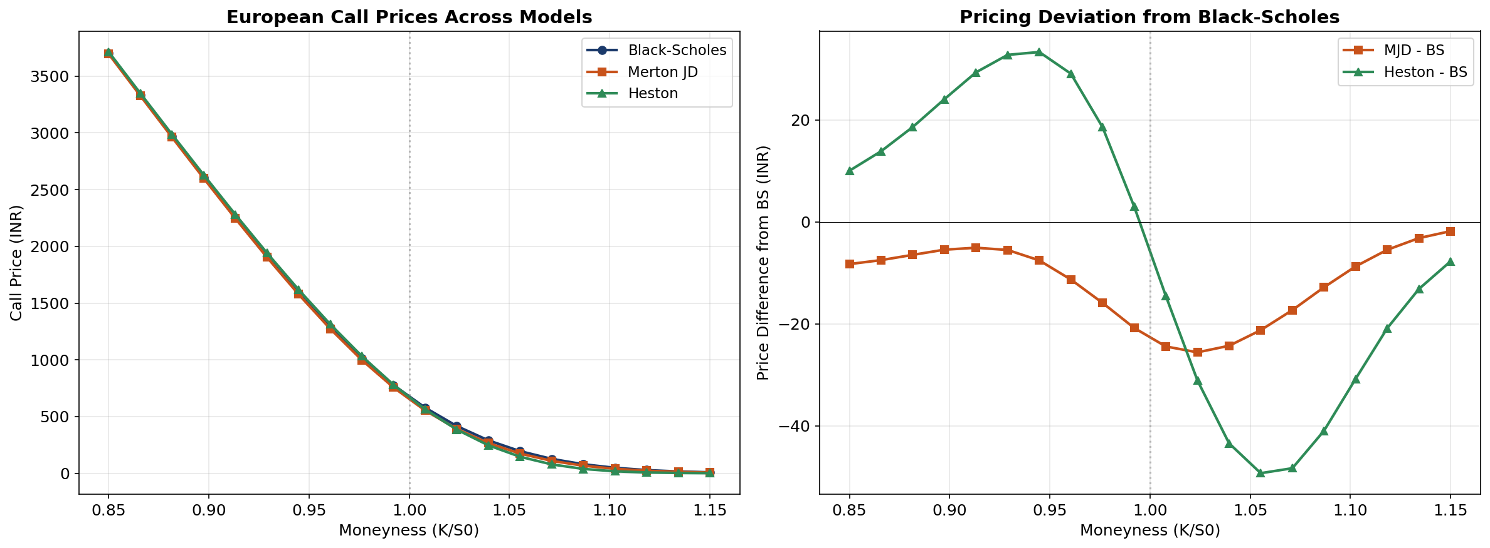
5. Option Prices — All Models Compared
MJD prices diverge from BS for OTM options (fat tails); Heston captures smile-driven deviation.
Bates (Heston + Jumps) will combine both effects — the most flexible model in this study.

Slide 25
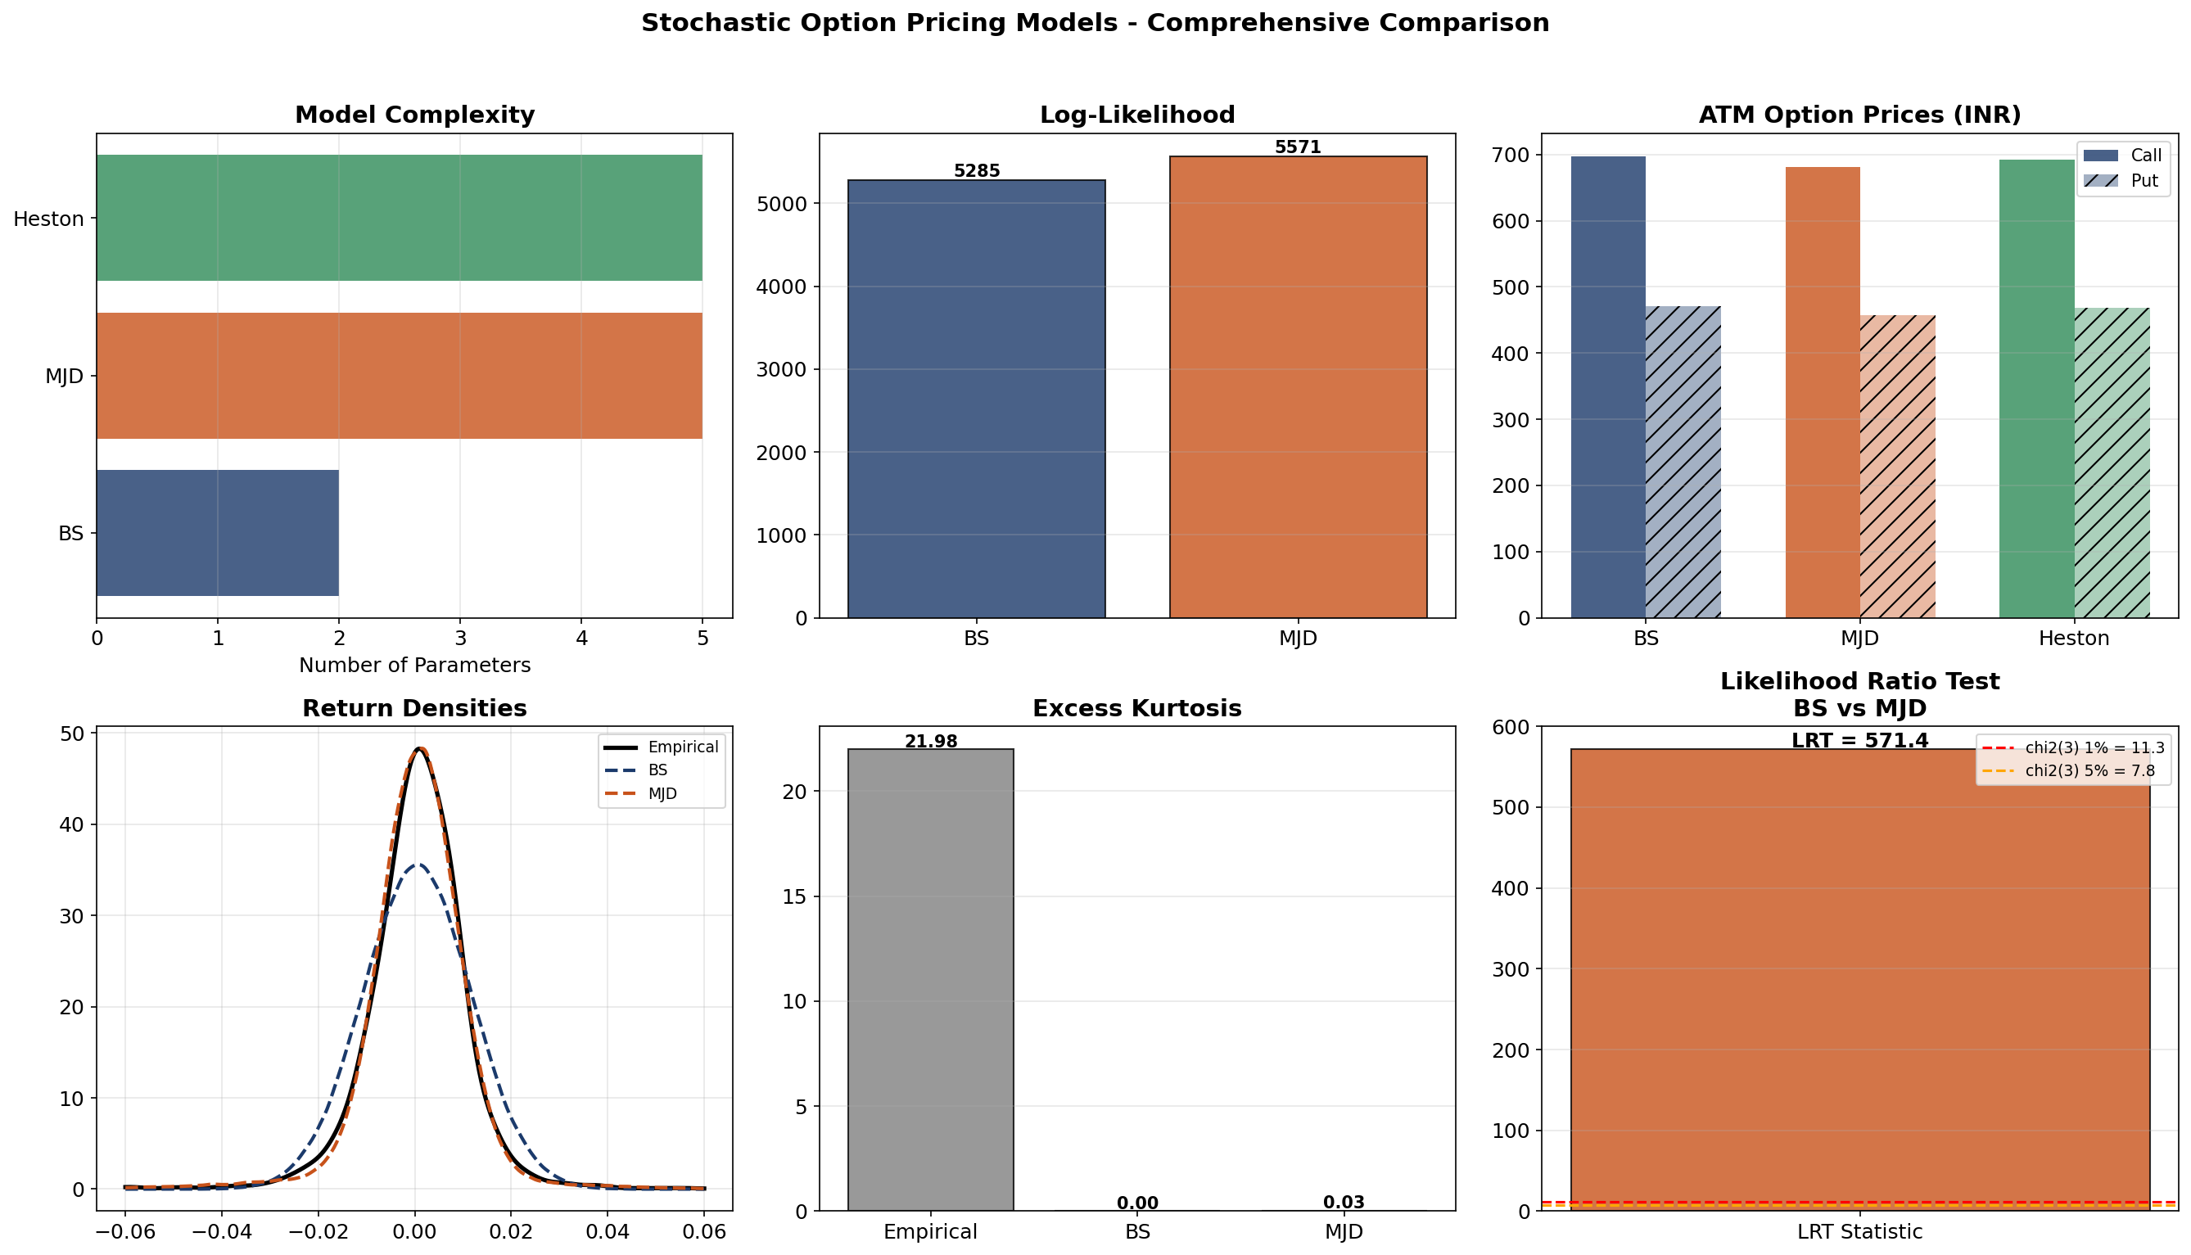
Summary — Comprehensive Comparison

Slide 26
Model Comparison Summary
Feature | Black-Scholes | Merton JD | Heston | Bates
SDE type | GBM | GBM + Poisson | GBM + CIR vol | GBM + CIR + Jumps
Parameters | 2 | 5 | 5 | 8
Return dist. | Gaussian | Mixture | Non-Gaussian | Non-Gaussian
Closed-form | Yes | Series approx. | Fourier | Fourier
Vol smile | No (flat IV) | Partial | Full smile | Full smile
Jumps | No | Yes | No | Yes
Extreme events | Poor | Good | Moderate | Best
Calibration | Analytic MLE | Numerical MLE | Option chain | Option chain

Slide 27
End-Term Evaluation Plan
Planned Deliverables:
1. Full Heston calibration to NIFTY option chain (3 maturities × 7 strikes)
2. Bates model (Heston + Jumps) — 8-parameter calibration
3. Comprehensive 4-model comparison:
• Option pricing RMSE on market prices
• Implied volatility smile fit across strikes & maturities
• 1% VaR backtesting on 2023-24 NIFTY data
4. Sensitivity analysis: Greeks (Δ, Γ, V) under each model
5. Statistical model selection: LRT (nested), AIC/BIC (non-nested)
6. Numerical methods: Tamed Euler vs Standard Euler convergence
for CIR process — connecting to Prof. Kumar's research
7. Future scope: McKean-Vlasov / mean-field game formulation
for multi-agent option markets [KNRS20]

Slide 28
References
Foundational Models:
[BS73] Black & Scholes (1973). J. Political Economy, 81(3), 637-654.
[Me76] Merton (1976). J. Financial Economics, 3(1-2), 125-144.
[He93] Heston (1993). Review of Financial Studies, 6(2), 327-343.
[Ba96] Bates (1996). Review of Financial Studies, 9(1), 69-107.
Statistical Methods:
[Aït-Sa02] Aït-Sahalia (2002). Econometrica, 70(1), 223-262.
[Aït-Ja07] Aït-Sahalia & Jacod (2007). Annals of Statistics, 35(1), 355-392.
[CT04] Cont & Tankov (2004). Financial Modelling with Jump Processes. CRC.
[Gl03] Glasserman (2003). MC Methods in Financial Engineering. Springer.
Supervisor's Research (Numerical SDE Methods):
[DKS16] Dareiotis, Kumar & Sabanis (2016). SIAM J. Numer. Anal., 54(3).
[KS17] Kumar & Sabanis (2017). Electr. J. Probability, 22, 1-19.
[KK20] Kumar & Kumar (2020). J. Comp. Appl. Math., 377, 112917.
[K20] Kumar (2020). DCDS-B. DOI: 10.3934/dcdsb.2020167.
[KNRS20] Kumar, Neelima, Reisinger & Stockinger (2020). arXiv:2006.00463.

Slide 29
Thank You
Comparative Study of Stochastic Models for Option Pricing in the Indian Stock Market
Under the supervision of Prof. Chaman Kumar
Department of Mathematics, IIT Roorkee
Questions?

