Slide 1
COMPARATIVE STUDY OF STOCHASTIC MODELS FOR OPTION PRICING
In the Indian Stock Market (NIFTY 50)
Black-Scholes → Merton Jump-Diffusion → Heston → Bates
Project Report | Mid-Term Evaluation | Academic Year 2025-26
Under the supervision of Prof. Chaman Kumar
Department of Mathematics, IIT Roorkee

Slide 2
Outline
1. Motivation: why option pricing needs better models
2. Data & Model Calibration (MLE on NIFTY returns)
3. Black–Scholes option pricing:
• GBM SDE → MLE → closed-form call/put → MC
4. Merton Jump–Diffusion option pricing:
• SDE with jumps → MLE → MC pricing
5. Option price comparison:
• Calls & puts across strikes
• OTM puts: where BS fails catastrophically
• Implied volatility smile
• Option pricing at crisis events
6. Statistical model selection (LRT, AIC/BIC)
7. Future work: Heston & Bates models

Slide 3
1. Why Option Pricing Needs Better Models
• NIFTY 50 index options are among the most actively traded contracts globally
• Practitioners use Black-Scholes to price & hedge — but it systematically misprices:
– Deep out-of-the-money (OTM) PUTS are underpriced → inadequate crash protection
– The "volatility smile" in market data contradicts BS flat-IV assumption
• Root cause: BS assumes Gaussian log-returns (thin tails + constant volatility)
→ assigns near-zero probability to large moves like COVID −13% day, election −8% gap
• This project: compare BS vs Merton Jump-Diffusion option prices on NIFTY 50
→ calibrate both models to historical data, then price European calls & puts
→ quantify how much BS underprices crash protection
• References: Black & Scholes (1973), Merton (1976)

Slide 4
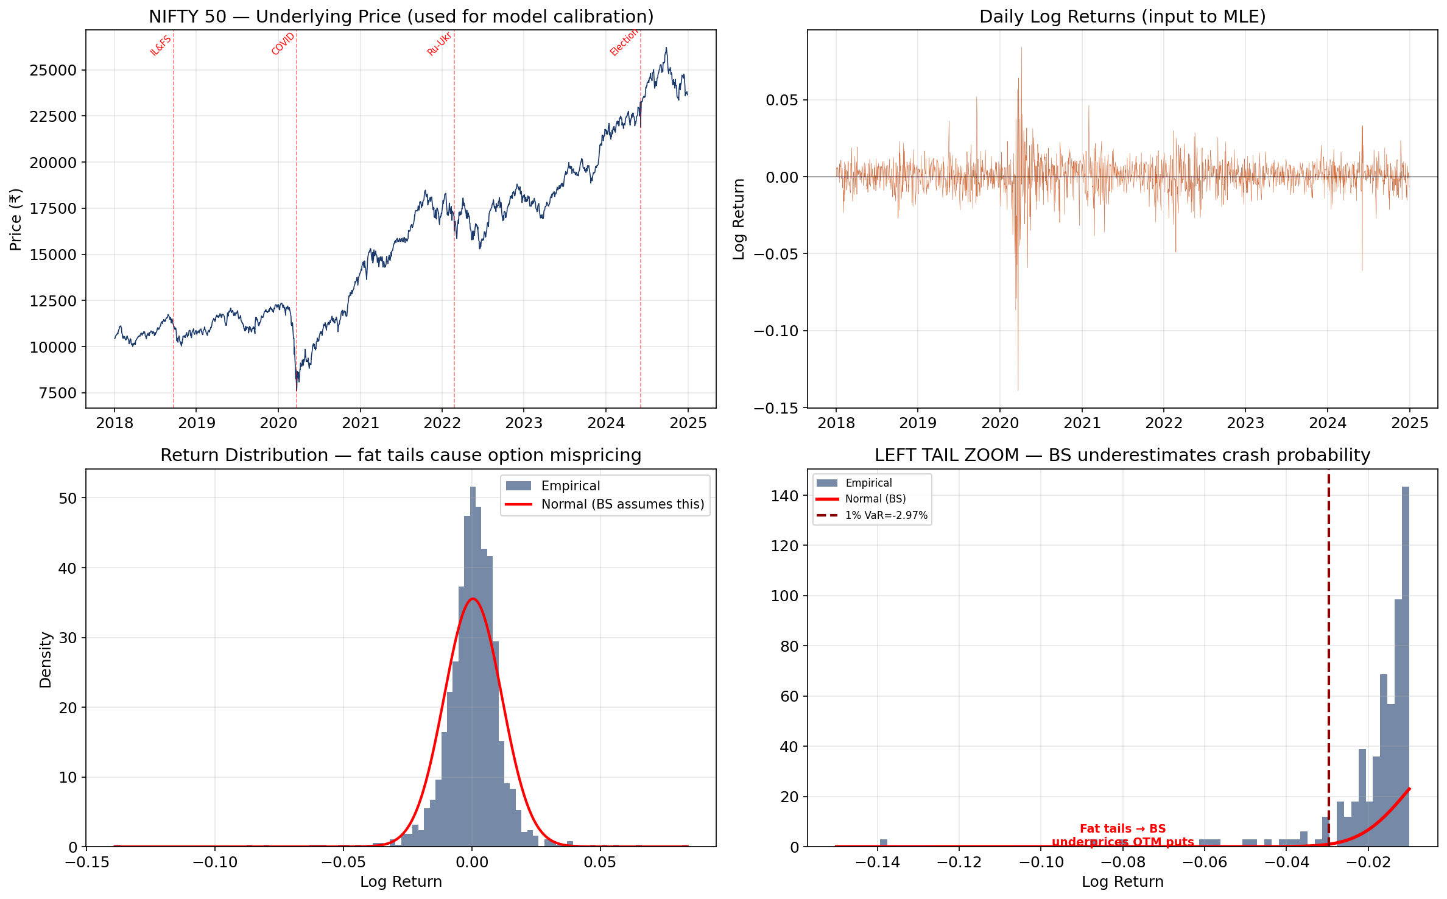
2. Calibration Data: NIFTY 50 (2018–2024)
NIFTY daily returns used to estimate model parameters via MLE. Left-tail zoom shows fat tails → BS underprices OTM puts.
Source: Yahoo Finance (^NSEI). Risk-free rate: RBI repo ≈ 6.5%

Slide 5
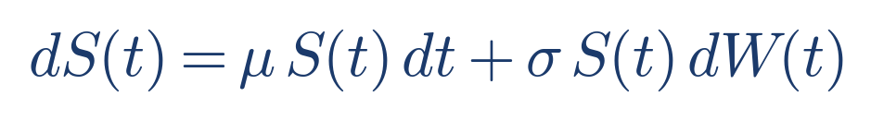
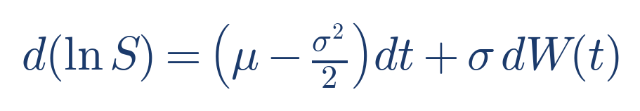
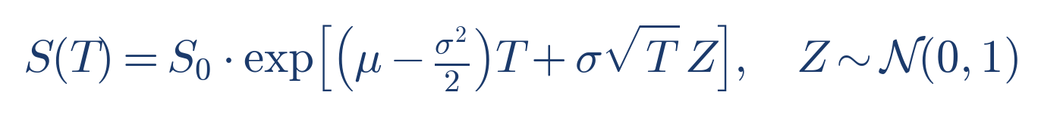
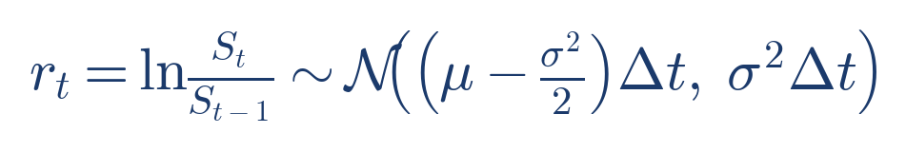
3. Black–Scholes: GBM SDE & Log-Price
GBM SDE → Itô's lemma gives the log-price SDE.
Integrating gives the log-normal terminal distribution S(T).
Daily log-returns are i.i.d. Gaussian — this is the model we fit via MLE.
The estimated σ̂ is then plugged into the BS option pricing formula.

Slide 6
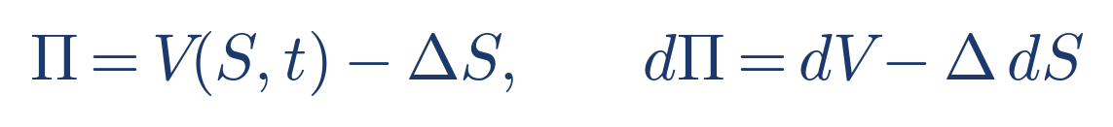
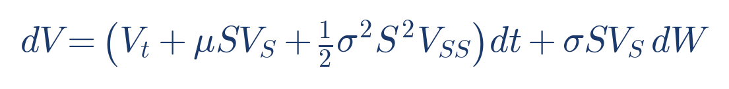

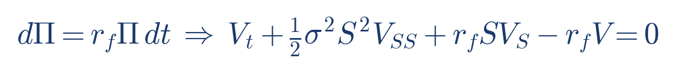
3. Black–Scholes PDE: Eliminating dW(t) via Delta Hedging (Proof)
Portfolio Π = long 1 option, short Δ shares.
Apply Itô to V(S,t); substitute dS = μSdt + σSdW.
Choose Δ = V_S ⇒ the random term cancels: dW disappears.
Crucial: μ cancels too ⇒ option price does NOT depend on expected stock return.
No-arbitrage: riskless Π must earn r_f ⇒ Black–Scholes PDE.
This is the key Nobel-Prize insight: dynamic replication → risk-neutral pricing.

Slide 7
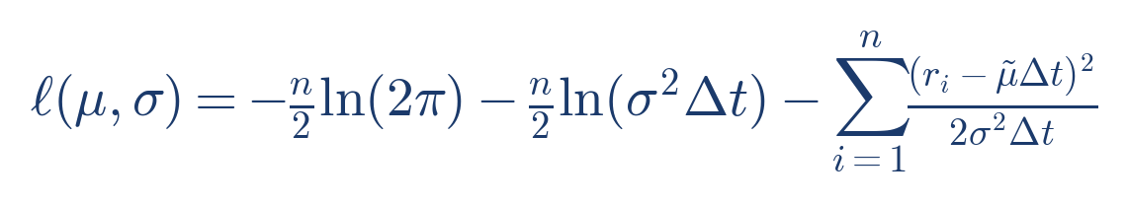
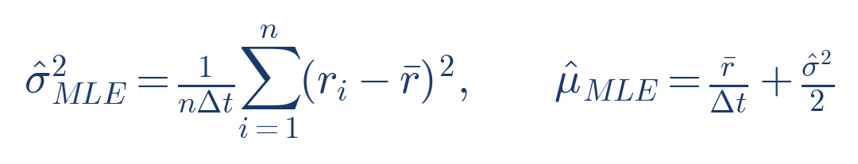
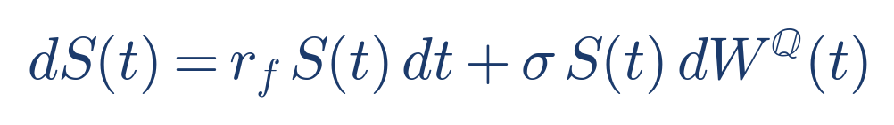
3. Black–Scholes: Maximum Likelihood Estimation
MLE on n daily NIFTY returns. Closed-form for σ̂² and μ̂ exists for GBM.
We use numerical optimisation (Nelder-Mead) for consistency with MJD estimation.
The key output for option pricing is σ̂ ≈ 17.8% (annualised).
For pricing: switch to risk-neutral measure Q. Drift becomes r_f, but σ stays the same.

Slide 8
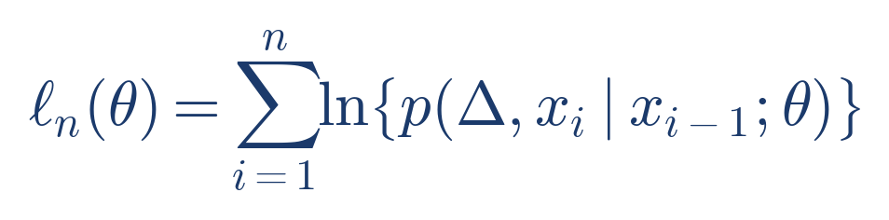
3.1 MLE for Discretely Sampled SDEs (Why it is hard)
Discrete data: X_{t_i} observed at fixed Δ (e.g., daily).
Exact MLE needs the transition density p(Δ, x_i | x_{i−1}; θ).
For most nonlinear SDEs this density is NOT available in closed form.
Aït-Sahalia’s key statement (Econometrica): for discretely sampled diffusions,
“the transition distribution and hence the likelihood … is not explicitly computable” in most cases,
so he constructs a convergent closed-form approximation using Hermite polynomials. [AS02]
Iacus (Springer book) formalizes the “fixed-Δ” scheme and emphasizes that with discrete-time observations
the likelihood is “almost always unavailable in explicit form,” motivating pseudo/approximated likelihoods. [Iac08]

Slide 9
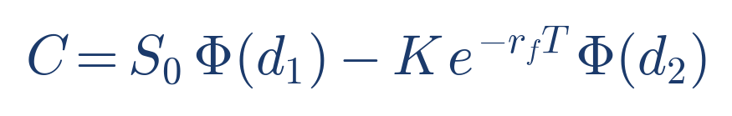
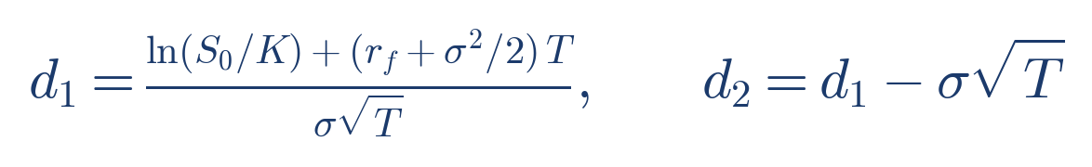
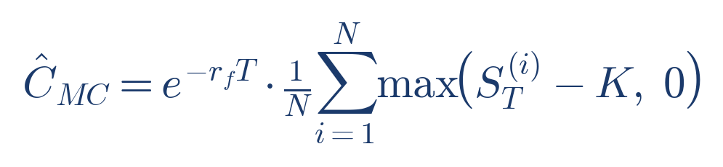
3. Black–Scholes: Closed-Form Option Prices
The celebrated BS formula gives exact European call (and put via put-call parity).
d₁ and d₂ encode moneyness, time to expiry, and volatility.
Monte Carlo estimator validates the closed-form: simulate N paths under Q, average discounted payoffs.
SE shrinks as 1/√N (CLT). [Glasserman, 2003]
Key limitation: σ is CONSTANT across all strikes and maturities → flat implied volatility surface.
→ In reality, NIFTY options trade with a pronounced volatility smile/skew. BS cannot reproduce this.

Slide 10
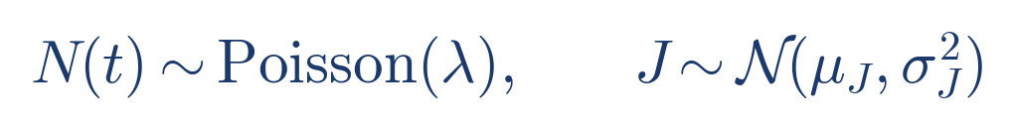
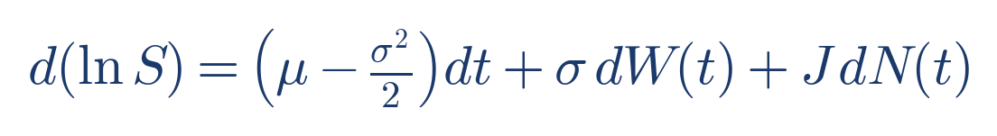
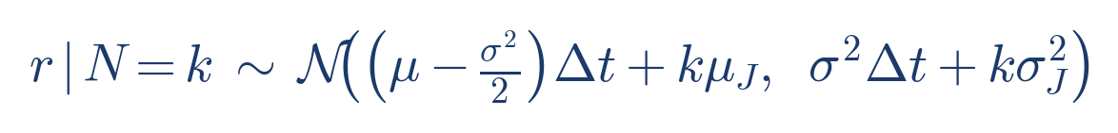
4. Merton Jump-Diffusion: SDE & Log-Return
Superimposes compound Poisson jumps on GBM — captures sudden dislocations.
Itô for jump-diffusions: extra J dN(t) term in log-price.
Conditional on k jumps: Gaussian with shifted mean & inflated variance.
This directly explains why MJD produces different option prices from BS.
[Me76] Merton (1976), [CT04] Cont & Tankov (2004).

Slide 11
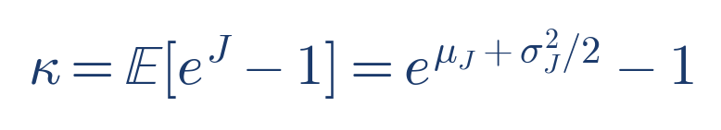
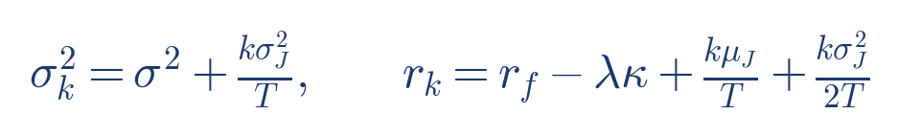
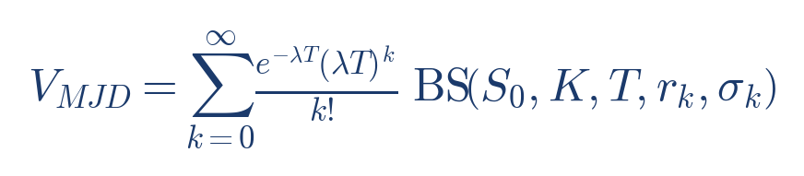
4. Merton JD Option Pricing: Risk-Neutral Compensator & Series (Proof)
Key arbitrage constraint: under Q, total expected growth (diffusion + expected jumps) must equal r_f.
Hence drift becomes (r_f − λκ). Conditional on k jumps, the terminal log-price is Gaussian ⇒ BS formula with modified (r_k, σ_k).
Final price is a Poisson-weighted average of BS prices across k. [Me76]

Slide 12
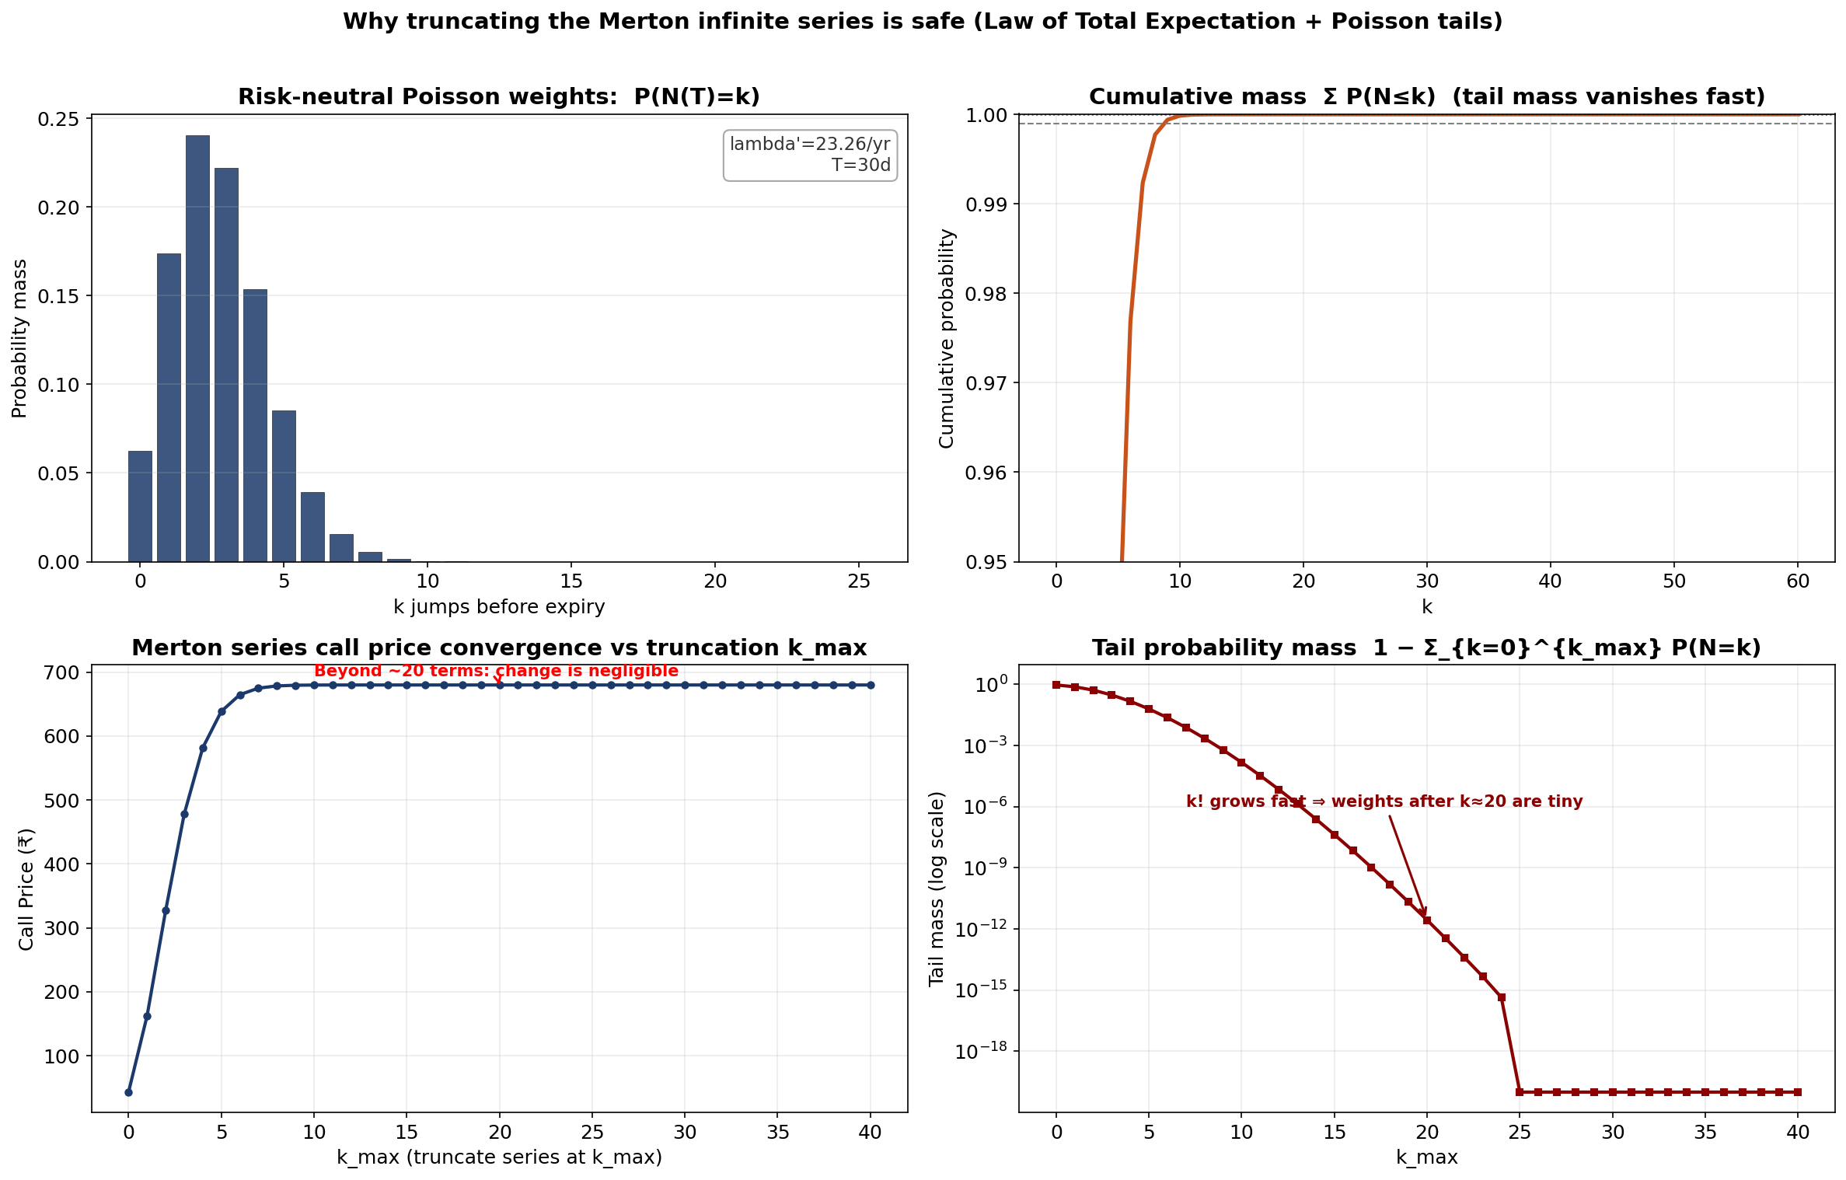
4.2 Why truncating the infinite series is safe (Visualization)
Poisson weights decay super-fast due to k! in the denominator ⇒ tail mass after k≈20 is negligible; price stabilizes.
This justifies truncating the Merton series in numerical implementations.

Slide 13
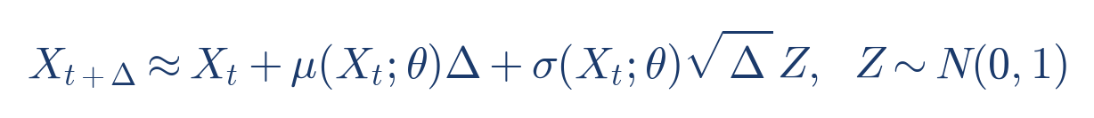
4.1 MLE in Practice: Exact vs Pseudo/Approximated Likelihood (Iacus)
Iacus (2008) classifies estimation under discrete observations into:
• Exact likelihood inference (when transition density is known, e.g., GBM/BS)
• Pseudo-likelihood methods (e.g., Euler Gaussian approximation)
• Approximated likelihood methods (Kessler, simulated likelihood, Hermite expansion)
Euler pseudo-likelihood uses the local Gaussian approximation over Δ:
this is the baseline idea behind many feasible estimators when p(Δ,·|·;θ) is unknown.
In our project:
• BS/GBM has an explicit Gaussian transition for log-returns ⇒ exact MLE is easy.
• MJD has a Poisson–Gaussian mixture transition ⇒ we maximize a (truncated) mixture log-likelihood numerically.
Reference: Iacus (2008), Chapter 3 (Parametric Estimation). [Iac08]

Slide 14
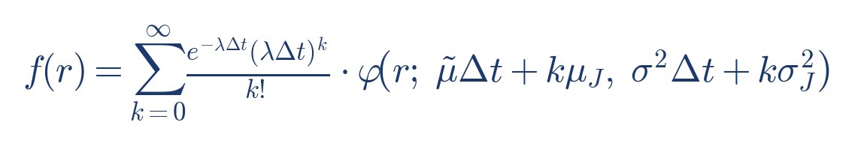
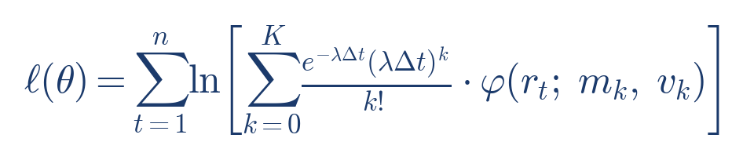
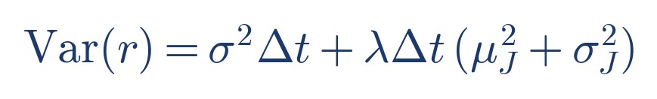
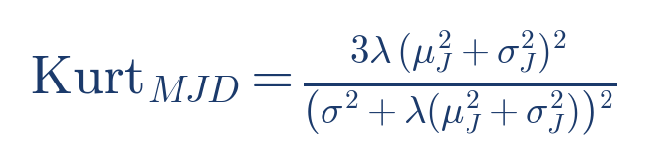
4. MJD: Likelihood & Excess Kurtosis
Log-likelihood = sum of log Gaussian-mixture densities.
Maximised numerically (L-BFGS-B) over θ = (μ,σ,λ,μ_J,σ_J).
Variance decomposition: jump component λ(μ_J²+σ_J²) adds kurtosis.
Excess kurtosis > 0 → fatter tails → higher OTM option prices.
This is the precise mechanism by which MJD prices puts higher than BS.

Slide 15
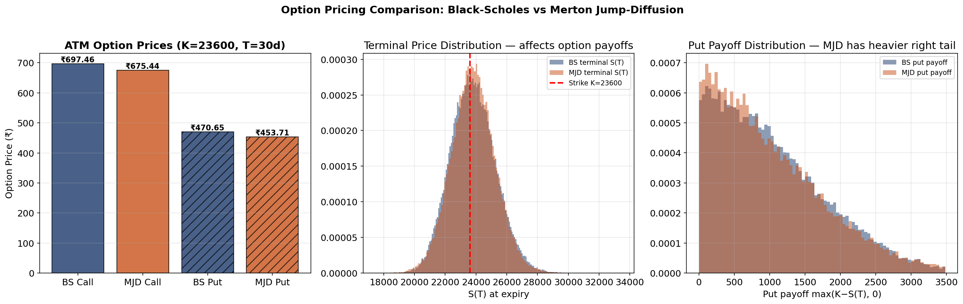
5. ATM Option Prices: BS vs MJD
Left: ATM call & put prices. Centre: terminal S(T) distributions — MJD has heavier tails.
Right: put payoff distribution — MJD assigns more weight to large payoffs (crash scenarios).

Slide 16
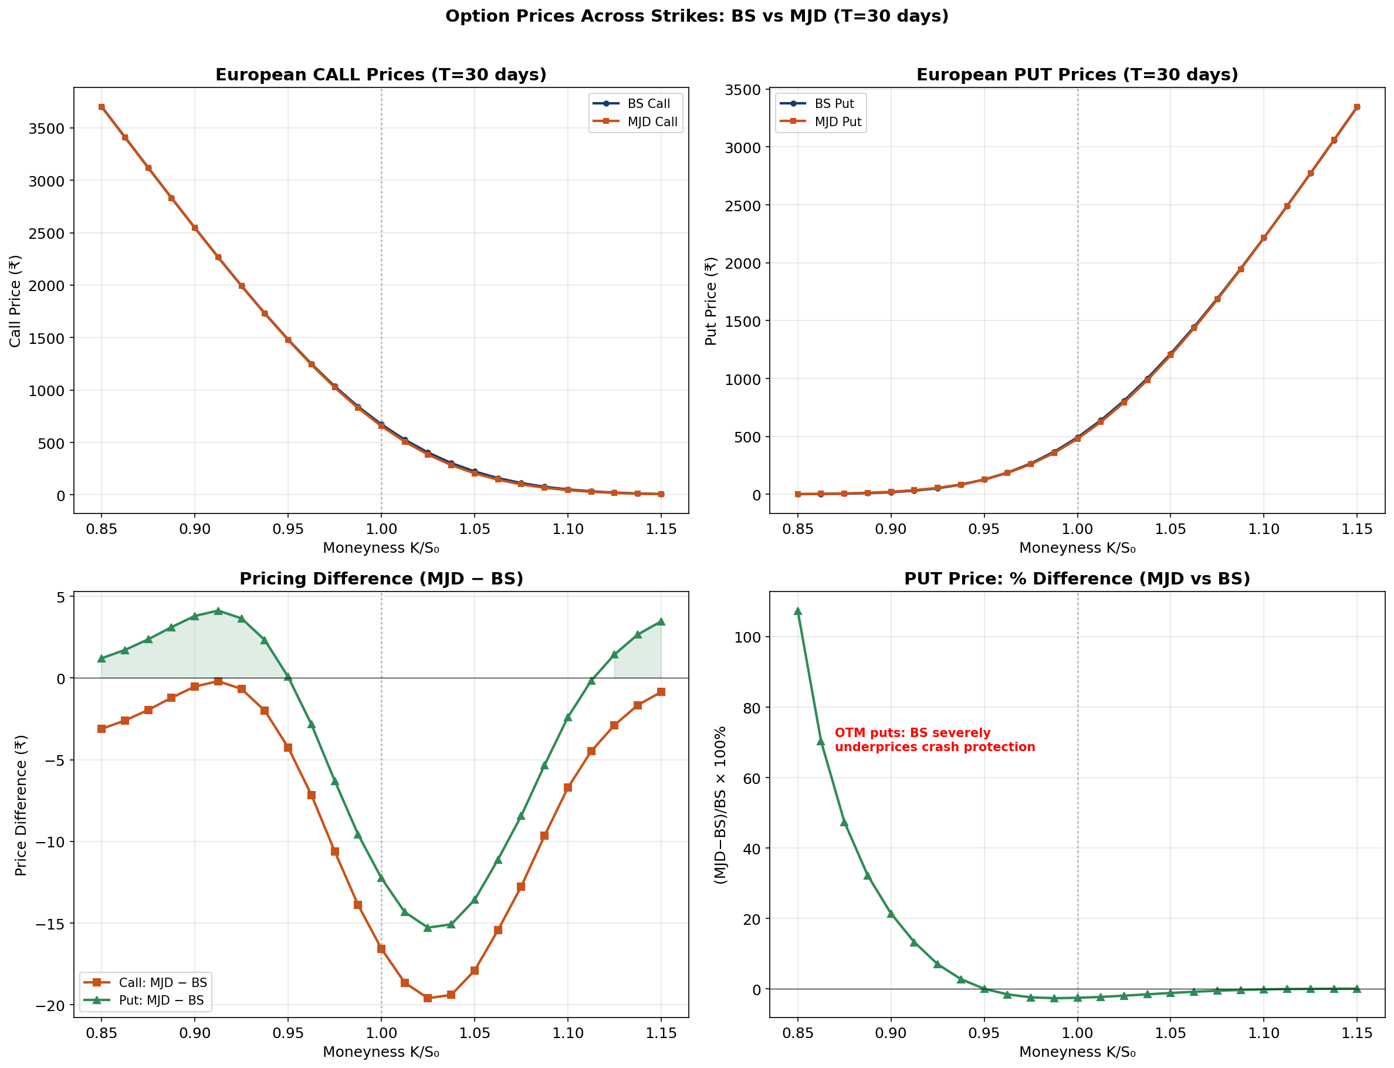
5. Option Prices Across Strikes
MJD puts are consistently more expensive than BS puts, especially for OTM puts (K/S₀ < 1).
Bottom-right: percentage difference shows BS can underprice OTM puts by 20-100%+.

Slide 17
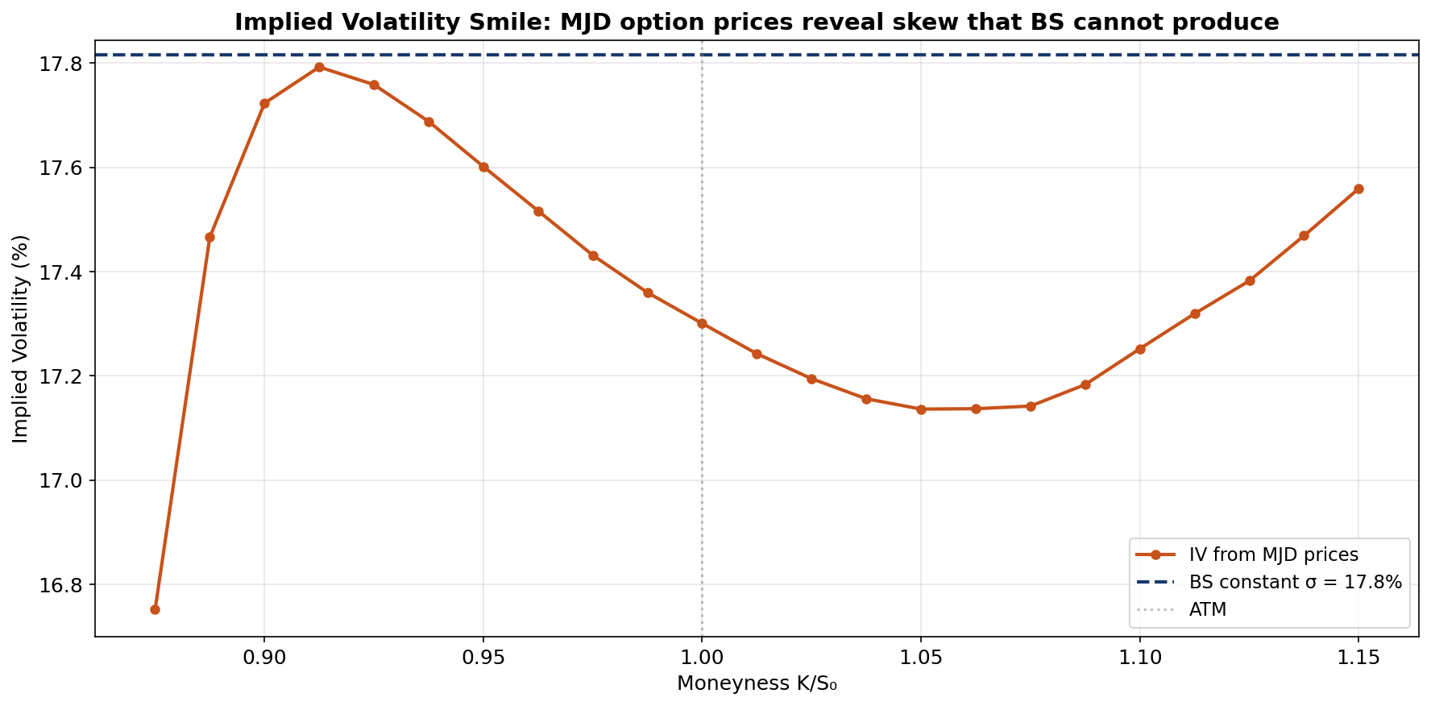
5. Implied Volatility Smile
BS-implied volatility backed out from MJD option prices. MJD produces the smile that market data shows.
BS can only produce a flat line — the "smile inconsistency" [Rubinstein, 1994].

Slide 18
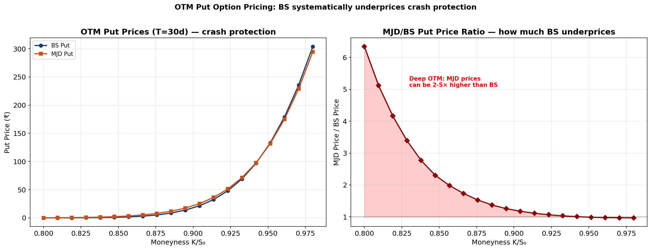
5. OTM Put Pricing — Where BS Fails Most
Deep OTM puts: MJD price can be 2–5× the BS price. This is crash protection that BS undervalues.
For a NIFTY options trader, using BS means systematically selling insurance too cheaply.

Slide 19
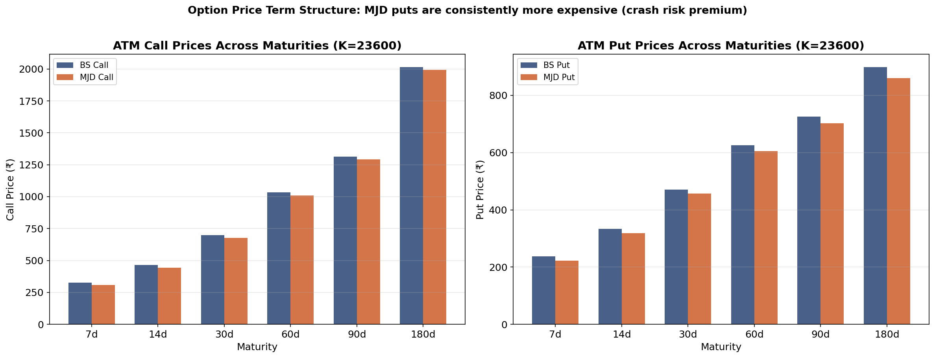
5. Option Prices Across Maturities
MJD puts are consistently more expensive than BS across all maturities — the jump risk premium persists.
Difference is largest for shorter maturities where individual jumps have more impact.

Slide 20
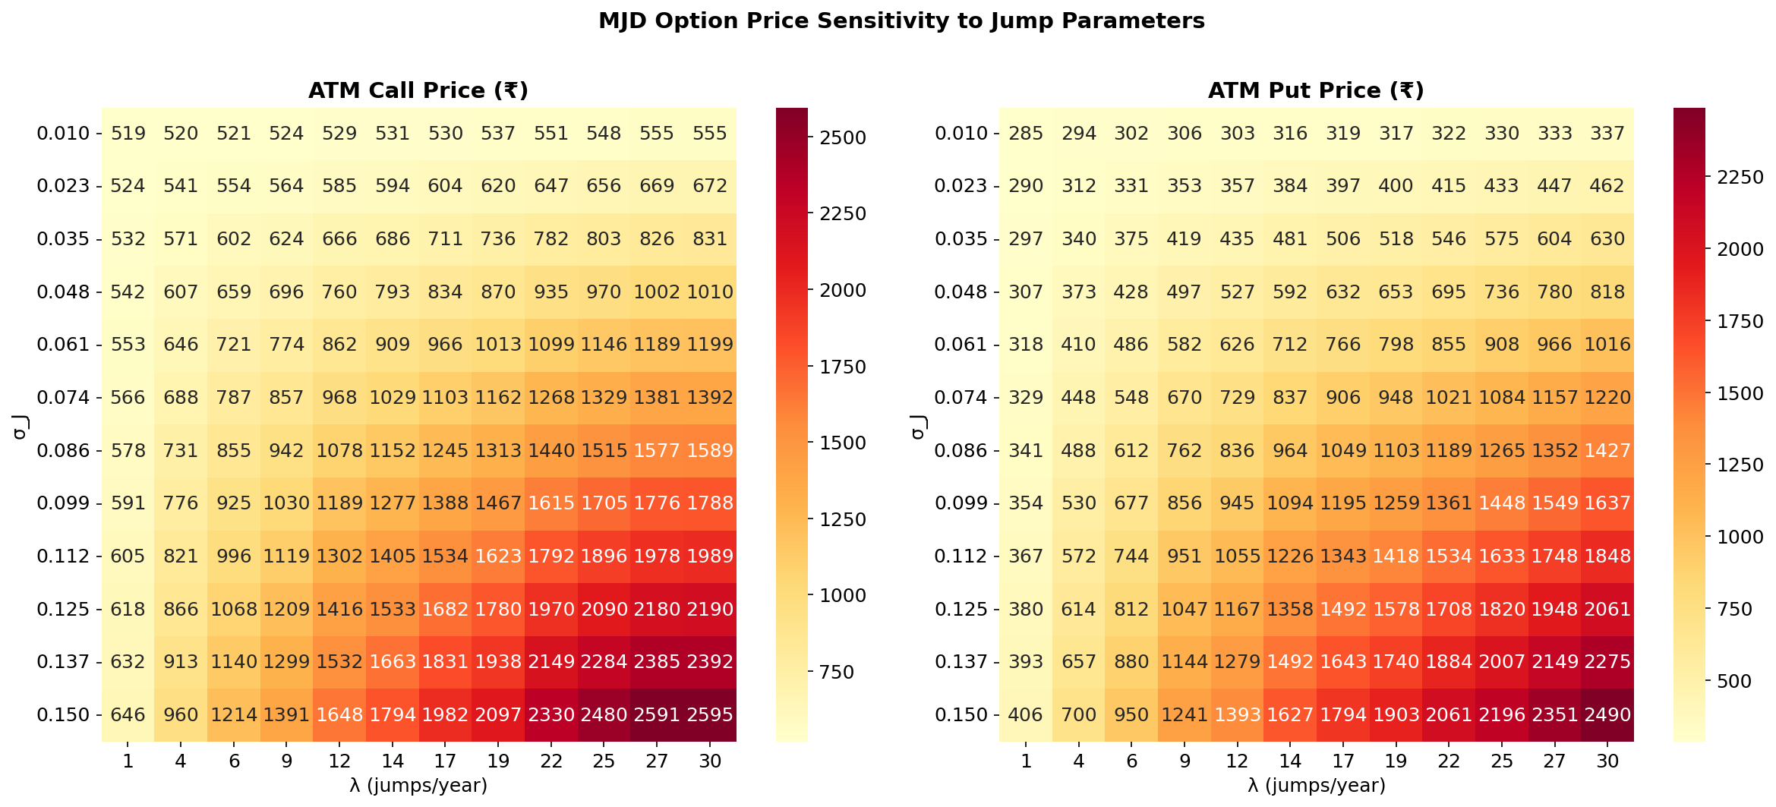
5. Option Price Sensitivity to Jump Parameters
Non-linear interaction between λ and σ_J on option prices. Higher jump intensity and vol → higher option prices.

Slide 21
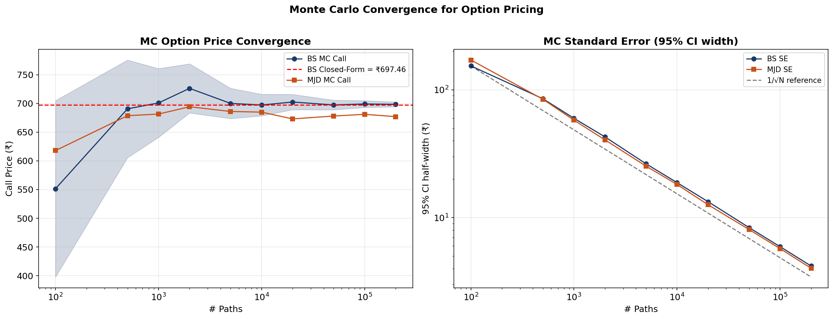
5. Monte Carlo Convergence (Option Prices)
BS MC converges to closed-form; MJD converges to its own value. SE ∝ 1/√N confirmed.
Validates both implementations and the theoretical pricing framework [Glasserman, 2003].

Slide 22
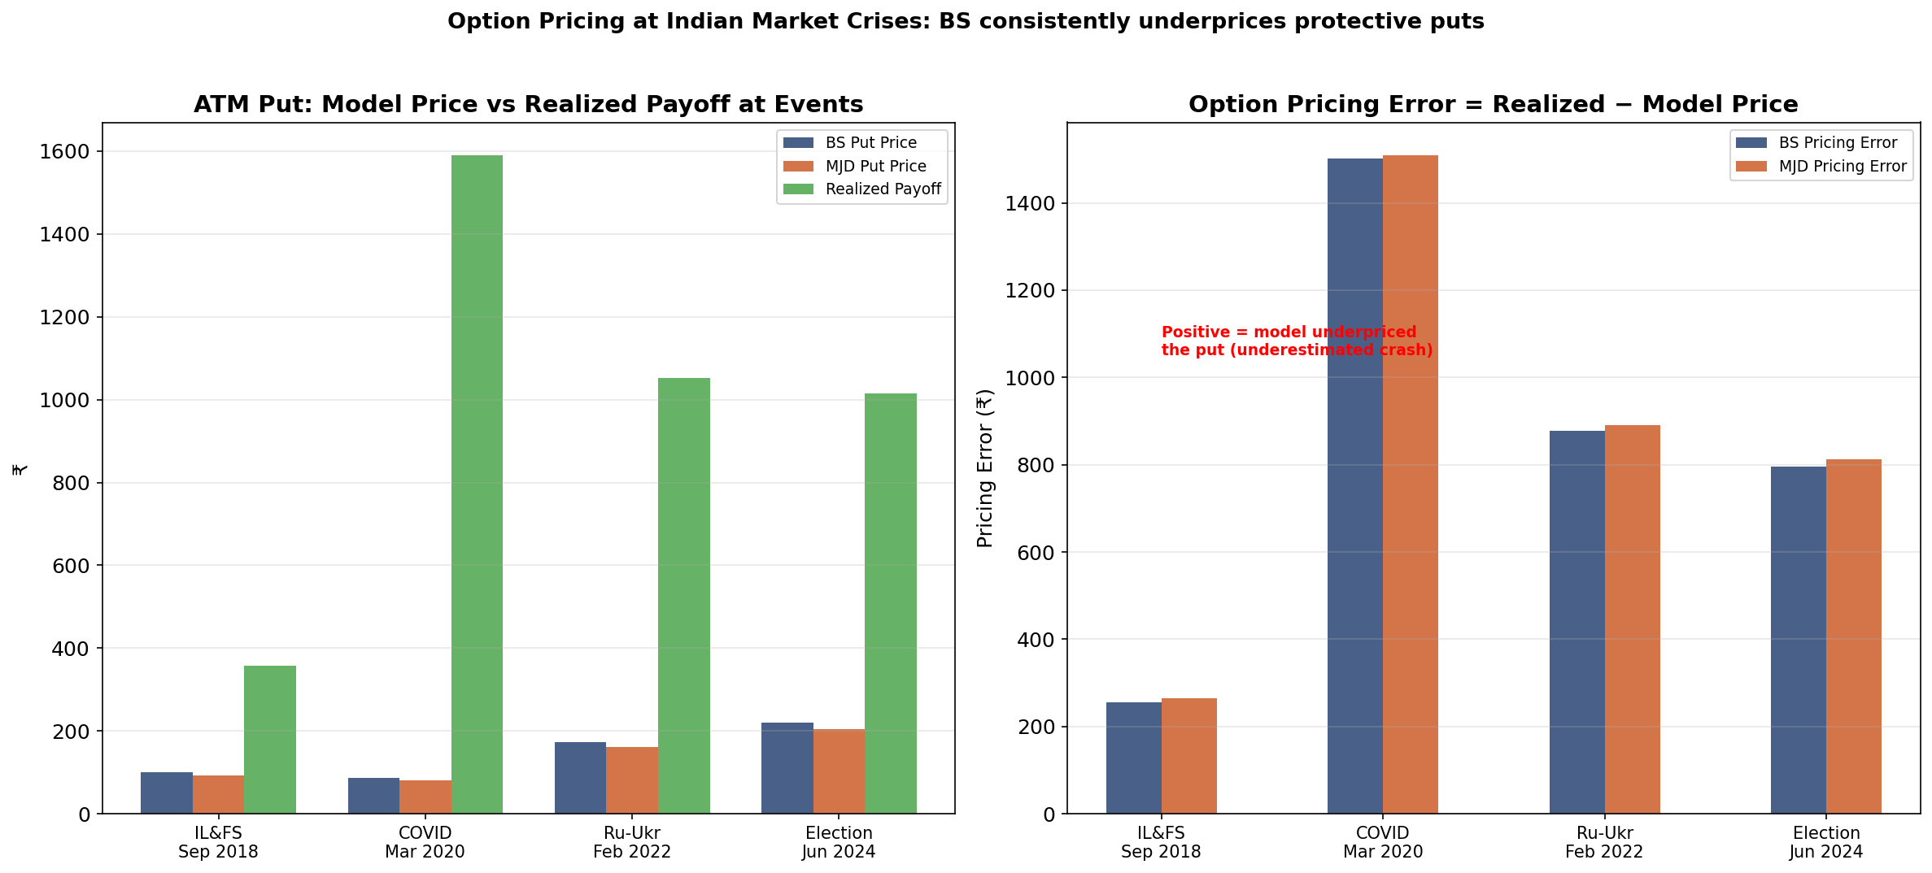
5. Option Pricing at Indian Market Crises
At each crisis: BS put price vs MJD put price vs realised payoff. BS consistently underprices — positive error = underpricing.

Slide 23
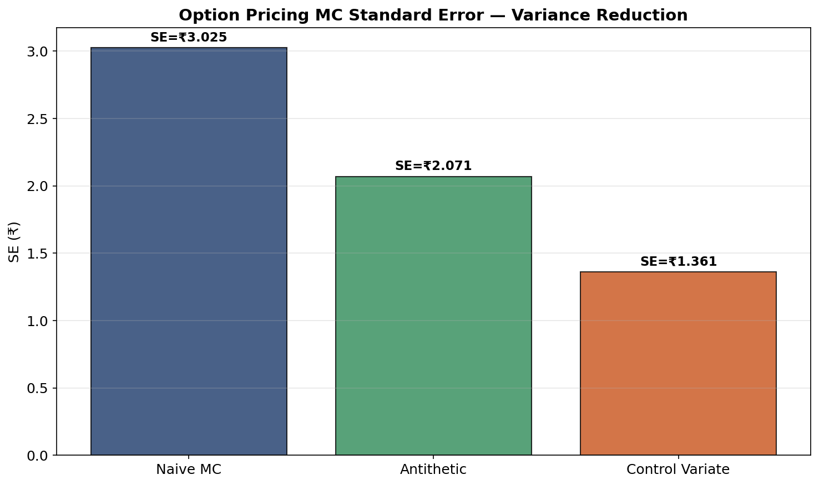
5. Variance Reduction for Option Pricing MC
Antithetic variates and control variates reduce MC standard error for option prices.
Control variate (using BS closed-form as control for MJD MC) gives ~50% SE reduction.
[Glasserman, 2003].

Slide 24
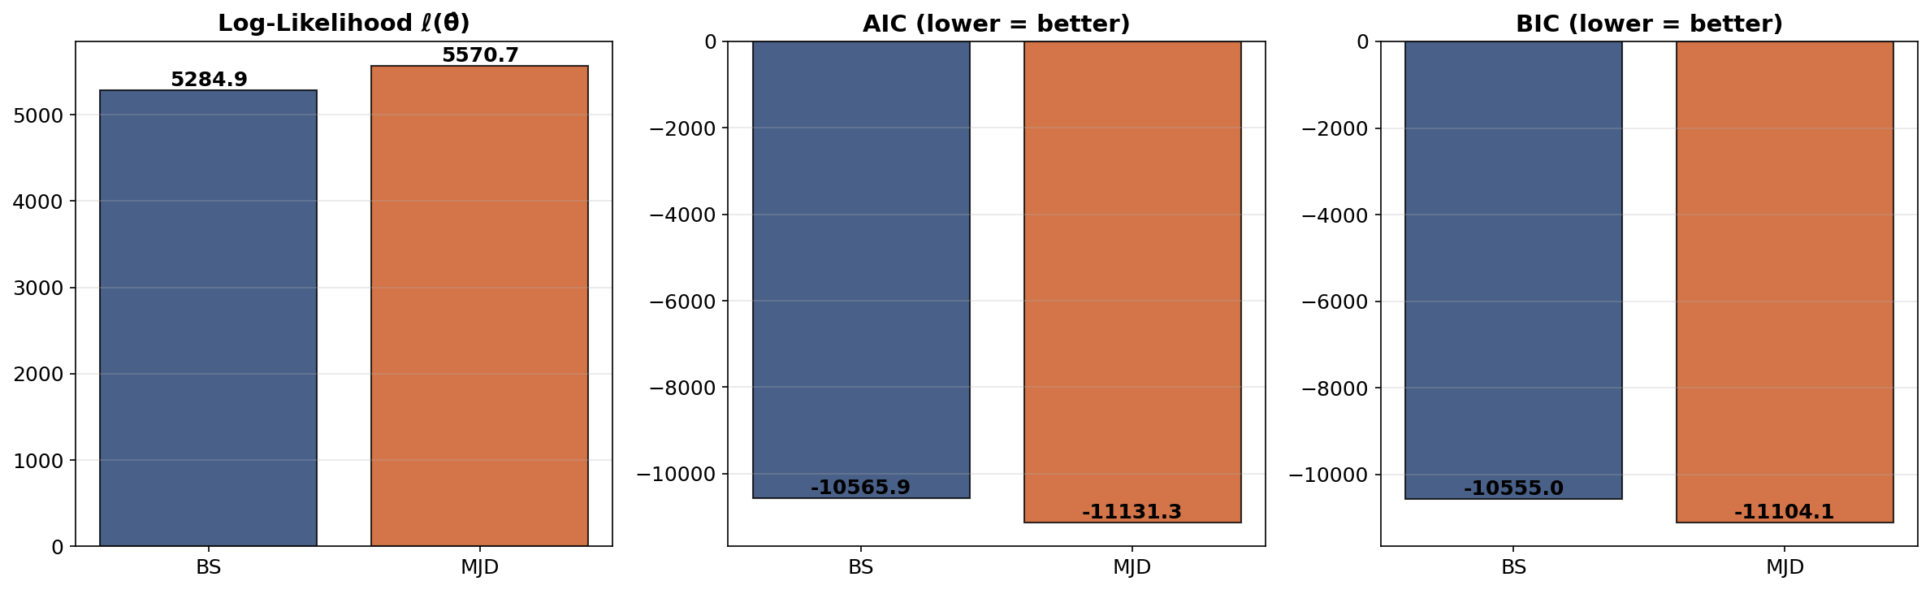
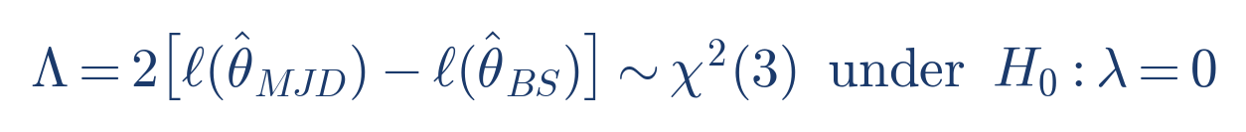
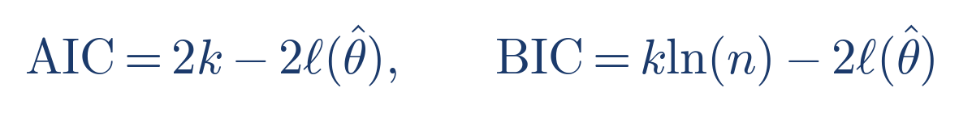
6. Statistical Model Selection
LRT p-value ≈ 0 → jumps are overwhelmingly significant. AIC & BIC both prefer MJD despite penalty for 3 extra parameters.

Slide 25
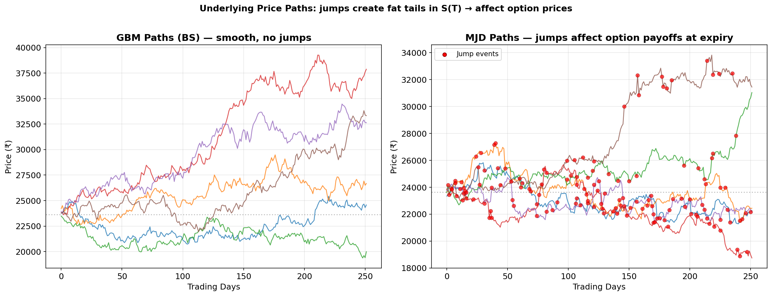
Underlying Paths: How Jumps Affect S(T)
GBM paths are smooth; MJD paths have jumps (red dots). Jump events change the terminal distribution S(T),
which is what determines option payoffs max(S(T)−K, 0) or max(K−S(T), 0).

Slide 26
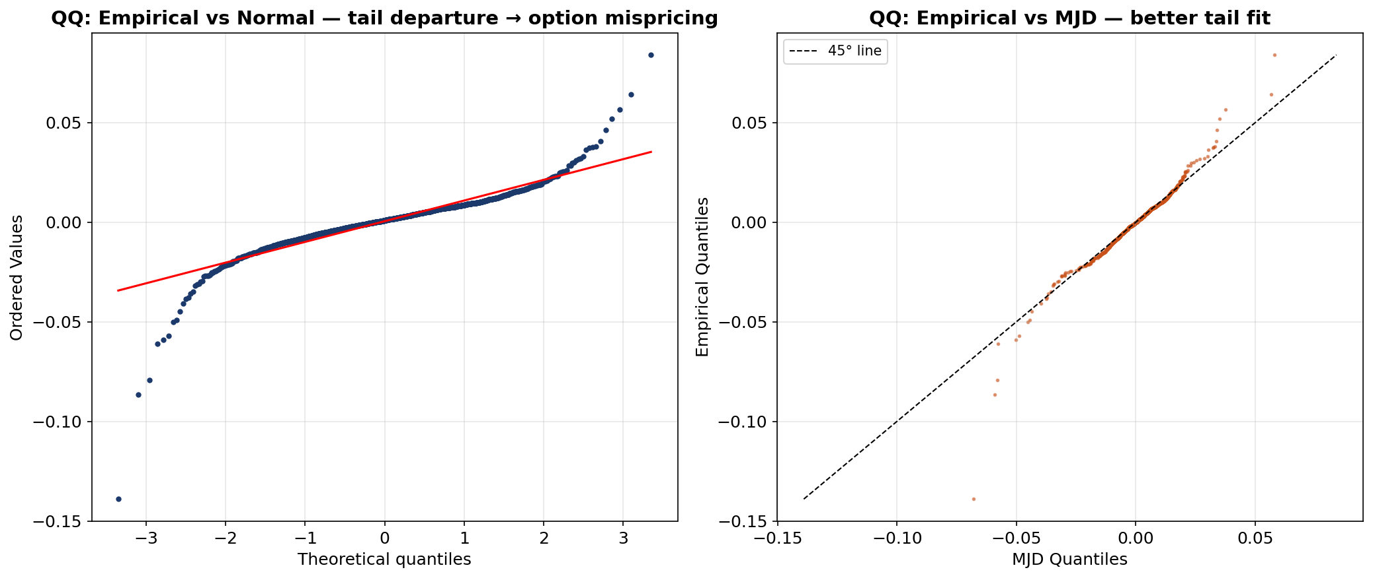
Return Diagnostics (Motivation for MJD)
QQ vs Normal: heavy-tailed departures → BS option mispricing. QQ vs MJD: better tail fit.

Slide 27
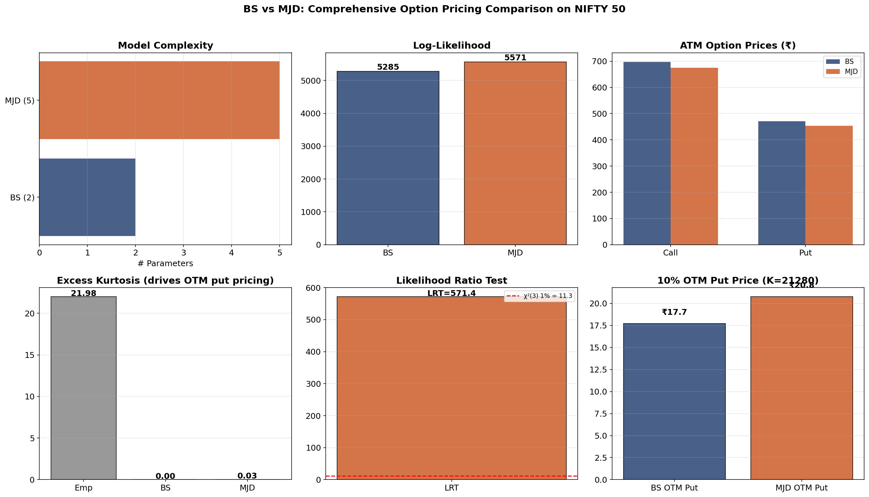
Summary: BS vs MJD Option Pricing Comparison

Slide 28
Model Comparison for Option Pricing
Feature | Black-Scholes | Merton JD
Underlying SDE | GBM (continuous) | GBM + Poisson jumps
Parameters | 2 (μ, σ) | 5 (μ, σ, λ, μ_J, σ_J)
Return distribution | Gaussian | Gaussian mixture
Option pricing | Closed-form (BS formula) | Monte Carlo required
Implied volatility | Flat (constant σ) | Smile / skew
OTM put pricing | Systematically low | More realistic
Captures crashes | No | Yes (jump component)
Calibration | Analytic MLE | Numerical MLE (L-BFGS-B)

Slide 29
7. Future Work & Connection to Supervisor Research
End-term: extend option pricing comparison to stochastic volatility models:
• Heston (1993): variance v(t) follows CIR process → produces full IV surface
• Bates (1996): Heston + jumps → 8 parameters, most flexible model
• Calibrate to live NIFTY option chain prices (not just returns)
Numerical challenge: CIR process has non-Lipschitz √v(t) coefficient
→ Standard Euler-Maruyama and Milstein Schemes will blow up, need to use tamed Milstein Schemes.
Prof. Chaman Kumar's research directly addresses this:
• Tamed Euler for Lévy SDEs [DKS16, SIAM J. Numer. Anal., 54(3)]
• Tamed Milstein for super-linear coefficients [KS17, EJP 22]
• Milstein for Markovian switching [KK20, J. Comp. Appl. Math. 377]
• McKean-Vlasov equations [KNRS20] — future scope: mean-field option markets

Slide 30
References
Option Pricing Models:
[BS73] Black & Scholes (1973). J. Political Economy, 81(3), 637–654.
[Me76] Merton (1976). J. Financial Economics, 3(1-2), 125–144.
[He93] Heston (1993). Review of Financial Studies, 6(2), 327–343.
[Ba96] Bates (1996). Review of Financial Studies, 9(1), 69–107.
Statistical & Computational Methods (MLE for discretely sampled SDEs):
[AS02] Aït-Sahalia, Y. (2002). Maximum likelihood estimation of discretely sampled diffusions:
a closed-form approximation approach. Econometrica, 70(1), 223–262.
[Iac08] Iacus, S.M. (2008). Simulation and Inference for Stochastic Differential Equations.
Springer Series in Statistics. Springer.
[CT04] Cont & Tankov (2004). Financial Modelling with Jump Processes.
[Gl03] Glasserman (2003). MC Methods in Financial Engineering.
[Ru94] Rubinstein (1994). J. Finance, 49(3), 771–818.
Supervisor's Research:
[DKS16] Dareiotis, Kumar & Sabanis (2016). SIAM J. Numer. Anal., 54(3).
[KS17] Kumar & Sabanis (2017). Electr. J. Probability, 22.
[KK20] Kumar & Kumar (2020). J. Comp. Appl. Math., 377.
[KNRS20] Kumar, Neelima, Reisinger & Stockinger (2020). arXiv:2006.00463.

Slide 31
Thank You
Comparative Study of Stochastic Models for Option Pricing in the Indian Stock Market
Under the supervision of Prof. Chaman Kumar
Department of Mathematics, IIT Roorkee
Questions?

