Slide 1







ANALYSIS OF TECHNOLOGY USAGE TRENDS
MOHIT BAKSHI

Slide 2



OUTLINE
Executive Summary
Introduction
Methodology
Results
Visualization – Charts
Dashboard
Discussion
Findings & Implications
Conclusion
Appendix

Slide 3

EXECUTIVE SUMMARY
Current Technology Usage Trend
Programming Language
Databases
Platforms
Web Frames
Desired Future Technologies
Programming Language
Databases
Platforms
Web Frames
Respondents Demographic Data
Distribution by age, country, gender & education level

Slide 4

INTRODUCTION
Topic of Analysis
Technology trend usage in the field of programming, web development , platforms and databases among developers around the world.
Purpose of the Analysis
Determination of top programming languages, databases, platforms and web frames used globally
Identify top emerging skills in the future
Audience for this Presentation
Software Developers
IT industry professionals
Computer science / IT students

Slide 5

METHODOLOGY
Data Collection (Sources)
Stack overflow developer 2019 survey
GitHub job postings
Data Wrangling
Data Exploration
Data Cleaning
Data Visualization
Plotly (python)
IBM Cognos (Dashboard)
Presentation

Slide 6
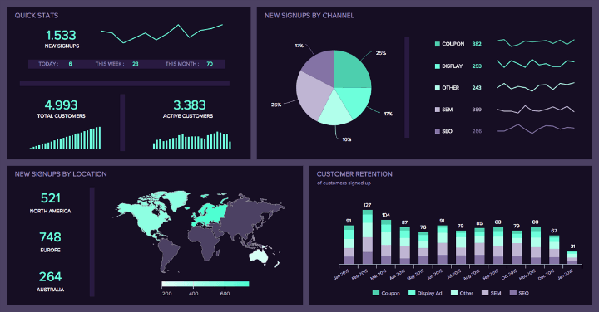
RESULTS :
Visualizations and Dashboards

Slide 7
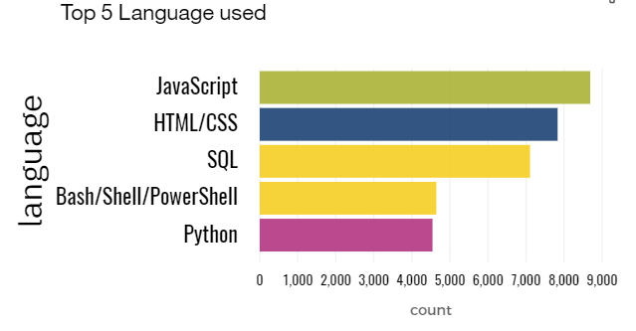
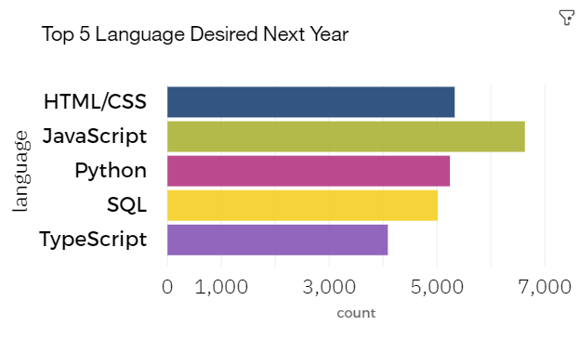
PROGRAMMING LANGUAGE TRENDS
Current Year
Next Year

Slide 8
PROGRAMMING LANGUAGE TRENDS - FINDINGS & IMPLICATIONS
Findings
Java script is the most used language worldwide
SQL and Python are ranked 3rd and 5th respectively among popular languages
Python will improve its rank from 5th to 3rd place
Implications
The field of web development is still vast and web developers are still in demand
The field of data science is emerging very fast
Python is gaining popularity very fast

Slide 9
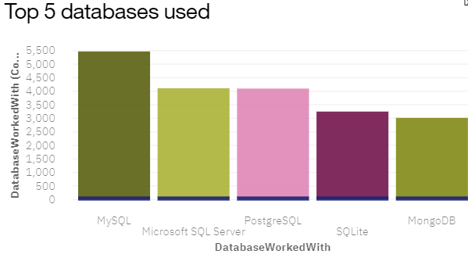
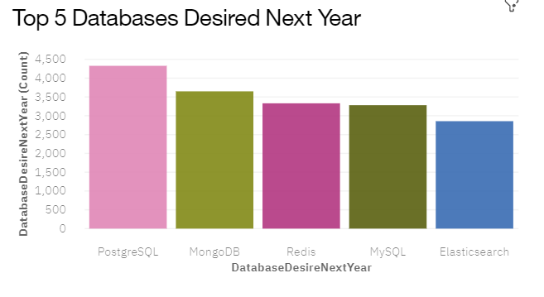
DATABASE TRENDS
Current Year
Next Year

Slide 10
DATABASE TRENDS - FINDINGS & IMPLICATIONS
Findings
MySQL is the most popular database world wide
MongoDB is ranked 5th in most popular Databases
MongoDB and Redis will improve their rankings in future significantly
Implications
Free and Open-source databases are still popular
Most programmers and organizations still prefer Relational databases
NoSQL databases will become more popular in future

Slide 11
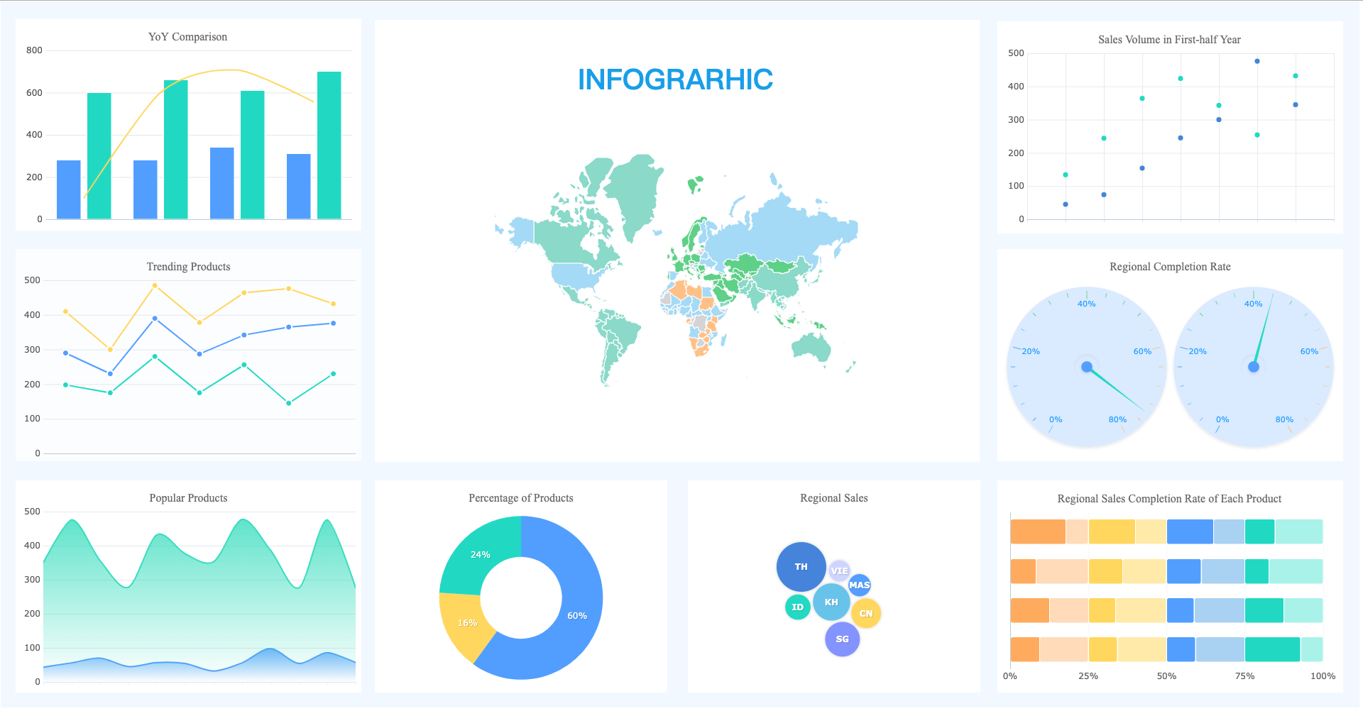
DASHBOARD
Link of the read-only view of the Cognos dashboard :
https://jp-tok.dataplatform.cloud.ibm.com/dashboards/0fe8d205-8ca2-4855-818b-58f95edd9eda/view/6307aa3b278f11f777cec8e407cd78077861730fb3bbd60681807b4959367497f36c4298c82e420b8c470163a0b8445e9b

Slide 12
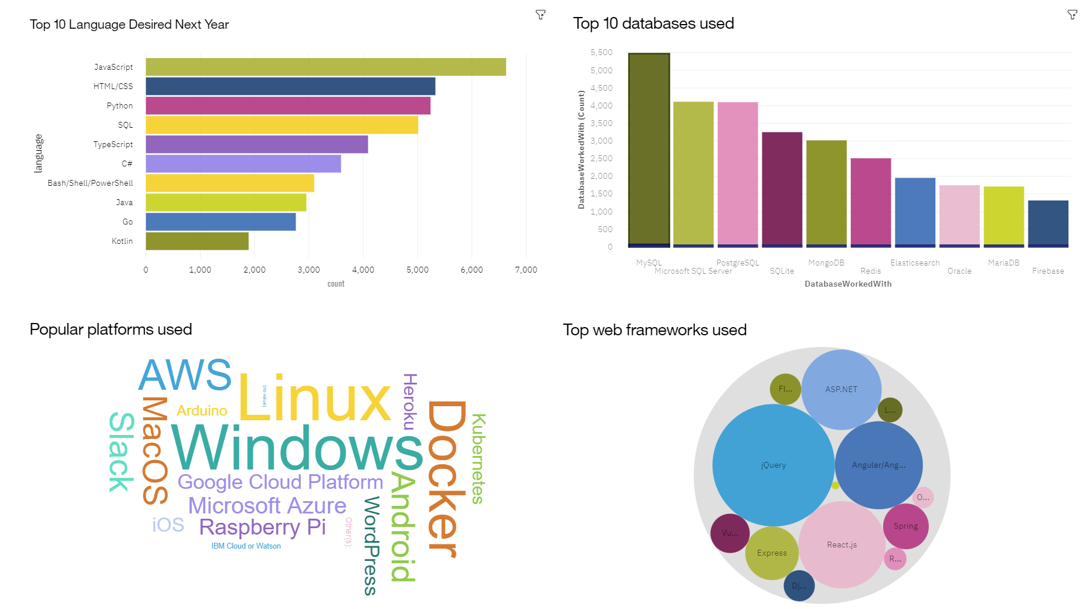
CURRENT TECHNOLOGY USAGE

Slide 13
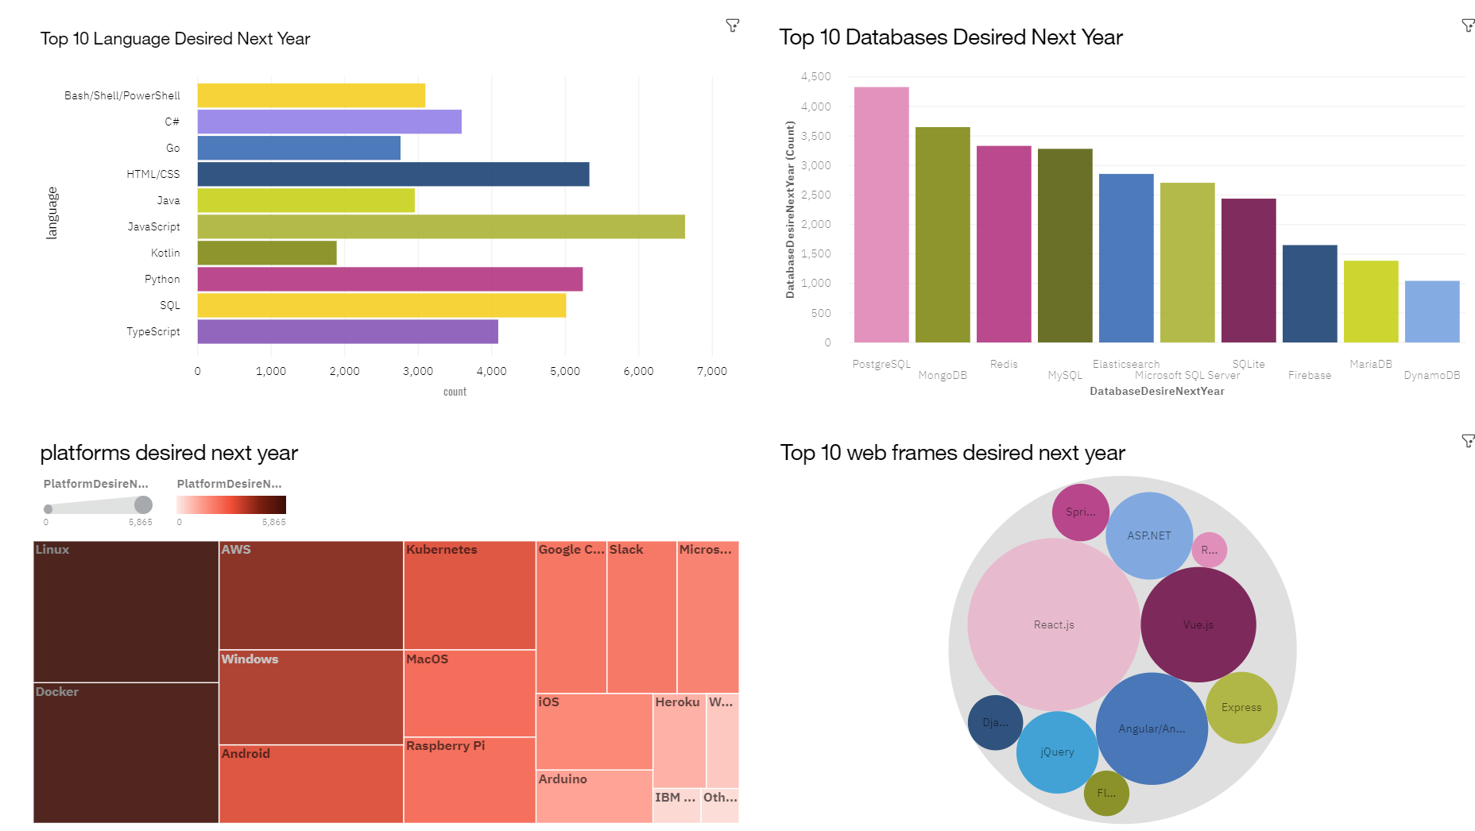
FUTURE TECHNOLOGY USAGE ESTIMATES

Slide 14
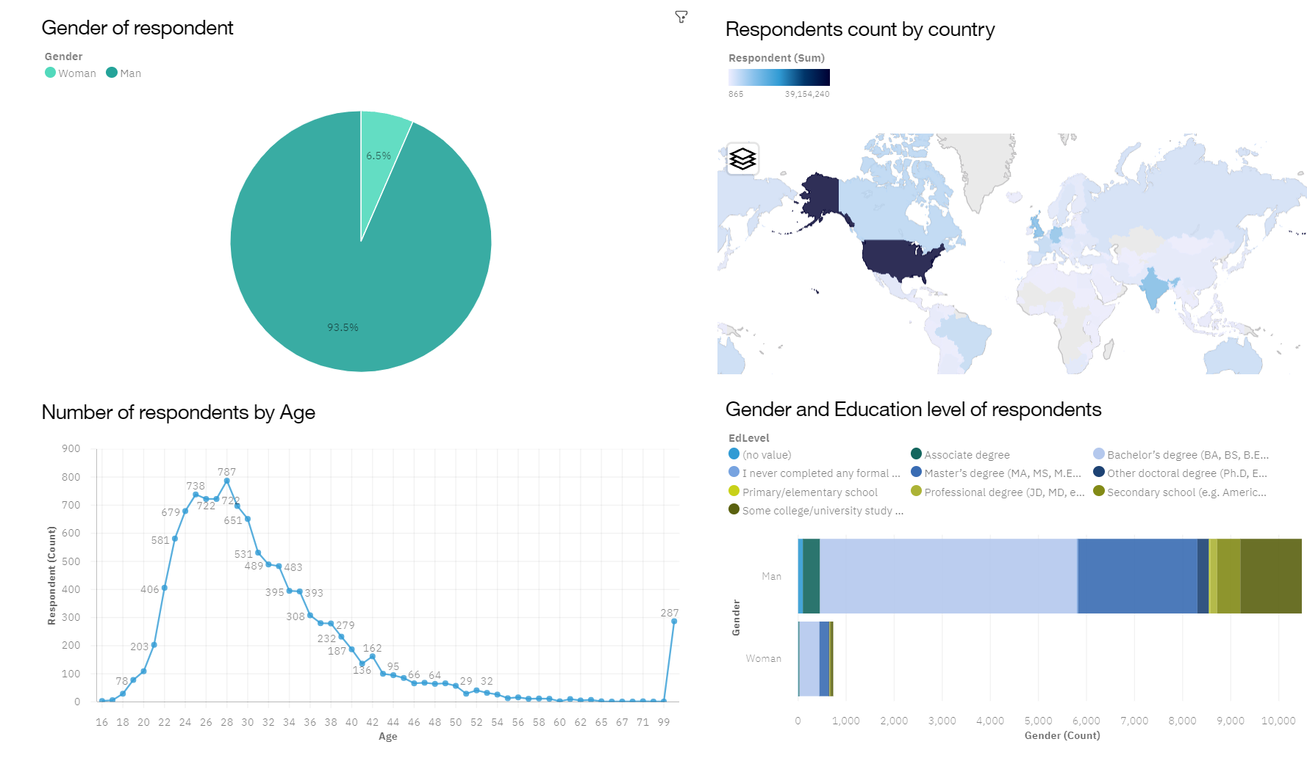
DEMOGRAPHIC DISTRIBUTION OF RESPONDENTS

Slide 15

DISCUSSION
KEY POINTS TO DISCUSS
Changes in The Usage of technology in the Future
Non uniform distribution of IT industry worldwide

Slide 16
OVERALL FINDINGS & IMPLICATIONS
Findings
SQL will remain popular and python will gain more popularity in the future .
MongoDB will continue to gain popularity in future.
Most of the IT professionals come from few countries like US and India.
Over 90 % of the Respondents are men.
Implications
Data science will emerge as a promising career in the future.
NoSQL databases would be more popular in coming years .
IT industry is concentrated in few regions of the world.
Female students and professionals should also be given adequate opportunities in IT related fields

Slide 17

CONCLUSION
Top programming languages for Data Science are SQL and python .
JavaScript continues to be the most popular language implying the huge demand of web developers in IT industry
NoSQL databases will be more popular in coming years
Even after so many years IT industry distribution is not uniform with majority of professionals representing only a few sections of society

Slide 18
APPENDIX
DATA SETS USED
Stack Overflow Developer Survey 2019 : https://cf-courses-data.s3.us.cloud-object-storage.appdomain.cloud/IBM-DA0321EN-SkillsNetwork/LargeData/m2_survey_data.csv

Slide 19
GITHUB JOB POSTINGS
Number of jobs
language

Slide 20
POPULAR LANGUAGES AND SALARIES DISTRIBUTION

