Slide 1


COVID 19 Detection Through Radiograph Images
Using Deep Learning Algorithm
Alpas, Michael (malpas2@illinois.edu)
Ahmad, Wasique (wasique2@illinois.edu)
Singh, Mohit (mohits3@illinois.edu)
Yadav, Upendra Singh (usyadav2@illinois.edu)
Team 1233
Course : CS 598 Deep Learning for Health Care – Spring 2021
Professor : Jimeng Sun

Slide 2

Agenda
Project Introduction
Methods and Approaches
Results
Optimization
Discussion
References
CS 598/Team 1233

Slide 3
Project Introduction
Background
  Motivated by earlier works from fellow students, professors and medical professionals
  Applied Convolutional Neural Network using PyTorch framework
  Cloud computing platform: AWS Services (SageMaker, S3, Lambda)
Objective:
  To apply DL algorithms which we learned from our class to possibly detect COVID-19
  Our aspiration is to learn and expand the knowledge of Deep learning
CS 598/Team 1233

Slide 4
Project Introduction
Dataset
  Used iee8023 data set (https://github.com/ieee8023/covid-chestxray-dataset)
    Public open dataset of chest x-ray and CT Images of patients positive or suspected of Covid-19. [2]
  Xray Image dataset from Ozturk and Covid-19 Kaggle Dataset [3]
  Total Images in combined Dataset
    4412 – Chest X-ray Images which contains –
    1851 – Normal X-rays
    1863 – Pneumonia
    698 – COVID-19
COVID-19 Detection Model:
  Split 70% training, 20% test and 10% validation
CS 598/Team 1233

Slide 5
Methods and Approaches
Data Pre-Processing
Image Resizing
          - ResNet50 Model (Resizing Image in 224*224)
          - InceptionV3 Model (Resizing Image in 299*299)
Normalization and Conversion of Images in-to multi-dimensional tensors
CS 598/Team 1233

Slide 6
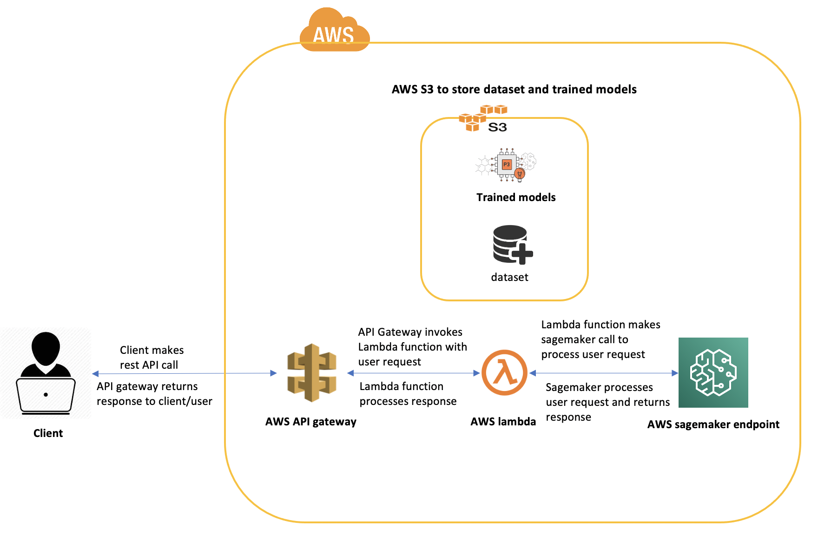
Methods and Approaches
High Level Architecture Diagram
Client Application (Angular.js)
Amazon API Gateway
AWS Lambda
AWS SageMaker
Amazon S3
Trained Models
- InceptionV3
- ResNet50
CS 598/Team 1233

Slide 7
Methods and Approaches
Model Development Cycle and its Components
Client Application (Angular.js) – Helps external user to upload any Chest Xray.
Amazon API Gateway - Exposes REST API to be consumed by any third-party client application.
AWS Lambda – Together with API Gateway, helps to expose model’s end point to external system.
Amazon S3 – Is used to store the dataset (images) needed for training, along with the trained models ready for deployment.
Amazon SageMaker – Is used to prepare, build, train and deploy machine learning models.
Trained Models – Inception V3 and ResNet50
CS 598/Team 1233

Slide 8
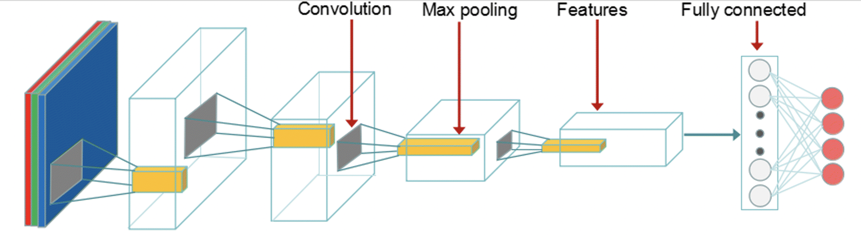
Methods and Approaches
ResNet50 Model Architecture
50 Layer deep classic neural network
Resnet50 Model is effective in solving the issue of diminishing gradient.
Uses Skip Connection to pass the residuals to next layer and hence enhances the detection of smaller objects.
CS 598/Team 1233

Slide 9
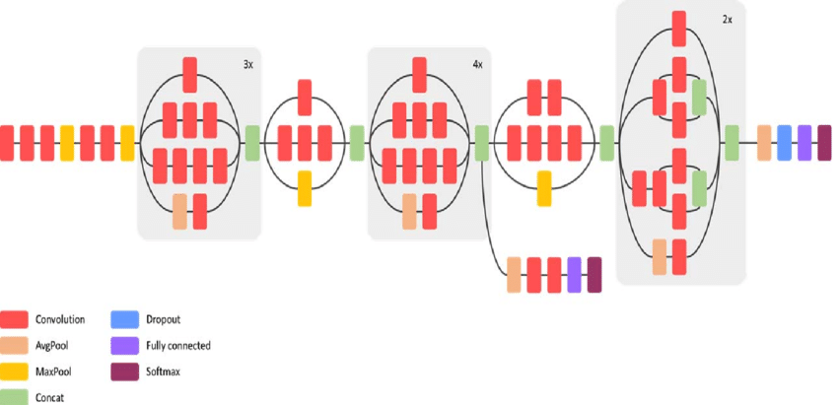
Methods and Approaches
InceptionV3 Model Architecture
Convolutional Neural Network which helps in analysis, classification and detection of finer objects of images.
Developed by Google Net community in Google.
Computationally efficient (both in terms of number of parameters generated by the network and computer hardware resources such as memory and CPU utilization).
- Uses Factorized Convolutions (helps in reducing computational efficiency),
- Uses Smaller Convolutions (replaces bigger convolutions to smaller convolutions),
- Dimension Reduction and parallel computations.
CS 598/Team 1233

Slide 10
Results
COVID Classification Result Metrics
Model Names | Precision (For COVID Images) | Recall (For COVID Images) | F1-Score (For COVID Images) | Accuracy
ResNet-50 – Small Dataset | .94 | .93 | .935 | .93
InceptionV3 - Small Dataset | .88 | .89 | .884 | .88
ResNet-50 –Large Dataset | .97 | .97 | .97 | .97
InceptionV3 Large Datset | .94 | .93 | .934 | .93
For the same dataset, ResNetV3 model outperformed InceptionV3 model.
CS 598/Team 1233

Slide 11
Optimization
SGD Vs ADAM Learning Rate
Gradient Descent methods are used to optimize the results.
SGD
Instead of performing computation in whole dataset SGD is used in smaller dataset with learning rate .001
ADAM (Adaptive Moment Estimation)
ADAM algorithm try to use both RMSProp and Momentum gradient descent optimization algorithms.
ADAM with 3e-5 learning rate gave better performance than SGD.
CS 598/Team 1233

Slide 12
Discussion
Result Observation
    Approximately 97% accuracy in ResNet-50 model and 93% accuracy in InceptionV3 Model.
ResNet-50 model is more accurate and effective compared to InceptionV3 model.
Vanishing Gradient issue with InceptionV3 model.
Challenges in environment creation and model hosting and deployment in AWS.
Future Work
Model can be further optimized, and accuracy could be reached to 99%.
Summary
Results based on this paper showed that the Convolutional Neural Network with minimized convolutional and fully connected layers are capable of detecting COVID-19 with good accuracy.
CS 598/Team 1233

Slide 13
References
Roberts, M., Driggs, D., Thorpe, M. et al. Common pitfalls and recommendations for using machine learning to detect and prognosticate for COVID-19 using chest radiographs and CT scans. Nat Mach Intell 3, 199–217 (2021). (link: https://doi.org/10.1038/s42256-021-00307-0)
Cohen, J. P. COVID-19 Image Data Collection. ArXiv. 2020, arXiv:2003.11597.
Ozturk T, Talo M, Yildirim EA, Baloglu UB, Yildirim O, Rajendra Acharya U. Automated detection of COVID-19 cases using deep neural networks with X-ray images. Comput Biol Med. 2020;121:103792. doi:10.1016/j.compbiomed.2020.103792
Sekeroglu B, Ozsahin I. Detection of COVID-19 from Chest X-Ray Images Using Convolutional Neural Networks. SLAS TECHNOLOGY: Translating Life Sciences Innovation. 2020;25(6):553-565. doi:10.1177/2472630320958376 (link: https://doi.org/10.1177/2472630320958376)
Apostolopoulos, I. D., Mpesiana, T. Covid-19: Automatic Detection from X-Ray Images Utilizing Transfer Learning with Convolutional Neural Networks. Phys. Eng. Sci. Med. 2020, 43, 635–640
Z. Zahisham, C. P. Lee and K. M. Lim, "Food Recognition with ResNet-50," 2020 IEEE 2nd International Conference on Artificial Intelligence in Engineering and Technology (IICAIET), Kota Kinabalu, Malaysia, 2020, pp. 1-5, DOI: 10.1109/IICAIET49801.2020.9257825. (link: https://doi.org/10.1016/j.procs.2018.05.069)
Peng, CY.J., So, TS.H., Stage, F.K. et al. The Use and Interpretation of Logistic Regression in Higher Education Journals: 1988–1999. Research in Higher Education 43, 259– 293 (2002). https://doi.org/10.1023/A:1014858517172
Wang, L., Lin, Z.Q. & Wong, A. COVID-Net: a tailored deep convolutional neural network design for detection of COVID-19 cases from chest X-ray images. Sci Rep 10, 19549 (2020). https://doi.org/10.1038/s41598-020-76550-z
Yoo, S. H., Geng, H., Chiu, T. L., Yu, S. K., Cho, D. C., Heo, J., Choi, M. S., Choi, I. H., Cung Van, C., Nhung, N. V., Min, B. J., & Lee, H. (2020). Deep Learning-Based Decision-Tree Classifier for COVID-19 Diagnosis From Chest X-ray Imaging. Frontiers in medicine, 7, 427. https://doi.org/10.3389/fmed.2020.00427
CS 598/Team 1233

Slide 14
Thank You
Michael Alpas, Mohit Singh, Upendra Yadav, Wasique Ahmad
CS 598 / Team 1233

