Slide 1
Business Analyst Internship Project Mohit Bhilala
Sales Performance Analysis
1

Slide 2
Agenda
• Project Overview
• Business Problem
• Dataset
• Methodology
• Dashboard
• KPIs
• Insights
• Recommendations
• Conclusion
2

Slide 3
Business Problem
Retail businesses need visibility into sales trends, profitability, products, and regional
performance to make data-driven decisions.
3

Slide 4
Dataset & Tools
Dataset: Sample Superstore
Tools:
• Python (Pandas)
• SQL
• Power BI
• Excel
• GitHub
4

Slide 5
Project Workflow
1. Data Collection
2. Data Cleaning
3. Exploratory Data Analysis
4. KPI Calculation
5. Dashboard Development
6. Business Insights
5

Slide 6
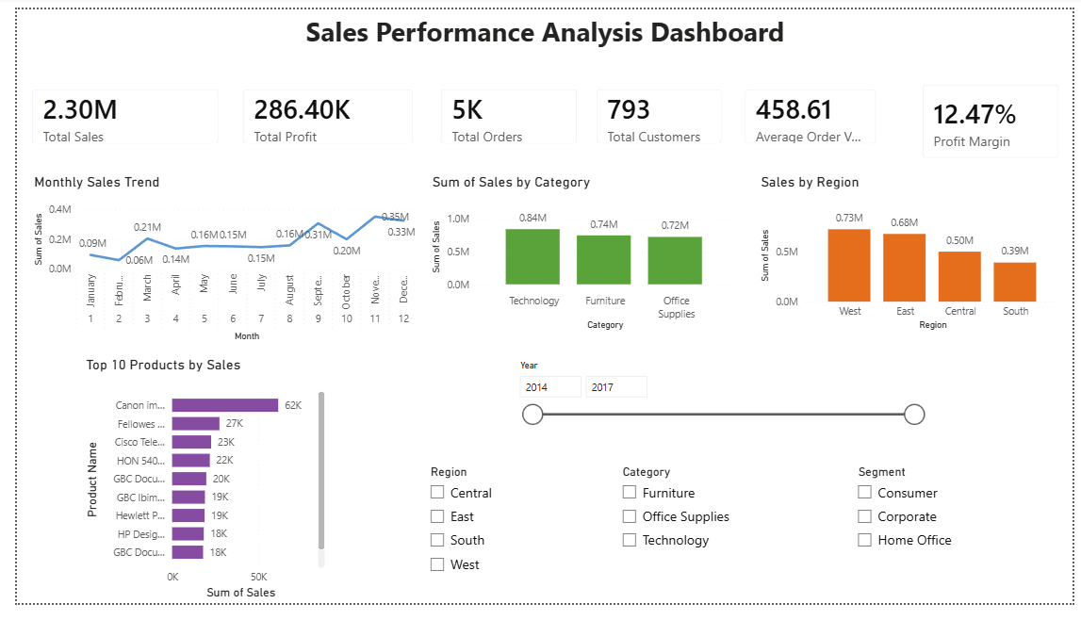
Dashboard KPIs
• Total Sales: 2.30M
• Total Profit: 286.40K
• Orders: 5,009
• Customers: 793
• Avg Order Value: 458.61
• Profit Margin: 12.47%
6

Slide 7
Dashboard Features
• Monthly Sales Trend
• Sales by Category
• Sales by Region
• Top 10 Products
• Interactive Filters (Year, Region, Category, Segment)
7

Slide 8
Key Business Insights
• Technology is the highest-selling category.
• West region generates the most revenue.
• Sales show seasonal variation.
• Top products contribute a significant share of revenue.
• Dashboard enables quick decision-making.
8

Slide 9
Recommendations
• Focus marketing on high-value customer segments.
• Increase inventory for top-performing products.
• Improve sales strategies in underperforming regions.
• Monitor monthly trends for forecasting.
9

Slide 10
Conclusion
This project :
•demonstrates end-to-end Business Analysis using Python, SQL, and Power BI.
• Interactive dashboard supports faster decisions.
• Easy filtering by Region, Category, Segment and Year.
• Future enhancement: sales forecasting
10

Slide 11
Thank You
Sales Performance Analysis
Business Analyst Internship Project
Prepared by: Mohit Bhilala
📧 Email: mohitbhilala22@gmail.com
MOHITBHILALA@KGPIAN.IITKGP.AC.IN
🐙 GitHub: https://github.com/mohitbhilala005
💼 LinkedIn: https://www.linkedin.com/in/mohit-bhilala-9460b7307
Thank You!
Questions?
10

