Slide 1



HACK MATRIX HACKATHON
TITLE PAGE
PROJECT TITLE : Peer Support Connector (HM-49)
TEAM NAME : The_Visionaries
TEAM MEMBERS :
ANANYA SHARMA
VANSHIKA AWASTHI
SAYOM BISWAS
MOHIT BHOOTRA

Slide 2

PROBLEM STATEMENT
Describe the problem clearly:
Students avoid seeking help from current Mental Health Platforms because they lack true anonymity, hyper-local peer empathy and frictionless access during crisis.
Who is affected by this problem?
University students are the one suffering from academic stress is silence and the campus administrators who are completely blind to their struggles.
Why this problem is important?
Because Untreated campus stress rapidly escalates into severe mental health crises and academic dropouts, making a frictionless, anonymous safety net essential .

Slide 3
EXISTING SOLUTIONS AND GAPS
List of existing Solutions : TalkCampus, Togetherall and 7 cups.
Mention their Limitations: The Global Empathy Gap, “Fake” Anonymity & Surveillance,
Quality Control Issues, High-Friction (Clinical UI).
Explain the gap your project will address:
True Anonymity: Zero sign-ups and ephemeral aliases guarantee absolute privacy without tracking.
Hyper-Local Empathy: Matching students exclusively with vetted campus peers who understand local pressures.
Smart & Fast Matching: Replacing endless scrolling with instant, tag-based routing to the right peer.
Interactive Relief: Swapping static PDFs for immediate, UI-driven coping tools and instant campus emergency routing.

Slide 4
PROPOSED SOLUTION
Explain your solution clearly: We are building a hyper-local, fiction-free mental health dispatch system. Unlike bloated corporate platforms, our application provides immediate, 100% anonymous peers-to-peer support tailored strictly to the unique ecosystem and pressures of our university
List key features:
Zero-login access, using temporary generated identities and local storage JWTs.
Instantly pairs students with campus peers based on specific stress tags.
Tier-3 Safeguarding Protocol: Automated “Trigger-word Middleware” that detects high-risk language and instantly routes to campus emergency contacts.
Aggregates anonymous stress tags to give administration real-time insights into campus mental health trends.
Explain how it solves the problem:
It guarantees absolute privacy by using MongoDB TTL indexes to auto-delete chat logs after 24 hours, completely removing “Surveillance anxiety”.
It bridges the “Empathy Gap” by ensuring students only talk to vetted peers who actually understand our specific campus culture and academic rigors.
It eliminates the “High-Friction Crisis” by replacing clunky counselor directories with an instant, two-click matching engine.

Slide 5
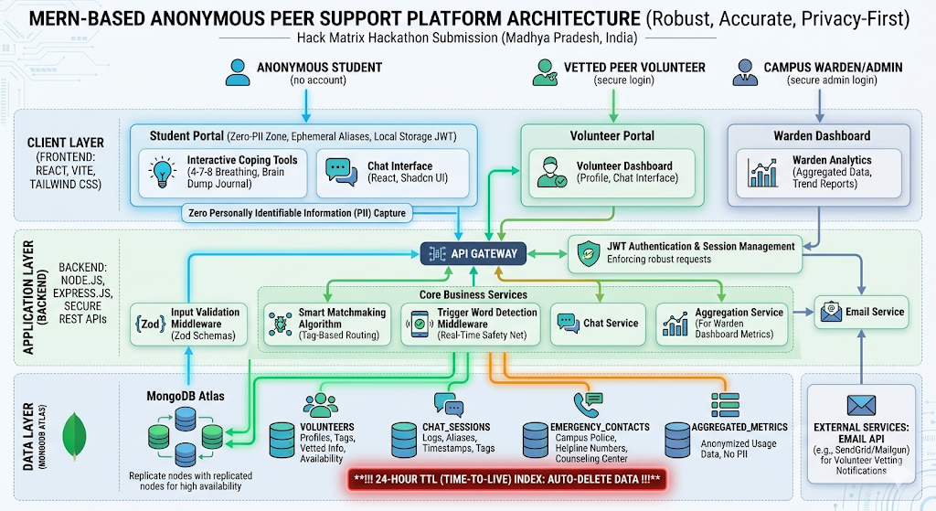
SYSTEM ARCHITECTURE

Slide 6
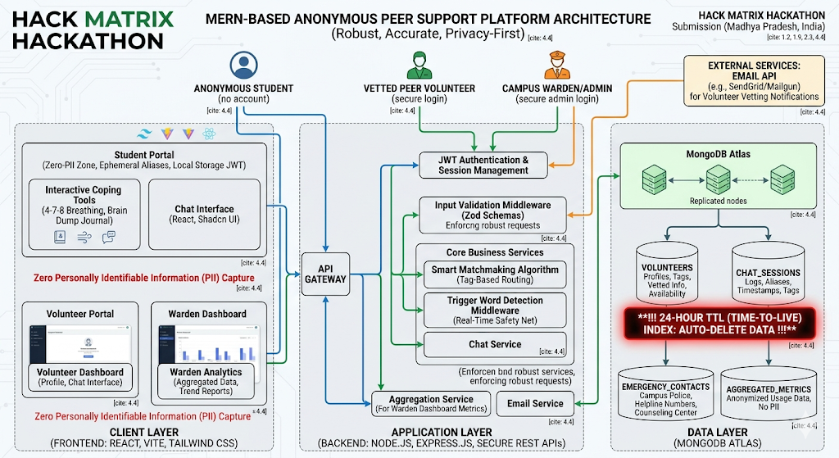
FLOWCHART / WORKING PROCESS

Slide 7
TECH STACK
Frontend ( UI Layer ):
React + Vite
Type Script
Tailwind CSS & shadcn/ui
Zod & React Hook form
Backend ( The Logic Layer ):
Node.js & Express.js
Zod (Server-Side)
Database ( Storage Layer ):
MongoDB Atlas

Slide 8
IMPLEMENTATION PLAN
Modules And Features we will build:
Anonymous Student Entry: Zero-login access using temporary aliases and a 24/7 interactive coping toolkit.
Smart routing & safety: tag-based peer matching with automated trigger-word detection for instant emergency diversion.
Vetted Volunteer Portal: A secure dashboard for trained peers to manage anonymous chats, featuring a one-click counselor escalation button.
Admin Analytics dashboard: Aggregates anonymized stress tags to give campus wardens real-time, predictive wellness trends.
Privacy core (Auto-Burn): 24-hour TTL database indexes that automatically delete all chat logs to guarantee absolute anonymity.

Slide 9
High Adoption Rates: Removing logins and tracking captures the massive percentage of students who usually suffer in silence.
Instant De-escalation: Automated tag-matching reduces the wait time for emotional support from days (waiting for a counselor) to seconds.
EXPECTED OUTCOME / IMPACT
Expected Results:
High Adoption rates: Removing logins and tracking captures the massive percentage of students who usually suffer in silence.
Instant De-escalation: Automated tag-mactching reduces the wait time for emotional support from days ( waiting for a counsellor) to seconds.
Benefits to Users:
Stigma- Free Safety: Absolute privacy guarantess they can vent without fear of it affecting their grades, placements, or reputation.
Actionable Empathy: They get practical advice rom campus peers who actually understand their exact local pressures, not generic sympathy from a bot.
Real-world Impact:
Dropout Reduction: Catching academic burnout early keeps overwhelmed students enrolled, healthy , and graduating.
Systematic Campus Change: The aggregated dashboard gives the administration the data they need to fix root causes (like brutal exam scheduling or placement stress) before they trigger campus-wide crises.

Slide 10
FUTURE SCOPE AND CONCLUSION
Future improvements:
AI Falllback Companion: An automated, anonymous AI listener deployed for immediate 24/7 support during hours when human peer volunteers are offline.
We will upgrade the dashboard to analyze anonymous trends and predict campus-wide stress spikes so the university can act proactively
Porting the Web application to iOS/Android to enable instant push notifications and even lower-friction access for students in crisis.
Final summary:
A campus-specific, fully anonymous mental health platform that guarantees absolute privacy through auto-deletion data, providing students with an instant safety net while giving administration actionable insights to prevent crises.
Scalability of the project:
The Platform scales instantly at zero initial cost, ready to handle thousands of concurrent students.

