Slide 1
Electric Vehicles Sales Analysis in India

Slide 2
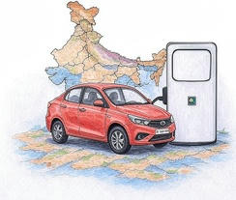
Introduction and Problem Statement
Company Overview:
AtliQ Motors is an automotive giant from the USA specializing in electric vehicles (EV).
In the last 5 years, their market share rose to 25% in electric and hybrid vehicles segment in North America.
As a part of their expansion plans, they wanted to launch their bestselling models in India where their market share is less than 2%.
Bruce Haryali, the chief of AtliQ Motors India wanted to do a detailed market study of existing EV/Hybrid market in India before proceeding further. Bruce gave this task to the data analytics team of AtliQ motors and Peter Pandey is the data analyst working in this team.

Slide 3


Objective and Scope
Task:
To understand a comprehensive market study to understand the EV market in India.
Scope:
Analysis of EV sales, penetration rates, market trend and business insight to support the expansion strategy.
Data Collection
The dataset is taken from the Vahan Sewa.

Slide 4
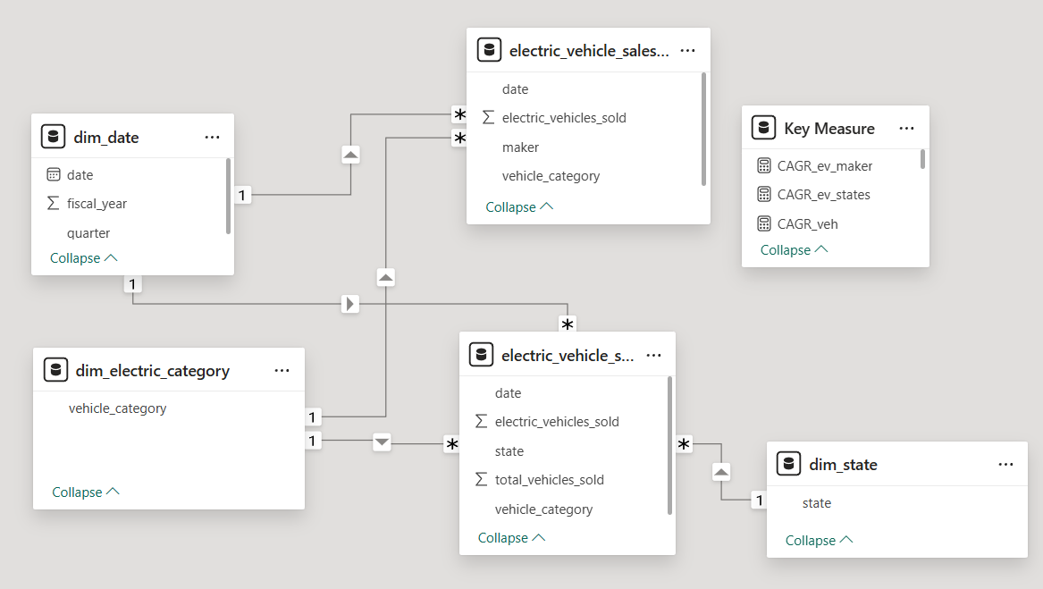
Data Modelling

Slide 5
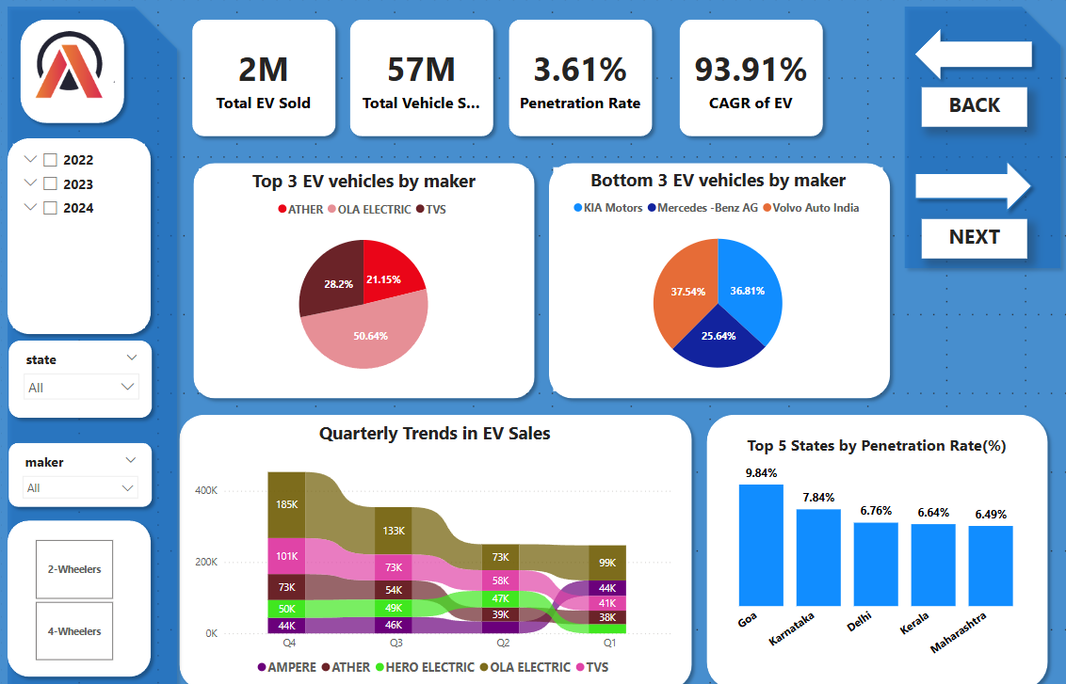
All the Key Metrics along the EV sold by Maker

Slide 6

Primary Research Question
continue to the next slide

Slide 7
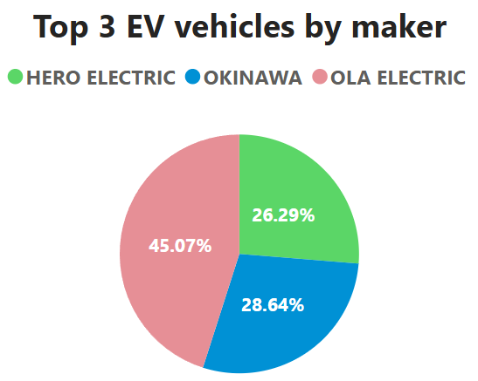
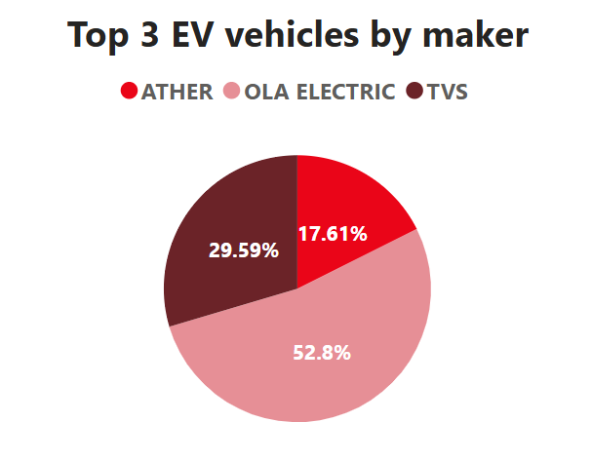
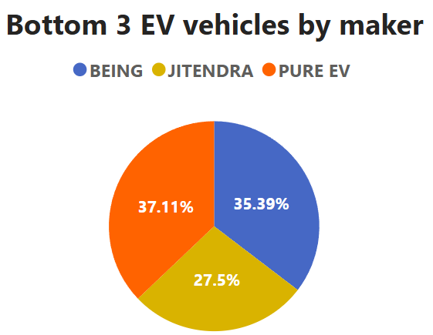
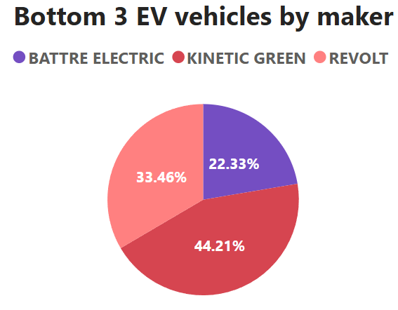
1.List the top 3 and bottom 3 makers for the fiscal years 2023 and 2024 in terms of the number of 2-wheelers sold.
2023
2024

Slide 8
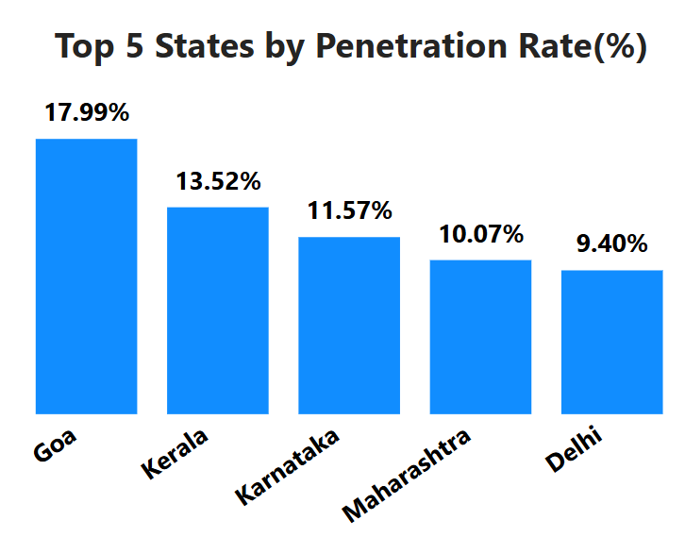
2. Identify the top 5 states with the highest penetration rate in 2-wheeler and 4-wheeler EV sales in FY 2024.

Slide 9
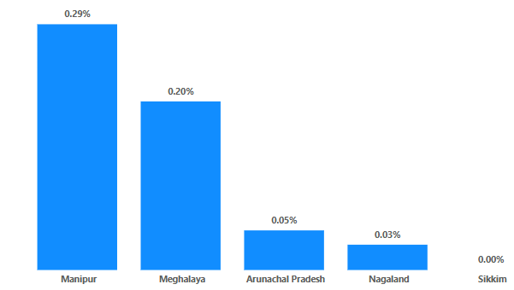
3. List the states with negative penetration (decline) in EV sales from 2022 to 2024?

Slide 10
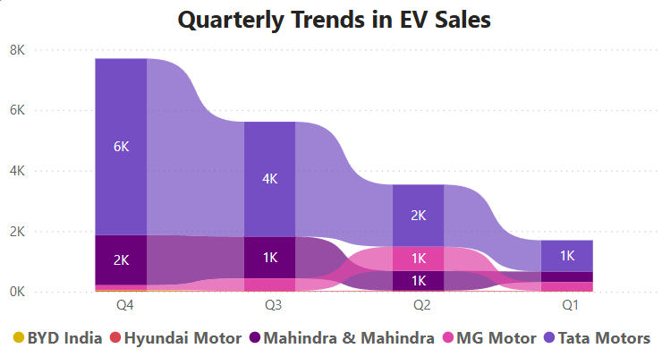
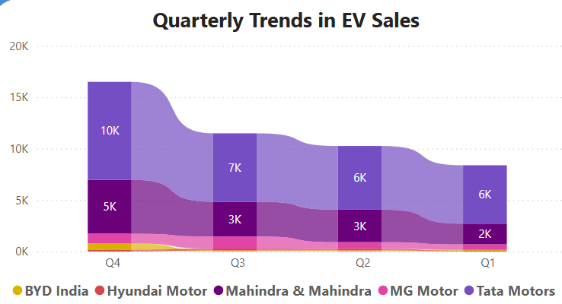
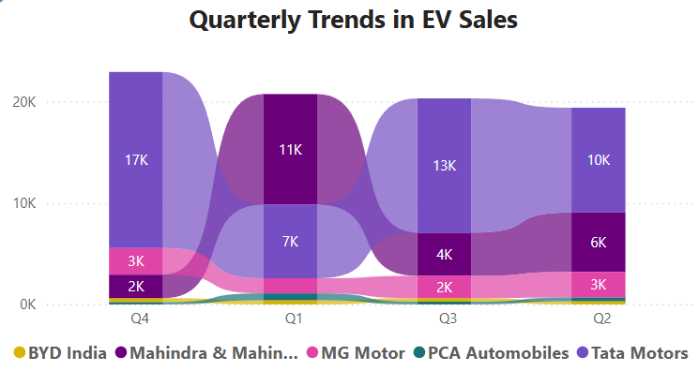
4. What are the quarterly trends based on sales volume for the top 5 EV makers (4-wheelers) from 2022 to 2024?
FY: 2023
FY: 2022
FY: 2024

Slide 11
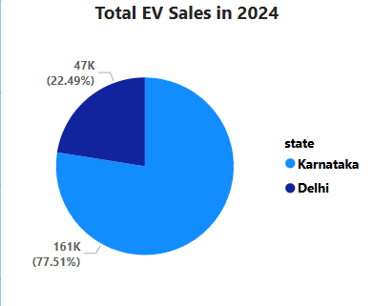
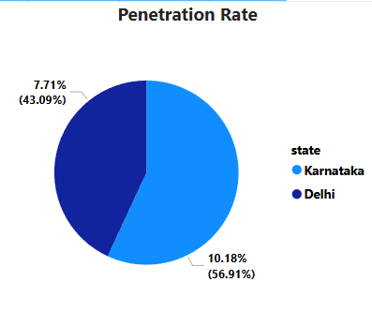
5. How do the EV sales and penetration rates in Delhi compare to Karnataka for 2024?

Slide 12
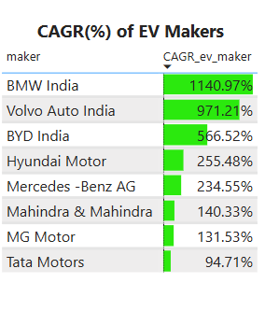
6. List down the compounded annual growth rate (CAGR) in 4-wheeler units for the top 5 makers from 2022 to 2024.

Slide 13
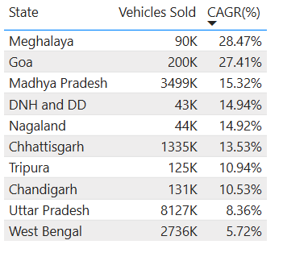
7. List down the top 10 states that had the highest compounded annual growth rate (CAGR) from 2022 to 2024 in total vehicles sold.

Slide 14
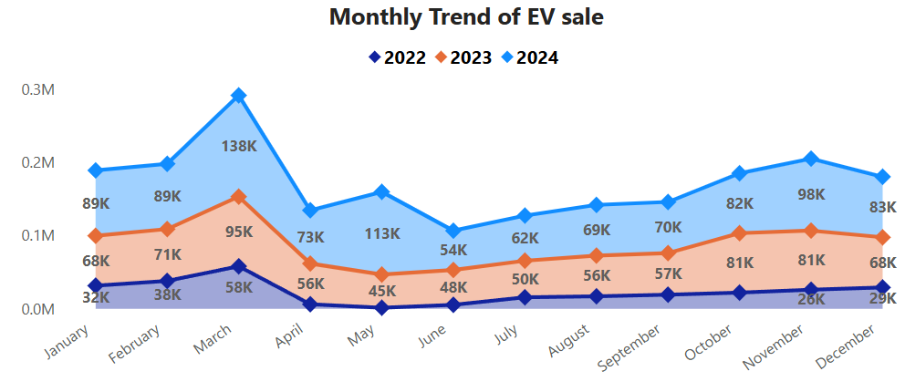
8. What are the peak and low season months for EV sales based on the data from 2022 to 2024?

Slide 15
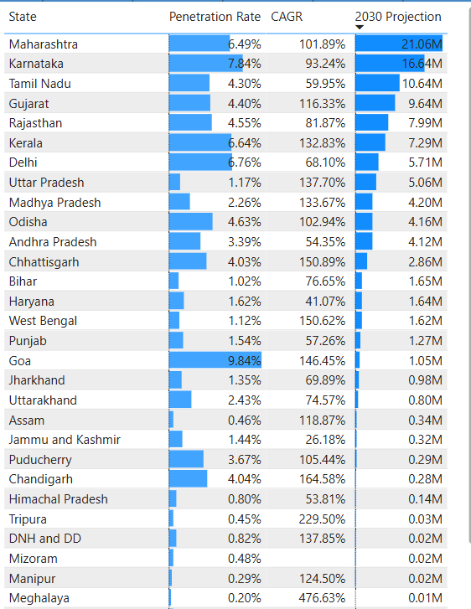
9. What is the projected number of EV sales (including 2-wheelers and 4 wheelers) for the top 10 states by penetration rate in 2030, based on the compounded annual growth rate (CAGR) from previous years?

