Slide 1
Analyzing Market Sentiments of Gold Commodity News Using NLP Techniques
Mini Project Presentation

Slide 2
Content
Introduction
Objectives
Methodology
Data Preprocessing
Sentiment Analysis Techniques
Implementation
Results
Conclusion

Slide 3
Introduction
This study explores how sentiment analysis methods can be applied to evaluate commodity news with a specific focus on the gold markets.
Investors and market participants must grasp and analyse sentiments within huge amounts of textual data.
Count Vectorizer and has been implemented for feature extraction and machine learning algorithm like random forest are both used for sentiment analysis

Slide 4
Objectives
To analyze the sentiment of news articles related to gold commodities using various NLP techniques.
To identify sentiment trends and their impact on the gold market.
To develop a model that can assist investors in making informed decisions.
Can NLP techniques effectively predict gold price movements based on news sentiment?

Slide 5
Methodology
Data Preprocessing:- Collecting high quality data set of 10,000+ news headlines of over 20 years which is related to gold commodity and are collected from diverse news source.
Noise Removal, tokenization, stop words removal, lowercasing and sorting is done to prepare the data
for training.
Feature Extraction:- After preprocessing, vectorization techniques are used to transform the data into numerical form. Either or both of the vectorization algorithms CountVectorizer and TfidfVectorizer can be used.
Model Training:- Now the vectorized data is then used to teach Random Forest machine learning models. Random Forest classifier takes multiple decision trees and take the average of the decision trees.
Model Evaluation:- After training, the models are evaluated using metrics such as precision, accuracy, F1-score and recall after training. The best performing model is then selected for more examination.
Sentiment Analysis:- Now the selected model is used to predict the sentiment of each headline in the dataset. The likelihood that a headline will fall into a negative, good or neutral class determines the headline’s sentiment.
Stock Price Prediction:- Finally, the sentiments can be used for the prediction of the gold stocks price, will the price go up or down based upon the prediction made using the data.

Slide 6
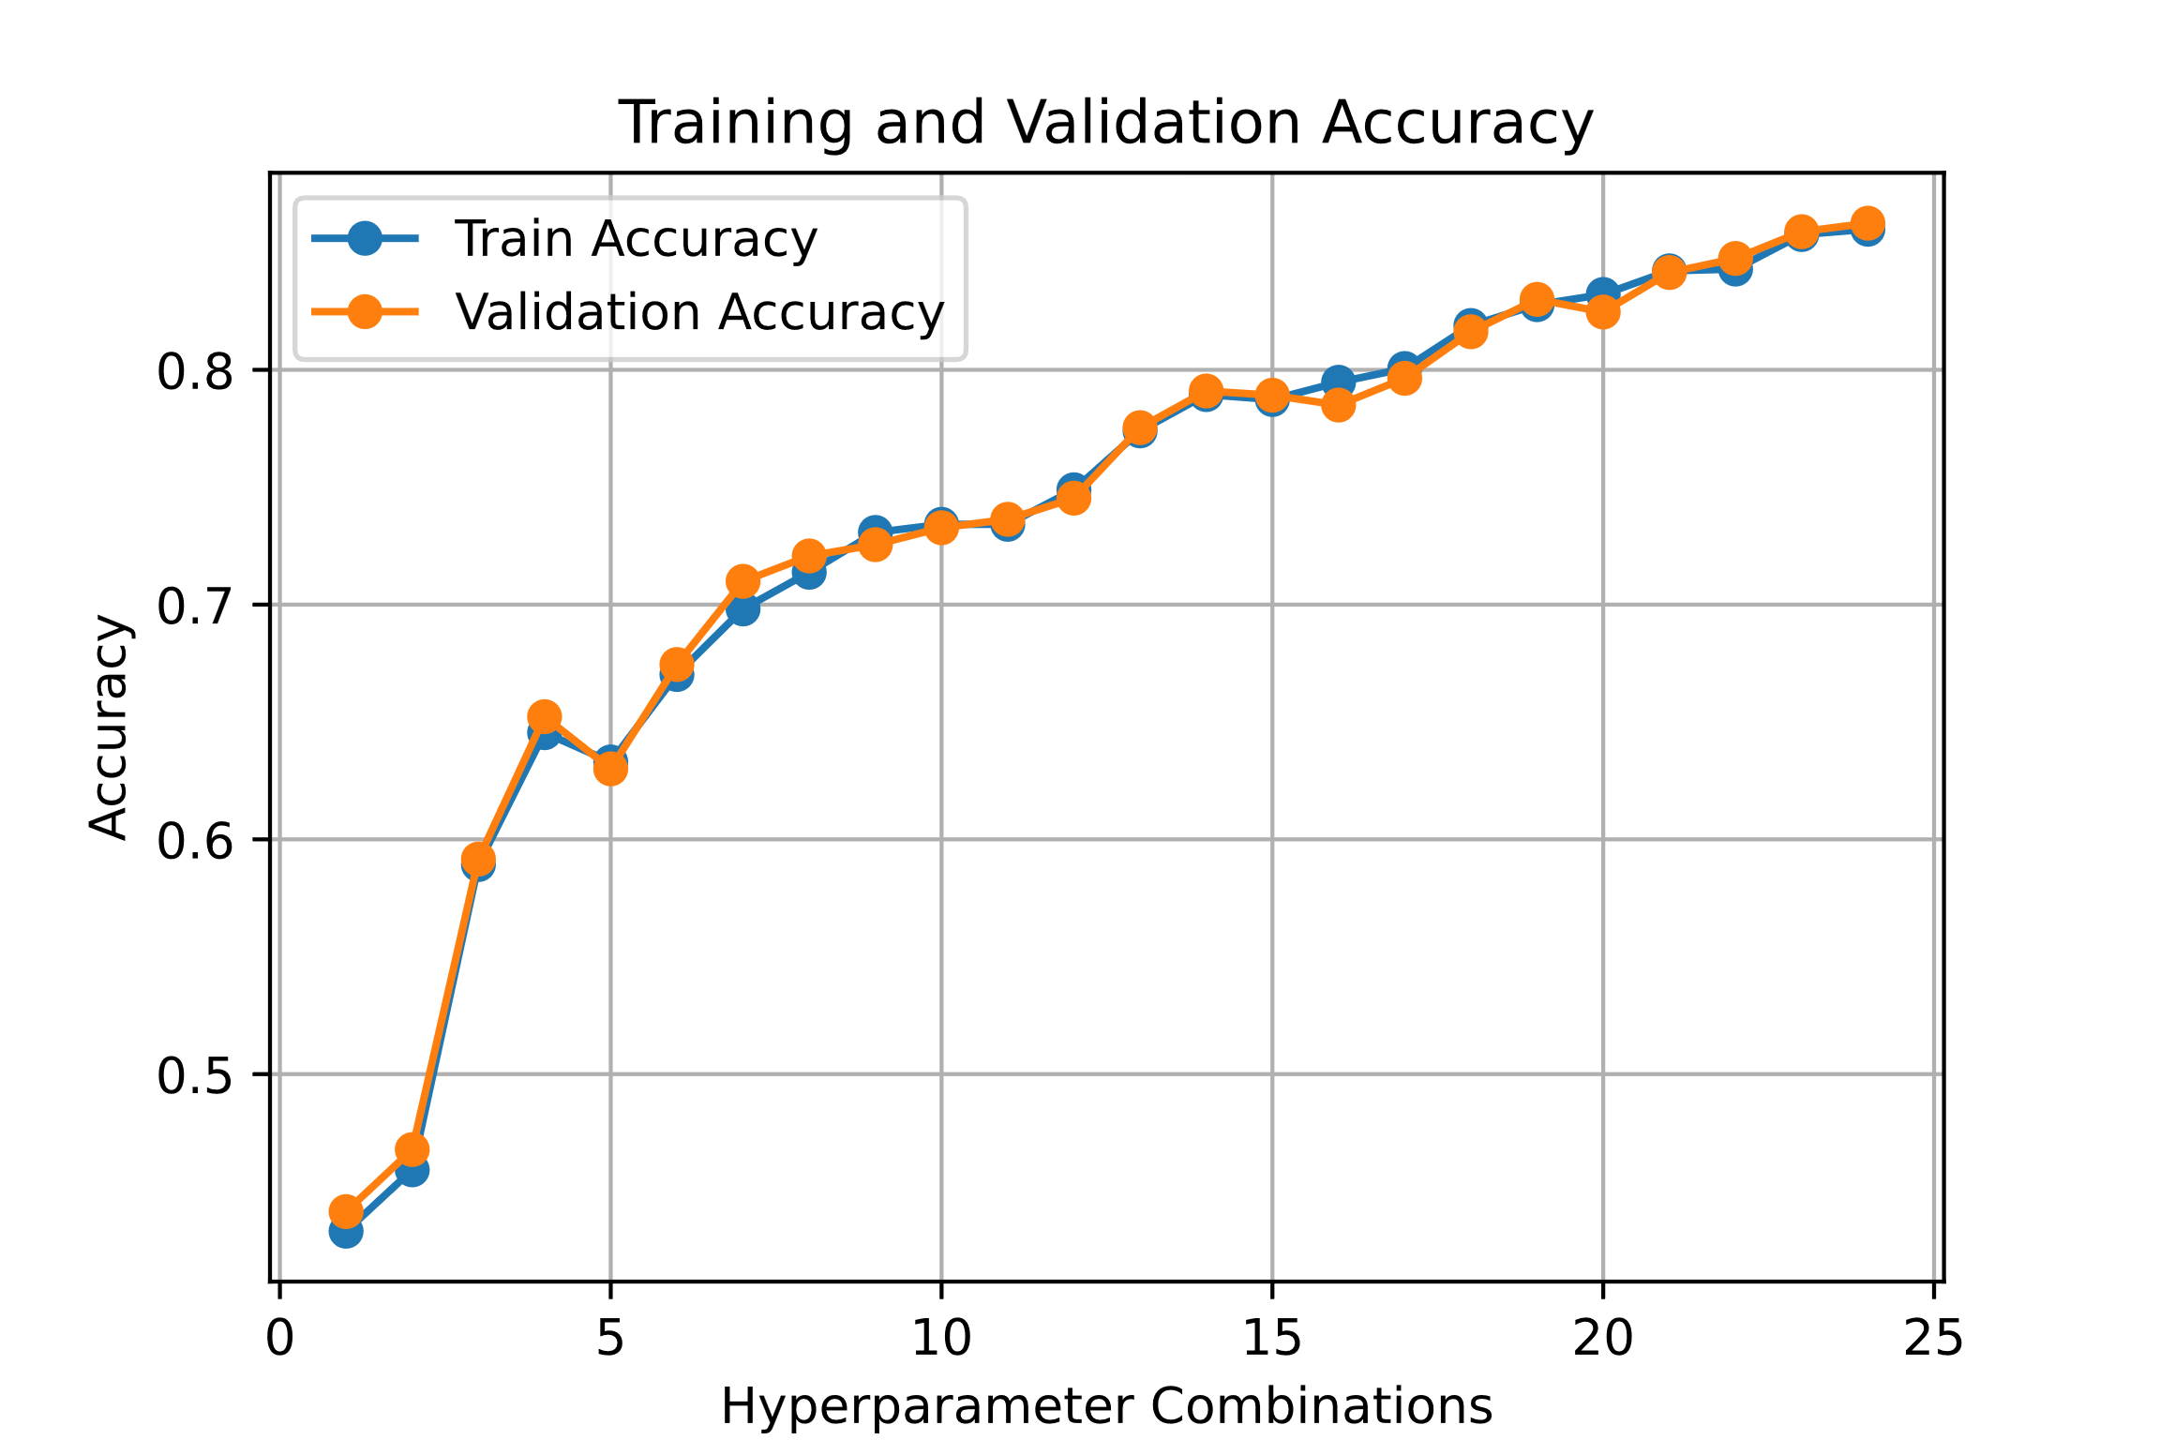
Results: Training and Validation Accuracy
shows the Training Accuracy vs Validation Accuracy. Here Validation Accuracy is 86.24%.

Slide 7
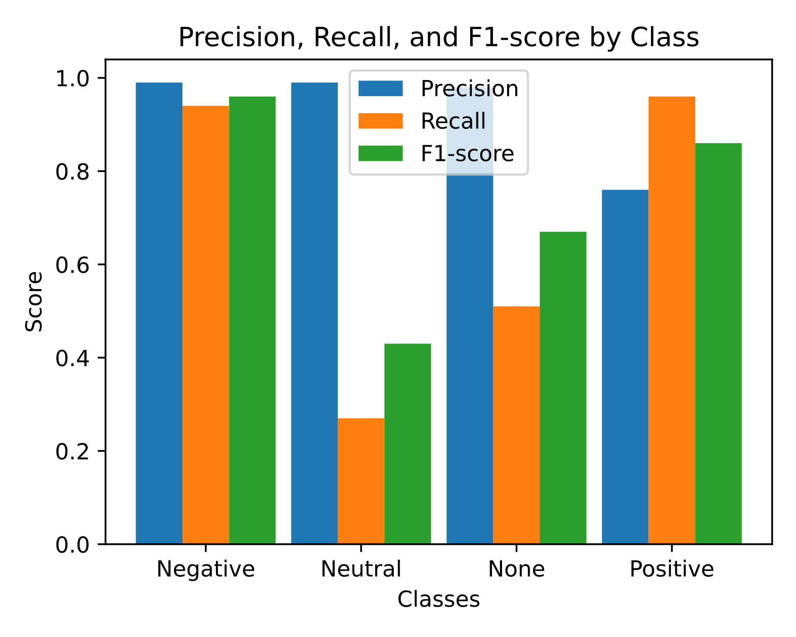
Performance Metrics
This grouped bar plot visualizes the performance metrics for each class. While the model performs well for positive, none and negative classes but it struggles with the neutral class showing relatively low recall and f1-score.

Slide 8
Tabular Representation of Evaluation metrics
The data shown in Table 1 are the values of the evaluation metrics in percentage achieved after training the random forest model.
Class | Precision | Recall | F-1 Score | Support
Positive | 76.0% | 99.0% | 86.0% | 701
Negative | 99.0% | 94.0% | 96.0% | 600
Neutral | 99.0% | 27.0% | 43.0% | 62
None | 98.0% | 51.0% | 68.0% | 302

Slide 9
Class Distribution of Sentiment
It shows the overall distribution of positive , negative, neutral and none sentiments in the dataset.

Slide 10
Conclusion
This has provided evidence that the CountVectorizer and Random Forest Algorithms are effective in sentiment analysis of stock price predictions. By converting the textual information into numerical features through CountVectorizer with classification capabilities of random forest, the model achieved high accuracy rate in identifying sentiment classes. Additionally, performance metrics were calculated to evaluate the performance of the model on various sentiment classes. Based on the results of evaluation it is suggested that there are possibilities to improve the model, mainly in enhancing the classification of ‘Neutral’ sentiment. But other than that, the model was able to achieve high prediction accuracy.

Slide 11
THANK YOU

