Slide 1
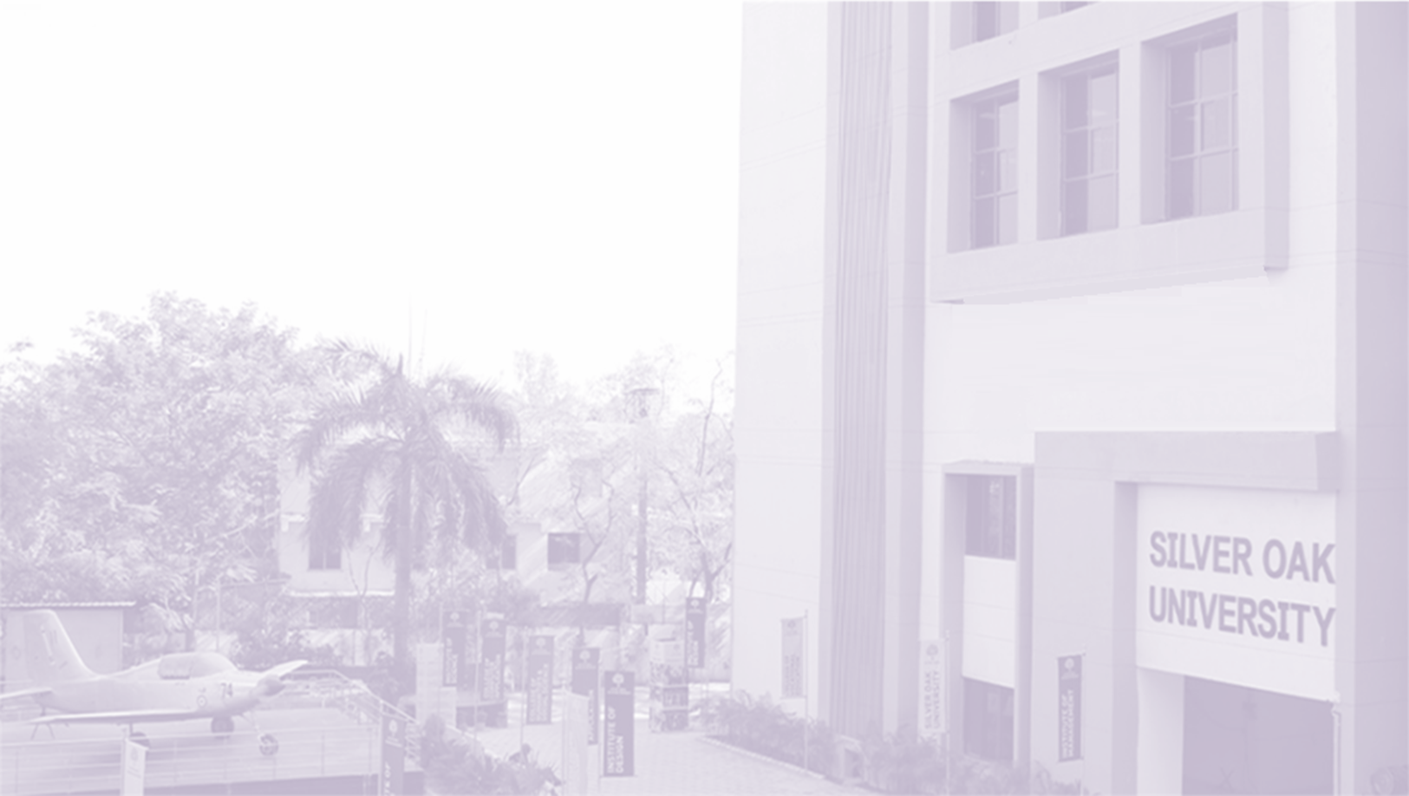

BTECH Computer Science Engineering
1010103494
MedVault - Smart Digital Health Record and Appointment System
Project ID | CSE_M2_41
Enrollment No | 2301031800016, 2301031800031, 2301031800084
Name | Mohit Kumar, Hemant Mali, Rahul Mali
Branch | Computer Science Engineering
Guide Name | Dr. Monali Suthar
Notes:
Course Code & Name: 1010063491(B.TECH(CSE-CS)-Minor Project,1010043494-Minor Project(B.TECH(CE)/(CSE),1010043493-Advanced Programming with Project-I(B.TECH(CE)/(CSE);Course Code & Name: 1010063491-Minor Project(CE-AIML)

Slide 2
Index
• Introduction
• Background and Motivation
• Relevance and Importance
• Literature review
• Research Gap
• Objectives
• Required Dataset,Tools and Technology
• Methodology
• Result
• Conclusion
• Future Work
• References

Slide 3
Introduction
• MedVault is a modern web-based Digital Health Ecosystem designed to connect Patients, Doctors, Receptionists, Administrators, and Pharmacists into a single platform.
• Replaces traditional paper-based prescriptions and fragmented manual OPD register entries with structured digital workflows.
• Features dedicated role-based portals for Patients (vitals & EMR vault), Doctors (consultation queue & digital Rx builder), and Receptionists (walk-in token management).
• Built using React 18, TypeScript, and Tailwind CSS on the frontend, powered by Supabase PostgreSQL for secure role-based data access.
• Goal: Create a lightweight, high-contrast, zero-delay healthcare portal that digitizes medical records and streamlines hospital consultations.
DEPARTMENT OF COMPUTER ENGINEERING
*Proprietary material of SILVER OAK UNIVERSITY

Slide 4
Background and Motivation
• Loss of Paper Prescriptions & Reports: Physical medical slips are easily misplaced or damaged, leaving doctors without patient medical history during follow-ups.
• Uncoordinated Reception & OPD Queues: Walk-in patients face long waiting lines without real-time updates between reception desks and doctor consultation rooms.
• Illegible Handwriting & Medication Risks: Handwritten prescriptions increase the risk of dosage confusion for pharmacists and patients.
• Lack of Centralized Digital Vaults: Patients struggle to access their lab diagnostic reports, vitals telemetry history, and active medication lists in one place.
• Motivation: Build an easy-to-use, high-performance web system that eliminates paper delays, automates OPD queue pushing, and generates verified digital A4 prescriptions.
DEPARTMENT OF COMPUTER ENGINEERING
*Proprietary material of SILVER OAK UNIVERSITY

Slide 5
Relevance and Importance
• Instant Consultation Queue Sync: Tokens created at reception immediately appear on the doctor's live queue without manual paper slips or page refreshes.
• Verified Digital Prescriptions: Doctors generate clean A4 digital prescriptions with dosage frequency (1-0-1), doctor signature stamp, and scannable QR verification.
• Patient Vitals Telemetry Tracking: Allows patients to track Blood Pressure, Heart Rate, SpO2, and Blood Glucose history in visual charts.
• Data Security & Row-Level Access: Ensures strict patient privacy where users only access their authorized medical records using Supabase RLS security policies.
• Scalable Architecture: Designed as an extensible foundation ready for government ABHA ID integration, video call telehealth, and hospital bed analytics.
DEPARTMENT OF COMPUTER ENGINEERING
*Proprietary material of SILVER OAK UNIVERSITY

Slide 6
Literature Review
Sr.No | Ref.No(Citation) | Algorithm / Approach | Dataset / Source | Key Result | Findings & Limitations
1 | [1] | Commercial Appointment Booking (Practo / Apollo 24/7) | Closed Commercial Database | Doctor search and appointment booking | Closed-source, subscription-based; lacks integrated reception token queue or doctor Rx generation.
2 | [2] | Legacy Hospital Information Systems (HIS) | Institutional Desktop Software | Internal hospital record management | Heavyweight desktop software; no patient-facing portal, digital health locker, or mobile access.
3 | [3] | Standalone EMR Storage Architectures | Clinical EHR Datasets | Centralized medical record storage | Focuses only on static storage; lacks live consultation line sync, digital signatures, or QR verification.
4 | [4] | Proposed MedVault Ecosystem | Supabase Relational Database | Integrated 5-role digital healthcare platform | Lightweight, open web architecture combining live reception queue push, digital Rx PDF export, and vitals telemetry.
DEPARTMENT OF COMPUTER ENGINEERING
*Proprietary material of SILVER OAK UNIVERSITY

Slide 7
Research Gap
• Commercial Platforms Lack Hospital-Side Integration: Platforms like Practo or Apollo 24/7 handle online booking but do not provide reception token generators or live doctor consultation queues.
• Legacy HIS Systems Are Heavyweight & Complex: Traditional hospital software requires expensive local server setups and lacks clean, responsive patient-facing web interfaces.
• No Integrated Prescription Signature Engine: Existing web portals rarely combine diagnosis entry, dosage frequency (1-0-1), doctor digital stamp, and A4 PDF export in one workflow.
• Fragmented Vitals Monitoring: Patients lack a unified digital health locker where live vitals, past prescriptions, and appointment records are accessible in one account.
• Research Gap Solved by MedVault: MedVault fills this gap by delivering a unified, role-based web platform that seamlessly connects Receptionists, Doctors, and Patients.
DEPARTMENT OF COMPUTER ENGINEERING
*Proprietary material of SILVER OAK UNIVERSITY

Slide 8
Objectives
• Design a Role-Based Healthcare Web Application providing customized portals for Patients, Doctors, Receptionists, Administrators, and Pharmacists.
• Implement Real-Time Reception Token Sync to automatically push walk-in patient tokens from reception desks to doctor consultation screens.
• Develop a Digital Prescription Studio featuring medicine selection, dosage timing (1-0-1), doctor digital stamp, and A4 PDF export with QR codes.
• Build a Patient Health Vault for tracking Blood Pressure, Heart Rate, SpO2, and Blood Glucose with digital document storage.
• Enforce Database-Level Row Security (RLS) using Supabase PostgreSQL to protect sensitive patient records and maintain medical privacy.
DEPARTMENT OF COMPUTER ENGINEERING
*Proprietary material of SILVER OAK UNIVERSITY

Slide 9
Required Dataset,Tools and Technology
• Frontend UI Framework: React 18, TypeScript, Tailwind CSS v4, Lucide React Icons
• State Management & Sync: Zustand central state store for real-time consultation queue updates
• Database & Security: Supabase PostgreSQL database with Row Level Security (RLS) policies
• PDF & QR Export Engine: jsPDF and html2canvas for generating verified digital A4 prescription PDFs
• Development IDE & Tools: Visual Studio Code, Vite Build Tool, Git Version Control
• Deployment (Planned): Vercel / Render cloud deployment for high-availability access
• Dataset: Not Applicable — System operates on real-time data generated by logged-in Patients, Doctors, and Receptionists.
DEPARTMENT OF COMPUTER ENGINEERING
*Proprietary material of SILVER OAK UNIVERSITY

Slide 10
Methodology
• Requirement Analysis: Identified operational bottlenecks in hospital OPD queues, paper prescriptions, and patient record tracking.
• System Architecture Design: Modularized the application into 5 interconnected role-based portals using React components.
• Database Modeling: Designed normalized PostgreSQL database tables for Users, Patients, Doctors, Appointments, and Prescriptions.
• State & Event Sync Implementation: Built Zustand store handlers to sync reception token entries directly with doctor consultation queues.
• Prescription Generator Development: Implemented A4 PDF rendering engine with digital doctor stamps and scannable QR verification.
• Testing & UI Refinement: Performed module-wise functional testing and enforced high-contrast accessible styling.
DEPARTMENT OF COMPUTER ENGINEERING
*Proprietary material of SILVER OAK UNIVERSITY

Slide 11
Result
• Patient Vault Completed: Live vitals dashboard (BP, HR, SpO2), digital health locker, and online appointment booking fully operational.
• Doctor OPD Studio Completed: Real-time patient queue list, digital prescription maker with 1-0-1 dosage options, doctor stamp, and PDF export fully working.
• Reception Desk Completed: Walk-in patient registration form, token creation, and live line synchronization working without page refreshes.
• Database & Security Verified: PostgreSQL schema deployed on Supabase with Row Level Security (RLS) policies protecting user records.
• Expected by Final Review: Complete integration of ABHA government ID lookup, emergency vitals triage, and WebRTC video call telemedicine.
DEPARTMENT OF COMPUTER ENGINEERING
*Proprietary material of SILVER OAK UNIVERSITY

Slide 12
Conclusion
• MedVault successfully bridges the gap between Patients, Doctors, and Receptionists by unifying healthcare operations into one modern web platform.
• Replaces unreadable paper prescriptions with verified digital A4 PDFs containing dosage guidance and scannable QR verification.
• Eliminates OPD queue delays through live reception-to-doctor token synchronization.
• Demonstrates a lightweight, high-performance web architecture that is easy to deploy, highly secure, and accessible on any device.
DEPARTMENT OF COMPUTER ENGINEERING
*Proprietary material of SILVER OAK UNIVERSITY

Slide 13
Future Work
• ABDM Government ABHA Health ID Integration: Connecting with national health gateways for 1-click cross-hospital EMR data decryption.
• Algorithmic Emergency Vitals Triage: Automated risk scoring (BP > 165/105 mmHg) to re-rank critical patients to Priority #1 in doctor queue.
• Native WebRTC P2P Telemedicine: Direct browser-to-browser encrypted video consultation with live canvas prescription drawing.
• Hospital Bed Occupancy & Inventory Analytics: Tracking available ICU/General beds and pharmacy stock levels for hospital administrators.
DEPARTMENT OF COMPUTER ENGINEERING
*Proprietary material of SILVER OAK UNIVERSITY

Slide 14
References
• S. A. Sanjiv, M. S. Krishna, J. Vigneshwaran, and K. Pradeepa, "Web Based Doctor Appointment Application Management System," International Journal of Creative and Open Research in Engineering and Management (IJCOREM), vol. 2, no. 4, Apr. 2026, doi: 10.55041/ijcope.v2i4.797.
• U. Pawar, S. Ponnusamy, D. J. Ahirrao, K. B. Mali, Y. S. Mahajan, and A. P. Irle, "MediNexus AI: An Intelligent Healthcare Appointment & Consultation Platform," International Scientific Journal of Engineering and Management (ISJEM), vol. 5, no. 5, May 2026, doi: 10.55041/ISJEM07131.
• H. Gehani, S. Rathkanthiwar, S. Jaiswal, K. Jaisinghani, A. Saonerkar, and A. Buche, "HealiQ: A Web-Based Doctor Appointment and Disease Prediction System for Smart Healthcare," Genetics and Molecular Research, vol. 25, no. 6s, 2026.
• M. Z. V. Affandi, F. I. Almeyda, M. F. Nazaruddin, and F. Mutaqin, "Development of a Web-Based Booking Portal System for a Hospital Information System," Journal of Artificial Intelligence and Engineering Applications, vol. 5, no. 3, Jun. 2026.
• A. Pariyar, S. H. R., and N. Kaur, "Enhancing the Healthcare System Through Mobile-Based Doctor’s Appointment Booking Application," Annals of Forest Research, vol. 66, no. 1, pp. 3143–3150, 2023.
DEPARTMENT OF COMPUTER ENGINEERING
*Proprietary material of SILVER OAK UNIVERSITY

