Slide 1
COVID PROTECTOR
Presented By:
MOHIT CHAUHAN(191500457)

Slide 2
OUTLINE
About the Project
Objective
Requirements
Snapshots from the website

Slide 3
ABOUT THE PROJECT
COVID PROTECTOR is an app which helps people to check weather they are ready to go outside their home , have taken proper precautions , they can check if they have COVID-19 symptoms and FAQ’s about and COVID-19 details.

Slide 4
OBJECTIVE
The main objective of this application is to provide information to people as on internet there is a lot of information about covid-19 virus but it can lead to confusion so to make it precise and helpful for all I developed this application.

Slide 5
REQUIREMENTS
Software Specification Used:-
Software used:Android Studio
Languages/Technologies Used: Java, XML
User Interface Design : Android Application

Slide 6
Hardware Used:
Processor Used: Intel i5
Operating System: Windows 10
RAM: 8 GB
Hardware Devices: Computer System
Hard Disk:1 TB

Slide 7
THIS IS HOW MY APP LOOKS
Hope you will like it :)

Slide 8
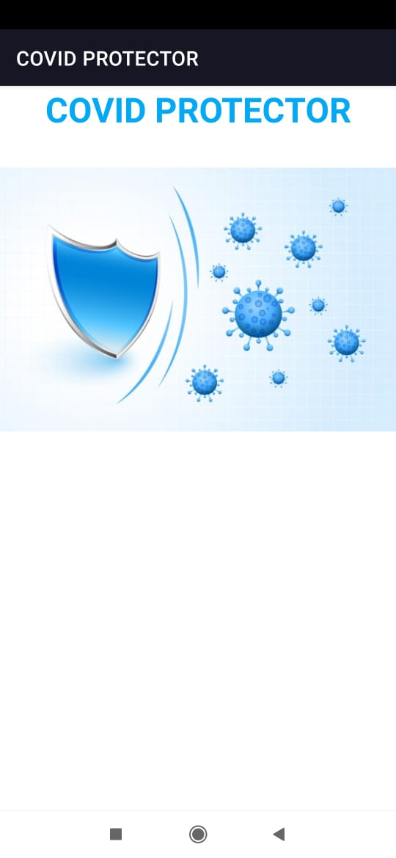
Splash Screen

Slide 9
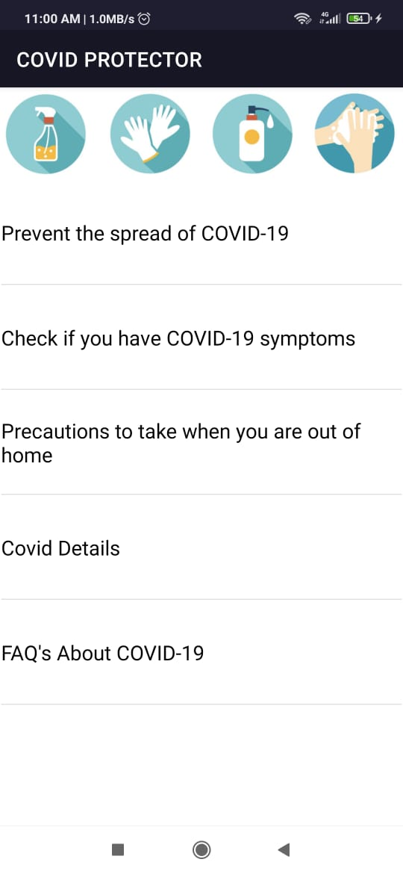
2. Main Screen

Slide 10
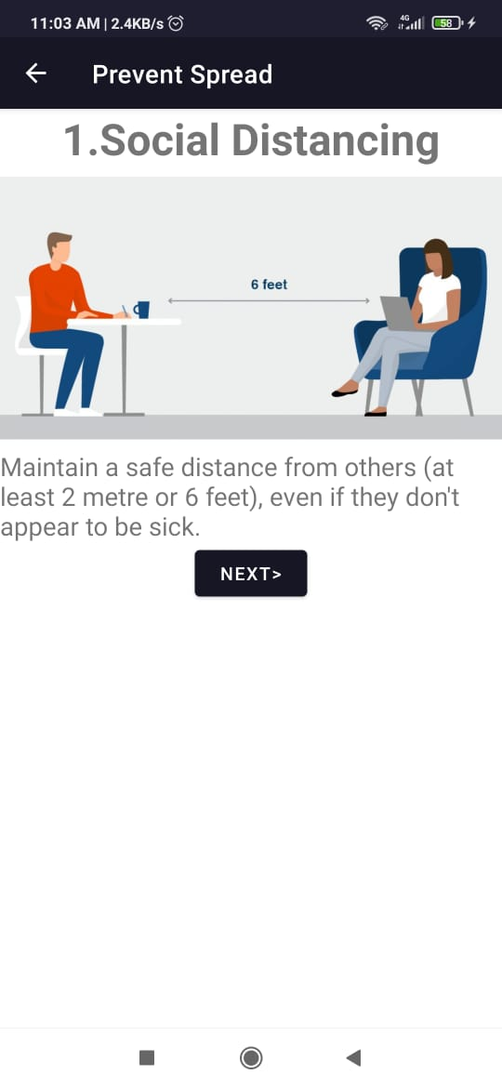
3.

Slide 11
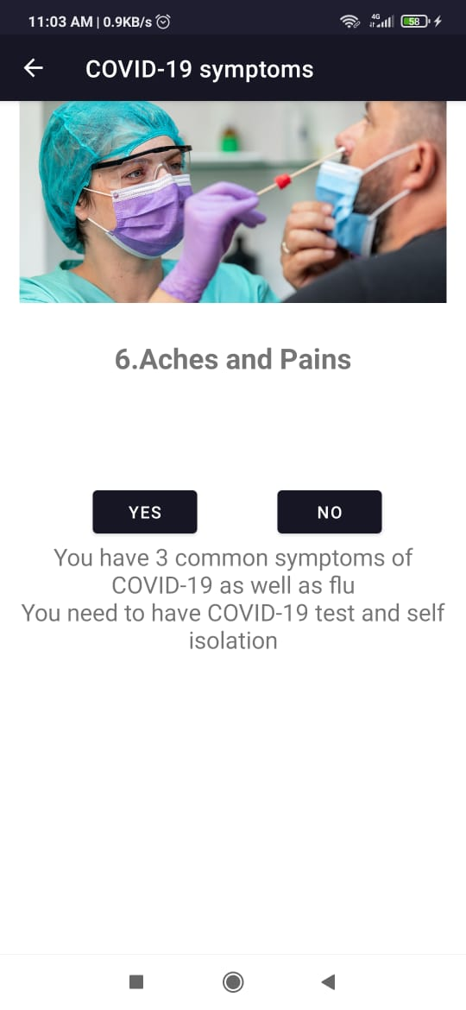
4.

Slide 12
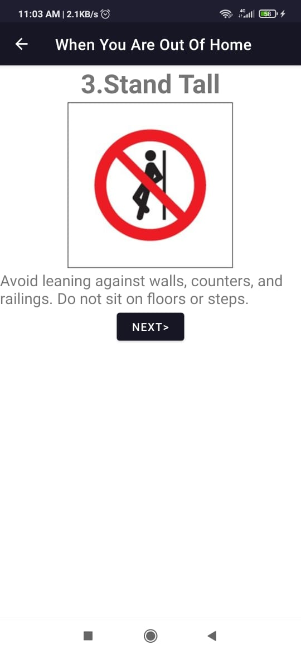
5.

Slide 13
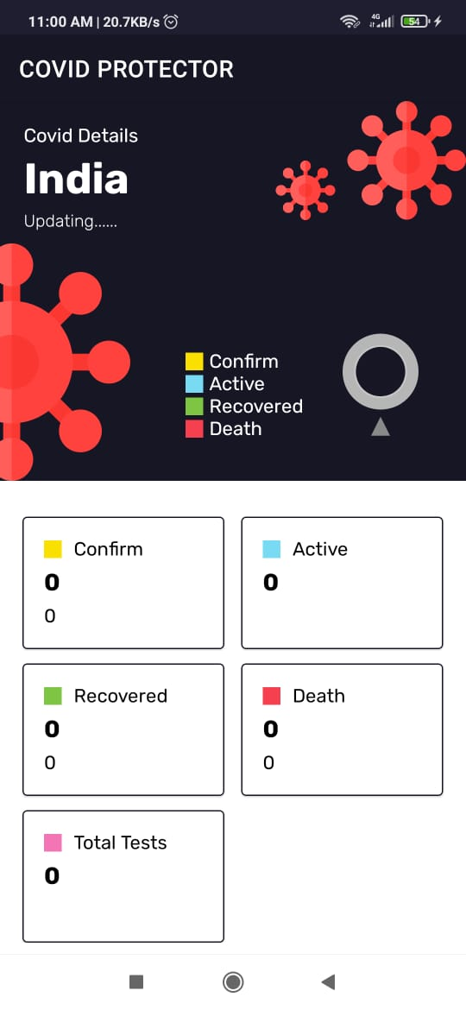
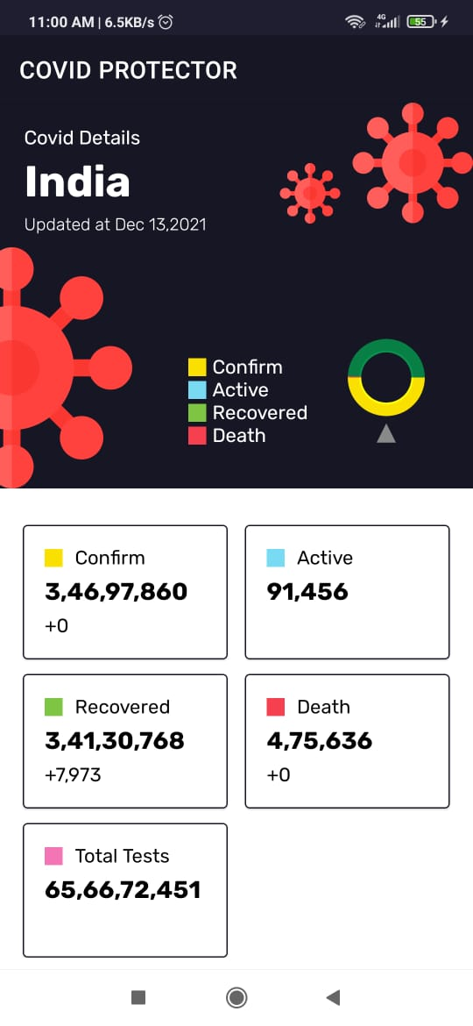
6.

Slide 14
Thank You!!!

