Slide 1
NextHikes IT Solutions
Basic Calculator using Python & Tkinter
By Mohit Singh

Slide 2
Introduction
A calculator is an essential tool used for performing basic mathematical operations in daily life.
It helps in solving calculations quickly and accurately.
This project focuses on developing a graphical calculator using Python programming language.
The Tkinter library is used to design the graphical user interface of the application.
Unlike command-line programs, this calculator provides an interactive and user-friendly experience.
Users can perform operations using buttons and a display screen.
The application follows event-driven programming concepts.
This project demonstrates practical implementation of Python GUI development.

Slide 3
Objective of the Project
• To develop a user-friendly graphical calculator application. • To perform basic arithmetic operations accurately. • To design an interactive interface using Tkinter. • To replace command-line calculation with GUI-based system. • To handle user input efficiently through buttons. • To implement error-free calculation process. • To store recent calculation history for reference. • To improve problem-solving and logical programming skills. • To understand event-driven programming concepts. • To build a real-world Python application

Slide 4
Tools & Technologies Used
Python Programming Language Used as the main language to write calculator logic and functions.
Tkinter Library (GUI) Used to create buttons, display screen, and graphical interface.
Visual Studio Code Used as the code editor for writing and testing the program.
GitHub Used to store, manage, and share the project code online.

Slide 5
Calculator Layout Design
Layout Structure of the Application
• The calculator window is created using the Tk() main root window.
• An Entry widget is placed at the top to display numbers, expressions, and results.
• A Frame container is used to organize all calculator buttons properly.
• The Grid layout manager is used to align buttons in rows and columns.
• Buttons are evenly spaced using padding and column weight configuration.
• The Equal (=) button is designed larger for better visibility and user experience.
• The layout is responsive and structured for clean and organized appearance.

Slide 6
Application Architecture
User clicks button
⬇
Value sent to function
⬇
Expression built
⬇ Evaluation performed
⬇ Result displayed

Slide 7
User Interface Design
UI Components
• Entry box for display – Shows the typed numbers, expressions, and final result of calculations.
• Number buttons (0–9, 00) – Used to input numeric values quickly into the calculator.
• Operation buttons – Used to perform actions like +, −, ×, ÷, and %.
• Equal (=) button – Calculates and displays the final result of the expression.
• History button – Displays the last 5 previous calculations for quick reference and reuse.

Slide 8
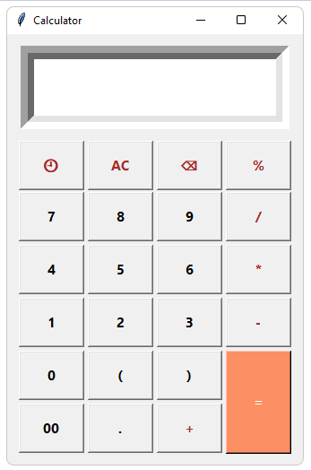
Final Calculator User Interface

Slide 9
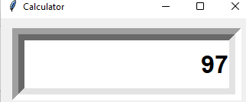
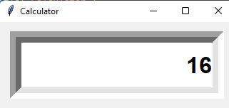
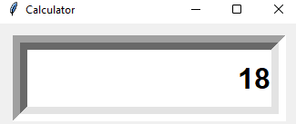
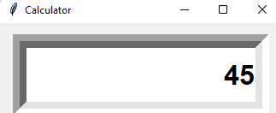
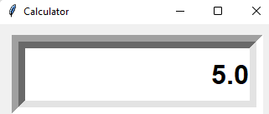
Calculator Functions
Addition (+) – Adds two numbers together (Example: 65 +32 = 97)
Subtraction (−) – Finds the difference between two numbers (Example: 32 − 16 = 16)
Multiplication (×) – Multiplies numbers to get product (Example: 6 × 3 = 18)
Backspace (⌫) – Deletes last entered digit (Example: 456 → 45)
Division (÷) – Divides one number by another (Example: 20 ÷ 4 = 5)

Slide 10
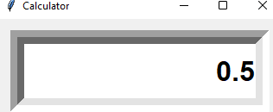
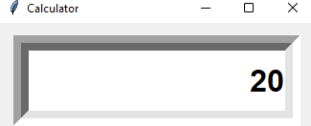
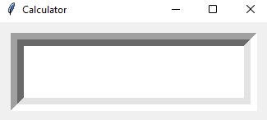
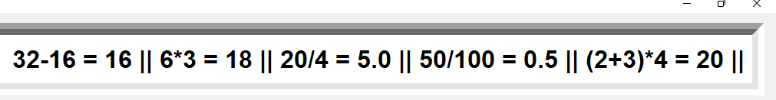
Calculator Functions
Percentage (%) – Converts number into percentage value (Example: 50% = 0.5)
Brackets ( ) – Controls calculation order (Example: (2 + 3) × 4 = 20)
Clear Button (AC) – Removes all input from screen
History Feature – Stores recent calculations ( shows last five expression + result History)

Slide 11
Main Functional Modules
Key Functions Explained :
press(value) - Handles button clicks by inserting numbers and operators into the display, and automatically adds multiplication when brackets are used.
equal() - Evaluates the entered mathematical expression, displays the result, and stores it in the history.
clear() - This function completely clears the calculator display so the user can start a new calculation.
backspace() - This function removes the last entered digit or operator from the display, allowing quick correction of input mistakes.
history() - This function displays the last five stored calculations on the screen, helping users review previous results.

Slide 12
Challenges Faced
• Designing a clean and user-friendly calculator interface • Aligning buttons properly using grid layout • Handling long mathematical expressions on small display • Managing incorrect or incomplete user input • Preventing crashes during calculation • Implementing calculation history feature • Limiting history storage efficiently • Resetting display after showing result • Handling special operations like percentage and brackets • Debugging layout and logic error

Slide 13
Solutions Implemented
• Used proper spacing, fonts, and organized layout for clean interface • Applied Tkinter grid system with padding and column configuration • Implemented dynamic input handling for long expressions • Used try-except block to manage incorrect input safely • Added error handling to prevent application crashes • Used Python list to store calculation history • Limited history storage to last five results • Implemented result reset logic after calculation • Added special logic for percentage and brackets • Tested and debugged layout and program logic thoroughly

Slide 14
Thank you

