Slide 1


Mohit Dadhich
09-11-2024

Slide 2

Event Overview
The GenAI Hackathon APAC Edition, powered by Hack2skill
Purpose
To encourage innovative AI solutions addressing
real-world challenge
Duration
29th January 2024 – 3rd May 2024
Team
1-4 members
Age
18+ only
Region
Asia Pacific (APAC)

Slide 3

Participation Statistics
Total Registrations: 38,000+
Teams Formed: 28,000+
Countries Involved: 18+ APAC countries.
Ideas Submitted: 2,400+.

Slide 4

Program Highlights
Masterclasses/Webinars:
14 sessions on Google Cloud GenAI tools.
Shortlisting Process:
Initial submissions: 2,400 ideas.
First shortlist: 350 teams
Finalists: 10 teams.
Price Pool
$35000

Slide 5

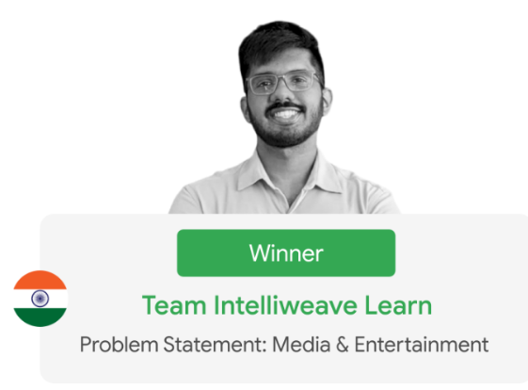
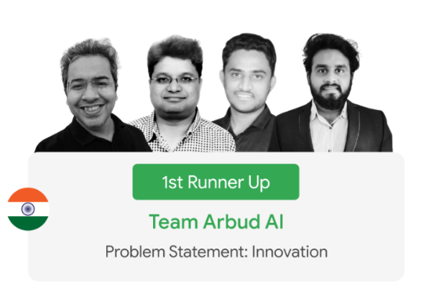
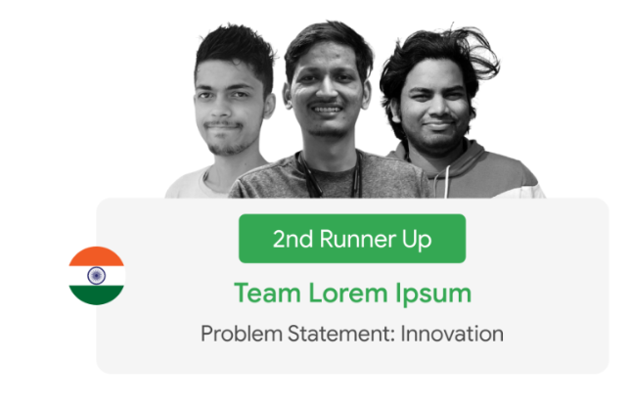
Key Milestones Achieved

Slide 6





Challenge Theme
Banking & Financial Services
Fraud Detection
Personalized Financial
Advice
Customer Service Automation
Compliance
Risk Management

Slide 7





Challenge Theme
Retail & ECommerce
Hyper-personalized Product Recommendations
Fraud Detection (Pattern Analysis)
AI-powered Supply Chain Optimization (Simulations)
Inventory Management (Demand Forecasting)
Immersive Shopping Experiences (AR/VR)

Slide 8





Challenge Theme
Manufacturing
Predictive Maintenance (Sensor Data Analysis)
Smart Logistics (Shipment Tracking and Inventory Management)
Automated Quality Control (Computer Vision)
Sustainable Manufacturing (Waste Reduction and
Efficiency Optimization)
Optimized Production Planning (Demand & Supply Forecasting)

Slide 9





Challenge Theme
Media & Entertainment
Personalized Content Recommendations
Automated Content
Creation
Sentiment Analysis and Audience Insights
Interactive Storytelling
Proactive Misinformation Detection
Personalized Learning Experiences

Slide 10


Challenge Theme
Innovation
Explainable AI
Addressing Global Challenges

Slide 11

Challenges Faced
Delays in Deliverables
Some teams faced issues with project timelines.
Resource Shortages
Limited access to necessary tools and mentorship
for some participants

Slide 12
Impact Of Challenges
Timeline Adjustment
Some projects required extensions to meet quality
standards
Team Morale
Initial setbacks affected team motivation but were
addressed through additional support

Slide 13
Action Plan For Future Events
Increase Resources
Request additional mentors and tools for participants
Enhanced Communication
Regular updates and check-ins with teams to monitor
progress
Feedback Mechanism
Implement post-event surveys to gather insights for
improvement

Slide 14
Conclusion
The GenAI Hackathon was a resounding success, showcasing innovative ideas and fostering collaboration across the APAC region.
Acknowledgment of all participants and sponsors for their contributions.

Slide 15

THANK YOU !!!

