Slide 2
Micro Services

Slide 3
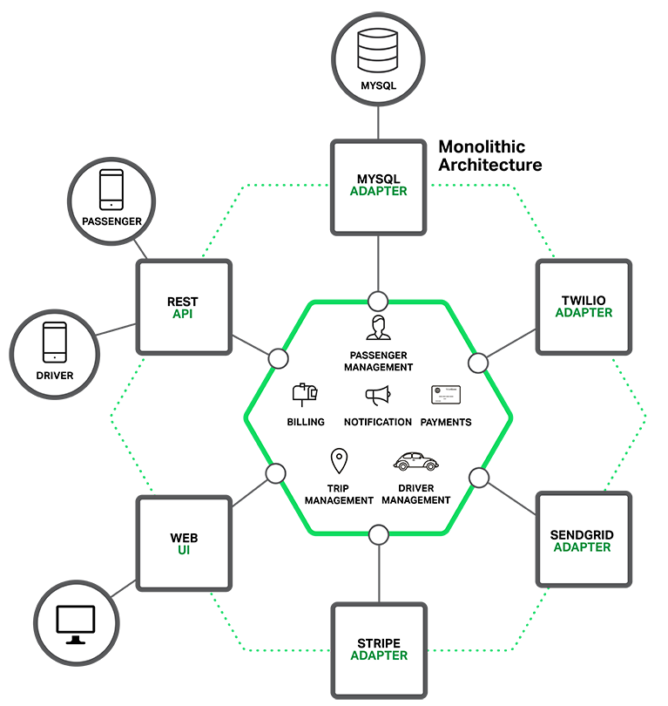
Monolith Architecture

Slide 4
contd..
At core is the business logic– implemented by modules defining services, domain objects, and events; surrounded by adapters interfacing the external world. E.g. database access components, messaging components web components.
The application is packaged and deployed as a monolith, despite having a logically modular architecture. The actual format depends on the application’s language and framework.
Java applications are packaged as WAR files and deployed on application servers such as Tomcat or Jetty.
Applications written in this style are simple to develop, test and deploy as IDEs and other tools are focused on building a single application. The packaged application is copied onto the server.

Slide 5
contd..
Applications grow over time and eventually becoming huge. The application is scaled by running multiple copies behind a load balancer. In the early stages of the project it works well.
During each sprint, the development team implements a few more issues, which, of course, means adding many lines of code. The application is complex and any attempts at agile development and delivery will flounder.
It’s simply too large for any single developer to fully understand. As a result, fixing bugs and implementing new features correctly becomes difficult and time consuming.
This tends to be a downwards spiral and if the codebase is difficult to understand, then changes won’t be made correctly
The larger the application, the longer the start‑up time. E.g. a survey with developers reported the start‑up time as 12 minutes.

Slide 6
contd..
Monolithic application is complex, obstruction to continuous deployment and difficult to scale as different modules have conflicting resource requirements.
Monolithic applications also have issues of reliability, as all modules are running within the same process, a bug in any module, e.g. memory leak, can potentially bring down the entire process.
Monolithic applications make it extremely difficult to adopt new frameworks and languages.

Slide 7
Solution – MicroService Architecture.
Microservices is a form of service-oriented architecture style, wherein applications are built as a collection of independent, smaller, loosely coupled services rather than one whole app.
Development process is more efficient by parallelizing small teams to work on different services. Easy to develop, test & deploy.
Microservice Architectures evolved as a solution to the scalability and innovotation challenges with Monolith architectures.
Microservice is the process of implementing Service-Oriented Architecture (SOA) by dividing the entire application as a collection of interconnected services, where each service serve only one business need.
Sam Newman defined microservice as Small autonomous services that work together. SOA is a design pattern and MicroService is implementation methodology.

Slide 8
contd..
Developing a Microservice-oriented application will include the following approaches –
Independent: Each microservice should be independently deployable.
Coupling: All microservices should be loosely coupled with one another such that changes in one will not affect the other.
Business Goal: Each service unit of the entire application should be the smallest and capable of delivering one specific business goal.

Slide 9
Advantages of using Microservice
Small-size: A service should not perform more than one business task, so it will be small in size and easy to maintain.
Focused: One microservice should be full stack in nature and should be committed to delivering only one business property.
Autonomous: Each microservice is an autonomous business unit of the entire application. So application becomes loosely coupled.
Technology heterogeneity: By implementing a heterogeneous system, max security, speed and a scalability can be achieved.
Resilience: Resilience is a property of isolating a software unit. Hence if one unit fails it does not impact the entire business.
Ease of deployment: The app is sub-divided into small units, each can be deployed in any environment very easily with less time complexity

Slide 10
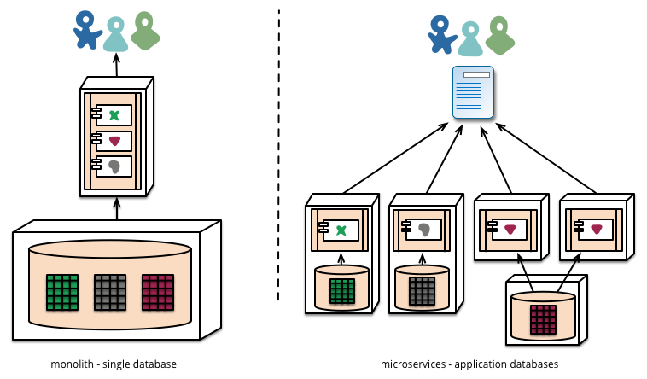
contd..

Slide 11
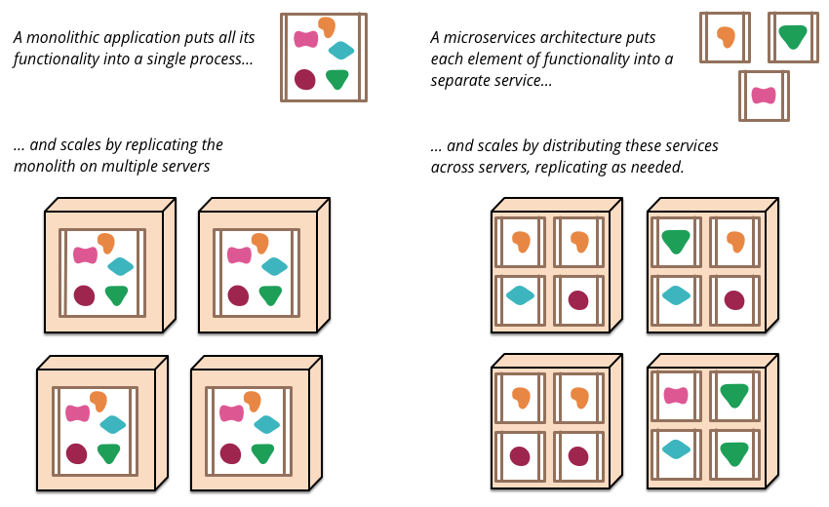
contd..

Slide 12
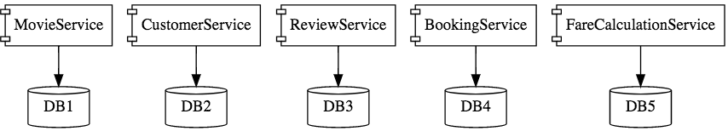
contd..
This is how the microservice application would look like –
Microservice Architectures involve a number of small, well designed, components interacting with messages.

Slide 13
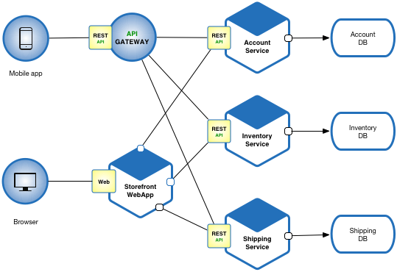
contd..

Slide 14
Challenges to MicroServices Architecture
Quick Setup needed : Developer should be able to create microservices quickly.
Automation : As a number of smaller components are involved, its imperative automate - Builds, Deployment, Monitoring etc.
Visibility : Needs large and auto monitoring as large number of smaller components are deployed and maintained.
Bounded Context : Microservice boundaries get evolved, so bounded contexts from domain design can be the start point.
Cost : Microservice is costly, as it requires to maintain different server space for different business tasks.
Configuration Management : Hundreds of configurations exist across application, hence need for config management.

Slide 15
contd..
Consistency : It is important to have some decentralized governance around the languages, platforms, technology and tools.
Dynamic Scale Up and Scale Down : Microservices can be relished if the applications can scaled up and down easily in the cloud.
Pack of Cards : Microservices should be fault tolerant by Design. If bottom of the chain fails, it can have knock-on effects on others.
Debugging : Centralized logging and dashboards are essential to make it easy to debug problems. As multiple services are involved.
Distributed system : A huge set of skilled professionals are required to support this big heterogeneous distributed software.
Enterprise readiness : It is quite difficult to make a microservice application enterprise ready compared to conventional software development model.

Slide 16
contd..
Solutions to Challenges with Microservice Architectures
Enable building production ready applications quickly
Provide non-functional features
embedded servers (easy deployment with containers)
metrics (monitoring)
health checks (monitoring)
externalized configuration

Slide 17
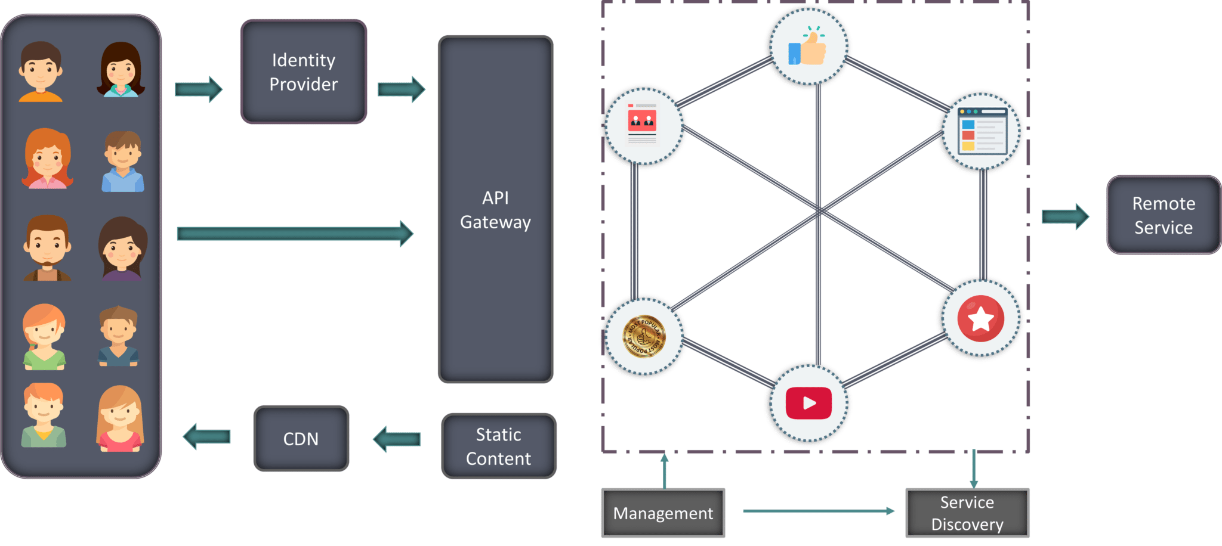
Components of MSA

Slide 18
contd..
Clients – Different users from various devices send requests.
Identity Providers – Authenticates user or clients identities and issues security tokens.
API Gateway – Handles client requests.
Static Content – Houses all the content of the system.
Management – Balances services on nodes and identifies failures.
Service Discovery – A guide to find the route of communication between microservices.
Content Delivery Networks – Distributed network of proxy servers and their data centers.
Remote Service – Enables the remote access information that resides on a network of IT devices.

Slide 19
Spring Boot
Spring Boot enables building production-ready applications quickly and provides non-functional features.
It helps in monitoring the multiples components and configuring those components externally
Auto-configuration intelligently provides a set of default behaviors that are driven by what jars are on the classpath.
Simplifies deployment by letting user package an application as an executable jar containing a pre-configured embedded web container (Tomcat or Jetty).
No need to install and configure Tomcat or Jetty on servers. Instead, to run your micro-service just have Java installed.

Slide 20
Spring Cloud
It is building blocks for Cloud and Microservices
It provides microservices infrastructure like provide use services such as Service Discovery, a Configuration server and Monitoring.
It provides several other open source projects like Netflix OSS.
It provides PaaS like Cloud Foundry, AWS and Heroku.
It uses Spring Boot style starters
Spring Cloud provides solutions to cloud enabled microservices. It leverages and builds on top of some of the cloud solutions open sourced by Netflix (Netflix OSS).
The evolution of the cloud and AWS in particular has reduced the operational complexity of building-deploying-operate microservices
Many of the products or systems being built with microservices are by teams with extensive experience of Continuos Delivery and it's precursor Continuous Integration.

Slide 21
contd..
Important Spring Cloud Modules
Naming Server (Eureka)
Ribbon (Client Side Load Balancing)
Feign (Easier REST Clients)
Visibility and Monitoring
Zipkin Distributed Tracing
Netflix API Gateway
Configuration Management
Spring Cloud Config Server
Fault Tolerance with Hystrix
There are many use-cases supported by Spring Cloud like Cloud Integration, Dynamic Reconfiguration, Service Discovery, Security, Client-side Load Balancing etc

Slide 22
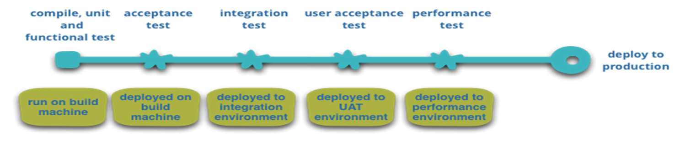
contd..
Illustration of the discussion in the build pipeline shown below.

Slide 23
contd..
Best Practices of Microservices Architecture
Separate data store for each Microservice
Keep code of a similar level of maturity.
Separate build for each Micro service
Always treat- sever as stateless.

Slide 24
Annotations
1. @EnableConfigServer
This Spring Cloud annotation turns application into a server that other apps can use to get their configuration. This is a very useful annotation using Spring Cloud, user can have one dedicated Java service for Configuration.
2. @EnableEurekaServer
This Spring Boot annotation makes the application a Eureka discovery service, which other applications can use to locate services through it. This is an important step in developing microservices in Java using Spring Cloud.
3. @EnableDiscoveryClient
This Spring Cloud annotation makes an application register in the service discovery and discovers other services through it.

Slide 25
contd..
4. @LoadBalanced
Used as a marker annotation indicating that the annotated Rest Template should use a RibbonLoadBalancerClient for interacting with the service(s).
5. @EnableCircuitBreaker
This Spring Cloud annotation configures Hystrix circuit breaker protocols. Use of the Circuit Breaker pattern allows a microservice to continue operating when a related service fails, preventing the cascading failure and thus giving the failing service time to recover.
6. @HystrixCommand(fallbackMethod = “fallbackMethodName”)
This Spring boot annotation marks methods to fall back to another method if they cannot succeed normally.

Slide 26
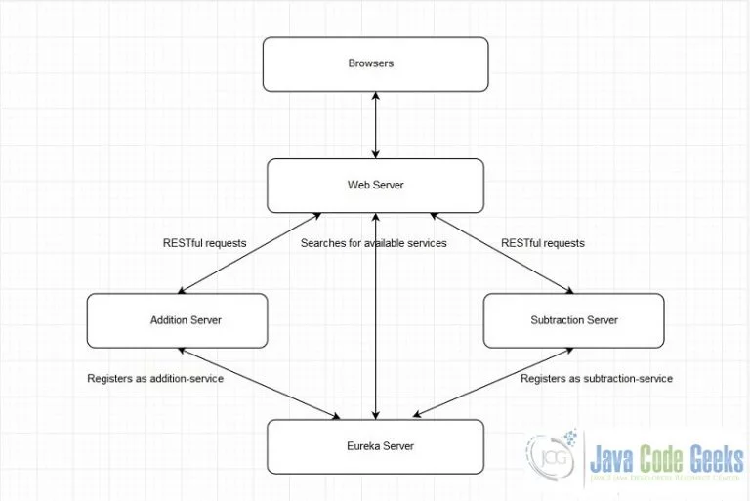
Case Study

Slide 27
contd..
This web application an arithmetic service. An arithmetic calculator served in a microservice approach.
The diagram shows two microservices, Addition Server and Subtraction Server.
The servers need to find each other so they need to register to the discovery server called Eureka.
Once the Web Server finds the micro service, it can then send requests,i.e. sends RESTful requests.
When the Web Server receives the response it then serves the result to the browser.

Slide 28
Program Elements
POM
The important parts of the POM are the following:
spring-boot-starter-parent – provide default configurations for our Spring Boot project
spring-boot-starter – setup Spring Boot
spring-boot-starter-web – setup Spring MVC and REST, use Embedded Tomcat
spring-boot-starter-thymeleaf – use Thymeleaf templating engine
spring-cloud-starter – setup Spring Cloud
spring-cloud-starter-netflix-eureka-server – Eureka for service registration
spring-cloud-dependencies – use the Finchley.RELEASE

Slide 29
contd..
@SpringBootApplication is a start–up annotation equal to declaring @Configuration, @EnableAutoConfiguration, and @ComponentScan.
The @EnableEurekaServer spins up a registry server that other applications can talk to.
Line 11 tells Spring Boot to look for the file eureka-server.properties for its configuration.
Indicating registerWithEureka as false stops the server from registering itself. Register ourself is when multiple discovery servers are run.
Open up a command prompt and let’s run the Eureka Server. But first we must compile our project, execute mvn clean package. After successful compilation, run java -jar target/spring-boot-microservices-0.0.1-SNAPSHOT.jar eureka and you should see some standard Spring logging output in the console.
Open your web browser, access http://localhost:1111/ and see dashboard.

Slide 30
contd..
Addition Server – provides the addition service. It simply adds two numbers.
EnableAutoConfiguration defines this as a Spring Boot application.
@EnableDiscoveryClient enables service registration and discovery. The server registers itself with the discovery server provided in the configuration file. The registration with the discovery server makes this a microservice.
As the configuration states, this microservice is named as addition – service. It will listen on port 2222. It will use the discovery server at http://localhost:1111/eureka/.
RenewalIntervalInSeconds for now is set to five but this is not recommended in production. By default the client refresh time is thirty seconds.

Slide 31
contd..
To check if microservices is up and running, in web browser, access http://localhost:2222/ and a message appears “Addition Server Microservice is running”.
Alternatively, access http://localhost:1111/eureka/apps/addition-service/ and an XML is got of the details of the addition service.
Or check the Eureka Server page and the addition-service should be listed under instances currently registered with Eureka.
Additional source files required to run the Addition Server.
HomeController.java The above controller simply directs requests to the root resource to index.html. All thymeleaf templates are found in src/main/resources. This particular template is located in src/main/resources/addition-server/templates.
AdditionController.java the doAdd method handles requests made on /add. It retrieves the parameters and adds them. It then returns a JSON string.

Slide 32
contd..
Subtraction Server
This server provides the subtraction service. It simply deducts a number from another number.
The SubtractionServer.java is similar to the AdditionServer.java code. The only difference is the configuration.
The cofiguration states, this microservice is named as subtraction-service. It will listen on port 3333. It will use the discovery server at http://localhost:1111/eureka/.
Run java -jar target/spring-boot-microservices-0.0.1-SNAPSHOT.jar subtraction and some standard Spring logging output in the console. To check if your microservices is up and running open your web browser, access http://localhost:3333/ and a message saying “Subtraction Server Microservice is running”.

Slide 33
contd..
Additional source files required to run the Subtraction Server.
HomeController.java – The above controller simply directs requests to the root resource to index.html. All thymeleaf templates are found in src/main/resources. This particular template is located in src/main/resources/subtraction-server/templates.
SubtractionController.java the doSubtract method handles requests made on /subtract. It retrieves the parameters and subtracts them. It then returns a JSON string.

Slide 34
contd..
Web Server – This server serves web pages to the browser. This server uses the microservices.
@SpringBootApplication is a convenience annotation that is equivalent to declaraing @Configuration, @EnableAutoConfiguration, and @ComponentScan. The @EnableDiscoveryClient enables service registration and discovery. The @ComponentScan(useDefaultFilters = false) indicates whether automatic detection of classes annotated with @Component, @Repository, @Service, or @Controller should be enabled.
@LoadBalanced marks RestTemplate< to be configured to use a LoadBalancerClient. This means the RestTemplate bean will be auto-configured by Spring Cloud to use a custom HttpRequestClient that uses Netflix Ribbon to do the microservices lookup. Ribbon is also a load-balancer. If you have multiple instances of a service available, Ribbon picks one for you
the application name is web-service. It will listen on port 4444. It will use the discovery server at http://localhost:1111/eureka/. Open up a command prompt and run java -jar target/spring-boot-microservices-0.0.1-SNAPSHOT.jar web. After some standard Spring logging, you should be able to access the web server at http://localhost:4444/. By this time, we have four open command prompts running four servers simultaneously. The web server page looks like the one below.
additional source files required to run the Web Server.
HomeController.java above controller simply directs requests to the root resource to index.html. All thymeleaf templates are found in src/main/resources. This particular template is located in src/main/resources/web-server/templates.
The doAdd method handles requests made on /add. It retrieves the parameters and passes it to the additionService object which was automatically injected by Spring. It then returns the sum.html template. The doSubtract method handles requests made on /subtract. It retrieves the parameters and passes it to the subtractionService object which was automatically injected by Spring. It then returns the difference.html template. The service classes are discussed in the next section.

Slide 35
contd..
Accessing the microservices
The above classes are similar. Both are annotated with @Service.
This indicates that the class is a service which is an operation offered as an interface that stands alone in the model, with no encapsulated state. This annotation serves as a specialization of @Component, allowing for implementation classes to be autodetected through classpath scanning.
RestTemplate is load balanced. The serviceUrl is provided by the main program. The restTemplate returns a JSON string which is displayed by the web server.

Slide 36
contd..
Shopping Cart case study
To build a simple microservices system following steps required
Creating Discovery Service (Creating Eureka Discovery Service)
Creating MicroService (the Producer)
Register itself with Discovery Service with logical service.
Create Microservice Consumers find Service registered with Discovery Service
Discovery client using a smart RestTemplate to find microservice.

Slide 37
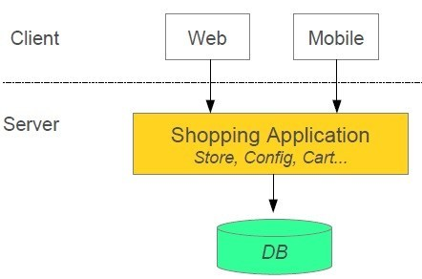
Micro Services Architecture
Shopping system without Microservices (Monolith architecture)
In this Monolith architecture i.e. all collaborating components combine all in one application.

Slide 38
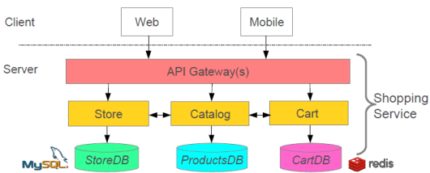
contd..
In MS architecture style, the main application divided into a set of sub-applications collaborating processes called microservices as below.

Slide 39
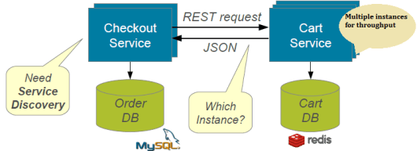
contd..
Service Discovery - Problem without discovery
How do services find each other?
What happens if we run multiple instances for a service

Slide 40
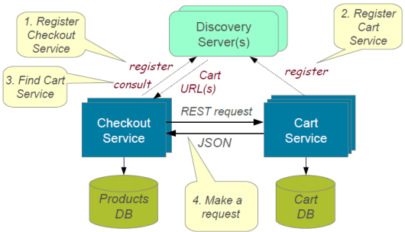
contd..
Resolution with service discovery

Slide 41
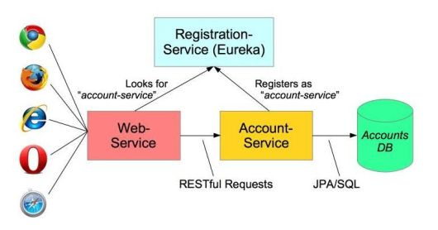
contd..
Implementing Client-Side Load Balancing – Netflix Ribbon provides several algorithms for Client-Side Load Balancing.
Spring provides smart RestTemplate for service discovery and load
balancing by using @LoadBalanced annotation with Rest Template
instance.

Slide 42
Thank You

