Slide 1
Spring -v 5.0

Slide 2
Topics
Sl.No. | Topic
1 | Spring Core
2 | Spring DAO
3 | Spring Transactions
4 | Spring Web – Servlets, JSP,
5 | Spring MVC

Slide 3
Background
Tight Coupling
In O.O. design, Coupling refers to the degree of direct knowledge that one element has of another. In other words, how often do changes in class A force related changes in class B.
Tight coupling means the two classes often change together. In other words, if A knows more than it should about the way in which B was implemented, then A and B are tightly coupled.
This scenario arises when a class assumes too many responsibilities, or when one concern is spread over many classes rather than having its own class.

Slide 4
contd..
class Employee
{
int eid;
String name
Address address;
Employee()
{
eid= 0;
name= “ ”;
address=new Address();
}
}
class Employee
{
int eid;
String name
Address address;
Employee ( int i1, String s, Address
address)
{ eid= i1;
name= s;
this.address=address;
}
}

Slide 5
contd..
Look-up problem
Applications developed using J2EE consist of many components, belonging to different frame works either within Java/J2EE or exterior.
These components offer transaction management, multithreading, security, etc.
Communication between components is thru servers of different vendors.
E.g. when a component C1 requires another component C2, then C1 itself is responsible for looking up the C2 as it depends upon.
The look–up happens by–name, i.e. name of the dependency is hardcoded in the component.
This approach result in heavy weight application. Services are included even when not needed.
Developers–architects spend lot of time in setting up configurations using xml files.

Slide 6
contd..
Problem with Testing
The code can’t be run in a unit test, since it presumes all kinds of services present, normally provided by the J2EE application server i.e. it is not testable outside of the container.
Deploying a J2EE application in a container and starting it up can be a very time-consuming task, so not very ideal if test cases need to run unit tests regularly.
Developer needs to comply to several seemingly arbitrary rules, and write code that is not so Object Oriented.
The classes have to be implemented in a very specific way, which coupled the business logic to the J2EE classes.
The code less extensible, and not very test friendly as it uses specific J2EE classes and interfaces.

Slide 7
contd..
Solution –
Solution is to write just POJOs, without the J2EE standards overhead.
No overhead to implement any interfaces or extend from other classes,
Clean implementation and design of domain with regular Java classes.

Slide 8
Spring Introduction
A J2EE Framework developed by Rod Johnson to make building applications easier.
The programming model is built upon Inversion of Control and Aspect-Oriented Programming.
Inversion of Control allows classes to be loosely coupled and dependencies written in xml or annotated.
The user code need not have Spring references all over the place as Spring integrates using these techniques to manage the business objects & their dependencies
Spring framework makes it possible to use them with simple POJO's. The framework that allows developer to pick and choose features to use from.

Slide 9
Features
Inversion of Control
Dependency Injection
Foundational support for JDBC, JPA, JMS
Spring MVC web application and RESTful web service framework
Seamless integration with other frameworks
Aspect-Oriented Programming including Spring's declarative transaction management
Much more…

Slide 10
Spring Modules
Spring ORM
Hiberanate, iBATIS and JDO Support
Spring Web
Servlet Struts Portlets
Spring AOP
Source-level Metadata
AOP Infra
Spring MVC
Web Framework, Web Views, JSP
Spring DAO
Transaction infra
JDBC and DAO
support
Spring Context
ApplicationContext UI Support validation JNDI, EJB
Spring Core
Beans
Core
Context
Exp Lang

Slide 11
Spring Core

Slide 12
Inversion of Control
IOC introduction –
Developing an application, involves dependencies between and on components, services, classes etc. which are ‘wired’ together on the spot where needed.
The disadvantage of this approach is that when user needs to use a different implementation of the dependency. It costs huge if change is necessitated in implementation context of the environment.
E.g. to use a different authentication service during development as in production, so change the code every time a production artifact is made, or unit–tests are run.
In the new approach, the wiring of dependencies is taken out of the code, and an external party manages the wiring, namely the CONTAINER. Hence the name Inversion of Control

Slide 13
contd..
It is also termed Dependency Injection because the container ‘injects’ the necessary dependencies instead of letting the developer manage them.
The framework reads configuration information and invokes the appropriate methods on the code to inject the dependencies.
However usage of Spring–containers leads to losing some of the advantages of static type checking.
The configuration information will not be read until runtime; therefore any incompatible type information given in the configuration will not cause errors to be produced until runtime.

Slide 14
Dependency Injection

Slide 15
Sample Application
public class EmailService
{
public void sendEmail(String message, String receiver)
{ //logic to send email
System.out.println("Email sent to "+receiver+ " with Message="+message);
}
}
public class MyApplication
{ private EmailService email = new EmailService();
public void processMessages(String msg, String rec)
{ //do some msg validation, manipulation logic etc
this.email.sendEmail(msg, rec);
} }

Slide 16
contd..
public class MyLegacyTest
{
public static void main(String[] args)
{
MyApplication app = new MyApplication();
app.processMessages("Hi Pankaj","pankaj@abc.com");
}
}

Slide 17
contd..
The code logic has certain limitations –
MyApplication class is responsible to initialize the email service and then use it. This leads to hard-coded dependency.
To switch to some other advanced email service in the future, it will require code changes in MyApplication class. This makes application hard to extend and if email service is used in multiple classes then that would be even harder.
To extend the application to provide an additional messaging feature, such as SMS or Facebook message, will require to write another application for that. This will involve code changes in application classes and in client classes too.
Testing the application will be very difficult since the application is directly creating the email service instance. There is no way we can mock these objects in our test classes.

Slide 18
Dependency Injection
Dependency Injection in Java requires at least the following:
Service components should be designed with base class or interface. It’s better to prefer interfaces or abstract classes that would define contract for the services.
Consumer classes should be written in terms of service interface.
Injector classes that will initialize the services and then the consumer classes.

Slide 19
contd..
MessageService - the contract for service implementations.
public interface MessageService
{ void sendMessage(String msg, String rec);
}
public class EmailServiceImpl implements MessageService
{ @Override
public void sendMessage(String msg, String rec)
{ //logic to send email
System.out.println("Email sent to "+rec+ " with Message="+msg);
}
}

Slide 20
contd..
public class SMSServiceImpl implements MessageService
{ @Override
public void sendMessage(String msg, String rec)
{ //logic to send SMS
System.out.println("SMS sent to "+rec+ " with Message="+msg);
}
}

Slide 21
contd..
public interface Consumer
{ void processMessages(String msg, String rec);
}
public class MyDIApplication implements Consumer
{ private MessageService service;
public MyDIApplication(MessageService svc)
{ this.service=svc; }
@Override
public void processMessages(String msg, String rec)
{ //do some msg validation, manipulation logic etc
this.service.sendMessage(msg, rec);
} }

Slide 22
contd..
public interface MessageServiceInjector
{ public Consumer getConsumer();
}
public class EmailServiceInjector implements MessageServiceInjector
{ @Override
public Consumer getConsumer()
{ return new MyDIApplication(new EmailServiceImpl());
} }
public class SMSServiceInjector implements MessageServiceInjector
{ @Override
public Consumer getConsumer()
{ return new MyDIApplication(new SMSServiceImpl());
} }

Slide 23
contd..
public class MyMessageDITest
{
public static void main(String[] args)
{ String msg = "Hi Pankaj";
String email = "pankaj@abc.com";
String phone = "4088888888";
MessageServiceInjector injector = null;
Consumer app = null;
//Send email
injector = new EmailServiceInjector();
app = injector.getConsumer();
app.processMessages(msg, email);
//Send SMS
injector = new SMSServiceInjector();
app = injector.getConsumer(); app.processMessages(msg, phone); }}

Slide 24
contd..
Application classes are responsible only for using the service.
Service classes are created in injectors.
If the application is to be further extended to allow facebook messaging, then only write Service classes and injector classes.
So dependency injection implementation is solved the problem with hard-coded dependency and helped in making our application flexible and easy to extend.
This approach helps in testing our application class by mocking the injector and service classes.

Slide 25
contd..
Some of the benefits of using Dependency Injection in Java are:
Separation of Concerns
Boilerplate Code reduction in application classes because all work to initialize dependencies is handled by the injector component
Configurable components makes application easily extendable
Unit testing is easy with mock objects

Slide 26
Dependency Injection
In an application, classes should be as independent as possible.
The mutual independence increase the possibility to reusability and test them independent of other classes when unit testing.
Dependency Injection (DI) implements the design pattern called Inversion of Control for resolving dependencies. Injection is the passing of a dependency to a dependent object that would use it.
Dependency Injection (or sometime called wiring) helps in connecting these classes together and same time keeping them independent.
Decouples object creators and locators from application logic
With Dependency injection
Beans define their dependencies through constructor–args or properties
The container provides the injection at runtime
Notes:
Inversion of Control has already been referred to as Dependency Injection. The basic principle is that beans define their dependencies (i.e. the other objects they work with) only through constructor arguments or properties. Then, it is the job of the container to actually inject those dependencies when it creates the bean. This is fundamentally the inverse (hence the name Inversion of Control) of the bean instantiating or locating its dependencies on its own using direct construction of classes, or something like the Service Locator pattern. While we will not elaborate too much on the advantages of Dependency Injection, it becomes evident upon usage that code gets much cleaner and reaching a higher grade of decoupling is much easier when beans do not look up their dependencies, but are provided them, and additionally do not even know where the dependencies are located and of what actual type they are.
As touched on in the previous paragraph, Inversion of Control/Dependency Injection exists in two major variants:
setter-based dependency injection is realized by calling setters on your beans after invoking a no-argument constructor to instantiate your bean. Beans defined in the BeanFactory that use setter-based dependency injection are true JavaBeans. Spring generally advocates usage of setter-based dependency injection, since a large number of constructor arguments can get unwieldy, especially when some properties are optional.
constructor-based dependency injection is realized by invoking a constructor with a number of arguments, each representing a collaborator or property. Although Spring generally advocates usage of setter-based dependency injection as much as possible, it does fully support the constructor-based approach as well, since you may wish to use it with pre-existing beans which provide only multi-argument constructors, and no setters. Additionally, for simpler beans, some people prefer the constructor approach as a means of ensuring beans can not be constructed in an invalid state.

Slide 27
contd..
DI is a process whereby objects define dependencies, other objects they work with, only through constructor args or args to a factory method or property. These are set on the object instance after it is constructed or returned from a factory method.
Dependency is an object on which a class depends. Injection refers to the process of injecting a dependency (object) into the dependent class.
The container then injects those dependencies, and it creates the bean. This process is named Inversion of Control. The bean itself controls the instantiation or location of its dependencies by using direct construction classes or a Service Locator.
DI allows the class to use object of another class without actually bothering on how to create that object. Its the process of supplying an external dependency to a software component.
prepared by- Vijay Kulkarni, Java Spring Trainer

Slide 28
contd..
Dependency Injection
XML based
Annotation based
Constructor
Setter methods
Constructor
Setter methods
prepared by- Vijay Kulkarni, Java Spring Trainer

Slide 29
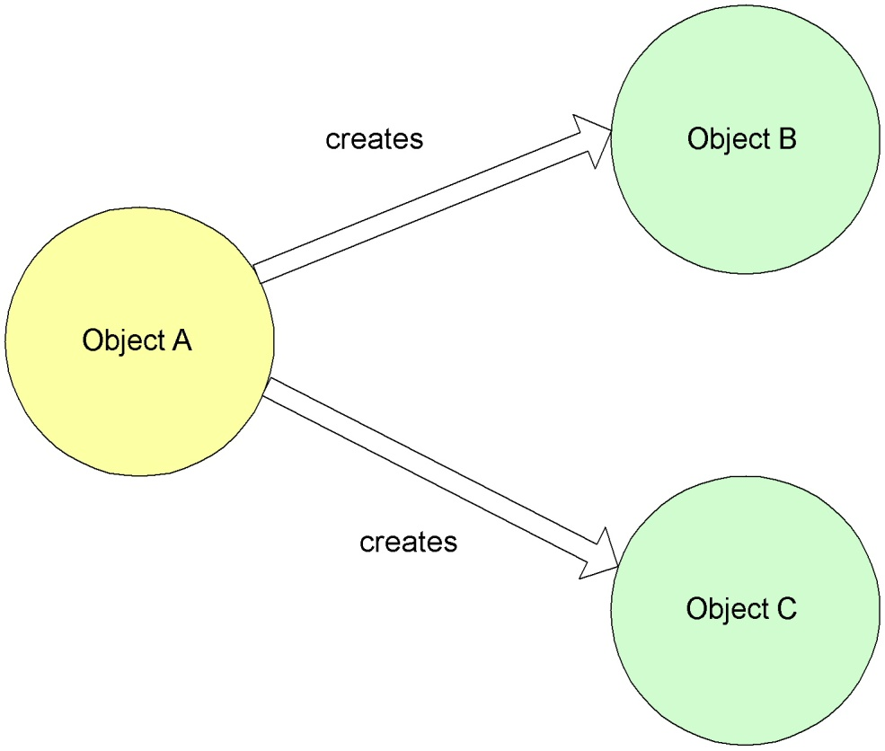
Constructor based DI
In Constructor based DI –
the dependency is injected into the class through a class Constructor.
the container invokes the class constructor with a number of arguments, each representing a dependency on other class.
prepared by- Vijay Kulkarni, Java Spring Trainer

Slide 30
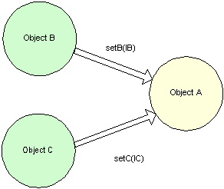
Setter-method based DI
In Setter–method based DI,
The other method of injecting dependency is through setter methods of the class where user creates instance and this instance will be used to call setter methods to access properties.
The container calls setter methods on the beans after invoking a no-argument constructor or no–argument static factory method to instantiate the bean.
prepared by- Vijay Kulkarni, Java Spring Trainer

Slide 31
XML -based DI
<bean> is the root tag of the xml configuration. The <bean> tag has two attributes id and class. id specifies the unique name of the object and class mentions the fully qualifies name of the class.
<bean> has two subelements viz.. <constructor–arg> and <property> used for constructor and setter method injection respectively.
The default is type is String, in case no data type is mentioned
Collection values can also be injected using these three elements.
list
set
map
There are other attributes at level of <bean> and both sub elements
prepared by- Vijay Kulkarni, Java Spring Trainer

Slide 32
contd..
<!-- A simple bean definition -->
<bean id = "..." class = "...">
<!-- collaborators and configuration for this bean go here -->
</bean>
<bean id = "..." class = "..." lazy-init = "true">
<!-- collaborators and configuration for this bean go here -->
</bean>
<bean id = "..." class = "..." init-method = "...">
<!-- collaborators and configuration for this bean go here -->
</bean>
<bean id = "..." class = "..." destroy-method = "...">
<!-- collaborators and configuration for this bean go here -->
</bean>

Slide 33
Annotation based DI
The bean configuration can be moved into the component class itself by using annotations on the relevant class, method, or field declarations.
If both are used then XML configuration will override annotations because XML configuration will be injected after annotations.
The annotations based configuration is turned off by default so need to turn it on by entering into spring XML file
<?xml version="1.0" encoding="UTF-8"?>
<beans xmlns: …………>
<context:annotation-config/>
<!-- beans declaration goes here -->
</beans>
prepared by- Vijay Kulkarni, Java Spring Trainer

Slide 34
contd..
Some important annotations in Spring –
@Bean – Applied to the method. Declares the bean object on the method which creates the bean object.
@Configuration – Specified on the class. Specifies the configuration of the bean objects.
@Required – The @Required annotation applies to bean property setter methods.
@Autowired – The @Autowired annotation is applied to bean property setter methods, non-setter methods, constructor and properties. @Autowired can be used to remove the confusion by specifiying which exact bean will be wired.
@Qualifier – The @Qualifier annotation is used along with @AutoWired if same bean is to be declared more than once.
prepared by- Vijay Kulkarni, Java Spring Trainer

Slide 35
contd..
Spring IoC container is totally decoupled from the format in which this configuration metadata is actually written.
The following are three ways to provide configuration metadata to the Spring Container:
XML based configuration file.
Annotation-based configuration
Java-based configuration
prepared by- Vijay Kulkarni, Java Spring Trainer

Slide 36
Spring Container
The Spring container is the core of the Spring Framework and works on principle of D.I. The container –
creates objects called as Spring Bean,
wire them together,
configure them, and
manage their complete lifecycle from creation till destruction.
The container gets its instructions by reading configuration metadata (either xml or annotations)
The IoC container makes use of Java POJO classes and configuration metadata to produce a fully configured and executable system or application.
prepared by- Vijay Kulkarni, Java Spring Trainer

Slide 37
contd..
Java POJO classes
Meta Data
Spring Container
Ready to use application
prepared by- Vijay Kulkarni, Java Spring Trainer

Slide 38
contd..
Sl.No. | Name | ver | Description
1. | BeanFactory |  | The container provides for maintaining a registry of different beans and their dependencies. Defined by the org.springframework.beans.factory.BeanFactory interface. It is simplest container providing basic support for DI
2. | Application Context |  | The container adds more enterprise–specific functionality such as the ability to resolve textual messages from a properties file and the ability to publish application events to interested event listeners. Defined by the org.springframework.context.Application Context interface. It includes all functionality of the BeanFactory container, so it is generally recommended over the BeanFactory.
prepared by- Vijay Kulkarni, Java Spring Trainer

Slide 39
contd..
Sl.No | Name | ver | Description
1. | XmlBean Factory |  | this container reads the configuration metadata from a xml file and uses it to create a fully configured system or application.
2. | FileSystemXmlApplication Context |  | this container loads the definitions of the beans from an XML file. The full path of the XML bean configuration file is given to the constructor.
3. | ClassPathXmlApplication Context |  | this container loads the definitions of the beans from an XML file. The container will look bean configuration XML file in CLASSPATH.
4. | WebXml Application Context |  | this container loads the XML file with definitions of all beans from within a web application.
prepared by- Vijay Kulkarni, Java Spring Trainer

Slide 40
contd..
AnnotationConfigApplicationContext – the container used for annotaion based configurations. It is a standalone application context which accepts annotated classes as input. E.g. @Configuration or @Component.
It was introduced since Spring ver 3.0.
Beans can be looked up with scan() or registered with register().
Allows for registering classes one by one using register(Class..) as well as for classpath scanning using scan(String..).
In case of multiple @Configuration classes, @Bean methods defined in later classes will override those defined in earlier classes. This can be leveraged to deliberately override certain bean definitions via an extra @Configuration class.
prepared by- Vijay Kulkarni, Java Spring Trainer

Slide 41
Spring Bean
Spring bean is an object that is instantiated, assembled, and managed by a Spring IoC container.
The bean definition contains the information called configuration metadata which is needed for the container to know the following :
how to create a bean
bean's lifecycle details
bean's dependencies
The configuration metadata in the form of xml or annotation is provided to the container.
prepared by- Vijay Kulkarni, Java Spring Trainer

Slide 42
Bean Life Cycle
Definition
Pre-Initialized
Ready
Destroyed
prepared by- Vijay Kulkarni, Java Spring Trainer

Slide 43
contd..
When a bean is instantiated, it may be required to perform some initialization to get it into a usable state and when the bean is no longer required and is removed from the container, some cleanup may be required.
There is list of the activities that take place behind the scenes between the time of bean instantiation and its destruction.
To define setup and teardown for a bean, declare the <bean> with init-method and/or destroy-method parameters in case of xml config and necessary attributes during annotations config.
It would be reasonable to assume that both of these dependencies should be provided via injection.
prepared by- Vijay Kulkarni, Java Spring Trainer

Slide 44
contd..
The configuration metadata translates into a set of the following properties that make up each bean definition.
Properties | Description
class | mandatory and specifies the bean class to be used to create the bean.
name | specifies the bean identifier uniquely. In xml–based configuration metadata, id and/or name attributes used to specify the bean identifier(s).
scope | specifies the scope of the objects created from a particular bean definition
constructor–arg | used to inject the dependencies
properties | used to inject the dependencies
autowiring mode | used to inject the dependencies
prepared by- Vijay Kulkarni, Java Spring Trainer

Slide 45
contd..
lazy-initialization mode | A lazy-initialized bean tells the IoC container to create a bean instance when it is first requested, rather than at startup.
initialization method | A callback to be called just after all necessary properties on the bean have been set by the container.
destruction method | A callback to be used when the container containing the bean is destroyed.
prepared by- Vijay Kulkarni, Java Spring Trainer

Slide 46
Bean Scopes
The Spring Framework supports following five scopes.
Scope | Description
singleton | This scopes the bean definition to a single instance per Spring IoC container (default).
prototype | This scopes a single bean definition to have any number of object instances.
request | This scopes a bean definition to an HTTP request. Only valid in the context of a web-aware Spring ApplicationContext.
session | This scopes a bean definition to an HTTP session. Only valid in the context of a web-aware Spring ApplicationContext.
global-session | This scopes a bean definition to a global HTTP session. Only valid in the context of a web-aware Spring ApplicationContext.
prepared by- Vijay Kulkarni, Java Spring Trainer

Slide 47
Inheritance in Spring Code
In case of xml configuration, the <bean> element attributes ‘parent’ or ‘abstract’ are used to indicate super or abstract class.
<bean id = "..." class = "..." parent = “…”>
<!-- collaborators and configuration for this bean go here -->
</bean>
<bean id = "..." class = "..." abstract = “…”>
<!-- collaborators and configuration for this bean go here -->
</bean>
However, Spring does not provide any annotation corresponding to the parent or abstract attributes of <bean> element xml config.
The bean definition inheritance is hard coded.
A child bean definition will inherit constructor argument values, property values, and method overrides from the parent.
prepared by- Vijay Kulkarni, Java Spring Trainer

Slide 48
contd..
The child bean definition also can add new values.
If the child bean contains init-method, destroy-method and/or static factory method settings, they override the corresponding parent settings.’
The settings that will always be taken from the child definition are depends on, autowire mode, dependency check, singleton, scope, lazy init.

Slide 49
AutoWiring
The auto–wiring feature is such with which there is no need for ref attribute and/or provide bean references explicitly. The auto– wire mode automatically wires the beans.
The autowire mode can be configured using “autowire” attribute in case of xml configuration
<bean id="bean_id" class="bean_class" autowire="default |
byname | byType | constructor | autodetect " />
In case of annotation configuration use @Autowired annotation.
The different autowiring modes supported by Spring are –
default or no
byName
byType
constructor
autodetect
prepared by- Vijay Kulkarni, Java Spring Trainer

Slide 50
contd..
Sl.No | Mode | Description
1. | by Name | The property name is used for searching a matching bean definition in configuration file. If found, it is injected in property else a error is raised.
2. | by Type | The property’s class type is used for searching a matching bean definition in configuration file. If found, it is injected in property else a error is raised.
3. | constructor | Similar to byType, but applies to constructor args. It will look for class type of constructor arguments, and then do a byType on all constructor arguments.
4. | auto detect | Autowiring by autodetect uses either of two modes i.e. constructor or byType modes. First it will try to look for valid constructor with arguments, If found the constructor mode is chosen. If there is no constructor defined in bean, or explicit default no-args constructor is present, the autowire byType mode is chosen.
prepared by- Vijay Kulkarni, Java Spring Trainer

Slide 51
contd..
Autowiring feature internally uses setter or constructor injection.
Autowiring can't be used to inject primitive and String values.
It requires the less code because we don't need to write the code to inject the dependency explicitly.
No control of programmer.
The default mode in traditional XML based configuration is no. The default mode in Java based @Autowired is byType.
prepared by- Vijay Kulkarni, Java Spring Trainer

Slide 52
Spring Expression Language
A powerful expression language, used to wire values into bean’s properties. It’s similar to other ELs, supporting querying and manipulating an object graph at runtime.
the spring expression language is enclosed with in
“#{expression language} ”
The expression language supports the following functionality
Literal expressions
Boolean and relational operators
Regular expressions
Class expressions
Accessing properties, arrays, lists, maps
Method invocation
Calling constructors
prepared by- Vijay Kulkarni, Java Spring Trainer

Slide 53
contd..
Relational operators
Assignment
Bean references
Array construction
Inline lists
Inline maps
Ternary operator
Variables
User defined functions
Collection projection
Collection selection
Templated expressions
prepared by- Vijay Kulkarni, Java Spring Trainer

Slide 54
Spring DAO
prepared by- Vijay Kulkarni, Java Spring Trainer

Slide 55
Data Access
Spring offers support for the following APIs and frameworks:
JDBC
Java Persistence API (JPA)
Java Data Objects (JDO)
Hibernate
Common Client Interface (CCI)
iBATIS SQL Maps
Oracle TopLink
prepared by- Vijay Kulkarni, Java Spring Trainer

Slide 56
contd..
Various data access libraries supported by Spring have quite different implementations, still they do tend to have similar usage patterns.
Spring takes advantage of this by providing sets of tailored support classes to aid in the building of data access logic, and specifically to aid in building DAO implementations.
When building a DAO for a supported database access mechanism, Spring provides helper classes to aid in implementation. These usually include a template class and a DAO support class
prepared by- Vijay Kulkarni, Java Spring Trainer

Slide 57
contd..
JDBC technology exceptions are checked, so use of try, catch blocks in the code at various places which increases the complexity of the application. Leads to writing a lot of repetitive code to perform the database operations e.g. write loading driver, connection, creating statement lot of times
If developer opens the connection with database, developer only is responsible to close that connection. Else may get some connection issues
JDBC framework throws error codes of the database, when ever an exception is raised. All java programmers may or may not know these codes. So the application is gonnabe database dependent
prepared by- Vijay Kulkarni, Java Spring Trainer

Slide 58
contd..
Spring framework provides one abstraction layer on top of existing JDBC technology, called as Spring-JDBC. Developers work with this abstraction layer and that layer internally uses JDBC.
Spring-JDBC layer take care about connection management and error managements, and programmers will concentrate on their logics, etc.
Spring framework provides an exception translator and it translates the checked exceptions obtained using JDBC to un-checked exceptions of Spring type and finally the un-checked exceptions are thrown to developer.
Opening and closing the database connection is taken care by the spring framework.
prepared by- Vijay Kulkarni, Java Spring Trainer

Slide 59
contd..
Spring framework uses DataSource interface to obtain the connection with database internally.
The two implementation classes of DataSource interface are –
org.springframework.jdbc.datasource.DriverManagerDataSource
org.apache.commons.dbcp.BasicDataSource
The above 2 classes are suitable for Spring application at developing stage. In real time developers uses connection pooling service provided by the application server.
DriverManagerDataSource is equal to DriverManager class, Spring framework internally opens a new connection and closes the connection for each operation done on the database.
BasicDataSource is given the apache, and this is better than DriverManagerDataSource because BasicDataSource having inbuilt connection pooling implementation.
prepared by- Vijay Kulkarni, Java Spring Trainer

Slide 60
contd..
JdbcTemplate –
The JdbcTemplate class is given in package org.springframework.jdbc.core.* and provides methods for executing the SQL commands on a database
JdbcTemplate class follows template design pattern, where a template class accepts input from the user and produces output to the user by hiding the interval details, provides the 3 methods –
execute()
update()
query().
execute() and update() are for non-select operations on the database, and query() is for select operations on the database.
JdbcTemplate class depends on DataSource object only. There are both setter, constructor injections in JdbcTemplate class for inserting DataSource object.
prepared by- Vijay Kulkarni, Java Spring Trainer

Slide 61
contd..
<bean id=”id1” class=”org.springframework.datasource.DriverManagerDataSource”>
<property name=”driverClassName” value=”” />
<property name=”url” value=”” />
<property name=”username” value=”” />
<property name=”password” value=”” />
</bean>
<bean id="id2" class="org.springframework.jdbc.core.JdbcTemplate">
<constructor-arg ref="id1" />
<bean>
prepared by- Vijay Kulkarni, Java Spring Trainer

Slide 62
contd..
<bean id=”id1” class=”org.springframework.datasource.DriverManagerDataSource”>
<property name=”driverClassName” value=”” />
<property name=”url” value=”” />
<property name=”username” value=”” />
<property name=”password” value=”” />
</bean>
<bean id="id2" class="org.springframework.jdbc.core.JdbcTemplate">
<property name="dataSource" ref="id1" />
<bean>
prepared by- Vijay Kulkarni, Java Spring Trainer

Slide 63
Spring Jdbc API
Row Mapper – An interface used by JdbcTemplate for mapping rows of a ResultSet on a per-row basis. ... RowMapper objects are typically stateless and thus reusable; used to implementing row-mapping logic in a single place. Usage
Step 1 − Create a JdbcTemplate object using a configured datasource.
Step 2 − Create a StudentMapper object implementing RowMapper interface.
Step 3 − Use JdbcTemplate object methods to make database operations while using POJO class object.
E.g. String SQL = "select * from Emp";
List <Emp> elist= jdbcTemplateObject.query(SQL, new EmpMapper());
jdbcTemplateObject − EmpJDBCTemplate object to read student records from database.
EmpMapper − EmpMapper object to map emp records to Emp objects.

Slide 64
contd..
BeanRowMapper – RowMapper implementation that converts a row into a new instance of the specified mapped target class. The mapped target class must be a top-level class and it must have a default or no-arg constructor.
Column values are mapped based on matching the column name as obtained from result set meta-data to public setters for the corresponding properties.
The names are matched either directly or by transforming a name separating the parts with underscores to the same name using "camel" case.
Mapping is provided for fields in the target class for many common types, e.g.: String, boolean, Boolean, byte, Byte, short, Short, int, Integer, long, Long, float, Float, double, Double, BigDecimal, java.util.Date, etc.

Slide 65
contd..
The queryForObject() method executes an SQL query and returns a result object. The result type is specified in the arguments.

Slide 66
Spring Web-MVC
prepared by- Vijay Kulkarni, Java Spring Trainer

Slide 67
Front Controller Pattern
Controller : is the initial contact point for handling all requests in the system; the controller may then delegate to a helper to complete authentication and authorization of a user or to initiate contact retrieval.
View: represents and displays information to the client; the view retrieves information from a model. Helpers support views by encapsulating and adapting the underlying data model for use in the display.
Dispatcher: responsible for view management and navigation, managing the choice of the next view to present to the user, and providing the mechanism for vectoring control to this resource.
Helper : responsible for helping a view or controller complete its processing; helpers gather data required by the view and store the intermediate model, in which case the helper is sometimes referred to as a value bean.
prepared by- Vijay Kulkarni, Java Spring Trainer

Slide 68
contd..
High level diagram depicting Spring Web Flow
Request
Delegate request
Front
Controller
Controller
model
Response
Delegate rendering
of response
model
Handles request & create model
Return
control
Render
response
View
Template
prepared by- Vijay Kulkarni, Java Spring Trainer

Slide 69
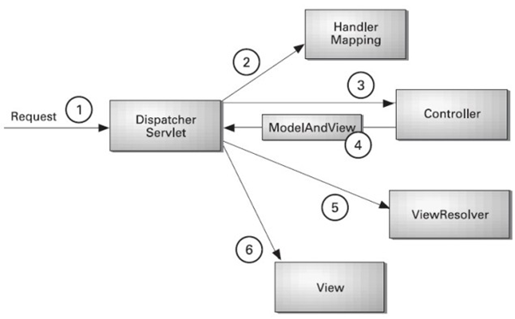
contd..
prepared by- Vijay Kulkarni, Java Spring Trainer

Slide 70
SpringMVC
Spring MVC framework is request-driven, designed around a central Servlet that dispatches requests to controllers and offers other functionality that facilitates the development of web applications.
Request routing is completely controlled by the Front Controller.
Proven pattern shown in Core J2EE Patterns
Components of Spring MVC are –
DispatcherServlet
Controller
Model
View
prepared by- Vijay Kulkarni, Java Spring Trainer

Slide 71
contd..
When a client request is given to DispatcherServlet, it performs the following operations:
Types of Phases :
Prepare the request context
Locate the handler
Execute interceptors with prehandler methods
Invoke handler
Execute interceptors with post hanlder methods
Handle Exceptions
Render the view
Execute interceptors after completion methods
prepared by- Vijay Kulkarni, Java Spring Trainer

Slide 72
contd..
View
Responsible for rendering output
View name resolution is highly configurable through file extension or
Accept header content type negotiation, through bean names, a properties file, or even a custom ViewResolver implementation.
Model
is a Map interface, which allows for the complete abstraction of the view technology.
Also possible to integrate directly with template based rendering technologies such as JSP,
The model Map is simply transformed into an appropriate format, such as JSP request attributes.
prepared by- Vijay Kulkarni, Java Spring Trainer

Slide 73
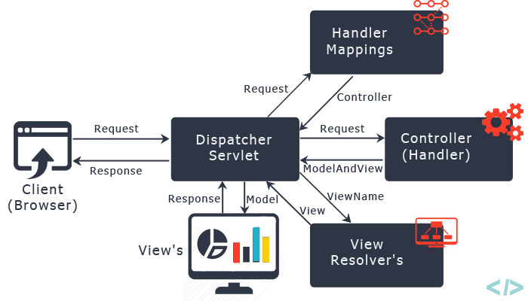
contd..
prepared by- Vijay Kulkarni, Java Spring Trainer

Slide 74
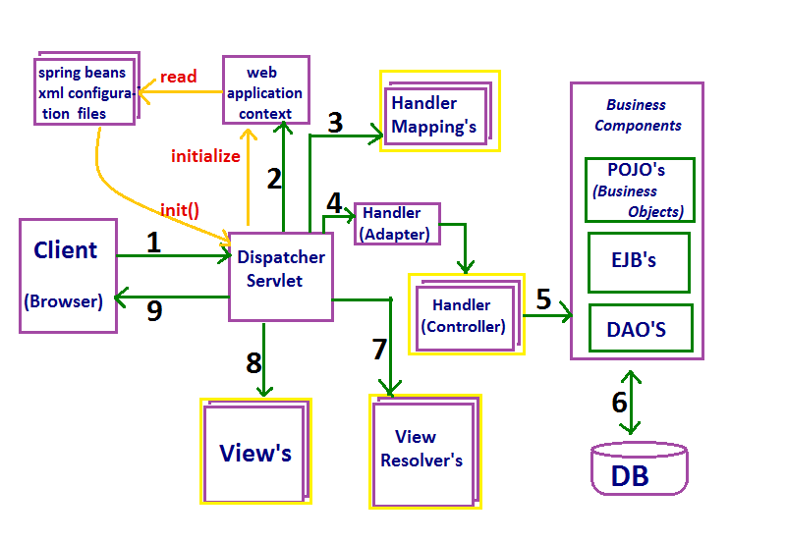
contd..
Detailed diagram depicting Spring Web Flow
prepared by- Vijay Kulkarni, Java Spring Trainer

Slide 75
Spring Web MVC flow
In summary, here is the flow of an HTTP request in Java application created using the Spring MVC framework:
1) The client sends an HTTP request to a specific URL
2) DispatcherServlet of Spring MVC receives the request 2) It passes the request to a specific controller depending on the URL requested using @Controller and @RequestMapping annotations. 3) Spring MVC Controller then returns a logical view name and model to DispatcherServlet.
prepared by- Vijay Kulkarni, Java Spring Trainer

Slide 76
contd..
4) DispatcherServlet consults view resolvers until actual View is determined to render the output 5) DispatcherServlet contacts the chosen view (like Thymeleaf, Freemarker, JSP) with model data and it renders the output depending on the model data 6) The rendered output is returned to the client as a response
prepared by- Vijay Kulkarni, Java Spring Trainer

Slide 77
contd..
The incoming request is intercepted by the DispatcherServlet that works as the front controller.
The DispatcherServlet gets an entry of handler mapping from the XML file and forwards the request to the controller.
The controller returns an object of ModelAndView.
The DispatcherServlet checks the entry of view resolver in the XML file and invokes the specified view component.
prepared by- Vijay Kulkarni, Java Spring Trainer

Slide 78
DispatcherServlet
DispatcherServlet is at the heart of Spring MVC. – Spring’s Front Controller implementation, completely integrated with the Spring IoC container.
DispatcherServlet inherits HttpServlet base class and is declared in the web.xml of the application.
On initialization of a DispatcherServlet, Spring MVC looks for a file named [servlet-name]-servlet.xml in the WEB-INF directory and creates the beans defined there. Any definitions of beans with the same name in the global scope are overridden.
prepared by- Vijay Kulkarni, Java Spring Trainer

Slide 79
contd..
The DispatcherServlet dispatches requests to handlers, with
configurable handler mappings,
view resolution,
locale,
timezone and theme resolution as well as support for uploading files.
The requests needed to be handled by the DispatcherServlet should be mapped by using a URL mapping. The default handler is based on the @Controller and @RequestMapping annotations.
Individual Controllers are used to handle many different URLs
prepared by- Vijay Kulkarni, Java Spring Trainer

Slide 80
contd..
DispatcherServlet Processing Sequence
On getting a request for a specific DispatcherServlet, request processing starts as follows:
The WebApplicationContext is searched for and bound in the request as an attribute that the controller and other elements in the process can use. It is bound by default under the key DispatcherServlet.WEB_APPLICATION_CONTEXT_ ATTRIBUTE.
a. The locale resolver is bound to the request to enable
elements in the process to resolve the locale to use when processing the request (rendering the view, preparing data, etc)
b. The theme resolver is bound to the request to let elements such as views determine which theme to use.
prepared by- Vijay Kulkarni, Java Spring Trainer

Slide 81
contd..
c. If a multipart file resolver is specified, the request is
inspected for multiparts; if multiparts are found, the
request is wrapped in a MultipartHttpServletRequest for
further processing by other elements in the process.
An appropriate handler is searched for. If a handler is found, the execution chain associated with the handler – preprocessors, postprocessors, & controllers is executed in order to prepare a model or rendering.
If a model is returned, the view is rendered. If no model is returned, (may be a pre or postprocessor intercepting the request,), then view is not rendered, as the request could already have been fulfilled.
prepared by- Vijay Kulkarni, Java Spring Trainer

Slide 82
HandlerMapping
Handler mappings
HandlerMapping automatically looks for @RequestMapping annotations on all @Controller beans.
The HandlerMapping classes extending from AbstractHandlerMapping have the following properties –
defaultHandler – used when this handler mapping does not result in a matching handler.
order – based on the value of the order property. Spring sorts all handler mappings in the context and applies the first matching handler
alwaysUseFullPath – if true, the full path within the current Servlet context is used to find an appropriate handler; else the path within the current Servlet mapping is used. (default is false)
urlDecode Defaults to true, the HttpServletRequest always exposes the Servlet path in decoded form.
prepared by- Vijay Kulkarni, Java Spring Trainer

Slide 83
@RequestMapping
@RequestMapping is the annotation used to map web requests onto specific handler classes and/or handler methods is org.springframework.web.bind.annotation.RequestMapping. Applied to the controller class and also to methods.
Sl.No. | Syntax | Description
1. | @RequestMapping with class - @Controller @RequestMapping("/home") public class HomeController { } | “/home” is the URI for which this controller will be used. This concept is very similar to servlet context of a web application.
2. | @RequestMapping with method – @RequestMapping(value="/method0") @ResponseBody public String method0() { return "method0"; } | used with method to provide the URI pattern for which handler method will be used. The annotation can be written as @RequestMapping("/method0"). @ResponseBody is to send the String response for this web request.
prepared by- Vijay Kulkarni, Java Spring Trainer

Slide 84
contd..
3. | @RequestMapping with multiple URIs– @RequestMapping (value={"/method1","/method1/second"}) @ResponseBody public String method1() { return "method1"; } | a single method can handle multiple URIs. Its possible to create String array for the URI mappings for the handler method.
4. | @RequestMapping with HTTP Method- @RequestMapping (value="/method2", method=RequestMethod.POST ) @ResponseBody public String method2() { return "method2"; } @RequestMapping (value="/method3", method = { RequestMethod.POST, RequestMethod.GET }) @ResponseBody public String method3() { return "method3"; } | in situations where different operations are to be performed based on the HTTP method used, even though request URI remains same. The @RequestMapping method variable can narrow down the HTTP methods for which this method will be invoked.
prepared by- Vijay Kulkarni, Java Spring Trainer

Slide 85
contd..
5. | @RequestMapping with headers –@RequestMapping(value="/method5", headers={"name=Rohit", "id=1001"}) @ResponseBody public String method5() { return "method5"; } | the headers that should be present to invoke the handler method can be specified.
6. | @RequestMapping with Produces and Consumes – @RequestMapping ( value="/method6", produces={"application/json","application/xml"}, consumes="text/html") @ResponseBody public String method6() { return "method6"; } | @RequestMapping provides produces and consumes vars which can specify the request content-type for which method will be invoked and the response-content type. The header content-type and accept are used to find out request contents and what is the mime message wanted in response.
prepared by- Vijay Kulkarni, Java Spring Trainer

Slide 86
contd..
7. | @RequestMapping with @PathVariable – @RequestMapping(value="/method7/{id}") @ResponseBody public String method7(@PathVariable("id") int id) { return "method7 with id="+id; } @RequestMapping(value="/method8/{id:[ \\d]+}/{name}") @ResponseBody public String method8(@PathVariable("id") long id, @PathVariable("name") String name) { return "method8 with id= "+id+" and name="+name; } | RequestMapping annotation can be used to handle dynamic URIs where one or more of the URI value works as a parameter. Even regular expression can be specified for URI dynamic parameter to accept only specific type of input. The @PathVariable annotation maps the URI variable to one of the method arguments.
prepared by- Vijay Kulkarni, Java Spring Trainer

Slide 87
contd..
8. | @RequestMapping with @RequestParam for URL parameters – @RequestMapping (value="/method9") @ResponseBody public String method9(@RequestParam(“id”) int id) { return "method9 with id= "+id; } | @RequestParam is used to retrieve the URL parameter and map it to the method argument. For the method to work, the parameter name should be “id” and it should be of type int.
9. | @RequestMapping default method –@RequestMapping() @ResponseBody public String defaultMethod() { return "default method"; } | When value is empty for a method, it works as default method for the controller class. Here the “/home” is mapped to HomeController and the method will be used for the default URI requests.
prepared by- Vijay Kulkarni, Java Spring Trainer

Slide 88
contd..
10. | @RequestMapping fallback method –@RequestMapping("*") @ResponseBody public String fallbackMethod() { return "fallback method"; } | a fallback method for the controller class is created to catch all the client requests even though there are no matching handler methods. It is useful in sending custom 404 response pages to users when there are no handler methods for the request.
prepared by- Vijay Kulkarni, Java Spring Trainer

Slide 89
contd..
prepared by- Vijay Kulkarni, Java Spring Trainer

Slide 90
Controller
Controller
user created component for handling requests.
they interpret user input and transform it into a model that is represented to the user
encapsulates navigation logic and delegate to the service objects for business logic
responsible for preparing a model Map with data and selecting a view name
can also write directly to the response stream and complete the request.
provide access to the application behavior that is defined through a service interface.
@Controller annotation indicates that a particular class serves the role of a controller.
prepared by- Vijay Kulkarni, Java Spring Trainer

Slide 91
contd..
Spring implements a controller in a very abstract way, which enables developer to create a wide variety of controllers.
annotations used are @RequestMapping, @RequestParam, @ModelAttribute;
Controllers implemented in this style do not have to extend specific base classes or implement specific interfaces.
Controllers do not usually have direct dependencies on Servlet APIs, although can be easily configured to access Servlet facilities.
The @Controller annotation acts as a stereotype for the annotated class, indicating its role. The dispatcher scans such annotated classes for mapped methods and detects @RequestMapping annotation.
prepared by- Vijay Kulkarni, Java Spring Trainer

Slide 92
contd..
The annotated controller beans can be defined explicitly, using a standard Spring bean definition in the dispatcher’s context.
Auto–detection is also possible. The @Controller stereotype aligned with Spring general support provides for detecting component classes in the classpath and auto–registering bean definitions for them.
Add component scanning to the configuration by using the spring-context schema.
prepared by- Vijay Kulkarni, Java Spring Trainer

Slide 93
Model
Model
The model can supply attributes used for rendering views.
To provide a view with usable data, simply add this data to its Model object.
The core Spring packages for Model are –
org.springframework.ui.Model,
org.springframework.ui.ModelMap &
org.springframework.web.servlet.ModelView
Additionally, maps with attributes can be merged with Model instances:
prepared by- Vijay Kulkarni, Java Spring Trainer

Slide 94
contd..
org.springframework.ui.Model – the Model can supply attributes used for rendering views.
To provide a view with usable data, simply add this data to its Model object.
Additionally, maps with attributes can be merged with Model instances:
org.springframework.ui.ModelMap – ModelMap is also used to pass values to render a view.
ModelMap provides for a collection of values to be passed and treat these values as if they were within a Map.
org.springframework.web.servlet.ModelView – The final interface to pass values to a view is the ModelAndView.
This interface allows us to pass all the information required by Spring MVC in one return.
prepared by- Vijay Kulkarni, Java Spring Trainer

Slide 95
contd..
ModelAndView – Holder for both Model and View in the web MVC framework.
This class merely holds both to make it possible for a controller to return both model and view in a single return value.
Represents a model and view returned by a handler, to be resolved by a DispatcherServlet.
The view can take the form of a String view name which will need to be resolved by a ViewResolver object;
alternatively a View object can be specified directly. The model is a Map, allowing the use of multiple objects keyed by name.
prepared by- Vijay Kulkarni, Java Spring Trainer

Slide 96
contd..
The Model ModelMap (ModelAndView)
The ModelMap class is essentially a Map that can make adding objects that are to be displayed in (or on) a View adhere to a common naming convention.
The ModelAndView class uses a ModelMap class that is a custom Map implementation that automatically generates a key for an object when an object is added to it.
prepared by- Vijay Kulkarni, Java Spring Trainer

Slide 97
contd…
Validation
Spring provides a Validator interface that can be used for validation in all layers of an application.
In Spring MVC it can configured for use as a global Validator instance, to be used whenever an @Valid or @Validated controller method argument is encountered, and/or
as a local Validator within a controller through an @InitBinder method. Global and local validator instances can be combined to provide composite validation.
prepared by- Vijay Kulkarni, Java Spring Trainer

Slide 98
contd..
There are three important configurations.
annotation-driven tells DispatcherServlet to look for Controller classes using @Controller annotation.
context:component-scan tells DispatcherServlet where to look for controller classes.
InternalResourceViewResolver bean configuration to specify location of view pages and suffix used. Controller class methods return name of the view page and then suffix is added to figure out the view page to use for rendering the response.
prepared by- Vijay Kulkarni, Java Spring Trainer

Slide 99
Views
Resolving views
Spring provides view resolvers, which enable user to render models in a browser without tying user to a specific view technology.
Out of the box, Spring enables you to use JSPs, Velocity templates and XSLT views.
The two interfaces that are important to the way Spring handles views are ViewResolver and View.
The ViewResolver provides a mapping between view names and actual views.
The View interface addresses the preparation of the request and hands the request over to one of the view technologies.
prepared by- Vijay Kulkarni, Java Spring Trainer

Slide 100
contd..
Implementing Controllers, all handler methods in the Spring Web MVC controllers must resolve to a logical view name, either explicitly (e.g., by returning a String, View, or ModelAndView) or
implicitly (i.e., based on conventions). Views in Spring are addressed by a logical view name and are resolved by a view resolver. Spring comes with quite a few view resolvers.
prepared by- Vijay Kulkarni, Java Spring Trainer

Slide 101
contd..
Interceptors
Interceptors HandlerInterceptors or WebRequestInterceptors are configured to be applied to all incoming requests or restricted to specific URL path patterns.
prepared by- Vijay Kulkarni, Java Spring Trainer

Slide 102
Configuring a Spring MVC Application
Configure the DispatcherServlet in web.xml
Configure ContextLoaderListener or ContextLoaderServlet to load the business tier and data tier ApplicationContexts
Create the web-tier ApplicationContext configuration file
Configure Controllers
Map URLs to Controllers
Map logical view names to view implementations
prepared by- Vijay Kulkarni, Java Spring Trainer

Slide 103
contd..
Creating the web-tier ApplicationContext configuration:
Naming is important – follows the
pattern /WEB-INF/<servlet_name> - servlet.xml
DispatcherServlet will automatically load this file when setting up its ApplicationContext
prepared by- Vijay Kulkarni, Java Spring Trainer

Slide 104
Spring AOP

Slide 105
Aspect Oriented Programming
Aspect Oriented Programming (AOP) provides modularity; AOP breaks the program logic into distinct parts called concerns.
An aspect is a modularization of a concern that cuts across multiple classes. E.g. unified logging. The unit of modularity in AOP is Aspect.
Most applications have concerns that 'cut' across different abstraction layers. E.g. logging. A cross-cutting concern is a concern that can affect the whole application and should be centralized in one location in code e.g. transaction management, authentication, logging, security etc. Every method of the service layer that is used needs to be logged on entry & exit.
prepared by- Vijay Kulkarni, Java Spring Trainer

Slide 106
contd..
Scenario – in usual way of application development, log statements all over the service layer, but logging is actually one concern and as such should be separated from the business logic into a different entity.
This is what Aspect–Oriented Programming frameworks i.e. AOP aim to do. An aspect is a modularization of a concern that cuts across multiple classes. : A package of functionality providing the cross-cutting requirements.
A Joinpoint is a point during the execution of a program, such as execution of a method or the handling of an exception, , exception handling, field access etc. JoinPoint represents a method execution.
An advice is an action taken by an aspect at a particular Joinpoint. Different types of advice include around, before and after advice.
prepared by- Vijay Kulkarni, Java Spring Trainer

Slide 107
contd..
Advice – Advice represents an action taken by an aspect at a particular join point. There are different types of advices:
Before Advice: it executes before a join point.
After Returning Advice: it executes after a joint point completes normally.
After Throwing Advice: it executes if method exits by throwing an exception.
After (finally) Advice: it executes after a join point regardless of join point exit whether normally or exceptional return.
Around Advice: It executes before and after a join point.
Advice is The implementation of functionality that will be applied.
prepared by- Vijay Kulkarni, Java Spring Trainer

Slide 108
contd..
AOP provides the pluggable way to dynamically add the additional concern before, after or around the actual logic. The Advice is modeled as an interceptor, maintaining a chain of interceptors around the Joinpoint.
A pointcut is a place or several places in the code where the crosscutting concern, the advice, is to be applied. The advice is applied to certain pointcuts in the code. A rule for matching the parts of the object model that the functionality will be applied to. Helps match an Advice to be applied by an Aspect at a particular JoinPoint.
The advice together with a pointcut is called an aspect, hence the name Aspect-Oriented Programming. Spring uses its own frame work based upon dynamic proxies and/or CGLIB byte code generation, but can integrate with others like AspectJ.
prepared by- Vijay Kulkarni, Java Spring Trainer

Slide 109
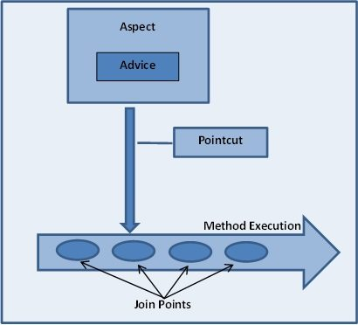
contd..
prepared by- Vijay Kulkarni, Java Spring Trainer

Slide 110
contd..
AOP Proxy – It is used to implement aspect contracts, created by AOP framework. It will be a JDK dynamic proxy or CGLIB proxy in spring framework.
Introduction – It means introduction of additional method and fields for a type. It allows you to introduce new interface to any advised object.
Target Object – It is the object i.e. being advised by one or more aspects. It is also known as proxied object in spring because Spring AOP is implemented using runtime proxies.
Weaving – It is the process of linking aspect with other application types or objects to create an advised object. Weaving can be done at compile time, load time or runtime. Spring AOP performs weaving at runtime.
prepared by- Vijay Kulkarni, Java Spring Trainer

Slide 111
contd..
Annotations and WildCard expressions –
1. To access method to only specific class, give package name
@Before(“execution(public String Circle.getName())”) – this aspect is run only for Circle class.
2. To apply aspect for all the methods which starts with get and irrespective of return type, use wildcard.
@Before(“execution(public * get*())”)
@Before(“execution( * get*())”)
prepared by- Vijay Kulkarni, Java Spring Trainer

Slide 112
contd..
To pass argument
@Before(“execution( * get*())”) –> Zero arguments
@Before(“execution( * get*(**))”) –> only one argument
@Before(“execution( * get*(..))”) –> two dots means, can have zero or more parameter.
@Before(“execution( * org.yash.watertechsol.model.*.get*())”) –> it applies to all classes available in Model
@After annotated methods run exactly after the all methods matching with pointcut expression.
prepared by- Vijay Kulkarni, Java Spring Trainer

Slide 113
interface JointPoint
This interface represents a generic runtime joinpoint (in the AOP terminology).
A runtime joinpoint is an event that occurs on a static joinpoint (i.e. a location in a the program).
For instance, an invocation is the runtime joinpoint on a method (static joinpoint). The static part of a given joinpoint can be generically retrieved using the getStaticPart() method.
In the context of an interception framework, a runtime joinpoint is then the reification of an access to an accessible object (a method, a constructor, a field), i.e. the static part of the joinpoint. It is passed to the interceptors that are installed on the static joinpoint.
prepared by- Vijay Kulkarni, Java Spring Trainer

Slide 114
contd..
AOP implementations are provided by:
AspectJ
Spring AOP
JBoss AOP
Spring AOP – Spring AOP can be used by 3 ways given below. But the widely used approach is Spring AspectJ Annotation Style. The 3 ways to use spring AOP are given below:
By Spring1.2 Old style (dtd based) (also supported in Spring3)
By AspectJ annotation-style
By Spring XML configuration-style(schema based)
prepared by- Vijay Kulkarni, Java Spring Trainer

Slide 115
Thank You
prepared by- Vijay Kulkarni, Java Spring Trainer

Slide 116
contd..
Annotations –
@RestController also known as a stereotype annotation. It provides hints for people reading the code and for Spring that the class plays a specific role. @RestController annotation tells Spring to render the resulting string directly back to the caller.
@Controller – Spring considers it when handling incoming web requests.
@RequestMapping annotation provides “routing” information. It tells Spring that any HTTP request with the / path should be mapped to the home method.
@Required: It applies to the bean setter method. It indicates that the annotated bean must be populated at configuration time with the required property, else it throws an exception BeanInitilizationException.

Slide 117
contd..
@Autowired: Spring provides annotation-based auto-wiring by providing @Autowired annotation. It is used to autowire spring bean on setter methods, instance variable, and constructor. When we use @Autowired annotation, the spring container auto-wires the bean by matching data-type.
@Configuration: It is a class-level annotation. The class annotated with @Configuration used by Spring Containers as a source of bean definitions.
@ComponentScan: It is used when we want to scan a package for beans. It is used with the annotation @Configuration. We can also specify the base packages to scan for Spring Components.
@Bean: It is a method-level annotation. It is an alternative of XML <bean> tag. It tells the method to produce a bean to be managed by Spring Container.

Slide 118
contd..
@Component: It is a class-level annotation. It is used to mark a Java class as a bean. A Java class annotated with @Component is found during the classpath. The Spring Framework pick it up and configure it in the application context as a Spring Bean.
@Controller: The @Controller is a class-level annotation. It is a specialization of @Component. It marks a class as a web request handler. It is often used to serve web pages. By default, it returns a string that indicates which route to redirect. It is mostly used with @RequestMapping annotation.
@EnableAutoConfiguration – This annotation tells Spring Boot to “guess” i.e. how user wants to configure Spring, based on the jar dependencies that have been added. E.g. if spring-boot-starter-web added Tomcat and Spring MVC, the auto-configuration assumes that user is developing a web application and sets up Spring accordingly.

Slide 119
contd..
The “main” Method – the final part of application is the main method, a standard method that follows the Java convention for an application entry point.
The main method delegates to Spring Boot’s SpringApplication class by calling run.
2. SpringApplication bootstraps our application, starting
Spring, which, in turn, starts the auto-configured Tomcat web server.
Note : The class is passed (E.g. TestMain.class) as an argument to the run method to tell SpringApplication which is the primary Spring component.
The args array is also passed through to expose any command-line arguments.

Slide 120
contd..
@Service: It is also used at class level. It tells the Spring that class contains the business logic.
@Repository: It is a class-level annotation. The repository is a DAOs (Data Access Object) that access the database directly. The repository does all the operations related to the database.

