Slide 2
Docker

Slide 3
Background
Virtualization is the technique of importing a Guest operating
system on top of a Host operating system.
This technique allowed developers to run multiple operating systems in different virtual machines all on the same host, thus no need for extra hardware resource.
The advantages of Virtual Machines or Virtualization are:
Multiple operating systems can run on the same machine
Maintenance and Recovery were easy in case of failure conditions
Total cost of ownership was also less due to the reduced need for infrastructure

Slide 4
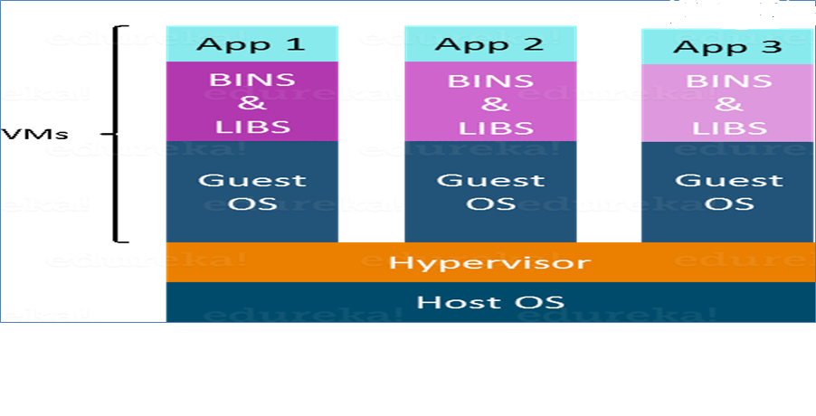
contd..
In the diagram it can be seen that there is a host operating system on which there are 3 guest operating systems running which is nothing but the virtual machines.

Slide 5
contd..
Virtualization also has its shortcomings.
Running multiple Virtual Machines in the same host operating system leads to performance degradation. This is because of the guest OS running on top of the host OS, which will have its own kernel and set of libraries and dependencies.
This takes up a large chunk of system resources, i.e. hard disk, processor and especially RAM.
Another problem with Virtual Machines which uses virtualization is that it takes almost a minute to boot-up. This is very critical in case of real-time applications.
Running multiple Virtual Machines leads to unstable performance as Boot up process is long and takes time
Hypervisors are not efficient as the host operating system

Slide 6
Containerization
These drawbacks led to the emergence of a new technique called CONTAINERIZATION, which is a type of Virtualization.
Containerization brings abstraction to the operating system and is more efficient because there is no guest OS.
It utilizes a host’s operating system, share relevant libraries & resources as per need unlike virtual machines.
Booting-up a container takes only a fraction of a second, as the container’s libs run on the host kernel, making processing and execution very fast.
All the containers share the host operating system and hold only the application related binaries & libraries, hence light weight.

Slide 7
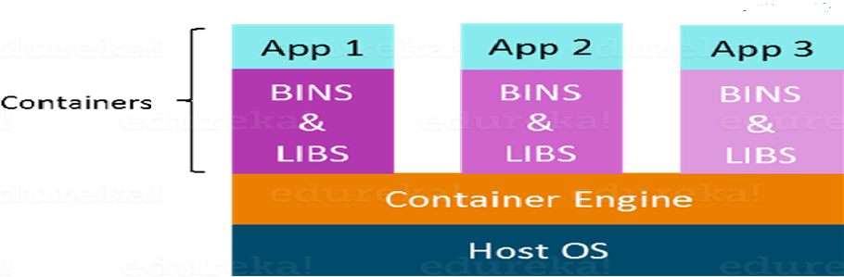
contd..
The host operating system is shared by all the containers.
Containers only contain application specific libraries which are separate for each container and are faster, do not waste any resources.
All these containers are handled by the containerization layer which is not native to the host operating system.
Hence a software is needed, which can enable to create & run containers on the host operating system.

Slide 8
Docker
Docker is a software containerization platform – developer can build the application, package them along with their dependencies into a container and then these containers can be easily shipped to run on other machines.
Docker packages an application and all its dependencies together in the form of Containers to ensure that the said application works seamlessly in any environment.
Docker truly lives up to its promise of Build, Ship and Run.
The developer can build a container which has different applications installed on it and give it to QA team who will only need to run the container to replicate the developer environment.

Slide 9
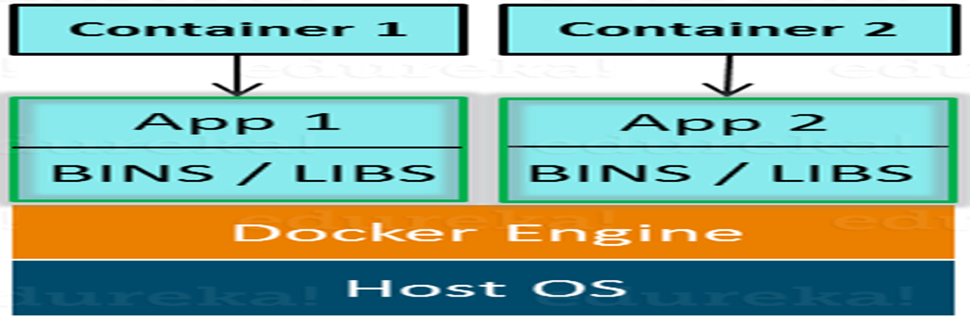
contd..
In above, each application will run on a separate container and will have its own set of libraries and dependencies.
There is process level isolation, meaning each application is independent of other. The developers can build applications that will not interfere with one another.

Slide 10
contd..
The QA team need not install all the dependent software and applications to test the code and this help to save time and energy.
Ensures that working environment is consistent across all individuals involved in the process - development to deployment.
The number of systems can be scaled up easily and the code can be deployed on them effortlessly.
To conclude - Virtualization and Containerization both let user run multiple operating systems inside a host machine.
Virtualization deals with creating many operating systems in a single host machine. Containerization on the other hand will create multiple containers for every type of application as needed.

Slide 11
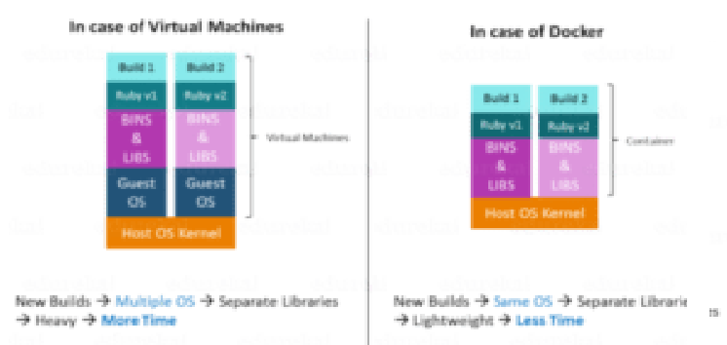
contd..
Comparison of Docker against Virtualization is on 3 parameters
Size
Startup
Integration

Slide 12
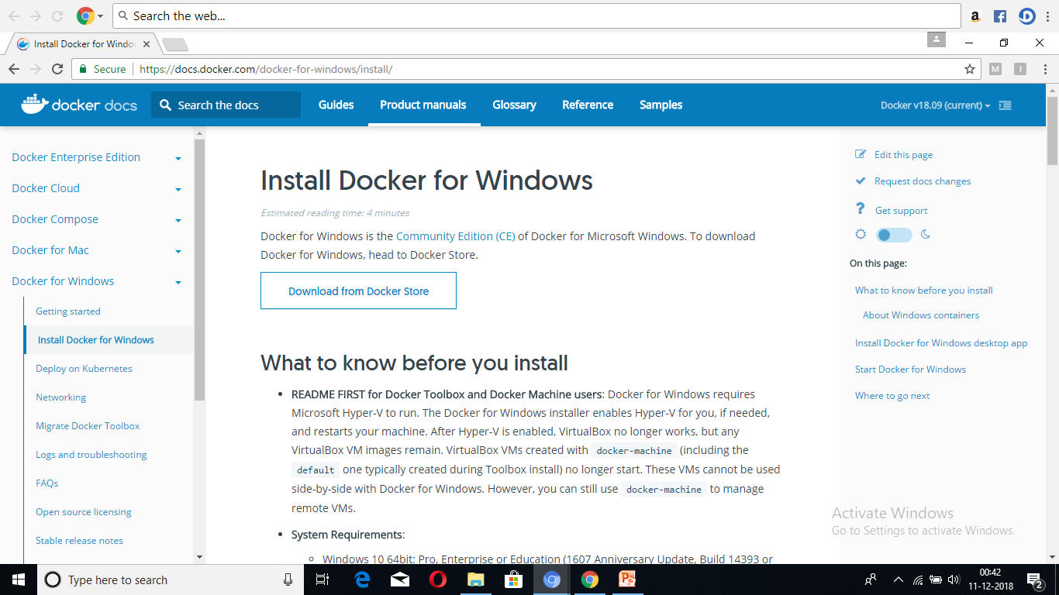
Docker installation

Slide 13
Exercise
Explore Docker hub

Slide 14
Getting started
Go to the terminal and type the commands
$ docker info
$ docker images
2. Run the application as - Maven build Give goals -
$ docker : build
3. At the terminal
$ docker images
$ docker ps
$ docker run
4. Run maven build command from inside the docker tool box.
That way maven has access to docker build

Slide 15
Commonly used commands
Docker version
Docker search
Docker pull
Docker run
Docker ps
Docker stop
Docker restart
Docker kill
Docker exec
Docker login
Docker commit
Docker push
Docker network
Docker history
Docker rmi
Docker ps –a
Docker copy
Docker logs
Docker volume
Docker logout

Slide 16
Docker Container and Image
Docker Engine provides the core Docker technology that enables images and containers.
The docker-image is read-only template with instructions for creating a docker-container. The docker image is described in text file called a Dockerfile, which has a simple, well-defined syntax.
An image does not have states.
Docker container is a running instance of an image; is an isolated and secure application platform, also it can share and has access to resources running in a different host or container.
Command Line Interface (CLI) can also be used to run, start, stop, move, or delete a container.

Slide 17
contd..
$ docker run hello-world
The above command docker run hello-world has three parts.
docker: It is docker engine and used to run docker program.
It tells to the operating system that user is running
docker program.
run: This subcommand is used to create and run a docker container.
hello-world: It is a name of an image. User needs to specify the name of an image which is to load into the container.

Slide 18
Dockerfile
A Dockerfile is a text document that contains commands that are used to assemble an image.
Docker builds images automatically by reading the instructions from the Dockerfile.
The docker build command is used to build an image from the Dockerfile.
$ docker build -f /path/to/a/Dockerfile .
The -f flag is used with docker build to point to a Dockerfile anywhere in the file system.

Slide 19
Dockerfile instructions
Docker runs instructions of Dockerfile in top to bottom order. The instructions are not case-sensitive.
To build an image, Dockerfile is created with a simple syntax for
defining the steps needed to create the image and run it.
Comment- statement must begin with #.
FROM – instruction is used to set the Base Image for the subsequent instructions. In other words directive sets the image on which the container will be based on.
Ex. FROM ubuntu
LABEL - LABEL instruction is used to set label for the image. Labels are used to an image to organize images of our project.
Ex. LABEL vendorl = “Sony India”
RUN – This instruction is used to execute any command of the current image.
Ex. RUN /bin/bash -c 'source $HOME/.bashrc; echo $HOME'

Slide 20
contd
CMD – used to execute application by the image. CMD is used in the following form. In other words sets the executable commands within the container.
Ex CMD ["executable", "param1", "param2"?]
This is preferred way to use CMD. There can be only one CMD in a
Dockerfile. If we use more than one CMD, only last one will execute
COPY – used to copy new files or directories from source to the filesystem of the container at the destination. In other words creates a copy of files from the file system in the container.
Ex. COPY abc/ /xyz
WORKDIR used to set the working directory for any RUN, CMD and COPY instruction that follows it in the Dockerfile. If work directory does not exist, it will be created by default. It can be used multiple times in a Dockerfile.
Ex. WORKDIR /var/www/html

Slide 21
contd..
Every instruction in a Dockerfile creates a layer in the image. Any
change in the Dockerfile, only those layers which have changed are rebuilt. This is part of what makes images so lightweight, small, and fast, when compared to other virtualization technologies.
A container is a runnable instance of an image.
User can create, start, stop, move, or delete a container using the Docker API or CLI.
By default, a container is well isolated from other containers and its host machine. User can control how isolated a container’s network, storage, or other underlying subsystems are from other containers or from the host machine.
The container can be connected to one or more networks, attach storage to it, or even create a new image based on its current state.

Slide 22
contd..
Dockerize a Website project
Login to Docker account
Create a folder for the project
Create necessary html, and/or css, js, images etc files
Create the Dockerfile and write this code.
FROM nginx:alpine
COPY . /usr/share/nginx/html

Slide 23
contd..
Container is defined by its image and configuration options provided, when created or started.
$ docker run -i -t ubuntu /bin/bash
When you run this command, the following happens (assuming, using the default registry configuration) –
If you do not have the ubuntu image locally, Docker pulls it from configured registry, as if, run docker pull ubuntu manually.
Docker creates new container, as if run docker container create command manually.
Docker allocates a read-write filesystem to the container, as its final layer. This allows a running container to create or modify files and directories in its local filesystem.

Slide 24
contd..
Docker creates a network interface to connect the container to the default network, since no networking options are specified. E.g. assigning an IP address to the container. By default, containers can connect to external networks using the host machine’s network connection.
Docker starts the container and executes /bin/bash. Because the container is running interactively and attached to user terminal (due to the -i and -t flags). Input can be from keyboard while the output is logged on to terminal.
To terminate the /bin/bash command, type exit and the container stops but is not removed.
It can be started again or remove it.

Slide 25
Dockerignore
There may be some files and folders that are although a part of the project but not needed to include in the Docker Build Context. It may be due to –
Security Issues – Some important files such as passwords, secret keys, .git folders, etc contain a lot of information about project and not to expose them to outside world to prevent intrusion.
Cache Invalidation – The COPY instruction means to copy the files and folders inside the Docker build context. Each statement inside the Dockerfile results in building a new intermediate image layer. Hence, repetitive changes to dockerfile, might lead to multiple Cache Invalidation and leads to wastage of resources.
Also, excluding unnecessary files from Docker Build Context will leads to lower Docker Image size.
It speeds up the process of building the Docker Image.

Slide 26
contd..
1. Type on search filed - docker maven plugin spring-boot
2. Track the link - GitHub- spotify/docker-maven-plugin Its a maven plugin for docker
3. Go to the link - Specify build info in the POM
4. Copy the plugin and go to the Spring boot project
5. Paste it in the <plugin> section in the pom.xml
6. Give the name to dockerimage.
Note : DO not build the application

Slide 27
Docker commands
Command | Description
docker ps | List containers
docker pull | Pull an image or a repository from a registry
docker push | Push an image or a repository to a registry
docker rename | Rename a container
docker stop | Stops the running containeer
dockert kill | Terminates the process
docker login | Log in to hub repository

Slide 28
Dockerizing SpringBoot application
Dockerizing an application involves the following
1. Build a Spring Boot Application
2. Attach a docker-maven-plugin
3. Launch containers

Slide 29
Docker architecture
Docker is written in the Go programming language and takes advantage of several features of the Linux kernel to deliver its functionality.
Docker uses a client–server architecture.
The Docker client talks to the Docker daemon, which does the heavy lifting of building, running, and distributing Docker containers.
The Docker client and daemon communicate using a REST API, over UNIX sockets or a network interface.
The Docker client and daemon can run on the same system, or user can connect a Docker client to a remote Docker daemon.
Another Docker client is Docker Compose, that lets developer work with applications consisting of a set of containers.
Docker uses a technology called namespaces to provide the isolated workspace called the container. When a container is run, Docker creates a set of namespaces for that container.

Slide 30
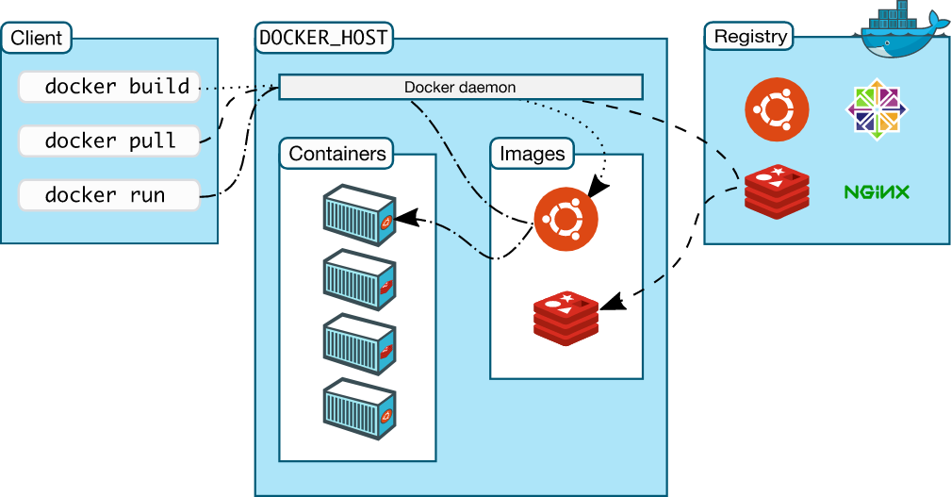
contd..

Slide 31
contd..
The Docker daemon – The Docker daemon (dockerd) listens for Docker API requests and manages Docker objects such as images, containers, networks, and volumes. A daemon can also communicate with other daemons to manage Docker services.
The Docker client – The Docker client (docker) is the primary way that many Docker users interact with Docker. When you use commands such as docker run, the client sends these commands to dockerd, which carries them out. The docker command uses the Docker API. The Docker client can communicate with more than one daemon.
Docker Desktop – Docker Desktop is an easy-to-install application for your Mac, Windows or Linux environment that enables you to build and share containerized applications and microservices. Docker Desktop includes the Docker daemon (dockerd), the Docker client (docker), Docker Compose, Docker Content Trust, Kubernetes, and Credential Helper. For more information, see Docker Desktop.

Slide 32
contd..
Docker registries – A Docker registry stores Docker images. Docker Hub is a public registry that anyone can use, and Docker is configured to look for images on Docker Hub by default. User can even run own private registry.
When docker pull or docker run commands are run, the required images are pulled from configured registry. When docker push command is used, image is pushed to configured registry.
Docker objects – Using Docker means, creating and using images, containers, networks, volumes, plugins, and other objects.

Slide 33
Docker Volumes
Volumes are a mechanism for persisting data generated by and used by Docker containers.
Features –
Volumes work on both Linux and Windows containers, are easier to back up or migrate, can be managed using Docker CLI commands or the Docker API.
Volumes can be more safely shared among multiple containers.
Volume drivers let you store volumes on remote hosts or cloud providers, to encrypt the contents of volumes, or to add other functionality.
New volumes can have their content pre-populated by a container.
Higher performance

Slide 34
contd..
The data doesn't persist when that container no longer exists, and it can be difficult to get the data out of the container if another process needs it.
A container's writable layer is tightly coupled to the host machine where the container is running. The data cannot be easily moveable somewhere else.
Writing into a container's writable layer requires a storage driver to manage the filesystem.
The volumes are stored on the host, independent of the container life cycle. This allows users to back up data and share file systems between containers easily.
A given volume can be mounted into multiple containers simultaneously. When no running container uses a volume, the volume is still available to Docker and not removed automatically.
Unused volumes can be removed with Docker volume prune.

Slide 35
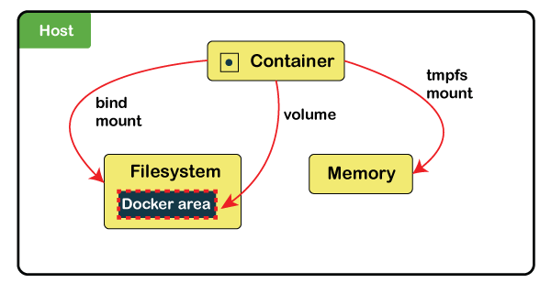
contd..
Volumes are stored in a part of the host filesystem, managed by Docker(/var/lib/docker/volumes/on Linux). Non-Docker processes should not modify this part of the filesystem.
Bind mounts may be stored anywhere on the host system.

Slide 36
contd..
Create a volume – to create and manage Docker volumes outside the scope of any container.
$ docker volume create [volume_name]
Docker automatically creates a directory for the volume on the host under the /var/lib/docker/volume/path.

Slide 37
docker-compose
Docker Compose is a Docker tool used to define and run multi-container applications. Docker–compose as an automated multi-container
YAML is used to configure application’s services and create all the app’s services from that configuration.
Compose is an excellent tool for development, testing, CI workflows, and staging environments.
Multiple isolated environments on a single host
Preserve volume data when containers are created
Only recreate containers that have changed
Variables and moving a composition between environments
Orchestrate multiple containers that work together
Note – Compose uses the Docker Engine. On desktop systems, such as Docker Desktop for Mac and Windows, Docker Compose is already included.

Slide 38
contd..
Docker Compose files work by applying multiple commands that are declared within a single docker–compose.yml configuration file.
The basic structure of a Docker Compose YAML file looks like this:
version: ‘X’
services:
web:
build: .
ports:
- "5000:5000"
volumes: - .:/code
redis:
image: redis

Slide 39
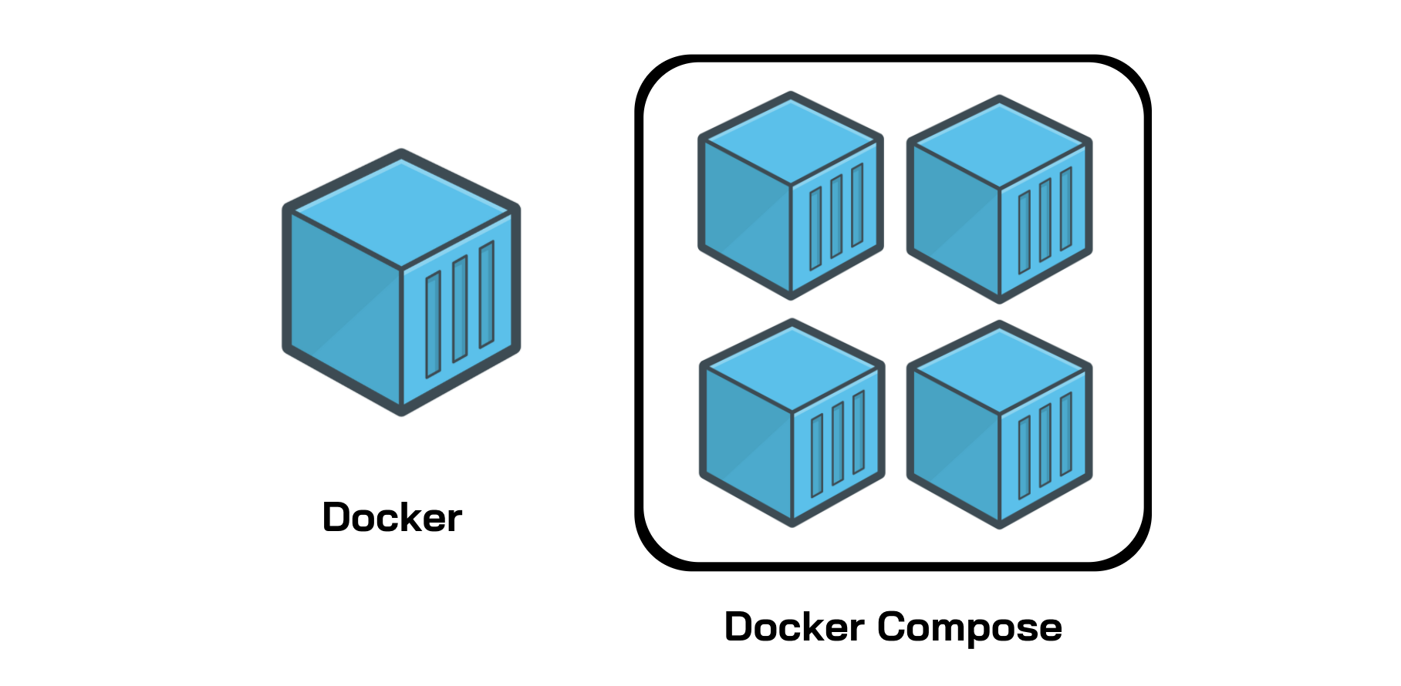
contd..

Slide 40
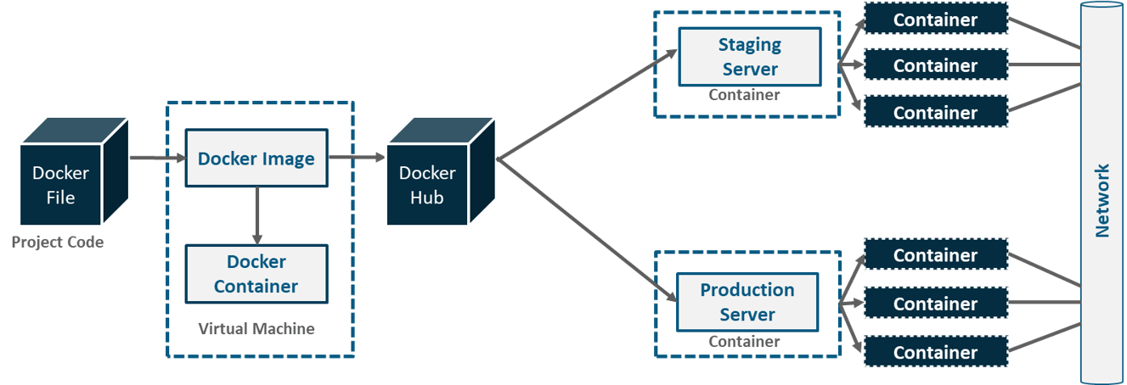
Docker Networking
A developer writes a code that stipulates application requirements or the dependencies in an easy to write Docker File and this Docker File produces Docker Images.

Slide 41
contd..
From public repositories, pull image as well upload images onto the Docker Hub.
Then, from Docker Hub, various teams such as Quality Assurance or Production teams will pull that image and prepare their own containers.
These individual containers, communicate with each other through a network to perform the required actions, and this is Docker Networking.

Slide 42
Goals of Docker Networking
Flexibility – Docker provides flexibility by enabling any number of applications on various platforms to communicate with each other.
Cross-Platform – Docker can be easily used in cross-platform which works across various servers with the help of Docker Swarm Clusters.
Scalability – Docker is a fully distributed network, which enables applications to grow and scale individually while ensuring performance.
Decentralized – Docker uses a decentralized network, which enables the capability to have the applications spread and highly available. In the event that a container or a host is suddenly missing from a pool of resource, then either an additional resource can be brought or pass over to services that are still available.
User – Friendly – Docker makes it easy to automate the deployment of services, making them easy to use in day-to-day life.
Support – Docker offers out-of-the-box supports. So, the ability to use Docker Enterprise Edition and get all of the functionality very easy and straightforward, makes Docker platform to be very easy to be used.
To enable the above goals, whats needed is the Container Network Model.

Slide 43
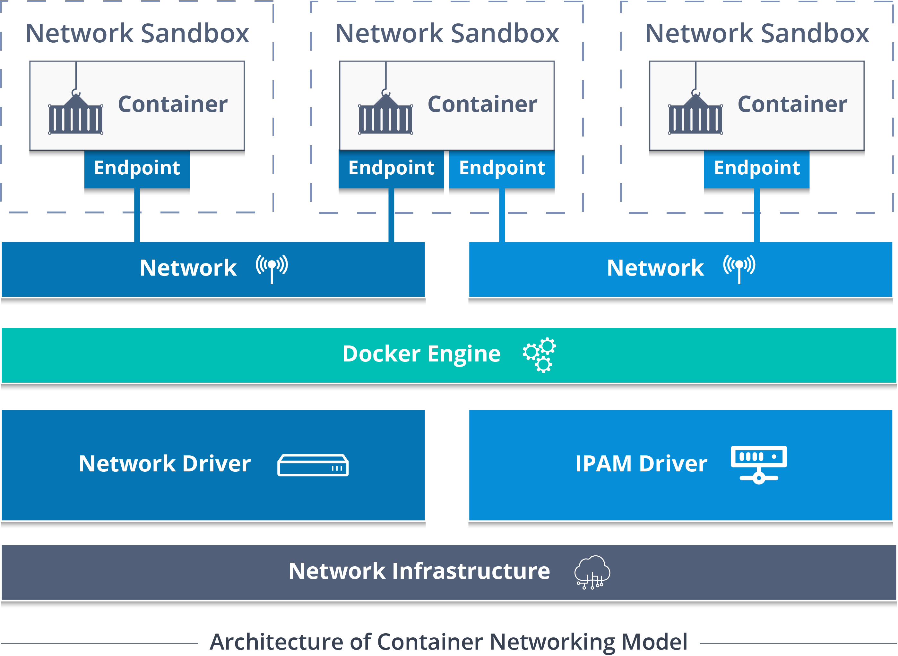
contd..

Slide 44
contd..
Container Network Model (CNM) standardizes the steps required to provide networking for containers using multiple network drivers. CNM requires a distributed key-value store like console to store the network configuration.
The CNM has interfaces for IPAM plugins and network plugins.
The IPAM plugin APIs are used to create/delete address pools and allocate/deallocate container IP addresses, whereas the network plugin APIs are used to create/delete networks and add/remove containers from networks.
Note – A bridge is the default network in docker.

Slide 45
contd..
Container Network Model Objects
Network Controller: Provides the entry-point into Libnetwork that exposes simple APIs for Docker Engine to allocate and manage networks. Since Libnetwork supports multiple inbuilt and remote drivers, Network Controller enables users to attach a particular driver to a given network.
Driver: Owns the network and is responsible for managing the network by having multiple drivers participating to satisfy various use-cases and deployment scenarios.
Network: Provides connectivity between a group of endpoints that belong to the same network and isolate from the rest. So, whenever a network is created or updated, the corresponding Driver will be notified of the event.

Slide 46
contd..
Endpoint: Provides the connectivity for services exposed by a container in a network with other services provided by other containers in the network. An endpoint represents a service and not necessarily a particular container, Endpoint has a global scope within a cluster as well.
Sandbox: Created when users request to create an endpoint on a network. A Sandbox can have multiple endpoints attached to different networks representing container’s network configuration such as IP-address, MAC-address, routes, DNS.
So, those were the 5 main objects of CNM.

Slide 47
Thank You

Slide 48
Services

Slide 49
When a container is removed, any changes to its state that are not stored in persistent storage disappear.

