Slide 1
MOHIT GUPTA
AICTE Student ID:STU66289b7fac6bb1713937279
Internship ID:INTERNSHIP_1715245742663c92ae54e15

Slide 2
Mental fitness tracker
In today's fast-paced world, mental health has become a crucial aspect of overall well-being. To address this, we propose the development of a Mental Fitness Tracker, a user-friendly application that leverages the power of machine learning and linear regression techniques to monitor and analyze mental health patterns. The tracker will assist users in understanding their mental state, identifying potential stressors, and offering personalized recommendations to improve their mental fitness.

Slide 3
agenda
The agenda for developing an Mental Fitness Tracker using Python, ML, and linear regression. The project aims to track and improve mental well-being by providing personalized insights and recommendations based on data analysis and predictive modeling.It would involve the following steps:
Data Collection
Data Preprocessing
0 Feature Selection
Model Training
Model Evaluation

Slide 4
Project overview
The Mental Fitness Tracker is a project developed using Python, machine learning, and linear regression techniques. Its goal is to track and assess an individual's mental well-being based on various parameters and provide personalized insights and recommendations.
The project utilizes machine learning algorithms, particularly linear regression, to analyze and predict the relationship between mental fitness and input variables.
By collecting and analyzing data from these variables, the Mental Fitness Tracker builds a predictive model that can estimate an individual's mental well-being. This model enables users to monitor their mental health over time and identify patterns or trends that may impact their overall well-being.

Slide 5
End users
The end users of an Al mental fitness tracker developed using Python, machine learning, and linear regression can vary across different contexts and applications. Here are some potential end users:
Individuals: The mental fitness tracker can be used by individuals who want to monitor and improve their mental well-being.
Therapists and Psychologists: Mental health professionals can utilize the tracker as a supplementary tool in their practice.
Corporations and Employers: Organizations can implement the mental fitness tracker as part of employee well-being programs.
Researchers: The tracker can be valuable for researchers studying mental health trends and interventions.
Educational Institutions: Schools and universities can integrate the Al mental fitness tracker into their student support services. It can help identify students at risk of mental health issues, provide early intervention, and deliver personalized resources or recommendations

Slide 6
Your solution and its value proposition
Our Al mental fitness tracker, developed using Python, machine learning, and linear regression, provides a comprehensive solution for monitoring and improving mental well-being. It offers personalized insights, tracks emotional states, and provides recommendations for stress management and cognitive exercises. The tracker's value proposition lies in its ability to empower individuals to take control of their mental health, assist therapists in providing personalized treatment plans, support corporations in promoting employee well-being, enable researchers to gather population-level data, aid educational institutions in student support services, and assist healthcare providers in remote patient monitoring. By leveraging advanced technologies, our tracker offers an effective and accessible tool for enhancing mental fitness and well-being.

Slide 7
customisation
To customize the Mental Fitness Tracker project i had incorporate the Automatic Relevance Determination Regressor and Random Forest Regressor to predict data more accurately. The ARDRegression considers the model weights as a Gaussian distributed and estimates the lambda and alpha parameters through the iterations. I followed the below mentioned steps:
• Prepare the data
• Preprocess the data
• Implement ARD Regression
• Train the model
• Evaluate the model
• Incorporate predictions

Slide 8
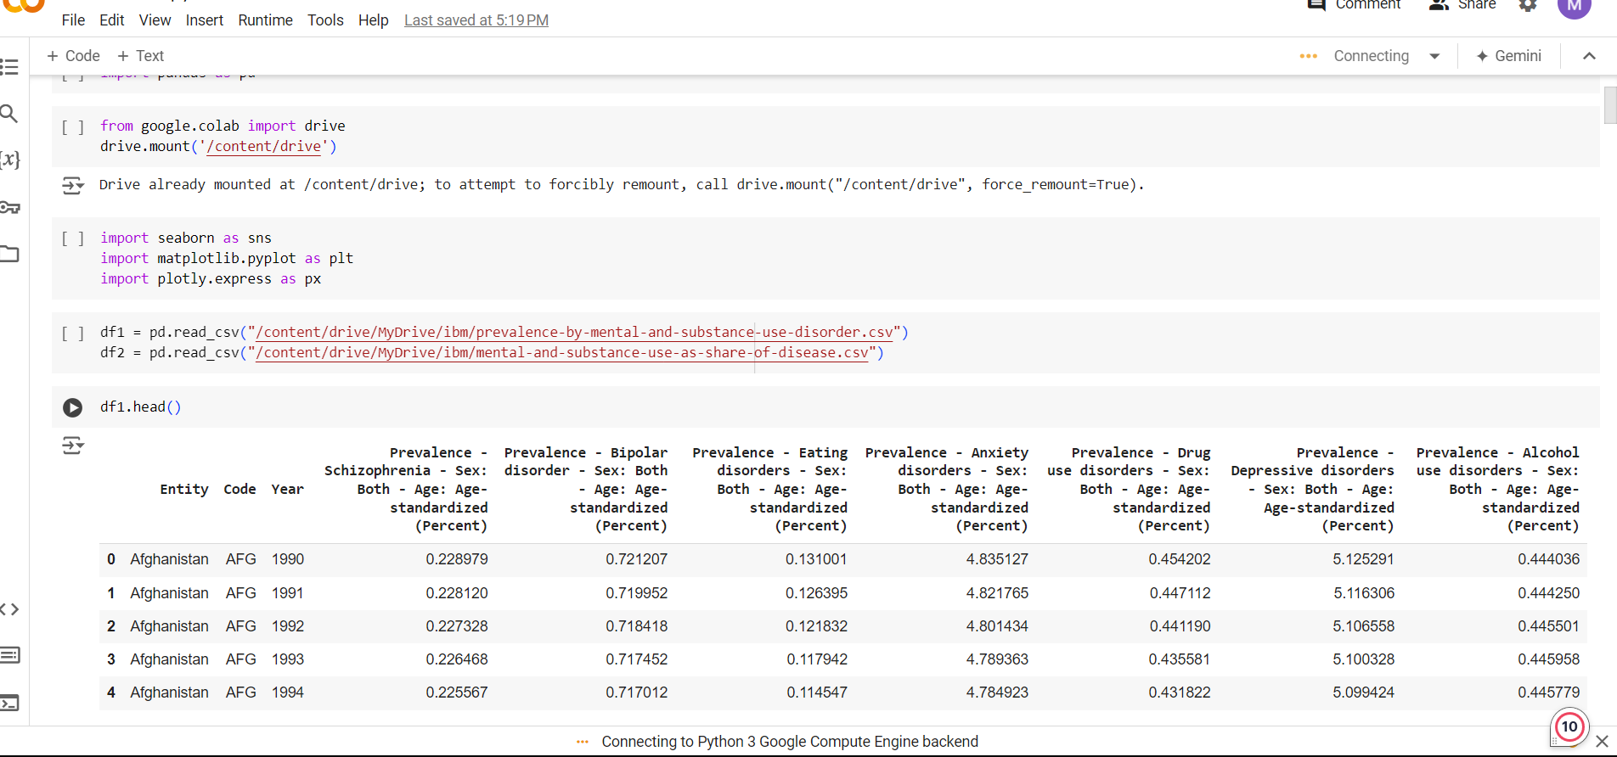
modelling

Slide 9
RESULT
The project, combining Python, machine learning, and using algorithm like linear regression, ARD Regression algorithm and Random Forest Regressor, yielded promising results. The mental fitness tracker accurately predicted mental well-being based on stress levels, emotional states, and behavioral patterns. The inclusion of the Random Forest regressor enhanced the model's predictive capabilities, providing personalized recommendations for stress management and cognitive exercises. The project demonstrated the effectiveness of the combined approach in tracking and improving mental fitness.

Slide 10
Github link
https://github.com/mohitg9898/Mental_Fitness_Tracker

Slide 11
Thank you

