Slide 1
CAR FEATURES AND MSRP

Slide 2
CAR FEATURES AND MSRP
Cars dataset with features including make, model, year, engine, and other properties of the car.
This dataset contains 15 columns and 11895 rows
Columns included-
1.Make-Make of the car
2.Model-Model name of the car
3.Year-Year it was manufactured
4.Engine fuel type-The kind of fuel the car uses
5.Engine HP-Horse power delivered by the engine

Slide 3
6.Engine Cylinders-Number of cylinders in the engine of the car
7.Transmission type-The type of transmission available in the car
8.Driven_Wheels-The wheels which are delivered with power from the engine (rear wheel,front wheel,all wheel)
9.Number of doors-Number of doors in the car
10.Vehicle Size-Size of the vehicle
11.Vehicle Style-Style of the vehicle (coupe,sedan etc.)
12.Highway MPG-Miles per gallon delivered by the car on highways
13.City MPG-Miles per gallon delivered by the car on city roads.
14.Popularity-Popularity of the car (data scrapped from twitter)
15.MSRP-List price or manufacturer's suggested retail price

Slide 4
1.Data Cleaning
The percentage of NaN values present in the dataset was ~0.5 percent
Before data cleaning.
This Dataset consists of both categorical and numerical attributes.
The techinques used to remove nan values were-
For categorical columns the category was compared with the respective model ie.,if one column contained NaN values in some row this row was compared to the corresponding rows before and after and if they had the same model the data from that row under the same column was copied in place of NaN

Slide 5
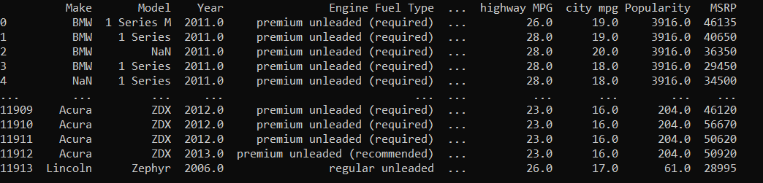
Some categorical column which had more variety were cleaned using bfill function of pandas.
NaN values from numerical columns were replaced with mean of that column
Before-

Slide 6
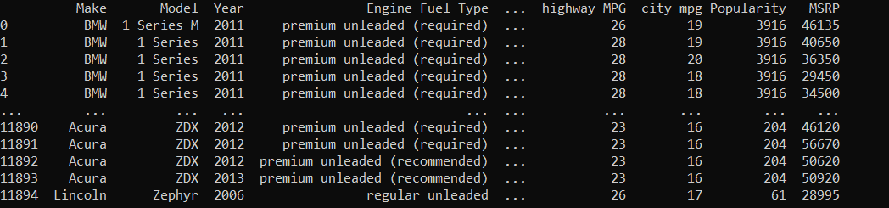
After

Slide 7
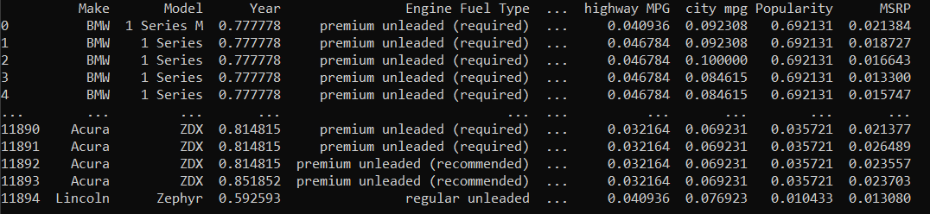
2.1 Data Normalization
Normalization-
All numerical values were normalized such that they fall under the range 0 to 1

Slide 8
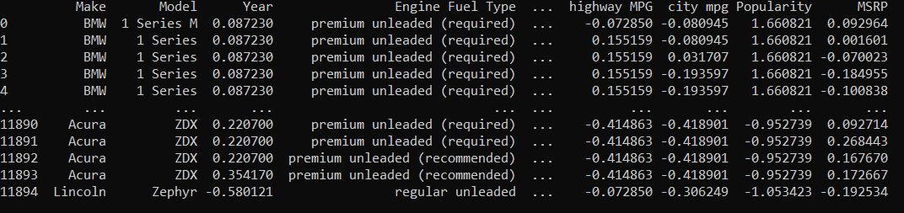
2.2 Data Standardization
Standardization-
All numerical values were manipulated such that their mean was 0 and they all had unit variance.

Slide 9
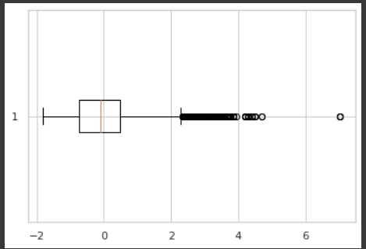
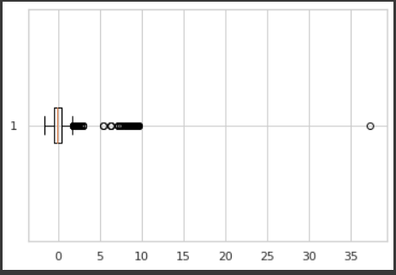
3.Data Visualization
Plotting graphs and making inferences
1.Boxplots
Boxplots are best used to find out outliers in data
The above graph shows outliers in the Horse power and highway mpg columns

Slide 10
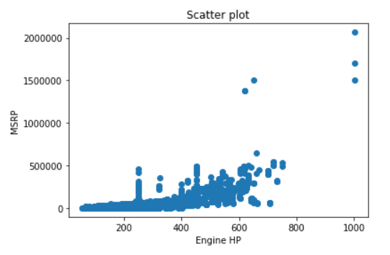
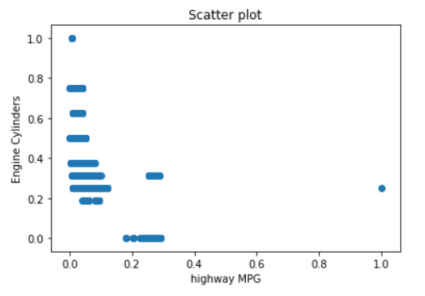
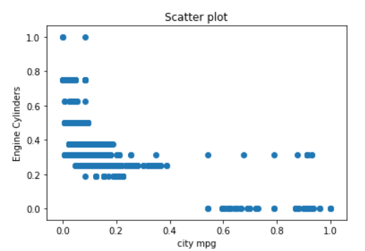
2.Scatter plots-
Can be used to predict the relation between two columns
The above scatter plots show relations between 2 columns-

Slide 11
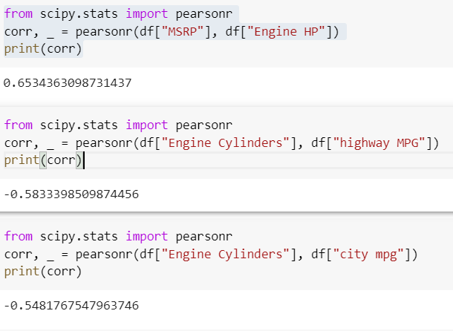
Graph between MSRP and Engine HP shows a directly proportional relation.
Graph between Number of cylinders and city and highway MPG shows a inversely proportional relation.
The values of the given Pearson coefficient for these columns confirm these conclusions.

Slide 12
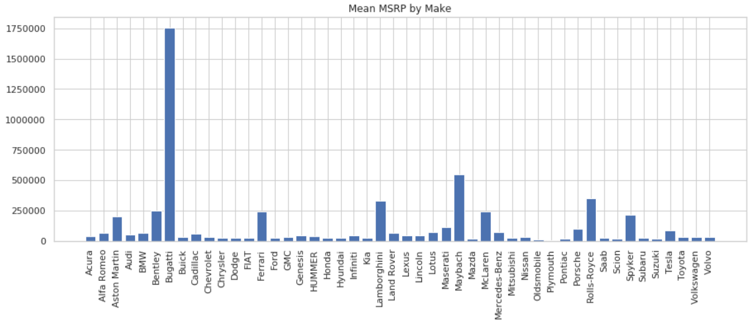
3.Barcharts
Used to visualize discrete data intervals
The graphs below show the bar graphs between Transmission types and Make versus their respective mean MSRP

Slide 13
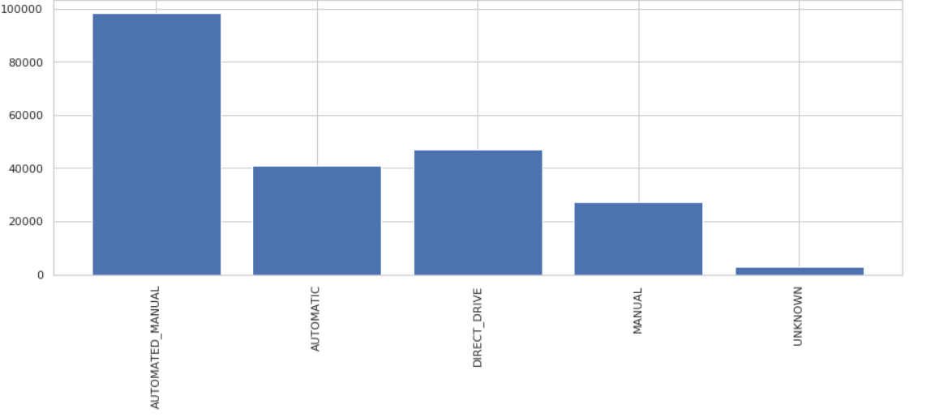
The graphs above show that the make Buggati has the highest average MSRP and the cars with automatic-manual type of transmission has highest average MSRP

Slide 14
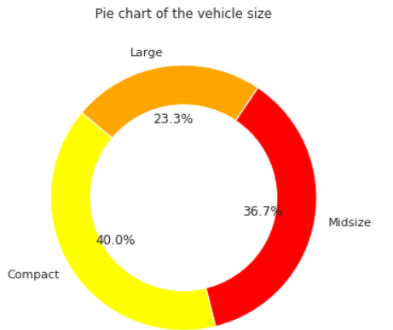
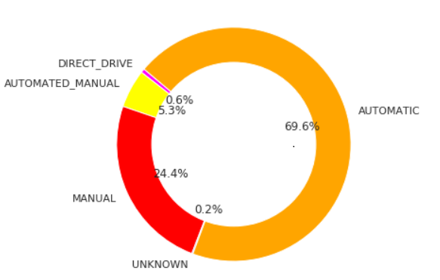
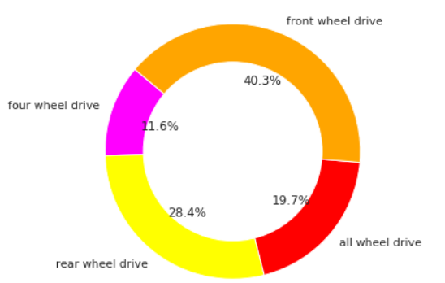
4.Pie Charts
A pie chart (or a circle chart) is a circular statistical graphic, which is divided into slices to illustrate numerical proportion.
The below pie charts show the ratio between different vehicle sizes, transmissions, drives

Slide 15
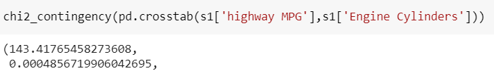
4.Hypothesis Testing
Chi-Squared test
1.
H0:Highway MPG is dependent on number of cylinders
H1:Highway MPG is independent on number of cylinders
The p value is 0.00048 which is < 0.05 thus we can reject H0

Slide 16

2.
H0:Transmission type is dependent on year the car was produced
H1:Transmission type is independent of the year of production of the car
The p value is 0.56 which is > 0.5 thus we fail to reject H0

Slide 17

3.
H0:MSRP is dependent on year the car was produced
H1:MSRP is independent of the year of production of the car
The p value is 0.99 which is > 0.5 thus we fail to reject H0

