Slide 1
OLA
Car Rental System

Slide 2
Problem Statement
The manual car rental services provides services only during office hours. So, customers have limited time frame for making any transaction or reservations of the car. Online car rental systems ,like OLA, on the other hand do not face such difficulty and is more flexible and reliable. By using such systems customer/user can:
Book a Ride for now.
Schedule a ride for later
Rent a car for desired amount of time
Before these features are accessible a customer has to login to the system with the following inputs:
Mobile Number
Name and Email Address (For first time only)
OTP received on entered mobile number.
After login the customer will be presented with a menu in which pickup and drop location in addition to other inputs need to be filled by him.

Slide 3
Problem Statement Contd.
Inputs required for each screen with there respective constraints:
1. Login:
S.NO | Input | Type Constraint | Range Constraint | Other Constraint
1 | Mobile Number | Integer | [10,10] | -
2 | Name | String | [3,20] | No Special Symbol
3 | Email Id | String | [13,31] | Gmail Id
4 | OTP | Integer | [4,6] | -

Slide 4
Problem Statement Contd.
2. Booking:
S.NO. | Input |  | Type Constraint | Range Constraint
1 | Pickup |  | String | [3,15]
2 | Drop |  | String | [3,15]
3 | Later |  | Integer | [0,1]
4 | Date | Day | Integer | [1,31] | further depends on month
 |  | Month | Integer | [1,12]
 |  | Year | Integer | [Present year, Present year+1]
5 | Time | Hour | Integer | [1,12]
 |  | Minute | Integer | [1,59]
 |  | A.M/P.M | Integer | [0,1]

Slide 5
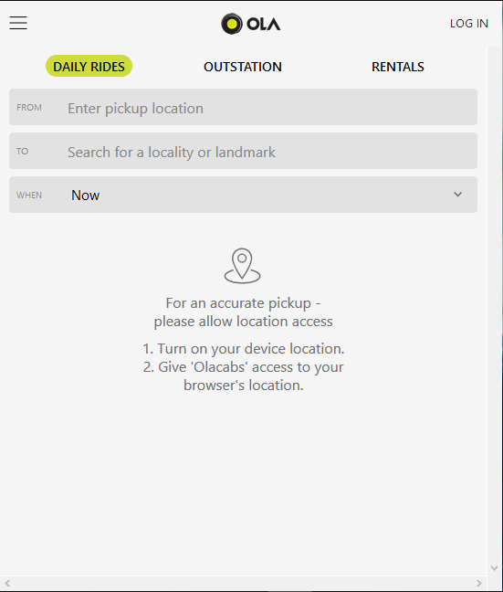
LOG IN
Daily Rides
Outstation
Rental
FROM:
To:
When: V

Slide 6
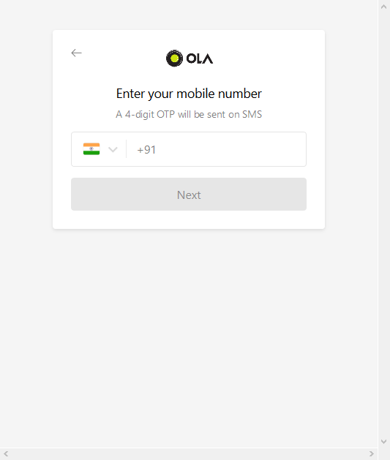
9999564854
NEXT

Slide 7
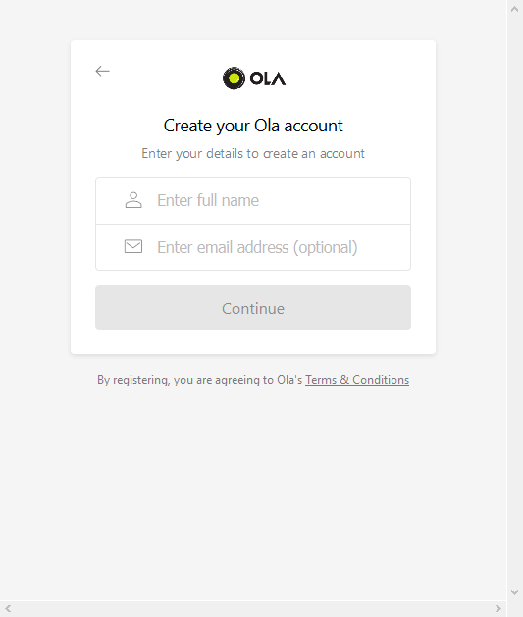
Name Mohit Goel
Email mohitgoel1888@gmail.com
Continue

Slide 8
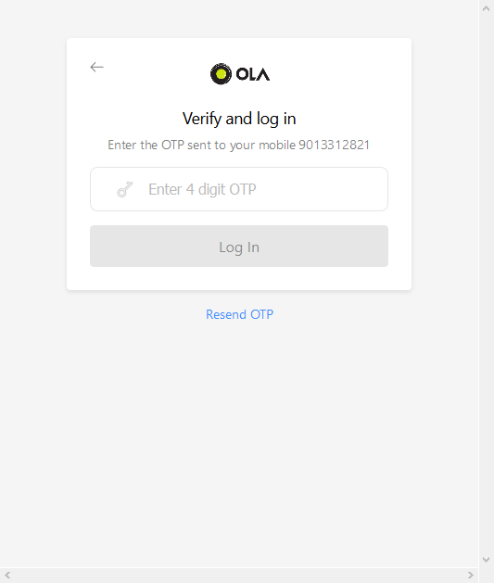
9999564854
0145
LOG IN

Slide 9

Daily Rides
Outstation
Rental
FROM:
To:
When: V

Slide 10
Daily Rides
Outstation
Rental
FROM:
To:
When: V
Now
Schedule for later

Slide 11
Daily Rides
Outstation
Rental
FROM:
To:
When: Now V

Slide 12
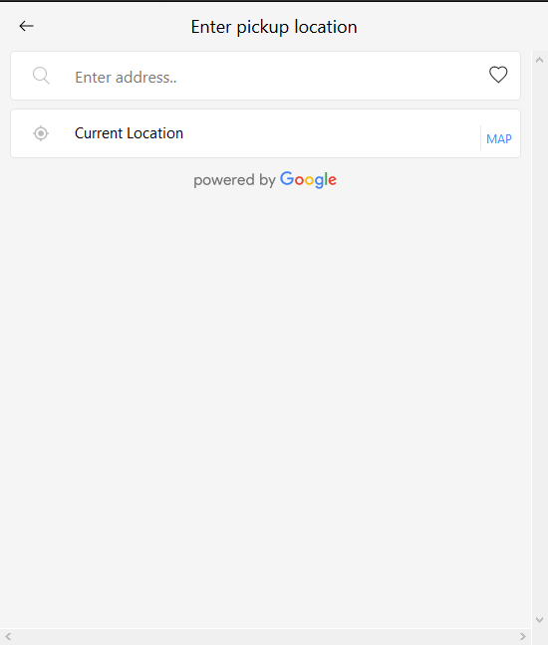
Enter address..
Current Location MAP

Slide 13
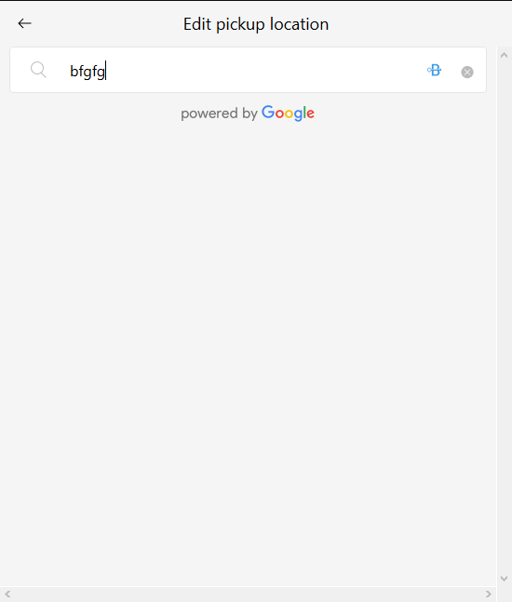
Bhagwan Parshu

Slide 14
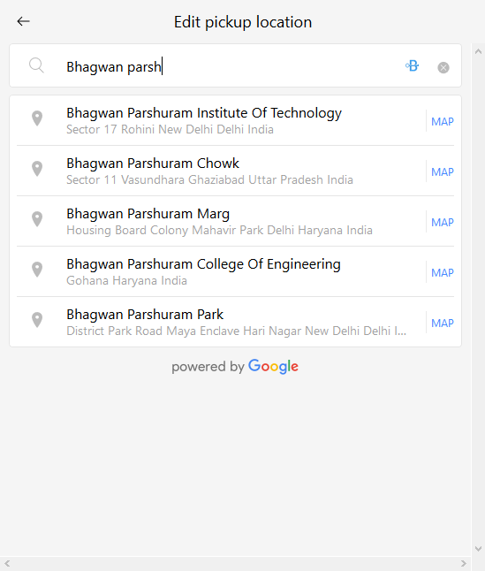
Bhagwan Parshu

Slide 15
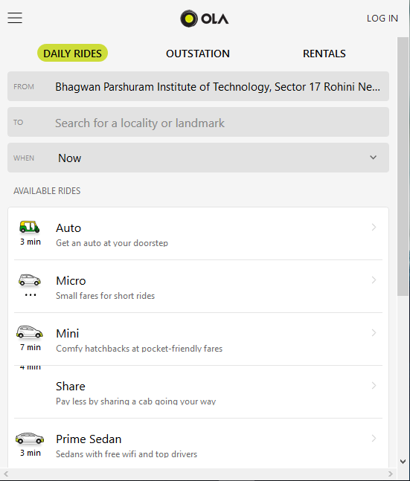
Daily Rides
Outstation
Rental
FROM: Bhagwan Parshuram Institute of Technology, Sector 17 Rohini Delhi India
To:
When: Now V

Slide 16
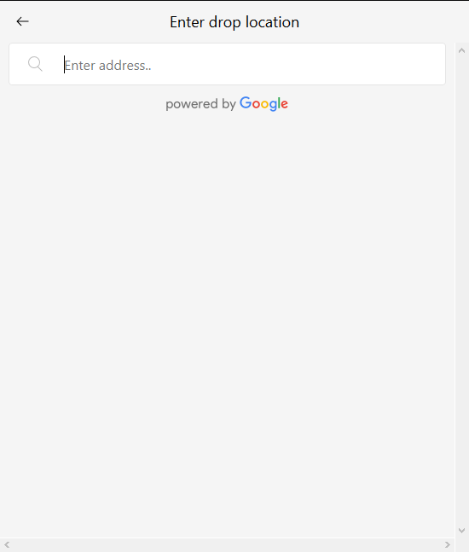
Rithala

Slide 17
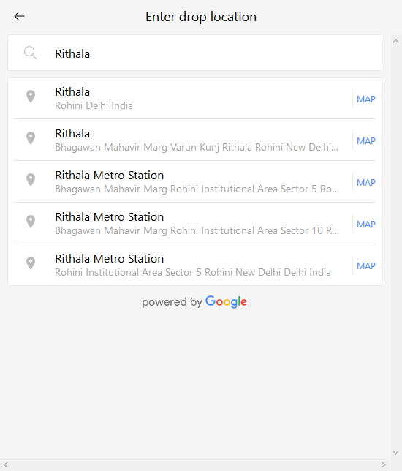

Slide 18
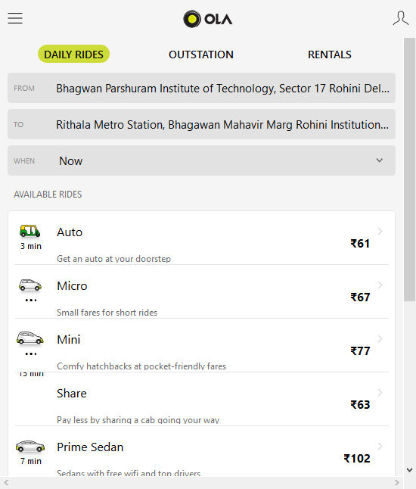
Daily Rides
Outstation
Rental
FROM: Bhagwan Parshuram Institute of Technology, Sector 17 Rohini Delhi India
To: Rithala Metro Station, Bhagawan Mahavir Marg Rohini Institutional Area Sector
When: Now

Slide 19
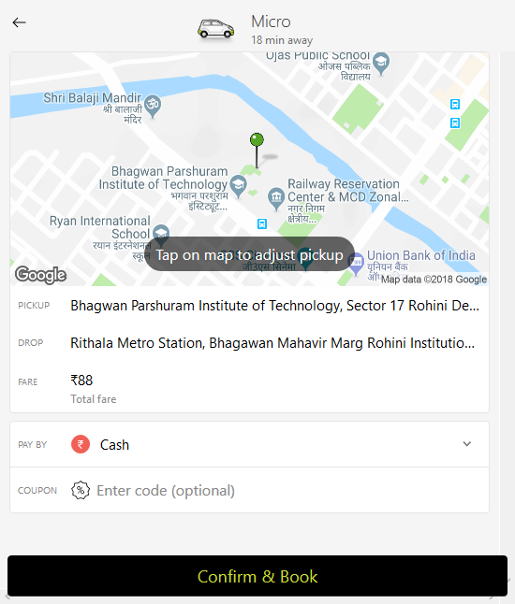

Slide 20
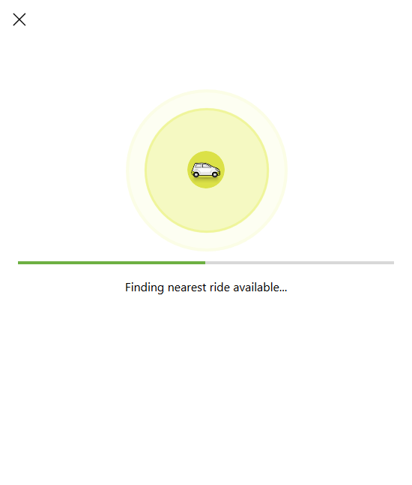

Slide 21
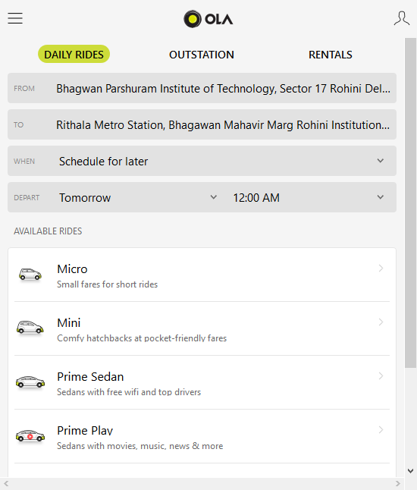
Daily Rides
Outstation
Rental
FROM:
To:
When: Schedule for later
Depart: 15/10/2018 Time: 9:00 P.M.

Slide 22
Daily Rides
Outstation
Rental
FROM: Bhagwan Parshuram Institute of Technology, Sector 17 Rohini Delhi India
To:
When: Schedule for later
Depart: 20/10/2018 Time: 10:00 A.M.

Slide 23
Daily Rides
Outstation
Rental
FROM: Bhagwan Parshuram Institute of Technology, Sector 17 Rohini Delhi India
To: Rithala Metro Station, Bhagawan Mahavir Marg Rohini Institutional Area Sector
When: Schedule for later
Depart: 20/10/2018 Time: 10:00 A.M.

Slide 24
Confirming Booking

Slide 25
Thank You

