Slide 1
A PROJECT 0N
ENCRYPTER
Submitted To: Submitted by:
Miss. Deepak Garg Mohit Goyal

Slide 2
content
Aim
Introduction
RSA Algorithm
    Working of RSA
Modules
    Welcome
    Generate
    Encrypt
    Decrypt
    Help
Data Flow diagram
E-R diagram
System requirements
Technologies uses
Conclusion
References

Slide 3
AIM
To create a platform independent desktop application, which can fulfill the task of encryption & decryption of text.

Slide 4
Introduction
The main objective of the project is to create platform independent desktop application, which can fulfill the task of encryption & decryption of text.
In today's scenario every one of us have some secrets & want privacy. Our application ‘Encrypter’ helps in maintaining the same.
By this application an user can easily encrypt a text message & can share it with others without any loss of privacy.

Slide 5
It is based on RSA algorithm, which is one of most secure cryptography technique.
Being based on RSA algorithm makes this application reliable.
Moreover, ‘Encrypter’ is coded using JAVA technology which makes it platform independent and portable.

Slide 6
RSA Algorithm
RSA is an algorithm for public-key cryptography.
RSA stands for Ron Rivest, Adi Shamir and Leonard Adleman, who first publicly described the algorithm in 1977.
A user of RSA creates and then publishes the product of two large prime numbers, along with an auxiliary value, as their public key.
The prime factors must be kept secret.
Anyone can use the public key to encrypt a message, but with currently published methods, if the public key is large enough, only someone with knowledge of the prime factors can feasibly decode the message.

Slide 7
Working of rsa
Select two large prime numbers p, q
Compute
n = p × q
v = (p-1) × (q-1)
Select small odd integer k relatively prime to v
    gcd(k, v) = 1
Compute d such that
(d × k)%v = (k × d)%v = 1
Public key is (k, n)
Private key is (d, n)
example
    p = 11
    q = 29
    n = 319
    v = 280
    k = 3
    d = 187
public key
    (3, 319)
private key
    (187, 319)

Slide 8
Modules
Welcome
Generate
Encrypt
Decrypt
Help

Slide 9
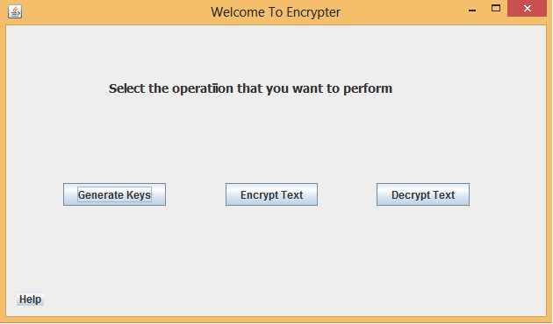
Welcome Module
From this module the user can choose the option according the task he wants to perform.

Slide 10
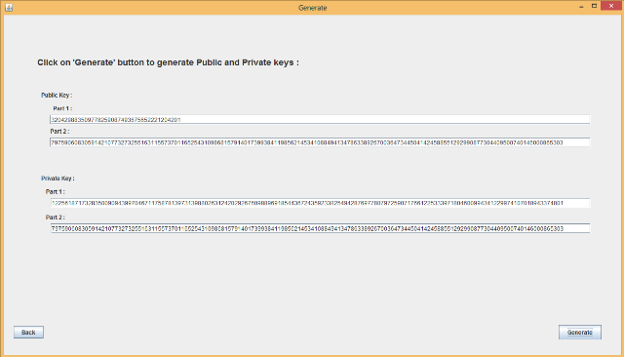
Generate module
From this module the user can generate ‘Public keys’ & ‘Private Keys’

Slide 11
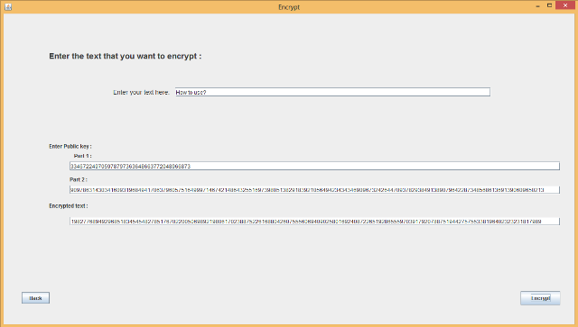
Encrypt module
From this module the user can encrypt the text message.

Slide 12
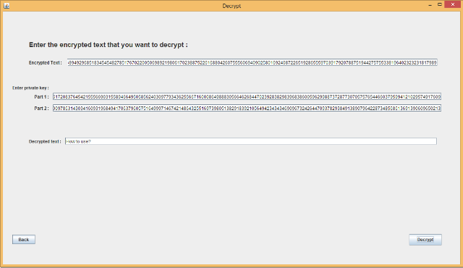
Decrypt module
From this module the user can decrypt the encrypted text message.

Slide 13
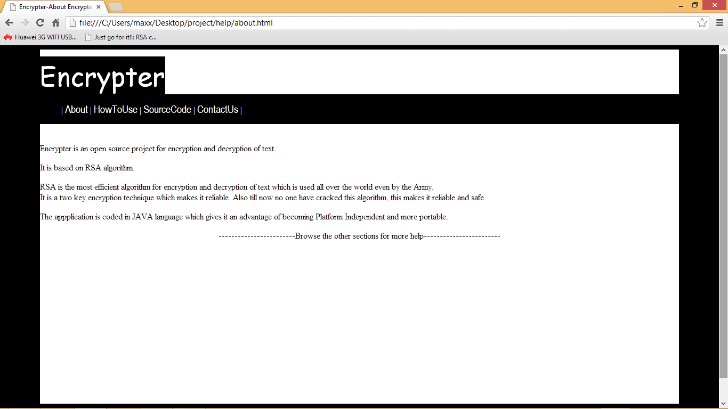
help module
From this the user can know more about the application & help on how to use the application.

Slide 14
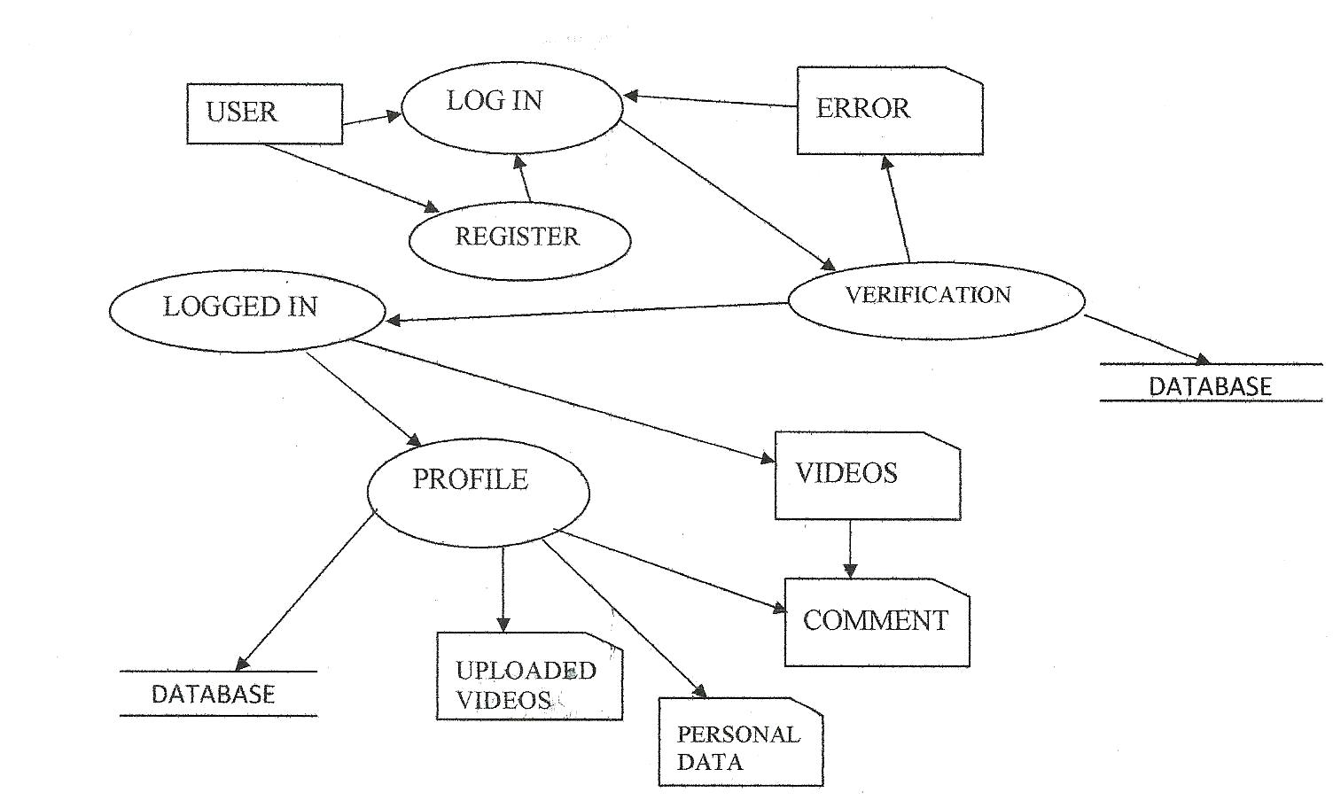
Data flow diagram

Slide 15
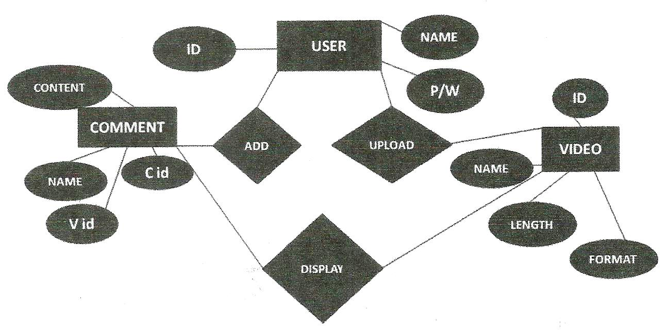
ER diagram

Slide 16
System requirements
RAM – 512MB
Free HDD space – 100MB
Working Internet Connection
HTML5 and CSS3 compatible Web Browser

Slide 17
Technologies used
JAVA
HTML 5
CSS 3

Slide 18
conclusion
Computer has clearly got advantage over the manual system. The computerized system is more reliable, efficient, cheap and fast.
At the end of the project, we can say that computer plays a very crucial role in the sharing of information. As computer is used in every field so it provides comfort and suitability to everyone. Providing maximum reliability, security and comfort to the users is the main goal of this project.

Slide 19
refrences
Book :
  Herbert Schildt, JAVATM : The Complete Reference, TATA McGraw-HILL, Seventh Edition.
Websites :
  http://en.wikipedia.org/wiki/RSA_(algorithm)
  www.stackoverflow.com
  www.w3schools.com

Slide 20
Any Questions?

Slide 21
Thank You

