Slide 1
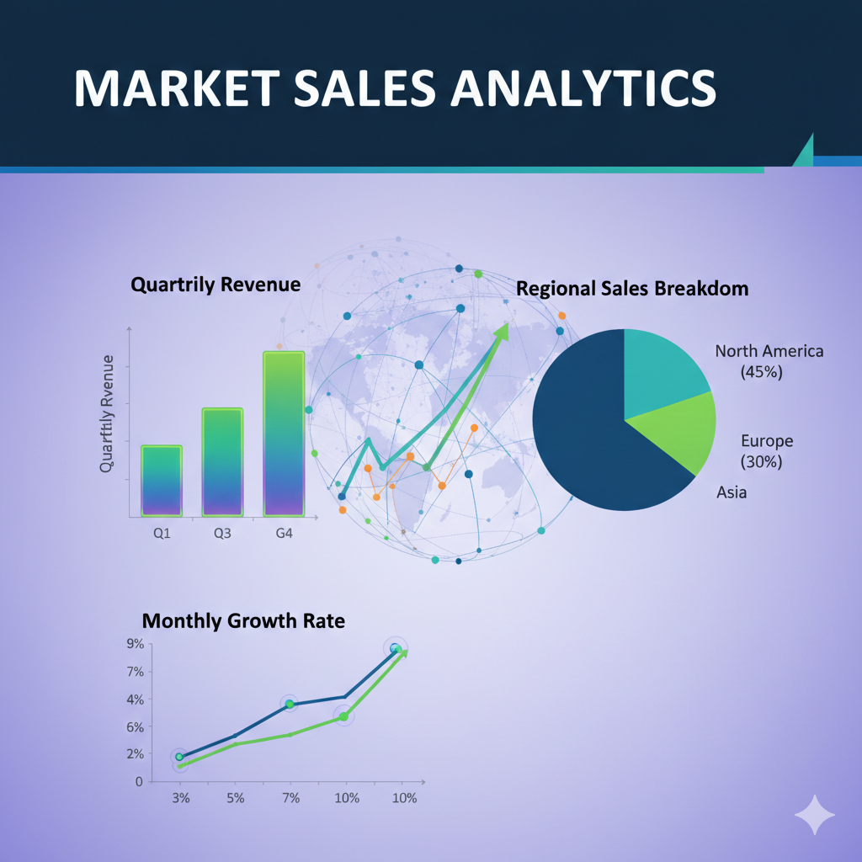

Slide 2

Unveiling Insights: Leveraging Data for Strategic Decision-Making
Problem Statement:
Atliq Hardware's, a leading computer hardware producer, faced a critical challenge. They needed quick and data-informed decisions to stay competitive in the ever-evolving market. The management noticed that they were missing crucial insights for strategic moves.
To tackle this, they hired a data analytics team, and I took on the SQL challenge. My aim? Answer 10 ad-hoc requests, translating data into valuable insights for strategic decision-making.
AtliQ Hardwares
by Mohith Raj

Slide 3
Key Insights:
Significant increase in unique products, with 334 in 2021 compared to 245 in 2020.
The "Notebook" segment boasts the highest product count, with 129 products.
The "Accessories" segment saw a notable increase in product counts, with 34 more products in 2021 compared to 2020.
"Flipkart" leads with the highest average pre-invoice discount percentage at 30.83%.
Fiscal year 2020's low sales in March and April improved in fiscal year 2021.
The "Retailer" channel contributes to 73.22% of gross sales, making it the key driver.
AtliQ Hardwares
by Mohith Raj

Slide 4
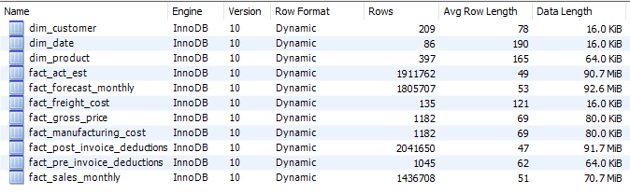
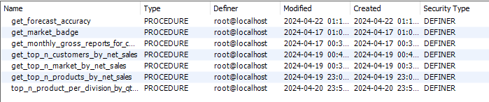

Database Overview
Tables
Stored Procedures
Functions
Views
AtliQ Hardwares
by Mohith Raj

Slide 5
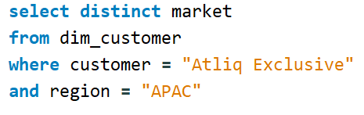
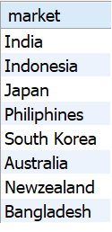
Provide the list of market in which customer
“Atliq Exclusive” operates its business in APAC region
AtliQ Hardwares
by Mohith Raj

Slide 6
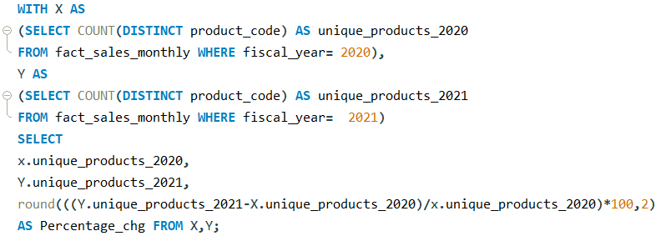

What is the percentage of unique product increase in 2021vs.2020?
AtliQ Hardwares
by Mohith Raj

Slide 7
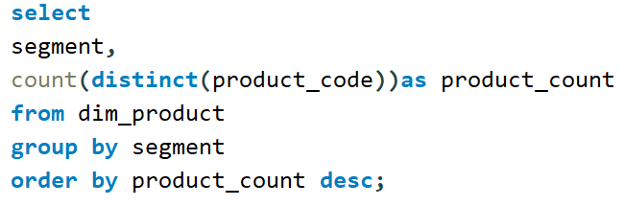
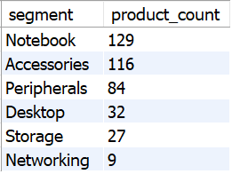
Provide a report with all the unique product counts for each segment
and sort them in descending order of product counts.
The final output contains 2 fields, segment product count.
AtliQ Hardwares
by Mohith Raj

Slide 8
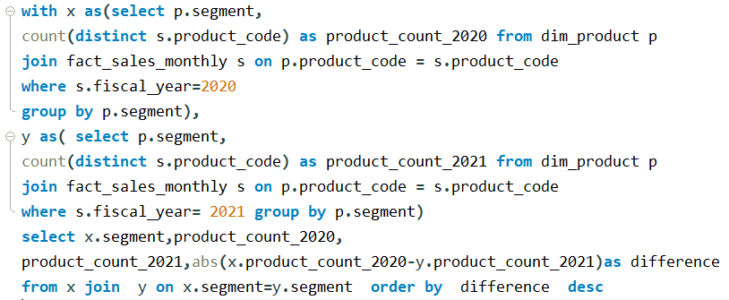
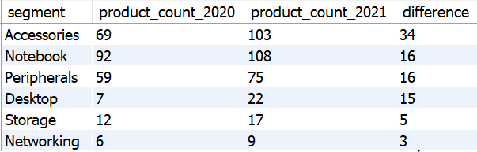
Follow-up: Which segment had the most increase in unique products in 2021 vs 2020? The final output contains these fields, segment, product count 2020 product_count_202I difference.
AtliQ Hardwares
by Mohith Raj

Slide 9
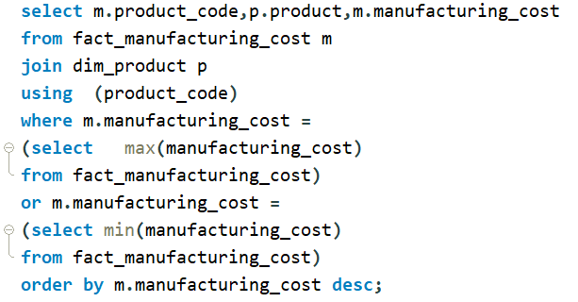

Get the products The final output that have the highest and lowest manufacturing costs
should contain these fields, product_code, product
AtliQ Hardwares
by Mohith Raj

Slide 10
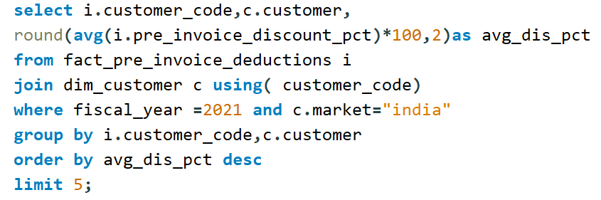
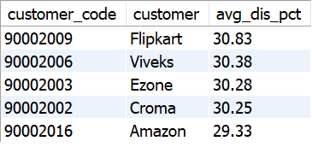
Generate a report which contains the top 5 customers who received an average high pre invoice discount_pct for the fiscal year 202I and in the Indian market. The final output contains these fields
customer_code customer average_discount_percentage.
AtliQ Hardwares
by Mohith Raj

Slide 11
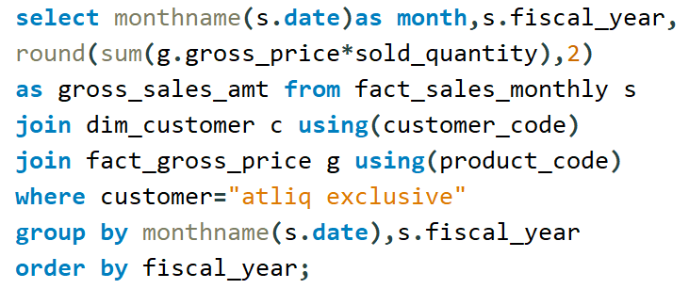
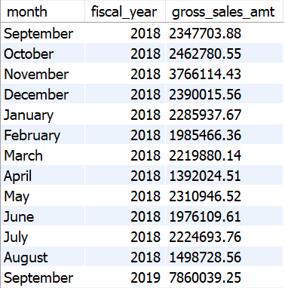
Get the complete report of the Gross sales amount for the customer "Atliq Exclusive "for each month. This analysis helps to get an idea of low and high-performing months and take strategic decisions. The final
report contains these columns: Month Year Gross sales Amount.
AtliQ Hardwares
by Mohith Raj

Slide 12
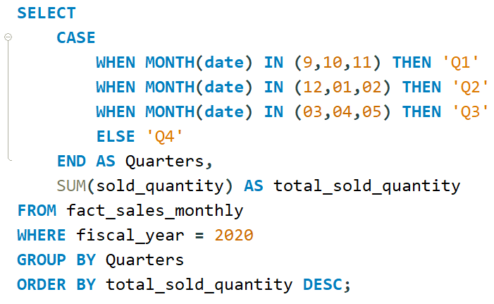
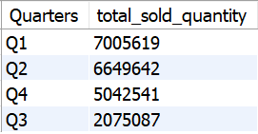
Which quarter of 2020, got the maximum total_sold_quantity? The final output contains these fields sorted by the total_sold_quantiy, Quarter, total_sold_quantity.
AtliQ Hardwares
by Mohith Raj

Slide 13
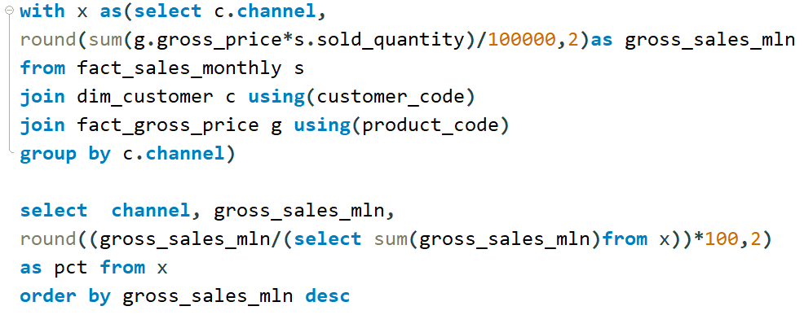
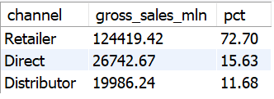
Which channel helped to bring more gross sales in the fiscal year 2021 and the percentage of contribution? The final output contains these fields, channel gross sales min percentage.
AtliQ Hardwares
by Mohith Raj

Slide 14
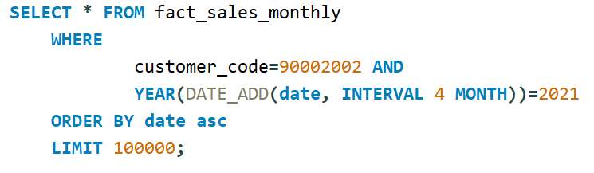
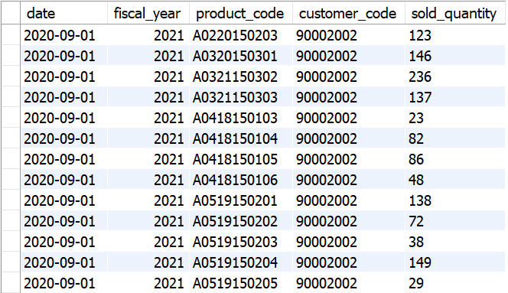
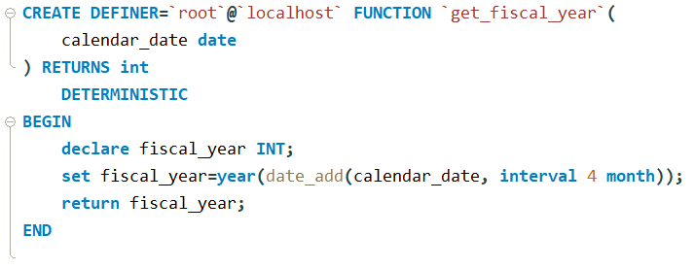
Get all the sales transaction data from fact_sales_monthly table for that customer(croma: 90002002) in the fiscal_year 2021
Create function for fiscal_year
AtliQ Hardwares
by Mohith Raj

Slide 15
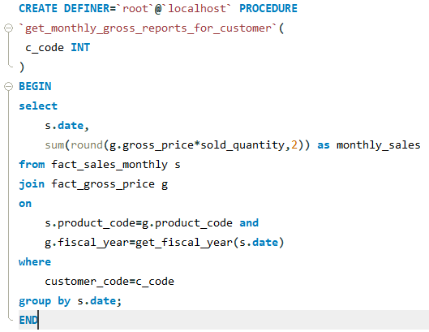
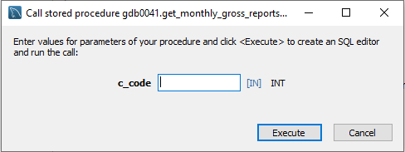
Generate monthly gross sales report for any customer using stored procedure
AtliQ Hardwares
by Mohith Raj

