Slide 1

COMPUTER NETWORKS
TEAM NETWORKS
Department of Computer Science and Engineering

Slide 2
COMPUTER NETWORKS
Application Layer
Department of Computer Science and Engineering

Slide 3
COMPUTER NETWORKS
Unit – 1 Application Layer
2.1 Principles of Network Applications
2.2 Web, HTTP and HTTPS

Slide 4
COMPUTER NETWORKS
Application Layer: Overview
Our goals:
Conceptual and implementation aspects of application-layer protocols
transport-layer service models
client-server paradigm
peer-to-peer paradigm
Learn about protocols by examining popular application-layer protocols
HTTP

Slide 5
COMPUTER NETWORKS
Some Network Apps
social networking
Web
text messaging
e-mail
multi-user network games
streaming stored video (YouTube, Hulu, Netflix)
P2P file sharing
voice over IP
real-time video conferencing (e.g., Skype, Hangouts)
Internet search
remote login
…

Slide 6








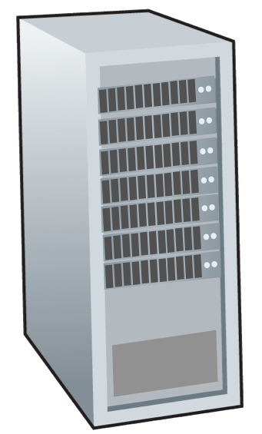







COMPUTER NETWORKS
Creating a Network App
application
transport
network
data link
physical
write programs that:
run on (different) end systems
communicate over network
e.g., web server software communicates with browser software
no need to write software for network-core devices
network-core devices do not run user applications
applications on end systems allows for rapid app development, propagation
mobile network
national or global ISP
local or regional ISP
home network
content
provider
network
application
transport
network
data link
physical
application
transport
network
data link
physical
datacenter
network
enterprise
network

Slide 7
COMPUTER NETWORKS
Client-Server Paradigm
server:
always-on host
permanent IP address
often in data centers, for scaling
clients:
contact, communicate with server
may be intermittently connected
may have dynamic IP addresses
do not communicate directly with each other
examples: HTTP, IMAP, FTP
mobile network
national or global ISP
local or regional ISP
home network
content
provider
network
datacenter
network
enterprise
network

Slide 8
COMPUTER NETWORKS
Peer-to-Peer Architecture
no always-on server
arbitrary end systems directly communicate
peers request service from other peers, provide service in return to other peers
self scalability – new peers bring new service capacity, as well as new service demands
peers are intermittently connected and change IP addresses
complex management
example: P2P file sharing
mobile network
national or global ISP
local or regional ISP
home network
content
provider
network
datacenter
network
enterprise
network

Slide 9
COMPUTER NETWORKS
Processes Communicating
process: program running within a host
within same host, two processes communicate using inter-process communication (defined by OS)
processes in different hosts communicate by exchanging messages
clients, servers
client process: process that initiates communication
server process: process that waits to be contacted
note: applications with P2P architectures have client processes & server processes

Slide 10

COMPUTER NETWORKS
Sockets
process sends/receives messages to/from its socket
socket analogous to door
sending process shoves message out door
sending process relies on transport infrastructure on other side of door to deliver message to socket at receiving process
two sockets involved: one on each side
application
socket
application
controlled by
app developer
process
process
transport
transport
network
network
controlled
by OS
link
Internet
link
physical
physical

Slide 11
COMPUTER NETWORKS
Addressing Processes
to receive messages, process must have identifier
host device has unique 32-bit IP address
Q: does IP address of host on which process runs suffice for identifying the process?
identifier includes both IP address and port numbers associated with process on host.
example port numbers:
HTTP server: 80
mail server: 25
to send HTTP message to gaia.cs.umass.edu web server:
IP address: 128.119.245.12
port number: 80
more shortly…
A: no, many processes can be running on same host

Slide 12
COMPUTER NETWORKS
An Application-layer Protocol defines:
types of messages exchanged,
e.g., request, response
message syntax:
what fields in messages & how fields are delineated
message semantics
meaning of information in fields
rules for when and how processes send & respond to messages
open protocols:
defined in RFCs, everyone has access to protocol definition
allows for interoperability
e.g., HTTP, SMTP
proprietary protocols:
e.g., Skype

Slide 13
COMPUTER NETWORKS
What transport service does an App needs?
data integrity
some apps (e.g., file transfer, web transactions) require 100% reliable data transfer
other apps (e.g., audio) can tolerate some loss
throughput
some apps (e.g., multimedia) require minimum amount of throughput to be “effective”
other apps (“elastic apps”) make use of whatever throughput they get
timing
some apps (e.g., Internet telephony, interactive games) require low delay to be “effective”
security
encryption, data integrity, …

Slide 14
COMPUTER NETWORKS
Transport service requirements: common apps
application
file transfer/download
e-mail
Web documents
real-time audio/video
streaming audio/video
interactive games
text messaging
data loss
no loss
no loss
no loss
loss-tolerant
loss-tolerant
loss-tolerant
no loss
throughput
elastic
elastic
elastic
audio: 5Kbps-1Mbps
video:10Kbps-5Mbps
same as above
Kbps+
elastic
time sensitive?
no
no
no
yes, 10’s msec
yes, few secs
yes, 10’s msec
yes and no

Slide 15
COMPUTER NETWORKS
Internet Transport Protocol Services
TCP service:
reliable transport between sending and receiving process
flow control: sender won’t overwhelm receiver
congestion control: throttle sender when network overloaded
does not provide: timing, minimum throughput guarantee, security
connection-oriented: setup required between client and server processes
UDP service:
unreliable data transfer between sending and receiving process
does not provide: reliability, flow control, congestion control, timing, throughput guarantee, security, or connection setup.

Slide 16
COMPUTER NETWORKS
Internet Transport Protocol Services
application
layer protocol
FTP [RFC 959]
SMTP [RFC 5321]
HTTP 1.1 [RFC 7320]
SIP [RFC 3261], RTP [RFC 3550], or proprietary (Skype)
DASH
WOW, FPS (proprietary)
transport protocol
TCP
TCP
TCP
TCP or UDP
TCP
UDP or TCP
application
file transfer/download
e-mail
Web documents
Internet telephony
streaming audio/video
interactive games

Slide 17
COMPUTER NETWORKS
Unit – 1 Application Layer
2.1 Principles of Network Applications
2.2 Web, HTTP and HTTPS

Slide 18
COMPUTER NETWORKS
Web, HTTP and HTTPS
First, a quick review…
web page consists of objects, each of which can be stored on different Web servers
object can be HTML file, JPEG image, Java applet, audio file,…
web page consists of base HTML-file which includes several referenced objects, each addressable by a URL, e.g.,
If a Web page contains HTML text and 5 JPEG images, then the Web page has 6 objects: the base HTML file plus the 5 images.
www.someschool.edu/someDept/pic.gif
host name
path name

Slide 19

COMPUTER NETWORKS
HTTP Overview
HTTP: hypertext transfer protocol
Web’s application layer protocol
client/server model:
client: browser that requests, receives, (using HTTP protocol) and “displays” Web objects
server: Web server sends (using HTTP protocol) objects in response to requests
HTTP request
PC running
Firefox browser
HTTP response
HTTP request
server running
Apache/IIS Web
server
HTTP response
iPhone running
Safari browser
Defined in RFC 1945; RFC 2616

Slide 20
COMPUTER NETWORKS
HTTP Overview (more)
HTTP uses TCP:
client initiates TCP connection (creates socket) to server, port 80
server accepts TCP connection from client
HTTP messages (application-layer protocol messages) exchanged between browser (HTTP client) and Web server (HTTP server)
TCP connection closed
HTTP is “stateless”
server maintains no information about past client requests
aside
protocols that maintain “state” are complex!
past history (state) must be maintained
if server/client crashes, their views of “state” may be inconsistent, must be reconciled

Slide 21
COMPUTER NETWORKS
HTTP Connections: two types
Non-persistent HTTP
TCP connection opened
at most one object sent over TCP connection
TCP connection closed
downloading multiple objects required multiple connections
Persistent HTTP
TCP connection opened to a server
multiple objects can be sent over single TCP connection between client, and that server
TCP connection closed

Slide 22
COMPUTER NETWORKS
Non-persistent HTTP: example
User enters URL:
www.someSchool.edu/someDepartment/home.index
(base HTML file containing text, references to 10 jpeg images)
1b. HTTP server at host www.someSchool.edu waiting for TCP connection at port 80 “accepts” connection, notifying client
1a. HTTP client initiates TCP connection to HTTP server (process) at www.someSchool.edu on port 80
2. HTTP client sends HTTP request message (containing URL) into TCP connection socket. Message indicates that client wants object someDepartment/home.index
3. HTTP server receives request message, forms response message containing requested object, and sends message into its socket
time

Slide 23
COMPUTER NETWORKS
Non-persistent HTTP: example (more)
User enters URL:
www.someSchool.edu/someDepartment/home.index
(containing text, references to 10 jpeg images)
4. HTTP server closes TCP connection.
5. HTTP client receives response message containing html file, displays html. Parsing html file, finds 10 referenced jpeg objects
6. Steps 1-5 repeated for each of 10 jpeg objects
time

Slide 24
COMPUTER NETWORKS
Non-persistent HTTP: response time
RTT (definition): time for a small packet to travel from client to server and back
HTTP response time (per object):
one RTT to initiate TCP connection
one RTT for HTTP request and first few bytes of HTTP response to return
obect/file transmission time
initiate TCP
connection
RTT
request file
RTT
time to
transmit
file
file received
time
time
Non-persistent HTTP response time = 2RTT+ file transmission time

Slide 25
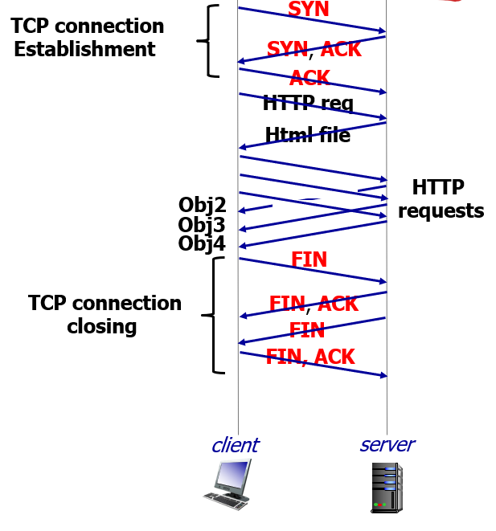
COMPUTER NETWORKS
Persistent HTTP (HTTP 1.1)
Non-persistent HTTP issues:
requires 2 RTTs per object
OS overhead for each TCP connection (TCP buffer and variables)
browsers often open multiple parallel TCP connections to fetch referenced objects in parallel
Persistent HTTP (HTTP1.1):
server leaves connection open after sending response
subsequent HTTP messages between same client/server sent over open connection
client sends requests as soon as it encounters a referenced object
as little as one RTT for all the referenced objects (cutting response time in half)

Slide 26
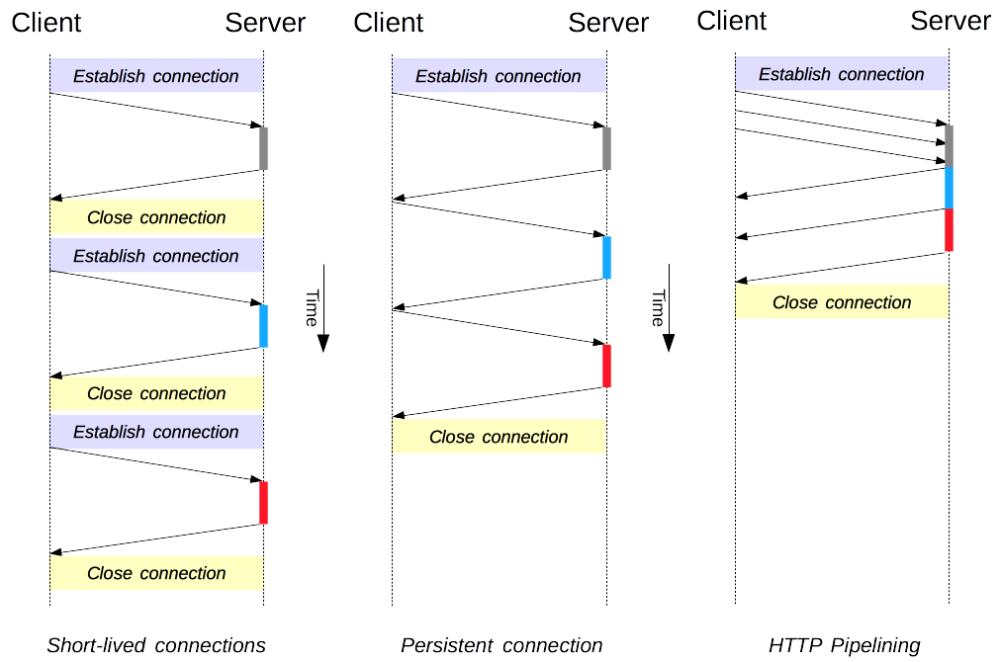
COMPUTER NETWORKS
Connection Management in HTTP/1.x

Slide 27
COMPUTER NETWORKS
Unit – 1 Application Layer
2.1 Principles of Network Applications
2.2 Web, HTTP and HTTPS

Slide 28
COMPUTER NETWORKS
HTTP Request Message
two types of HTTP messages: request, response
HTTP request message:
ASCII (human-readable format)
carriage return character
line-feed character
request line (GET, POST,
HEAD commands)
GET /index.html HTTP/1.1\r\n
Host: www-net.cs.umass.edu\r\n
User-Agent: Firefox/3.6.10\r\n
Accept: text/html,application/xhtml+xml\r\n
Accept-Language: en-us,en;q=0.5\r\n
Accept-Encoding: gzip,deflate\r\n
Accept-Charset: ISO-8859-1,utf-8;q=0.7\r\n
Keep-Alive: 115\r\n
Connection: keep-alive\r\n
\r\n
header
lines
carriage return, line feed at start of line indicates end of header lines
* Check out the online interactive exercises for more examples: http://gaia.cs.umass.edu/kurose_ross/interactive/

Slide 29
COMPUTER NETWORKS
HTTP Request Message: General Format
method
sp
URL
sp
version
cr
lf
request
line
header field name
value
cr
lf
~
~
header
lines
~
~
header field name
value
cr
lf
cr
lf
~
entity body
~
body
~
~
HTTP specifications [RFC 1945; RFC 2616; RFC 7540]

Slide 30
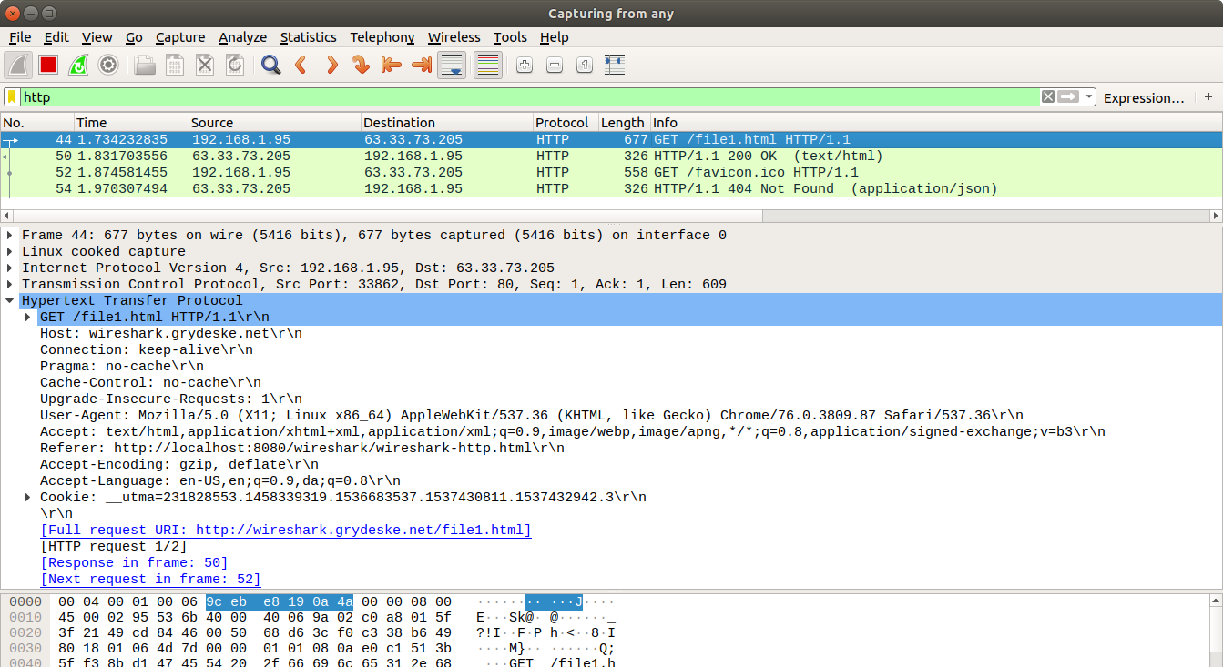
COMPUTER NETWORKS
HTTP Request Message – Wireshark Capture

Slide 31
COMPUTER NETWORKS
Other HTTP Request Messages
POST method:
web page often includes form input
user input sent from client to server in entity body of HTTP POST request message
HEAD method:
requests headers (only) that would be returned if specified URL were requested with an HTTP GET method.
GET method (for sending data to server):
include user data in URL field of HTTP GET request message (following a ‘?’):
PUT method:
uploads new file (object) to server
completely replaces file that exists at specified URL with content in entity body of POST HTTP request message
www.somesite.com/animalsearch?monkeys&banana

Slide 32
COMPUTER NETWORKS
HTTP Response Message
status line (protocol
status code status phrase)
HTTP/1.1 200 OK\r\n
Date: Sun, 26 Sep 2010 20:09:20 GMT\r\n
Server: Apache/2.0.52 (CentOS)\r\n
Last-Modified: Tue, 30 Oct 2007 17:00:02 GMT\r\n
ETag: "17dc6-a5c-bf716880"\r\n
Accept-Ranges: bytes\r\n
Content-Length: 2652\r\n
Keep-Alive: timeout=10, max=100\r\n
Connection: Keep-Alive\r\n
Content-Type: text/html; charset=ISO-8859-1\r\n
\r\n
data data data data data ...
header
lines
data, e.g., requested
HTML file
* Check out the online interactive exercises for more examples: http://gaia.cs.umass.edu/kurose_ross/interactive/

Slide 33
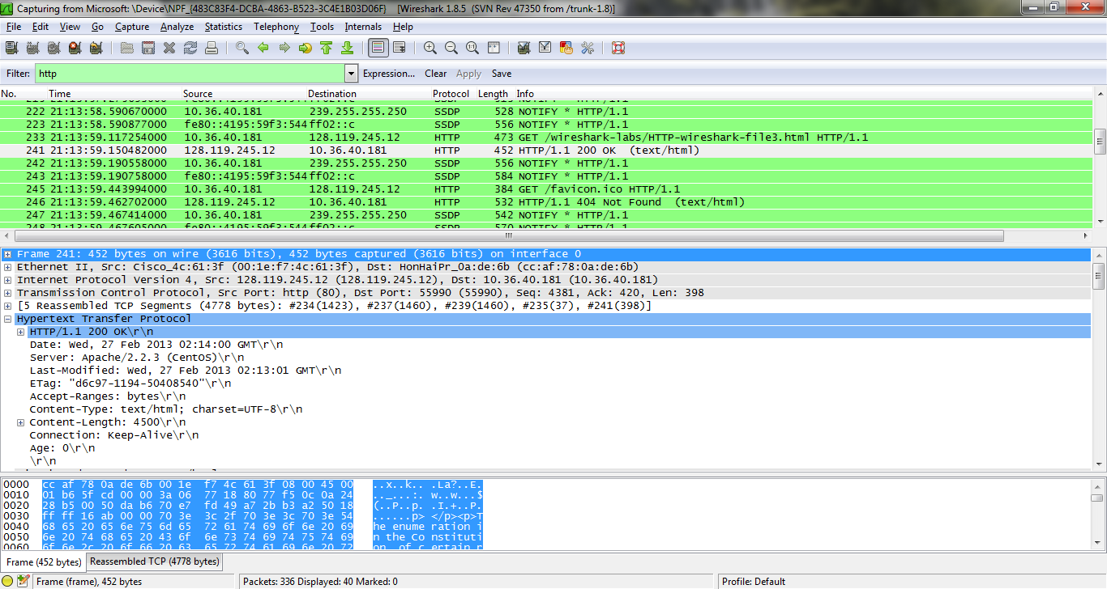
COMPUTER NETWORKS
HTTP Response Message – Wireshark Capture

Slide 34
COMPUTER NETWORKS
HTTP Response Status Codes
status code appears in 1st line in server-to-client response message.
some sample codes:
200 OK
request succeeded, requested object later in this message
301 Moved Permanently
requested object moved, new location specified later in this message (in Location: field)
400 Bad Request
request msg not understood by server
404 Not Found
requested document not found on this server
505 HTTP Version Not Supported

Slide 35
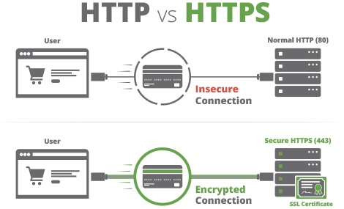
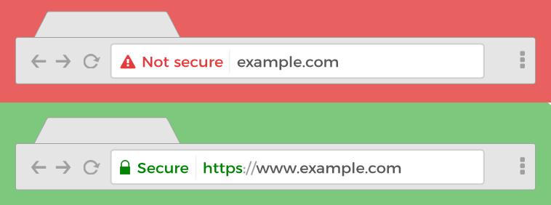
COMPUTER NETWORKS
HTTP vs HTTPS
HTTPS is HTTP with encryption – All communications between browser and server are encrypted (bi-directional).
‘S’ refers ‘Secure’ or HTTP over Secure Socket Layer.
Uses TLS (SSL) to encrypt normal HTTP requests and responses.
Attackers can't read the data crossing the wire and you know you are talking to the server you think you are talking too.

Slide 36
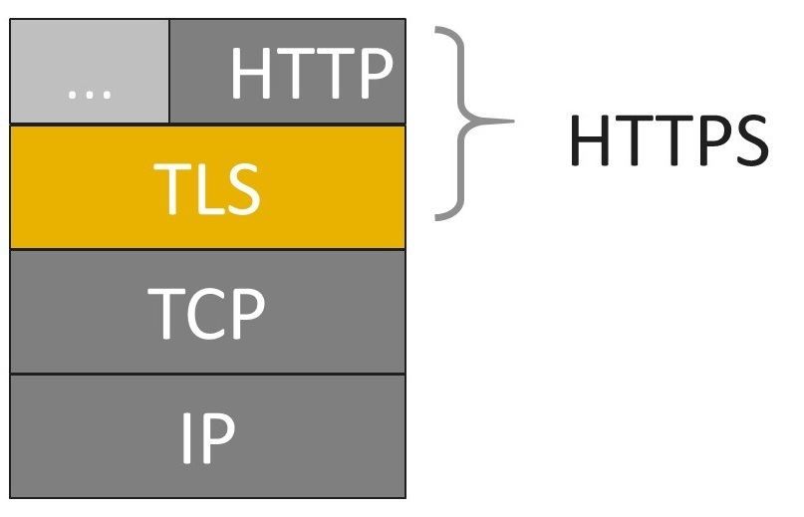
COMPUTER NETWORKS
HTTP vs HTTPS (more)
HTTP + TLS -> Encrypted
Uses port no. 443 for data communication.
HTTPS is based on public/private-key cryptography.
The public key is used for encryption
The secret private key is required for decryption.
SSL certificate is a web server’s digital certificate issued by a third party CA.
Create an encrypted connection and establish trust.
Is my certificate SSL or TLS?
Any message encrypted with Bob’s public key can be only decrypted with Bob’s private key.

Slide 37
COMPUTER NETWORKS
How does SSL works?
Step 1: Browser requests secure pages (HTTPS) from a server.
Step 2: Server sends its public key with its SSL certificate (digitally signed by a third party – CA).
Step 3: On receipt of certificate, browser verifies issuer’s digital signature. (green padlock key)
Step 4: Browser creates a symmetric key (shared key), keeps one and gives a copy to server. Encrypts it using server’s public key.
Step 5: On receipt of encrypted secret key, decrypts it using its private key and gets browser’s secret key.
Asymmetric and Symmetric key algorithms work together.
Asymmetric key algorithm – verify identity of the owner & its public key -> Establish trust.
Once connection is established, Symmetric key algorithm is used to encrypt and decrypt the traffic.

Slide 38
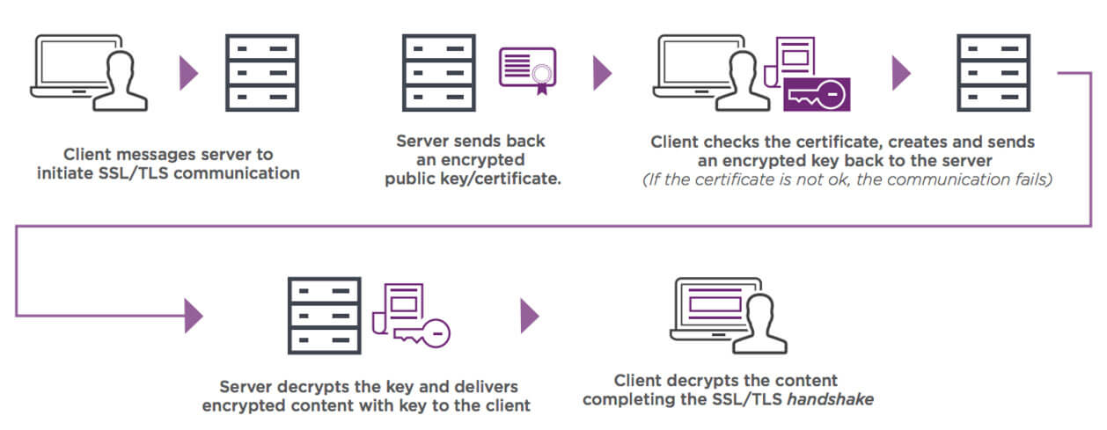
COMPUTER NETWORKS
How does SSL works?

Slide 39

COMPUTER NETWORKS
Benefits of HTTPS over HTTP using SSL Certificates
Stronger Google ranking.
Updated browser labels.
Improved security.
Increased customer confidence / safer experience.
Build customer trust and improve conversions.

Slide 40
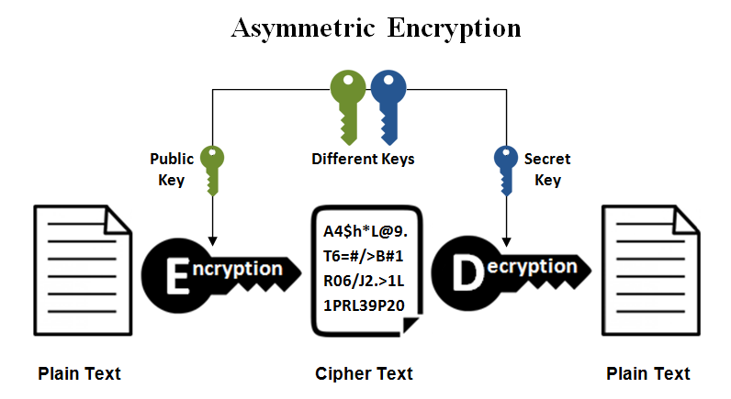
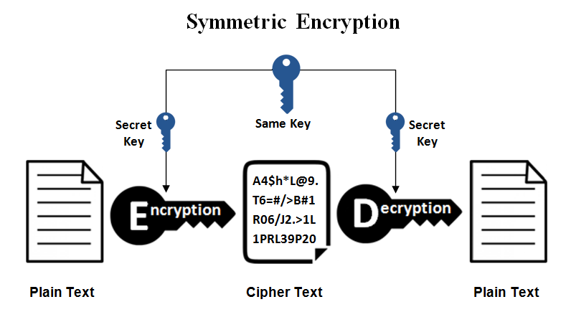
COMPUTER NETWORKS
Benefits of HTTPS over HTTP using SSL Certificates

Slide 41

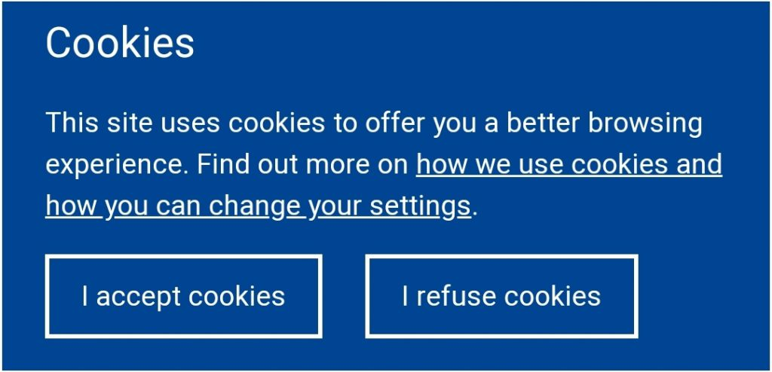

COMPUTER NETWORKS
Cookies
Website/HTTP/Internet cookies
Piece of data from a specific website
Stored on a user’s computer
Allows sites to keep track of users
Eg: language selection

Slide 42

COMPUTER NETWORKS
Maintaining user/server state: cookies
Recall: HTTP GET/response interaction is stateless
no notion of multi-step exchanges of HTTP messages to complete a Web “transaction”
no need for client/server to track “state” of multi-step exchange
all HTTP requests are independent of each other
no need for client/server to “recover” from a partially-completed-but-never-completely-completed transaction
a stateful protocol: client makes two changes to X, or none at all
X
lock data record X
X
OK
update X X’
X’
OK
t’
update X X’’
OK
X’’
unlock X
OK
X’’
time
time
Q: what happens if network connection or client crashes at t’ ?

Slide 43
COMPUTER NETWORKS
Maintaining user/server state: cookies (more)
Web sites and client browser use cookies to maintain some state between transactions
four components:
1) cookie header line of HTTP response message
2) cookie header line in next HTTP request message
3) cookie file kept on user’s host, managed by user’s browser
4) back-end database at Web site
Example:
Susan uses browser on laptop, visits specific e-commerce site for first time
when initial HTTP requests arrives at site, site creates:
unique ID (aka “cookie”)
entry in backend database for ID
subsequent HTTP requests from Susan to this site will contain cookie ID value, allowing site to “identify” Susan

Slide 44
COMPUTER NETWORKS
Maintaining user/server state: cookies (more)
client
server
ebay 8734
usual HTTP request msg
Amazon server
creates ID
1678 for user
cookie file
usual HTTP response
set-cookie: 1678
backend
database
create
entry
ebay 8734
amazon 1678
usual HTTP request msg
cookie: 1678
cookie-
specific
action
access
usual HTTP response msg
one week later:
access
ebay 8734
amazon 1678
usual HTTP request msg
cookie: 1678
cookie-
specific
action
usual HTTP response msg
time
time

Slide 45
COMPUTER NETWORKS
HTTP Cookies: Comments
What cookies can be used for:
track user’s browsing history
remembering login details
track visitor count
shopping carts
recommendations
save coupon codes for you
aside
cookies and privacy:
cookies permit sites to learn a lot about you on their site.
third party persistent cookies (tracking cookies) allow common identity (cookie value) to be tracked across multiple web sites
Challenge: How to keep state:
protocol endpoints: maintain state at sender/receiver over multiple transactions
cookies: HTTP messages carry state

Slide 46

COMPUTER NETWORKS
Web Caches (Proxy Servers)
Goal: satisfy client request without involving origin server
user configures browser to point to a Web cache
browser sends all HTTP requests to cache
if object in cache: cache returns object to client
else cache requests object from origin server, caches received object, then returns object to client
proxy
server
HTTP request
HTTP request
client
HTTP response
HTTP response
origin
server
HTTP request
HTTP response
client
origin
server

Slide 47
COMPUTER NETWORKS
Web Caches (Proxy Servers)
Web cache acts as both client and server
server for original requesting client
client to origin server
typically cache is installed by ISP (university, company, residential ISP)
Why Web caching?
reduce response time for client request (speed)
cache is closer to client
reduce traffic on an institution’s access link (saves bandwidth)
internet is dense with caches
enables “poor” content providers to more effectively deliver content
privacy – surf the internet anonymously
activity logging

Slide 48

COMPUTER NETWORKS
Caching example
(15 req/sec) * (100 Kbits/req)/(1.54 Mbps) = 0.974
(15 req/sec) * (100 Kbits/req)/(1 Gbps) = 0.0015
Scenario:
access link rate: 1.54 Mbps
RTT from institutional router to server: 2 sec
Web object size: 100K bits
Average request rate from browsers to origin servers: 15/sec
average data rate to browsers: 1.50 Mbps
origin
servers
public
Internet
1.54 Mbps
access link
Performance:
LAN utilization: .0015
access link utilization = .97
end-end delay = Internet delay +
access link delay + LAN delay
= 2 sec + minutes + usecs
problem: large delays at high utilization!
institutional
network
1 Gbps LAN

Slide 49
COMPUTER NETWORKS
Caching example: buy a faster access link
Scenario:
access link rate: 1.54 Mbps
RTT from institutional router to server: 2 sec
Web object size: 100K bits
Avg request rate from browsers to origin servers: 15/sec
avg data rate to browsers: 1.50 Mbps
154 Mbps
origin
servers
public
Internet
154 Mbps
1.54 Mbps
access link
Performance:
LAN utilization: .0015
access link utilization = .97
end-end delay = Internet delay +
access link delay + LAN delay
= 2 sec + minutes + usecs
institutional
network
.0097
1 Gbps LAN
Cost: faster access link (expensive!)
msecs

Slide 50
COMPUTER NETWORKS
Caching example: install a web cache
Scenario:
access link rate: 1.54 Mbps
RTT from institutional router to server: 2 sec
Web object size: 100K bits
Avg request rate from browsers to origin servers: 15/sec
avg data rate to browsers: 1.50 Mbps
origin
servers
public
Internet
1.54 Mbps
access link
institutional
network
Performance:
LAN utilization: .?
access link utilization = ?
average end-end delay = ?
How to compute link
utilization, delay?
1 Gbps LAN
local web cache
Cost: web cache (cheap!)

Slide 51
COMPUTER NETWORKS
Caching example: install a web cache
Calculating access link utilization, end-end delay with cache:
suppose cache hit rate is 0.4: 40% requests satisfied at cache, 60% requests satisfied at origin
origin
servers
public
Internet
access link: 60% of requests use access link
data rate to browsers over access link
= 0.6 * 1.50 Mbps = .9 Mbps
utilization = 0.9/1.54 = .58
1.54 Mbps
access link
institutional
network
average end-end delay
= 0.6 * (delay from origin servers)
+ 0.4 * (delay when satisfied at cache)
= 0.6 (2.01) + 0.4 (~msecs) = ~ 1.2 secs
1 Gbps LAN
local web cache
lower average end-end delay than with 154 Mbps link (and cheaper too!)

Slide 52
COMPUTER NETWORKS
Conditional Get
client
server
Goal: don’t send object if cache has up-to-date cached version
no object transmission delay
lower link utilization
cache: specify date of cached copy in HTTP request
If-modified-since: <date>
server: response contains no object if cached copy is up-to-date:
HTTP/1.0 304 Not Modified
HTTP request msg
If-modified-since: <date>
object
not
modified
before
<date>
HTTP response
HTTP/1.0
304 Not Modified
HTTP request msg
If-modified-since: <date>
object
modified
after
<date>
HTTP response
HTTP/1.0 200 OK
<data>

Slide 53
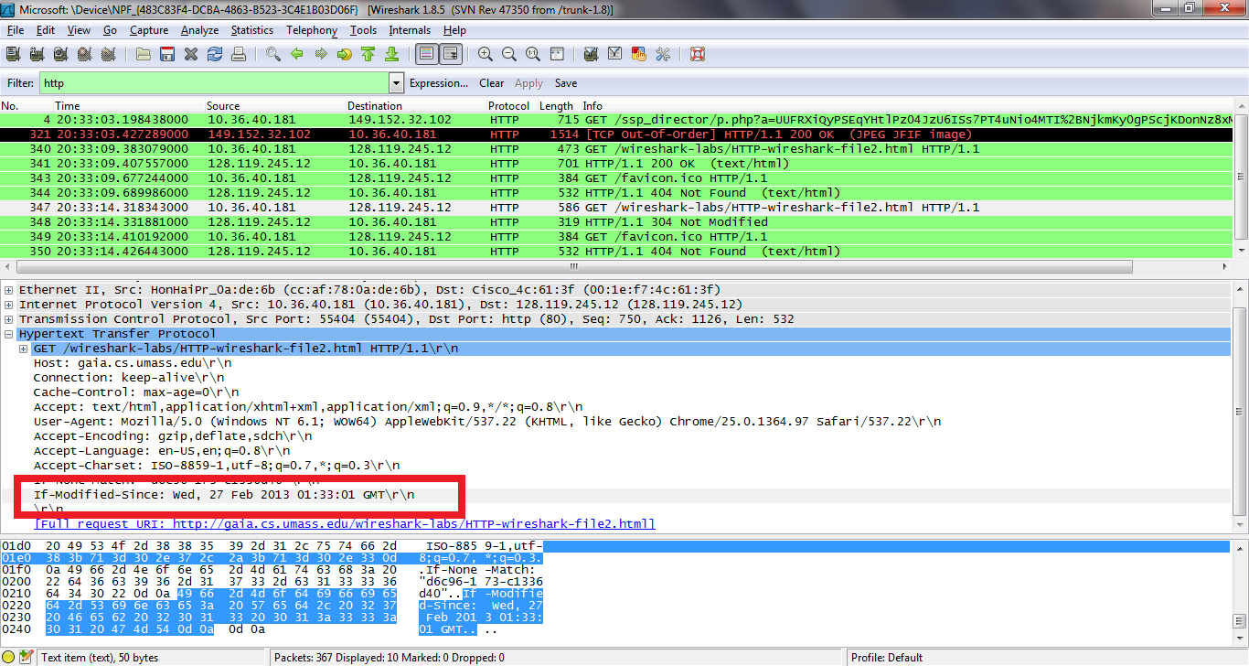
COMPUTER NETWORKS
Conditional Get (more)

Slide 54
THANK YOU
TEAM NETWORKS
Department of Computer Science and Engineering

