Slide 1

COMPUTER NETWORKS
TEAM NETWORKS
Department of Computer Science and Engineering

Slide 2
COMPUTER NETWORKS
Transport Layer
Department of Computer Science and Engineering

Slide 3
COMPUTER NETWORKS
Transport Layer
3.4 principles of reliable data transfer
3.5 connection-oriented transport: TCP
segment structure
reliable data transfer
flow control
connection management
3.6 principles of congestion control
3.7 TCP congestion control

Slide 4

COMPUTER NETWORKS
Principles of reliable data transfer
sending process
receiving process
application
data
data
transport
reliable channel
reliable service abstraction

Slide 5
COMPUTER NETWORKS
Principles of reliable data transfer
sending process
receiving process
receiving process
sending process
application
data
data
transport
application
data
data
reliable channel
transport
reliable service abstraction
sender-side of
reliable data transfer protocol
receiver-side
of reliable data transfer protocol
transport
network
unreliable channel
reliable service implementation

Slide 6
COMPUTER NETWORKS
Principles of reliable data transfer
sending process
receiving process
application
data
data
transport
sender-side of
reliable data transfer protocol
receiver-side
of reliable data transfer protocol
Complexity of reliable data transfer protocol will depend (strongly) on characteristics of unreliable channel (lose, corrupt, reorder data?)
transport
network
unreliable channel
reliable service implementation

Slide 7

COMPUTER NETWORKS
Principles of reliable data transfer
sending process
receiving process
application
data
data
transport
sender-side of
reliable data transfer protocol
receiver-side
of reliable data transfer protocol
Sender, receiver do not know the “state” of each other, e.g., was a message received?
unless communicated via a message
transport
network
unreliable channel
reliable service implementation

Slide 8
COMPUTER NETWORKS
Reliable data transfer: getting started
rdt_send(): called from above, (e.g., by app.). Passed data to deliver to receiver upper layer
deliver_data(): called by rdt to deliver data to upper layer
sending process
receiving process
rdt_send()
data
data
deliver_data()
data
sender-side
implementation of rdt reliable data transfer protocol
receiver-side
implementation of rdt reliable data transfer protocol
packet
udt_send()
Header
data
Header
data
rdt_rcv()
unreliable channel
udt_send(): called by rdt
to transfer packet over
unreliable channel to receiver
rdt_rcv(): called when packet arrives on receiver side of channel
Bi-directional communication over unreliable channel

Slide 9
COMPUTER NETWORKS
Reliable data transfer: getting started
We will:
incrementally develop sender, receiver sides of reliable data transfer protocol (rdt)
consider only unidirectional data transfer
but control info will flow in both directions!
use finite state machines (FSM) to specify sender, receiver
event causing state transition
actions taken on state transition
state: when in this “state” next state uniquely determined by next event
state
1
state
2
event
actions

Slide 10

COMPUTER NETWORKS
rdt1.0: reliable transfer over a reliable channel
underlying channel perfectly reliable
no bit errors
no loss of packets
separate FSMs for sender, receiver:
sender sends data into underlying channel
receiver reads data from underlying channel
Wait for call from above
rdt_send(data)
Wait for call from below
rdt_rcv(packet)
sender
packet = make_pkt(data)
udt_send(packet)
receiver
extract (packet,data)
deliver_data(data)

Slide 11
COMPUTER NETWORKS
rdt2.0: channel with bit errors
underlying channel may flip bits in packet
checksum (e.g., Internet checksum) to detect bit errors
the question: how to recover from errors?
How do humans recover from “errors” during conversation?

Slide 12
COMPUTER NETWORKS
rdt2.0: channel with bit errors
underlying channel may flip bits in packet
checksum to detect bit errors
the question: how to recover from errors?
acknowledgements (ACKs): receiver explicitly tells sender that pkt received OK
negative acknowledgements (NAKs): receiver explicitly tells sender that pkt had errors
sender retransmits pkt on receipt of NAK
Automatic Repeat reQuest
stop and wait
sender sends one packet, then waits for receiver response

Slide 13
COMPUTER NETWORKS
rdt2.0: FSM Specifications
rdt_send(data)
snkpkt = make_pkt(data, checksum)
udt_send(sndpkt)
rdt_rcv(rcvpkt) &&
isNAK(rcvpkt)
sender
Wait for call from above
Wait for ACK or NAK
udt_send(sndpkt)
rdt_rcv(rcvpkt) && corrupt(rcvpkt)
udt_send(NAK)
rdt_rcv(rcvpkt) && isACK(rcvpkt)
Wait for call from below
Λ
receiver
rdt_rcv(rcvpkt) && notcorrupt(rcvpkt)
extract(rcvpkt,data)
deliver_data(data)
udt_send(ACK)

Slide 14
COMPUTER NETWORKS
rdt2.0: FSM Specifications
rdt_send(data)
stop-and-wait
snkpkt = make_pkt(data, checksum)
udt_send(sndpkt)
rdt_rcv(rcvpkt) &&
isNAK(rcvpkt)
sender
Wait for call from above
Wait for ACK or NAK
isNAK(rcvpkt)
udt_send(sndpkt)
rdt_rcv(rcvpkt) && corrupt(rcvpkt)
udt_send(NAK)
rdt_rcv(rcvpkt) && isACK(rcvpkt)
isACK(rcvpkt)
Wait for call from below
Λ
receiver
Note: “state” of receiver (did the receiver get my message correctly?) isn’t known to sender unless somehow communicated from receiver to sender
that’s why we need a protocol!
rdt_rcv(rcvpkt) && notcorrupt(rcvpkt)
extract(rcvpkt,data)
deliver_data(data)
udt_send(ACK)

Slide 15
COMPUTER NETWORKS
rdt2.0: operation with no errors
rdt_send(data)
snkpkt = make_pkt(data, checksum)
udt_send(sndpkt)
rdt_rcv(rcvpkt) &&
isNAK(rcvpkt)
sender
Wait for call from above
Wait for ACK or NAK
udt_send(sndpkt)
rdt_rcv(rcvpkt) && corrupt(rcvpkt)
udt_send(NAK)
rdt_rcv(rcvpkt) && isACK(rcvpkt)
Wait for call from below
Λ
receiver
rdt_rcv(rcvpkt) && notcorrupt(rcvpkt)
extract(rcvpkt,data)
deliver_data(data)
udt_send(ACK)

Slide 16
COMPUTER NETWORKS
rdt2.0: corrupted packet scenario
rdt_send(data)
snkpkt = make_pkt(data, checksum)
udt_send(sndpkt)
rdt_rcv(rcvpkt) &&
isNAK(rcvpkt)
sender
Wait for call from above
Wait for ACK or NAK
udt_send(sndpkt)
rdt_rcv(rcvpkt) && corrupt(rcvpkt)
udt_send(NAK)
rdt_rcv(rcvpkt) && isACK(rcvpkt)
Wait for call from below
Λ
receiver
rdt_rcv(rcvpkt) && notcorrupt(rcvpkt)
extract(rcvpkt,data)
deliver_data(data)
udt_send(ACK)

Slide 17
COMPUTER NETWORKS
rdt2.0 has a fatal flaw!
what happens if ACK/NAK corrupted?
sender doesn’t know what happened at receiver!
can’t just retransmit: possible duplicate
handling duplicates:
sender retransmits current pkt if ACK/NAK corrupted
sender adds sequence number to each pkt
receiver discards (doesn’t deliver up) duplicate pkt
stop and wait
sender sends one packet, then waits for receiver response

Slide 18
COMPUTER NETWORKS
rdt2.1: sender, handling garbled ACK/NAKs
rdt_send(data)
sndpkt = make_pkt(0, data, checksum)
udt_send(sndpkt)
rdt_rcv(rcvpkt) && (corrupt(rcvpkt) ||
isNAK(rcvpkt) )
Wait for call 0 from above
Wait for ACK or NAK 0
udt_send(sndpkt)
rdt_rcv(rcvpkt)
&& notcorrupt(rcvpkt) && isACK(rcvpkt)
rdt_rcv(rcvpkt)
&& notcorrupt(rcvpkt)
&& isACK(rcvpkt)
Λ
Λ
Wait for ACK or NAK 1
Wait for
call 1 from above
rdt_rcv(rcvpkt)
&& (corrupt(rcvpkt) ||
isNAK(rcvpkt) )
rdt_send(data)
udt_send(sndpkt)
sndpkt = make_pkt(1, data, checksum)
udt_send(sndpkt)

Slide 19
COMPUTER NETWORKS
rdt2.1: receiver, handling garbled ACK/NAKs
rdt_rcv(rcvpkt) && notcorrupt(rcvpkt)
&& has_seq0(rcvpkt)
extract(rcvpkt,data)
deliver_data(data)
sndpkt = make_pkt(ACK, chksum)
udt_send(sndpkt)
rdt_rcv(rcvpkt) && (corrupt(rcvpkt)
rdt_rcv(rcvpkt) && (corrupt(rcvpkt)
sndpkt = make_pkt(NAK, chksum)
udt_send(sndpkt)
sndpkt = make_pkt(NAK, chksum)
udt_send(sndpkt)
Wait for
0 from below
Wait for
1 from below
rdt_rcv(rcvpkt) &&
not corrupt(rcvpkt) &&
has_seq1(rcvpkt)
rdt_rcv(rcvpkt) &&
not corrupt(rcvpkt) &&
has_seq0(rcvpkt)
sndpkt = make_pkt(ACK, chksum)
udt_send(sndpkt)
sndpkt = make_pkt(ACK, chksum)
udt_send(sndpkt)
rdt_rcv(rcvpkt) && notcorrupt(rcvpkt)
&& has_seq1(rcvpkt)
extract(rcvpkt,data)
deliver_data(data)
sndpkt = make_pkt(ACK, chksum)
udt_send(sndpkt)

Slide 20
COMPUTER NETWORKS
rdt2.1: discussion
sender:
seq # added to pkt
two seq. #s (0,1) will suffice. Why?
must check if received ACK/NAK corrupted
twice as many states
state must “remember” whether “expected” pkt should have seq # of 0 or 1
receiver:
must check if received packet is duplicate
state indicates whether 0 or 1 is expected pkt seq #
note: receiver can not know if its last ACK/NAK received OK at sender

Slide 21
COMPUTER NETWORKS
rdt2.2: a NAK-free protocol
same functionality as rdt2.1, using ACKs only
instead of NAK, receiver sends ACK for last pkt received OK
receiver must explicitly include seq # of pkt being ACKed
duplicate ACK at sender results in same action as NAK: retransmit current pkt
As we will see, TCP uses this approach to be NAK-free

Slide 22
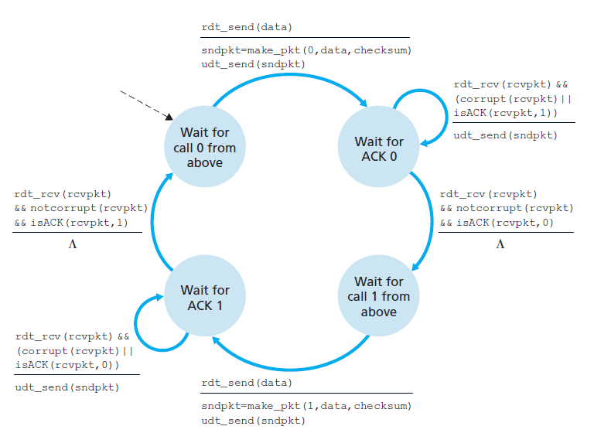
COMPUTER NETWORKS
rdt2.2: sender fragments

Slide 23
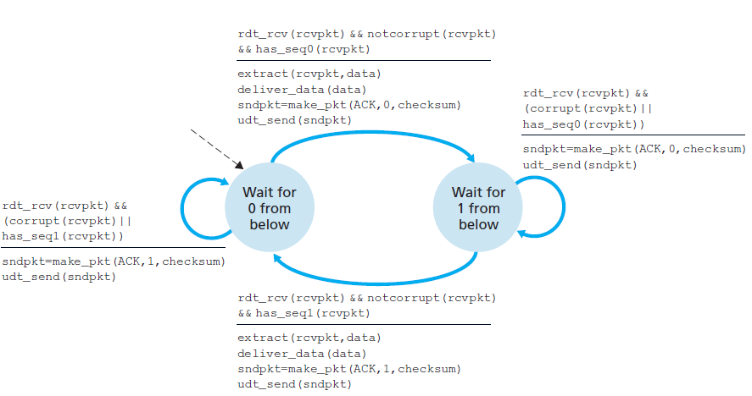
COMPUTER NETWORKS
rdt2.2: receiver fragments

Slide 24
COMPUTER NETWORKS
rdt3.0: channel with errors and loss
New channel assumption: underlying channel can also lose packets (data, ACKs)
checksum, sequence #s, ACKs, retransmissions will be of help … but not quite enough
Q: How do humans handle lost sender-to-receiver words in conversation?

Slide 25

COMPUTER NETWORKS
rdt3.0: channel with errors and loss
Approach: sender waits “reasonable” amount of time for ACK
retransmits if no ACK received in this time
if pkt (or ACK) just delayed (not lost):
retransmission will be duplicate, but seq #s already handles this!
receiver must specify seq # of packet being ACKed
use countdown timer to interrupt after “reasonable” amount of time
timeout

Slide 26
COMPUTER NETWORKS
rdt3.0: sender
rdt_send(data)
sndpkt = make_pkt(0, data, checksum)
udt_send(sndpkt)
start_timer
Wait for
call 0 from above
Wait for ACK0
rdt_rcv(rcvpkt)
&& notcorrupt(rcvpkt)
&& isACK(rcvpkt,1)
rdt_rcv(rcvpkt)
&& notcorrupt(rcvpkt)
&& isACK(rcvpkt,0)
stop_timer
stop_timer
Wait for ACK1
Wait for
call 1 from above
rdt_send(data)
sndpkt = make_pkt(1, data, checksum)
udt_send(sndpkt)
start_timer

Slide 27
COMPUTER NETWORKS
rdt3.0: sender
rdt_send(data)
rdt_rcv(rcvpkt) &&
( corrupt(rcvpkt) ||
isACK(rcvpkt,1) )
sndpkt = make_pkt(0, data, checksum)
udt_send(sndpkt)
start_timer
rdt_rcv(rcvpkt)
Λ
Λ
Wait for
call 0 from above
Wait for ACK0
timeout
udt_send(sndpkt)
start_timer
rdt_rcv(rcvpkt)
&& notcorrupt(rcvpkt)
&& isACK(rcvpkt,1)
rdt_rcv(rcvpkt)
&& notcorrupt(rcvpkt)
&& isACK(rcvpkt,0)
stop_timer
stop_timer
Wait for ACK1
Wait for
call 1 from above
timeout
udt_send(sndpkt)
start_timer
rdt_rcv(rcvpkt)
rdt_send(data)
Λ
rdt_rcv(rcvpkt) &&
( corrupt(rcvpkt) ||
isACK(rcvpkt,0) )
sndpkt = make_pkt(1, data, checksum)
udt_send(sndpkt)
start_timer
Λ

Slide 28

COMPUTER NETWORKS
rdt3.0 in action
sender
receiver
sender
receiver
send pkt0
pkt0
send pkt0
pkt0
rcv pkt0
rcv pkt0
ack0
send ack0
ack0
send ack0
rcv ack0
rcv ack0
send pkt1
pkt1
send pkt1
pkt1
rcv pkt1
X
ack1
send ack1
loss
rcv ack1
send pkt0
pkt0
rcv pkt0
timeout
resend pkt1
ack0
send ack0
pkt1
rcv pkt1
ack1
send ack1
rcv ack1
send pkt0
pkt0
(a) no loss
rcv pkt0
ack0
send ack0
(b) packet loss

Slide 29
COMPUTER NETWORKS
rdt3.0 in action
sender
receiver
sender
receiver
send pkt0
send pkt0
pkt0
pkt0
rcv pkt0
rcv pkt0
send ack0
ack0
send ack0
ack0
rcv ack0
rcv ack0
send pkt1
pkt1
send pkt1
pkt1
rcv pkt1
rcv pkt1
ack1
send ack1
send ack1
X
ack1
loss
timeout
resend pkt1
timeout
resend pkt1
pkt1
rcv pkt1
pkt1
rcv pkt1
ack1
(detect duplicate)
rcv ack1
(detect duplicate)
rcv ack1
send ack1
send pkt0
pkt0
send ack1
send pkt0
pkt0
ack1
rcv pkt0
rcv pkt0
rcv ack1
send ack0
ack0
send ack0
(ignore)
ack0
pkt1
(c) ACK loss
(d) premature timeout/ delayed ACK

Slide 30
COMPUTER NETWORKS
Performance of rdt3.0 (stop-and-wait)
U _{sender}: utilization – fraction of time sender busy sending
example: 1 Gbps link, 15 ms prop. delay, 8000 bit packet
time to transmit packet into channel:
L
8000 bits
D_{trans} =
=
=
8 microsecs
R
10⁹ bits/sec

Slide 31
COMPUTER NETWORKS
rdt3.0: stop-and-wait operation
sender
receiver
first packet bit transmitted, t = 0
first packet bit arrives
RTT
last packet bit arrives, send ACK
ACK arrives, send next
packet, t = RTT + L / R

Slide 32
COMPUTER NETWORKS
rdt3.0: stop-and-wait operation
sender
receiver
L / R
=
L/R
U_{sender}
RTT
+ L / R
.008
RTT
=
30.008
=
0.00027
rdt 3.0 protocol performance stinks!
Protocol limits performance of underlying infrastructure (channel)

Slide 33
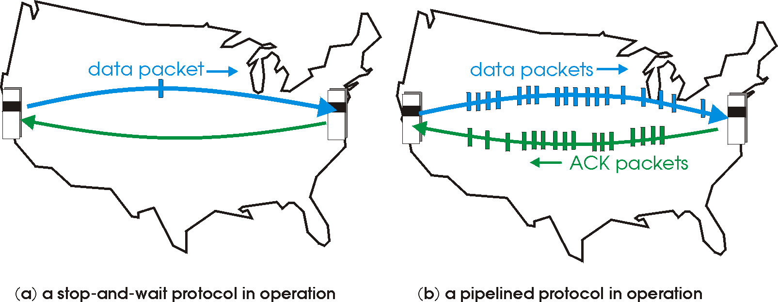
COMPUTER NETWORKS
rdt3.0: pipelined protocol operations
pipelining: sender allows multiple, “in-flight”, yet-to-be-acknowledged packets
range of sequence numbers must be increased
buffering at sender and/or receiver

Slide 34
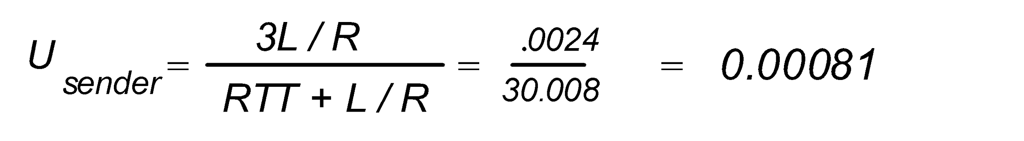
COMPUTER NETWORKS
Pipelining: increased utilization
sender
receiver
first packet bit transmitted, t = 0
last bit transmitted, t = L / R
first packet bit arrives
RTT
last packet bit arrives, send ACK
last bit of 2nd packet arrives, send ACK
last bit of 3rd packet arrives, send ACK
ACK arrives, send next
packet, t = RTT + L / R
3-packet pipelining increases
utilization by a factor of 3!

Slide 35
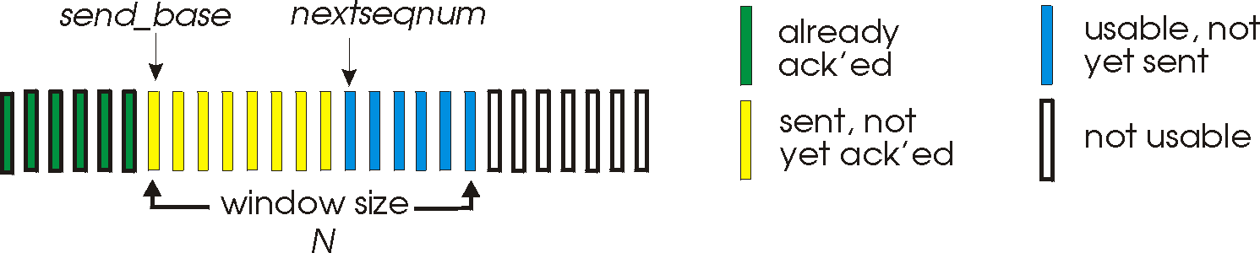
COMPUTER NETWORKS
Go-Back-N: Sender
sender: “window” of up to N, consecutive transmitted but unACKed pkts
k-bit seq # in pkt header
0, base-1
nextseqnum, base+N-1
base, nextseqnum-1
base+N
cumulative ACK: ACK(n): ACKs all packets up to, including seq # n
on receiving ACK(n): move window forward to begin at n+1
timer for oldest in-flight packet
timeout(n): retransmit packet n and all higher seq # packets in window

Slide 36
COMPUTER NETWORKS
Go-Back-N: Receiver
ACK-only: always send ACK for correctly-received packet so far, with highest in-order seq #
may generate duplicate ACKs
need only remember rcv_base
on receipt of out-of-order packet:
can discard (don’t buffer) or buffer: an implementation decision
re-ACK pkt with highest in-order seq #
Receiver view of sequence number space:
received and ACKed
…
…
Out-of-order: received but not ACKed
rcv_base
Not received
GBN Applet -
https://computerscience.unicam.it/marcantoni/reti/applet/GoBackProtocol/goback.html

Slide 37
COMPUTER NETWORKS
Go-Back-N in action
sender window (N=4)
sender
receiver
0 1 2 3 4 5 6 7 8
send pkt0
send pkt1
send pkt2
send pkt3
(wait)
0 1 2 3 4 5 6 7 8
receive pkt0, send ack0
receive pkt1, send ack1
receive pkt3, discard, (re)send ack1
0 1 2 3 4 5 6 7 8
X
0 1 2 3 4 5 6 7 8
loss
0 1 2 3 4 5 6 7 8
rcv ack0, send pkt4
0 1 2 3 4 5 6 7 8
rcv ack1, send pkt5
receive pkt4, discard, (re)send ack1
ignore duplicate ACK
receive pkt5, discard, (re)send ack1
pkt 2 timeout
0 1 2 3 4 5 6 7 8
send pkt2
send pkt3
send pkt4
send pkt5
0 1 2 3 4 5 6 7 8
0 1 2 3 4 5 6 7 8
rcv pkt2, deliver, send ack2
rcv pkt3, deliver, send ack3
rcv pkt4, deliver, send ack4
rcv pkt5, deliver, send ack5
0 1 2 3 4 5 6 7 8

Slide 38

COMPUTER NETWORKS
Go-Back-N: example
In GB3, if every 5th packet that is transmitted is lost and if we have to send 10 packets, then how many transmissions are required?
18

Slide 39
COMPUTER NETWORKS
Transport Layer - Roadmap
3.4 principles of reliable data transfer
3.5 connection-oriented transport: TCP
segment structure
reliable data transfer
flow control
connection management
3.6 principles of congestion control
3.7 TCP congestion control

Slide 40
COMPUTER NETWORKS
Selective Repeat
receiver individually acknowledges all correctly received packets
buffers packets, as needed, for eventual in-order delivery to upper layer
sender times-out/retransmits individually for unACKed packets
sender maintains timer for each unACKed pkt
sender window
N consecutive seq #s
limits seq #s of sent, unACKed packets

Slide 41
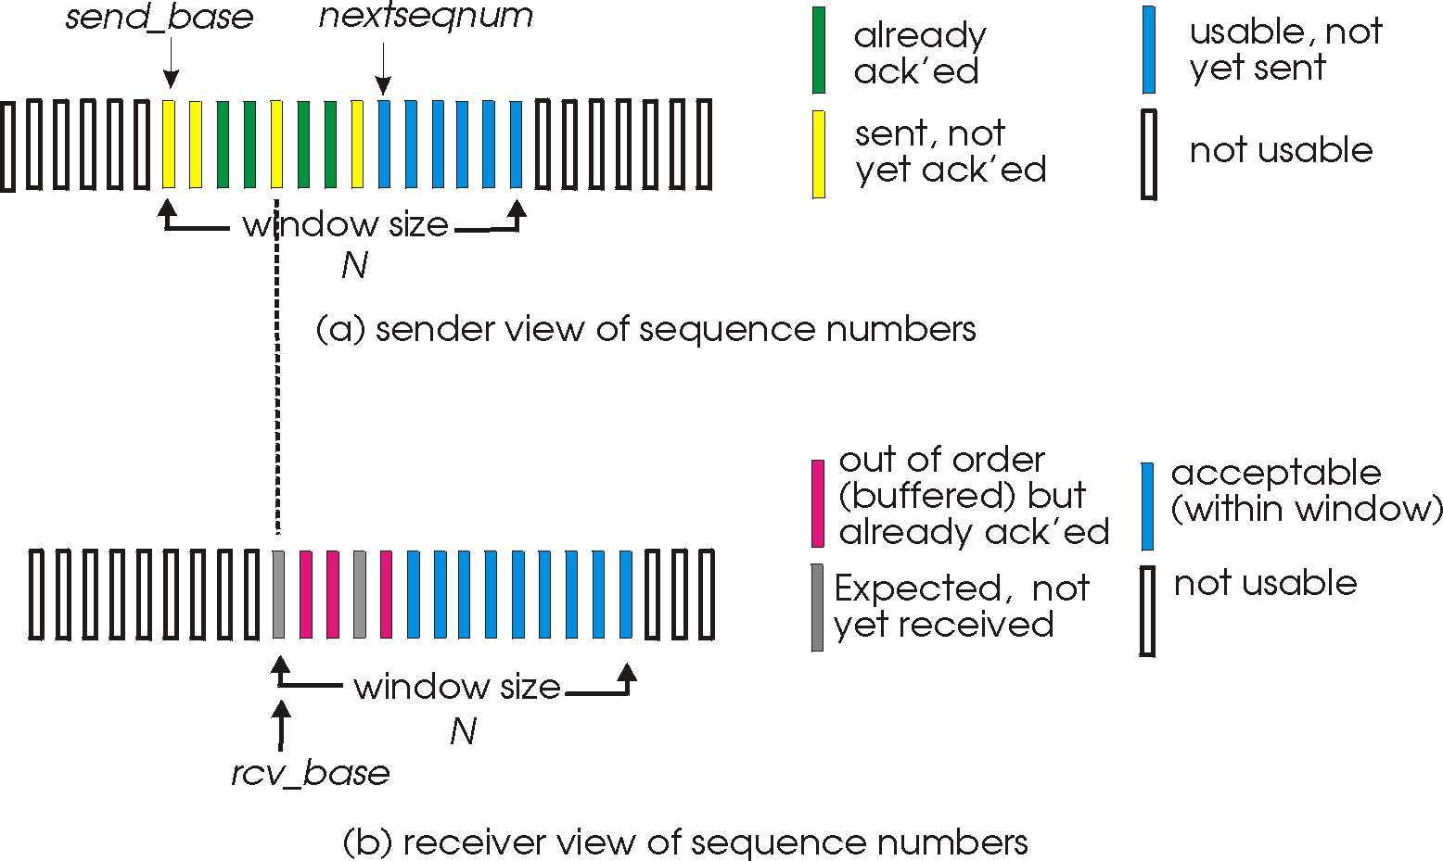
COMPUTER NETWORKS
Selective Repeat: sender, receiver windows
Selective Repeat Applet -
https://computerscience.unicam.it/marcantoni/reti/applet/SelectiveRepeatProtocol/selRepProt.html

Slide 42
COMPUTER NETWORKS
Selective Repeat: sender, receiver
sender
receiver
data from above:
if next available seq # in window, send packet
timeout(n):
resend packet n, restart timer
ACK(n) in [sendbase,sendbase+N]:
mark packet n as received
if n smallest unACKed packet, advance window base to next unACKed seq #
packet n in [rcvbase, rcvbase+N-1]
send ACK(n)
out-of-order: buffer
in-order: deliver (also deliver buffered, in-order packets), advance window to next not-yet-received packet
packet n in [rcvbase-N,rcvbase-1]
ACK(n)
otherwise:
ignore

Slide 43
COMPUTER NETWORKS
Selective Repeat in action
sender window (N=4)
sender
receiver
0 1 2 3 4 5 6 7 8
send pkt0
send pkt1
send pkt2
send pkt3
(wait)
0 1 2 3 4 5 6 7 8
receive pkt0, send ack0
receive pkt1, send ack1
receive pkt3, buffer,
send ack3
0 1 2 3 4 5 6 7 8
X
0 1 2 3 4 5 6 7 8
loss
0 1 2 3 4 5 6 7 8
rcv ack0, send pkt4
0 1 2 3 4 5 6 7 8
rcv ack1, send pkt5
receive pkt4, buffer,
send ack4
record ack3 arrived
receive pkt5, buffer,
send ack5
pkt 2 timeout
0 1 2 3 4 5 6 7 8
send pkt2
(but not 3,4,5)
0 1 2 3 4 5 6 7 8
0 1 2 3 4 5 6 7 8
rcv pkt2; deliver pkt2,
pkt3, pkt4, pkt5; send ack2
0 1 2 3 4 5 6 7 8
Q: what happens when ack2 arrives?

Slide 44
COMPUTER NETWORKS
Selective Repeat: example
In GB3, if every 5th packet that is transmitted is lost and if we have to send 10 packets, then how many transmissions are required?
12

Slide 45
COMPUTER NETWORKS
Selective repeat: a dilemma!
example:
seq #s: 0, 1, 2, 3 (base 4 counting)
window size=3
sender window
(after receipt)
receiver window
(after receipt)
0 1 2 3 0 1 2
pkt0
0 1 2 3 0 1 2
pkt1
0 1 2 3 0 1 2
0 1 2 3 0 1 2
pkt2
X
0 1 2 3 0 1 2
0 1 2 3 0 1 2
pkt0
X
0 1 2 3 0 1 2
0 1 2 3 0 1 2
pkt1
0 1 2 3 0 1 2
X
0 1 2 3 0 1 2
pkt2
0 1 2 3 0 1 2
timeout
retransmit pkt0
0 1 2 3 0 1 2
0 1 2 3 0 1 2
pkt0
0 1 2 3 0 1 2
pkt3
will accept packet
with seq number 0
X
0 1 2 3 0 1 2
(b) oops!
pkt0
will accept packet
with seq number 0
(a) no problem

Slide 46

COMPUTER NETWORKS
sender window
(after receipt)
receiver window
(after receipt)
Selective repeat: a dilemma!
0 1 2 3 0 1 2
pkt0
example:
seq #s: 0, 1, 2, 3 (base 4 counting)
window size=3
0 1 2 3 0 1 2
pkt1
0 1 2 3 0 1 2
0 1 2 3 0 1 2
pkt2
0 1 2 3 0 1 2
0 1 2 3 0 1 2
0 1 2 3 0 1 2
pkt3
X
0 1 2 3 0 1 2
receiver can’t see sender side
receiver behavior identical in both cases!
something’s (very) wrong!
pkt0
will accept packet
with seq number 0
(a) no problem
Q: what relationship is needed between sequence # size and window size to avoid problem in scenario (b)?
0 1 2 3 0 1 2
pkt0
0 1 2 3 0 1 2
pkt1
0 1 2 3 0 1 2
0 1 2 3 0 1 2
pkt2
X
0 1 2 3 0 1 2
X
0 1 2 3 0 1 2
X
timeout
retransmit pkt0
0 1 2 3 0 1 2
pkt0
will accept packet
with seq number 0
(b) oops!

Slide 47

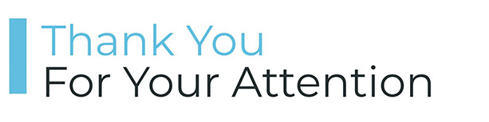
COMPUTER NETWORKS
Suggested Readings

Slide 48
COMPUTER NETWORKS
Transport Layer - Roadmap
3.4 principles of reliable data transfer
3.5 connection-oriented transport: TCP
segment structure
reliable data transfer
flow control
connection management
3.6 principles of congestion control
3.7 TCP congestion control

Slide 49
COMPUTER NETWORKS
TCP: Overview RFCs: 793,1122,1323, 2018, 2581
point-to-point:
one sender, one receiver
reliable, in-order byte steam:
no “message boundaries"
full duplex data:
bi-directional data flow in same connection
MSS: maximum segment size
cumulative ACKs
pipelining:
TCP congestion and flow control set window size
connection-oriented:
handshaking (exchange of control messages) initializes sender, receiver state before data exchange
flow controlled:
sender will not overwhelm receiver

Slide 50
COMPUTER NETWORKS
TCP segment structure
32 bits
source port #
dest port #
segment seq #: counting bytes of data into bytestream (not segments!)
ACK: seq # of next expected byte; A bit: this is an ACK
sequence number
acknowledgement number
length (of TCP header)
head
len
not
used
A
P
S
receive window
flow control: # bytes receiver willing to accept
C
E
U
R
F
Internet checksum
checksum
Urg data pointer
options (variable length)
C, E: congestion notification
TCP options
application
data
(variable length)
data sent by application into TCP socket
RST, SYN, FIN: connection management

Slide 51
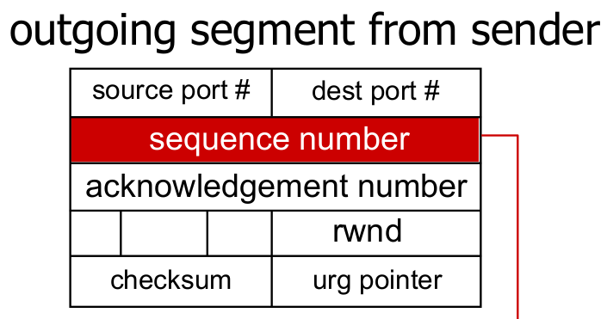
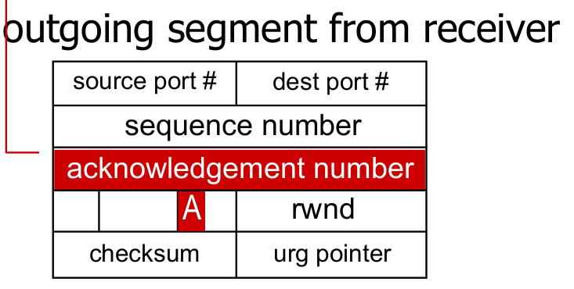
COMPUTER NETWORKS
TCP sequence numbers and ACKs
Sequence numbers:
byte stream “number” of first byte in segment’s data
window size
N
Acknowledgements:
seq # of next byte expected from other side
cumulative ACK
sender sequence number space
sent
ACKed
sent, not-yet ACKed
(“in-flight”)
usable
but not
yet sent
not
usable
Q: how receiver handles out-of-order segments
A: TCP spec doesn’t say, - up to implementor

Slide 52
COMPUTER NETWORKS
TCP sequence numbers and ACKs
Host A
Host B
User types‘C’
Seq=42, ACK=79, data = ‘C’
host ACKs receipt of‘C’, echoes back ‘C’
Seq=79, ACK=43, data = ‘C’
host ACKs receipt of echoed ‘C’
Seq=43, ACK=80
simple telnet scenario

Slide 53
COMPUTER NETWORKS
TCP round trip time, time out
Q: how to set TCP timeout value?
longer than RTT, but RTT varies!
too short: premature timeout, unnecessary retransmissions
too long: slow reaction to segment loss
Q: how to estimate RTT?
SampleRTT:measured time from segment transmission until ACK receipt
ignore retransmissions
SampleRTT will vary, want estimated RTT “smoother”
average several recent measurements, not just current SampleRTT

Slide 54
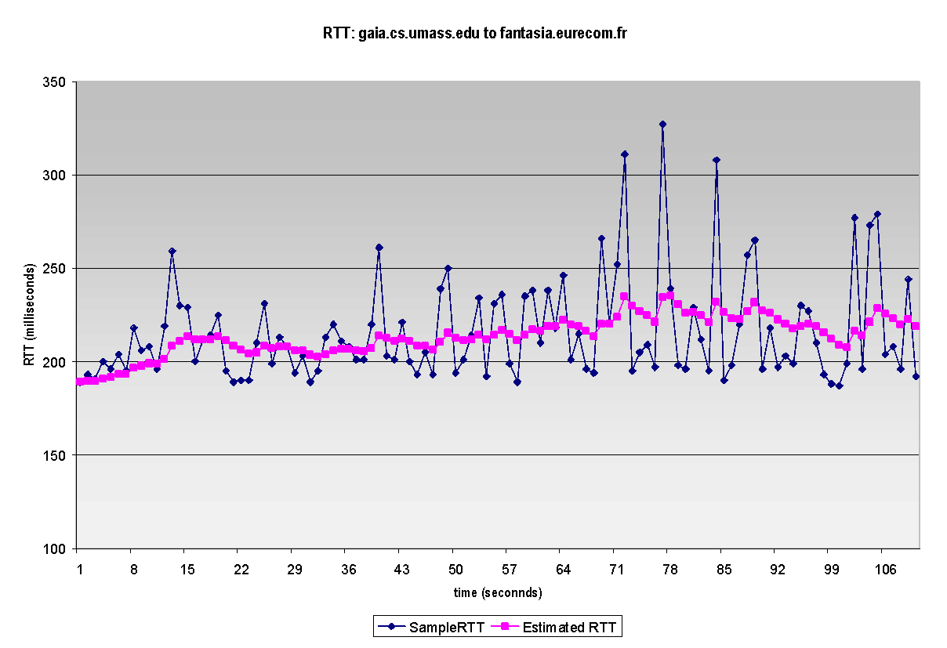
COMPUTER NETWORKS
TCP round trip time, time out
EstimatedRTT = (1- α)*EstimatedRTT + α*SampleRTT
exponential weighted moving average (EWMA)
influence of past sample decreases exponentially fast
typical value: α = 0.125
RTT: gaia.cs.umass.edu to fantasia.eurecom.fr
RTT (milliseconds)
sampleRTT
EstimatedRTT
time (seconds)

Slide 55
COMPUTER NETWORKS
TCP round trip time, time out
timeout interval: EstimatedRTT plus “safety margin”
large variation in EstimatedRTT: want a larger safety margin
TimeoutInterval = EstimatedRTT + 4*DevRTT
estimated RTT
“safety margin”
DevRTT: EWMA of SampleRTT deviation from EstimatedRTT:
DevRTT = (1-β)*DevRTT + β*|SampleRTT-EstimatedRTT|
(typically, β = 0.25)

Slide 56
COMPUTER NETWORKS
Transport Layer - Roadmap
3.4 principles of reliable data transfer
3.5 connection-oriented transport: TCP
segment structure
reliable data transfer
flow control
connection management
3.6 principles of congestion control
3.7 TCP congestion control

Slide 57
COMPUTER NETWORKS
TCP Sender (simplified)
event: data received from application
create segment with seq #
seq # is byte-stream number of first data byte in segment
start timer if not already running
think of timer as for oldest unACKed segment
expiration interval: TimeOutInterval
event: timeout
retransmit segment that caused timeout
restart timer
event: ACK received
if ACK acknowledges previously unACKed segments
update what is known to be ACKed
start timer if there are still unACKed segments

Slide 58
COMPUTER NETWORKS
TCP Receiver: ACK Generation
Event at receiver
arrival of in-order segment with
expected seq #. All data up to
expected seq # already ACKed
arrival of in-order segment with
expected seq #. One other
segment has ACK pending
arrival of out-of-order segment
higher-than-expect seq. # .
Gap detected
arrival of segment that
partially or completely fills gap
TCP receiver action
delayed ACK. Wait up to 500ms
for next segment. If no next segment,
send ACK
immediately send single cumulative
ACK, ACKing both in-order segments
immediately send duplicate ACK,
indicating seq. # of next expected byte
immediate send ACK, provided that
segment starts at lower end of gap

Slide 59
COMPUTER NETWORKS
TCP: retransmission scenarios
Host A
Host B
Host A
Host B
SendBase=92
Seq=92, 8 bytes of data
Seq=92, 8 bytes of data
timeout
Seq=100, 20 bytes of data
timeout
ACK=100
X
ACK=100
ACK=120
Seq=92, 8 bytes of data
Seq=92, 8
bytes of data
SendBase=100
send cumulative
ACK for 120
SendBase=120
ACK=100
ACK=120
SendBase=120
lost ACK scenario
premature timeout

Slide 60

COMPUTER NETWORKS
TCP: retransmission scenarios
Host A
Host B
Seq=92, 8 bytes of data
Seq=100, 20 bytes of data
ACK=100
X
ACK=120
Seq=120, 15 bytes of data
cumulative ACK covers for earlier lost ACK

Slide 61

COMPUTER NETWORKS
TCP fast retransmit
Host A
Host B
TCP fast retransmit
if sender receives 3 additional ACKs for same data (“triple duplicate ACKs”), resend unACKed segment with smallest seq #
likely that unACKed segment lost, so don’t wait for timeout
Seq=92, 8 bytes of data
Seq=100, 20 bytes of data
X
ACK=100
ACK=100
timeout
ACK=100
Receipt of three duplicate ACKs indicates 3 segments received after a missing segment – lost segment is likely. So retransmit!
ACK=100
Seq=100, 20 bytes of data

Slide 62
COMPUTER NETWORKS
Transport Layer - Roadmap
3.4 principles of reliable data transfer
3.5 connection-oriented transport: TCP
segment structure
reliable data transfer
flow control
connection management
3.6 principles of congestion control
3.7 TCP congestion control

Slide 63
COMPUTER NETWORKS
TCP flow control
application
process
Application removing data from TCP socket buffers
Q: What happens if network layer delivers data faster than application layer removes data from socket buffers?
TCP socket
receiver buffers
TCP
code
Network layer delivering IP datagram payload into TCP socket buffers
IP
code
from sender
receiver protocol stack

Slide 64


COMPUTER NETWORKS
TCP flow control
Q: What happens if network layer delivers data faster than application layer removes data from socket buffers?
application
process
Application removing data from TCP socket buffers
TCP socket
receiver buffers
TCP
code
Network layer delivering IP datagram payload into TCP socket buffers
IP
code
from sender
receiver protocol stack

Slide 65
COMPUTER NETWORKS
TCP flow control
Q: What happens if network layer delivers data faster than application layer removes data from socket buffers?
application
process
Application removing data from TCP socket buffers
TCP socket
receiver buffers
flow control
TCP
code
receiver controls sender, so sender won’t overflow receiver’s buffer by transmitting too much, too fast
IP
code
from sender
receiver protocol stack

Slide 66
COMPUTER NETWORKS
TCP flow control
to application process
TCP receiver “advertises” free buffer space in rwnd field in TCP header
RcvBuffer size set via socket options (typical default is 4096 bytes)
many operating systems autoadjust RcvBuffer
sender limits amount of unACKed (“in-flight”) data to received rwnd
guarantees receive buffer will not overflow
RcvBuffer
buffered data
rwnd
free buffer space
TCP segment payloads
TCP receiver-side buffering
LastByteRcvd – LastByteRead ≤ RcvBuffer
rwnd = RcvBuffer – [LastByteRcvd – LastByteRead]

Slide 67
COMPUTER NETWORKS
TCP flow control
TCP receiver “advertises” free buffer space in rwnd field in TCP header
RcvBuffer size set via socket options (typical default is 4096 bytes)
many operating systems autoadjust RcvBuffer
sender limits amount of unACKed (“in-flight”) data to received rwnd
guarantees receive buffer will not overflow
flow control: # bytes receiver willing to accept
receive window
TCP segment format

Slide 68
COMPUTER NETWORKS
Transport Layer - Roadmap
3.4 principles of reliable data transfer
3.5 connection-oriented transport: TCP
segment structure
reliable data transfer
flow control
connection management
3.6 principles of congestion control
3.7 TCP congestion control

Slide 69
COMPUTER NETWORKS
TCP connection management
before exchanging data, sender/receiver “handshake”:
agree to establish connection (each knowing the other willing to establish connection)
agree on connection parameters (e.g., starting seq #s)
application
application
connection state: ESTAB
connection variables:
seq # client-to-server
server-to-client
rcvBuffer size
at server,client
connection state: ESTAB
connection Variables:
seq # client-to-server
server-to-client
rcvBuffer size
at server,client
network
network
Socket clientSocket =
newSocket("hostname","port number");
Socket connectionSocket = welcomeSocket.accept();

Slide 70
COMPUTER NETWORKS
TCP 3-way handshake
Server state
Client state
serverSocket = socket(AF_INET,SOCK_STREAM)
serverSocket.bind((‘’,serverPort))
serverSocket.listen(1)
connectionSocket, addr = serverSocket.accept()
clientSocket = socket(AF_INET, SOCK_STREAM)
LISTEN
clientSocket.connect((serverName,serverPort))
LISTEN
choose init seq num, x
send TCP SYN msg
SYNSENT
SYNbit=1, Seq=x
choose init seq num, y
send TCP SYNACK
msg, acking SYN
SYN RCVD
SYNbit=1, Seq=y
ACKbit=1; ACKnum=x+1
received SYNACK(x)
indicates server is live;
send ACK for SYNACK;
this segment may contain
client-to-server data
ESTAB
ACKbit=1, ACKnum=y+1
received ACK(y)
indicates client is live
ESTAB

Slide 71
COMPUTER NETWORKS
Closing a TCP connection
client, server each close their side of connection
send TCP segment with FIN bit = 1
respond to received FIN with ACK
on receiving FIN, ACK can be combined with own FIN
simultaneous FIN exchanges can be handled

Slide 72
COMPUTER NETWORKS
Closing a TCP connection
client state
server state
ESTAB
ESTAB
clientSocket.close()
FIN_WAIT_1
can no longer
send but can
receive data
FINbit=1, seq=x
CLOSE_WAIT
ACKbit=1; ACKnum=x+1
can still
send data
FIN_WAIT_2
wait for server
close
LAST_ACK
FINbit=1, seq=y
TIMED_WAIT
can no longer
send data
ACKbit=1; ACKnum=y+1
timed wait
for 2*max
segment lifetime
CLOSED
CLOSED

Slide 73
COMPUTER NETWORKS
Suggested Readings

Slide 74
COMPUTER NETWORKS
Transport Layer - Roadmap
3.4 principles of reliable data transfer
3.5 connection-oriented transport: TCP
segment structure
reliable data transfer
flow control
connection management
3.6 principles of congestion control
3.7 TCP congestion control

Slide 75
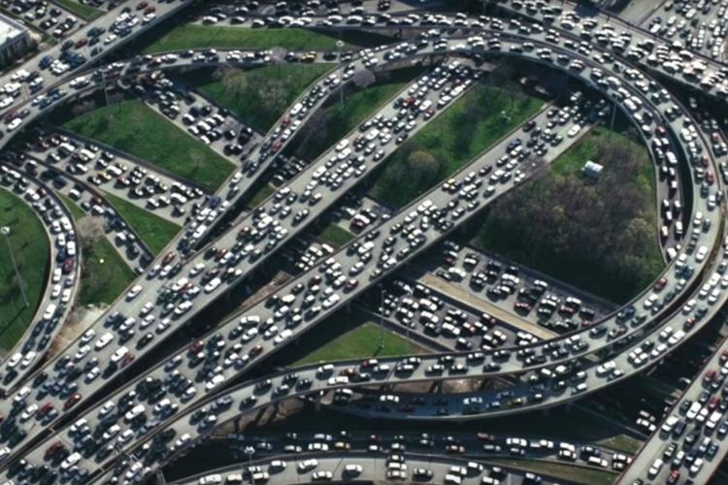
COMPUTER NETWORKS
Principles of congestion control
Congestion:
informally: “too many sources sending too much data too fast for network to handle”
manifestations:
long delays (queueing in router buffers)
packet loss (buffer overflow at routers)
different from flow control!
a top-10 problem!
congestion control: too many senders, sending too fast
flow control: one sender too fast for one receiver

Slide 76
COMPUTER NETWORKS
Causes/costs of congestion: scenario 1
original data: λ_{in}
throughput: λ_{out}
Simplest scenario:
Host A
one router, infinite buffers
input, output link capacity: R
infinite shared output link buffers
two flows
R
R
no retransmissions needed
Host B
R/2
Q: What happens as arrival rate λ_{in} approaches R/2?
λ_{out}
delay
throughput:
λ_{in}
R/2
λ_{in}
R/2
maximum per-connection throughput: R/2
large delays as arrival rate λ_{in} approaches capacity

Slide 77
COMPUTER NETWORKS
Causes/costs of congestion: scenario 2
one router, finite buffers
sender retransmits lost, timed-out packet
application-layer input = application-layer output: λ_{in} = λ_{out}
transport-layer input includes retransmissions : λ’_{in} >= λ_{in}
Host A
λ_{in} : original data
λ'_{in}: original data, plus retransmitted data
λ_{out}
R
R
Host B
finite shared output link buffers

Slide 78
COMPUTER NETWORKS
Causes/costs of congestion: scenario 2
Idealization: perfect knowledge
sender sends only when router buffers available
R/2
λ_{out}
throughput:
Host A
λ_{in} : original data
λ_{in}
copy
λ'_{in}: original data, plus retransmitted data
λ_{out}
R/2
free buffer space!
R
R
Host B
finite shared output link buffers

Slide 79

COMPUTER NETWORKS
Causes/costs of congestion: scenario 2
Idealization: some perfect knowledge
packets can be lost (dropped at router) due to full buffers
sender knows when packet has been dropped: only resends if packet known to be lost
Host A
λ_{in} : original data
copy
λ'_{in}: original data, plus retransmitted data
no buffer space!
R
R
Host B
finite shared output link buffers

Slide 80
COMPUTER NETWORKS
Causes/costs of congestion: scenario 2
Idealization: some perfect knowledge
packets can be lost (dropped at router) due to full buffers
sender knows when packet has been dropped: only resends if packet known to be lost
R/2
λ_{out}
“wasted” capacity due to retransmissions
when sending at R/2, some packets are needed retransmissions
throughput:
Host A
λ_{in} : original data
λ_{in}
λ'_{in}: original data, plus retransmitted data
R/2
free buffer space!
R
R
Host B
finite shared output link buffers

Slide 81


COMPUTER NETWORKS
Causes/costs of congestion: scenario 2
Realistic scenario: un-needed duplicates
packets can be lost, dropped at router due to full buffers – requiring retransmissions
but sender times can time out prematurely, sending two copies, both of which are delivered
R/2
λ_{out}
“wasted” capacity due to un-needed retransmissions
throughput:
when sending at R/2, some packets are retransmissions, including needed and un-needed duplicates, that are delivered!
Host A
λ_{in} : original data
λ_{in}
copy
λ'_{in}: original data, plus retransmitted data
R/2
timeout
free buffer space!
R
R
Host B
finite shared output link buffers

Slide 82
COMPUTER NETWORKS
Causes/costs of congestion: scenario 2
Realistic scenario: un-needed duplicates
packets can be lost, dropped at router due to full buffers – requiring retransmissions
but sender times can time out prematurely, sending two copies, both of which are delivered
R/2
λ_{out}
“wasted” capacity due to un-needed retransmissions
throughput:
when sending at R/2, some packets are retransmissions, including needed and un-needed duplicates, that are delivered!
λ_{in}
R/2
“costs” of congestion:
more work (retransmission) for given receiver throughput
unneeded retransmissions: link carries multiple copies of a packet
decreasing maximum achievable throughput

Slide 83
COMPUTER NETWORKS
Causes/costs of congestion: scenario 3
four senders
multi-hop paths
timeout/retransmit
Q: what happens as λ_{in} and λ_{in}’ increase ?
A: as red λ_{in}’ increases, all arriving blue pkts at upper queue are dropped, blue throughput → 0
Host A
λ_{in} : original data
λ'_{in}: original data, plus retransmitted data
Host B
finite shared output link buffers
Host D
λ_{out}
Host C

Slide 84
COMPUTER NETWORKS
Causes/costs of congestion: scenario 3
R/2
λ_{out}
λ_{in}’
R/2
another “cost” of congestion:
when packet dropped, any upstream transmission capacity and buffering used for that packet was wasted!

Slide 85
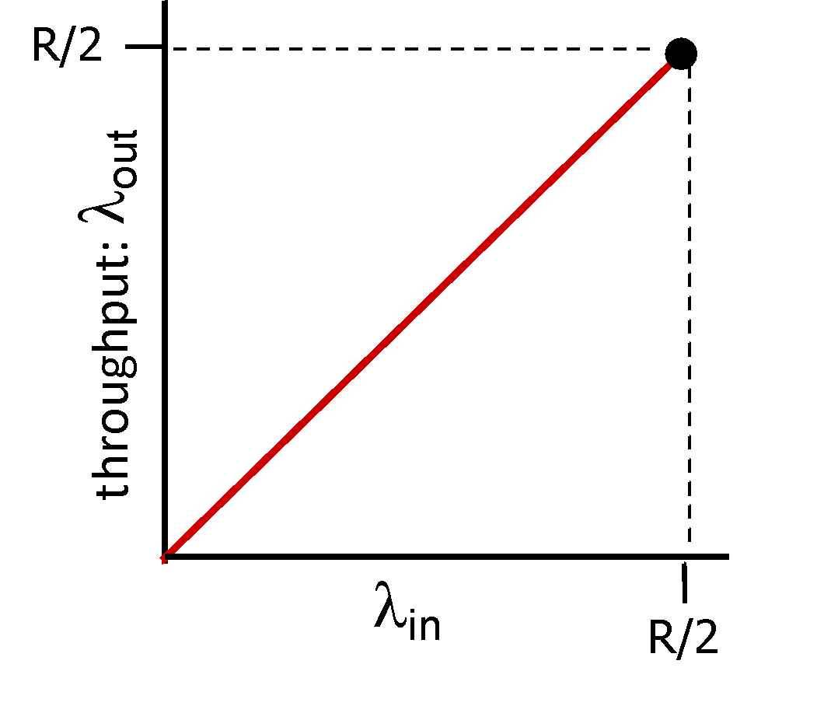
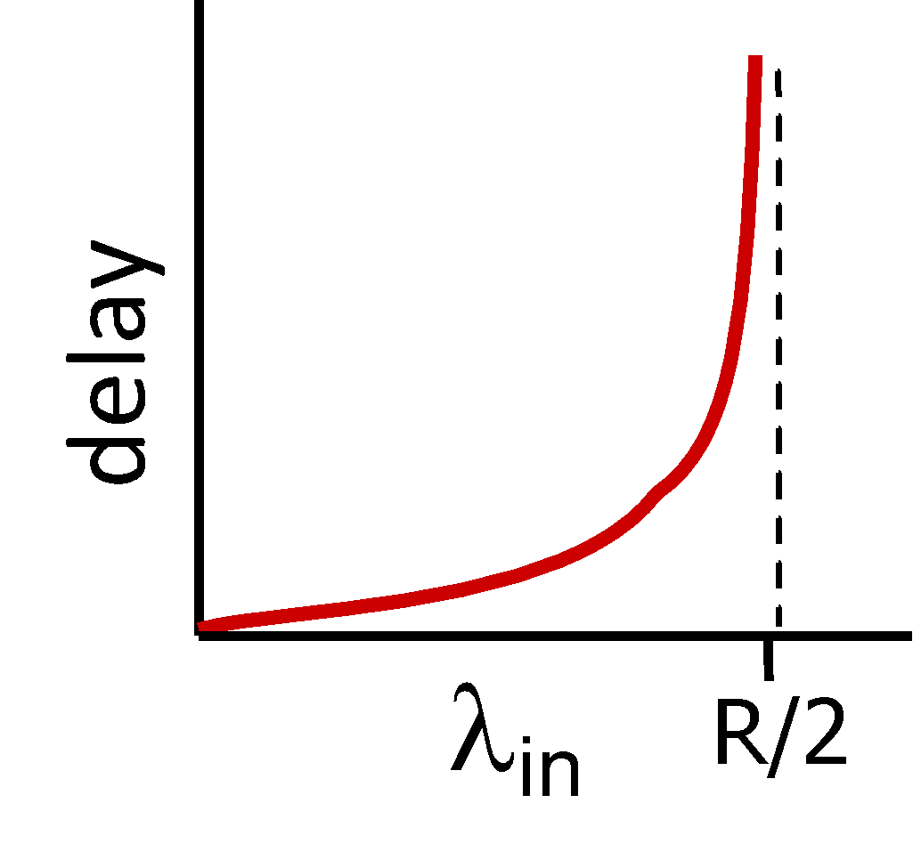
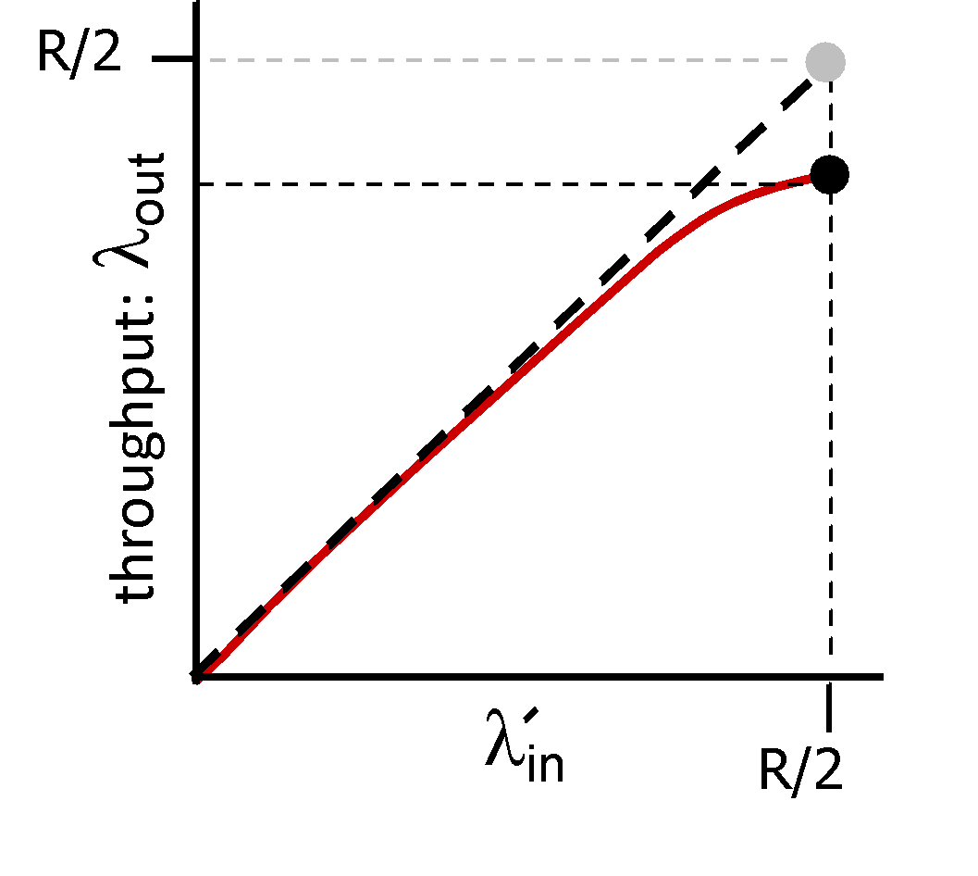
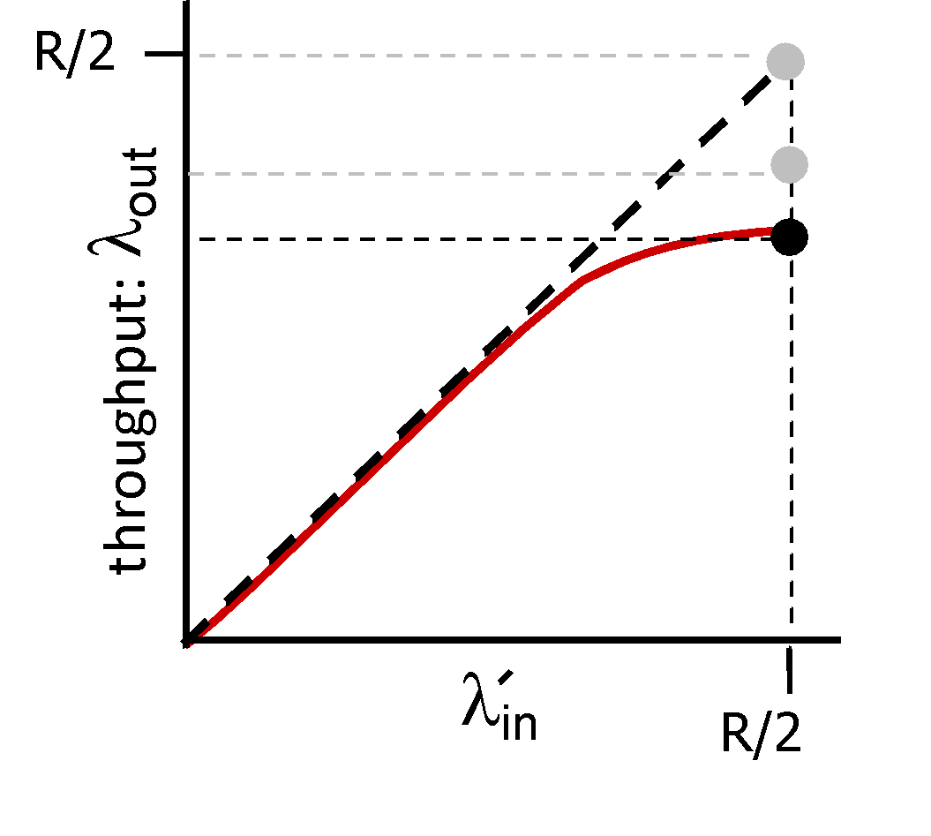
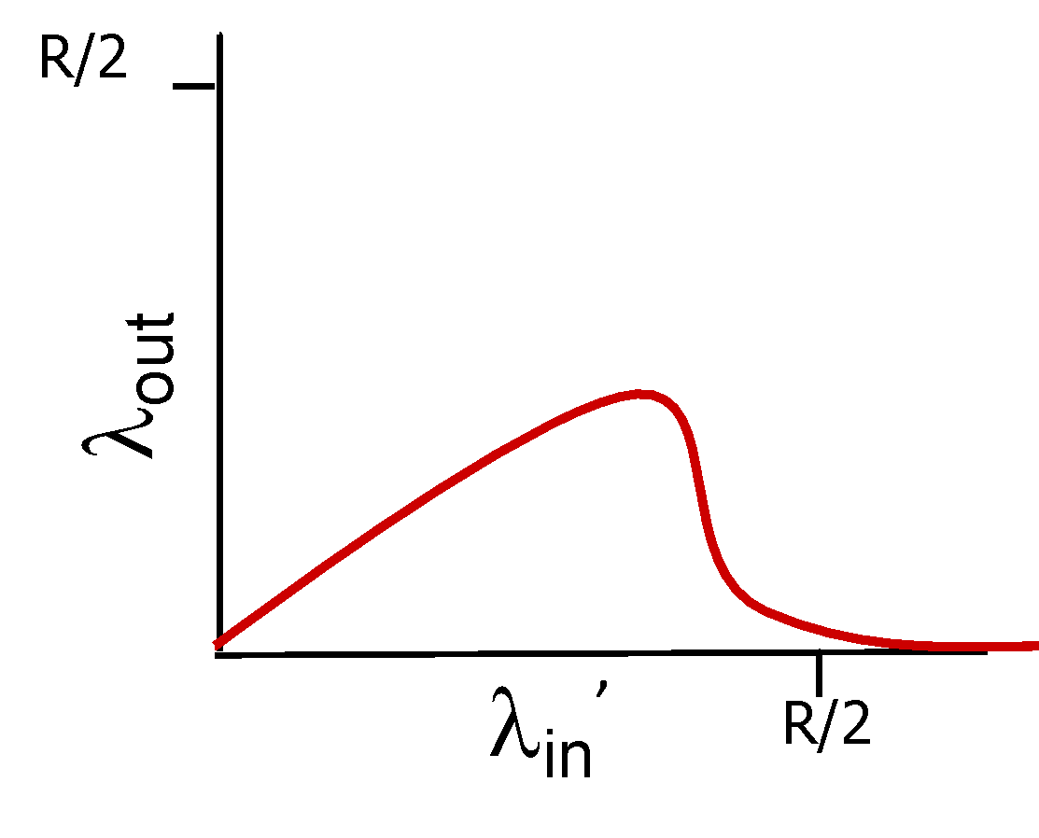
COMPUTER NETWORKS
Causes/costs of congestion: insights
throughput can never exceed capacity
delay increases as capacity approached
loss/retransmission decreases effective throughput
un-needed duplicates further decreases effective throughput
upstream transmission capacity / buffering wasted for packets lost downstream

Slide 86
COMPUTER NETWORKS
Approaches towards congestion control
End-end congestion control:
no explicit feedback from network
congestion inferred from observed loss, delay
ACKs
data
data
ACKs
approach taken by TCP

Slide 87
COMPUTER NETWORKS
Approaches towards congestion control
Network-assisted congestion control:
routers provide direct feedback to sending/receiving hosts with flows passing through congested router
may indicate congestion level or explicitly set sending rate
explicit congestion info
ACKs
data
data
ACKs
TCP ECN, ATM, DECbit protocols

Slide 88
COMPUTER NETWORKS
Suggested Readings

Slide 89
COMPUTER NETWORKS
Transport Layer - Roadmap
3.4 principles of reliable data transfer
3.5 connection-oriented transport: TCP
segment structure
reliable data transfer
flow control
connection management
3.6 principles of congestion control
3.7 TCP congestion control

Slide 90
COMPUTER NETWORKS
TCP congestion control: details
sender sequence number space
TCP sending behavior:
roughly: send cwnd bytes, wait RTT for ACKS, then send more bytes
cwnd
last byte
ACKed
cwnd
sent, but not-yet ACKed
(“in-flight”)
available but not used
TCP rate
~
bytes/sec
~
RTT
last byte sent
TCP sender limits transmission:
cwnd is dynamically adjusted in response to observed network congestion (implementing TCP congestion control)
<
cwnd
LastByteSent- LastByteAcked

Slide 91
COMPUTER NETWORKS
TCP: Determine sender rate
Too fast – congestion collapse
Too cautious and too slowly – under utilize the bandwidth
Send at a high rate without congesting the network
Guiding principles:
A lost segment implies congestion, and hence, the TCP sender’s rate should be decreased when a segment is lost.
An acknowledged segment indicates that the network is delivering the sender’s segments to the receiver, and hence, the sender’s rate can be increased when an ACK arrives for a previously unacknowledged segment.
Bandwidth probing.
TCP congestion-control algorithm
(1) slow start, (2) congestion avoidance, and (3) fast recovery

Slide 92
COMPUTER NETWORKS
TCP congestion control: AIMD
approach: senders can increase sending rate until packet loss (congestion) occurs, then decrease sending rate on loss event
Additive Increase
Multiplicative Decrease
increase sending rate by 1 maximum segment size every RTT until loss detected
cut sending rate in half at each loss event
AIMD sawtooth behavior: probing for bandwidth
TCP sender Sending rate
time

Slide 93
COMPUTER NETWORKS
TCP AIMD: more
Multiplicative decrease detail: sending rate is
Cut in half on loss detected by triple duplicate ACK (TCP Reno)
Cut to 1 MSS (maximum segment size) when loss detected by timeout (TCP Tahoe)
Why AIMD?
AIMD – a distributed, asynchronous algorithm – has been shown to:
optimize congested flow rates network wide!
have desirable stability properties

Slide 94
COMPUTER NETWORKS
TCP slow start
Host A
Host B
when connection begins, increase rate exponentially until first loss event:
initially cwnd = 1 MSS
double cwnd every RTT
done by incrementing cwnd for every ACK received
one segment
RTT
two segments
four segments
summary: initial rate is slow, but ramps up exponentially fast
time

Slide 95
COMPUTER NETWORKS
TCP: detecting, reacting to loss
loss indicated by timeout:
cwnd set to 1 MSS;
window then grows exponentially (as in slow start) to threshold, then grows linearly
loss indicated by 3 duplicate ACKs: TCP RENO
dup ACKs indicate network capable of delivering some segments
cwnd is cut in half window then grows linearly
TCP Tahoe always sets cwnd to 1 (timeout or 3 duplicate acks)

Slide 96
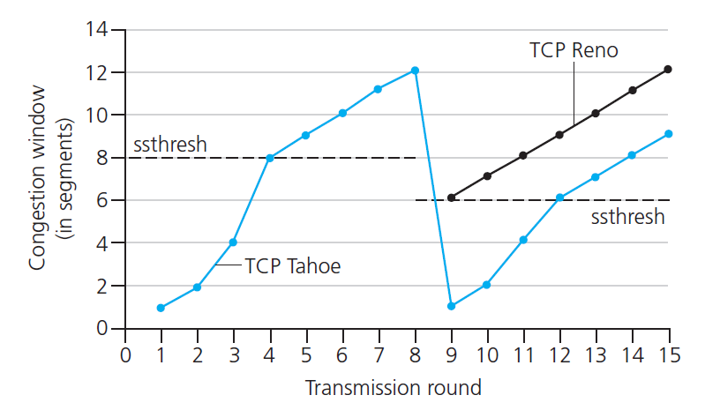

COMPUTER NETWORKS
TCP: from slow start to congestion avoidance
Q: when should the exponential increase switch to linear?
A: when cwnd gets to 1/2 of its value before timeout.
X
Implementation:
variable ssthresh
on loss event, ssthresh is set to 1/2 of cwnd just before loss event

Slide 97
COMPUTER NETWORKS
Summary: TCP congestion control
New
ACK!
New
ACK!
.
duplicate ACK
new ACK
dupACKcount++
new ACK
cwnd = cwnd + MSS (MSS/cwnd)
dupACKcount = 0
transmit new segment(s), as allowed
cwnd = cwnd+MSS
dupACKcount = 0
transmit new segment(s), as allowed
Λ
cwnd = 1 MSS
ssthresh = 64 KB
dupACKcount = 0
cwnd > ssthresh
slow
start
Λ
congestion
avoidance
timeout
ssthresh = cwnd/2
cwnd = 1 MSS
dupACKcount = 0
retransmit missing segment
duplicate ACK
timeout
dupACKcount++
ssthresh = cwnd/2
cwnd = 1 MSS
dupACKcount = 0
retransmit missing segment
timeout
New
ACK!
ssthresh = cwnd/2
cwnd = 1
dupACKcount = 0
retransmit missing segment
New ACK
dupACKcount == 3
cwnd = ssthresh
dupACKcount = 0
dupACKcount == 3
ssthresh= cwnd/2
cwnd = ssthresh + 3
retransmit missing segment
ssthresh= cwnd/2
cwnd = ssthresh + 3
retransmit missing segment
fast
recovery
duplicate ACK
cwnd = cwnd + MSS
transmit new segment(s), as allowed

Slide 98
THANK YOU
TEAM NETWORKS
Department of Computer Science and Engineering

