Slide 1

COMPUTER NETWORKS
TEAM NETWORKS
Department of Computer Science and Engineering

Slide 2
COMPUTER NETWORKS
Unit – 4 Network Layer and Internet Protocol
4.5 Introduction to Network Layer Protocols
DHCP
ICMP
4.6 IPv6 Addressing
4.7 Introduction to Routing Algorithms

Slide 3
COMPUTER NETWORKS
Unit – 4 Network Layer and Internet Protocol
4.5 Introduction to Network Layer Protocols
DHCP
ICMP
4.6 IPv6 Addressing
4.7 Introduction to Routing Algorithms

Slide 4
COMPUTER NETWORKS
IP addresses: how to get one?
That’s actually two questions:
Q: How does a host get IP address within its network (host part of address)?
Q: How does a network get IP address for itself (network part of address)
How does host get IP address?
hard-coded by sysadmin in config file (e.g., /etc/rc.config in UNIX)
DHCP: Dynamic Host Configuration Protocol: dynamically get address from as server
“plug-and-play”

Slide 5
COMPUTER NETWORKS
DHCP: Dynamic Host Configuration Protocol
goal: host dynamically obtains IP address from network server when it “joins” network
can renew its lease on address in use
allows reuse of addresses (only hold address while connected/on)
support for mobile users who join/leave network
DHCP overview:
host broadcasts DHCP discover msg [optional]
DHCP server responds with DHCP offer msg [optional]
host requests IP address: DHCP request msg
DHCP server sends address: DHCP ack msg

Slide 6





COMPUTER NETWORKS
DHCP client-server scenario
Typically, DHCP server will be co-located in router, serving all subnets to which router is attached
DHCP server
223.1.1.1
223.1.2.1
223.1.2.5
223.1.1.2
223.1.1.4
223.1.2.9
223.1.1.3
223.1.3.27
arriving DHCP client needs
address in this network
223.1.2.2
223.1.3.1
223.1.3.2

Slide 7


COMPUTER NETWORKS
DHCP client-server scenario
DHCP server: 223.1.2.5
DHCP discover
Arriving client
src : 0.0.0.0, 68
dest.: 255.255.255.255,67
yiaddr: 0.0.0.0
transaction ID: 654
Broadcast: is there a DHCP server out there?
DHCP offer
src: 223.1.2.5, 67
dest: 255.255.255.255, 68
yiaddrr: 223.1.2.4
transaction ID: 654
lifetime: 3600 secs
Broadcast: I’m a DHCP server! Here’s an IP address you can use
The two steps above can be skipped “if a client remembers and wishes to reuse a previously allocated network address” [RFC 2131]
DHCP request
src: 0.0.0.0, 68
dest:: 255.255.255.255, 67
yiaddrr: 223.1.2.4
transaction ID: 655
lifetime: 3600 secs
Broadcast: OK. I would like to use this IP address!
DHCP ACK
src: 223.1.2.5, 67
dest: 255.255.255.255, 68
yiaddrr: 223.1.2.4
transaction ID: 655
lifetime: 3600 secs
Broadcast: OK. You’ve got that IP address!

Slide 8
COMPUTER NETWORKS
DHCP: more than IP addresses
DHCP can return more than just allocated IP address on subnet:
address of first-hop router for client
name and IP address of DNS sever
network mask (indicating network versus host portion of address)

Slide 9


COMPUTER NETWORKS
DHCP: example
DHCP
DHCP
UDP
IP
Eth
Phy
Connecting laptop will use DHCP to get IP address, address of first-hop router, address of DNS server.
DHCP
DHCP
DHCP
DHCP
DHCP REQUEST message encapsulated in UDP, encapsulated in IP, encapsulated in Ethernet
DHCP
DHCP
UDP
IP
Eth
Phy
168.1.1.1
DHCP
DHCP
DHCP
Ethernet frame broadcast (dest: FFFFFFFFFFFF) on LAN, received at router running DHCP server
DHCP
router with DHCP
server built into
router
Ethernet demux’ed to IP demux’ed, UDP demux’ed to DHCP

Slide 10
COMPUTER NETWORKS
DHCP: example
DHCP
UDP
IP
Eth
Phy
DCP server formulates DHCP ACK containing client’s IP address, IP address of first-hop router for client, name & IP address of DNS server
DHCP
DHCP
DHCP
DHCP
encapsulated DHCP server reply forwarded to client, demuxing up to DHCP at client
DHCP
DHCP
UDP
IP
Eth
Phy
DHCP
DHCP
DHCP
router with DHCP
server built into
router
client now knows its IP address, name and IP address of DNS server, IP address of its first-hop router
DHCP

Slide 11
COMPUTER NETWORKS
IP addressing: last words…
Q: how does an ISP get block of addresses?
A: ICANN: Internet Corporation for Assigned Names and Numbers http://www.icann.org/
allocates IP addresses, through 5 regional registries (RRs) (who may then allocate to local registries)
manages DNS root zone, including delegation of individual TLD (.com, .edu, …) management
Q: are there enough 32-bit IP addresses?
ICANN allocated last chunk of IPv4 addresses to RRs in 2011
NAT (next) helps IPv4 address space exhaustion
IPv6 has 128-bit address space
"Who the hell knew how much address space we needed?" Vint Cerf (reflecting on decision to make IPv4 address 32 bits long)

Slide 12
COMPUTER NETWORKS
Unit – 4 Network Layer and Internet Protocol
4.5 Introduction to Network Layer Protocols
DHCP
ICMP
4.6 IPv6 Addressing
4.7 Introduction to Routing Algorithms

Slide 13
COMPUTER NETWORKS
ICMP: Internet Control Message Protocol
Used by hosts and routers to communicate network-layer information.
Typical use of ICMP is for error reporting.
Eg: “Destination network unreachable”
ICMP messages – carried as IP payloads.
ICMP is often considered part of IP, but architecturally it lies just above IP.
ICMP messages have a type and a code field.
Type Code description
0 0 echo reply (ping)
3 0 dest. network unreachable
3 1 dest host unreachable
3 2 dest protocol unreachable
3 3 dest port unreachable
3 6 dest network unknown
3 7 dest host unknown
4 0 source quench (congestion control - not used)
8 0 echo request (ping)
9 0 route advertisement
10 0 router discovery
11 0 TTL expired
12 0 bad IP header

Slide 14
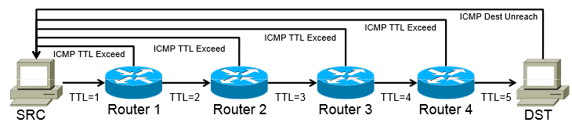
COMPUTER NETWORKS
ICMP: Internet Control Message Protocol
Perform – Network diagnostics
Utilities traceroute and ping – use ICMP.
Other examples of ICMP messages:
Source quench message (congestion)
Parameter problem (bad IP header)
Time exceeded message (TTL)
Destination unreachable
Redirection message

Slide 15
COMPUTER NETWORKS
Unit – 4 Network Layer and Internet Protocol
4.5 Introduction to Network Layer Protocols
DHCP
ICMP
4.6 IPv6 Addressing
4.7 Introduction to Routing Algorithms

Slide 16
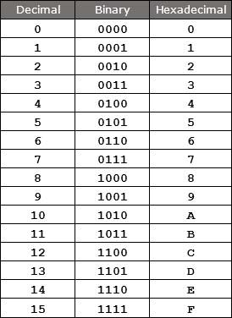
COMPUTER NETWORKS
Introduction to IPv6
128 bits address
340 undecillion address (340 + 33 digits)
IPv6 address space is 2⁹⁶ times of the IPv4 address.
Made up of eight 16-bit blocks (octet)
Separated by ‘:’
Hexadecimal, each hexadecimal character – 4 bits
Rules:
Discard leading Zero(es)
If two of more blocks contain consecutive zeroes, omit them all and replace with double colon sign ::
340,282,366,920,938,463,374,607,431,768,211,456

Slide 17
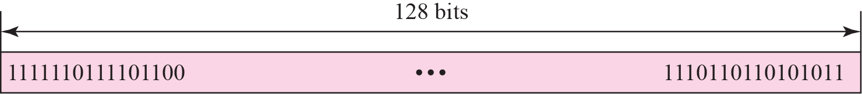
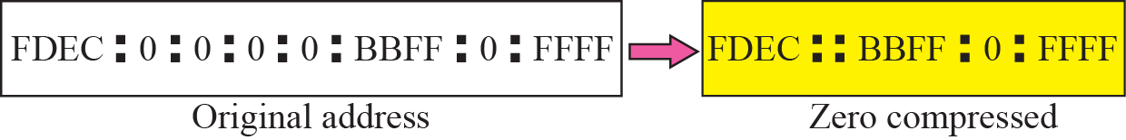

COMPUTER NETWORKS
Introduction to IPv6
Colon hexadecimal notation
Zero compression
CIDR address
Rule 1
Rule 2

Slide 18

COMPUTER NETWORKS
IPv6 Addressing
Show the unabbreviated colon hex notation for the following IPv6 addresses:
a. An address with 64 0s followed by 64 1s.
b. An address with 128 0s.
c. An address with 128 1s.
d. An address with 128 alternative 1s and 0s.
Solution
a. 0000:0000:0000:0000:FFFF:FFFF:FFFF:FFFF
b. 0000:0000:0000:0000:0000:0000:0000:0000
c. FFFF:FFFF:FFFF:FFFF:FFFF:FFFF:FFFF:FFFF
d. AAAA:AAAA:AAAA:AAAA:AAAA:AAAA:AAAA:AAAA

Slide 19
COMPUTER NETWORKS
IPv6 Addressing
The following shows the zero contraction version of addresses in previous example.
a. :: FFFF:FFFF:FFFF:FFFF
b. ::
c. FFFF:FFFF:FFFF:FFFF:FFFF:FFFF:FFFF:FFFF
d. AAAA:AAAA:AAAA:AAAA:AAAA:AAAA:AAAA:AAAA

Slide 20
COMPUTER NETWORKS
IPv6 Addressing
Show abbreviations for the following addresses:
a. 0000:0000:FFFF:0000:0000:0000:0000:0000
b. 1234:2346:0000:0000:0000:0000:0000:1111
c. 0000:0001:0000:0000:0000:0000:1200:1000
d. 0000:0000:0000:0000:0000:FFFF:24.123.12.6
Solution
a. 0:0:FFFF::
b. 1234:2346::1111
c. 0:1::1200:1000
d. ::FFFF:24.123.12.6

Slide 21
COMPUTER NETWORKS
IPv6 Addressing
Decompress the following addresses and show the complete unabbreviated IPv6 address:
a. 1111::2222
b. ::
c. 0:1::
d. AAAA:A:AA::1234
Solution
a. 1111:0000:0000:0000:0000:0000:0000:2222
b. 0000:0000:0000:0000:0000:0000:0000:0000
c. 0000:0001:0000:0000:0000:0000:0000:0000
d. AAAA:000A:00AA:0000:0000:0000:0000:1234

Slide 22
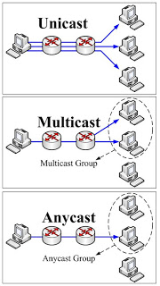
COMPUTER NETWORKS
Three Address Types
In IPv6, a destination address belong to:
Unicast Address (one-to-one) – defines a single interface (computer or router)
Multicast Address (one-to-many) – also defines a group of computers, each member of the group receives a copy.
Anycast Address (one-to-nearest) – defines a group of computers that all share a single address.
Broadcast Address (one-to-all) – ×

Slide 23
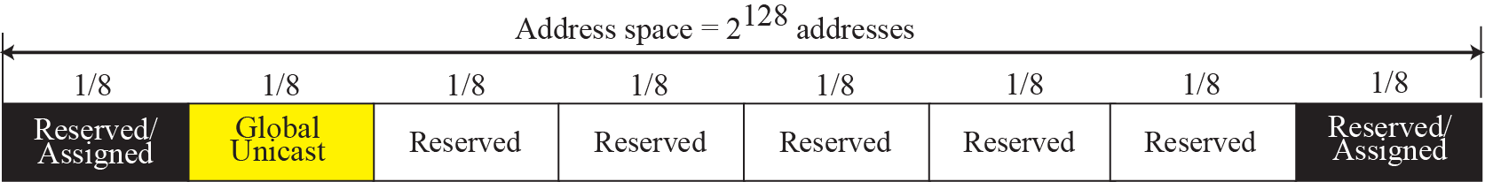
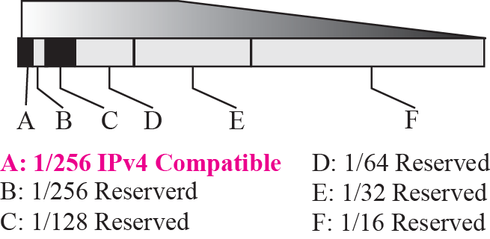
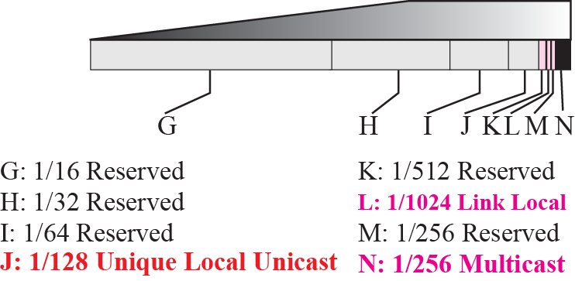
COMPUTER NETWORKS
Address Space Allocation

Slide 24
COMPUTER NETWORKS
IPv6 Protocol: Rationale for Change
Larger address space
Better header format
New options
Allowance for extension
Support for resource allocation
Support for more security
checksum: removed entirely to reduce processing time at each hop
options: allowed, but outside of header, indicated by “Next Header” field
ICMPv6: new version of ICMP
fragmentation/reassembly: no

Slide 25
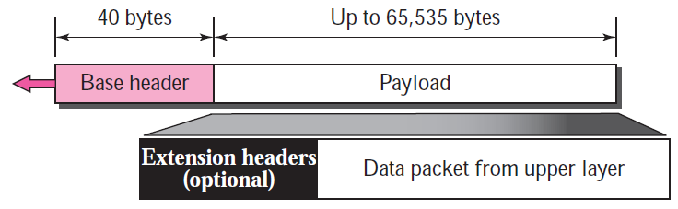
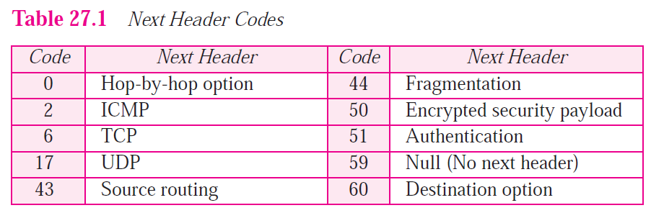
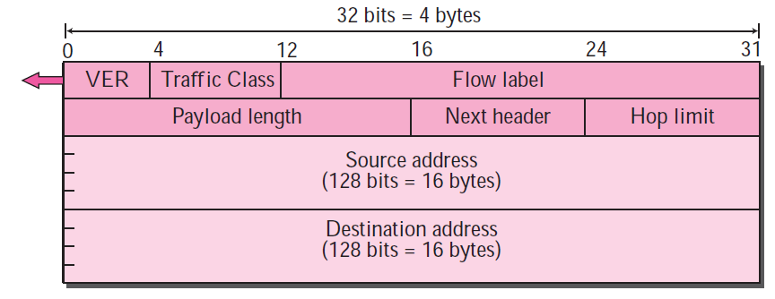
COMPUTER NETWORKS
IPv6 Datagram Format
Format of the base header

Slide 26
COMPUTER NETWORKS
Transition from IPv4 to IPv6
not all routers can be upgraded simultaneously
no “flag days”
how will network operate with mixed IPv4 and IPv6 routers?
tunneling: IPv6 datagram carried as payload in IPv4 datagram among IPv4 routers (“packet within a packet”)
tunneling used extensively in other contexts (4G/5G)
IPv4 header fields
IPv6 header fields
IPv4 payload
IPv4 source, dest addr
IPv6 source dest addr
UDP/TCP payload
IPv6 datagram
IPv4 datagram

Slide 27
COMPUTER NETWORKS
Tunneling and Encapsulation
Ethernet connecting two IPv6 routers:
A
B
Ethernet connects two IPv6 routers
E
F
IPv6
IPv6
IPv6
IPv6
IPv6 datagram
Link-layer frame
The usual: datagram as payload in link-layer frame
IPv4 network connecting two IPv6 routers
A
B
E
F
IPv6
IPv6/v4
IPv6/v4
IPv6
IPv4 network

Slide 28
COMPUTER NETWORKS
Tunneling and Encapsulation
Ethernet connecting two IPv6 routers:
A
B
Ethernet connects two IPv6 routers
E
F
IPv6
IPv6
IPv6
IPv6
IPv6 datagram
Link-layer frame
The usual: datagram as payload in link-layer frame
IPv4 tunnel connecting two IPv6 routers
A
B
IPv4 tunnel
connecting IPv6 routers
E
F
IPv6
IPv6/v4
IPv6/v4
IPv6
IPv6 datagram
IPv4 datagram
tunneling: IPv6 datagram as payload in a IPv4 datagram

Slide 29
COMPUTER NETWORKS
Tunneling
A
B
IPv4 tunnel
connecting IPv6 routers
E
F
logical view:
IPv6
IPv6/v4
IPv6/v4
IPv6
A
B
C
D
E
F
physical view:
IPv6
IPv6/v4
IPv4
IPv4
IPv6/v4
IPv6
flow: X
src: A
dest: F
data
src:B
dest: E
src:B
dest: E
src:B
dest: E
flow: X
src: A
dest: F
data
Flow: X
Src: A
Dest: F
data
Flow: X
Src: A
Dest: F
data
Flow: X
Src: A
Dest: F
data
Note source and destination addresses!
A-to-B:
IPv6
B-to-C:
IPv6 inside
IPv4
C-to-D:
IPv6 inside
IPv4
D-to-E:
IPv6 inside
IPv4
E-to-F:
IPv6

Slide 30
COMPUTER NETWORKS
IPv6 Adoption
https://www.akamai.com/us/en/resources/our-thinking/state-of-the-internet-report/state-of-the-internet-ipv6-adoption-visualization.jsp

Slide 31
COMPUTER NETWORKS
Unit – 4 Network Layer and Internet Protocol
4.5 Introduction to Network Layer Protocols
DHCP
ICMP
4.6 IPv6 Addressing
4.7 Introduction to Routing Algorithms

Slide 32





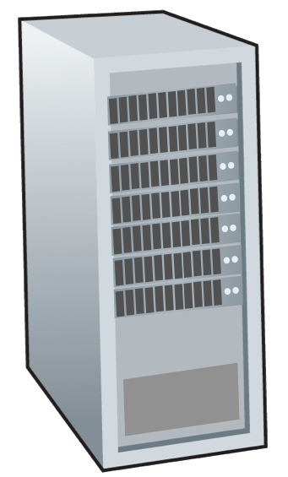






COMPUTER NETWORKS
Routing Protocols
Routing protocol goal: determine “good” paths (equivalently, routes), from sending hosts to receiving host, through network of routers
path: sequence of routers packets traverse from given initial source host to final destination host
“good”: least “cost”, “fastest”, “least congested”
routing: a “top-10” networking challenge!
mobile network
national or global ISP
application
transport
network
link
physical
network
link
physical
network
link
physical
network
link
physical
network
link
physical
network
link
physical
datacenter
network
application
transport
network
link
physical
enterprise
network

Slide 33
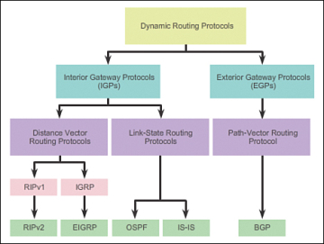
COMPUTER NETWORKS
Routing Algorithms

Slide 34
Graph abstraction: link costs
COMPUTER NETWORKS
Routing Protocols
5
c_{a,b}: cost of direct link connecting a and b
e.g., c_{w,z} = 5, c_{u,z} = ∞
cost defined by network operator: could always be 1, or inversely related to bandwidth, or inversely related to congestion
v
3
w
2
5
u
2
1
z
3
1
2
x
y
1
graph: G = (N,E)
N: set of routers = { u, v, w, x, y, z }
E: set of links ={ (u,v), (u,x), (v,x), (v,w), (x,w), (x,y), (w,y), (w,z), (y,z) }

Slide 35
Routing algorithm classification
COMPUTER NETWORKS
Routing Protocols
global: all routers have complete topology, link cost info
“link state” algorithms
dynamic: routes change more quickly
periodic updates or in response to link cost changes
How fast do routes change?
static: routes change slowly over time
decentralized: iterative process of computation, exchange of info with neighbors
routers initially only know link costs to attached neighbors
“distance vector” algorithms
global or decentralized information?

Slide 36
Dijkstra’s link-state routing algorithm
COMPUTER NETWORKS
Routing Protocols - Dijkstra’s link-state routing algorithm
centralized: network topology, link costs known to all nodes
accomplished via “link state broadcast”
all nodes have same info
computes least cost paths from one node (“source”) to all other nodes
gives forwarding table for that node
iterative: after k iterations, know least cost path to k destinations
notation
c_{x,y}: direct link cost from node x to y; = ∞ if not direct neighbors
D(v): current estimate of cost of least-cost-path from source to destination v
p(v): predecessor node along path from source to v
N': set of nodes whose least-cost-path definitively known

Slide 37

COMPUTER NETWORKS
Routing Protocols - Dijkstra’s link-state routing algorithm
1 Initialization:
2 N' = {u} /* compute least cost path from u to all other nodes */
3 for all nodes v
4 if v adjacent to u /* u initially knows direct-path-cost only to direct neighbors */
5 then D(v) = c_{u,v} /* but may not be minimum cost! */
6 else D(v) = ∞
7
8 Loop
9
10
11
12
13
14
15 until all nodes in N'
find w not in N' such that D(w) is a minimum
add w to N'
update D(v) for all v adjacent to w and not in N' :
D(v) = min ( D(v), D(w) + c_{w,v} )
/* new least-path-cost to v is either old least-cost-path to v or known
least-cost-path to w plus direct-cost from w to v */

Slide 38
Dijkstra’s algorithm: an example
COMPUTER NETWORKS
Routing Protocols - Dijkstra’s link-state routing algorithm
v
w
x
y
z
Step
0
1
2
3
4
5
N'
D(v),p(v)
D(w),p(w)
D(x),p(x)
D(y),p(y)
D(z),p(z)
u
2,u
5,u
1,u
∞
∞
ux
2,u
4,x
2,x
∞
uxy
2,u
3,y
4,y
uxyv
3,y
4,y
uxyvw
4,y
uxyvwz
Initialization (step 0): For all a: if a adjacent to then D(a) = c_{u,a}
5
find a not in N' such that D(a) is a minimum
add a to N'
update D(b) for all b adjacent to a and not in N' :
D(b) = min ( D(b), D(a) + c_{a,b} )
v
3
w
2
5
u
2
1
z
3
1
2
x
y
1

Slide 39
Example contd..
COMPUTER NETWORKS
Routing Protocols - Dijkstra’s link-state routing algorithm
5
v
3
w
2
5
u
2
1
z
3
1
2
x
y
1
resulting least-cost-path tree from u:
resulting forwarding table in u:
v
w
destination
outgoing link
v
x
y
w
x
(u,v)
(u,x)
(u,x)
(u,x)
(u,x)
route from u to v directly
u
z
x
route from u to all other destinations via x
y

Slide 40
Another example:
COMPUTER NETWORKS
Routing Protocols - Dijkstra’s link-state routing algorithm
v
w
x
y
z
x
D(v),
p(v)
D(w),
p(w)
D(x),
p(x)
D(y),
p(y)
D(z),
p(z)
9
Step
N'
0
u
7,u
3,u
5,u
∞
∞
5
7
4
1
uw
6,w
5,u
∞
8
2
uwx
6,w
11,w
14,x
u
3
w
y
z
2
3
uwxv
10,v
14,x
3
4
uwxvy
12,y
7
4
5
uwxvyz
v
notes:
construct least-cost-path tree by tracing predecessor nodes
ties can exist (can be broken arbitrarily)

Slide 41
Distance vector algorithm
COMPUTER NETWORKS
Routing Protocols - Bellman-Ford Distance Vector Routing Algorithm
Based on Bellman-Ford (BF) equation (dynamic programming):
Bellman-Ford equation
Let D_{x}(y): cost of least-cost path from x to y.
Then:
D_{x}(y) = min_{v} { c_{x,v} + D_{v}(y) }
v’s estimated least-cost-path cost to y
min taken over all neighbors v of x
direct cost of link from x to v

Slide 42
Bellman-Ford: Example
COMPUTER NETWORKS
Routing Protocols - Bellman-Ford Distance Vector Routing Algorithm
Suppose that u’s neighboring nodes, x,v,w, know that for destination z:
Bellman-Ford equation says:
D_{v}(z) = 5
D_{w}(z) = 3
D_{u}(z) = min { c_{u,v} + D_{v}(z),
c_{u,x} + D_{x}(z),
c_{u,w} + D_{w}(z) }
5
v
3
w
2
5
= min {2 + 5,
1 + 3,
5 + 3} = 4
u
2
1
z
3
1
2
x
y
1
node achieving minimum (x) is next hop on estimated least-cost path to destination (z)
D_{x}(z) = 3

Slide 43
Distance vector algorithm:
COMPUTER NETWORKS
Routing Protocols - Bellman-Ford Distance Vector Routing Algorithm
key idea:
from time-to-time, each node sends its own distance vector estimate to neighbors
when x receives new DV estimate from any neighbor, it updates its own DV using B-F equation:
D_{x}(y) ← min_{v}{c_{x,v} + D_{v}(y)} for each node y ∊ N
under minor, natural conditions, the estimate D_{x}(y) converge to the actual least cost d_{x}(y)

Slide 44
Distance vector algorithm:
COMPUTER NETWORKS
Routing Protocols - Bellman-Ford Distance Vector Routing Algorithm
each node:
iterative, asynchronous: each local iteration caused by:
local link cost change
DV update message from neighbor
wait for (change in local link cost or msg from neighbor)
recompute DV estimates using DV received from neighbor
distributed, self-stopping: each node notifies neighbors only when its DV changes
neighbors then notify their neighbors – only if necessary
no notification received, no actions taken!
if DV to any destination has changed, notify neighbors

Slide 45
Distance vector: example
COMPUTER NETWORKS
Routing Protocols - Bellman-Ford Distance Vector Routing Algorithm
DV in a: D_{a}(a)=0
D_{a}(b) = 8
D_{a}(c) = ∞
D_{a}(d) = 1
D_{a}(e) = ∞
D_{a}(f) = ∞
D_{a}(g) = ∞
D_{a}(h) = ∞
D_{a}(i) = ∞
a
b
c
8
1
t=0
1
1
All nodes have distance estimates to nearest neighbors (only)
A few asymmetries:
missing link
larger cost
d
e
f
1
1
All nodes send their local distance vector to their neighbors
1
1
1
g
h
i
1
1

Slide 46
Distance vector: Iteration
COMPUTER NETWORKS
Routing Protocols - Bellman-Ford Distance Vector Routing Algorithm
a
b
c
8
1
t=1
1
1
All nodes:
receive distance vectors from neighbors
compute their new local distance vector
send their new local distance vector to neighbors
d
e
f
1
1
1
1
1
g
h
i
1
1

Slide 47
Distance vector: Iteration
COMPUTER NETWORKS
Routing Protocols - Bellman-Ford Distance Vector Routing Algorithm
a
compute
compute
compute
b
c
8
1
t=1
1
1
All nodes:
receive distance vectors from neighbors
compute their new local distance vector
send their new local distance vector to neighbors
d
compute
e
f
compute
compute
1
1
1
1
1
g
h
i
compute
compute
1
compute
1

Slide 48
Distance vector: Iteration
COMPUTER NETWORKS
Routing Protocols - Bellman-Ford Distance Vector Routing Algorithm
a
b
c
8
1
t=1
1
1
All nodes:
receive distance vectors from neighbors
compute their new local distance vector
send their new local distance vector to neighbors
d
e
f
1
1
1
1
1
g
h
i
1
1

Slide 49
Distance vector: Iteration
COMPUTER NETWORKS
Routing Protocols - Bellman-Ford Distance Vector Routing Algorithm
a
b
c
8
1
t=2
1
1
All nodes:
receive distance vectors from neighbors
compute their new local distance vector
send their new local distance vector to neighbors
d
e
f
1
1
1
1
1
g
h
i
1
1

Slide 50
Distance vector: Iteration
COMPUTER NETWORKS
Routing Protocols - Bellman-Ford Distance Vector Routing Algorithm
compute
compute
compute
a
b
c
2
1
t=2
1
1
All nodes:
receive distance vectors from neighbors
compute their new local distance vector
send their new local distance vector to neighbors
d
compute
compute
compute
e
f
1
1
1
1
1
g
compute
compute
compute
h
i
8
1

Slide 51
Distance vector: Iteration
COMPUTER NETWORKS
Routing Protocols - Bellman-Ford Distance Vector Routing Algorithm
a
b
c
8
1
t=2
1
1
All nodes:
receive distance vectors from neighbors
compute their new local distance vector
send their new local distance vector to neighbors
d
e
f
1
1
1
1
1
g
h
i
1
1
…. and so on

Slide 52
Distance vector example: computation
COMPUTER NETWORKS
Routing Protocols - Bellman-Ford Distance Vector Routing Algorithm
DV in b:
DV in c:
D_{c}(a) = ∞
D_{c}(b) = 1
D_{c}(c) = 0
D_{c}(d) = ∞
D_{c}(e) = ∞
D_{c}(f) = ∞
D_{c}(g) = ∞
D_{c}(h) = ∞
D_{c}(i) = ∞
D_{b}(a) = 8
D_{b}(c) = 1
D_{b}(d) = ∞
D_{b}(e) = 1
D_{b}(f) = ∞
D_{b}(g) = ∞
D_{b}(h) = ∞
D_{b}(i) = ∞
DV in a: D_{a}(a)=0
D_{a}(b) = 8
D_{a}(c) = ∞
D_{a}(d) = 1
D_{a}(e) = ∞
D_{a}(f) = ∞
D_{a}(g) = ∞
D_{a}(h) = ∞
D_{a}(i) = ∞
a
b
c
8
1
t=1
1
1
b receives DVs from a, c, e
DV in e:
D_{e}(a) = ∞
D_{e}(b) = 1
D_{e}(c) = ∞
D_{e}(d) = 1
D_{e}(e) = 0
D_{e}(f) = 1
D_{e}(g) = ∞
D_{e}(h) = 1
D_{e}(i) = ∞
d
e
f
1
1
Let’s next take a look at the iterative computations at nodes
1
1
1
g
h
i
1
1

Slide 53
COMPUTER NETWORKS
Routing Protocols - Bellman-Ford
DV in c:
D_{c}(a) = ∞
D_{c}(b) = 1
D_{c}(c) = 0
D_{c}(d) = ∞
D_{c}(e) = ∞
D_{c}(f) = ∞
D_{c}(g) = ∞
D_{c}(h) = ∞
D_{c}(i) = ∞
DV in b:
D_{b}(a) = 8
D_{b}(c) = 1
D_{b}(d) = ∞
D_{b}(e) = 1
D_{b}(f) = ∞
D_{b}(g) = ∞
D_{b}(h) = ∞
D_{b}(i) = ∞
DV in a: D_{a}(a)=0
D_{a}(b) = 8
D_{a}(c) = ∞
D_{a}(d) = 1
D_{a}(e) = ∞
D_{a}(f) = ∞
D_{a}(g) = ∞
D_{a}(h) = ∞
D_{a}(i) = ∞
a
b
c
b
8
compute
1
t=1
1
1
b receives DVs from a, c, e, computes:
DV in e:
D_{e}(a) = ∞
D_{e}(b) = 1
D_{e}(c) = ∞
D_{e}(d) = 1
D_{e}(e) = 0
D_{e}(f) = 1
D_{e}(g) = ∞
D_{e}(h) = 1
D_{e}(i) = ∞
e
d
e
f
1
1
D_{b}(a) = min{c_{b,a}+D_{a}(a), c_{b,c} +D_{c}(a), c_{b,e}+D_{e}(a)} = min{8,∞,∞} = 8
D_{b}(c) = min{c_{b,a}+D_{a}(c), c_{b,c} +D_{c}(c), c _{b,e} +D_{e}(c)} = min{∞,1,∞} = 1
D_{b}(d) = min{c_{b,a}+D_{a}(d), c_{b,c} +D_{c}(d), c _{b,e} +D_{e}(d)} = min{9,2,∞} = 2
1
1
1
D_{b}(e) = min{c_{b,a}+D_{a}(e), c_{b,c} +D_{c}(e), c _{b,e} +D_{e}(e)} = min{∞,∞,1} = 1
DV in b:
D_{b}(f) = min{c_{b,a}+D_{a}(f), c_{b,c} +D_{c}(f), c _{b,e} +D_{e}(f)} = min{∞,∞,2} = 2
D_{b}(g) = min{c_{b,a}+D_{a}(g), c_{b,c} +D_{c}(g), c _{b,e}+D_{e}(g)} = min{∞, ∞, ∞} = ∞
D_{b}(a) = 8
D_{b}(c) = 1
D_{b}(d) = 2
D_{b}(e) = 1
D_{b}(f) =2
D_{b}(g) = ∞
D_{b}(h) = 2
D_{b}(i) = ∞
g
h
1
i
1
D_{b}(h) = min{c_{b,a}+D_{a}(h), c_{b,c} +D_{c}(h), c _{b,e}+D_{e}(h)} = min{∞, ∞, 2} = 2
D_{b}(i) = min{c_{b,a}+D_{a}(i), c_{b,c} +D_{c}(i), c _{b,e}+D_{e}(i)} = min{∞, ∞, ∞} = ∞

Slide 54
COMPUTER NETWORKS
Routing Protocols - Bellman-Ford
DV in b:
DV in c:
D_{c}(a) = ∞
D_{c}(b) = 1
D_{c}(c) = 0
D_{c}(d) = ∞
D_{c}(e) = ∞
D_{c}(f) = ∞
D_{c}(g) = ∞
D_{c}(h) = ∞
D_{c}(i) = ∞
D_{b}(a) = 8
D_{b}(c) = 1
D_{b}(d) = ∞
D_{b}(e) = 1
D_{b}(f) = ∞
D_{b}(g) = ∞
D_{b}(h) = ∞
D_{b}(i) = ∞
DV in a: D_{a}(a)=0
D_{a}(b) = 8
D_{a}(c) = ∞
D_{a}(d) = 1
D_{a}(e) = ∞
D_{a}(f) = ∞
D_{a}(g) = ∞
D_{a}(h) = ∞
D_{a}(i) = ∞
a
b
c
8
1
t=1
1
1
c receives DVs from b
DV in e:
D_{e}(a) = ∞
D_{e}(b) = 1
D_{e}(c) = ∞
D_{e}(d) = 1
D_{e}(e) = 0
D_{e}(f) = 1
D_{e}(g) = ∞
D_{e}(h) = 1
D_{e}(i) = ∞
d
e
f
1
1
1
1
1
g
h
i
1
1

Slide 55
COMPUTER NETWORKS
Routing Protocols - Bellman-Ford
DV in c:
D_{c}(a) = ∞
D_{c}(b) = 1
D_{c}(c) = 0
D_{c}(d) = ∞
D_{c}(e) = ∞
D_{c}(f) = ∞
D_{c}(g) = ∞
D_{c}(h) = ∞
D_{c}(i) = ∞
DV in b:
D_{b}(a) = 8
D_{b}(c) = 1
D_{b}(d) = ∞
D_{b}(e) = 1
D_{b}(f) = ∞
D_{b}(g) = ∞
D_{b}(h) = ∞
D_{b}(i) = ∞
a
b
c
1
compute
8
t=1
1
1
c receives DVs from b computes:
d
e
f
D_{c}(a) = min{c_{c,b}+D_{b}(a}} = 1 + 8 = 9
DV in c:
D_{c}(a) = 9
D_{c}(b) = 1
D_{c}(c) = 0
D_{c}(d) = 2
D_{c}(e) = ∞
D_{c}(f) = ∞
D_{c}(g) = ∞
D_{c}(h) = ∞
D_{c}(i) = ∞
D_{c}(b) = min{c_{c,b}+D_{b}(b)} = 1 + 0 = 1
D_{c}(d) = min{c_{c,b}+D_{b}(d)} = 1+ ∞ = ∞
D_{c}(e) = min{c_{c,b}+D_{b}(e)} = 1 + 1 = 2
D_{c}(f) = min{c_{c,b}+D_{b}(f)} = 1+ ∞ = ∞
D_{c}(g) = min{c_{c,b}+D_{b}(g)} = 1+ ∞ = ∞
* Check out the online interactive exercises for more examples: http://gaia.cs.umass.edu/kurose_ross/interactive/
g
h
i
D_{c}(h) = min{c_{bc,b}+D_{b}(h)} = 1+ ∞ = ∞
D_{c}(i) = min{c_{c,b}+D_{b}(i)} = 1+ ∞ = ∞

Slide 56
COMPUTER NETWORKS
DV in b:
Routing Protocols - Bellman-Ford
D_{b}(a) = 8
D_{b}(c) = 1
D_{b}(d) = ∞
D_{b}(e) = 1
D_{b}(f) = ∞
D_{b}(g) = ∞
D_{b}(h) = ∞
D_{b}(i) = ∞
DV in e:
D_{e}(a) = ∞
D_{e}(b) = 1
D_{e}(c) = ∞
D_{e}(d) = 1
D_{e}(e) = 0
D_{e}(f) = 1
D_{e}(g) = ∞
D_{e}(h) = 1
D_{e}(i) = ∞
DV in d:
D_{c}(a) = 1
D_{c}(b) = ∞
D_{c}(c) = ∞
D_{c}(d) = 0
D_{c}(e) = 1
D_{c}(f) = ∞ D_{c}(g) = 1
D_{c}(h) = ∞
D_{c}(i) = ∞
a
b
c
8
1
t=1
Q: what is new DV computed in e at t=1?
1
1
e receives DVs from b, d, f, h
d
compute
f
DV in f:
D_{c}(a) = ∞
D_{c}(b) = ∞
D_{c}(c) = ∞
D_{c}(d) = ∞
D_{c}(e) = 1
D_{c}(f) = 0
D_{c}(g) = ∞
D_{c}(h) = ∞
D_{c}(i) = 1
e
DV in h:
D_{c}(a) = ∞
D_{c}(b) = ∞
D_{c}(c) = ∞
D_{c}(d) = ∞
D_{c}(e) = 1
D_{c}(f) = ∞
D_{c}(g) = 1
D_{c}(h) = 0
D_{c}(i) = 1
1
1
1
1
1
g
h
i
1
1

Slide 57
Distance vector: state information diffusion
COMPUTER NETWORKS
Routing Protocols - Bellman-Ford
Iterative communication, computation steps diffuses information through network:
t=0
c’s state at t=0 is at c only
a
b
c
8
1
c’s state at t=0 has propagated to b, and may influence distance vector computations up to 1 hop away, i.e., at b
t=1
1
1
t=1
t=2
c’s state at t=0 may now influence distance vector computations up to 2 hops away, i.e., at b and now at a, e as well
t=2
d
e
f
1
1
c’s state at t=0 may influence distance vector computations up to 3 hops away, i.e., at b,a,e and now at c,f,h as well
t=3
t=3
1
1
1
c’s state at t=0 may influence distance vector computations up to 4 hops away, i.e., at b,a,e, c, f, h and now at g,i as well
t=4
g
h
i
1
1
t=4

Slide 58
Distance vector: link cost changes
COMPUTER NETWORKS
Routing Protocols - Bellman-Ford
link cost changes:
node detects local link cost change
updates routing info, recalculates local DV
if DV changes, notify neighbors
1
y
4
1
x
z
50
t₀ : y detects link-cost change, updates its DV, informs its neighbors.
“good news
travels fast”
t₁ : z receives update from y, updates its table, computes new least cost to x , sends its neighbors its DV.
t₂ : y receives z’s update, updates its distance table. y’s least costs do not change, so y does not send a message to z.

Slide 59
Distance vector: link cost changes
COMPUTER NETWORKS
Routing Protocols - Bellman-Ford
link cost changes:
node detects local link cost change
“bad news travels slow” – count-to-infinity problem:
60
y
4
1
x
z
50
y sees direct link to x has new cost 60, but z has said it has a path at cost of 5. So y computes “my new cost to x will be 6, via z); notifies z of new cost of 6 to x.
z learns that path to x via y has new cost 6, so z computes “my new cost to x will be 7 via y), notifies y of new cost of 7 to x.
y learns that path to x via z has new cost 7, so y computes “my new cost to x will be 8 via y), notifies z of new cost of 8 to x.
z learns that path to x via y has new cost 8, so z computes “my new cost to x will be 9 via y), notifies y of new cost of 9 to x.
…
see text for solutions. Distributed algorithms are tricky!

Slide 60
COMPUTER NETWORKS
Distance Vector vs Link State
 | Distance Vector | Link State
Primary principle | Send entire routing table to its neighbors | Only provides link state information
Learning about network | Learn about network only from neighbors | Learn about network from all routers
Building the routing table | Based on inputs from only neighbors | Based on complete database collected from all routers
Advertisement of updates | Sends periodic updates every 30-90 seconds – Broadcasts updates | Use triggered updates, only when there is a change – Multicasts updates
Routing loops | Vulnerable | Less prone to routing loops

Slide 61
COMPUTER NETWORKS
Distance Vector vs Link State
 | Distance vector | Link State
Convergence (stabilization) | Slow | Fast
Resources | Less CPU power and memory | More CPU power and memory required
Cost |  | More than Distance vector
Scalability |  | More scalable than distance vector
Examples | RIP, IGRP | OSPF, IS-IS

Slide 62

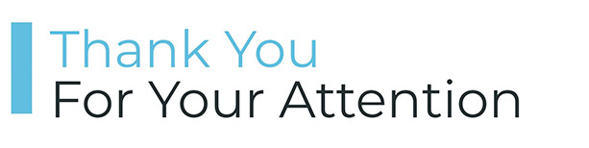
COMPUTER NETWORKS
Suggested Readings

Slide 63
THANK YOU
TEAM NETWORKS
Department of Computer Science and Engineering

