Slide 1

Microprocessor & Computer Architecture (μpCA)
UE22CS252B
Session - 11

Slide 2
Microprocessor & Computer Architecture (μpCA)
UE22CS252B
Instruction Encoding – 2

Slide 3
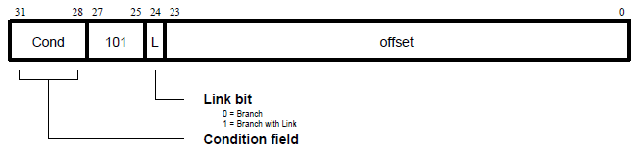
Branch Instruction
Ex 1: B LOOP
Ex 2: BL SUBROUTINE

Slide 4
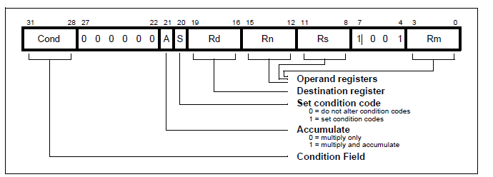
Multiplication Instructions
Ex 1: MUL R0, R1, R2
Ex 2: MLA R0, R1, R2 , R3

Slide 5
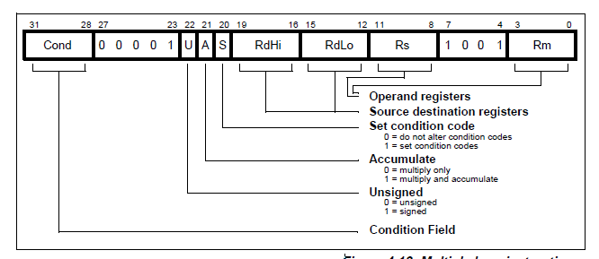
Multiplication Instructions
Ex 3: SMULL R0, R1, R2 , R3
Ex 4: UMLAL R0, R1, R2 , R3

Slide 6
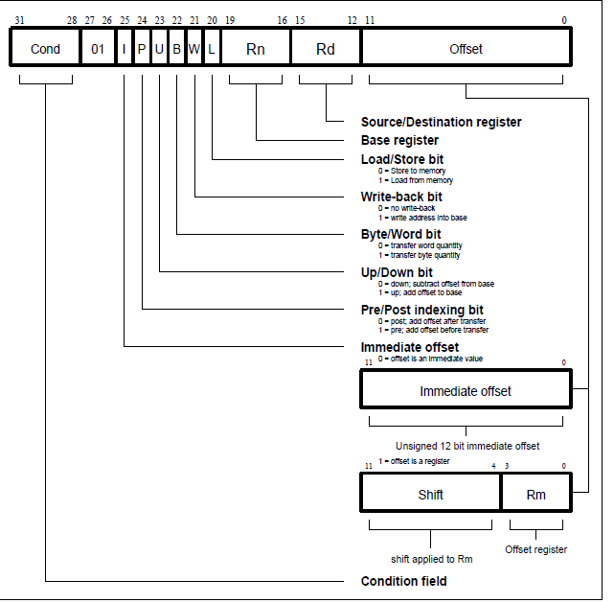
Data Transfer Instruction

Slide 7

Data Transfer Instruction:STR
Ex:
STR R0, [R1]
1110 01 0 1 1 0 0 0 0001 0000 0000 0000 0000
1110 01 I P U B W L 0001 0000 0000 0000 0000
Binary Code: E5810000

Slide 8
Data Transfer Instruction:LDR
Ex:
LDR R0, [R1], R2
1110 01 I P U B W L 0001 0000 0000 0000 0010
1110 01 1 0 1 0 0 1 0001 0000 0000 0000 0010
E6910002

Slide 9
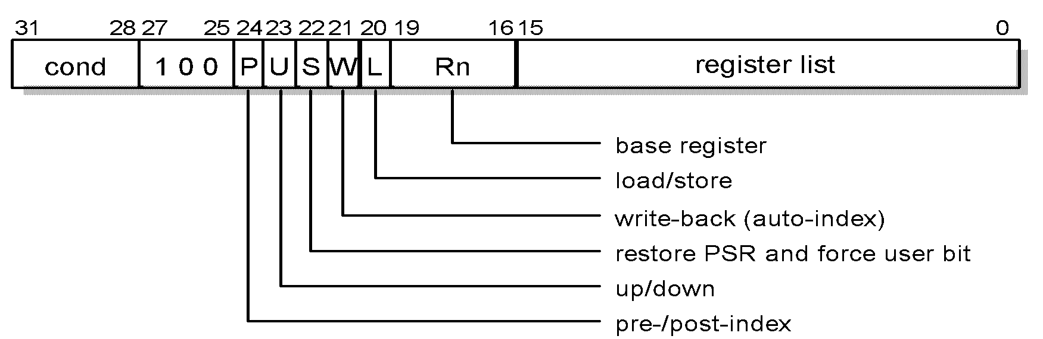
Block Transfer Instructions
Ex 1: LDMIA R13! , { R0, R5 - R8, R11}
Ex 2: STMIA R13! , { R8, R4- R6, R12}

Slide 10
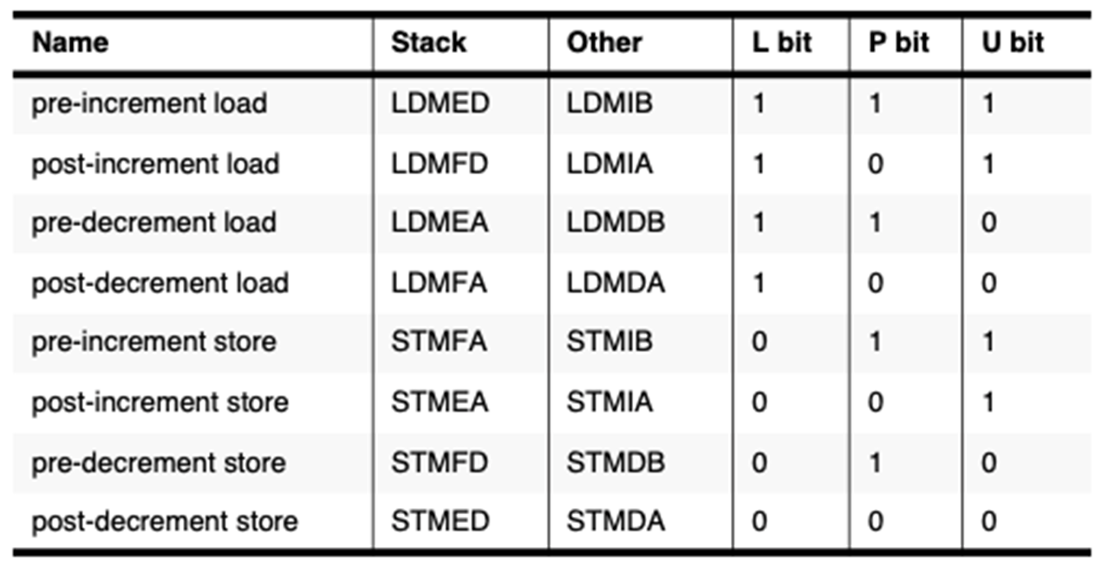
Block Transfer Instruction : Addressing Mode

Slide 11

Block Transfer Instruction : LDM
LDMIA R13! , { R0, R5 - R8, R11}
1110 100 P U S W L 1101 0000 R11 00R8R7R6R5 0000R0
1110 100 0 1 0 1 1 1101 0000 1 001 1 1 1 00001
E8BD09E1

Slide 12
Block Transfer Instruction : STM
STMIB R13! , { R8, R4- R6, R12}
1110 100 1 1 0 1 0 1101 00010 00101110000
1110 100 P U S W L 1101 000R120 00R8 0R6R5R4 0000
E9AD1170

Slide 13
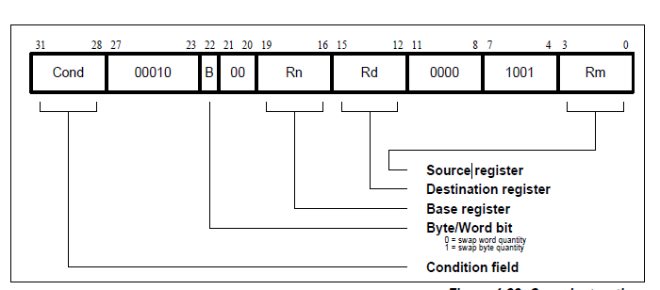
SWAP:

Slide 14

THANK YOU
V R BADRI PRASAD
badriprasad@pes.edu
Department of Computer Science and Engineering

