Slide 1

Microprocessor & Computer Architecture (μpCA)
UE22CS251B
Session - 1.1
Team – RR Campus
Prof. V R Badri Prasad (2) – Theory Anchor
Prof. Deepashree H L (2)
Prof. Chitra G M (2) – Lab Anchor
Prof. Jayashree S (1)
Prof. Chandravva Hebbi (2)
Dr. Shivakumar Dalali (2)
Dr. Ashok Kumar Patil (1)
Team – EC Campus
Dr. Prajwala T R (2) – Theory Co-Anchor
Dr. Shantala P T (3)
Prof. Deepti C (2) – Lab Co-Anchor
Dr. Charu kathuria (2)
Prof. Surabhi Choudhary(2)

Slide 2
Microprocessor & Computer Architecture (μpCA)
UE22CS252B
Introduction

Slide 3
What we Know? [studied in 3 sem ]
Digital Design!
In DDCO course, increase logic circuit speed, decrease logic resources required and decrease power consumed
Goal is to Optimize fundamental physical quantities of time, space and energy.
Computer Organization !
Hardware Abstraction above Digital Logic and below Operating System.
Hardware details which are required by programmers, such as Control signals, Interfaces and Memory

Slide 4
What we study - Syllabus
Unit 1: Architecture
Introduction, ISA Classification - RISC and CISC, Memory Addressing, Operands - Types and Size, Instruction Set - Operations, Control Flow, Instruction Encoding, Case Study - ARM/ MIPS/ x86 Processor. 14 Hours
Unit 2: Pipeline
3- Stage Pipelining, 5 - Stage Pipelining, Pipeline Datapath and Control, Data Hazards – Forwarding vs. Stalling, Control Hazards, Branch Prediction Mechanisms and Exceptions, Performance Metrics. 14 Hours
Unit 3 : Cache Optimization & I/O Architecture
Basics of Caches - Fully Associative, Direct Mapped and Set Associative, Cache Performance, Basic Cache Optimizations. Introduction to flash storage, Connecting Processors, Memory and I/O devices, Interfacing I/O Devices to the Processor, Memory and Operating System. 14 Hours
Unit 4: Advances in Architecture
Parallel Computing : Introductory concepts and terminology-Flynn’s taxonomy, parallel computing memory architectures, parallel programming models, parallel examples: matrix multiplication, Amdahl’s Law, Gustafson Law, Hardware Multi threading, Multi-Core Architecture , Introduction to GPU computing 14 Hours
Course Information

Slide 5
Evaluation Policy
ISA1 - 40 Marks - Reduced to 20 Marks : Syllabus - Unit 1, Unit 2
ISA2 - 40 Marks - Reduced to 20 Marks : Syllabus - Unit 3, Uni t4
Theory Assignments: 2 numbers x 5 marks each = 10 marks
ISA -> ISA1 + ISA2 + Theory Assignments = 20 + 20 + 10 = 50 marks
FSA -> Laboratory Marks - 10 marks : Lab Programs - 6 numbers : 08 marks
Lab Assignment - 6 numbers : 02 marks
Mini Project Marks - 10 Marks
Subtotal - 20 marks
ESA -> Conducted for 100 marks and reduced to 50 marks
Total Marks : ISA + FSA + ESA
50 + 20 + 50 = 120 Marks
Final Grade is awarded by reducing 120 Marks to 100 Marks.

Slide 6
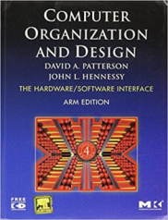
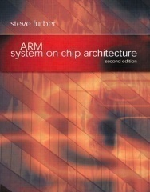
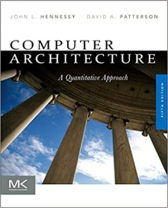
Text and Reference Book(s)
T1: “Computer Organization and Design”, Patterson, Hennessey, 5th Edition, Morgan Kaufmann, 2014.
T2: “Computer Organization and Design – ARM Edition”, Patterson, Hennessey, 4th Edition, Morgan Kaufmann, 2010.
T3: “ARM System-on-Chip Architecture”, Steve Furber, 2nd Edition, 2015, Pearson India.
R1:“Computer Architecture: A Quantitative Approach”, Hennessey, Patterson, 5th Edition, Morgan Kaufmann, 2011.
R2: “The Definitive Guide to the ARM Cortex-M0 and Cortex MO+ processors”, Joseph Yiu, 2nd Edition, Newnes, 2015.

Slide 7
Job Profiles….

Slide 8
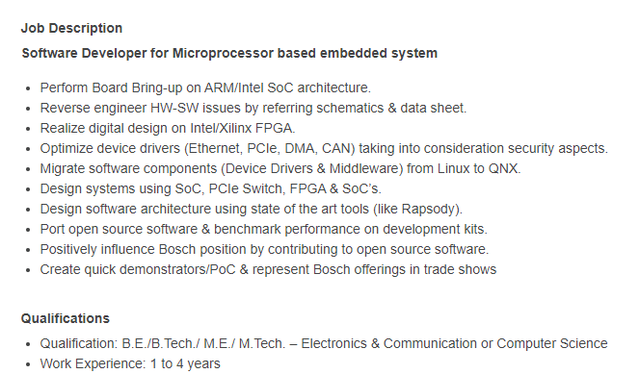

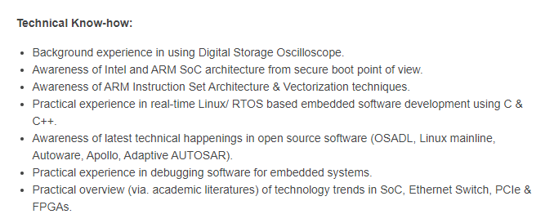
Job Description 1

Slide 9
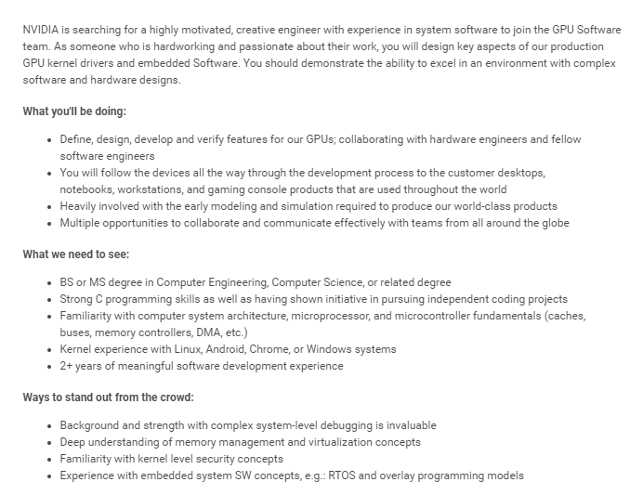

Job Description 2

Slide 10

Job Description 3
Role Description (Role & Responsibilities) 1. Mandatory skills 16bit 32bit Microcontroller Microprocessor
2. Embedded systems Firmware Device driver development experience Programming Strong in C
3. Communication protocols UART CAN SPI Ethernet Modbus TCP IP IDE usage
4. Code composer studio IAR workbench Code warrior RTOS VxWorks FreeRTOS Ti RTOS Bootloader
5. Multi threading concepts Preferred skills Strong in Cplusplus Assembly language experience
Capgemini
Firmware Developer
Mobiveil: CPU Processor Design
Job Summary: Bachelors or Masters degree in Computer Science or Electrical/Computer Engineering.
Understanding of general purpose CPU micro architecture, including knowledge of areas such as processor pipelines, caches, memory hierarchy, and multi-processor systems.
Knowledge and or Experience in RTL Design hardware development using Verilog, ideally block design in a CPU design project or similar high performance project.
Understanding of CPU instruction set architecture and assembly language.
Familiarity with ARM architecture and micro-architecture for current ARM CPU cores is helpful but not required.
Software development skills and/ or experience is helpful (C/C++, Python/Perl, Shell scripting) Experience modelling microprocessors using higher-level languages, like C/C++, is helpful but not required Effective communication skills and the ability to collaborate with a team

Slide 11

Job Description 4
Open-Silicon: Software Engineer
Job Description:
Solid programming experience in C or C++.
Adequate knowledge of Object oriented programming and design concepts.
Should have good knowledge of System software, Microprocessors/Microcontrollers, Memory subsystem, Hardware IPs .
Proven experience in embedded systems design with low level driver programming , bootloader, preemptive, multitasking real-time operating systems
Should have exposure to scripting language e.g. Perl/Shell/Python etc.
Experience in hands-on development and troubleshooting on embedded boards.
Familiarity with software configuration management tools, defect tracking tools, and peer review Good team player, should be able to handle task independently

Slide 12
Microprocessor & Computer Architecture (μpCA)
UE22CS252B
Introduction to
Microprocessors and Microcontrollers
RISC and CISC Architectures
Session - 1.11

Slide 13


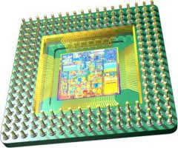
Is MICROPROCESSOR
Brain or Heart
of a computer System
???
Statutory Warning: does not resemble anyone over here

Slide 14
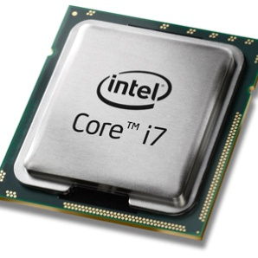
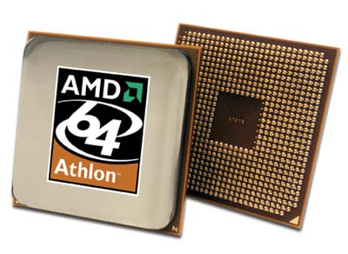
What we study?
What is a μicroProcessor?
Brain of the Computer
Basic Computing Unit on an Integrated Chip (IC)
Three basic characteristics differentiate microprocessors:
Instruction set , Bandwidth, Clock speed
What is Computer Architecture ?
The engineering decisions and tradeoffs that must be made in order to produce a “Good" Design”.
i.e Execution Time, Space and Resource

Slide 15

Why Study Microprocessor?
Everywhere we have devices which are controlled by
“Microprocessor” or “Microcontroller”
Because its part of the Curriculum!!! ☺

Slide 16

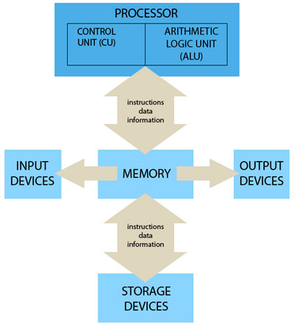
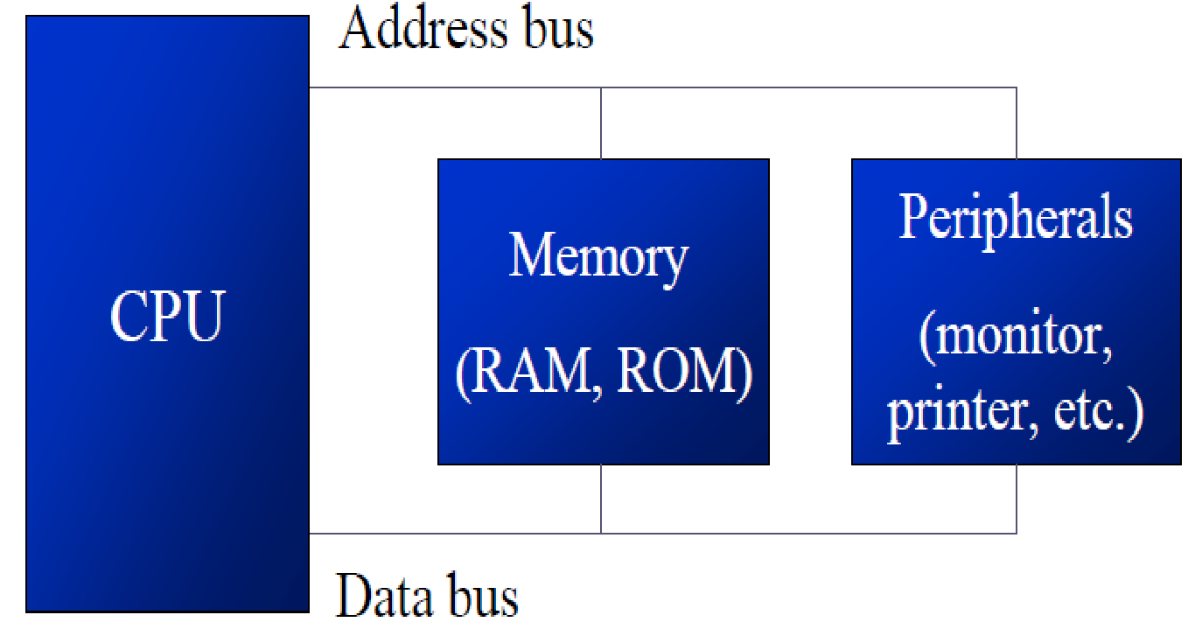
Microprocessor & Computer Architecture Computer Organization & Computer Architecture
Computer Organization refers to the Operational Units and there interconnections that realize or recognize the specifications of Computer Architecture.
Organizational attributes includes Hardware details transparent to the programmer such as control signals , Interface between computers and peripherals and the memory technology used.
Computer Architecture refers to those attributes of a system visible to a programmer, the other way those attributes that have direct impact on the logical execution of the program.
Architectural attributes include the instruction set, the no of bits used to represent the data types, Input Output mechanism and technique for addressing memories.

Slide 17
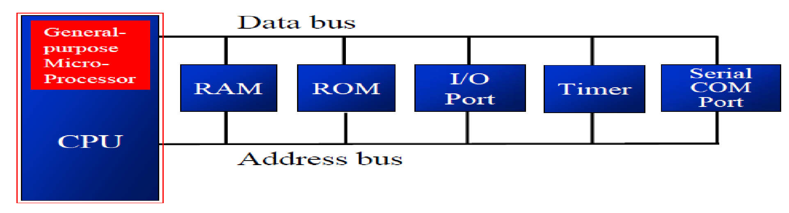
Microprocessor & Computer Architecture Microprocessor
Accepts digital data as input, processes it according to instructions stored in its memory, and provides results as output.
Don’t have RAM, ROM, and other peripheral on the chip.
Memory , I/O and other components need to be connected externally.
Cannot be used in compact systems.
Power Consumption is High.

Slide 18
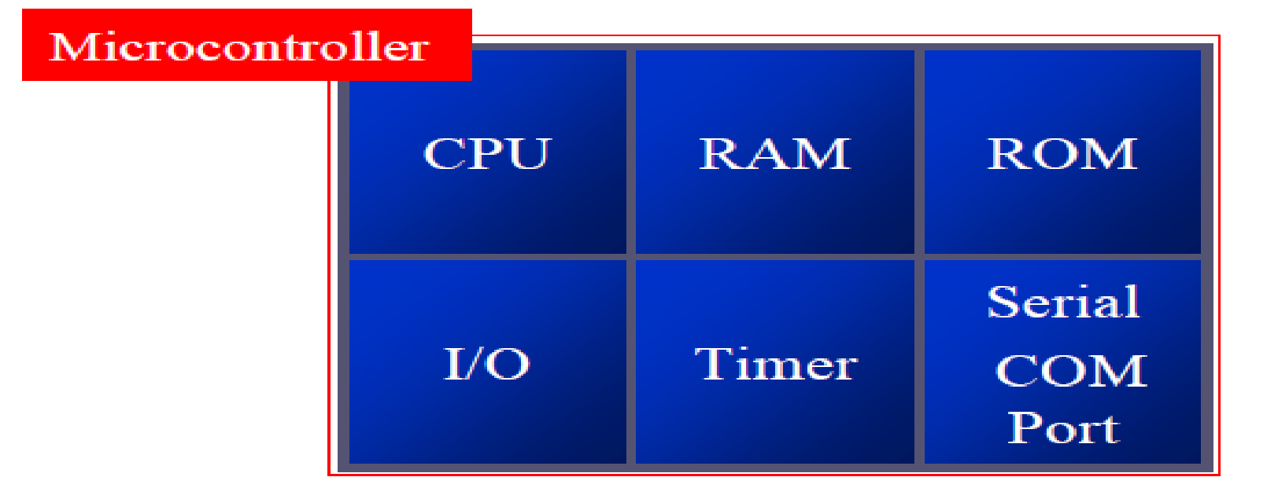
Microprocessor & Computer Architecture Microcontroller
Comprises of CPU, in addition with a fixed amount of RAM, ROM and other
peripherals all embedded on a single chip.
Also termed as a mini computer or a computer on a single chip.
Designed to perform specific tasks.
Requires small resources like RAM, ROM, I/O ports etc. and hence can be embedded
on a single chip.
Reduces the size and the cost.

Slide 19
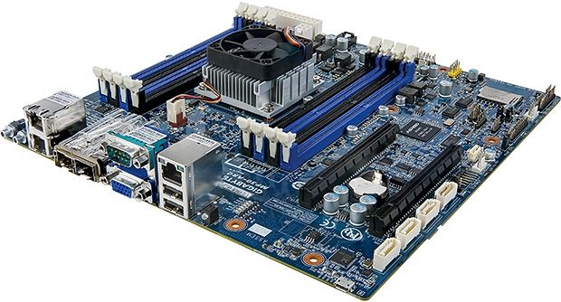
Microprocessor, Where am I?

Slide 20
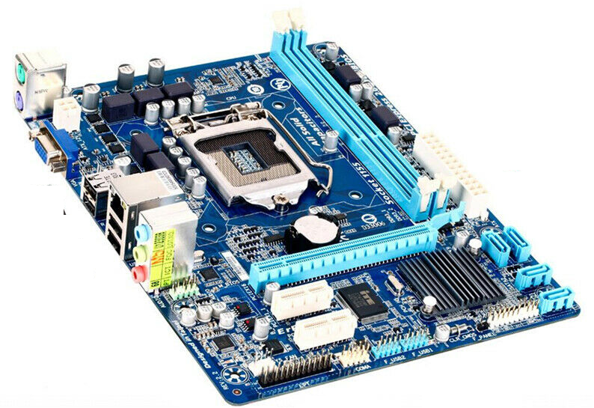
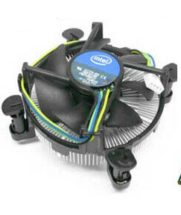
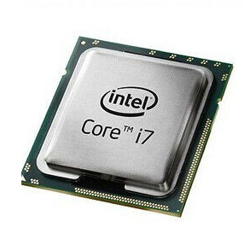
Microprocessor, Where am I?

Slide 21
Microprocessor - Evolution
4004 | Nov. 15,1971
8008 | April 1972
8080 | April 1974
8085 | March 1976
8086 | June 8, 1978
8088 | June 1979
80286 | Feb. 1982
i80386 | 1985 - 1990
I80486 | 1989 - 1992
Intel Pentium | 1993 - 1999
Intel Pentium MMX | 1996 - 1999
Intel Atom | 2008 - 2009 (as Centrino Atom), 2008–present (as Atom)
Intel Celeron | 1998–present
Intel Pentium Pro | 1995 - 1998
Intel Pentium II | 1997 - 1999
Intel Pentium III | 1999 - 2003
Intel Xeon | 1998–present
Pentium 4 | 2000 - 2008
Pentium 4 | 2000 - 2008
Pentium M | 2003 - 2008
Pentium D/EE | 2005 - 2008

Slide 22
Microprocessor - Evolution
Intel Pentium Dual-Core | 2006 - 2009
Intel Pentium (2009) | 2009–present
Intel Core | 2006 - 2008
Intel Core 2 | 2006 - 2011
Intel Core i3 | 2010–present
Intel Core i5 | 2009–present
Intel Core i7 | 2008–present
Intel Core i7 (Extreme Edition) | 2011–present
Intel Core i9 | 2018–present
Intel Core i9 (Extreme Edition) | Q3 2017–present

Slide 23
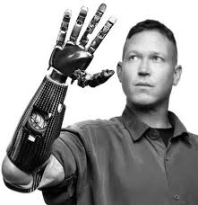
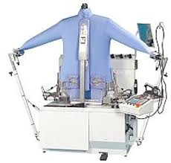
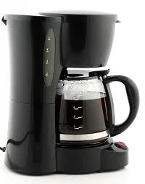
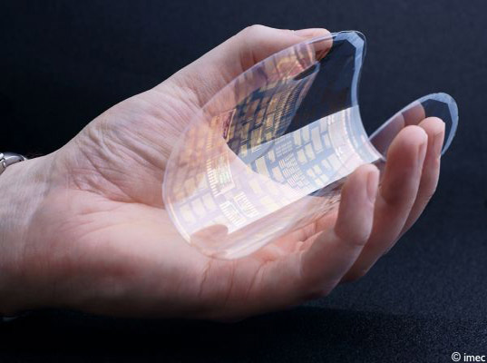
Why Study Microprocessor ?
Because its part of the Curriculum!!! ☺
Everywhere we have devices which are controlled by “Microprocessor” or “Microcontroller”

Slide 24
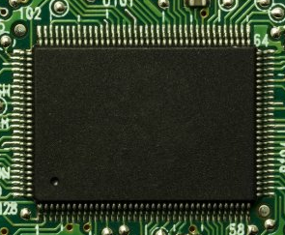
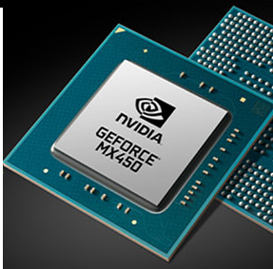
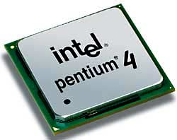
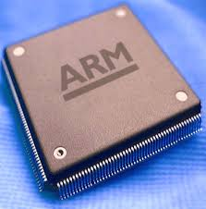
Classification of Microprocessors
CISC: Complex Instruction Set Computer
RISC: Reduced Instruction Set Computer
Microprocessor
Special Purpose
CISC
RISC

Slide 25
How to Classify Microprocessors?
Three basic characteristics differentiate microprocessors:
Instruction set: The set of instructions that the microprocessor can execute.
Bandwidth : The number of bits processed in a single instruction.
Clock Speed : How many instructions per second the processor can execute.
Given in megahertz (MHz),

Slide 26
Instruction Set Architecture (ISA)
The complete collection of instructions that are understood by a CPU
Example: Data Movement, Data Processing, Branch Instruction……etc
Designers decide the ISA for respective Microprocessor.
It is responsibility of Compiler to generate correct and Optimized code for respective Microprocessor.
Main criteria to classify CISC & RISC Processor

Slide 27

CISC – Complex Instruction Set Computer
Preamble
Earliest machines were programmed in assembly language and memory was slow and expensive.
The CISC philosophy made sense, and was commonly implemented in such large computers as the PDP-11 and the DEC system 10 and 20 machines.
Most common microprocessor designs such as the Intel 80x86 and Motorola 68K series followed the CISC philosophy.
But recent changes in software and hardware technology have forced a reexamination of CISC and many modern CISC processors are hybrids, implementing many RISC principles and vive versa.
CISC was developed to make compiler development simpler. It shifts most of the burden of generating machine instructions to the processor.

Slide 28
CISC: Complex Instruction Set Computer
CISC processors were evolved in the 1970s.
During this period, the computer memory used to be ‘small’ and ‘very expensive’.
Philosophy of CISC processors is to simplify the code and make it shorter in order to reduce the memory requirement.
In a CISC processor, a single instruction has ‘several low-level operations. This makes the CISC instructions short but ‘complex’.

Slide 29
CISC: Complex Instruction Set Computer
Architecture
CISC processors typically had variable length instruction sets with many formats.
Typically allowed values in memory to be used as operands in data processing instructions.
A 2-operand instruction format
Register sets were getting larger, but none was as large as RISC and most processors had different registers for different purposes.
CISC Organization
Microprogrammed control instruction decode logic.
It was easier to implement and less expensive.
CISC processors allowed little, if any, overlap between consecutive instructions.
The ease of microcoding new instructions allowed designers to make CISC machines upwardly compatible
May take many clock cycles to complete a single instruction.
Microprogram instruction sets can be written to match the constructs of high-level languages, the compiler does not have to be complicated.
Pentium is considered a modern CISC processor.

Slide 30
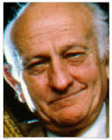

RISC – Reduced Instruction Set Computer
John Cocke - (May 30, 1925 – July 16, 2002), was an
American computer scientist recognized for his large contribution
on computer architecture and optimizing compiler design.
Originated the RISC concept in 1974.
Considered by many to be "the father of RISC architecture.”
Proved that about 20% of the instructions in a computer did 80% of the work.
The term RISC is credited to David Patterson, a teacher at
the University of California in Berkeley. The concept was used in
Sun Microsystems' SPARC microprocessors and led to the
founding of what is now MIPS Technologies, part of Silicon Graphics.
A number of current microchips now use the RISC concept.

Slide 31
RISC: Reduced Instruction Set Computer
Idea of RISC processors was originated in the 1974 and Implemented in 1980’s.
Philosophy of RISC processors is to simplify operation of Individual Instruction.
Separate Instruction for Load and Store (Data Movement)
Number of lines of code in the program increases but Amount of work done by individual instruction is REDUCED.

Slide 32
RISC – Reduced Instruction Set Computer
Architecture
A fixed (32-bit).
A load-store architecture where instructions that process data, operate only on registers and are separate from instructions that access memory.
A large register bank (thirty-two 32-bit registers).
Instruction size with few formats.
RISC Organization
Hard-wired instruction decode logic (design of the control unit).
Pipelined execution.
Single-cycle execution.
RISC Advantages
A smaller die size.
A shorter development time.
A higher performance.
RISC Drawbacks
Poor code density.
Do not execute x86 code.

Slide 33
RISC Vs CISC Machines Today
With the rise of embedded systems and mobile computing, the terms RISC and CISC have lost their significance
Both architectures almost seem to have adopted the strategies of the other.
Some RISC systems provide more extravagant instruction sets than some CISC systems.
CISC chips are now able to execute more than one instruction within a single clock, including Pipelining.
The RISC Vs CISC debate started when chip-area and processor design complexity were issues – now energy and power are the issues.
The two top competitors today are ARM and Intel – Intel focuses on performance and ARM focuses on efficiency (British company – Acron RISC Machine)

Slide 34
RISC – Reduced Instruction Set Computer
State of the art processor technology has changed significantly since RISC chips were first introduced in the early '80s.
A number of advancements are used by both RISC and CISC processors.
The lines between the two architectures have begun to blur.
In fact, the two architectures almost seem to have adopted the strategies of the other.
Since, the processor speeds have increased, CISC chips are now able to execute more than one instruction within a single clock.
This also allows CISC chips to make use of pipelining.
With other technological improvements, it is now possible to fit many more transistors on a single chip.

Slide 35
RISC vs CISC
RISC
Simple instructions, few in number.
Fixed length instructions.
Multiple register sets.
Three operands per instruction.
Parameter passing through register windows.
Single-cycle instructions.
Hardwired control.
Highly pipelined.
Complexity in compiler.
Only LOAD/STORE instructions access memory.
Few addressing modes.
CISC
Many complex instructions.
Variable length instructions.
Single register set.
One or two register operands per instruction.
Parameter passing through memory.
Multiple cycle instructions.
Microprogrammed control.
Less pipelined.
Many instructions can access memory.
Many addressing modes.

Slide 36
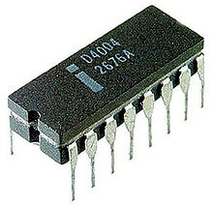
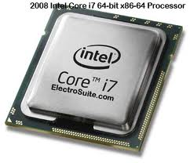
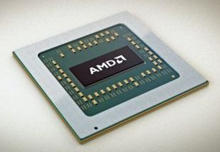
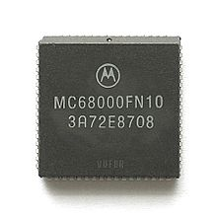
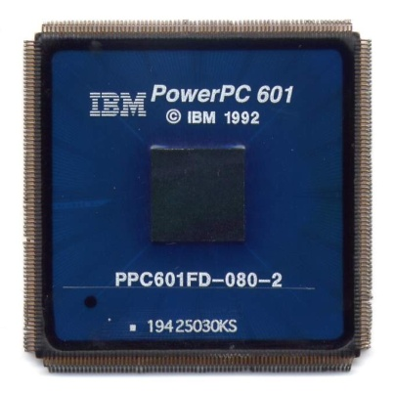
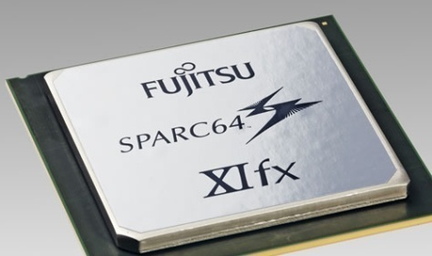
Our Choice-> ARM
Mostly on----------------🡪

Slide 37

THANK YOU
V R BADRI PRASAD
Department of Computer Science and Engineering

