Slide 1

Microprocessor & Computer Architecture (μpCA)
UE22CS252B
Session - 3

Slide 2
Microprocessor & Computer Architecture (μpCA)
UE22CS252B
ARM program structure
and
Introduction to Arm Simulator

Slide 3
ARM Program Structure
Address
Instruction & Data
.text
Address of Instruction 1 ARM Instruction_1
Address of Instruction 2 ARM Instruction_2
…………………………. ………………………….
…………………………. ………………………….
Address of Instruction n ARM Instruction_n
.data
Address of Data1 Declaration of variable 1
Address of Data2 Declaration of variable 2
………………………………………………………………………………………
……………………………………………………………………………………..
Address of Data n Declaration of variable n
Note: Blue color depict the code written by the programmer
Orange color depict the address assigned during execution

Slide 4
General Format of Instruction
MNEMONIC{condition}{S} {Rd},Operand1,Operand2
MNEMONIC - Short name of the instruction. Eg: ADD,SUB….
{condition} - Condition that is needed to be met in order for the instruction to be executed EG: EQ, MI,GT,LT,LE,AL,NE
{S} - An optional suffix. If S is specified, the condition flags are updated on the result of the operation . Eg: To set N,O, C, V of CPSR
{Rd} - Register (destination) for storing the result of the instruction
Operand1 - First operand. Either a register or an immediate value
Operand2 - Second (flexible) operand. Can be an immediate value (number) or a register with an optional shift

Slide 5
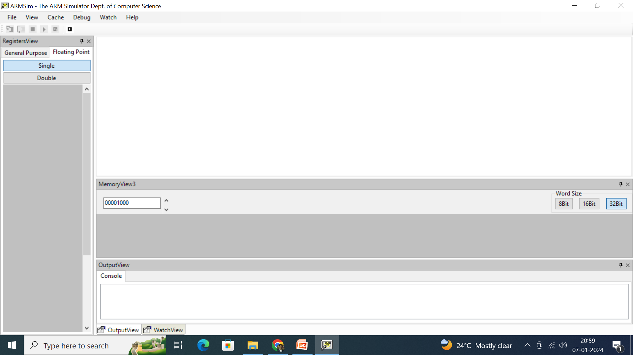
ARMSIMULTOR
NOTE: Recommended to use and demo on ARM simulator directly.

Slide 6
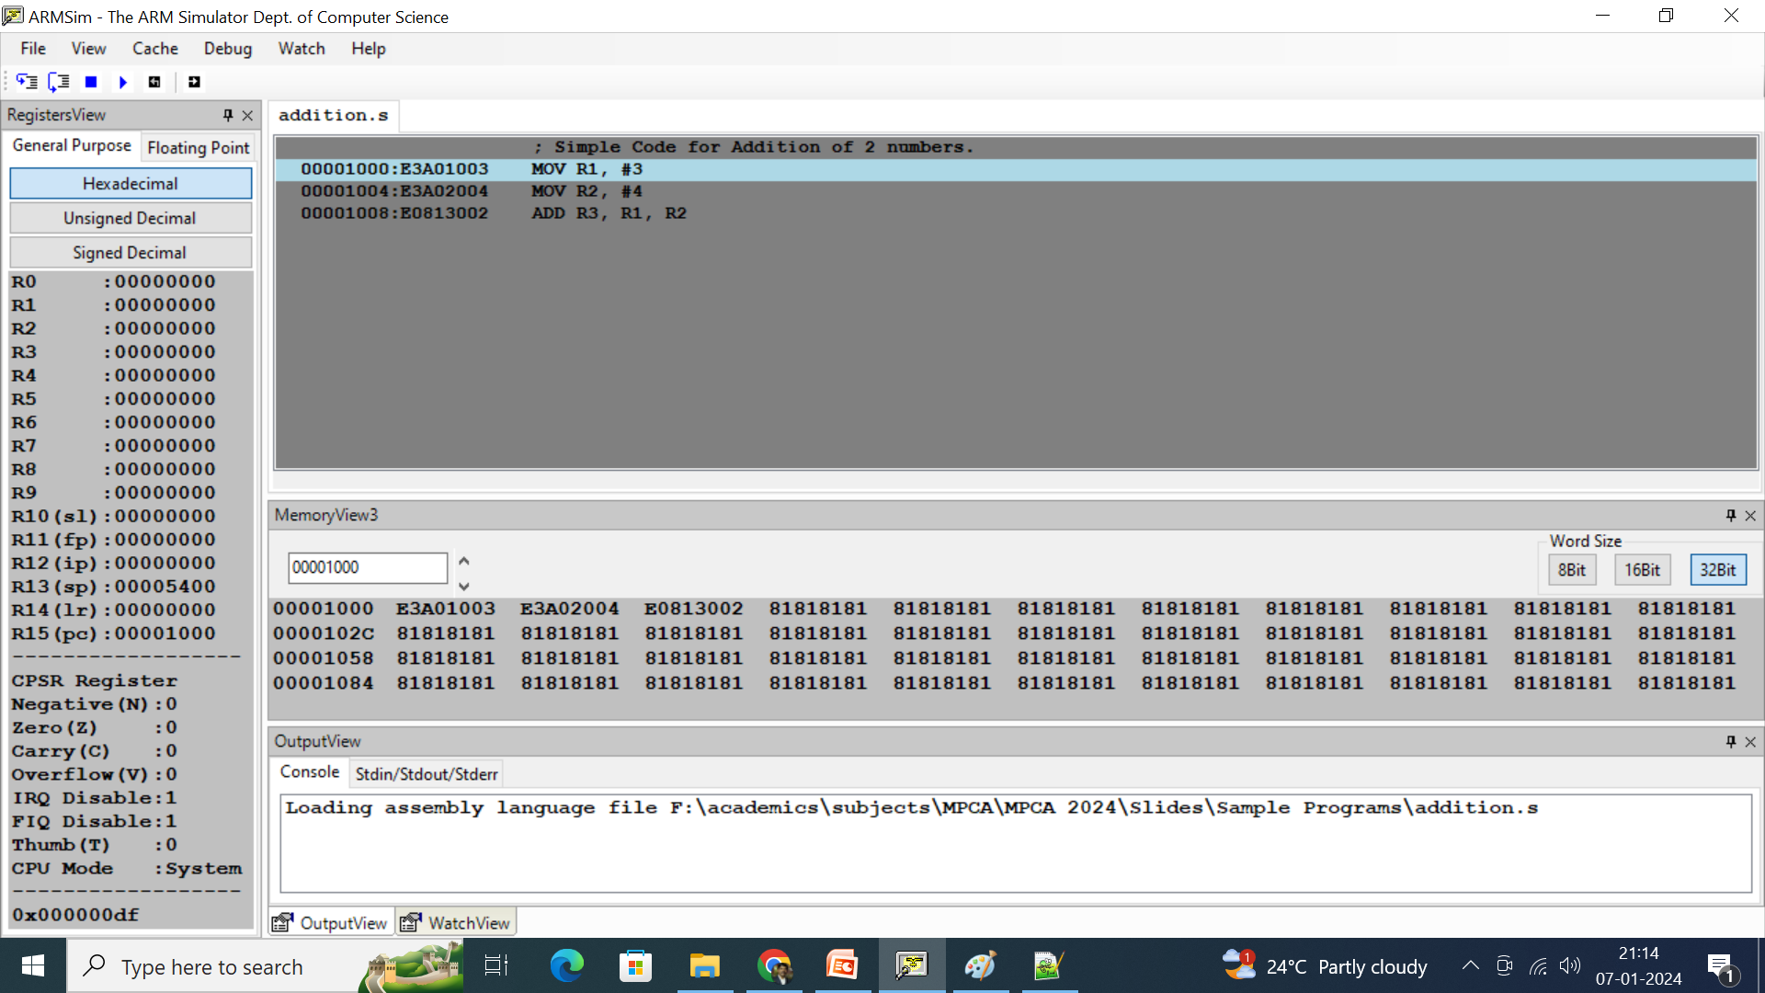
Loading Sample Program on ARMSIMULATOR

Slide 7
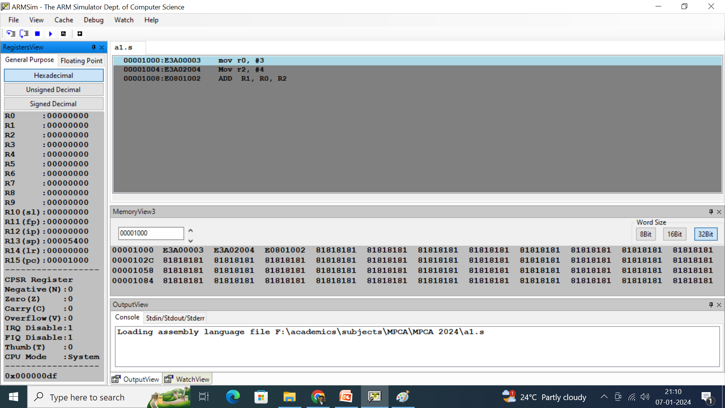
Register View (ARMSIM Simulator)

Slide 8
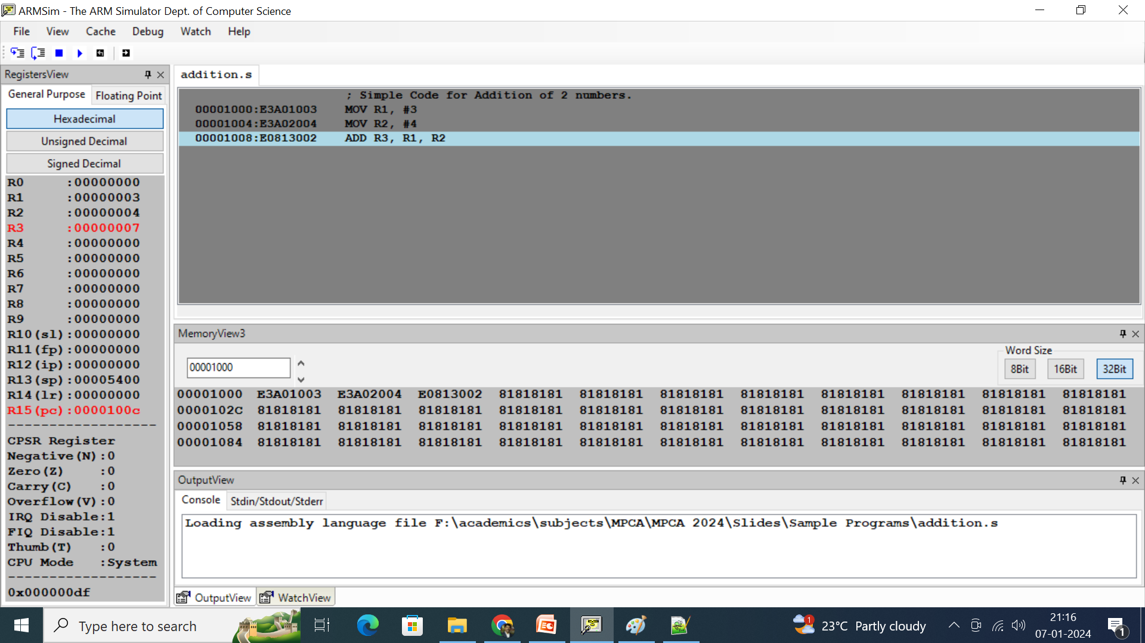
General Format of Instruction Example

Slide 9
Samples of following types of Numerical Data on Simulator
Demonstration of te following data is shown in the simulator.
Decimal Numbers
Hexadecimal Numbers
Octal Numbers
Usage of Bytes, Decimal and Hexadecimal data in the code and in the Simulator
Read and observe the contents of the following in the simulator.
Memory
Stack
Registers
Flag Register
Console

Slide 10
ARM Instruction Set
ARM instruction set
Data processing
instructions
Data transfer
instructions
Block transfer
instructions
Branching instructions
Multiply instructions
Software interrupt
instructions

Slide 11

THANK YOU
V R BADRI PRASAD
badriprasad@pes.edu
Department of Computer Science and Engineering

