Slide 1

Microprocessor & Computer Architecture (μpCA)
UE22CS252B
Session - 7

Slide 2
Microprocessor & Computer Architecture (μpCA)
UE22CS252B
Multiple Load / Store Instructions or Block Transfer

Slide 3

Multiple register LOAD / STORE
Transfer a block of data more efficiently.
Used for procedure entry and exit for saving and restoring workspace registers and the return address
For ARM7, 2+Nt cycles
(N: #words, t: time for a word for sequential access).
Increase interrupt latency since it can’t be
interrupted.
Registers are considered in increasing order always.
LDMIA R1, {R0, R2, R5} @ R0 = mem[R1]
@ R2 = mem[R1+4]
@ R5 = mem[R1+8]

Slide 4
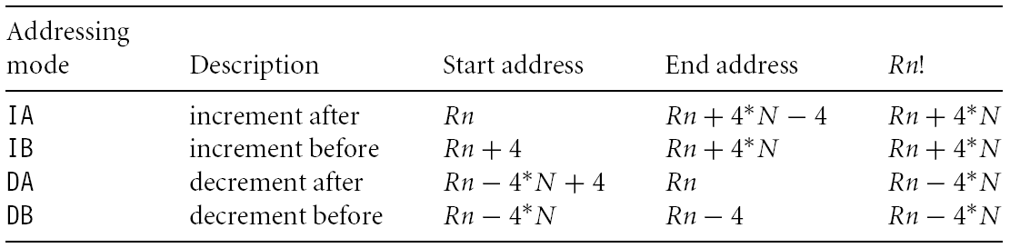
Multiple register LOAD / STORE

Slide 5
Multiple register LOAD / STORE
LDM<mode> Rn, {<registers>}
IA: addr:=Rn
IB: addr:=Rn+4
DA: addr:=Rn-#<registers>*4+4
DB: addr:=Rn-#<registers>*4
For each Ri in <registers>
IB: addr:=addr+4
DB: addr:=addr-4
Ri:=M[addr]
IA: addr:=addr+4
DA: addr:=addr-4
<!>: Rn:=addr
Rn
R1
R2
R3

Slide 6
Multiple register LOAD / STORE
LDMIA R0, {R1,R2,R3}
or
LDMIA R0, {R1-R3}
R1: 10
R2: 20
R3: 30
R0: 0x10
addr | data
0x010 | 10
0x014 | 20
0x018 | 30
0x01C | 40
0x020 | 50
0x024 | 60
R0

Slide 7
Multiple register LOAD Example-01
Program to transfer data from memory locations to
registers using single Load Multiple Instruction using IA condition
.DATA
A: .WORD 100,200,300,400,500,600,700,800
B: .WORD 0,0,0,0,0,0,0,0
.TEXT
LDR R0,=A
LDR R7,=B
LDMIA R0!,{R1,R8,R9,R11}
.END

Slide 8
Multiple register STORE Example-01 CONTD..
Program to transfer data from memory locations to
registers using single STORE Multiple Instruction using IA condition
.DATA
A: .WORD 100,200,300,400,500,600,700,800
B: .WORD 0,0,0,0,0,0,0,0
.TEXT
LDR R0,=A
LDR R7,=B
LDMIA R0!,{R1,R8,R9,R11}
STMIA R7!,{R8,R9,R11,R1}
.END

Slide 9
Multiple register LOAD/STORE
LDM<mode> Rn, {<registers>}
IA: addr:=Rn
IB: addr:=Rn+4
DA: addr:=Rn-#<registers>*4+4
DB: addr:=Rn-#<registers>*4
For each Ri in <registers>
IB: addr:=addr+4
DB: addr:=addr-4
Ri:=M[addr]
IA: addr:=addr+4
DA: addr:=addr-4
<!>: Rn:=addr
Rn
R1
R2
R3

Slide 10
Multiple register LOAD/STORE
LDMIB R0!, {R1,R2,R3}
R1: 20
R2: 30
R3: 40
R0: 0x01C
addr | data
0x010 | 10
0x014 | 20
0x018 | 30
0x01C | 40
0x020 | 50
0x024 | 60
R0

Slide 11
Multiple register LOAD/STORE Example-02
Program to transfer data from memory locations to registers using
single STORE Multiple Instruction using IB condition
.DATA
A: .WORD 100,200,300,400,500,600,700,800,900,1000
B: .WORD 0,0,0,0,0,0,0,0,0,0
.TEXT
LDR R0,=A
LDR R11,=B
LDMIB R0!,{R1-R10}
STMIB R11!,{R1-R10}
.END

Slide 12
Multiple register LOAD/STORE
LDM<mode> Rn, {<registers>}
IA: addr:=Rn
IB: addr:=Rn+4
DA: addr:=Rn-#<registers>*4+4
DB: addr:=Rn-#<registers>*4
For each Ri in <registers>
IB: addr:=addr+4
DB: addr:=addr-4
Ri:=M[addr]
IA: addr:=addr+4
DA: addr:=addr-4
<!>: Rn:=addr
R1
R2
R3
Rn

Slide 13
Multiple load/store REGISTER
LDMDA R0!, {R1,R2,R3}
R1: 40
R2: 50
R3: 60
R0: 0x018
addr | data
0x010 | 10
0x014 | 20
0x018 | 30
0x01C | 40
0x020 | 50
0x024 | 60
R0

Slide 14
Multiple register LOAD/STORE Example-02
Program to transfer data from memory locations to registers using
single STORE Multiple Instruction using DA condition
. .DATA
A: .WORD 100,200,300,400,500,600,700,800,900,1000
B: .WORD 0,0,0,0,0,0,0,0,0,0
.TEXT
LDR R0,=A
ADD R0,R0,#36 ; ADD 36 TO POINT TO THE LOCATION STARTING AT A
LDR R11,=B
LDMDA R0!,{R1-R10}
STMDA R11!,{R1-R10}
.END

Slide 15
Multiple Load/Store REGISTER
LDM<mode> Rn, {<registers>}
IA: addr:=Rn
IB: addr:=Rn+4
DA: addr:=Rn-#<registers>*4+4
DB: addr:=Rn-#<registers>*4
For each Ri in <registers>
IB: addr:=addr+4
DB: addr:=addr-4
Ri:=M[addr]
IA: addr:=addr+4
DA: addr:=addr-4
<!>: Rn:=addr
R1
R2
R3
Rn

Slide 16
Multiple load/Store REGISTER
LDMDB R0!, {R1,R2,R3}
R1: 30
R2: 40
R3: 50
R0: 0x018
addr | data
0x010 | 10
0x014 | 20
0x018 | 30
0x01C | 40
0x020 | 50
0x024 | 60
R0

Slide 17
Multiple register LOAD/STORE Example-03
Program to transfer data from memory locations to registers using
single STORE Multiple Instruction using DB condition
.DATA
A: .WORD 100,200,300,400,500,600,700,800,900,1000
B: .WORD 0,0,0,0,0,0,0,0,0,0
.TEXT
LDR R0,=A
ADD R0,R0,#40
LDR R11,=B
ADD R11,R11,#-4
LDMDB R0!,{R1-R10}
STMDB R11!,{R1-R10}
.END

Slide 18

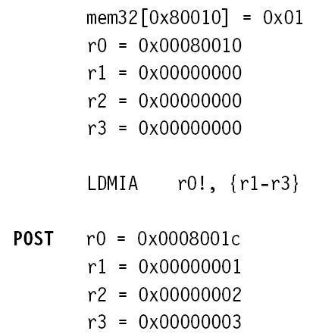
Multiple register LOAD/STORE Example-04

Slide 19
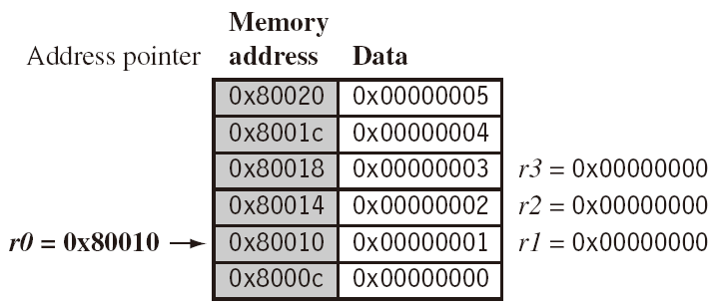
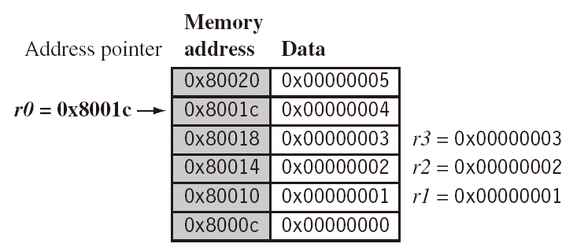
Multiple register LOAD/STORE Example-04
LDMIA r0!, {r1-r3}

Slide 20
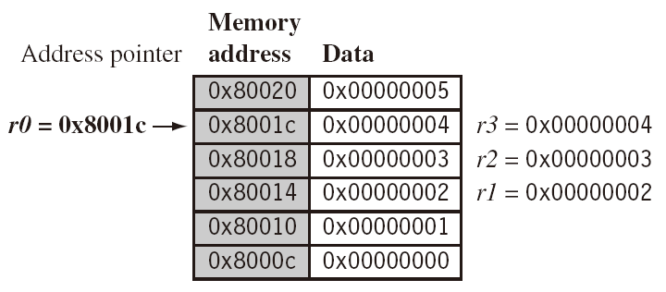
Multiple register LOAD/STORE Example-05
LDMIB r0!, {r1-r3}

Slide 21
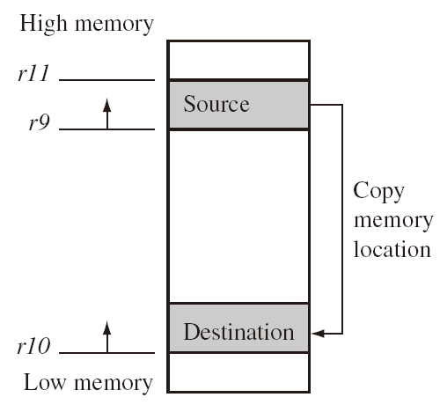
Multiple register LOAD / STORE- Application
Write a program using ARM7TDMI - ISA to copy a block 512 bytes of data from location A to location B if the rate of data transfer rate is 32 bytes.
R9: address of the source A
R10: address of the destination B
R11: count : 16
loop: LDMIA R9!, {R0-R7}
STMIA R10!, {R0-R7}
CMP R11,#16
BNE loop

Slide 22
Microprocessor & Computer Architecture (μpCA)
UE22CS252B
Block Transfer Instructions:
Stack Operations

Slide 23
Block Transfer Instructions(STACK)
The Memory access can be in LIFO order.
i.e Can be treated like STACK.
R13 is a stack pointer which will keep the address of TOP of the STACK.
Mainly used in Procedural Call.
Stack can grow upward or downward direction based on the MODE used by the user in the program.
Addr | data
0x1010
0x1014
0x1018 | 10
0x101C | 20
0x1010 | 30
0x1020 | 40
0x1024 | 50
0x1028 | 60
0x102C
0x1030
0x1034

Slide 24
Block Transfer Instructions(STACK)
10 | 20 | 10 | 140 | 15 | 60 | 27
Addr | data
0x1010
0x1014
0x1018
0x101C
0x1010
0x1020
0x1024
0x1028
0x102C
0x1030
0x1034
R13=0x1018
SP

Slide 25
Block Transfer Instructions(STACK)
10 | 20 | 75 | 140 | 15 | 60 | 27
Addr | data
0x1010
0x1014
0x1018 | 10
0x101C
0x1010
0x1020
0x1024
0x1028
0x102C
0x1030
0x1034
R13=0x101C
SP

Slide 26
Block Transfer Instructions(STACK)
10 | 20 | 75 | 140 | 15 | 60 | 27
Addr | data
0x1010
0x1014
0x1018 | 10
0x101C | 20
0x1010
0x1020
0x1024
0x1028
0x102C
0x1030
0x1034
R13=0x1010
SP

Slide 27
Block Transfer Instructions(STACK)
10 | 20 | 75 | 140 | 15 | 60 | 27
Addr | data
0x1010
0x1014
0x1018 | 10
0x101C | 20
0x1010 | 75
0x1020
0x1024
0x1028
0x102C
0x1030
0x1034
R13=0x1020
SP

Slide 28
Block Transfer Instructions(STACK)
10 | 20 | 75 | 140 | 15 | 60 | 27
Addr | data
0x1010
0x1014
0x1018 | 10
0x101C | 20
0x1010 | 75
0x1020 | 140
0x1024
0x1028
0x102C
0x1030
0x1034
R13=0x1024
SP

Slide 29
Block Transfer Instructions(STACK)
Syntax:
<LDM/STM> <Addressing Mode> R13 {!}, Registers
Addressing Mode | =LDM | =STM
Full ascending (FA) | LDMDA | STMIB
Full descending (FD) | LDMIA | STMDB
Empty ascending (EA) | LDMDB | STMIA
Empty descending (ED) | LDMIB | STMDA
STM is used to PUSH on to the STACK
LDM is used to POP from the STACK

Slide 30
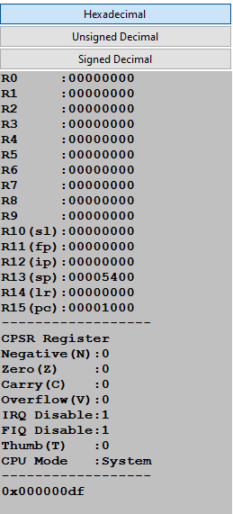
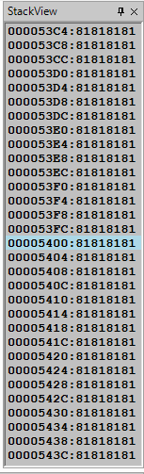
Block Transfer Instructions(STACK)
.text
MOV R0,#4
MOV R1,#5
STMEA R13!, {R0,R1}
.end
Initially Stack is Empty

Slide 31
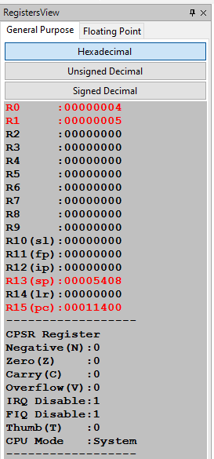
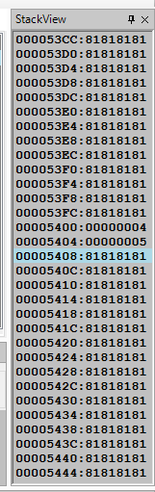
Block Transfer Instructions(STACK)
.text
MOV R0,#4
MOV R1,#5
STMEA R13!, {R0,R1}
.end
PUSH

Slide 32
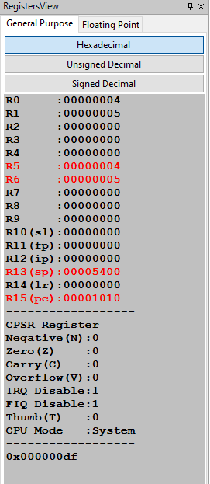
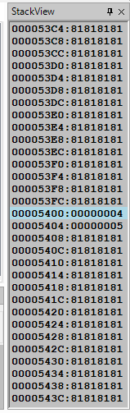
Block Transfer Instructions(STACK)
.text
MOV R0,#4
MOV R1,#5
STMEA R13!, {R0,R1}
LDMEA R13!,{R5,R6}
.end
POP
Again the Stack is Empty

Slide 34

THANK YOU
Team MPCA
Department of Computer Science and Engineering

