Slide 1

Microprocessor & Computer Architecture (μpCA)
UE22CS252B
Session - 2.3

Slide 2
Microprocessor & Computer Architecture (μpCA)
UE22CS252B
Pipeline Processor- Hazards

Slide 3

Facts About Pipeline Processor
Pipelining improves the CPU instruction throughput. (Pipeline Throughput) Ideally, CPI = 1.
Pipelining does not reduce the execution time of an instruction. (Pipeline Latency)
Infact, it slightly increases the execution time due to the increased control overhead of the pipeline stage register delays.
All instructions that share a pipeline must have the same stages in the same order.
Add does nothing during Mem stage
sw does nothing during WB stage
b{cond} does nothing in EX, MEM & WB stage

Slide 4
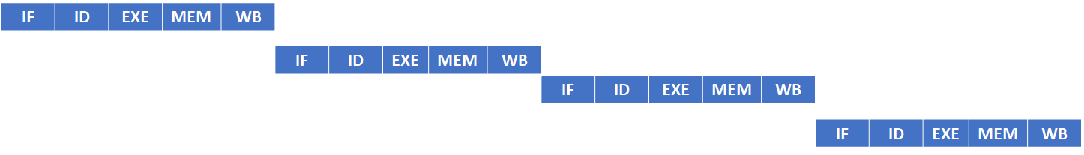
Non-Pipeline Execution
sub R2, R1, R3
and R4, R4, R5
orr R8, R5, R6
add R9, R3, R5
sub R2, R1, R3
and R4, R4, R5
orr R8, R5, R6
add R9, R3, R5
If Each stage takes 10ns, the latency will be 50 ns and the throughput is 200 ns

Slide 5
Pipelining is Good
sub R2, R1, R3
and R4, R4, R5
orr R8, R5, R6
add R9, R3, R5
IF | ID | EXE | MEM | WB
50ns
IF | ID | EXE | MEM | WB
60ns
IF | ID | EXE | MEM | WB
70ns
IF | ID | EXE | MEM | WB
80ns
If Each stage take 10ns, the latency will be 50 ns
If Each stage take 10ns, the throughput is 80 ns instead of 200 ns

Slide 6
Pipelining, But What May Go Wrong?
Is Good, When every instruction is independent of the other and can execute in the pipeline without any constraint
But in application programs, most of the statements are
dependent on each other
C = A + B;
E = C * D;
This causes constraint on the pipeline to execute these
dependent instructions in given 5 cycles.
Increases Latency

Slide 7
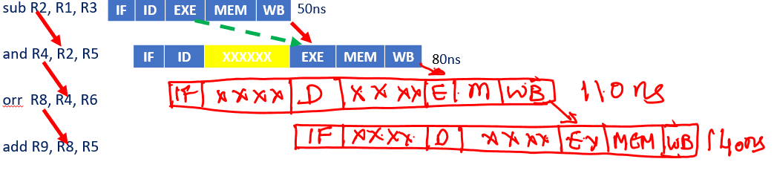
Pipelining, But What May Go Wrong?
If Each stage take 10ns, the latency will be 50 ns
If Each stage take 10ns, the throughput is 80 ns instead of 200 ns
With gap between stages, the throughput is 140 ns instead of 80ns

Slide 8
Pipelining, What May Go Wrong?🡪 Hazards
Situations that prevent the next instruction in the instruction stream from executing during its designated cycle
Condition that prevents an instruction in the pipe from executing its next scheduled pipe stage
Where one instruction cannot immediately follow another
Hazards reduce the performance from the ideal speedup gained by pipelining

Slide 9
Hazards: Limits to Pipelining
Structural Hazard:
Due to structure of the pipeline
Hardware cannot support combination of instructions in the pipeline needing the same resources
Data Hazard:
Due to data dependencies between instructions
Instruction depends on the result of prior instruction still in the pipeline
Control Hazard:
Due to control instructions
Pipelining of branches & other instructions that change the PC

Slide 10
Stalls
Common solution for any type of hazard is to stall the pipeline until the hazard is resolved (Stall Cycles)
This is achieved by inserting one or more “bubbles” in the pipeline
To do this, hardware or software must detect that a hazard has occurred (Hazard Detection)

Slide 11
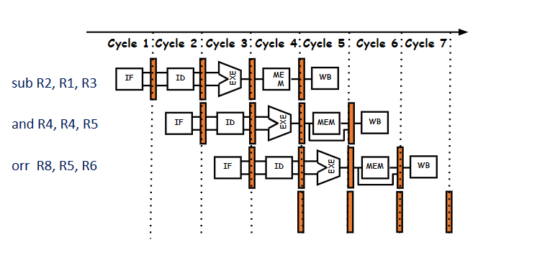
Stalls

Slide 12
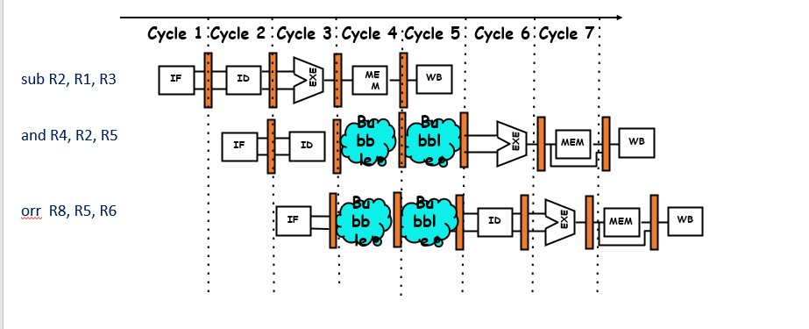
Stalls

Slide 13
Stalls
Instruction Number | Clock number
 | 1 | 2 | 3 | 4 | 5 | 6 | 7 | 8 | 9 | 10
sub R2, R1, R3 | IF | ID | EX | MEM | WB
and R4, R2, R5 |  | IF | ID | stall | stall | EX | MEM | WB
orr R8, R5, R6 |  |  | IF | stall | stall | ID | EX | MEM | WB

Slide 14
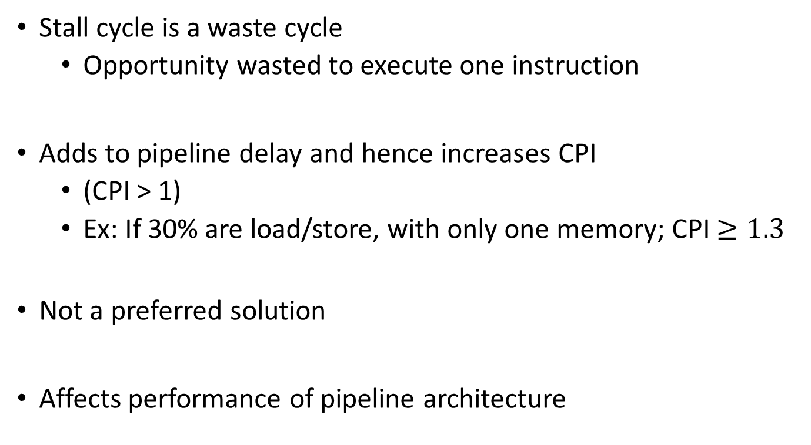
Disadvantage

Slide 15
Performance of Pipelines with Stalls
A stall causes the pipeline performance to degrade the ideal performance.
Average instruction time unpipelined
Speedup from pipelining = ------------------------------------------------
Average instruction time pipelined
CPI _{unpipelined} * Clock Cycle Time _{unpipelined}
= --------------------------------------------------------
CPI _{pipelined} * Clock Cycle Time _{pipelined}
CPI _{unpipelined}
= ----------------------------------------------------
1+ Pipeline stall cycles per instruction
Note 1: Ignoring the cycle time overhead of pipelining and assume the stages are all perfectly balanced, then the cycle time of the two machines are equal
Note 2: Ideal CPI of pipeline processor is almost always =1
CPI_{pipelined} = Ideal CPI + Pipeline stall clock cycles per instruction
= 1 + Pipeline stall clock cycles per instruction

Slide 16
Performance of Pipelines with Stalls
If all instructions take the same number of cycles, which must also equal the number of pipeline stages ( the depth of the pipeline) then unpipelined CPI is equal to the depth of the pipeline
Pipeline depth
Speedup = -----------------------------------------------------
1 + Pipeline stall cycles per instruction
If there are no pipeline stalls, this leads to the intuitive result that pipelining can improve performance by the depth of pipeline.

Slide 17
Structural Hazard
If a resource conflict arises due to a hardware resource being required by more than one instruction in a single cycle, and one or more such instructions cannot be accommodated, then a structural hazard occurs, for example:
when a pipelined machine has a shared single-memory for data and instructions.
Unified Memory
when a machine has only one register file write port
Skip MEM stage for add/sub..
when a machine has overlapping of read and write
Overlap ID & WB

Slide 18
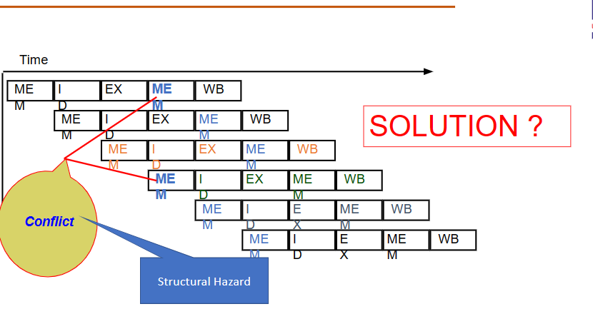
IF = MEM = Unified Mem operation

Slide 19
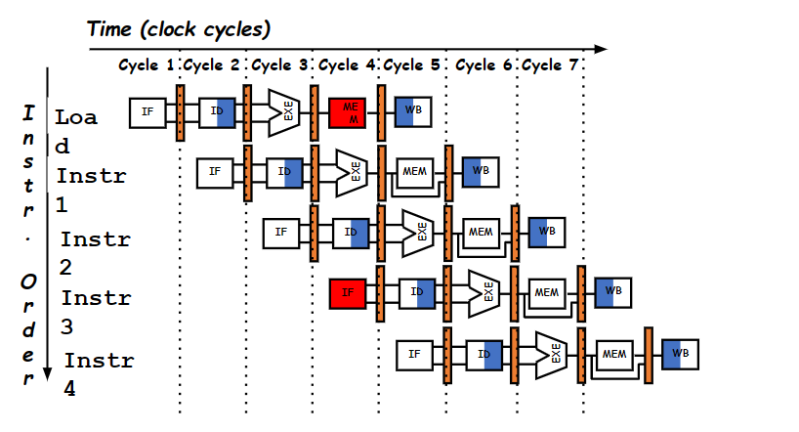
Structural Hazard: IF VS MEM:

Slide 20
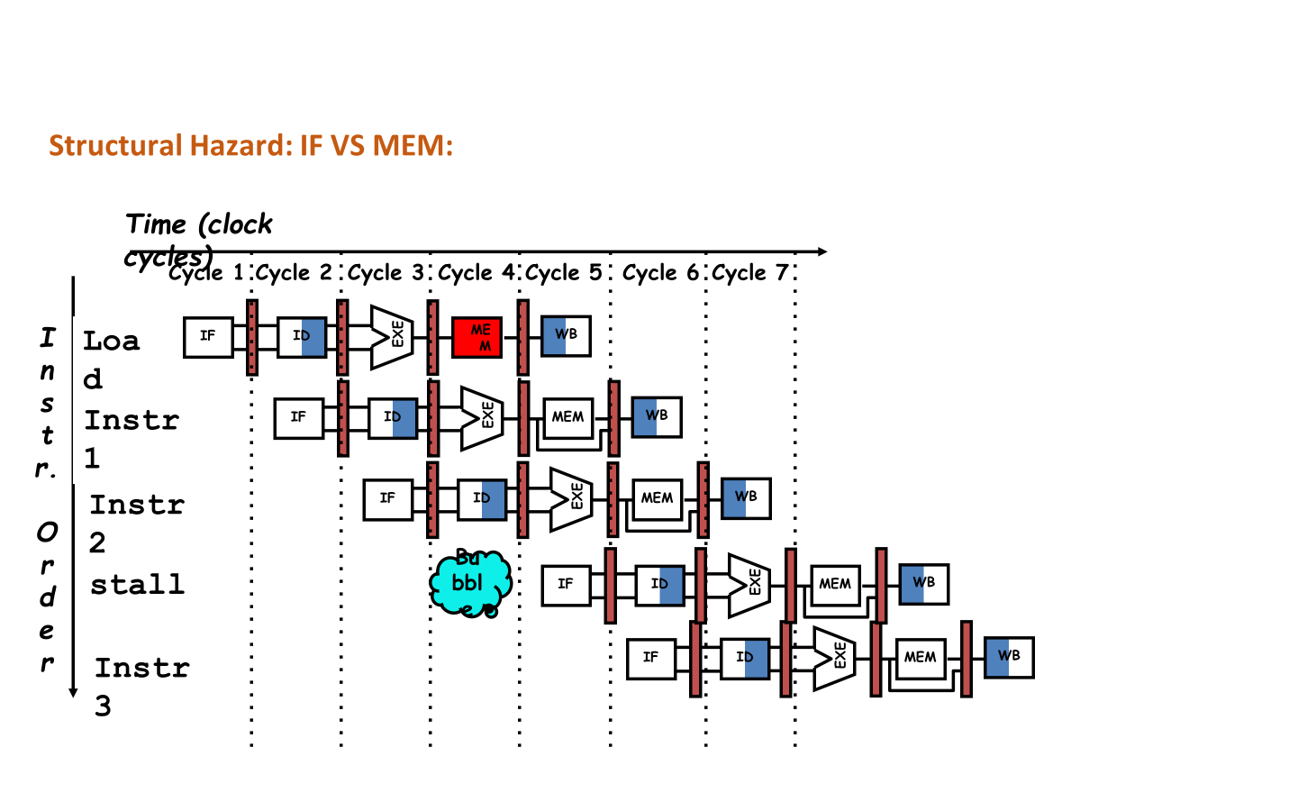
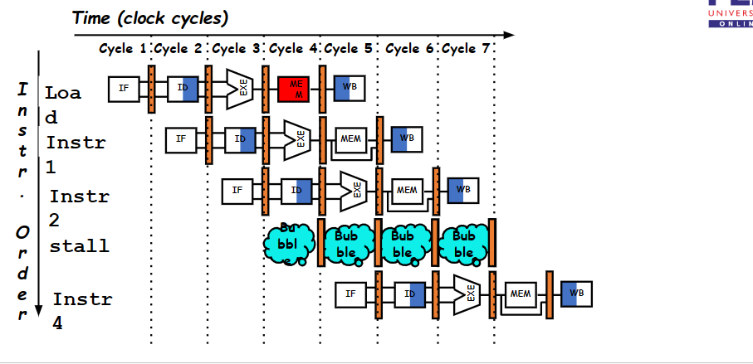
Structural Hazard: IF VS MEM:

Slide 21
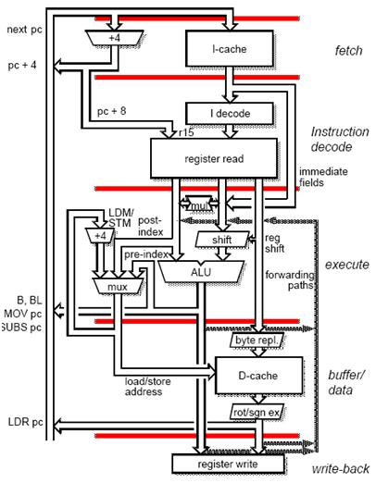
Structural Hazard: IF VS MEM: Solution
Replication of resources
Split Memory (Instruction Memory & Data Memory)
Harvard Memory Architecture
Instruction Memory
Data Memory

Slide 22
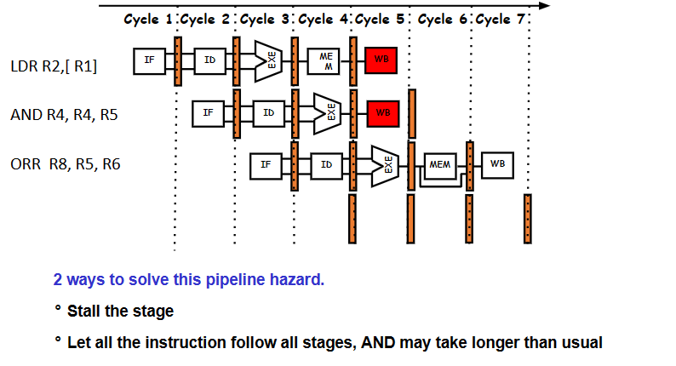
Structural Hazard: WB Vs WB:

Slide 23
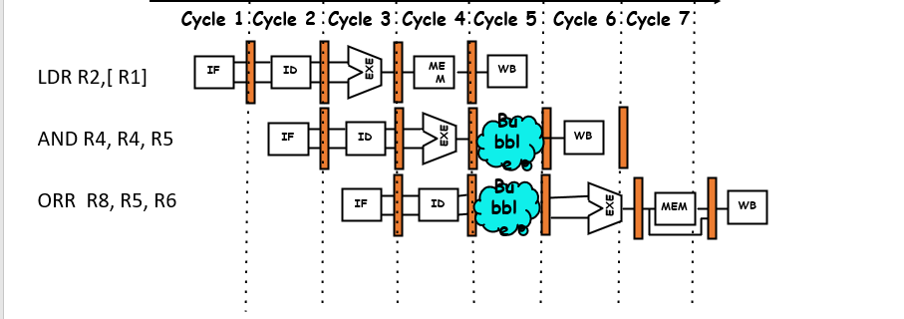
Structural Hazard: WB Vs WB: 🡪 Solution 1
2 ways to solve this pipeline hazard.
°Stall the stage
°Let all the instruction follow all stages, AND may take longer than usual

Slide 24
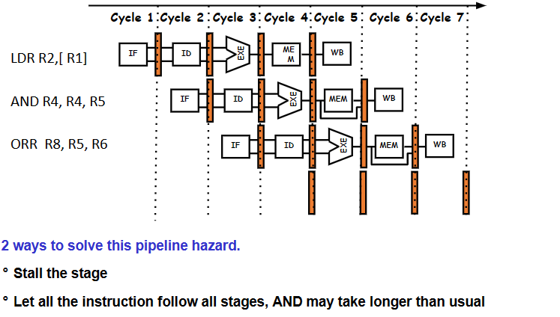
Structural Hazard: WB Vs WB: 🡪 Solution 2

Slide 25
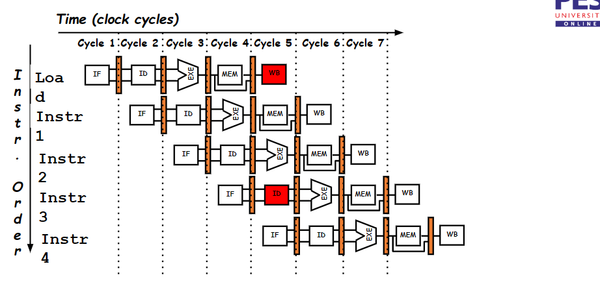
Structural Hazard: ID VS WB

Slide 26
Structural Hazard: ID VS WB
Partitioning/Overlapping
1st half of the cycle Reg Write
2nd half of the same cycle Reg Read

Slide 27
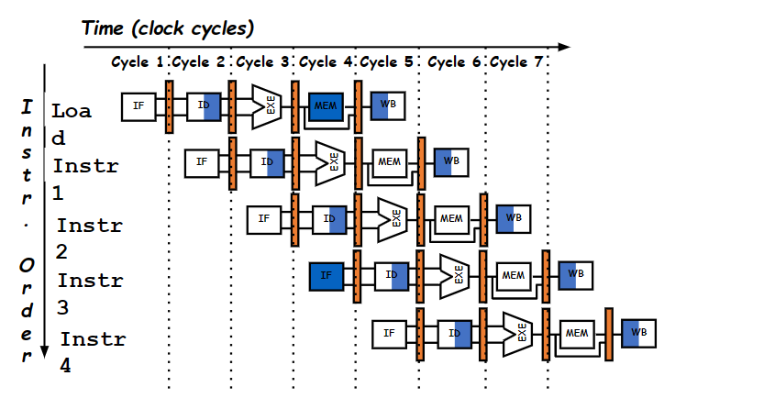
Partitioning/Overlapping

Slide 28
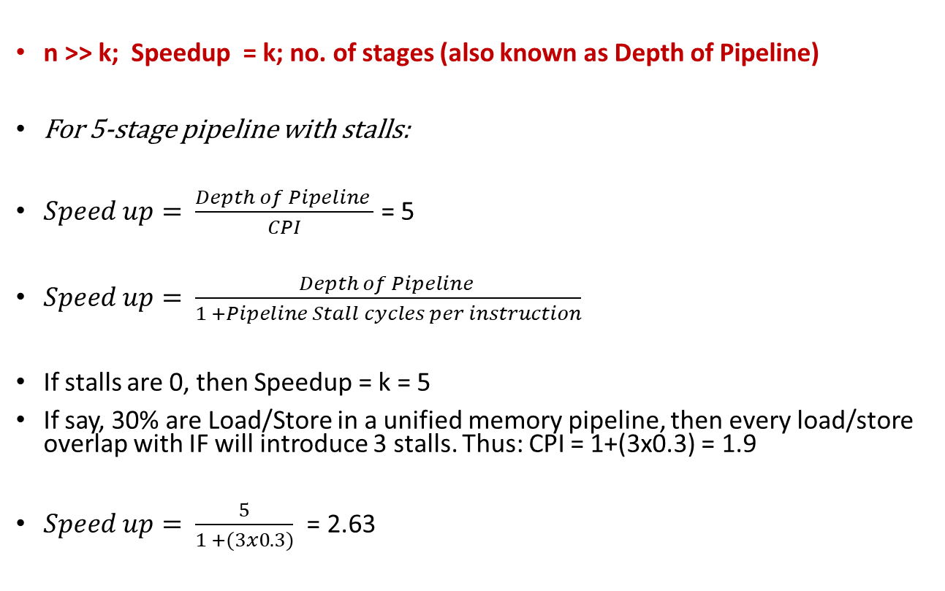
Performance (with stalls)

Slide 29

THANK YOU
Team MPCA
Department of Computer Science and Engineering

