Slide 1

Microprocessor & Computer Architecture (μpCA)
UE22CS252B
Session - 2.5

Slide 2
Microprocessor & Computer Architecture (μpCA)
UE22CS252B
Pipeline Processor: Data Hazard 2

Slide 3

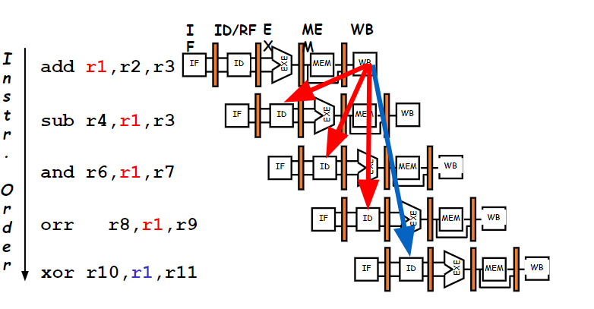
How to Attack RAW Dependency?

Slide 4
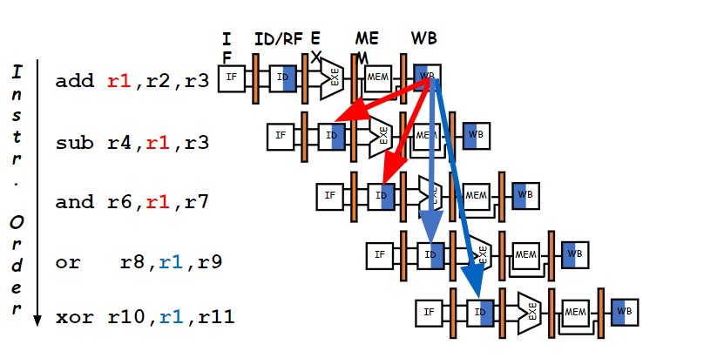
How to Attack RAW Dependency?

Slide 5
Attacking Data Hazard
In Software
Solution 1: Re-order instructions
Solution 2: insert independent instructions (or no-ops) Ex: MOV R0, R0
In Hardware
Solution 1: Insert bubbles (i.e. stall the pipeline)
Solution 2: Data Forwarding

Slide 6
Software Solution 1🡪 By Compiler
ADD R0,R0,R1
ADD R2,R3,R4
ADD R5,R0,R4
SUB R6,R4,R7
XOR R8,R4,R7
ADD R0,R0,R1
ADD R2,R3,R4
SUB R6,R4,R7
XOR R8,R4,R7
ADD R5,R0,R4
Out of Order Execution by Compiler

Slide 7
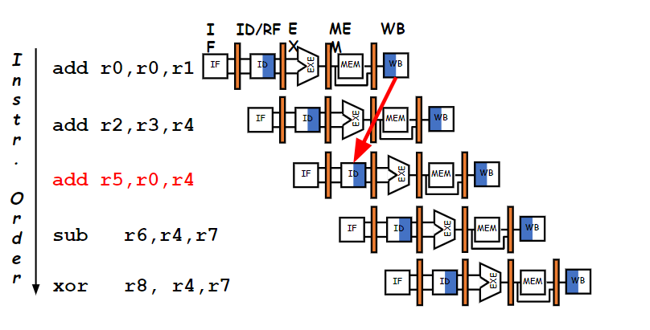
Software Solution 1🡪 By Compiler

Slide 8
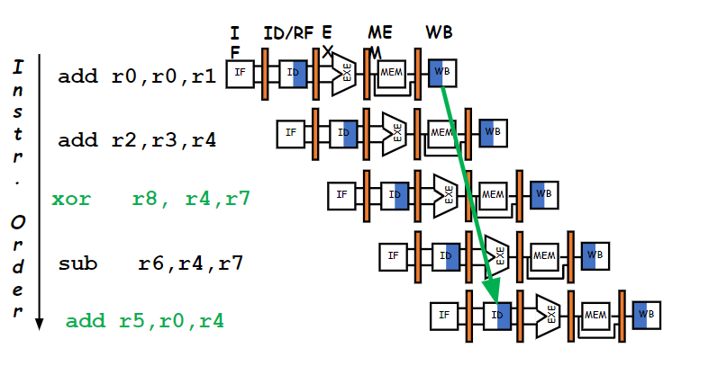
Software Solution 1🡪 By Compiler

Slide 9
Attacking Data Hazard
In Software
Solution 1: Re-order instructions
Solution 2: insert independent instructions (or no-ops) Ex: MOV R0, R0
In Hardware
Solution 1: Insert bubbles (i.e. stall the pipeline)
Solution 2: Data Forwarding

Slide 10
Software Solution 2🡪 By Compiler
Insert NOP or MOV R0, R0
The compiler can guarantee that no data hazards exist adding NOP or MOV instructions where needed. [Instruction Scheduling]
sub R2, R1, R3
NOP or MOV R0, R0
NOP or MOV R0, R0
and R12, R2, R5 orr R10, R6, R2 add R4, R2, R2 str R5, [R2, #100]
sub R2, R1, R3 and R12, R2, R5 orr R10, R6, R2 add R4, R2, R2 str R5, [R2, #100]

Slide 11
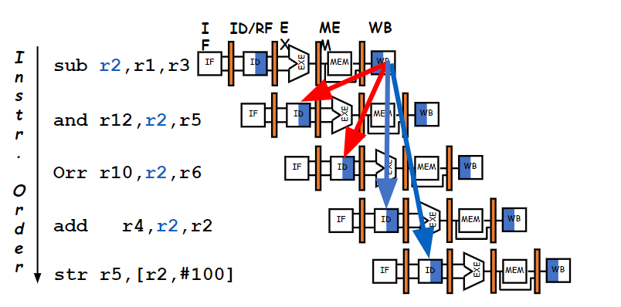
Software Solution 2🡪 By Compiler

Slide 12
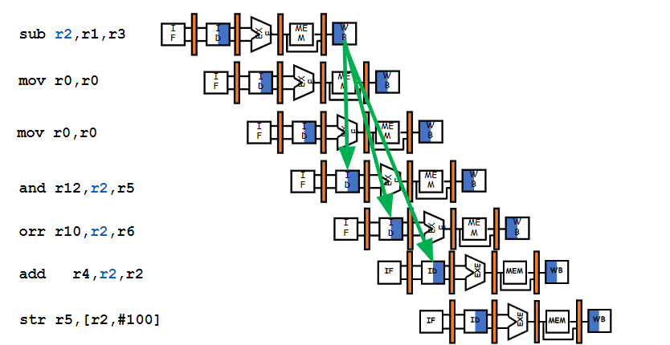
Software Solution 2🡪 By Compiler

Slide 13
Where are NOPs needed?
sub R2, R1, R3
and R4, R2, R5
orr R8, R2, R6
add R9, R4, R2
rsb R1, R6, R7
sub R2, R1, R3
NOP
NOP
and R4, R2, R5
orr R8, R2, R6
NOP
add R9, R4, R2
rsb R1, R6, R7

Slide 14
Attacking Data Hazard
In Software
Solution 1: Re-order instructions
Solution 2: Insert independent instructions (or no-ops) Ex: MOV R0, R0
In Hardware
Solution 1: Insert bubbles (i.e. stall the pipeline)
Solution 2: Data Forwarding

Slide 15
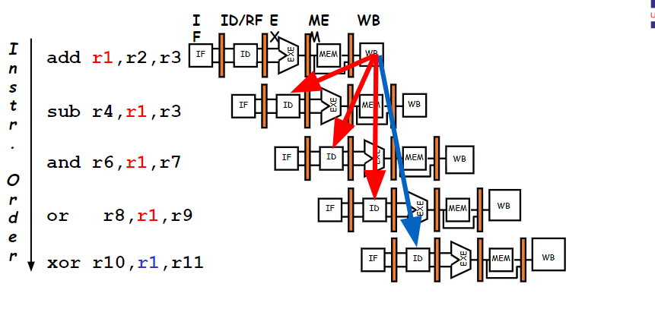
Hardware Solution 1

Slide 16
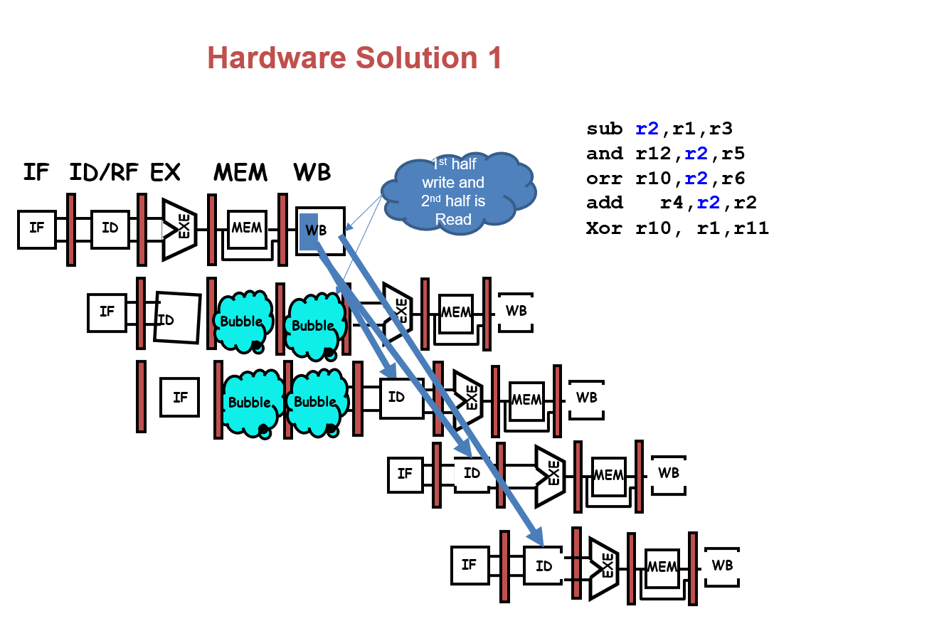
Hardware Solution 1

Slide 17
Attacking Data Hazard
In Software
Solution 1: Re-order instructions
Solution 2: Insert independent instructions (or no-ops) Ex: MOV R0, R0
In Hardware
Solution 1: Insert bubbles (i.e. stall the pipeline)
Solution 2: Data Forwarding

Slide 18
Hardware Solution 2: Data Forwarding
We could avoid stalling if we could get to EX stage the ALU output from “previous instruction” to ALU input for the “current instruction”
Suppose initially, register i holds the number 2i (ie. R3 = 6; R6=12; R8 = 16…)
Result available
6
8
EXE
add R2, R3, R4
IF
ID
14
MEM
WB
IF
ID
6
4
ALU
MEM
WB
orr R5, R3, R2
14
Result Required

Slide 19
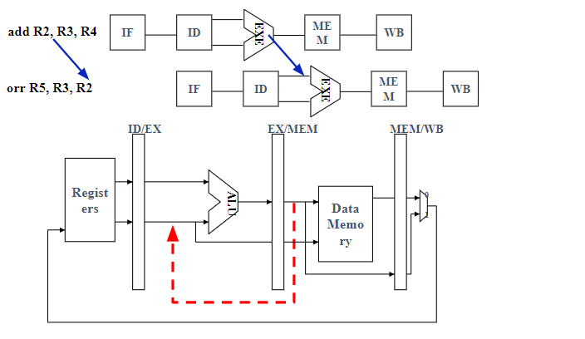
Hardware Solution 2: Data Forwarding

Slide 20
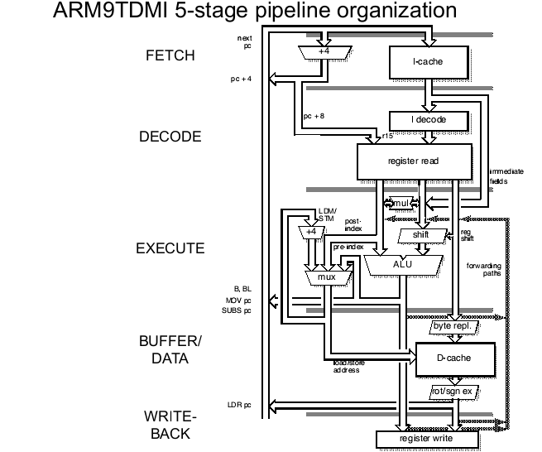
Hardware Solution 2: Data Forwarding
add R2, R3, R4
orr R5, R3, R2
Data Forwarding

Slide 21
Hardware Solution 2: Data Forwarding
Also known as:
Register –bypassing
Short-circuiting
Forwarding handles hazards at both
EX stage
MEM stage

Slide 22
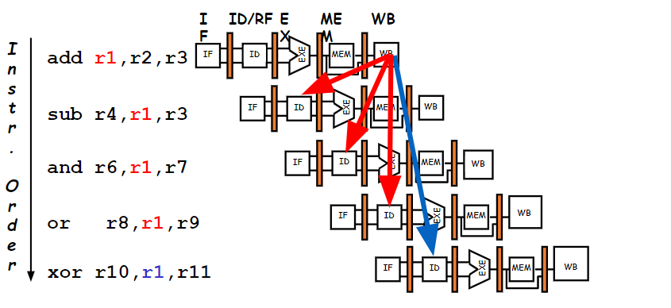
Hardware Solution 2: Data Forwarding

Slide 23
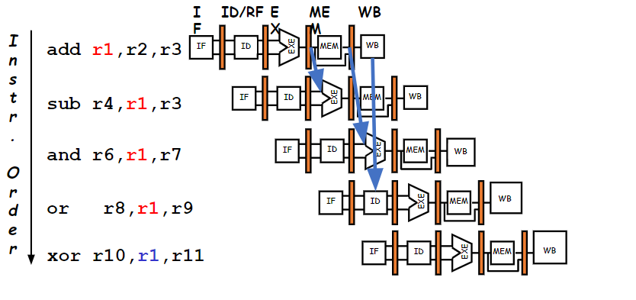
Hardware Solution 2: Data Forwarding

Slide 24
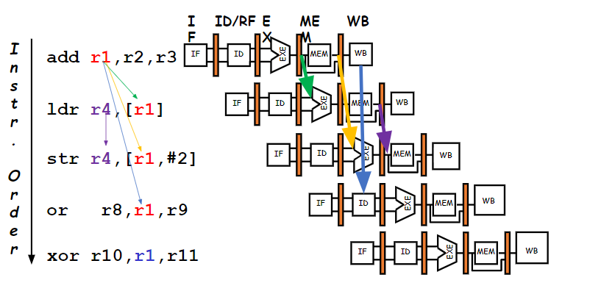
Hardware Solution 2: Data Forwarding

Slide 25
Hardware change for Forwarding
NextPC
mux
Registers
ALU
Data
Memory
ID/EX
EX/MEM
MEM/WR
mux
Immediate
mux
What circuit detects and resolves this hazard?

Slide 26
Does Forwarding eliminate all hazards??
Consider this example:
LDR R0, [R1, #60]
ADD R2, R0, R4
NO! You may need to stall after loads

Slide 27
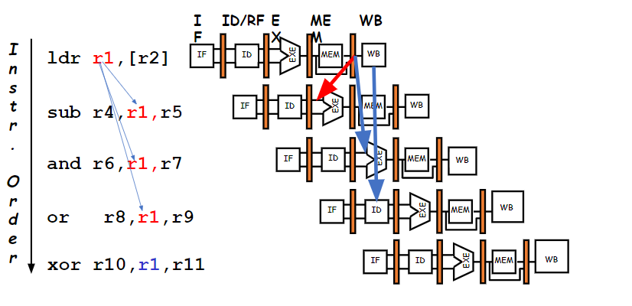
Hardware Solution 2: Data Forwarding

Slide 28
Think About It
ldr R7, [R2]
ldr R6, [R2, #4]
add R4, R5, R6
str R6, [R2, #4]
With forwarding we need to find only one independent instructions to place between them,
swapping the ldr instructions works:
ldr R6, [R2, #4]
ldr R7, [R2]
add R4, R5, R6
str R6, [R2, #4]
IF ID EXE MEM WB
IF ID EXE MEM WB
IF ID EXE MEM WB
IF ID EXE MEM WB
Without forwarding we need two independent instructions to place between them, so in addition a nop is added.
ldr R6, [R2, #4]
ldr R7, [R2]
nop
add R4, R5, R6
str R6, [R2, #4]
Why?

Slide 29
Think About It
a = b + c;
d = e – f;
After Reordering &
Assuming Data Forwarding
Eliminate dependency
by renaming registers
Before:
ldr R2, =b
ldr R3, =c
add R1, R2, R3
str R1, =a
ldr R2, =e
ldr R3, =f
sub R1, R2, R3
str R1, =d
ldr R2, =b
ldr R3, =c
add R1, R2, R3
str R1, =a
ldr R5, =e
ldr R6, =f
sub R4, R5, R6
str R4, =d
ldr R2, =b
ldr R3, =c
ldr R5, =e
add R1, R2, R3
ldr R6, =f
str R1, =a
sub R4, R5, R6
str R4, =d
Draw the timing diagram check, if stalls are required?

Slide 30

THANK YOU
Team MPCA
Department of Computer Science and Engineering

