Slide 1

Microprocessor & Computer Architecture (μpCA)
UE22CS252B
Session - 2.7

Slide 2
Microprocessor & Computer Architecture (μpCA)
UE22CS252B
Pipeline Processor: Branch Prediction

Slide 3

Branch Prediction
Guessing the branch
One of the important problems in “Computer Architecture”
Static: prediction by compiler
Dynamic: prediction by hardware
Static Prediction
Always Not Taken (easiest)
Always Taken
Taken / Not taken
Dynamic Prediction
1- bit
2-bit
others

Slide 4
Static Predictions
OR
Always Taken
Always Not Taken

Slide 5
Static Predictions
Early studies indicated that 2/3 of branches are taken
but 30% of those branches were unconditional!
For conditional branches there appears to be no preferred direction.
Always Taken

Slide 6
Alternative Static Predictions
Accuracy improvements
are barely noticeable.
Static prediction based on
profiling is slightly better.
Static branch-not-taken
has no implementation
cost on pipeline.
Forward Always Not Taken
Backward Always Taken

Slide 7
Static Prediction🡪 Taken
Consider a program with two branch statement with the following behavior
T T N T TN TT T T N T T T T TT N T T T T TNT
How many Miss Prediction ?
5 miss predictions
T
T
NT
T
NT
T
T
T
NT
T
T
T
T
T
NT
T
T
T
T
NT
√
√
X
√
X
√
√
√
X
√
√
√
√
√
X
√
√
√
√
X

Slide 8
Static Prediction🡪 Not Taken
Consider a program with two branch statement with the following behavior
T T N T TN TT T T N T T T T TT N T T T T TNT
How many Miss Prediction?
15 miss predictions
T
T
NT
T
NT
T
T
T
NT
T
T
T
T
T
NT
T
T
T
T
NT
X
X
√
X
√
X
X
X
√
X
X
X
X
X
√
X
X
X
X
√

Slide 9
Dynamic Predictors
Prediction of a given branch changes with the execution of the program.
Simple: a finite-state machine encodes the outcome of a few recent executions of the branch.
Elaborate: Not only early branch outcomes, but other correlated parts of the programs are considered.

Slide 10
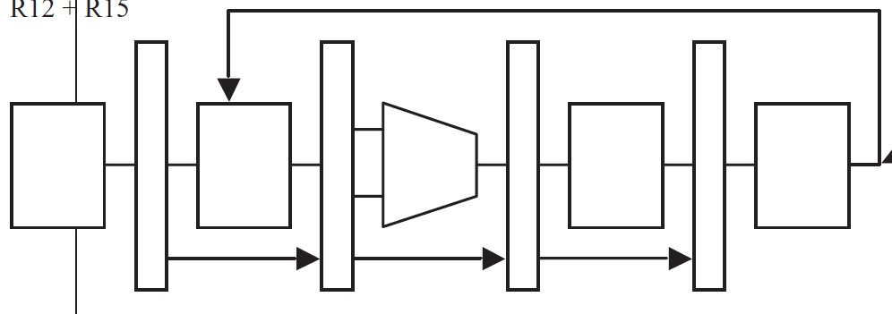
When to Predict?
Static prediction: at the Instruction Decode stage
Know that the instruction is a branch
Dynamic prediction: at the Instruction Fetch stage
How to Know that the instruction is Branch
How to Know the target Address?
Should check Irrespective of branch instruction or not
How?

Slide 11
One-bit Predictor
Simplest method:
A branch prediction buffer or Branch History Table (BHT) indexed by low address bits of the branch instruction.
Each buffer location (or BHT entry) contains one bit indicating whether the branch was recently taken or not.
Change bit on misprediction
Always mispredicts in first and last loop iterations.

Slide 12
Branch History Table or Branch Prediction Buffer:-> One Bit
Address | Branch Address | Target Address | Prediction
000 | 432 | 456 | 1
001 | 97 | 123 | 0
010 | 130 | 143 | 1
011 | 67 | 98 | 0
100 | 84 | 244 | 1
101 | 261 | 532 | 1
110 | 518 | 786 | 1
111 | 1031 | 1134 | 0
32 bit 84
0 | …………… | 0 | 0 | 0 | 1 | 1 | 0 | 1 | 0 | 0
Ex:
000080 : add R1, R2, R3
0000084: beq R1, R2, 244
0000088: sub R1, R4, R5
orr R2, R7, R8
….
0000244: add R1, R4, R5
PC=84
IF | ID | EXE | MEM | WB
PC=88 or 244
IF

Slide 13
Branch History Table or Branch Prediction Buffer:-> One Bit
Address | Branch Address | Target Address | Prediction
000 | 432 | 456 | 1
001 | 97 | 123 | 0
010 | 130 | 143 | 1
011 | 67 | 98 | 0
100 | 84 | 244 | 1
101 | 261 | 532 | 1
110 | 518 | 786 | 1
111 | 1031 | 1134 | 0
32 bit 84
0 | …………… | 0 | 0 | 0 | 1 | 1 | 0 | 1 | 0 | 0
Ex:
000080 : add R1, R2, R3
0000084: beq R1, R2, 244
0000088: sub R1, R4, R5
orr R2, R7, R8
….
0000244: add R1, R4, R5
PC=244
If Branch Taken, update PC
IF | ID | EXE | MEM | WB
IF | ID | EXE | MEM | WB

Slide 14
Branch History Table or Branch Prediction Buffer:-> One Bit
Address | Branch Address | Target Address | Prediction
000 | 432 | 456 | 1
001 | 97 | 123 | 0
010 | 130 | 143 | 1
011 | 67 | 98 | 0
100 | 84 | 244 | 0
101 | 261 | 532 | 1
110 | 518 | 786 | 1
111 | 1031 | 1134 | 0
32 bit 84
0 | …………… | 0 | 0 | 0 | 1 | 1 | 0 | 1 | 0 | 0
Ex:
000080 : add R1, R2, R3
0000084: beq R1, R2, 244
0000088: sub R1, R4, R5
orr R2, R7, R8
….
0000244: add R1, R4, R5
PC=88
If Branch Not Taken Continue with normal execution
IF | ID | EXE | MEM | WB
IF | ID | EXE | MEM | WB

Slide 15
1 Bit Branch Prediction
NT
T
T
NT
T
NT
OR
T
NT
NT
T
NT
T

Slide 16
1 Bit Branch Prediction
NT
T
T
NT
T
NT
Consider a program with two branch statement with the following behavior
T T N T TN TT T T N T T T T TT N T T T T TNT
How many Miss Prediction if the Initial state is NT?
10 miss predictions
T
T
NT
T
NT
T
T
T
NT
T
T
T
T
T
NT
T
T
T
T
NT
X
√
X
X
X
X
√
√
X
X
√
√
√
√
X
X
√
√
√
X

Slide 17
1 Bit Branch Prediction
T
NT
NT
T
NT
T
Consider a program with two branch statement with the following behavior
T T N T TN TT T T N T T T T TT N T T T T TNT
How many Miss Prediction if the Initial state is NT?
9 miss predictions
T
T
NT
T
NT
T
T
T
NT
T
T
T
T
T
NT
T
T
T
T
NT
√
√
X
X
X
X
√
√
X
X
√
√
√
√
X
X
√
√
√
X

Slide 18
1 Bit Branch Prediction
NT
T
T
NT
T
NT
1-bit
for(j=0; j<n ; j++)
begin S1; S2; …; Sk end;
J
Pred
Outc
0
NT
T
1
T
T
n
T
NT
2 Missprediction for each loop
0
NT
T
1
T
T

Slide 19
m ≤ 0
for(i=0 ; i < m ; i++)
for(j=0; j<n ; j++)
begin S1; S2; …; Sk end;
i ← 0
1-bit
n ≥ 0
i
j
Pred
Outc
0
0
NT
T
j ← 0
0
1
T
T
S1; S2; …; Sk
0
n
T
NT
1
0
NT
T
T
j←j+1
1
1
T
T
j < n
NT
i←i+1
2 × m misspredictions
i < m
i←i+1

Slide 20
2 Bit Branch Prediction

Slide 21
Towards 2-Bit Predictor
What is the problem with 1-Bit predictor
Aliasing Problem
branches with same lower order bits will reference the same entry, causing mutual prediction
Shortcomings with loops
Always mispredict twice for every loop
Mispredict upon exiting a loop, since this is a surprise
If we repeat the loop, we’ll miss again since we’ll predict, branch not taken

Slide 22
What is the problem with 1-Bit predictor
m ≤ 0
for(i=0 ; i < m ; i++)
for(j=0; j<n ; j++)
begin S1; S2; …; Sk end;
i ← 0
1-bit
n ≥ 0
i
j
Pred
Outc
0
0
NT
T
j ← 0
0
1
T
T
S1; S2; …; Sk
0
n
T
NT
1
0
NT
T
T
j←j+1
1
1
T
T
j < n
If m= 100 & n=10
2 miss prediction per Iteration
2 × m miss predictions for iterations
2x100= 200 miss predictions
8 x m Correct Predictions ( Single Iteration)
8x100= 800 Correct Predictions for nxm iterations
NT
i←i+1
i < m
i←i+1
Accuracy of Correct Predictions = 800/1000= 80%

Slide 23
Two -bit Predictor
Think Twice Before Mis predicting
Taken
Not Taken
11
10
Taken
00: Strong Not Taken
01: Weak Not Taken
10: Weak Taken
11: Strong Taken
Not Taken
Taken
Taken
01
00
Start
Not Taken
Not Taken
1st bit is prediction bit.
2nd bit is conviction bit (How much sure that the prediction is correct)

Slide 24
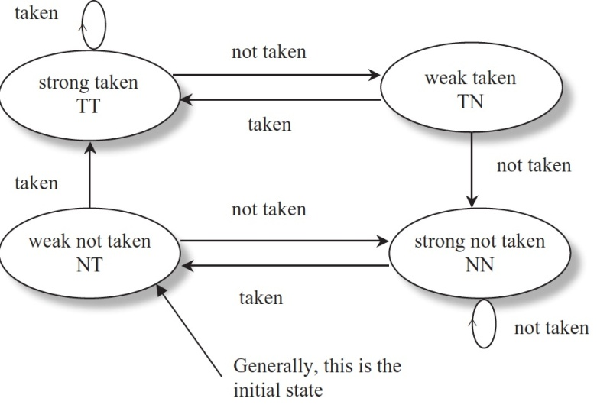
m ≤ 0
for(i=0 ; i < m ; i++)
for(j=0; j<n ; j++)
begin S1; S2; …; Sk end;
i ← 0
1-bit
2-bit
n ≥ 0
i
j
Pred
Outc
State
Pred
Outc
0
0
NT
T
wNT
NT
T
j ← 0
0
1
T
T
sT
T
T
S1; S2; …; Sk
0
n
T
NT
sT
T
NT
1
0
NT
T
wT
T
T
T
j←j+1
1
1
T
T
sT
T
T
j < n
NT
i←i+1
i < m
m + 1 misspredictions
i←i+1

Slide 25
m ≤ 0
for(i=0 ; i < m ; i++)
for(j=0; j<n ; j++)
begin S1; S2; …; Sk end;
m + 1 misspredictions
i ← 0
1-bit
2-bit
n ≥ 0
i
j
Pred
Outc
State
Pred
Outc
0
0
NT
T
wNT
NT
T
j ← 0
0
1
T
T
sT
T
T
S1; S2; …; Sk
0
n
T
NT
sT
T
NT
1
0
NT
T
wT
T
T
T
j←j+1
1
1
T
T
sT
T
T
j < n
If m= 100 & n=10
1 miss prediction per Iteration
1 + m miss predictions for m iterations 1+100= 101 miss predictions
9 Correct Predictions ( Single Iteration)for m-1 iterations
8 correct predictions in the 1st iteration
9x(m-1)+8x1 Correct Predictions for nxm iterations
9x99+8=891+8=899 Correct Predictions
NT
i←i+1
i < m
i←i+1
Accuracy of Correct Predictions = 899/1000≈ 90%

Slide 26
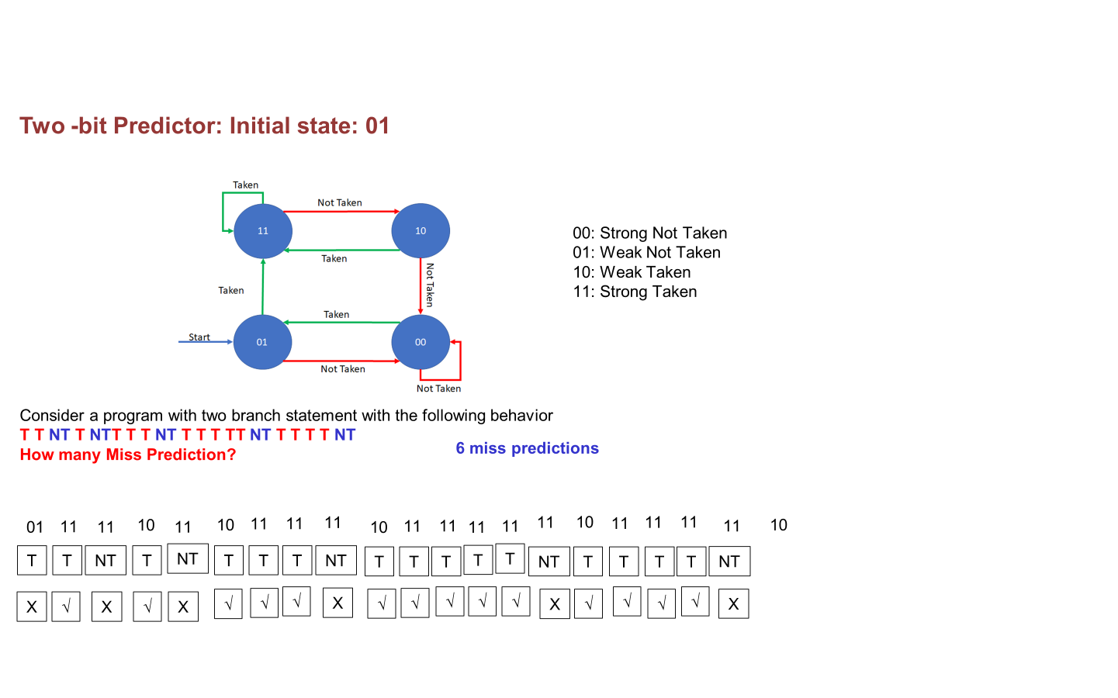
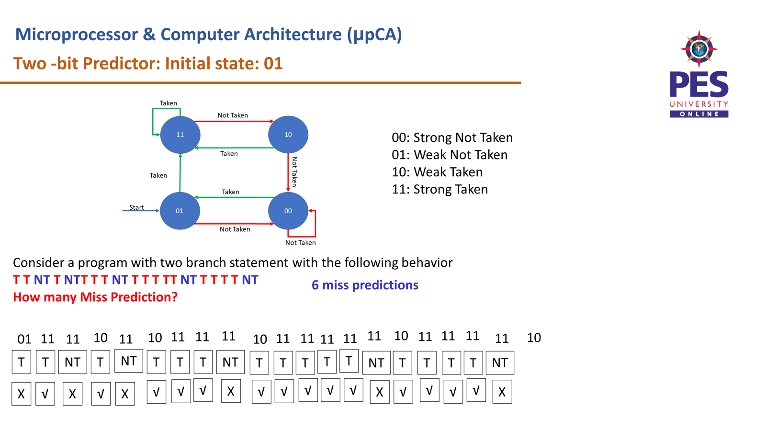

Slide 27
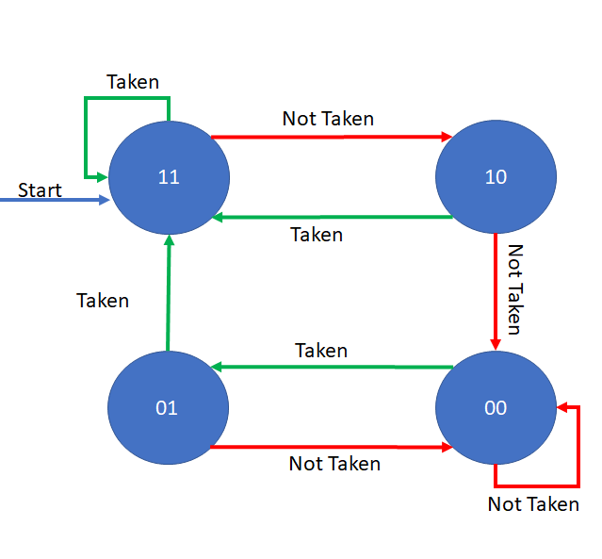
Two -bit Predictor: Initial state: 11
00: Strong Not Taken
01: Weak Not Taken
10: Weak Taken
11: Strong Taken
Consider a program with two branch statement with the following behavior
T T NT T NTT T T NT T T T TT NT T T T T NT
How many Miss Prediction?
5 miss predictions
11
11
11
10
11
10
11
11
11
10
11
11
11
11
11
10
11
11
11
11
10
T
T
NT
T
NT
T
T
T
NT
T
T
T
T
T
NT
T
T
T
T
NT
√
√
X
√
X
√
√
√
X
√
√
√
√
√
X
√
√
√
√
X

Slide 28
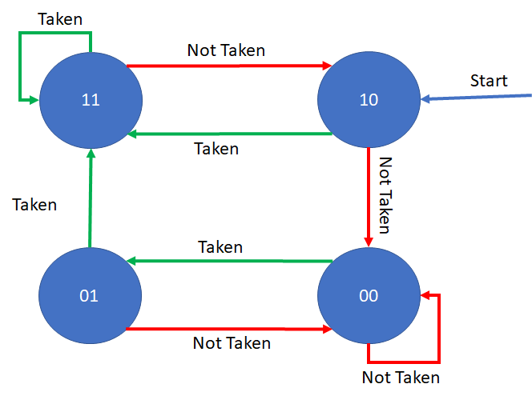
Two -bit Predictor: Initial state: 10
00: Strong Not Taken
01: Weak Not Taken
10: Weak Taken
11: Strong Taken
Consider a program with two branch statement with the following behavior
T T NT T NTT T T NT T T T TT NT T T T T NT
How many Miss Prediction?
5 miss predictions
10
11
11
10
11
10
11
11
11
10
11
11
11
11
11
10
11
11
11
11
10
T
T
NT
T
NT
T
T
T
NT
T
T
T
T
T
NT
T
T
T
T
NT
√
√
X
√
X
√
√
√
X
√
√
√
√
√
X
√
√
√
√
X

Slide 29
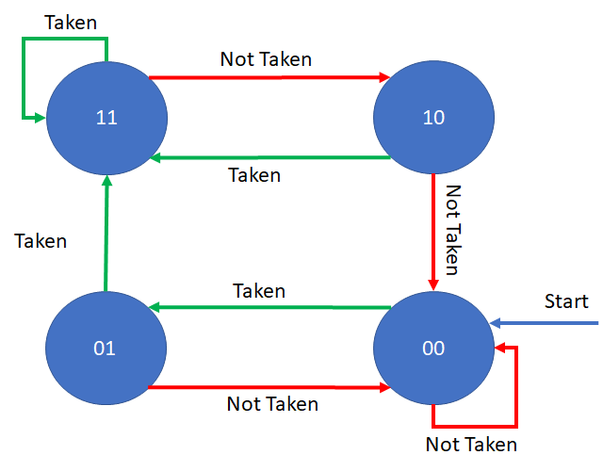
Two -bit Predictor: Initial state🡪 00
00: Strong Not Taken
01: Weak Not Taken
10: Weak Taken
11: Strong Taken
Consider a program with two branch statement with the following behavior
T T NT T NTT T T NT T T T TT NT T T T T NT
How many Miss Prediction?
7 miss predictions
00
01
11
10
11
10
11
11
11
10
11
11
11
11
11
10
11
11
11
11
10
T
T
NT
T
NT
T
T
T
NT
T
T
T
T
T
NT
T
T
T
T
NT
X
X
X
√
X
√
√
√
X
√
√
√
√
√
X
√
√
√
√
X

Slide 30
Think About It
Which predictor is best suitable if the following is the likely outcome of branch instruction? Suggest the suitable initial state
T NT T NT T NT T NT T TN
T T T T T T T T T T T T T T T
NT NT NT NT NT NT NT NT NT

Slide 31

THANK YOU
Team MPCA
Department of Computer Science and Engineering

