Slide 1

Matrices in Sports Analytics: A Game-Changer
A matrix is a powerful mathematical tool, essentially a table of numbers organized in rows and columns. Far from being an abstract concept, matrices are revolutionizing the world of sports. From strategic decision-making to enhancing individual performance and deep game analysis, they offer a clear, structured way to interpret complex data.

Slide 2


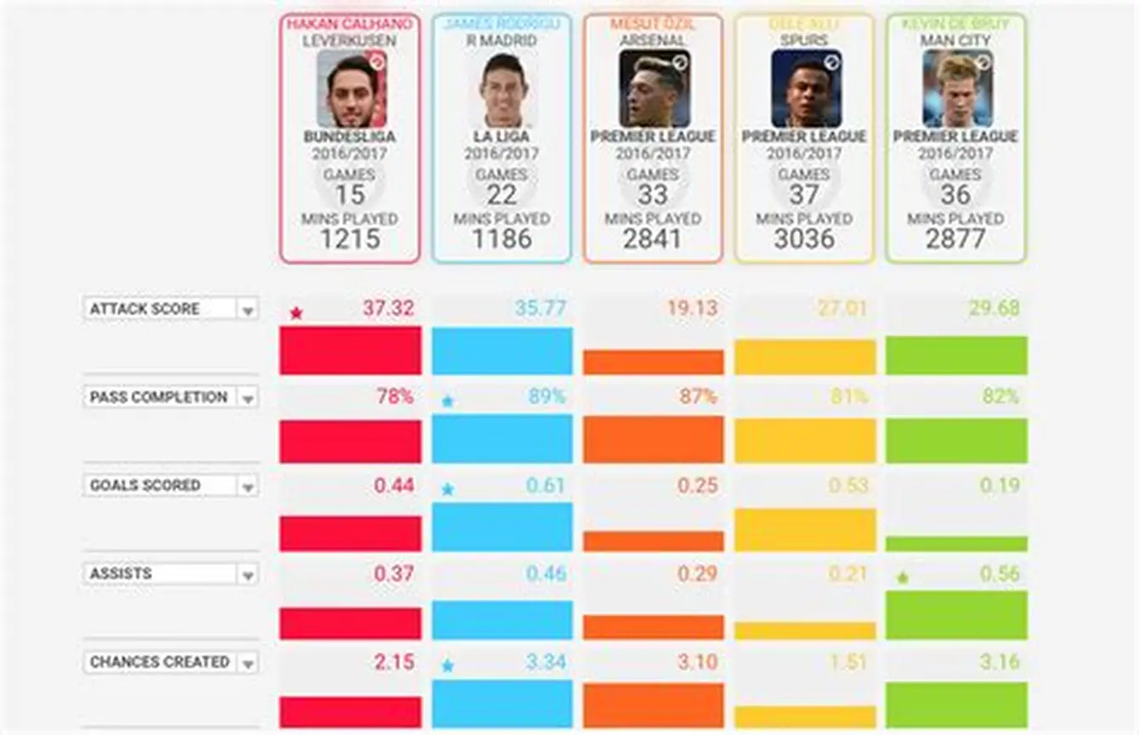

Unveiling Player Performance Through Statistical Matrices
Football Player Stats
Instant Comparison & Insight
Imagine a matrix for a football team where each row represents a player and each column details their performance metrics like goals scored, successful passes, tackles made, and fouls committed.
This structured data allows coaches to quickly compare players, identify top performers, pinpoint areas for improvement, and make informed decisions about team selection and training focus.

Slide 3





Mastering Team Strategy with Positional Matrices
Beyond individual stats, matrices are indispensable for team strategy and planning. In fast-paced games like basketball or hockey, coaches meticulously use matrices to analyze player movements and formations on the court or ice.
Each cell in the matrix can represent a specific zone or position.
Player movements are tracked and recorded, revealing patterns.
This visual data helps identify effective plays and tactical weaknesses.
By understanding which strategies yield the best results, teams can refine their tactics, optimize player interactions, and ultimately enhance teamwork for competitive advantage.
Analyze Player Movement
Identify Effective Plays
Optimize Teamwork
Track positions to identify patterns.
Pinpoint successful offensive and defensive strategies.
Refine coordination and improve overall performance.

